Slide 1

Petaluma’s Pollution Prevention Program (P4)
Petaluma, California

Slide 2


Petaluma Overview
~60,000 residents.
The Petaluma River flows through heart of downtown
and discharges into San Pablo Bay.
CWA 303(d) list due to diazinon, nutrients, pathogens, sediment and trash.
Ellis Creek Water Recycling Facility: Average dry weather flow 4.28 MGD.
Maximum peak flow of 38.7 MGD.

Slide 3
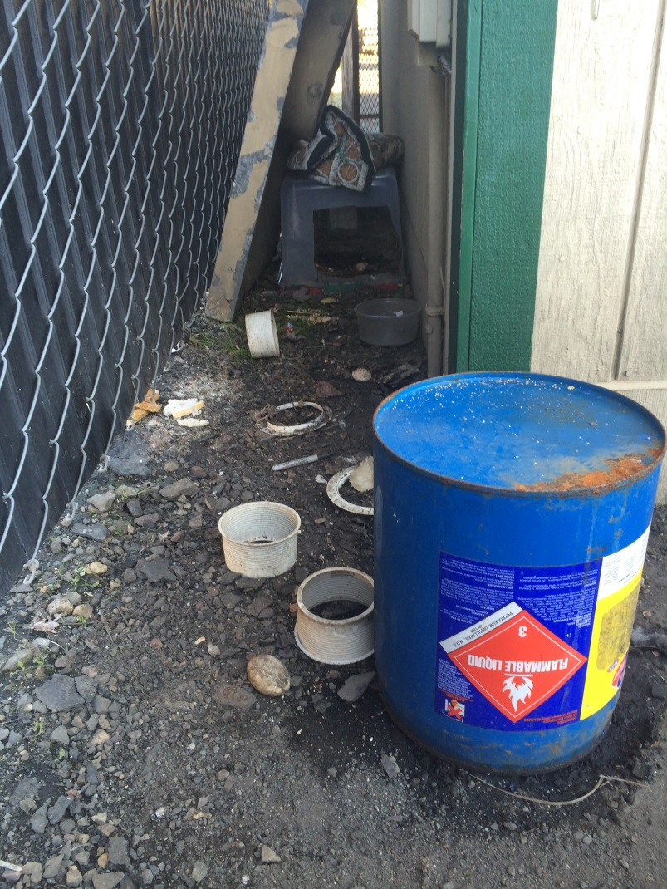
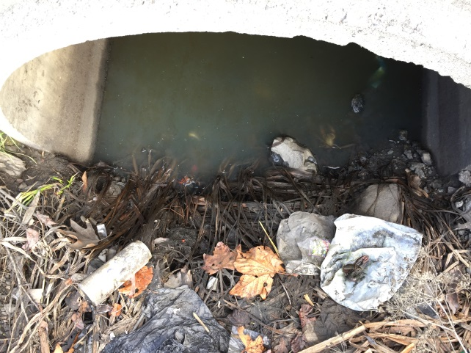
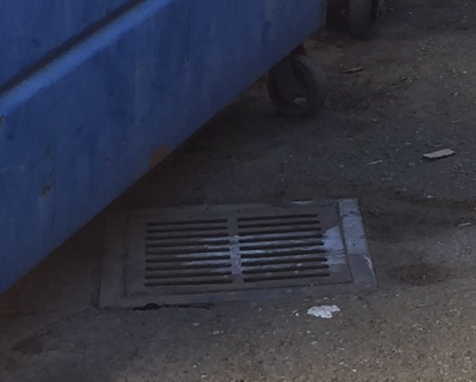
Pollution Prevention Overview
FOG Program
Dental Facility Inspection
Pharmaceutical Disposal
Community Outreach
Regional Collaborations

Slide 4
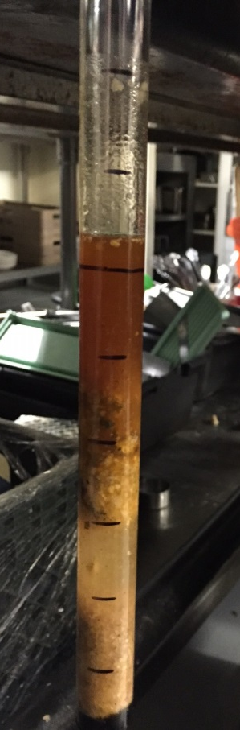
FOG Program
Inspections for restaurant and auto facilities.
Variation of 25% rule for loading.
Inspections cover FOG, Pollution Prevention and Stormwater protection.
Restaurants inspected annually.
Auto Facilities inspected biennially.
Inspection frequencies increase due to failure.

Slide 5
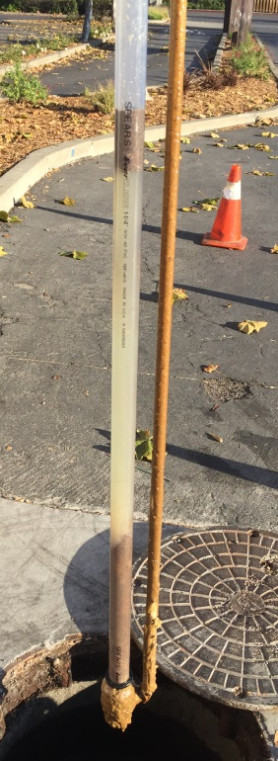
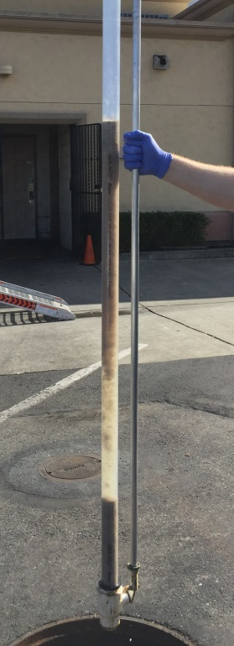
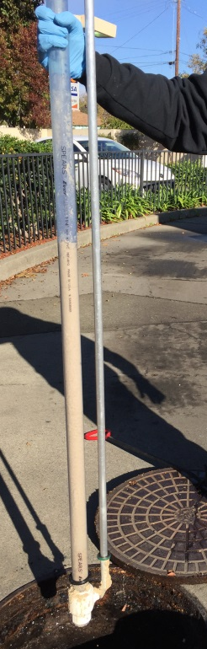
FOG Program
Lists of Users are continually updated using plan review, business licensing, and in-field observations.
2016 – 156 restaurants in program
2015 – 132 restaurants in program
2014 – 118 restaurants in program
2016 – 69% passed inspections
2015 – 57% passed inspections

Slide 6
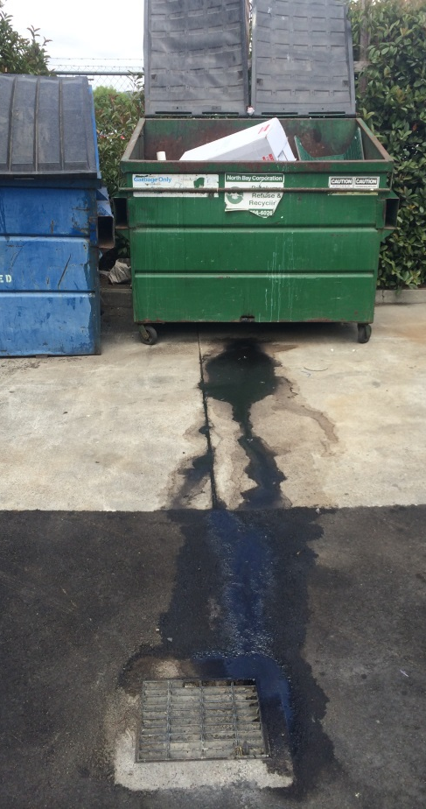
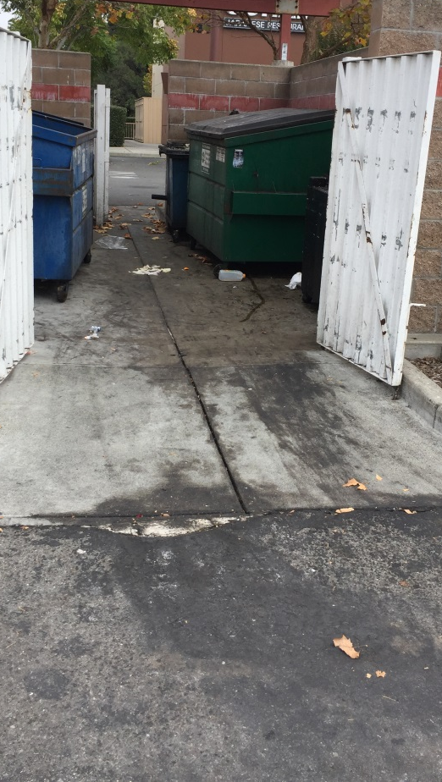
FOG Program
Inspections cover non-FOG topics including:
Waste prevention
77% of facilities utilizing grease rendering bins in 2016
Trash Containment
Review BMPs
81% of facilities had dumpster lids closed in 2016 (72% in 2015)
Storm protection
Review floor mat washing locations and procedures
Review dry clean-up methods and spill kits
Investigate staining or flow leading towards storm drain

Slide 7
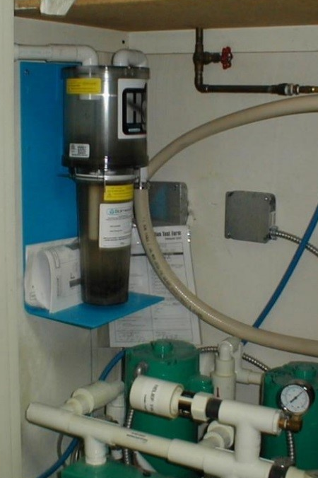
Dental Facilities
Voluntary program/certification (2009 and 2010) with 18% of practices voluntarily installing amalgam separators.
Municipal Code modified in 2011 to require practices follow the California Dental Association’s BMPs.
Facilities are inspected every 3 years.
41 dental offices as of 2015.
2015 - 76% pass rate.
Ready to adopt new regulations when EPA finalizes Dental Effluent Guidelines.

Slide 8
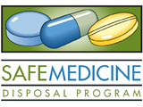
Pharmaceutical Disposal
Petaluma works with Safe Medicine Disposal Program (a regional Sonoma and Mendocino County effort) to provide accessible locations for proper disposal to residents.
12,745 lbs of medications collected in Petaluma since 2012.
Second largest collection site in Sonoma County.
Over 100,000 lbs of medications have been collected by the Safe Medicine Disposal Program.

Slide 9
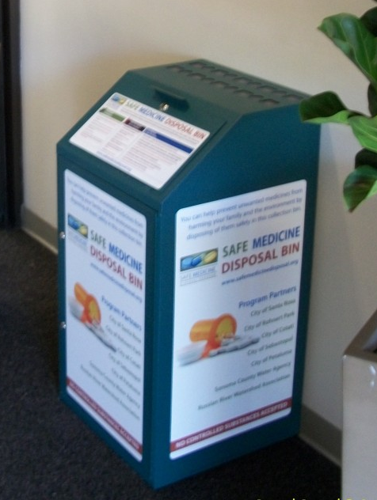
Pharmaceutical Disposal
The Sonoma County Board of Supervisors directed the Sonoma County Department of Health Services, Sonoma County Water Agency and the entire Safe Medicine Disposal Collaborative to work on a Safe Medicine Disposal Ordinance by the end of 2016.

Slide 10
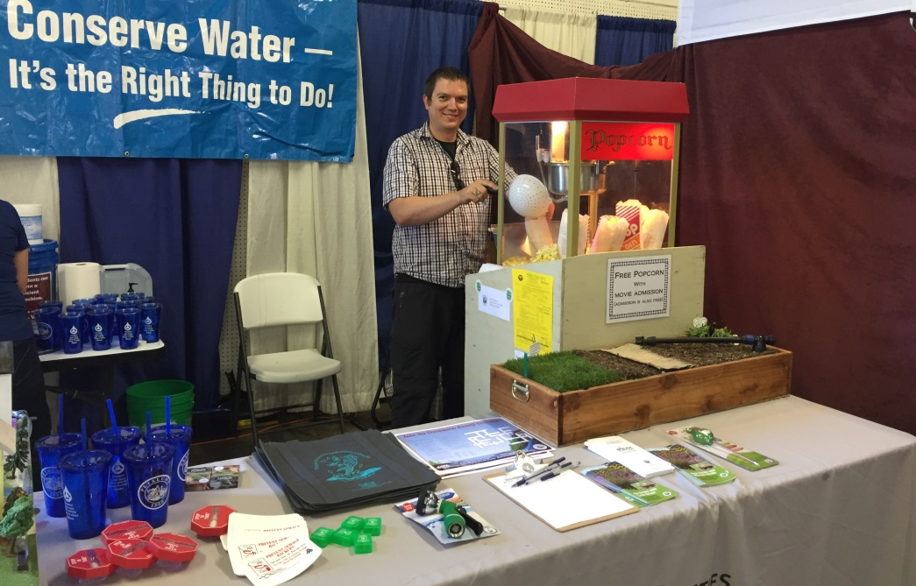
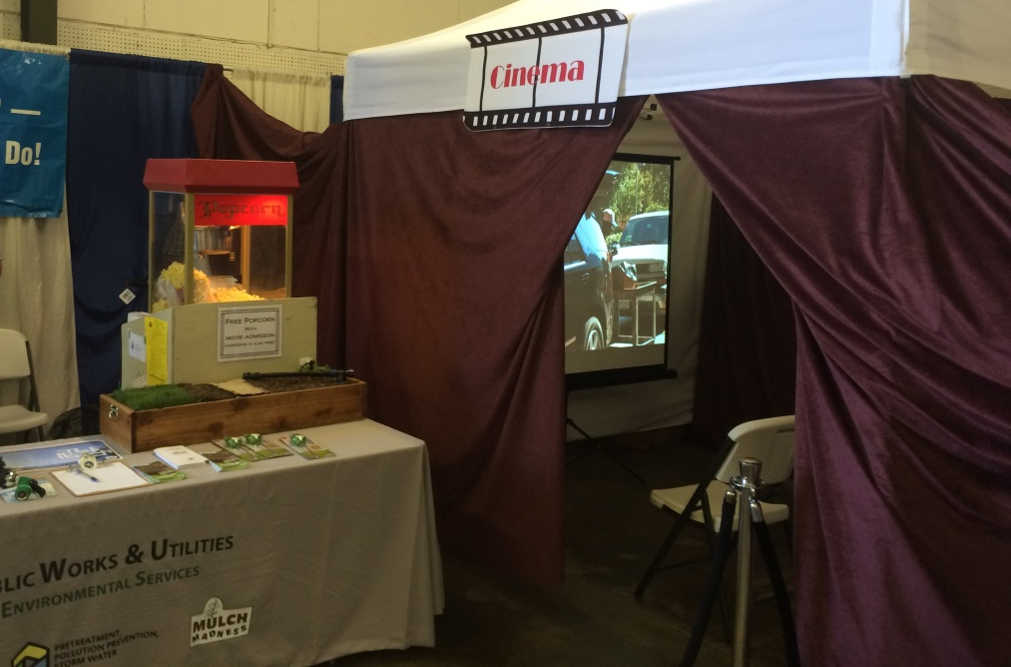
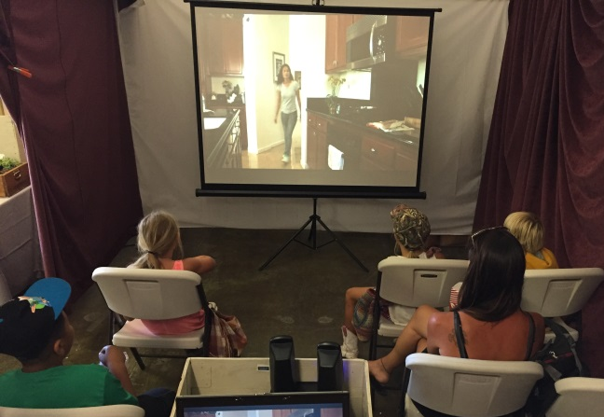
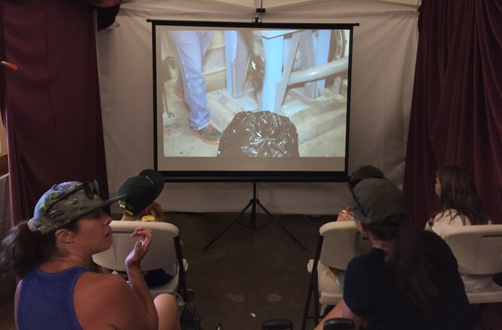
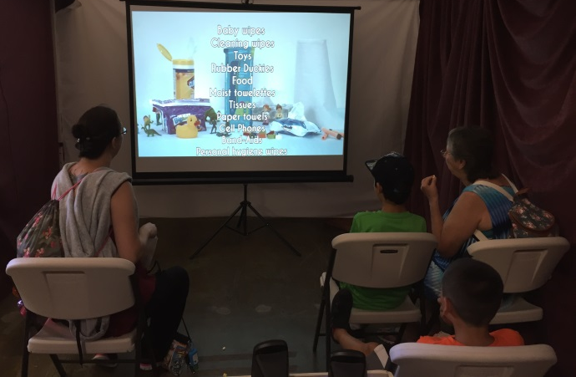
Community Outreach: Events
Sonoma-Marin Fair 2016

Slide 11
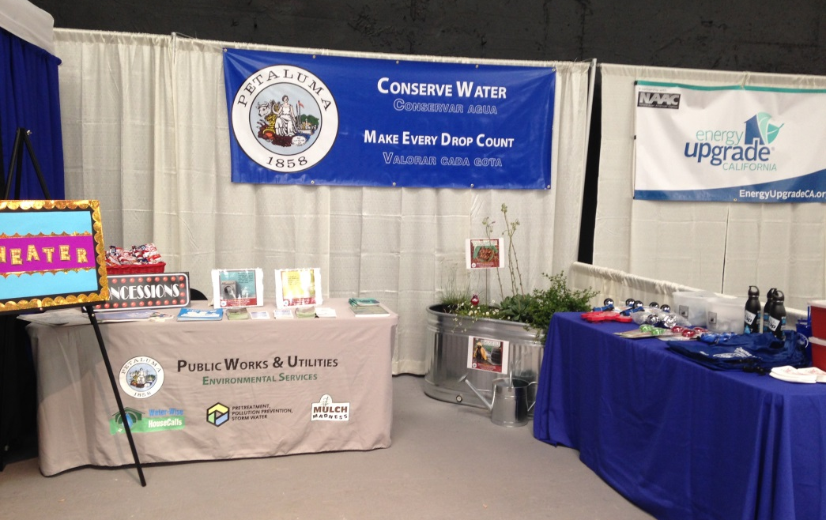
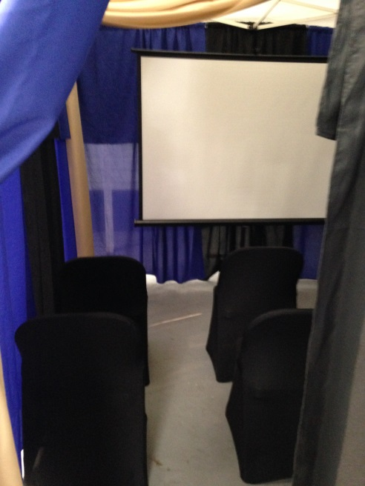
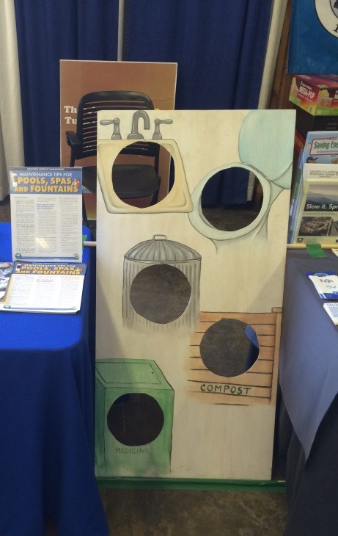
Community Outreach: Events
Sonoma County Harvest Fair 2016

Slide 12
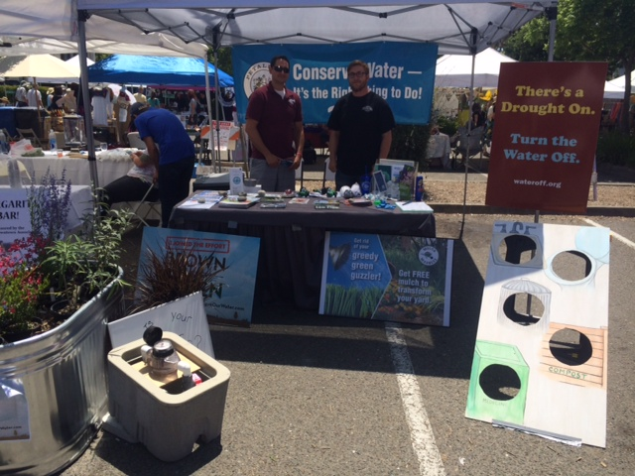
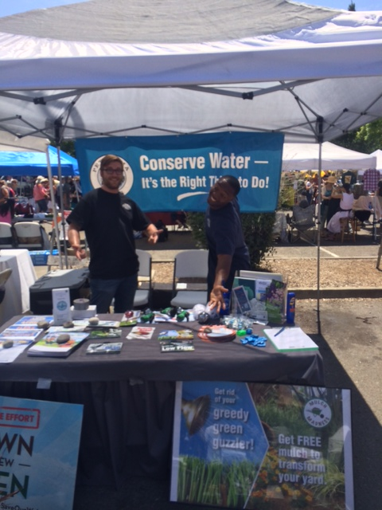
Community Outreach: Events
Petaluma Art and Garden Festival

Slide 13
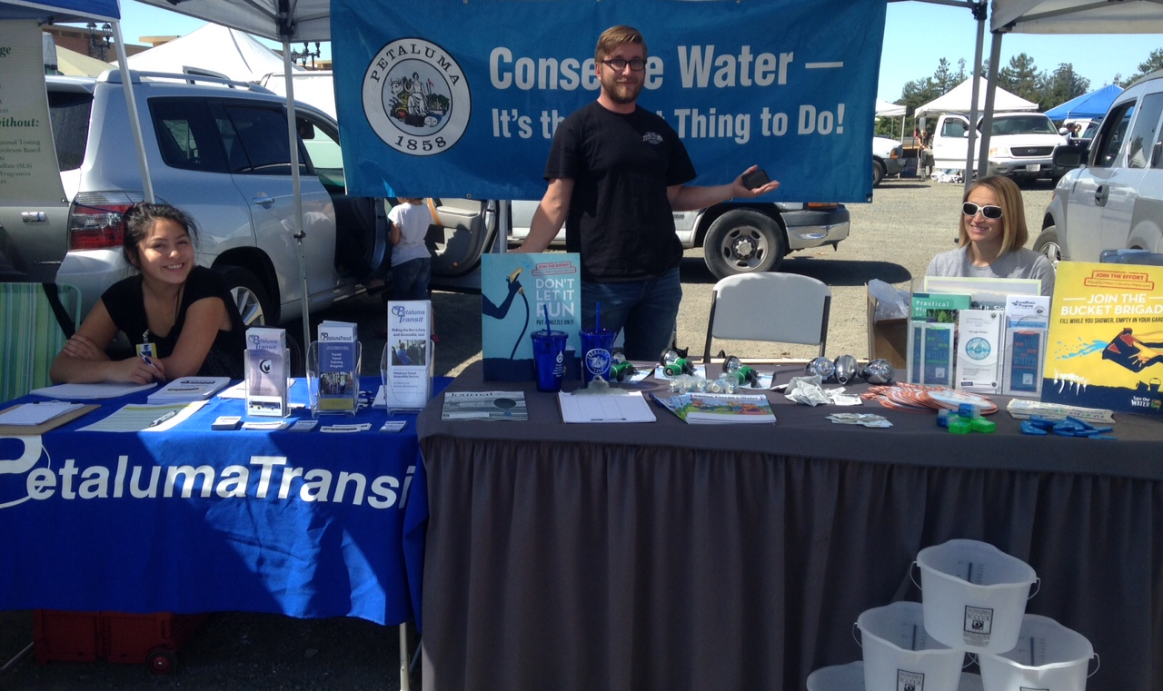
Community Outreach: Events
Farmers Markets

Slide 14
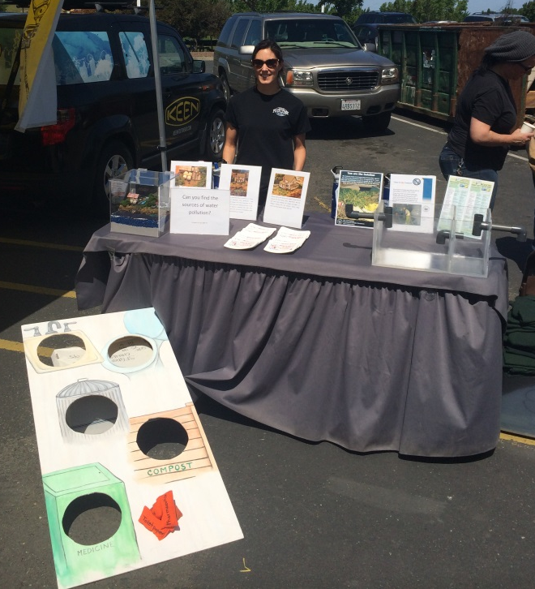
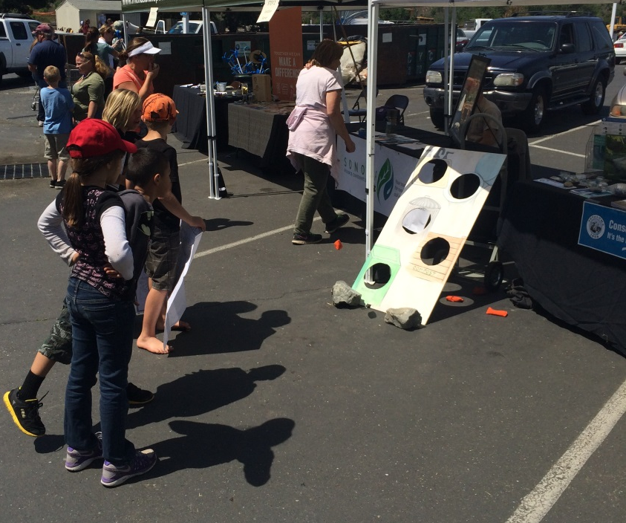
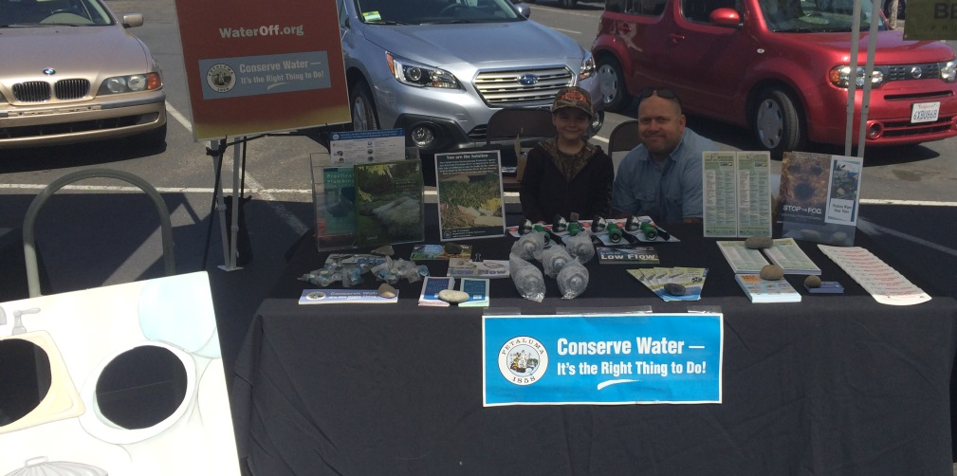
Community Outreach: Events
River Clean-up

Slide 15
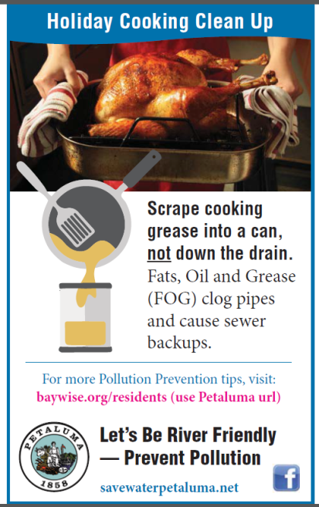
Community Outreach: Advertising
Online
Newspaper
Bus Ads
Before the Movie Ads

Slide 16
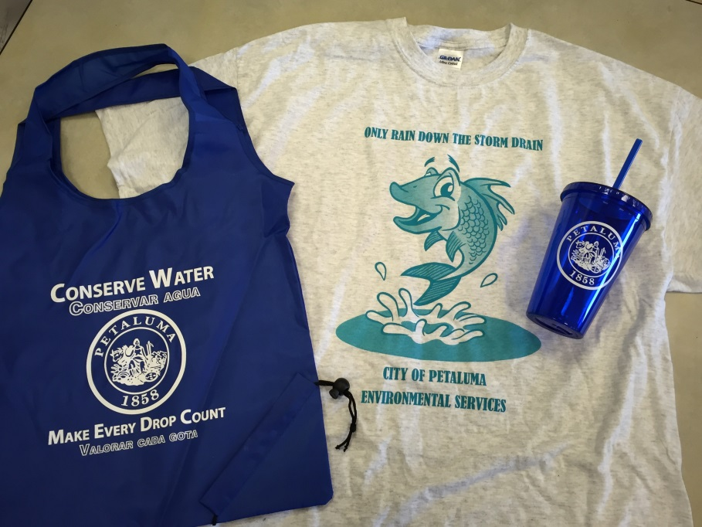
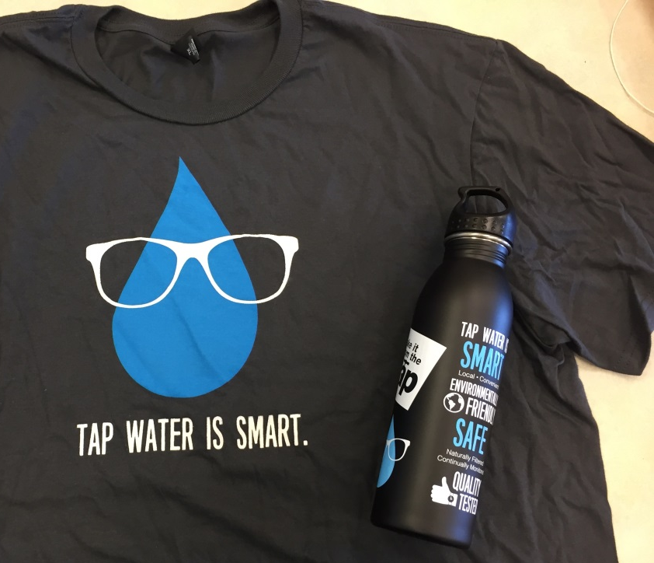
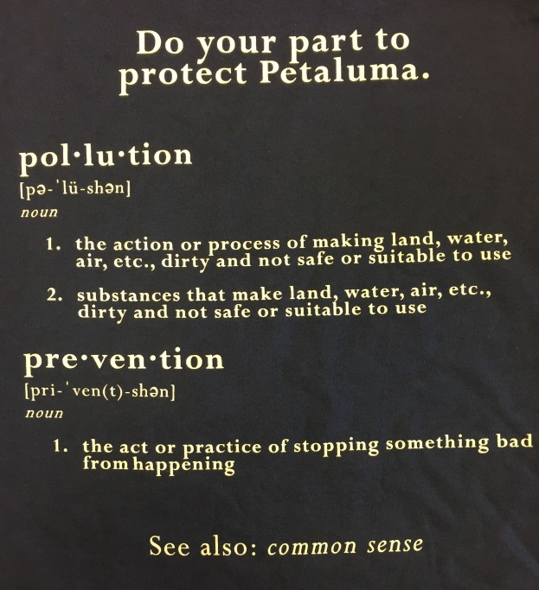
Community Outreach: SWAG
Shirts
Water Bottles
Cups
Pet Waste Bag Dispensers
Grease Scrapers

Slide 17





Regional Collaborations

Slide 18
Petaluma’s Pollution Prevention Program
Petaluma’s Environmental Services Section is a small but strong group committed to protecting our local and regional environment.
Questions?

