Slide 1
I/I Reduction Efforts
EBMUD and the Satellite Agencies
BACWA Collection Systems
November 10, 2016

Slide 2
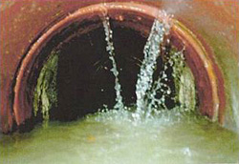
Overview
Background
Consent Decree
Work Requirements
Regional PSL Program
Regional Technical Support Program
Results to Date
Key Challenges
Next Steps

Slide 3
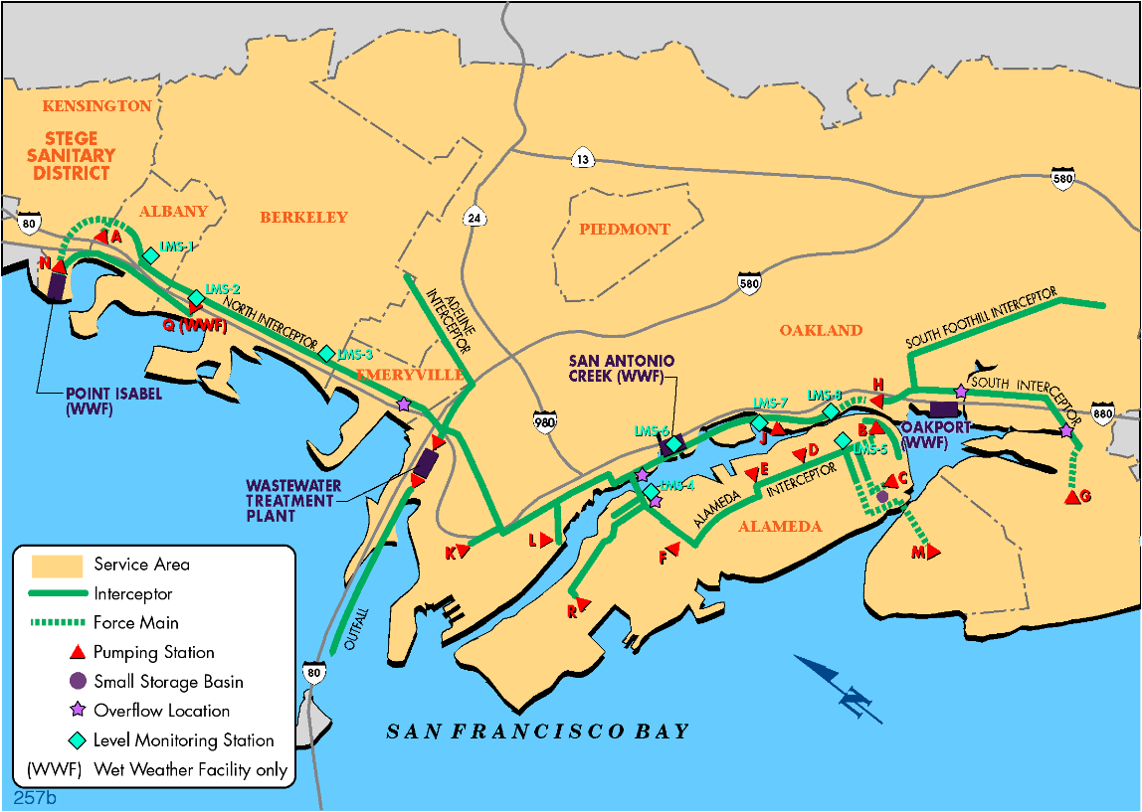
Background
EBMUD Assets:
1 MWWTP
3 Wet Weather Facilities
29 Miles of Interceptor
Satellite Assets:
1,600 miles of sanitary sewer
collection system
Private Assets:
~ 1,600 miles of PSL

Slide 4
Background
Wet Weather Timeline
  Late 1980s – developed three wet weather facilities
  2007 – Permit remanded as WWFs do not meet secondary treatment standards
    EBMUD NPDES Permit now prohibits discharge from the Wet Weather Facilities
    Satellites’ NPDES Permits now prohibit causing or contributing to WWF discharges

Slide 5
Background
Wet Weather Timeline (cont.)
  2009 – District entered into a Stipulated Order
  2011 – Satellites entered into a Stipulated Order
  2014 – District and Satellite agencies entered into
  Consent Decree

Slide 6
Consent Decree
Consent Decree designed to remove significant amount of I/I from the collection system through asset management
  Notable shift from historical approach of treatment and/or regional storage
  If check-in milestones are not met, potential for work to shift towards the traditional approach
Rehabilitation/repair/replacement to be performed by the responsible party
  PSLs :: homeowners/business owners
  Sewer mains/manholes :: Satellite agencies
  Interceptor System :: District

Slide 7
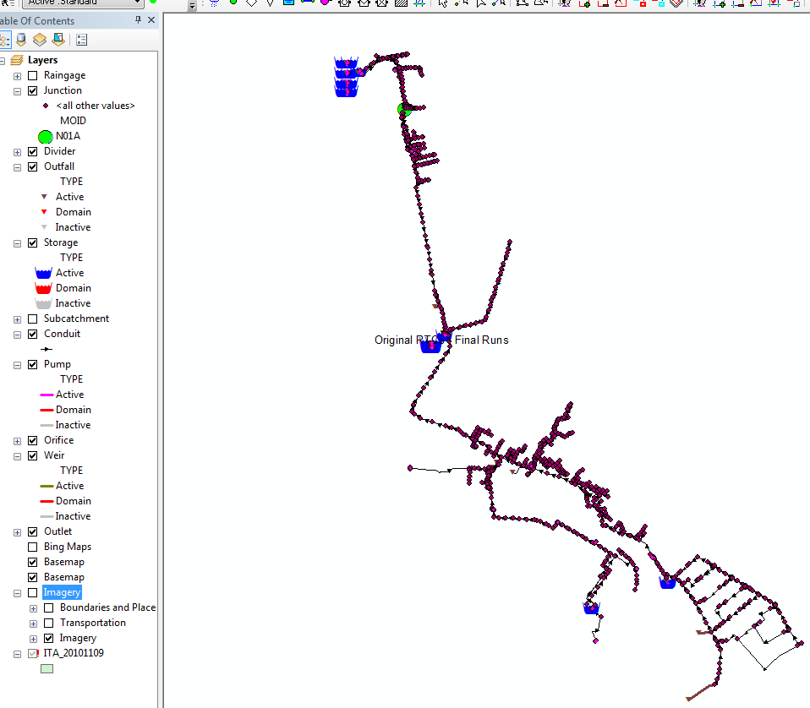
Consent Decree
Basis for Compliance
  Flow Model
    Interceptor System Model
    Volumetrically conservative
    Calibrated Annually
    Design Storm condition

Slide 8
Consent Decree
Key Compliance Dates
  2022 Check-in #1
  2027 San Antonio Creek WWF discharges eliminated
  2030 Check-in #2
  2033 Point Isabel WWF discharges eliminated
  2035 Oakport WWF discharges eliminated
  Failure to meet check-in targets results in, as yet undefined, revised work requirements with significant EPA discretion

Slide 9
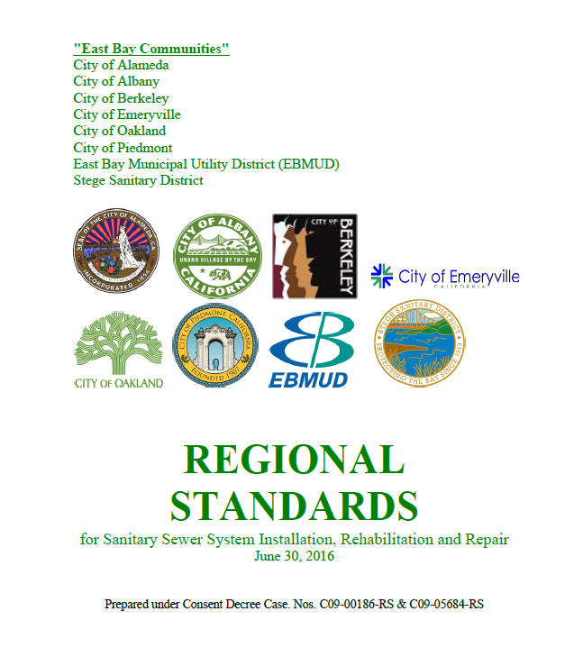
Work Requirements
EBMUD and Satellite Agency Requirements
  Regional Standards
  Reporting
Satellite Agency Requirements
  PSL ordinance implementation
  Sewer main and manhole rehabilitation
  Inflow and rapid infiltration source reduction
  CCTV Inspection / Cleaning / FOG control
  Chemical root control
  Capacity monitoring (Stege and Oakland only)

Slide 10
Work Requirements
EBMUD Requirements
  Management of Regional PSL Program
  Implementation of the Regional Technical Support Program (RTSP), focusing on inflow investigations
  Construction of Urban Runoff Diversion Project (URDP) and PS Q Flow Reversal
  Additional Efforts
    Modeling and Effluent Limitations

Slide 11
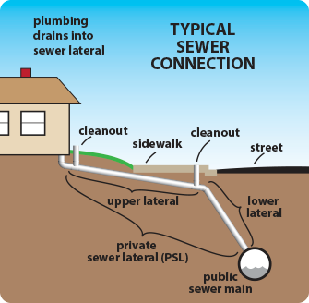
PSL Program
PSL is privately-owned pipe
that conveys waste flows
from property to publicly-
owned sewer mains
Collectively, PSLs in the
region are equivalent in
length to the publicly-owned
regional collection system

Slide 12
PSL Program
Regional PSL Program includes all of SD-1, except for the City of Berkeley (which manages its own)
Three triggers
  Title transfer
  Construction/Remodeling
  Alter water meter
Ordinance compliance remains high
  FY2016 compliance of 95% (KPI of 90%)
  Approx. 21,200 certificates issued since 2011
  Approx. 280-miles of PSLs certified leak-free
    Complete replacement of PSL 75% of time

Slide 13
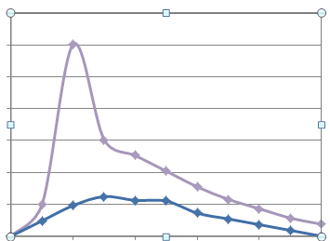
RTSP
Key Challenge
  Uncertainty regarding WHY the collection system has such a fast response during wet weather
Program Components
  Requires minimum of $2M/yr to
  identify sources of inflow and rapid
  infiltration
  EBMUD identifies specific
  sources of infiltration and inflow
  Satellite communities pursue
  source elimination
Wet Weather Flows
Time

Slide 14
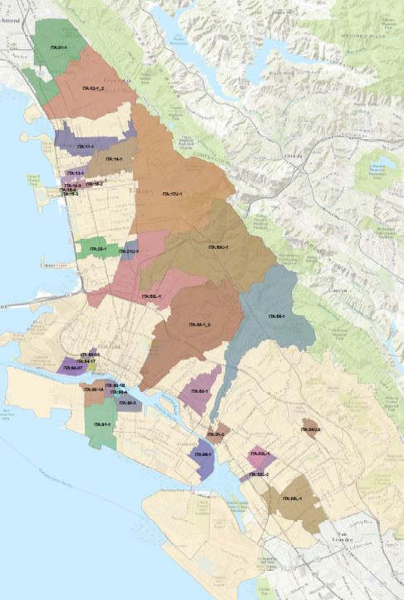
RTSP Investigations Performed
Investigation Methodologies Used
  Flow Monitoring
  Smoke Testing
  Closed-circuit television inspection
    Traditional video and digital photography
  Manhole inspection
    Top-side and digital photography
  Focused Electrode Leak Location
  Salinity Sampling

Slide 15
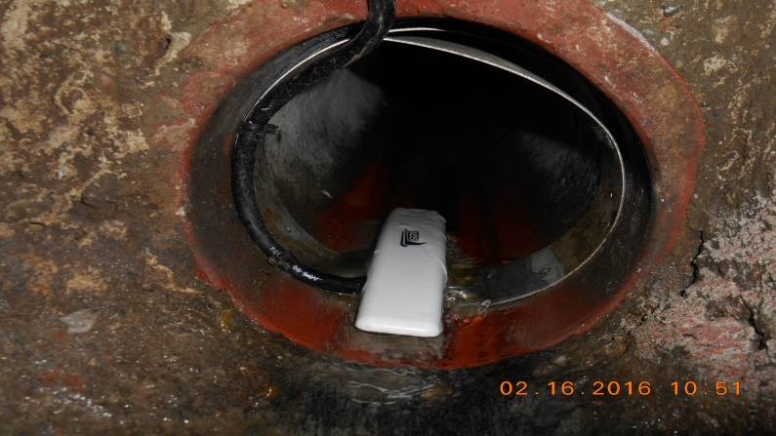
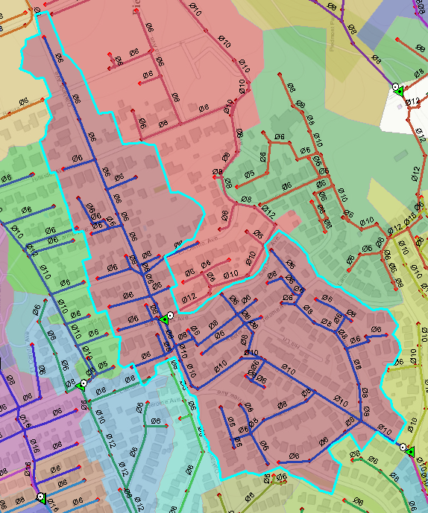
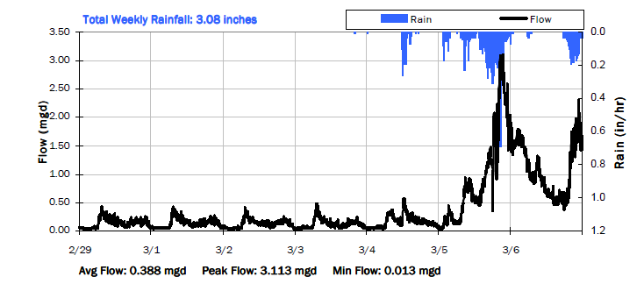
RTSP Flow Monitoring

Slide 16
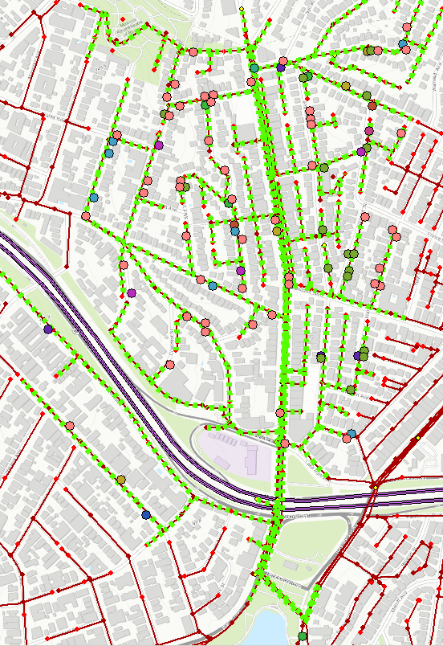
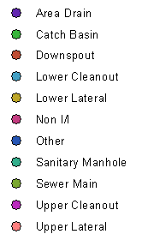
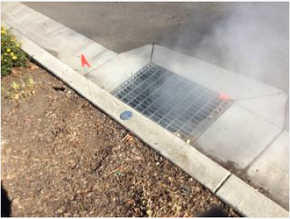
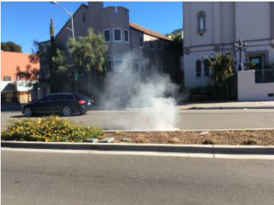
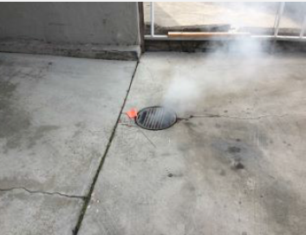
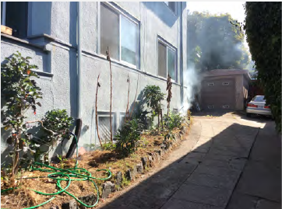
RTSP Smoke Testing
Sample Catch Basin Defect
Sample Area Drain
Defect
Sample Downspout
Defect

Slide 17
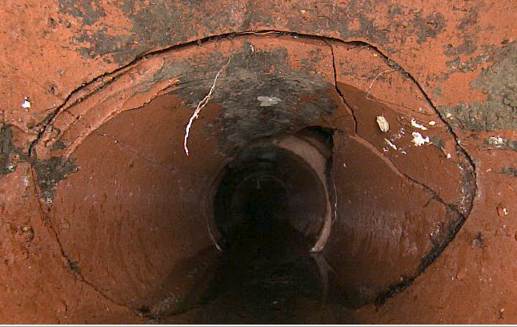
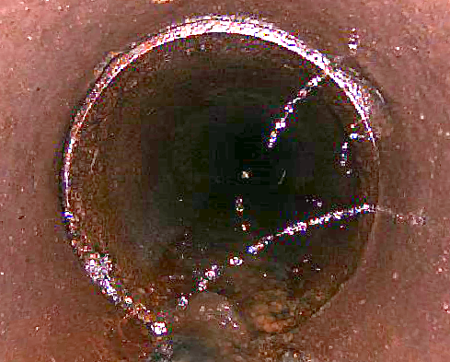
RTSP CCTV

Slide 18
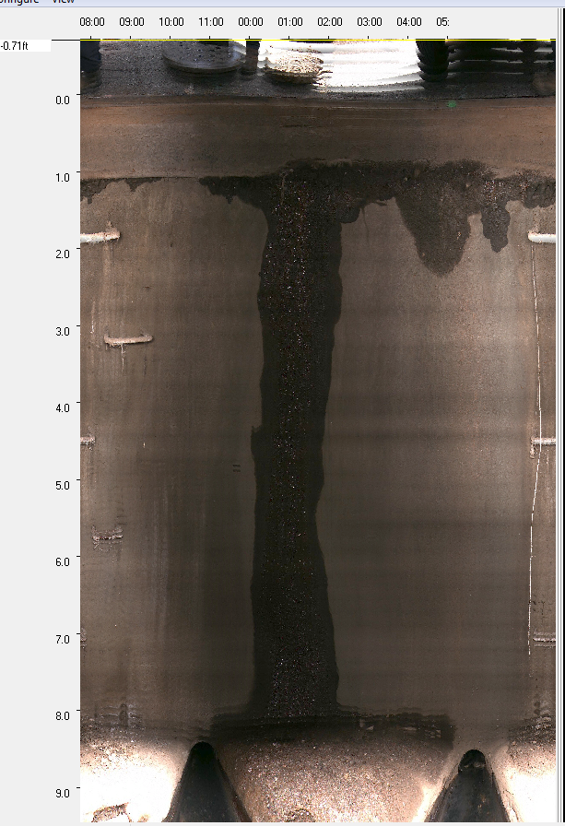
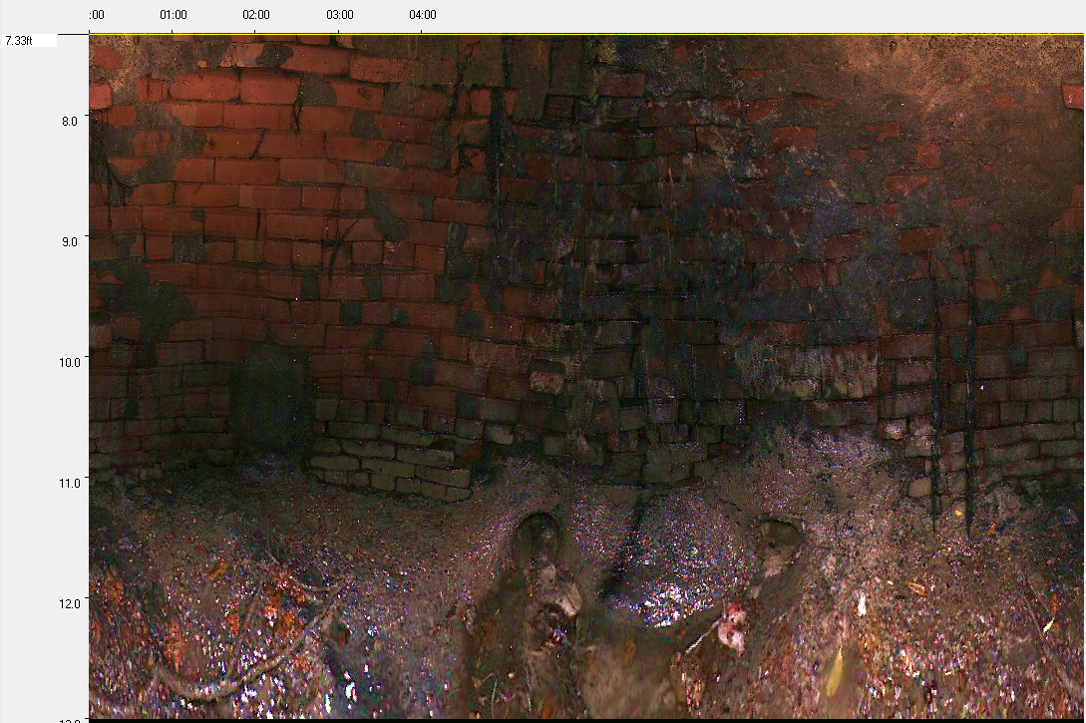
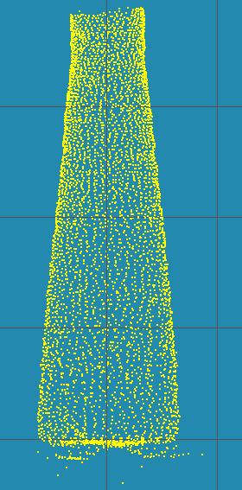
RTSP Manhole Inspection

Slide 19
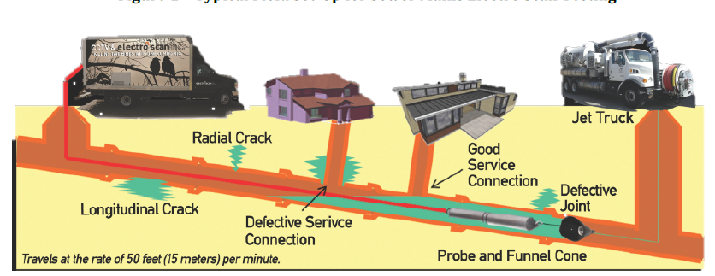
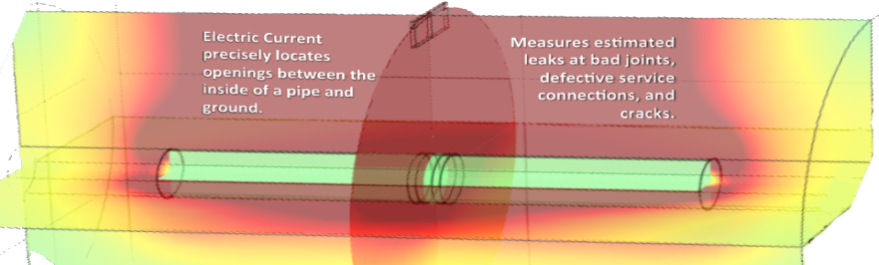
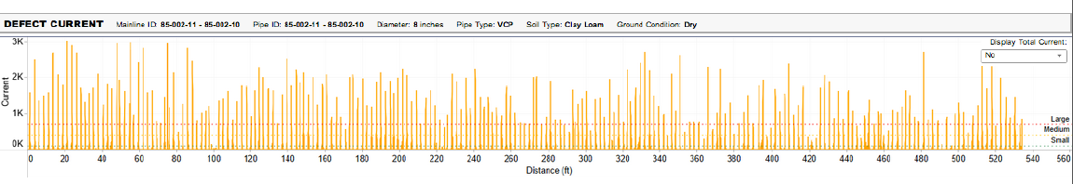
RTSP Focused Electrode Leak Location

Slide 20
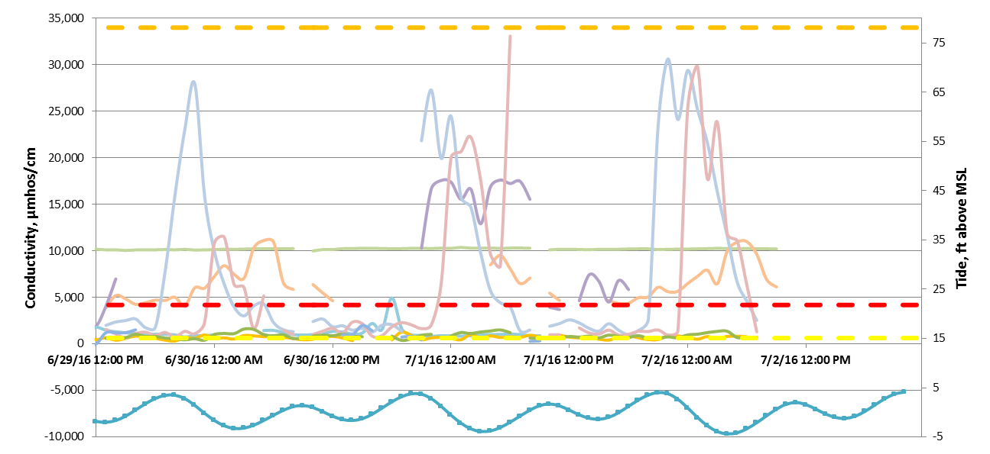
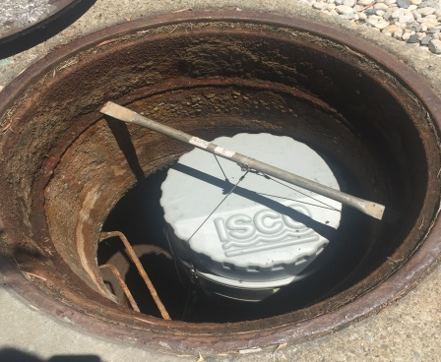
RTSP Salinity Sampling

Slide 21
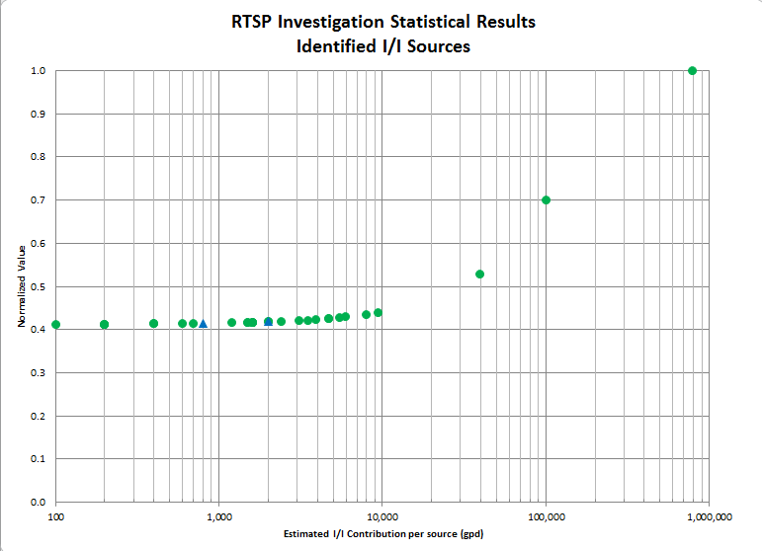
RTSP Findings to Date

Slide 22
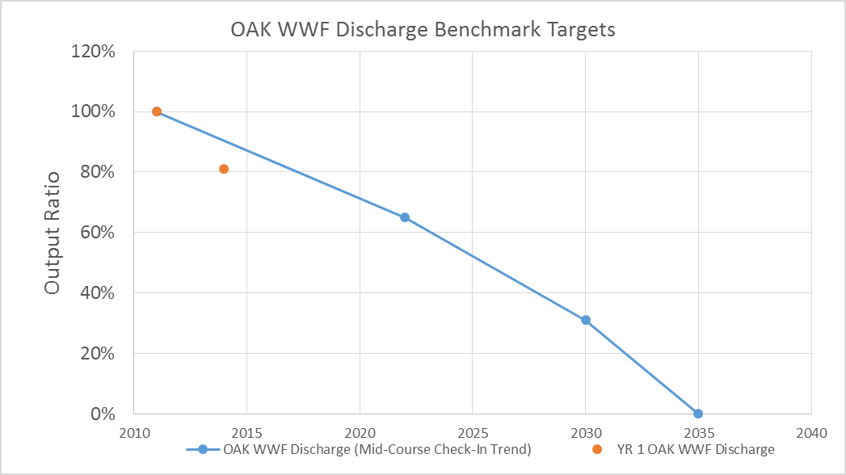
Compliance Status
First Annual Check-in last December
Reductions to date appear consistent with expectations, although data is limited

Slide 23
Key Challenges
Locating I/I sources
Data Management/Data Handling
Long-term maintenance

Slide 24
Next Steps
Continue to Develop and Implement RTSP
  Data analysis
  Field work
  Evaluation of technologies and resources
Continue implementation of Regional PSL Program and Capital Projects
Continue to monitor performance regarding flow reductions and prepare for the 2022 Check-in

Slide 25
Questions?
Chris Dinsmore
EBMUD
christopher.dinsmore@ebmud.com
510-287-0522

