Slide 1
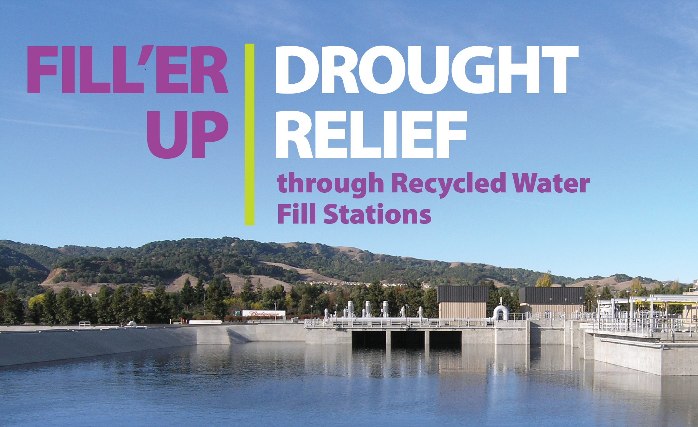

Bay Area Clean Water
Agencies (BACWA)
Recycled Water Committee
Oakland, CA
June 3, 2015

Slide 2
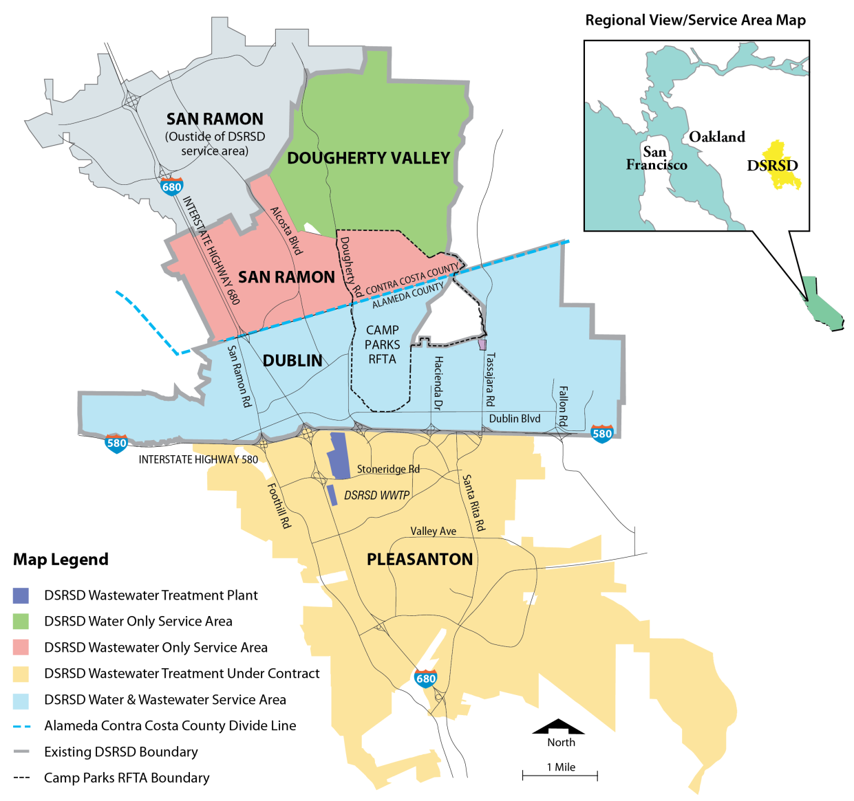

About DSRSD
Distribute potable and recycled water
Collect and treat wastewater
Distribute potable and recycled water; collect and treat wastewater
Treat wastewater by contract

Slide 3

Potable Water Restrictions
DSRSD declared an updated State of Community Drought Emergency May 5, 2014
Overall conservation goal of 25%
  5% inside
  50-60% outside
Use of potable water:
  Prohibited for construction purposes
  Limited for irrigation purposes

Slide 4
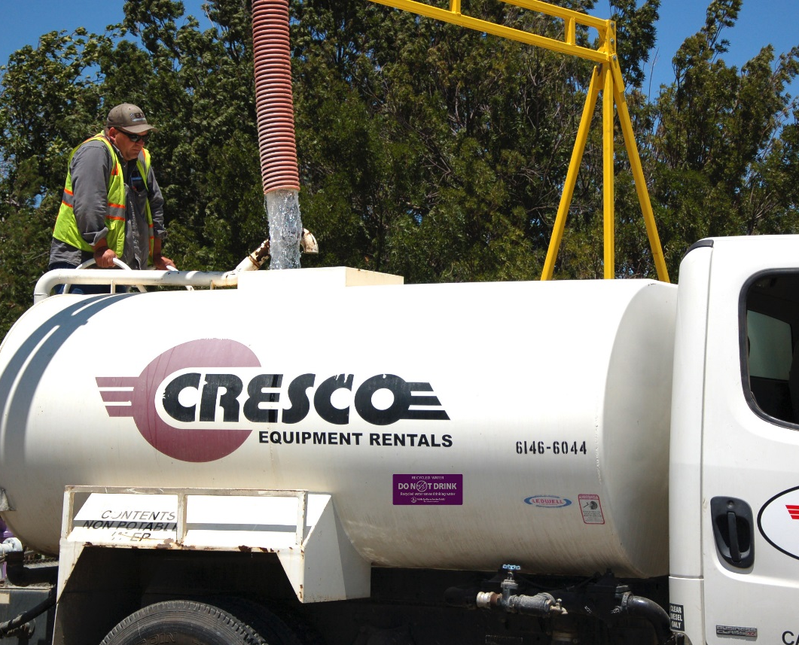
Commercial Fill Station
Operational since 2007
            Required all potable water construction meters returned to District
            Required use of recycled water for construction and surface washing activities
            Commercial fill station use increased by 98%
Typical loads 2,000-4,000 gallons
Upgraded fill station to a 1,000 GPM fill rate
$10/load for recycled water
PIN gives drivers access 24/7
            Distributed 16.9 MG (52 AF)

Slide 5
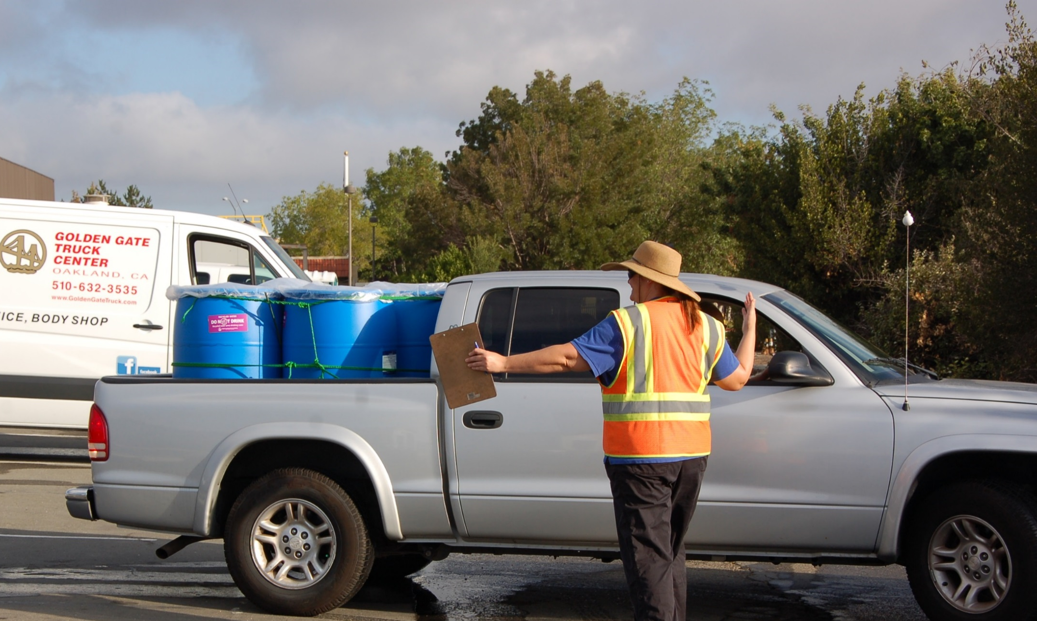
Residential Recycled Water Fill Station
DSRSD’s Drought Response Action Plan included conceptual program offering free recycled water to residents:
  To conserve potable water; and
  Mitigate residents concerns about maintaining landscaping over the summer
Program hurdles:
  Regulatory approval
  Public acceptance and participation
  Safeguarding health and safety at the fill station and customers’ homes

Slide 6


Regulatory Approvals
State Water Resources Control Board (SWRCB)
  User Agreement with instructions
  http://www.dsrsd.com/home/showdocument?id=929
  Training program
  Recycled water stickers for customer’s containers
Regional Water Quality Control Board
  CDPH submittal and approval
  Allowed under 96-011 General Permit
  Report requested after the first month
Large container stickers 4” X 8”
Small container stickers 3.5” X 5”

Slide 7
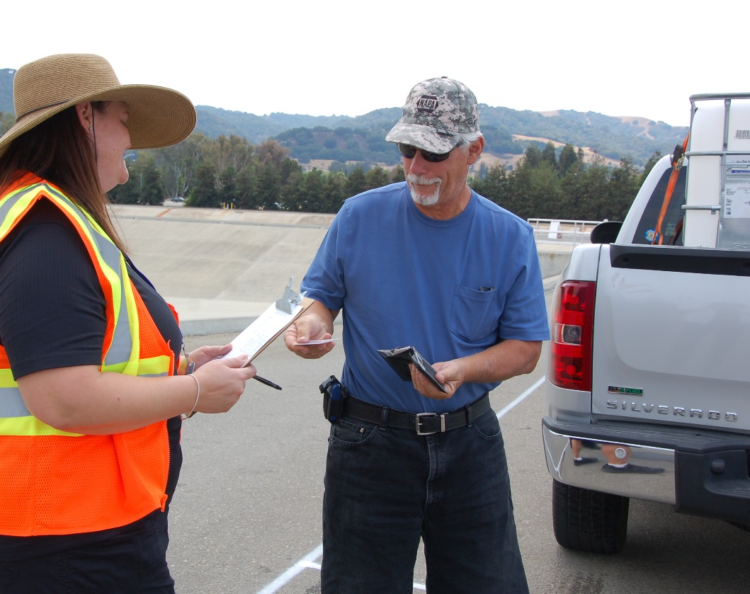
Residential Recycled Water
Fill Station
Must receive training prior to the first use
Must sign user agreement prior to the first use
Wallet ID card
  Verifies resident has completed training and user agreement
OK to make multiple trips in a day

Slide 8
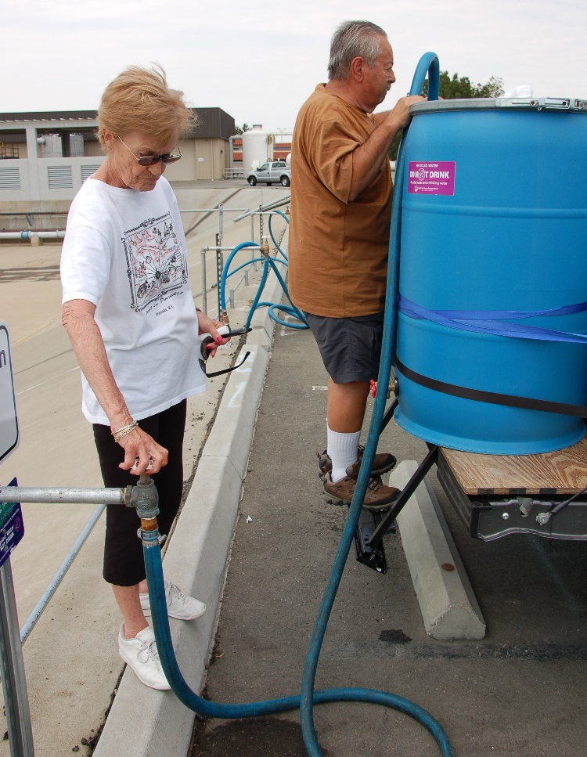
Residential Recycled Water Fill Station
Recycled water is free
Fill Station is open to all- not just DSRSD customers
Minimum 1 gallon and Maximum 300 gallons per trip
Open only during posted hours
Attendant checks wallet cards and logs loads

Slide 9
Residential Recycled Water
Fill Station
Summer hours: Open 7 days/week
  Monday, Wednesday, Thursday, & Friday – New customer sign-ups: 11:00 a.m. to 12:00; Open to all customers 12:00 p.m. to 7:00 p.m.
  Tuesday, Saturday & Sunday – Open to all: 8:00 a.m. to 12:00 p.m.; New customer sign-ups: 12:00 p.m. to 1:00 p.m.
Open throughout winter… closed when it rains
  Winter hours: Open 4 days/week
By the end of 2014:
  DSRSD distributed over 2.30 MG of recycled water to residents via milk jugs, buckets, and totes
  495 residential participants
Now over 1,300 customers
  Average 49,000 gallons collected per day; 400 - 500 trips a day
  Since January 2015, over 3.075 MG

Slide 10
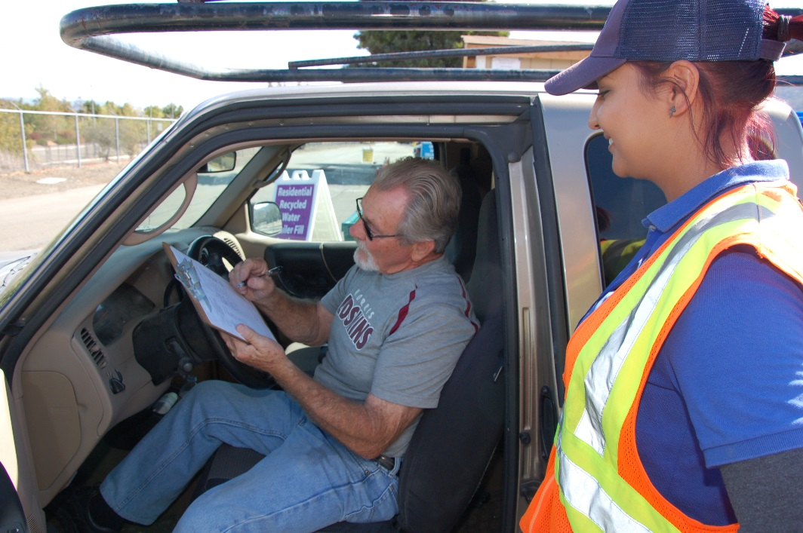
Staffing Considerations
Hire and train attendants (temporary employees)
$12/hour pay rate ($15/hour to temp agency)
Use District staff to man the facility one day per week

Slide 11
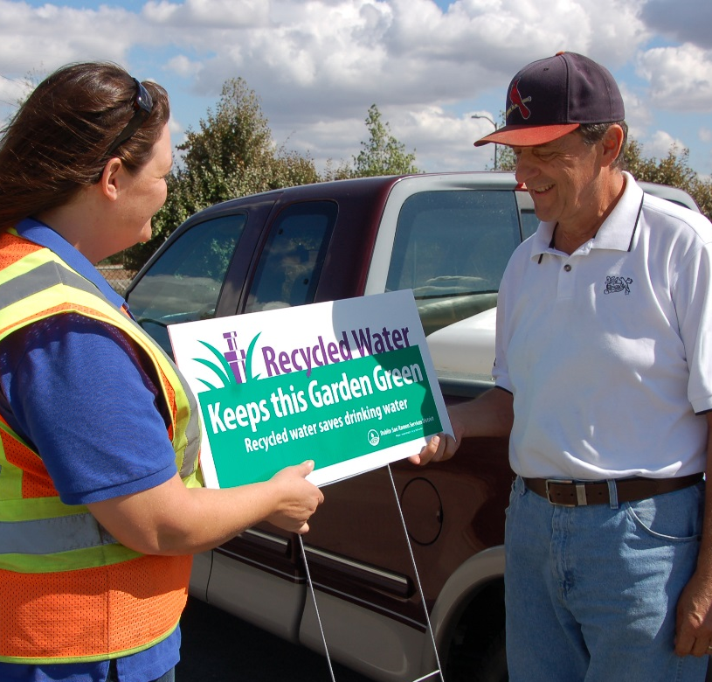
Unexpected Benefits of the Residential Fill Station
Users have become comfortable with recycled water. They love it, they want it, they are no longer afraid of it
Media loved the program (local, state, national, and even international reporters)
Users and the media are now better educated about recycled water and
its role in creating sustainable communities
“Recycled Water Keeps this Garden Green” signs given to residential users to post in their yard.

Slide 12
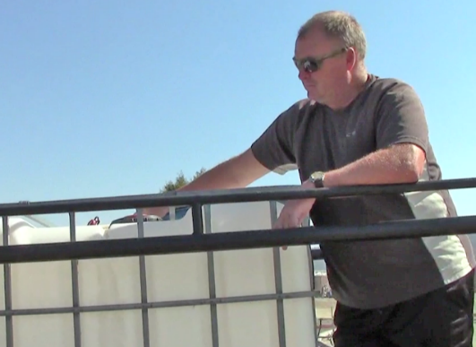
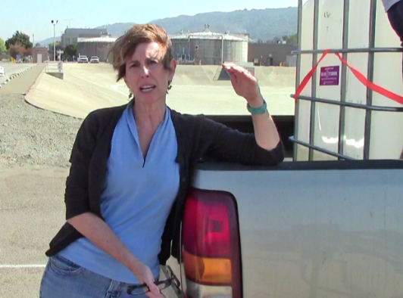
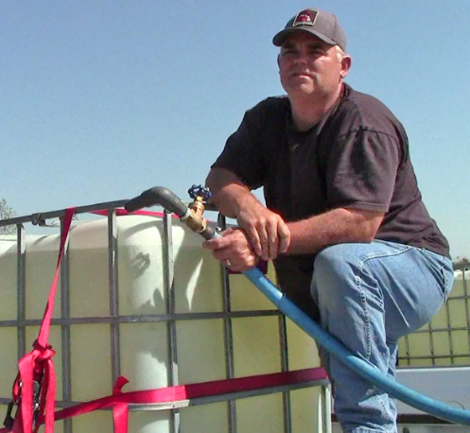
What Customers Say
“Everyone who comes here is pretty happy about it. It’s a fantastic program that’s for the future. They keep adding stations as it gets more popular - making it as convenient as possible. I love the program. I hope more people do it.”
“We started with 5 gallon water jugs, moved up to a 55 gallon drum and now we’ve got the 275 gallon tote. Our yard is really green. We’re really glad this program has been offered.”
“It’s an awesome service and everyone is so nice. It does help. More agencies need to do this or it’s just water that gets dumped into the Bay.”
“When I walk my dog by the creek, you’re going to find a lot more bacteria in the creek than in this recycled water.”

Slide 13
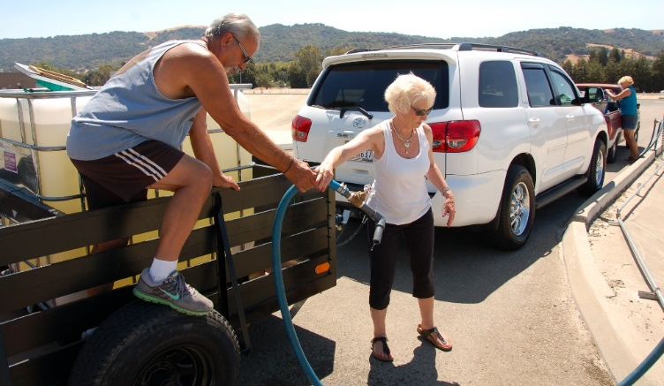
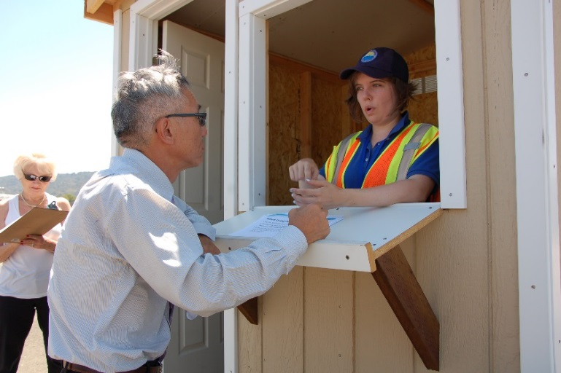
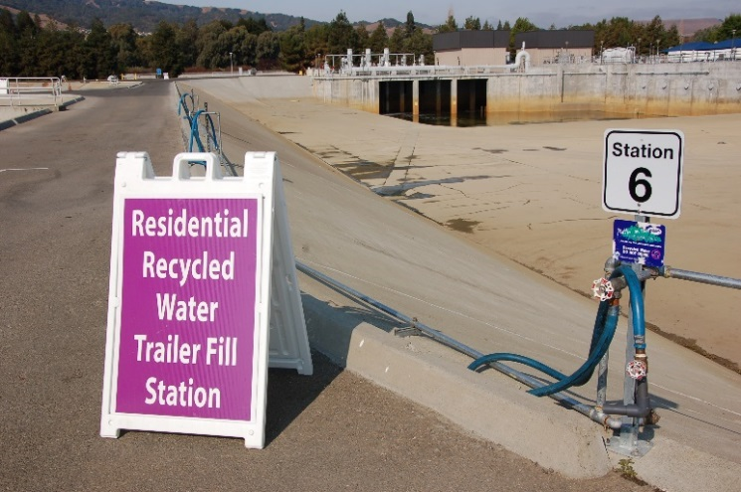
Lessons Learned
Three hose bibs not enough…
now there are eight
Provide a mix of “back-in” and “drive through” fill stations for trailers
Need shut off valves on the end of hoses
Things break, repairs are common
Shed is needed for attendant shelter and storage of materials
Signage is crucial
  Traffic control is needed when busy
    Average between 100 – 350 customer trips/day
  Some people are not good drivers
  Residents need a clear route through the plant

Slide 14
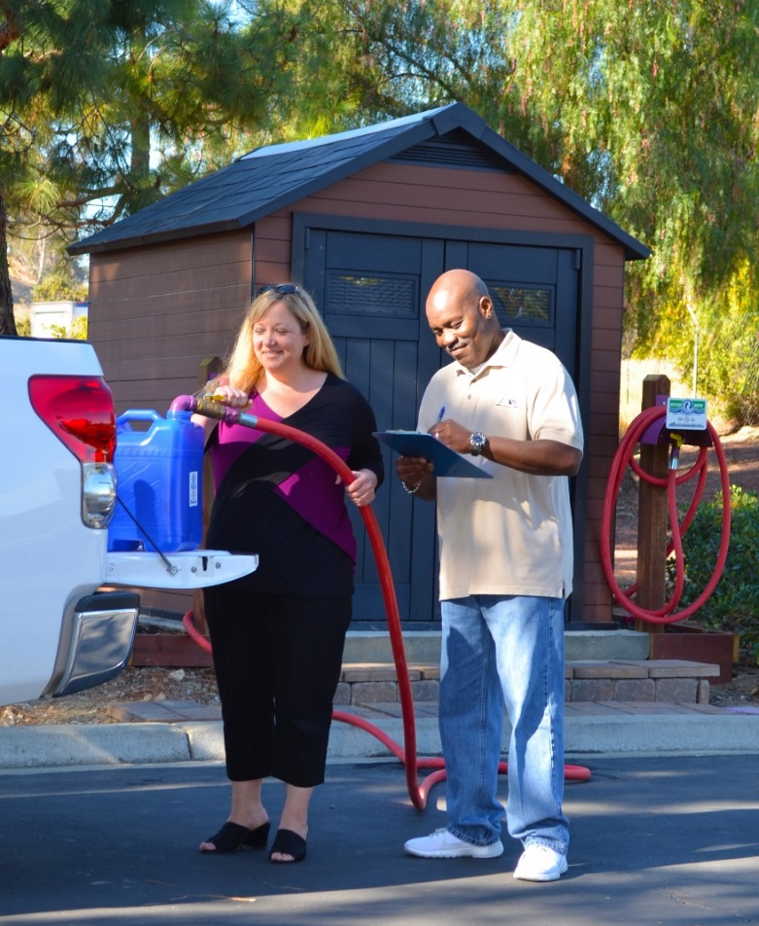
The Concept is Already Being Replicated
City of Livermore
Central Contra Costa Sanitary District
Others?

Slide 15
Acknowledgments
DSRSD Board of Directors:
Georgean Vonheeder-Leopold
Ed Duarte
Pat Howard
Richard Halket
Dawn Benson
DSRSD Staff:
Bert Michaleczk, General Manager
Dan Gallagher, Operations Manager/Drought Coordinator
Levi Fuller, Wastewater Treatment Plant Operations Manager
Dan Lopez, Mechanical Maintenance Supervisor
Shawn Quinlan, Mechanic II
Steven Delight, Senior Civil Engineer
Stefanie Olson, Clean Water Programs Specialist
Florence Khaw, Environmental Compliance Inspector II
DSRSD Staff (Continued):
Sue Stephenson, Community Affairs Supervisor
Renee Olsen, Community Affairs Specialist II
Joyce Chang, Graphic Designer
Lori Martin, Administrative Assistant II
Louanne Ivy, Administrative Analyst II
Simone Grashuis, Human Resources Tech
Ann Cigliuti, Environmental Compliance Inspector II
Kapil Mohan, Environmental Compliance Inspector II
State Water Resources Control Board, San Francisco District
Robert Brownwood, District Engineer/Senior Sanitary Engineer
Vladimir Rakhamimov, Associate Sanitary Engineer
San Francisco Bay Area Regional Water Quality Control Board:
Blair Allen, Water Resources Control Engineer

Slide 16
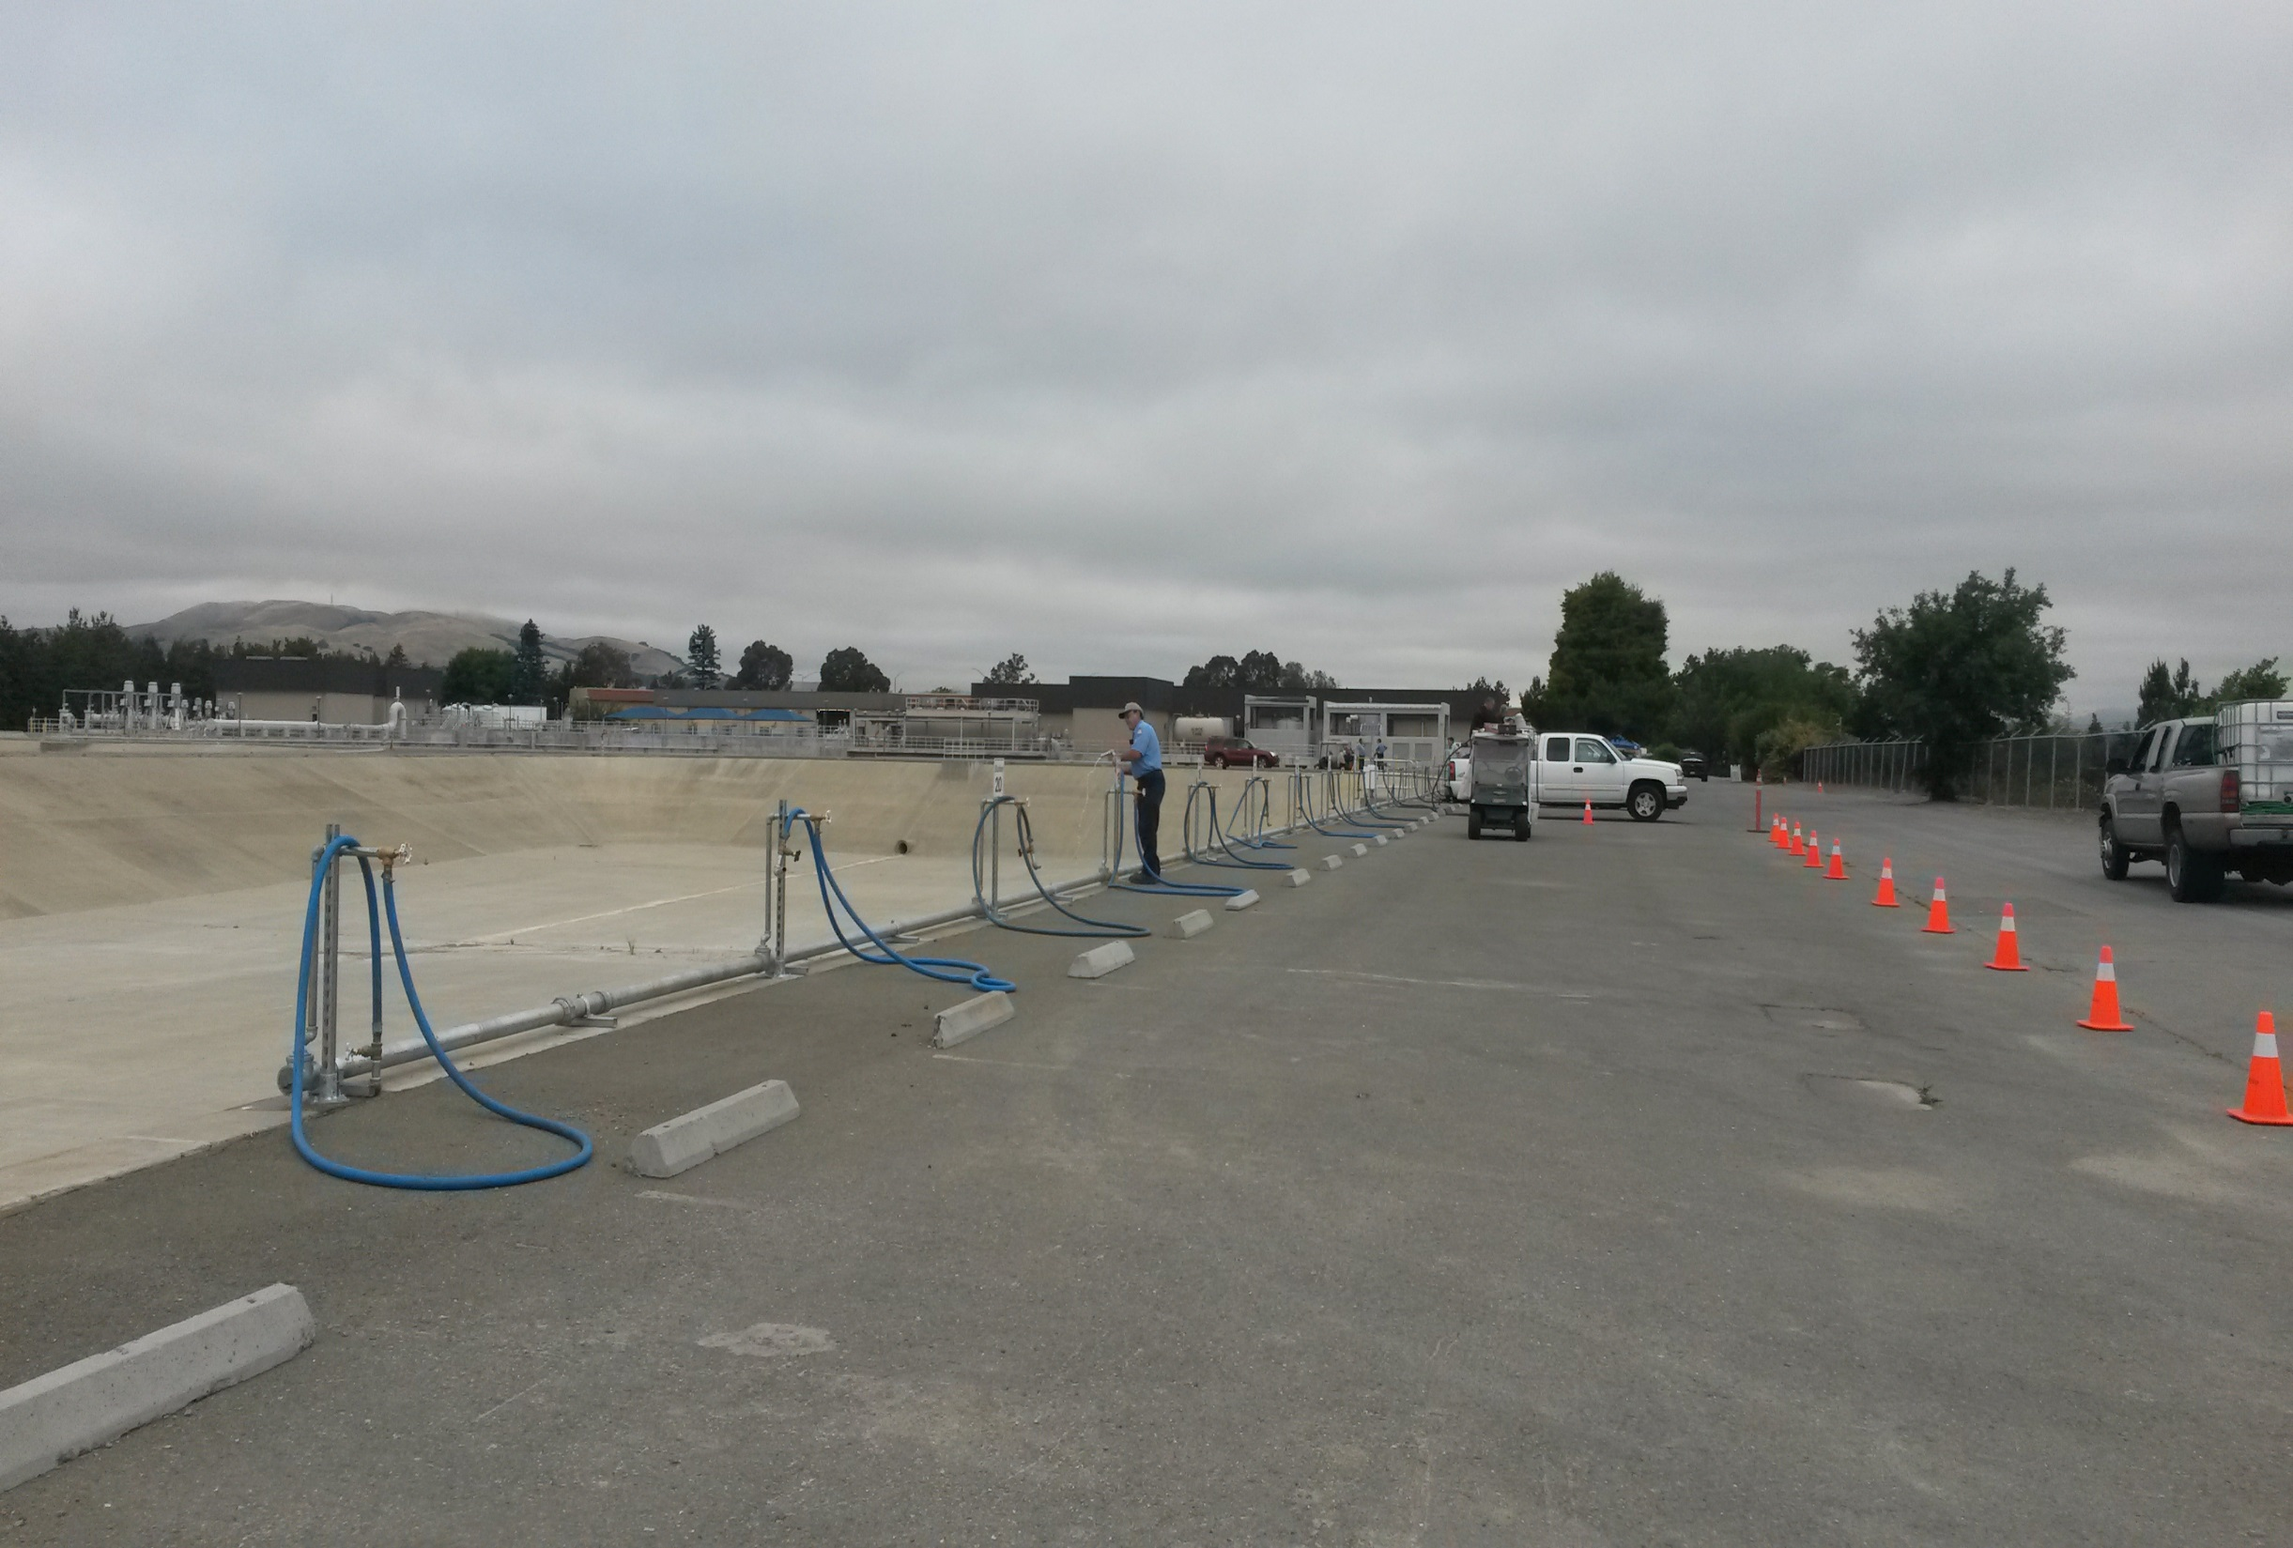
Adding 10 additional stations

Slide 17
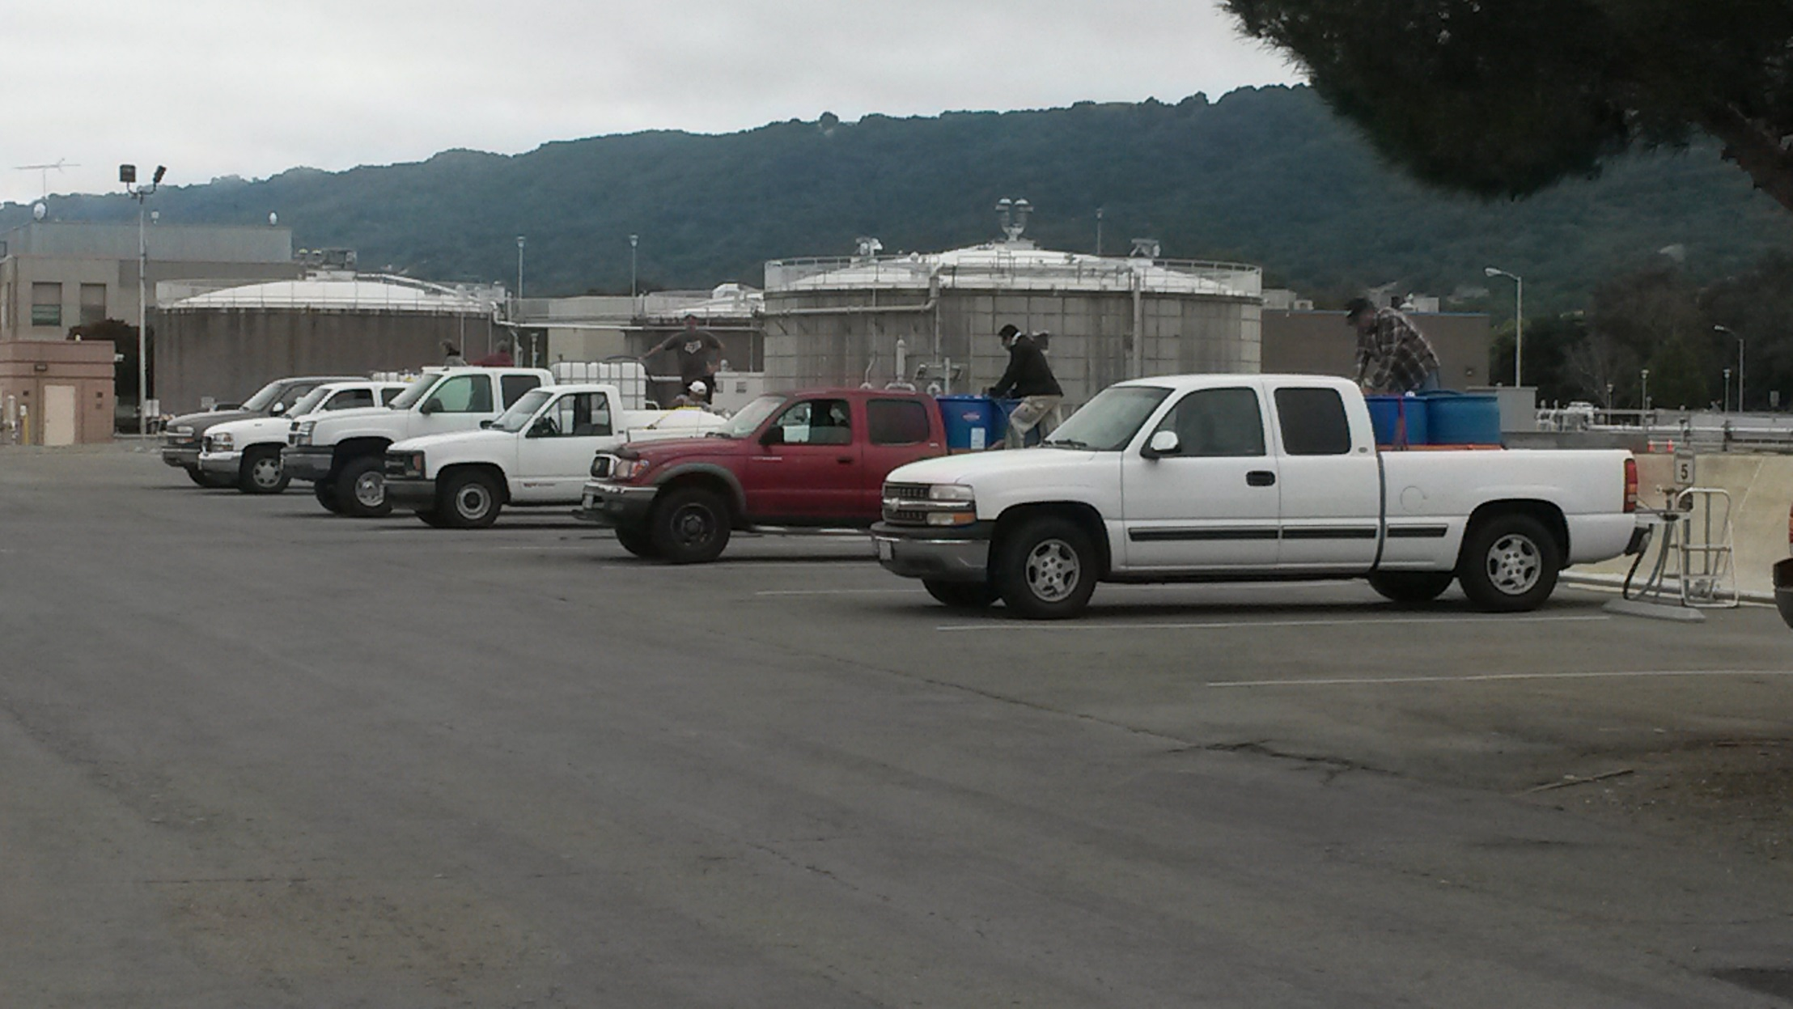
Fill Station Customers on Tuesday Morning

Slide 18
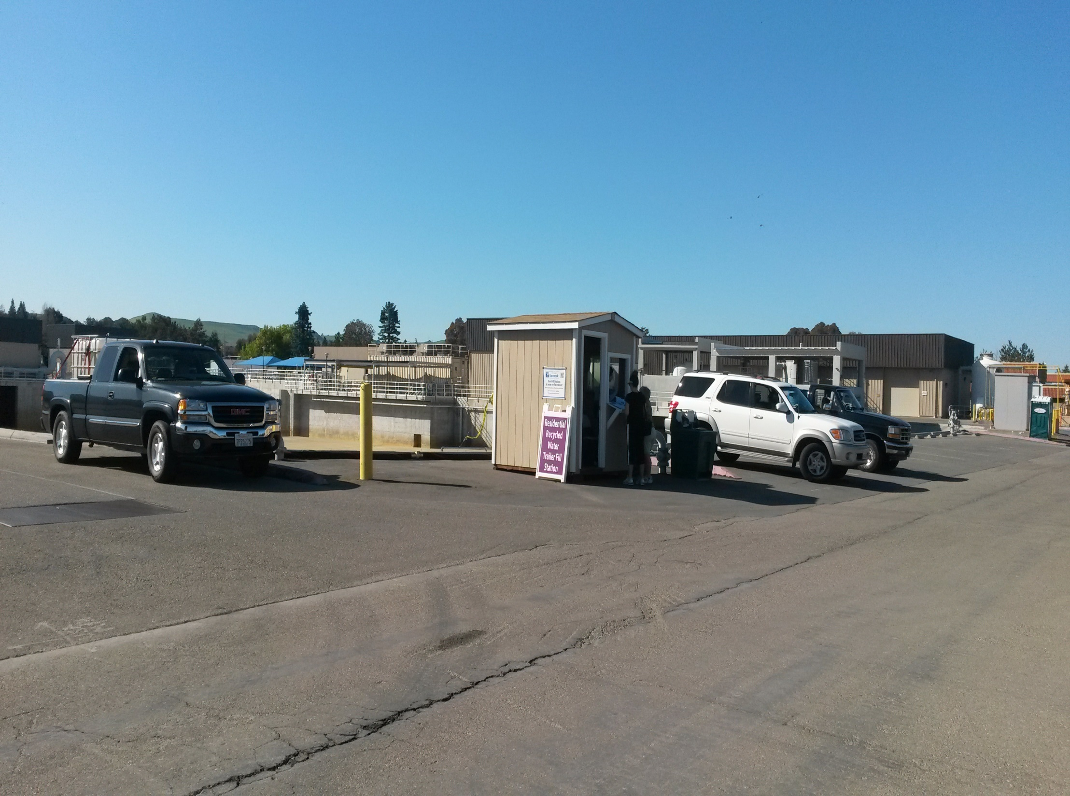
Rhodora Biagtan
Biagtan@dsrsd.com
(925) 875-2255
Stefanie Olson
Olsons@dsrsd.com
(925) 875-2245
Questions?

