Slide 2
Presentation Outline
Current Drought Conditions
Drought Impacts
Collection System Solutions & Agency Examples
  Alternative Water Supplies
  Alternative Maintenance Equipment & Methods

Slide 3
Current Drought Conditions

Slide 4
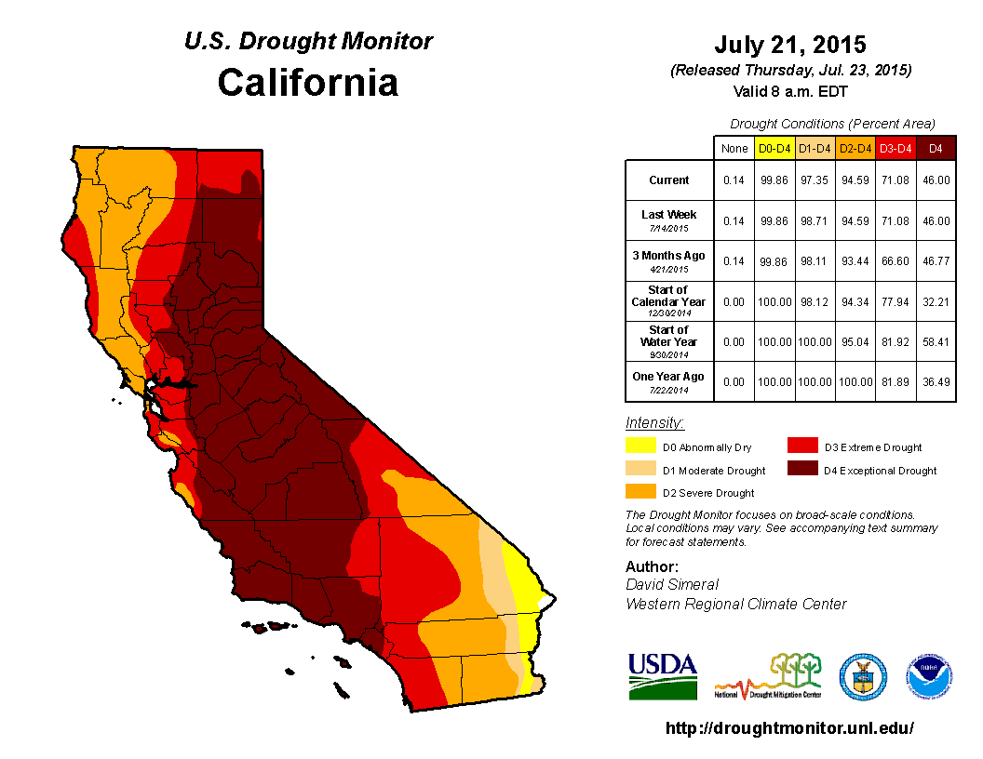
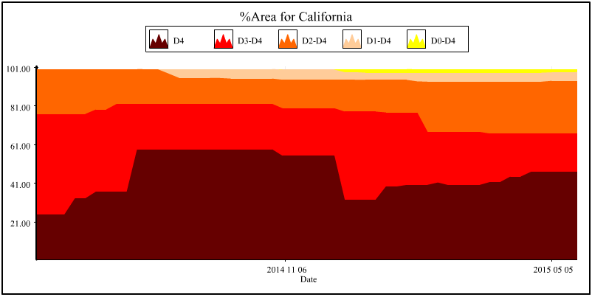
California Drought Monitor, July 23, 2015
Affects Entire State
% Area Coverage better this year than last year

Slide 5
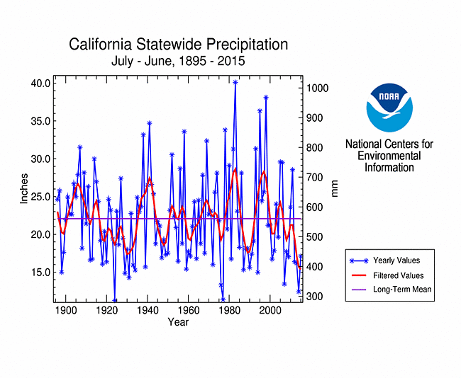
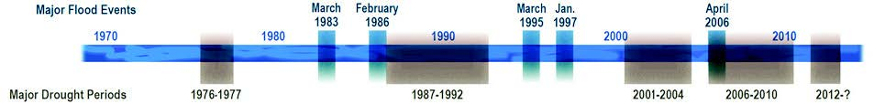
Historic Statewide Precipitation Patterns
Historical record shows cyclical drought/flood
Current drought severe in both intensity and length
Highly randomized: does not mean several more years of drought are not possible

Slide 6
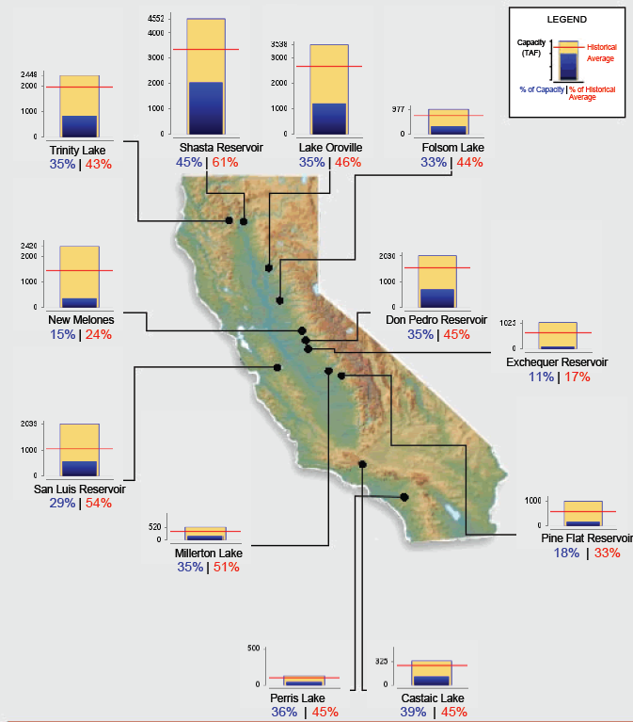
2015 Reservoir Conditions
Current reservoir levels are much lower than 2 years ago (2013)
Situation is more dire in Southern CA
Overall, greater storage in Northern CA

Slide 7
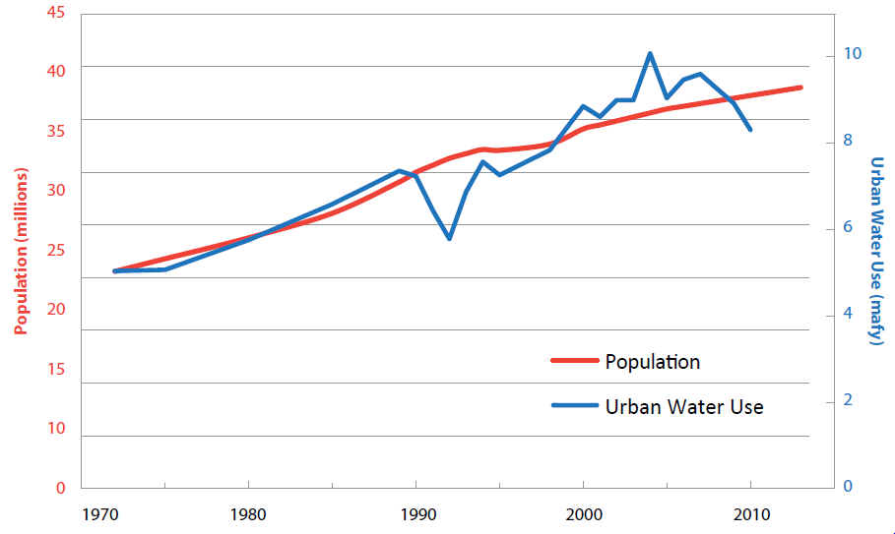
California Water Usage & Population
(1970 – 2010)
Water Usage per Capita is NOT increasing
California population is continually increasing, bringing increased demand

Slide 8
Drought Impacts

Slide 9
Wastewater Treatment Impacts
Lower influent average day flows
  Higher influent contaminate concentrations
  Potential compliance issues for untreated contaminates (e.g. salts)
  Deceptive plant flow ratings

Slide 10
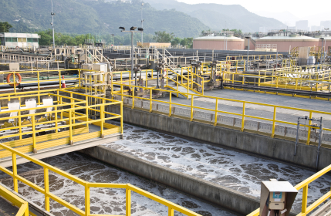
Wastewater Treatment Impacts
Higher salt water intrusion in coastal areas
Increased demand for recycled water production

Slide 11
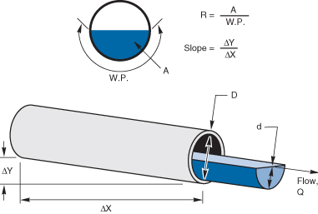
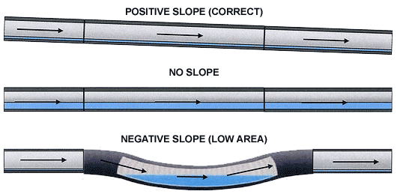
Collection System Impacts
Lower average day flows
  Lower sewer flow velocities
  Higher rate of sediment deposits
  Concerns in flat sewers and sags

Slide 12
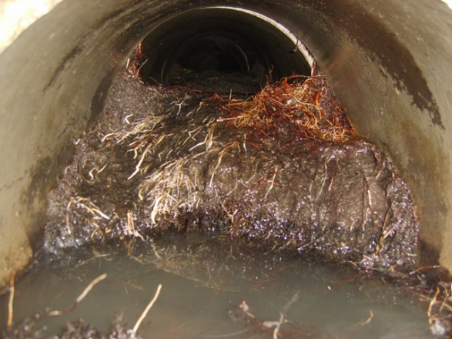

Collection System Impacts
Increased root intrusion
  Roots compensate for the lack of soil moisture to keep tree evenly anchored
  Root sizes increase to obtain more water and minerals
Mandatory water reductions of 20-30%

Slide 13
WWTP Drought Solutions

Slide 14
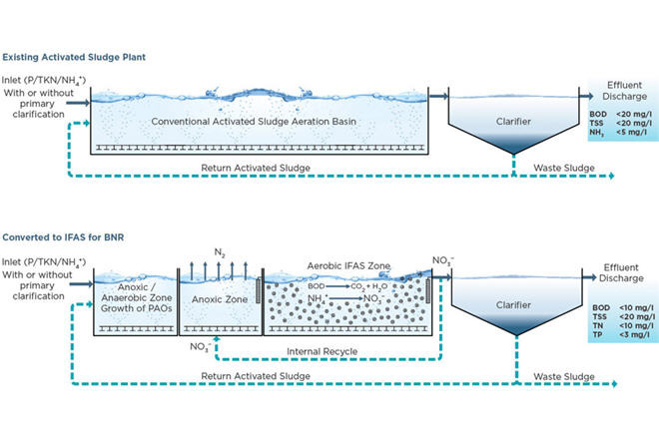
Wastewater Treatment Solutions
Increased influent ammonium concentrations = higher effluent nitrate levels
Potential MLE processes modifications to meet nitrate limits:
  Increase the recycle rate to the anoxic zone
  Lower DO at the end of the aerobic zone
❷
❶

Slide 15
Wastewater Treatment Solutions
  Reactors are sized by the solids retention time, which isn’t changing (much)
Conventional Activated Sludge:
  Automated dissolved oxygen controls can regulate oxygen rates as detention times increase
  If reactor has no automated dissolved oxygen control, aeration rates may increase O&M costs

Slide 16
Wastewater Treatment Solutions
Re-rate plant capacity based on loads and population projections – not flow rate
Blending or sidestream treatment for salt reduction
Increased groundwater recharge to combat salt water intrusion
Increase recycled water production

Slide 17

Agency Example
WWTP: Increased recycled water delivery to OCWD for groundwater recharge
  Potentially helps lower salt water intrusion rates
Collection System: Looking into Haaker vactor truck with recycling capabilities

Slide 18
Collection System Drought Solutions & Agency Examples

Slide 19
Alternative Water Supplies
Use of non-potable water supplies including recycled water for hydro-flushing operations
Challenges:
  Availability of supply
  Increased refill drive times
  Particulates can sometimes clog equipment
    Turbidity levels:
      Recycled water = 2.0 NTU (particles up to 100 micron)
      Drinking water = 0.1-0.3 NTU

Slide 20
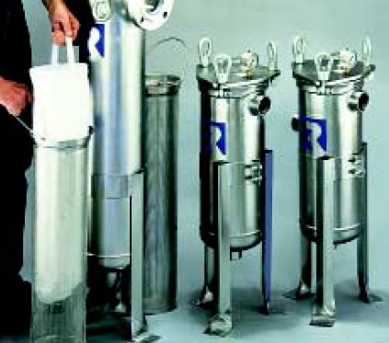
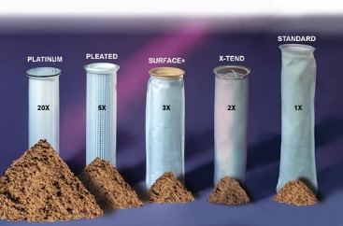
Bag Filters
Hydro-truck tank fill:
  10 micron or larger (bacteria = 1 micron)
  Manufacturers: Pentarr, Jamison, Rosedale, Granger, etc.

Slide 21

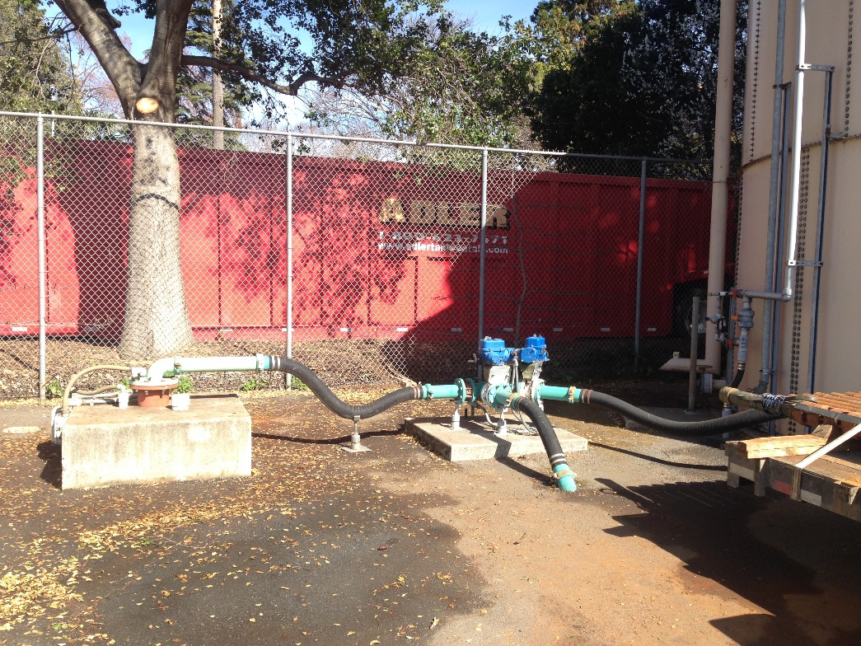
Agency Example: Alternative Water Supply
Rehab and redevelopment of non-potable Washington Well for:
  Sewer hydro-flushing
  Street sweeping
  Park irrigation

Slide 22
Agency Example: Alternative Water Supply
West Valley Sanitation District
Recycled Water Import Pilot Project
  Rental tank located at Corp Yard
  Contract water hauler
  Required Y-strainer on tank discharge pipe, and air gap bypass connections on truck fill
  Hydrotrucks fill with RW on the first tank of the day, and after lunch
  Estimated 35% reduction in potable water use
  No expected loss in crew productivity
Possible permanent solutions
  Purchase tank
  Use staff to haul water
  Advocate for permanent RW supply

Slide 23
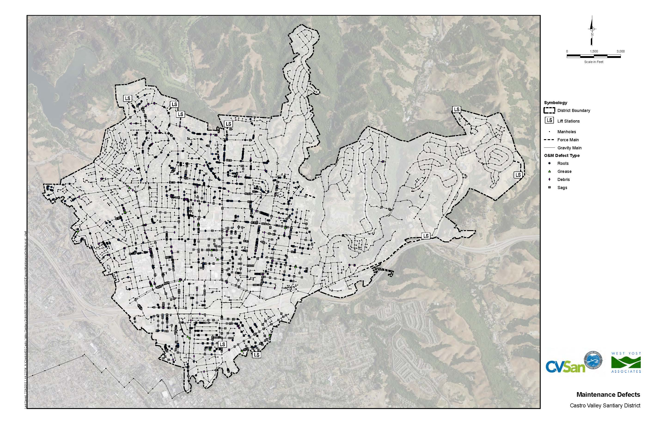
Defect-specific Maintenance Methods
  Hydro-jetting vs. mechanical rodding (no water)
  Chemical root control vs. continued hydro-jetting

Slide 24

Agency Example
50% rodding, 50% hydro-jet (normal)
Using recycled water for 25-35% of hydro-jetting
  5 DSRSD hydrants in Dublin/San Ramon
  CCCSD hydrants in Martinez and Pleasant Hill
  First hydro-truck fill of the day is CCCSD RW for Walnut Creek/Lamorinda
If required by EBMUD, prepared to rent two temporary tanks and have CCCSD RW hauled to Walnut Creek
  $10-15K/month for equipment and hauling
  50% reduced hydro-crew productivity due to increased tank refill drive times

Slide 25
Efficient Maintenance Equipment & Methods
CCTV before/during cleaning
Water-efficient jetters and nozzles
Decreased hydro-jet flowrate, increased jet pressure

Slide 26
Decreased Hydro-jet Flowrate
Less water consumption
Reduced maintenance costs
  Fewer fill ups = less drive time
More available pressure
Improved safety
  Fewer blown toilets
  Reduced noise levels

Slide 27

Agency Example
Starting July 1, 2015, only clean sewers if needed
  CCTV inspection triggers cleaning
  Expected to reduce cleaning by 25-30%
  Projected to save 5,600 gallons/month
Uses a non-potable well to:
  Fill hydro-Vacs at least once per day and anytime a crew is at the plant
  Irrigate District plant landscaping

Slide 28

Agency Example
CCTV inspections trigger cleaning
  Moved from:
  2-hydro-crews + 1-CCTV crew
  to:
  1-hydro-crew + 2-CCTV crews
  One CCTV crew codes defects
  One CCTV crew flies-through ahead of hydro-crew to identify cleaning needs

Slide 29

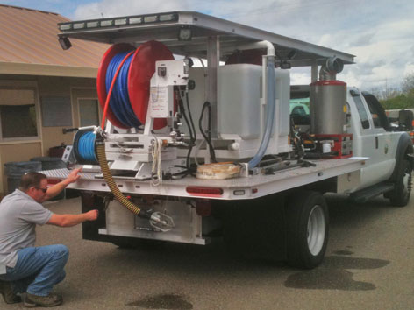
Agency Example
Water-efficient equipment
  New nozzles on standard combo truck
    Reduced from 80 gpm to 65 gpm
  Harben skid jetter for root cutting
    600-gallon tank, 18 gpm @ 4000 psi
    6” – 8” pipe only

Slide 30
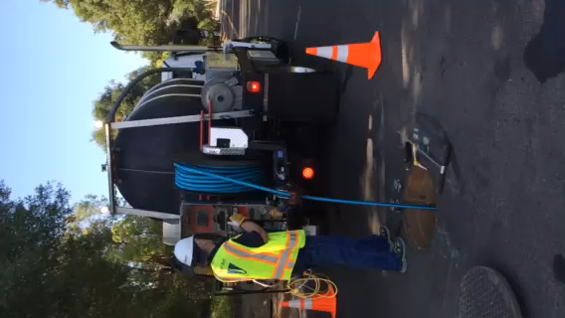
New $242K Pipe Hunter
Jet Eye video system = no water on pull-back unless needed
30-50 gpm @ 2500 psi
50-75% water savings
¼” hose is lighter, less water needed to jet up the pipe
If heavy roots:
  Mark exact footage, remove Jet Eye, add root saw blade, CCTV after to confirm

Slide 31
Solutions – Focused Maintenance
Based on risk assessment results that consider pipe condition, SSO and work order history, consequences of SSO’s, etc. that can support decisions to reduced cleaning frequencies during drought years, etc.
Consider:
  Slope calculations
  Sag defect code mapping
  Focus on high-risk/high-maintenance frequency sewers, rather than low-risk/routine-maintenance

Slide 32
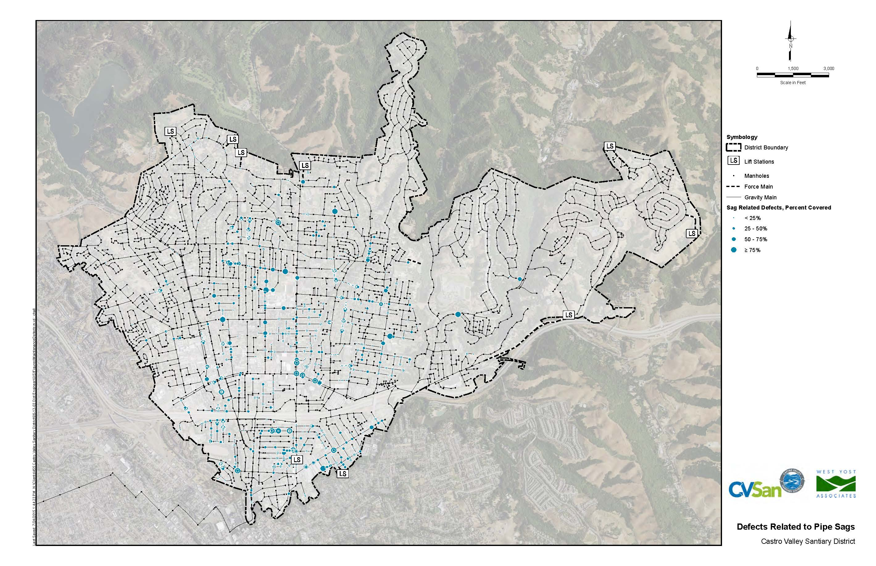
Solutions – Focused Maintenance

Slide 33
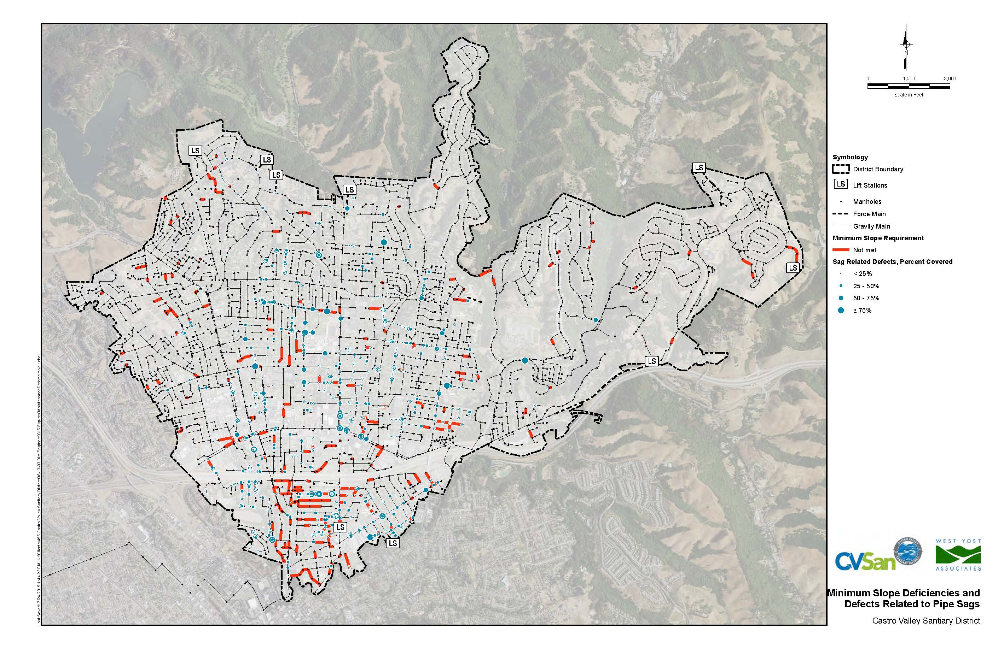
Solutions – Focused Maintenance

Slide 34

Questions?
Lani Good, PE
(925) 949-5822
lgood@westyost.com

Slide 35
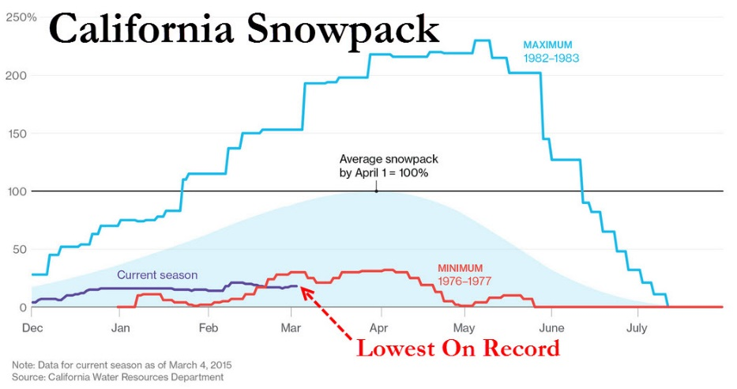
Water Supply Impacts
Less snow pack storage available
Lower fill rates of reservoirs
Less precipitation to offset irrigation demands
Lower surface water flows available during high-demand summers

Slide 36
Water Supply Solutions: Diversify Supplies
Water portfolio diversification with reliable alternative water supplies
Non-potable irrigation wells
Recycled water use
  Direct reuse for irrigation
  Indirect potable reuse
    Groundwater recharge & recovery
    Water supply impoundments (San Diego Water Authority)
  Direct potable reuse
    Still years away

Slide 37
Water Supply Solutions: Increase Storage
Groundwater recharge using raw water
  Recharge in wet years
  Recover in dry years
  Aquifer Storage and Recovery (ASR) injection wells
  Recharge spreader basins
  Limited to ½ of extraction capacity
    Central Valley extraction rate = 2000-4000 gpm; recharge rate = 1000-2000 gpm
  Must be treated to near drinking water standards since particulates clog recharge well/basin media/soils

Slide 38
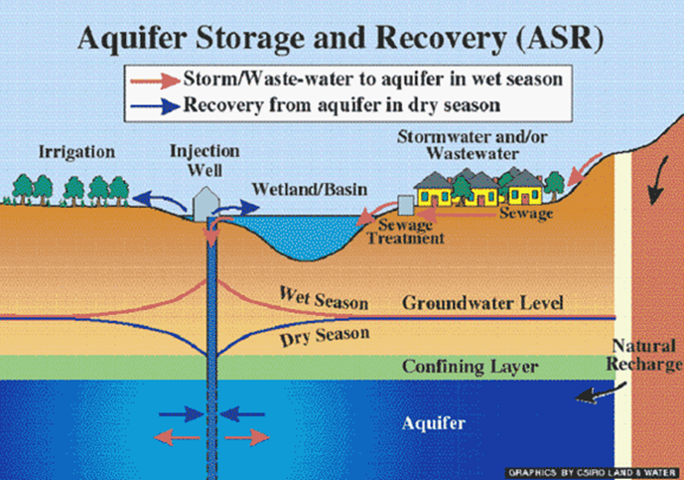
Water Supply Solutions: Increase Storage
Groundwater recharge of tertiary-treated wastewater
  Consistent, reliable supply
  Recharged at a constant flow rate
    Year-round
    Both wet and dry years

Slide 39
Decreased Hydro-jet Flowrate
It takes flow to move mass and it takes PSI to cut mass;
Light sludge can be cleaned up with low GPM and PSI;
Hard clogged sewer can be removed with low GPM and high PSI;
Heavy clogged sewer drain debris needs high GPM and lower PSI;
Roots in sewer lines need medium GPM with 3500 to 4000 PSI

