Slide 1
P2
a guide to reporting
2015

Slide 2

Permit requirements come from…
San Francisco Bay Basin Plan
State Implementation Policy (SIP)

Slide 3


Two “types” of programs
General Programs (Basin Plan § 4.13.2.3)
Targeted Programs (Basin Plan § 4.13.2.4; SIP §2.4.5.1)

Slide 4

Review Goals
Ensure permit requirements are met
2. Obtain overview of programs

Slide 5

General Program Reporting

Slide 6


General Program Reporting
Identification of tasks addressing the pollutant of concern
  Specific to one pollutant or cover multiple pollutants
  Individual tasks (e.g., inspections, collection programs) or regional (and beyond) efforts (e.g., BAPPG projects)
Description of tasks performed
If applicable, explanation why pollutant isn’t covered

Slide 7

General Program Reporting
Identification of evaluation criteria (e.g., pounds of pollutants collected, # violations to inspections completed, influent monitoring results, outreach response).
Hard numbers

Slide 8
General Program Reporting
Summary of all pollution prevention activities and results
  All tasks in Requirements 4, 5, and 6
Hard numbers

Slide 9
General Program Reporting
Evaluation of success based off criteria ID’d in Requirement 7
  Actual reported numbers (e.g., waste collected, monitoring data)
  Description of outreach response (e.g., attendance, changes in consumer behavior).
Discussion linking evaluation criteria to results

Slide 10
General Program Reporting
Requirement 7 (evaluation criteria) should guide efforts for Requirement 8 (efforts & results), and Requirement 8 should inform Requirement 9.
Example:
Evaluation criteria = # SSOs related to FOG
Effort = Inspections of food service establishments
Results = 3 FOG-related SSOs
Evaluation = 3 FOG-related SSOs, down from 4 FOG-related SSOs last year.

Slide 11
Targeted Program Reporting
Attachment of monitoring data or data integrated into the report

Slide 12
Targeted Program Reporting
Accelerated monitoring data
Control strategy tasks

Slide 13

Streamlining
Combine requirements

Slide 14
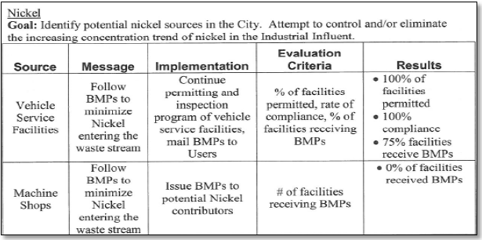
Streamlining
Tables

Slide 15
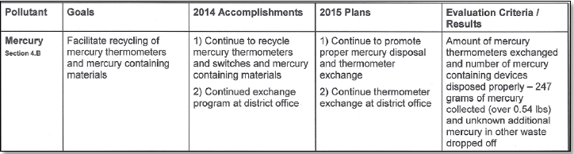
Streamlining
Tables

Slide 16
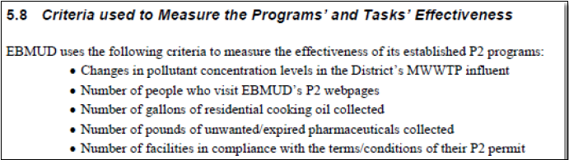
Streamlining
Lists

Slide 17
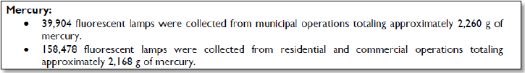
Streamlining
Quantifying Results

Slide 18
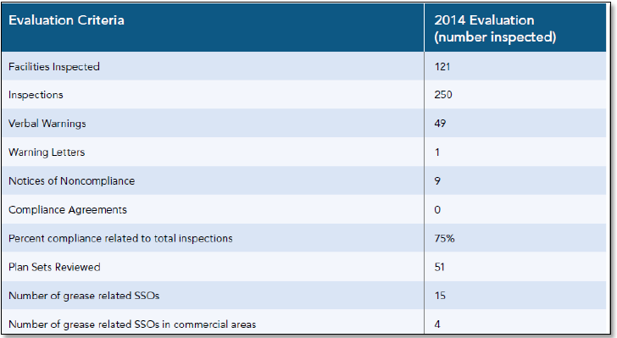
Streamlining
Quantifying Results

Slide 19
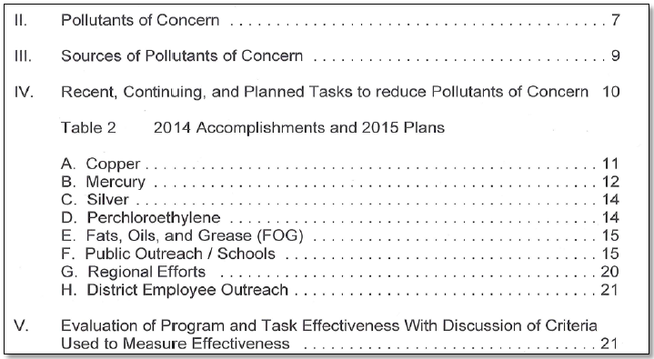
Streamlining
Logical structure

