Slide 1


O’Rorke Outreach for BAPPG: FY 2015/16
Emiko Hashisaki
Account Supervisor | O'Rorke, Inc.
June 1, 2016

Slide 2
FY 2015/16 Budget: $20,000
Task 1 – Dioxin Partnership with Air District
Task 2 – FOG Outreach to Food Trucks
Task 3 – No Drugs Down the Drain
Task 4 – Trash (Toilets Aren’t Trash Cans & Wipes)
Task 5 – Annual Report Support
Task 6 – Personal Care Products
Task 7 – Miscellaneous P2 Agency Coordination (Website)
Task 8 – Alkyl Phenol Ethoxylates & Commercial Laundry
Task 9 – FY 2016/17 Outreach Plan

Slide 3
FY 2015/16 Budget: $20,000
Additional Projects:
Chinook Book Mobile Ads
Chinook Book Print Ads
How-To Guide for working with BAPPG Consultants

Slide 4
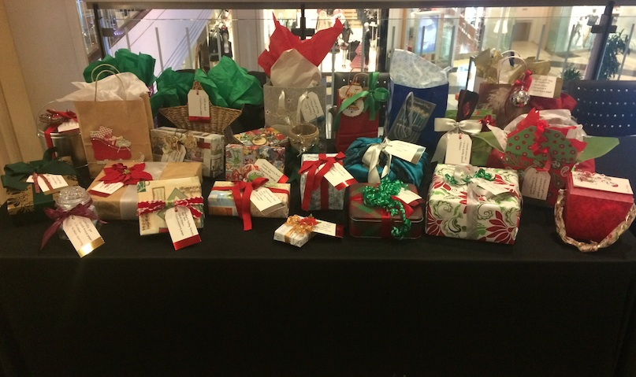
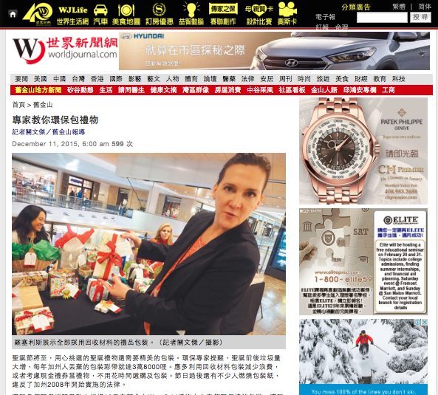

Task 1 – Dioxin Partnership with Air District
Press Event on December 10 at Westfield Mall in San Francisco
BAPPG credited in press release and event signage
Event Coverage:
12 stories
$12,242 publicity value

Slide 5
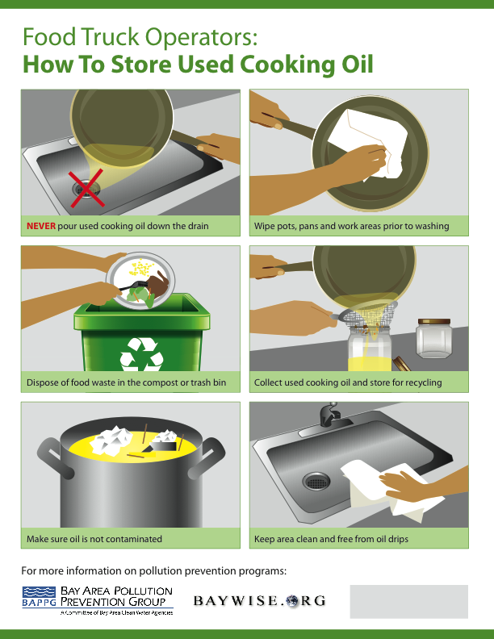
Task 2 – FOG Outreach to Food Trucks
Flyer designed to educate Food Truck owners about FOG best practices
Currently updating flyer to include FOG drop-off locations throughout the Bay Area

Slide 6

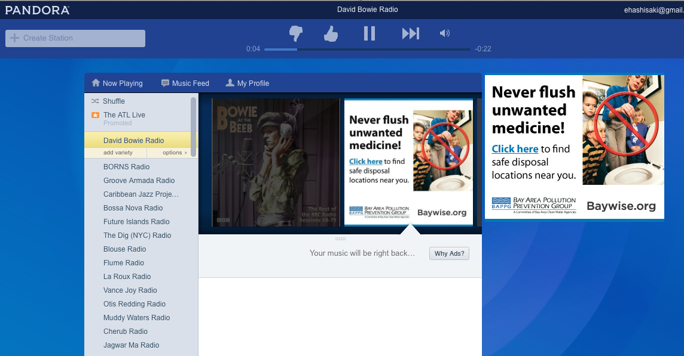
Task 3 – No Drugs Down the Drain
Regional online campaign
Facebook Online Ads
Ran 4/25 – 5/29
913,925 impressions
1,617 clicks, .17% CTR
Pandora Ads
Ran 5/2 – 5/8 & 5/23 – 5/29
484,480 impressions
623 clicks, .26% CTR

Slide 7

Task 4 – Trash (Toilets Aren’t Trash Cans & Wipes)
Pitched article to local parenting publications
Covered by the Berkeley Parents Network
Poster designed for parents groups

Slide 8
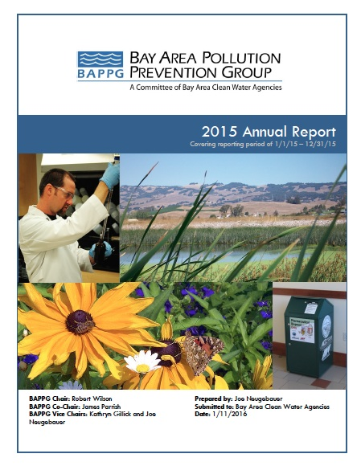
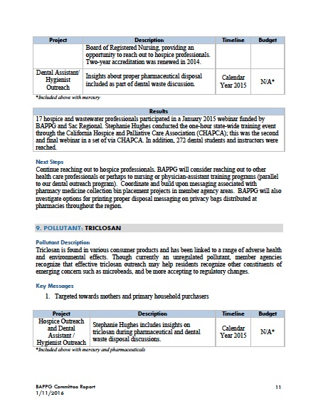
Task 5 – Annual Report Support
Provided graphic design support for 2015 Annual Report

Slide 9

Task 6 – Personal Care Products (Triclosan)
Regional online campaign
Facebook online ads
514,118 impressions
7,372 clicks
1.4% CTR

Slide 10

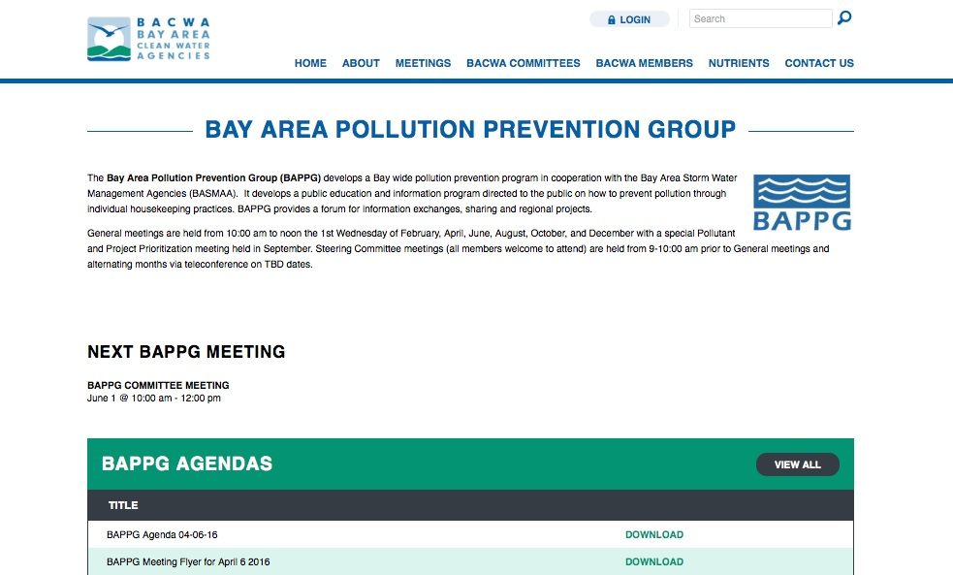
Task 7 – Miscellaneous Agency P2 Coordination (Website)
BACWA Website training webinar on October 29
Lorien Fono from BACWA trained BAPPG members
Use Wordpress CMS
Upload documents
Make copy changes to BAPPG page

Slide 11
Task 8 – Alkyl Phenol Ethoxylates & Commercial Laundry
Plan submitted on 9/29/15
On 5/13/16 BAPPG confirmed that APE’s were being phased out by the industry
Funds for this task were reallocated

Slide 12
Task 9 – FY 2016/17 Outreach Plan
O’Rorke will work with BAPPG to develop a strategy for FY 2016/17 outreach

Slide 13

Additional Projects: Chinook Book Mobile Ads
Mobile ads designed for BAPPG’s placements with Chinook Book

Slide 14


Additional Projects: Chinook Book Print Ads
Print ads designed for BAPPG’s placements with Chinook Book

Slide 15
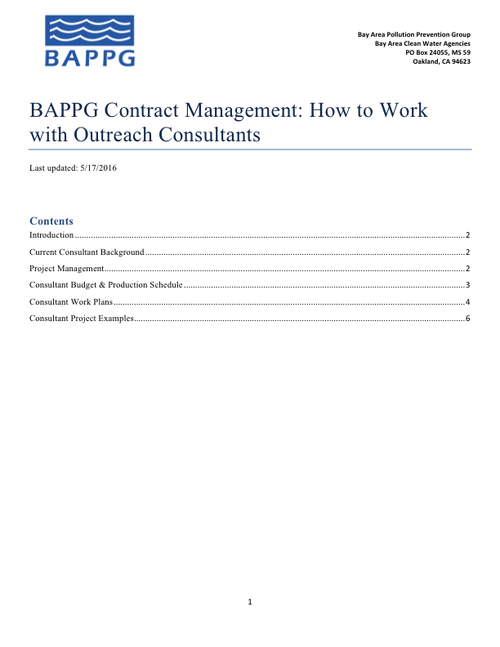
Additional Projects: How-To Guide
Explains how to manage marketing consultants
Detailed descriptions of BAPPG staff and contractor responsibilities
Contains examples of:
Production schedules
Past work plans
Past budgets
Sample projects

Slide 16
Recommendations for FY 2016/17
Consolidate task list to focus on several larger tasks, rather than multiple small tasks
Consider funding one large regional campaign per Fiscal Year
Additional outreach to Spanish and Chinese speaking audiences

Slide 17
Thank you!
Emiko Hashisaki Account Supervisor | O'Rorke, Inc.
Office: (415) 543-9119 x153
emiko@ororkeinc.com | ororkeinc.com

