Slide 1


2016 Clean Air Plan
Regional Climate Protection Strategy
Christy Riviere
Principal Planner
BACWA Air Issues & Regulations ● Wednesday, June 15, 2016
Notes:
Good morning,
Here to present the 2016 Clean Air Plan and Regional Climate Protection Strategy
I’ll start with a brief overview of the Clean Air Plan
Then will talk about our approach in developing the Plan
As well as give a summary of the control measures and our next steps

Slide 2

The Clean Air Plan
Purpose:
Reduce emissions and ambient concentrations of pollutants
Reduce exposure to air pollutants that pose the greatest health risk
Reduce greenhouse gas emissions and protect the climate
Core Components:
State mandated ozone plan
All feasible control measures
Multi-pollutant approach
2
Notes:
The Clean Air Plan has three primary purposes:
To reduce emissions and ambient concentrations of emissions
Reduce exposure to pollutants that cause greatest health risk, ie diesel pm
Reduce GHGs and protect the climate
The plan includes 3 core components:
Region’s state mandated ozone plan
Bay Area is designated as non‐attainment for both 1 hour and the 8 hour ozone standards…therefore
The California Clean Air Act requires the Air District to develop a plan with all feasible measures to reduce emissions of ozone and to reduce transport of ozone to neighboring air basins.
All Feasible Control Measures are those things we will do to reduce emissions, from adopting rules, incentive program, or working closely with local governments to assist them in reducing emissions, ie via their Climate Protection Plans
The 2010 Clean Air Plan was first in state and nation to be multi-pollutant plan
Intention of a multi-pollutant approach is to maximize co benefits and to minimize trade offs

Slide 3
New for 2016
Climate Strategy: comprehensive strategy that responds to Air District’s 2013 Climate Resolution to reduce GHGs to 80 percent below 1990 levels by 2050 and to prepare a regional climate strategy via Clean Air Plan.
Sector Approach: Aligns all control measures into nine economic sectors, consistent with ARB’s AB 32 Scoping Plan.
3
Notes:
New for 2016 in the Clean Air Plan is a comprehensive regional climate strategy, and a related sector approach
In November 2013 the Air District Board adopted a climate protection resolution to reduce GHGs 80% below 1990 by 2050 – consistent with the governor’s executive order
The resolution also called on Air District to lead a regional climate planning effort via the Clean Air Plan
Therefore, we wanted the Clean Air Plan to not only be comprehensive in its strategies to reduce GHGS, but have a strong climate orientation.
There seemed no better way to do this is than to organize plan, and especially the control measures, by economic sector – consistent w/ AB32
This would give the plan a clear Climate framework, but also ensure that we were comprehensive in our approach, ie develop strategies that included every segment of the economy

Slide 4
2016 Plan
Objectives
Decarbonize Electricity
Reduce Energy Use
Local government partnerships
Rules
Permitting
Grants
Research
Tools
Electrification
Collaboration
Reduce Non Energy GHGs
Reduce Pollutants/ Exposure
Outreach
4
Notes:
This slide demonstrates our overall approach in preparing an integrated Clean Air Plan and Climate Protection Strategy
Weve used this image before to convey our Regional Climate Protection Strategy, but also works for the entire Clean Air Plan and demonstrates the integration
This overall approach was developed after multiple conversations with local government planning, and climate and public health staff, as well as advocates and business groups.
Approximately a year and half ago, we began by holding meetings in all 9 counties, in addition to holding sector based meetings; where we invited professionals or specialist from each of the nine sectors to meet with us.
At these meetings we described our intention, to build an integrated Clean Air and climate plan, and that we wanted input on the strategies the Air district could take to reduce GHGs.
In these meeting we discussed the various tools the Air District has at its disposal, ie grants, incentives, rule, permitting, outreach and discussed how we could achieve our objectives.
For Climate, focus is on:
Reducing Demand or Increasing Efficiency
Electrification
Decarbonizing Electricity
Reducing Non Energy GHGs
By adding Reduce Emissions and Exposure, this approach then encompasses not only GHGs, but ozone, PM, and TACs
Outreach also assisted us in developing the specific measures we have for each economic sector

Slide 5
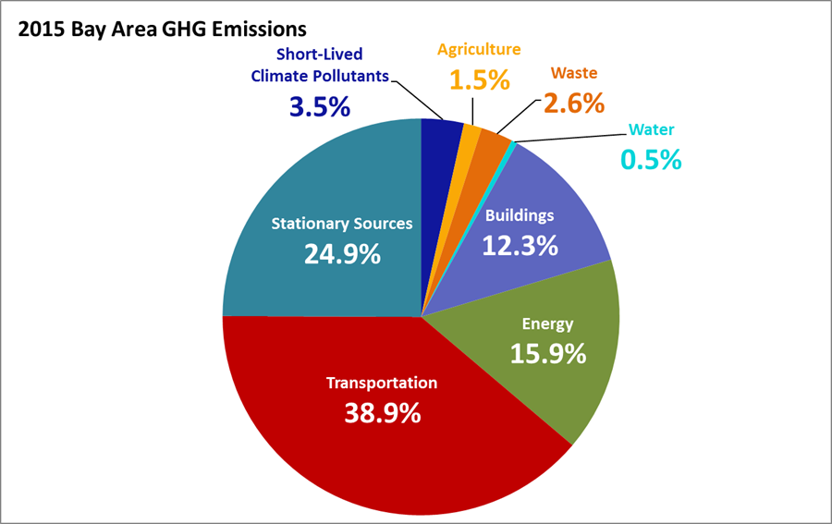
Bay Area GHG’s by Sector
5
Notes:
In the waste and water sectors, we will develop rules to further address emissions from landfills and composting facilities, and also work closely with local governments:
We’ll develop model ordinances and best practices to help communities meet their aggressive waste diversion goals
And are considering a rule to reduce GHG emissions from water treatment plants.

Slide 6
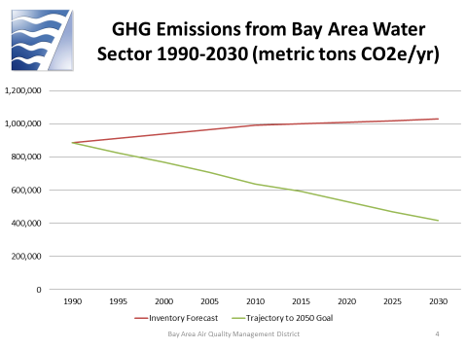
Water
6
Notes:
In the waste and water sectors, we will develop rules to further address emissions from landfills and composting facilities, and also work closely with local governments:
We’ll develop model ordinances and best practices to help communities meet their aggressive waste diversion goals
And are considering a rule to reduce GHG emissions from water treatment plants.

Slide 7

Water: Challenges and Opportunities
Challenges:
Limited control over water consumption
Per capita water use is declining, but population is rising
New state regs to reduce nutrient discharge at POTWs may increase GHGs
Opportunities:
GHGs from POTWs subject to Air District permit requirements
Drought provides opportunity to reduce water use
Potential for Air District to provide funds/incentives for green infrastructure in POTWs
7
Notes:
In the waste and water sectors, we will develop rules to further address emissions from landfills and composting facilities, and also work closely with local governments:
We’ll develop model ordinances and best practices to help communities meet their aggressive waste diversion goals
And are considering a rule to reduce GHG emissions from water treatment plants.

Slide 8
Draft Water Control Measures
Reduce Emissions from Water Treatment Plants
Initiate process to better understand and quantify GHG emissions from POTWs
Explore rulemaking to reduce GHG emissions emitted directly from water treatment plants (methane)
Work with POTW operators and BACWA to obtain funding for the development of green infrastructure in POTWs
Collaborate with POTWs on potential streamlining of the Air District’s permitting process to promote biogas recovery, as well as to address conflicting regulations, ie State regs on nutrient removal
0.5%
8
Notes:
In the waste and water sectors, we will develop rules to further address emissions from landfills and composting facilities, and also work closely with local governments:
We’ll develop model ordinances and best practices to help communities meet their aggressive waste diversion goals
And are considering a rule to reduce GHG emissions from water treatment plants.

Slide 9
Draft Water Control Measures
Reduce Water Use
Support local efforts to reduce water use
  Disseminate best practices for reducing water consumption and increasing water recycling
  Encourage adoption of water conservation ordinances
  Incorporate public outreach and education on water conservation into Air District outreach programs
Incorporate best practices for water use in local plan guidance, CEQA guidance and other resources for cities and counties
0.5%
9
Notes:
In the waste and water sectors, we will develop rules to further address emissions from landfills and composting facilities, and also work closely with local governments:
We’ll develop model ordinances and best practices to help communities meet their aggressive waste diversion goals
And are considering a rule to reduce GHG emissions from water treatment plants.

Slide 10

Review and Comment
10
Notes:
In the waste and water sectors, we will develop rules to further address emissions from landfills and composting facilities, and also work closely with local governments:
We’ll develop model ordinances and best practices to help communities meet their aggressive waste diversion goals
And are considering a rule to reduce GHG emissions from water treatment plants.

Slide 11

Review and Comment
http://www.baaqmd.gov/plans-and-climate/air-quality-plans/plans-under-development
11
Notes:
In the waste and water sectors, we will develop rules to further address emissions from landfills and composting facilities, and also work closely with local governments:
We’ll develop model ordinances and best practices to help communities meet their aggressive waste diversion goals
And are considering a rule to reduce GHG emissions from water treatment plants.

Slide 12
Next Steps
Draft Plan/EIR, Socio-Economic Analysis, Summer 2016
2nd Round Open Houses, Fall 2016
Final Plan to Board, Fall/Winter 2016
12
Notes:
Draft Plan will include inventory for all pollutants, health and climate impacts as well as the individual control measures

