Slide 1
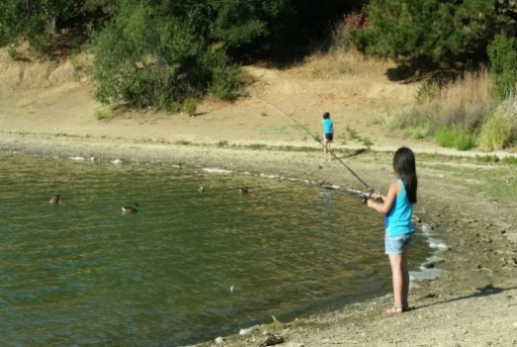
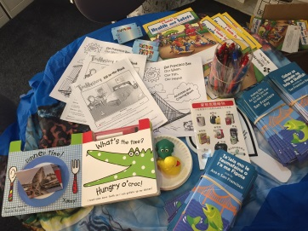
APA Family Support Services Project Update OCTOBER 2016

Slide 2
Mission
​APA’s mission is to promote healthy children and families by providing family support services to prevent child abuse and domestic violence.
APA also advocates for culturally competent services for Asians and Pacific Islanders through education, community building and leadership development.
Today, our services are made available to families of all ethnicities and we have expanded the range of family support services we provide.

Slide 3
Our Work
Chinatown FRC: strengthens families with a spectrum of services to prevent and if necessary, treat problems that may occur as a result of stress, barriers and challenges of language, finances, and lack of resource.
Visitacion Valley Strong Families: plays an active role in developing community in the Visitacion Valley neighborhood.
API Family Resource Network: a collaboration of 22 linguistically and culturally competent family resource agencies in San Francisco with the mutual goal of promoting healthy families through education and advocacy citywide.
Notes:
1) Provide families with access to services & opportunities
2) Build parent knowledge and skills
3) Support school readiness and school success
4) Provide intensive support services for families in need
5) Promote community development

Slide 4
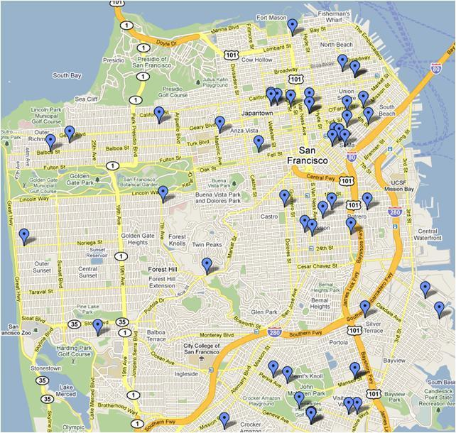
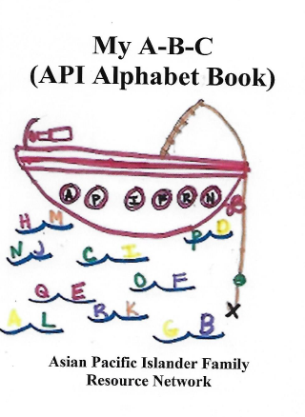
Working Collaboratively

Slide 5
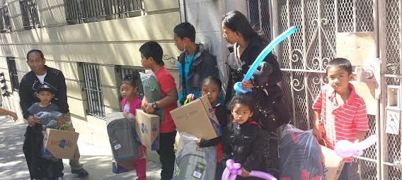
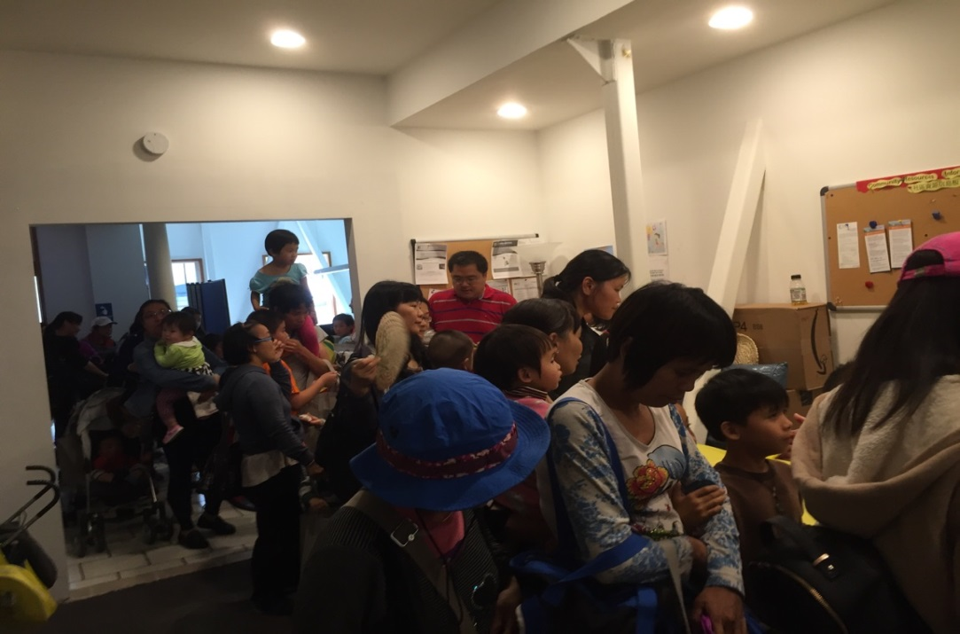
Providing Quality Services
School Readiness and Healthy Learning Activities
N: 195 Families Served
N: 271 Children Served

Slide 6
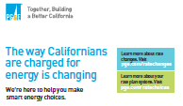
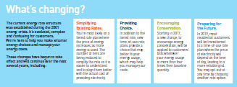
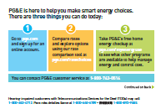
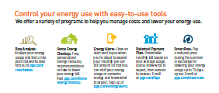
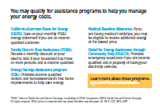
Advocating Effectively
Outreach and Education Project (i.e. PG&E Project)
The way Californians are charged for energy is changing. The changes are intended to make rates more understandable to customers, to ensure the price customers pay for energy is more closely aligned with the actual cost of providing it, and to offer customers choice when it comes to their rate plans. The first step in achieving these goals is to create awareness. PG&E funds APIFRN (due to cultural and linguistic capacities) to help community members make smarter energy choices and manage their energy costs.

Slide 7
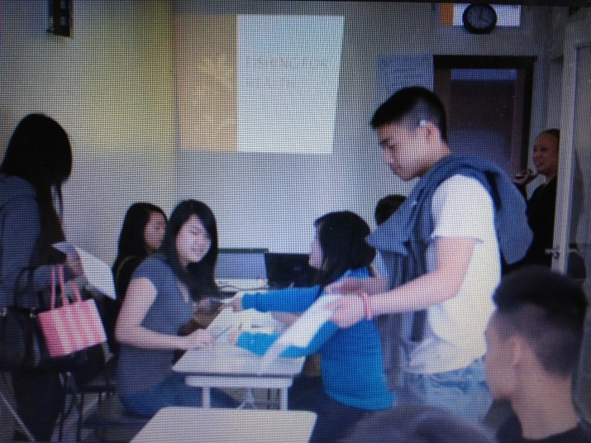
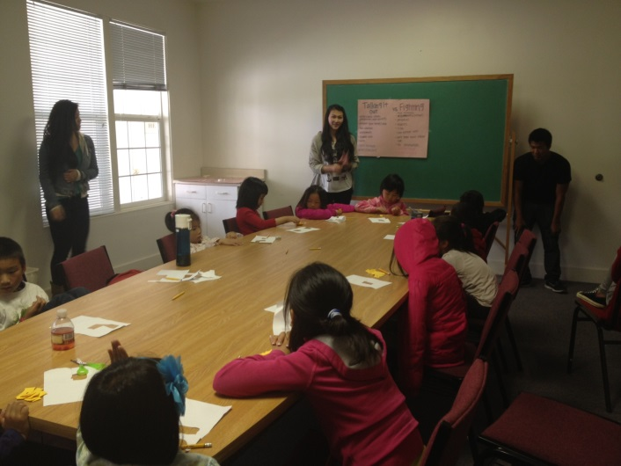
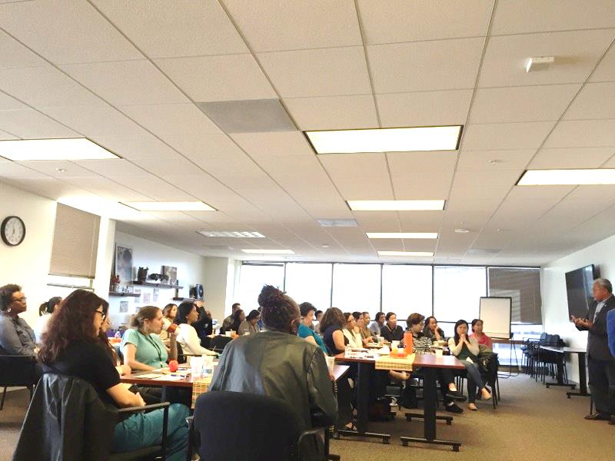
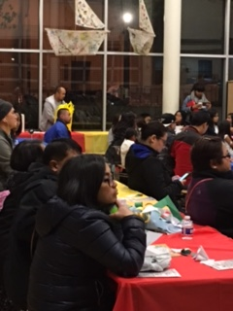
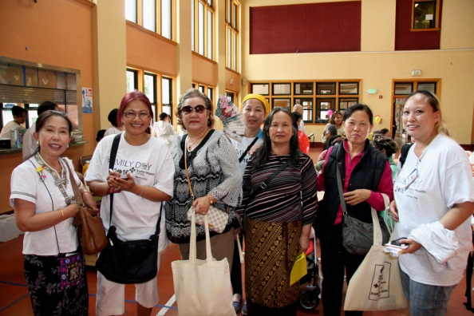
Leadership Development

Slide 8
API SF Bay Fish Outreach and Education Project
Train our community partners and they educate the families on healthy fish consumption and safety fish handling
Promote awareness and understanding of fish consumption advisories for the API population in San Francisco
Research Survey to identify individuals who are high consumers. Outreach among our partnering agencies, local “hot spot” fishing area, bait shops, clinics, schools and places frequent by at-risk API population. Education Workshop to promote reduction in human exposure to mercury and PCBs. Provide materials and facilitate discussion and supportive system on alternatives and resources for healthy fish consumption.

Slide 9
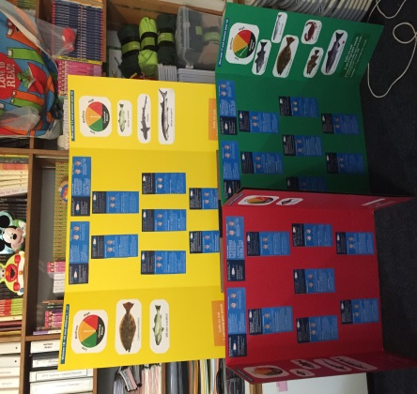
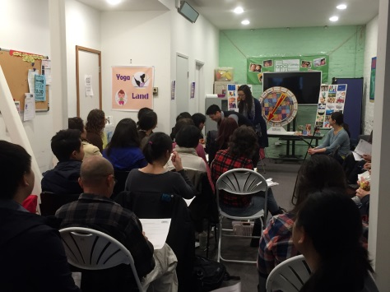
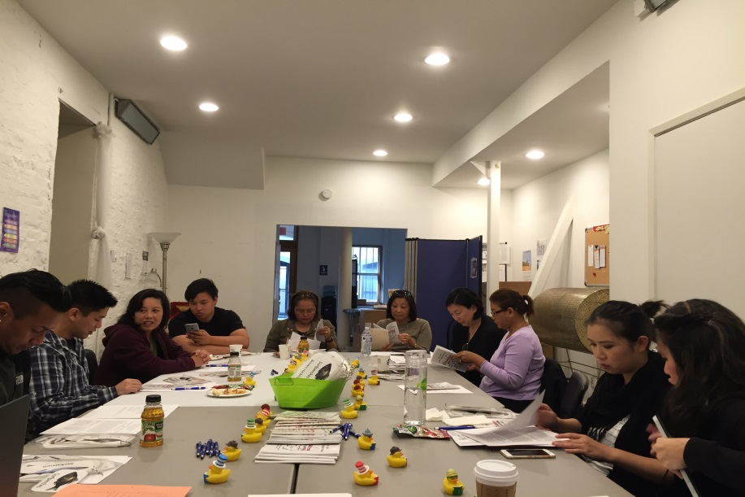
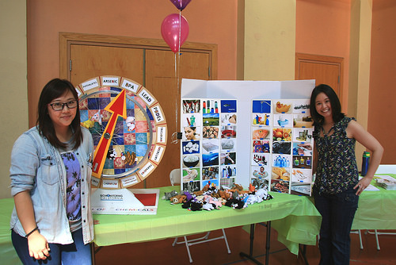
Training

Slide 10
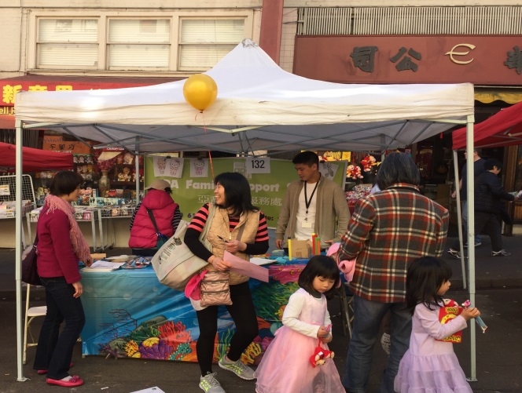
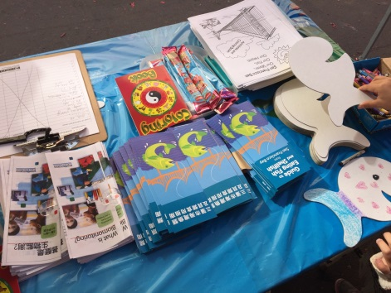
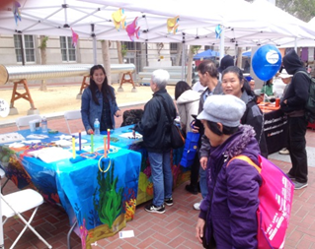
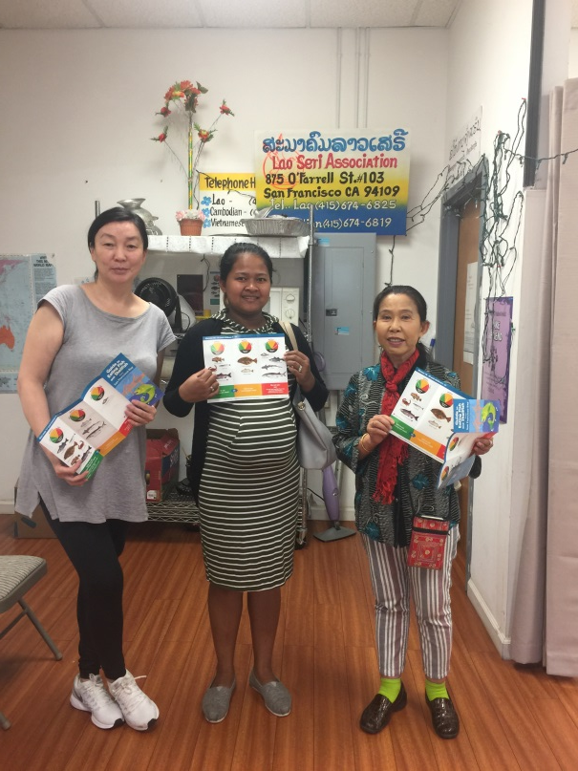
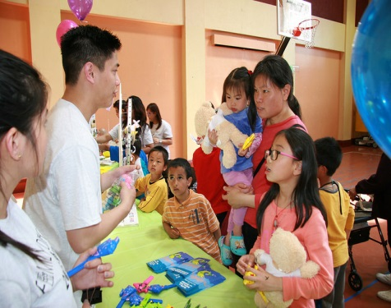
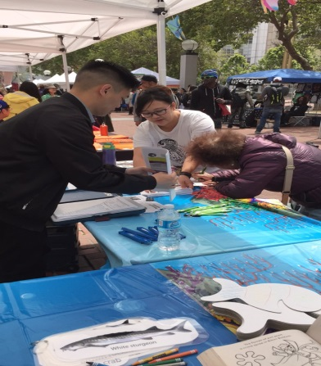
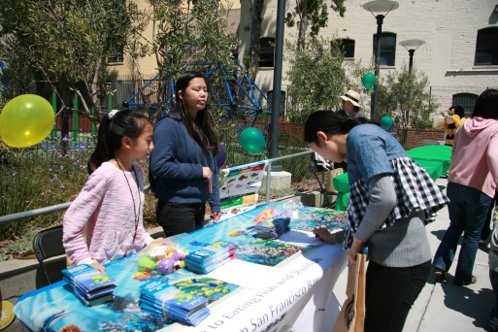
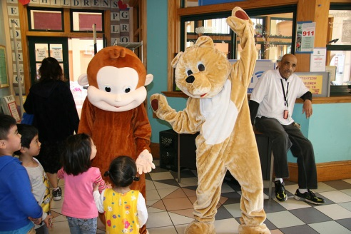
Outreach

Slide 11
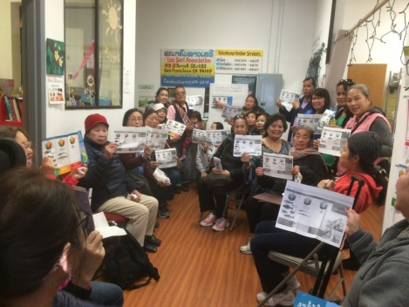
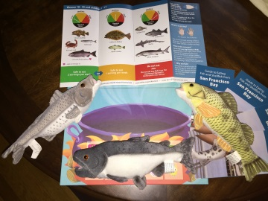
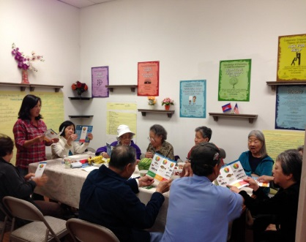
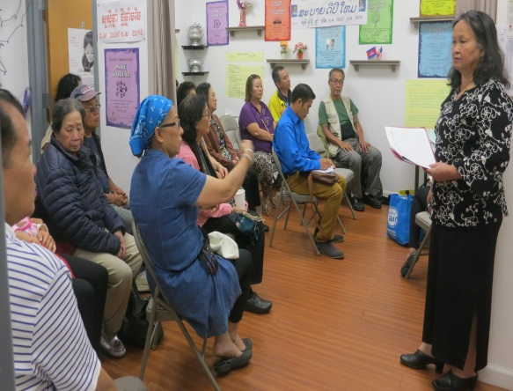
Workshop

Slide 12
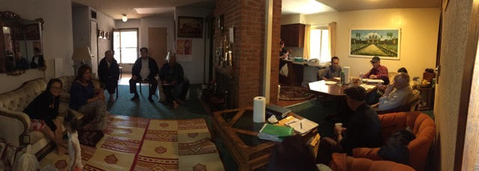
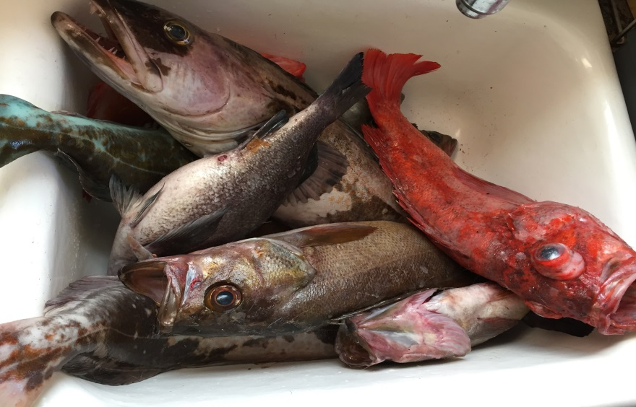
Case Management
What’s in the Bay?
What do you eat?

Slide 13
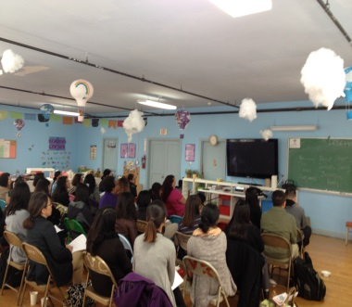
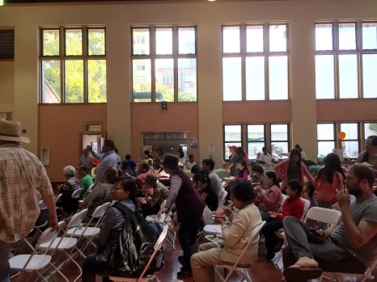
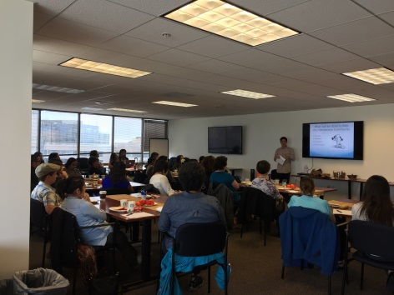
Community Forum

Slide 14
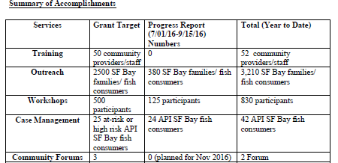
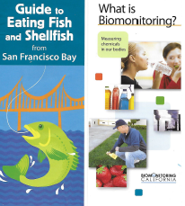
Community Building
“Building community as a means to increase social justice, individual well-being and reduce negative impacts of otherwise disconnected individuals.”
Promote awareness and understanding of fish consumption advisories, contamination issues, or health risks and benefits associated with eating San Francisco Bay Fish and reduce human exposure to mercury and PCBs from eating San Francisco Bay fish.

