Slide 1

WCWD Pollution Prevention Program
Overview

Slide 2
Identification of POC’s
Basin Plan (Water Quality Objectives)
NPDES Permit
Special Studies (Sampling)
Professional Trade Associations and Groups
  BACWA
  BAPPG
  CWEA
Notes:
We sample the influent with the same frequency required for the effluent for CN, and the plant influent, effluent and biosolids are evaluated to determine if there are any other POC’s. Data is compared to previous reporting periods to identify trends.

Slide 3
Sources of POC’s
Industrial applications
Mercury
  Dental Facilities
  Medical facilities
  Household hazardous waste
Pesticides
  Insecticides
  Flea Control
Notes:
Pretreatment covers most of the metals.
Dioxin: Paper mills, PVC plastic manufacturing, Pesticide manufacturing
CN: metal finishers, plastic, chemical, iron and steel mills
PCB’s: building demo- we require closing off the lateral before demo begins
HHW: flourescent bulbs, switches, relays, themometers
Fipronil, imidocloprid

Slide 4
Sources of POC’s
Copper
  Pools and spas
  Auto service facilities (wash racks)
  Plumbing practices
  Laboratories
FOG
  FSE’s
  Vehicle service facilities
  Residential discharges

Slide 5
Sources of POC’s
Wipes
  Residential
  Schools
  Long-term care facilities
Emerging POC’s are tracked e.g. pharmaceuticals, microplastics (fibers) via regional efforts and BAPPG projects

Slide 6
Tasks to reduce POC’s
    Plant tours
    Presentations to community groups
    Community events
    Regional campaigns
    Outreach to commercial facilities
    Industrial User inspections and sampling
    Social media (YouTube, Google plus, facebook, WCWD newsletter
Notes:
Tours: Make connections between wastewater treatment processes and what they do at home. Kids love to correct their parents! Use their offspring against them to change behavior! 1,000 people have attended tours since 2012.
Presentations: Rotary Club meetings, parent groups, middle school career fairs, neighborhood coordinating council meetings.
Events: El Sobrante Stroll, North Richmond Shoreline Festival, West County Business Expo- take the pledge!
Regional: Radio ads during holidays for FOG, Holiday PSA’s on wrapping paper, outreach to Dental hygenist community, support for federal, state and local legislation….All the great work done regionally in the Bay Area through our contracts with Stephanie, Kelly Moran, O’Rorke.
Outreach to swim schools, long term care facilities, schools
Inspections of laboratories, metal finishers, auto service, dental…evaluate all incoming IU’s! BMP’s required.

Slide 7
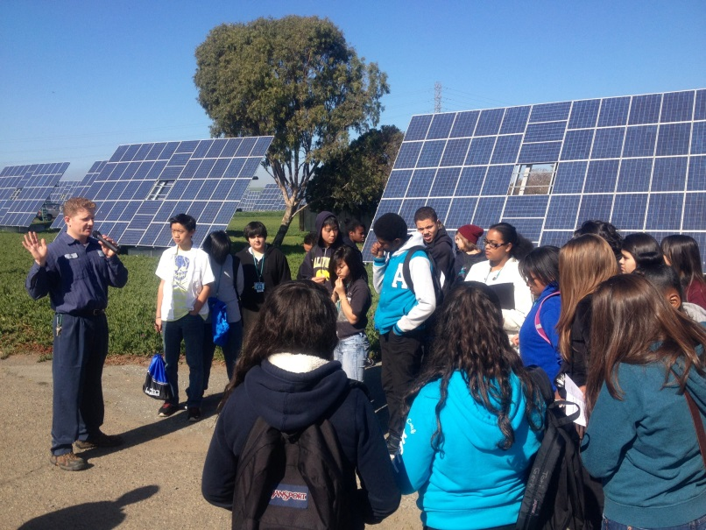
Plant Tours
Teach the students how wastewater treatment facilities use natural forces and living things to clean the water.
Make connections between what they do at home/school and how it affects our ability to keep our water supply clean.
Talk about what to do with FOG, wipes, pharmaceutical waste and household hazardous waste.
Enlist them as ambassadors of clean water!
Give them tools to take home!
Notes:
Recycled water, recoverable energy, wastewater careers etc…

Slide 8
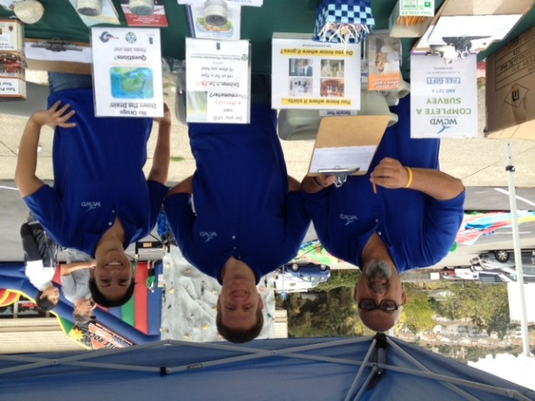
Community events
El Sobrante Stroll and Richmond Shoreline Festival
Toilet display
Pharmaceutical collection
Take the pledge!
Outreach materials
Give-aways
Notes:
Toilet display really gets conversations started with residents. Brochures on FOG, No drugs down the drain, toilets aren’t trashcans, wastewater treatment, HHW. GIVE-AWAYS: grease collection cups, pens, door hangers, WCWD backpacks, pins, P2 pledge magnets.

Slide 9
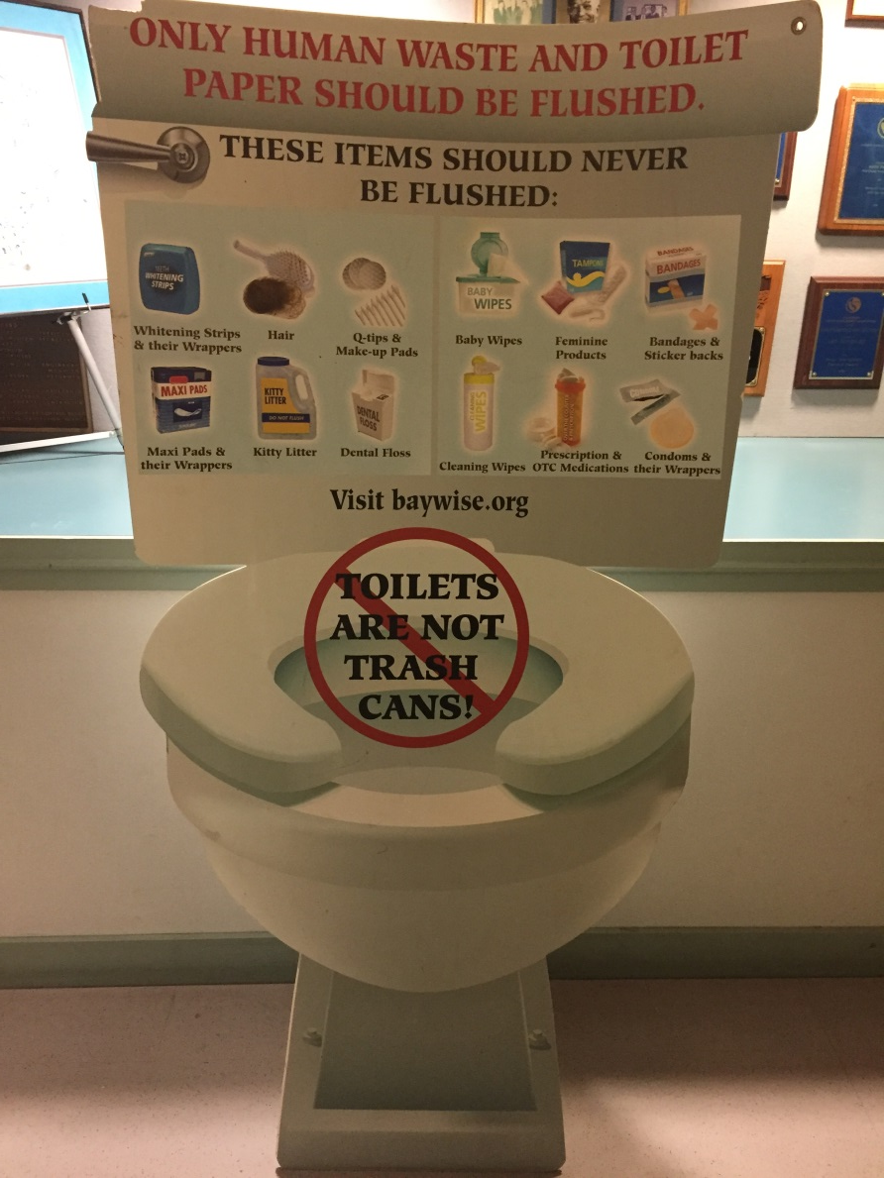
Toilets Aren’t Trashcans

Slide 10
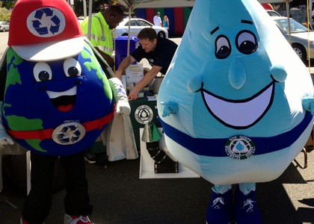
WCWD mascot…. WILLY!

Slide 11
Social Media
https://www.facebook.com/WestCountyWD
https://plus.google.com/+WcwdOrg1921/posts
https://www.youtube.com/user/WestCountyWD/
http://wcwd.govoffice3.com/
Photo’s, videos, links to news articles on wastewater, P2 messages on wipes, FOG, Holiday wrapping paper,

Slide 12
Measures of effectiveness
Physical counts
  Number of pledges taken at events
  Number of people taking plant tours
  Amounts of HHW collected
  Number of SSO’s in collection system
Zip code tally’s
Sampling results
Notes:
Zip code’s quantify how many people in our service area are being reached. Sampling of influent, effluent and biosolids show us the trends of POC’s and give an idea of how effective our P2 program is.

Slide 13
Thank you all for the great work you’re doing protecting our environment!

