Slide 1

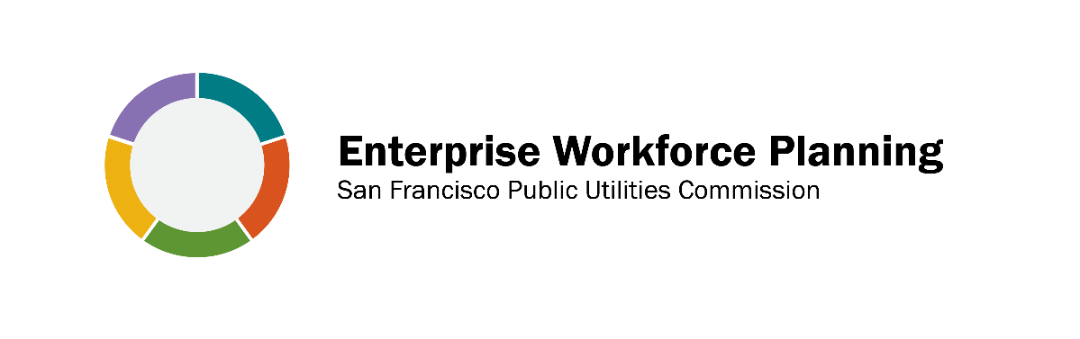
R2P2 Competency Model San Francisco Public Utilities Commission

Slide 2

The Competency Model Initiative was created by SFPUC’s Workforce Planning Team to address changing workforce needs and succession planning
Current initiatives include the Leadership and Occupational Competency Models
Related projects include alignment of personnel processes, including recruitment and selection, performance management, and career development

Slide 3
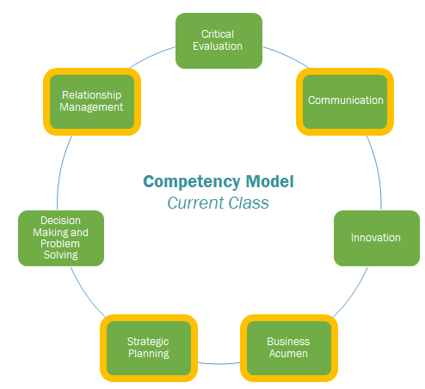

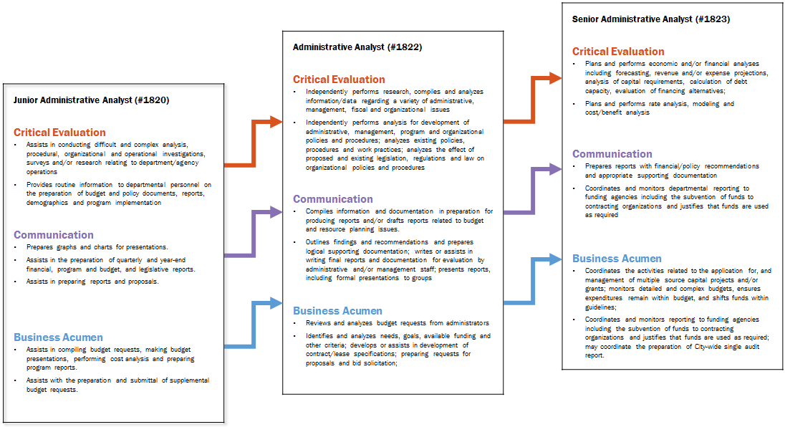
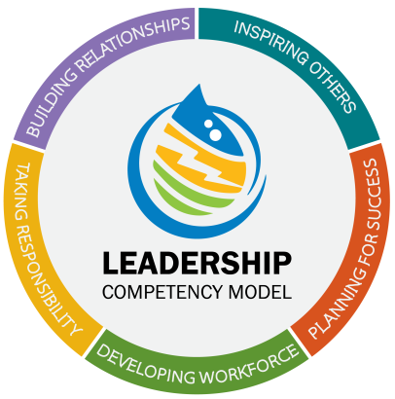
Agenda
What is a competency?
What is a competency model?
Presentation of Leadership Competency Model
Pollution Prevention Competency Models
Competency Modeling compared to Job Analysis
Advantages and Applications of Competency Modeling

Slide 4
What is a competency?

Slide 5
What is a competency?
A competency is simply a collection of closely related
knowledge, skills, abilities, and traits,
relevant for success in a given area.

Slide 6
What is a competency?
For example…Let’s think about what it takes to succeed at Relationship Management
Attitudes
Cooperative
Relationship Management
Knowledge
Negotiation Tactics
Skills
Traits
Communication
Extraversion
Notes:
Each one of the above options leverages task-specific knowledge, experience, as well as general skills and abilities to be successful.
For example, proficiency in project management depends on
Knowledge of PM principles, terms, and strategies
Experience managing projects
Ability to communicate with others
And so on…
So you can see, there are many different contributors to success, but by grouping them all as a competency it becomes much more manageable to discuss these contributors.

Slide 7
How are competencies developed?
Published Literature
We use a variety of methods and processes in the development and continual refinement of every competency
Confirm with SMEs
External Resources
Incorporating Feedback
Internal Resources
Let’s look at an example…
Interviewing SMEs

Slide 8
Development of the Safety competency
Published Literature
We used a variety of methods and processes in the development and continual refinement of the safety competency
Confirm with H & S Committee
External Resources
SCM Safety Assessment Report
ANSI-Z10 Standards
Industry Best practices
Incorporating Feedback
Internal Resources
Wastewater
Water Quality
Fleet
Health & Safety
Interviewing SMEs

Slide 9

Themes from Interviews
What does it take to excel at Safety?
Proactive Attitude
SAFETY
Knowledge from Training
Listening Skills
Traits like Empathy

Slide 10
What does a competency look like?
Relationship Management
Builds open, honest, and respectful relationships through effective communication and collaboration techniques; develops networks and builds alliances across boundaries to maintain strategic relationships and achieve common goals; utilizes a variety of communication approaches to successfully gain support, influence others, and strengthen partnerships
Expert
Advanced
Proficient
Basic
Aware
Competency Title
Competency Description
5 Levels of Expertise
Behavioral examples of what it takes to be successful at each level
Notes:
Anatomy of our model

Slide 11
The Safety Competency
SAFETY EXCELLENCE
Embraces and actively promotes a safety culture based on universally shared values, beliefs, and behaviors in which each member of the organization sees him or herself as being responsible for their own safety and the safety of those around them. The SFPUC’s safety culture implies a relentless improvement of safety behaviors and awareness of any conditions that may lead to injury, by embracing a work environment based on employee participation, ownership, teamwork, communication, training, and leadership.
Expert | Directs the future of our safety culture at the SFPUC by creating policies, such as dynamic safety controls and procedures, that are based on current industry research, best practices, and regulatory requirements
Advanced | Promotes the cultural importance of safety by recognizing those who demonstrate the admirable levels of proactive safety behaviors
Proficient | Demonstrates the cultural importance of safety by modeling appropriate and proactive behaviors and expressing support when coworkers practice effective safety behaviors
Basic | Works to combat a climate of apathy and complacency by asking questions, listening actively, and expressing genuine concern, when appropriate
Aware | Understands that mocking or joking about safety procedures is detrimental to developing a healthy safety culture
Safety Excellence is defined here, giving a framework for everyone to work with and align to
You can see in this excerpt how there is a behavioral example about Safety culture at every proficiency level
In the full Safety Competency, each level actually has about 10+ behavioral examples!
and that the skill or scope of the behaviors increases as the proficiency levels increase
Notes:
Anatomy of our model

Slide 12
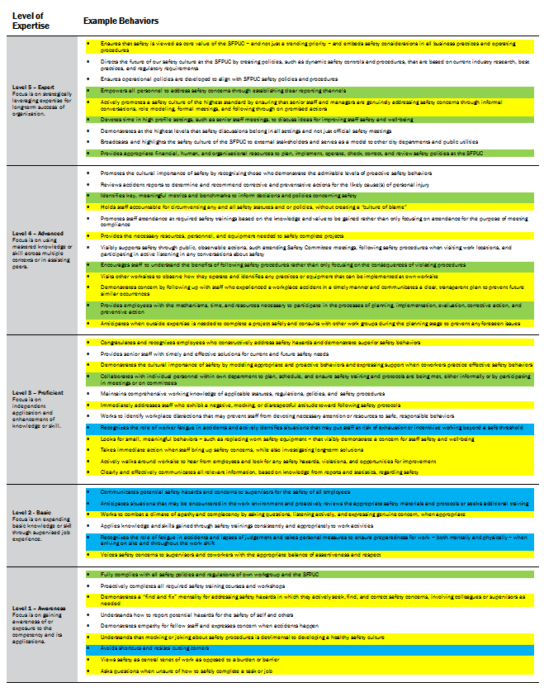
Sources of behaviors
Here you can see the current collection of example behaviors in the Safety Competency, and the sources we used to develop each behavior
ANSI-Z10 MODEL recommended by report
INTERVIEWS with SFPUC staff
HEALTH & SAFETY information from NEO
Notes:
At this point we can start handing out the competency sheets!

Slide 13
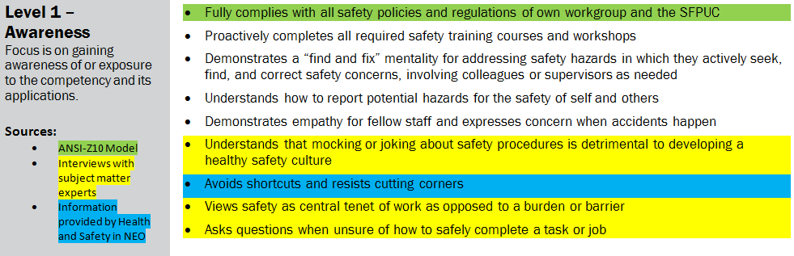





Other behaviors were derived from research on best practices from industry leaders

Slide 14
Proficiency Levels
Employees will have different target proficiency levels for success depending on job class and work group
I’m a new intern! My supervisor told me that I should strive for the behaviors in Level 1 (Aware) if I want to be successful .
As a first-time supervisor, I need to be performing at Level 3 (Proficient) to be successful in my new role.
I’m a chief engineer with years of experience and specialized knowledge. The behaviors at Level 4 (Advanced) guide my personal performance and development goals.
I’m an AGM operating at the highest level of the organization. Therefore, the behaviors at Level 5 (Expert) define the expectations for success in my role.
But how do I know what level I should be operating at?

Slide 15


Validation Process
Ratings will be conducted to match proficiency level to job classes by managers and supervisors
SME
Ratings
SAMPLE COMPETENCY
5 - Expert
4 – Advanced
3 – Proficient
2 – Basic
1 - Aware
SENIOR ENGINEER
AGM
SUPERVISOR
The progression of proficiency levels represents
-Increased organizational impact
-Increased expertise
SENIOR
ANALYST
This validation process is essential to making sure that the competencies are job relevant
JUNIOR
ENGINEER
UTILITY ANALYST
PRINCIPAL ANALYST
INTERN
DIRECTOR
APPRENTICE

Slide 16
What is a competency model?

Slide 17
What is a competency model?
A competency model is simply a collection of competencies relevant for success in a given area.

Slide 18
What is a competency model?
Innovation
Safety is only one competency
Competency:
Strategic Planning
Safety
A COMPETENCY MODEL is
Collection of competencies important for success in a given area
How do we determine which competencies should
be included together in a model?
Delegation
Let’s look at an example…
Relationship Management
Business Acumen
Remember, there are many other competencies
Notes:
A competency model is simply a collection of competencies important for success in a given area.
For example,
A Leadership Competency Model would be the collection of competencies needed to be a successful leader at the SFPUC.
An Engineering competency model would be the collection of competencies needed to be a successful engineer at the SFPUC.

Slide 19
Which competencies are important for success as a leader at the SFPUC?

Slide 20
Development of the Leadership Competency Model
After this rigorous process and collaboration between organization leaders and EWP, these are the 16 competencies identified as most important to leadership success at the SFPUC
SET VISION AND DIRECTION
INNOVATION
MOTIVATION
RELATIONSHIP MANAGEMENT
Validation of competencies with constant feedback
POLITICAL SAVVY
CONFLICT MANAGEMENT AND RESOLUTION
DELEGATION
TALENT MANAGEMENT
Development of competencies based on rigorous methodologies
VALUING DIVERSITY
ACCOUNTABILITY
DECISION MAKING AND PROBLEM SOLVING
RISK MANAGEMENT
Interviews with Leadership Team and subject matter experts
ADAPTABILITY
STRATEGIC PLANNING
BUSINESS ACUMEN
CHANGE MANAGEMENT
Literature Review of over 110 academic journal articles, case studies, and existing Competency Models in the public and private sector
Notes:
The leaders of our organization have worked with enterprise workforce planning to identify the 16 competencies most important to leadership success at the SFPUC.

Slide 21
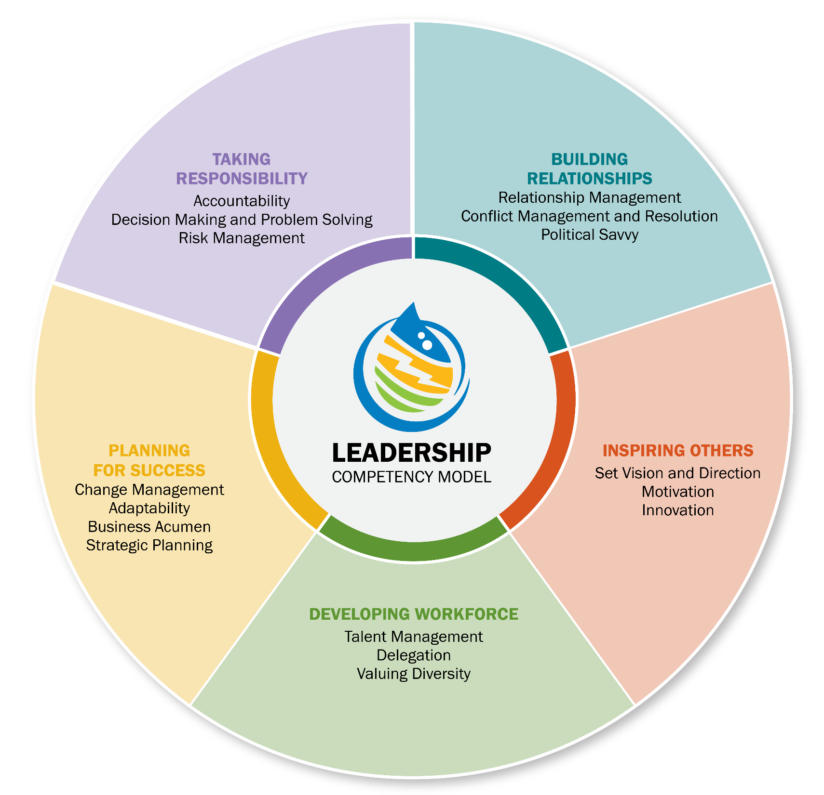
For ease of use, we organized the leadership competencies into five categories
SET VISION AND DIRECTION
INNOVATION
MOTIVATION
RELATIONSHIP MANAGEMENT
POLITICAL SAVVY
CONFLICT MANAGEMENT AND RESOLUTION
DELEGATION
TALENT MANAGEMENT
VALUING DIVERSITY
ACCOUNTABILITY
DECISION MAKING AND PROBLEM SOLVING
RISK MANAGEMENT
ADAPTABILITY
STRATEGIC PLANNING
BUSINESS ACUMEN
CHANGE MANAGEMENT
Notes:
The leaders of our organization have worked with enterprise workforce planning to identify the 16 competencies most important to leadership success at the SFPUC.

Slide 22
Competency models developed for Pollution Prevention and Resource Recovery

Slide 23




LEADERSHIP
competencies
TECHNICAL
competencies
Human Resources
These are the competencies from the leadership model that are most important for the specific occupational area, as determined by subject matter experts in the occupational group
These are customized, role-specific competencies that reflect the unique professional expertise and technical skills required in your profession
OCCUPATIONAL COMPETENCY MODEL
Collection of competencies needed for success in a given occupational area
Occupational competency models are made up of three parts
Communications
Contracts Administration
Let’s look at an example…
BEHAVIORAL
competencies
These are non-technical competencies that are critical for success at work, that are likely to be shared by many work groups
Notes:
Occupational competency models are a mix of three kinds of competencies:
Leadership – We first identify the competencies from the Leadership Model that are most important for the specific occupational area.
Behavioral – Next, we incorporate other general behavioral competencies that are critical for success in your field, such as Consultation or Customer Service or Project Management.
Technical/Functional – Finally, we develop customized, role-specific competencies that reflect the unique professional expertise and technical skills required in your profession, such as Classification and Work Analysis for Human Resource professionals or Hazardous Materials Expertise for Health and Safety professionals.

Slide 24
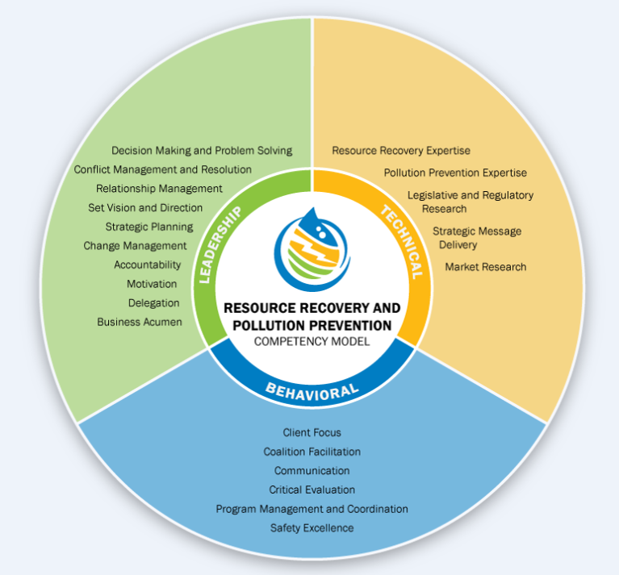
Remember, these are each individual competencies which are the
building blocks that make
up this occupational
model
and each one includes a definition
and example behaviors
at five different proficiency levels
Communication
Effectively exchange information with stakeholders in a variety of settings and modalities to meet organizational goals within a customer-centric environment. This domain includes verbal and written communication skills, persuasion and diplomacy, facilitation skills, public relations and the ability to conduct effective meetings and presentations.
Expert: Focus is on strategically leveraging expertise for long term success of organization. | Creates strategy and systems for a culture that fosters efficient and effective communications Crafts messages to be delivered to stakeholders regarding high-visibility organizational issues Builds support and inspires confidence through clear communications Comfortably communicates HR vision, practices, and policies to stakeholders in a variety of forums
Advanced: Focus is on using mastered knowledge or skill across multiple contexts or in assisting peers. | Communicates strategy and initiatives to business unit leaders and HR staff Disseminates HR and other executives’ messages to stakeholders clearly and through appropriate communication modes for target audiences. Creates opportunities for open communication across and within areas of responsibility Engages in conversations with stakeholders using open, honest, and appropriate communication modes and methods to achieve desired outcomes
Proficient: Focus is on independent application and enhancement of knowledge or skill. | Develops and delivers well-organized, impactful presentations Listens actively to understand stakeholder concerns and delivers constructive feedback Crafts clear messages that inform others of relevant organizational information Ensures that HR decisions from senior leaders are understood and communicated by HR representatives
Basic: Focus is on expanding basic knowledge or skill through supervised job experience. | Promptly responds to stakeholder concerns via written, verbal, or electronic communication Produces accurate reports and documents that are appropriate to the target audience Communicates policies, procedures, culture, etc. to new and existing employees
Aware: Focus is on gaining awareness of or exposure to the competency and its applications. | Uses discretion when communicating sensitive information Notifies upper management of appropriate issues or concerns Produces accurate and error free communication
The Safety competency that we described earlier is seen right here

Slide 25
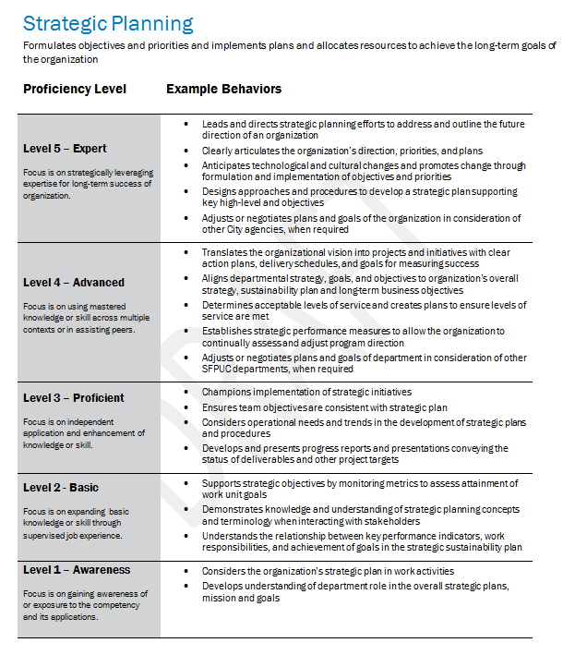
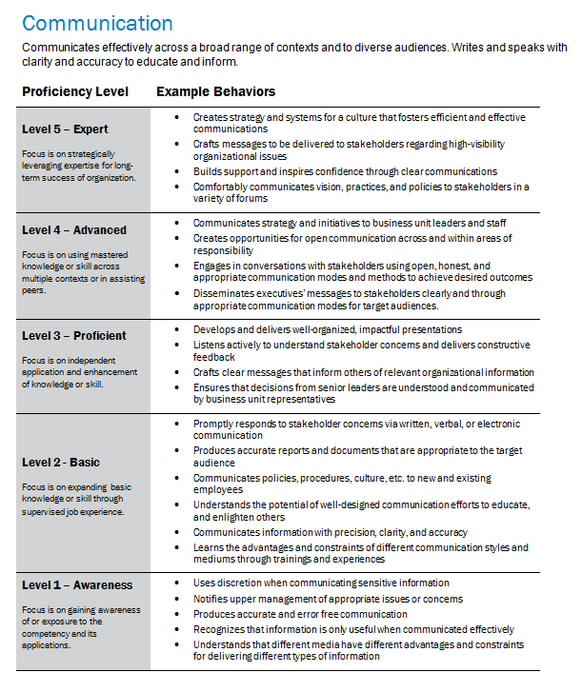
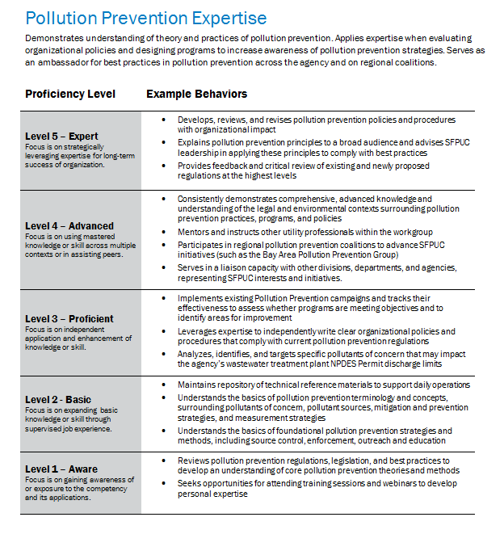
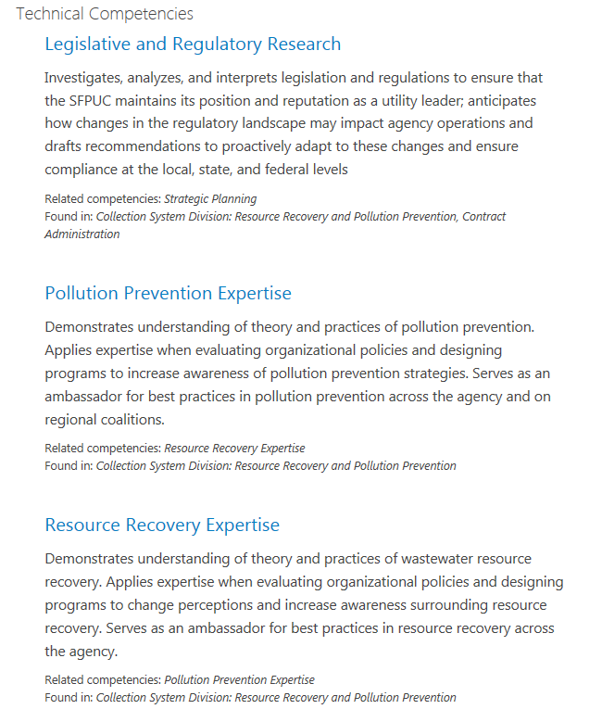

Slide 26
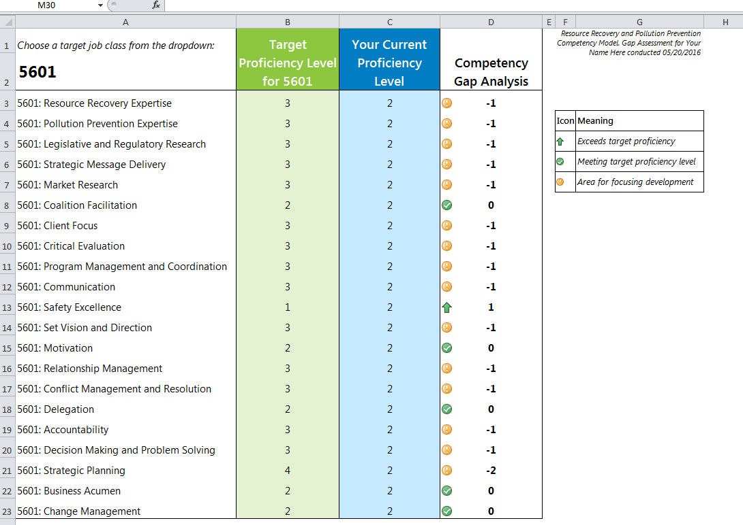
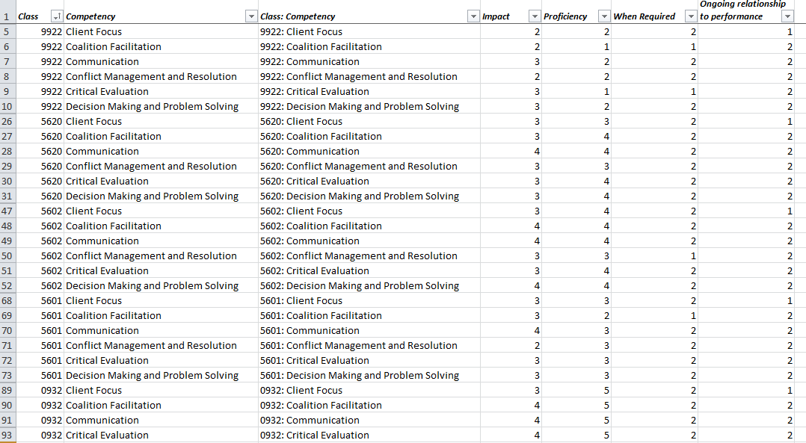
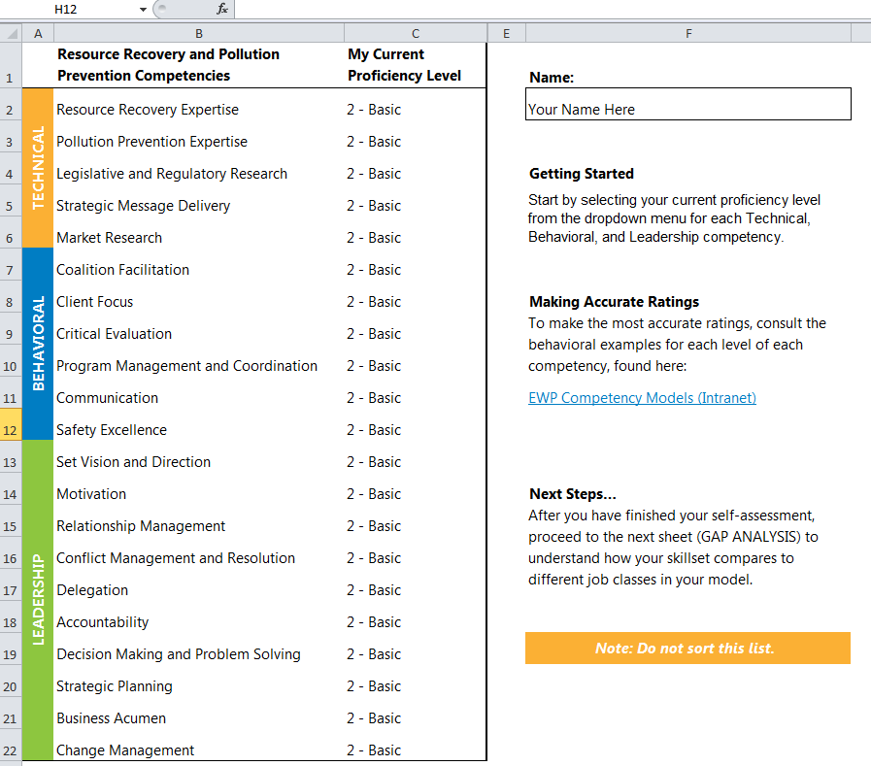

Slide 27
How does this process interact with our
current job analysis methods?

Slide 28
TRADITIONAL JOB ANALYSIS
COMPETENCY MODELING
describes necessary performance
describes desired performance
focuses on one job class at a time
developed for many job classes at a time (e.g., job series, occupational area, organization)
considers the knowledge and skills needed for the job in its current state
considers current needs as well as future, aspirational needs
BOTH METHODS
gather information
from many sources
validate findings
using input from
subject matter experts
only considers needs of that class
considers priorities of organizational leaders
uses language specific to the job
uses common language and metrics that are meaningful across the organization

Slide 29
What are some advantages and applications of developing competency models?

Slide 30
Advantages and Applications of Competency Modeling
Common language between systems
Transparent career paths
Performance Management
Employee Development
Selection
Strategic Workforce Planning

Slide 31
Common language
Competencies give us a way to see the connecting threads from job to job and how an employee must progress in skill and scope of responsibility
SENIOR ANALYST
ANALYST
CRITICAL EVALUATION
Level 4
JUNIOR ANALYST
CRITICAL EVALUATION
Level 3
CRITICAL EVALUATION
Level 2
COMMUNICATION
Level 4
COMMUNICATION
Level 3
COMMUNICATION
Level 2
BUSINESS ACUMEN
Level 4
BUSINESS ACUMEN
Level 3
BUSINESS ACUMEN
Level 2

Slide 32
Transparent career paths
Competency models increase transparency and help identify potential career paths.
New Competencies
Critical Evaluation
Risk Management
Shared Competencies
Relationship Management
Communication
Relationship Management
Communication
Competency Model
Current Class
Competency Model
Desired Class
The employee may want to work on developing these new competencies to prepare for a new opportunity
to those of another class
An employee can compare the competencies of their current class
Decision Making and Problem Solving
Innovation
Delegation
Political Savvy
Strategic Planning
Business Acumen
Strategic Planning
Business Acumen
Since the two jobs share many competencies, this might be a viable career path
And see that many competencies are shared between the two
Notes:
Advantage – clearly defines competencies needed and outlines career path, especially useful for identifying soft skills
Note - This slide demonstrates how competency models give us a shared language and make it easy to compare classes/occupations. Useful for identify career paths and creating individual development plans.

Slide 33
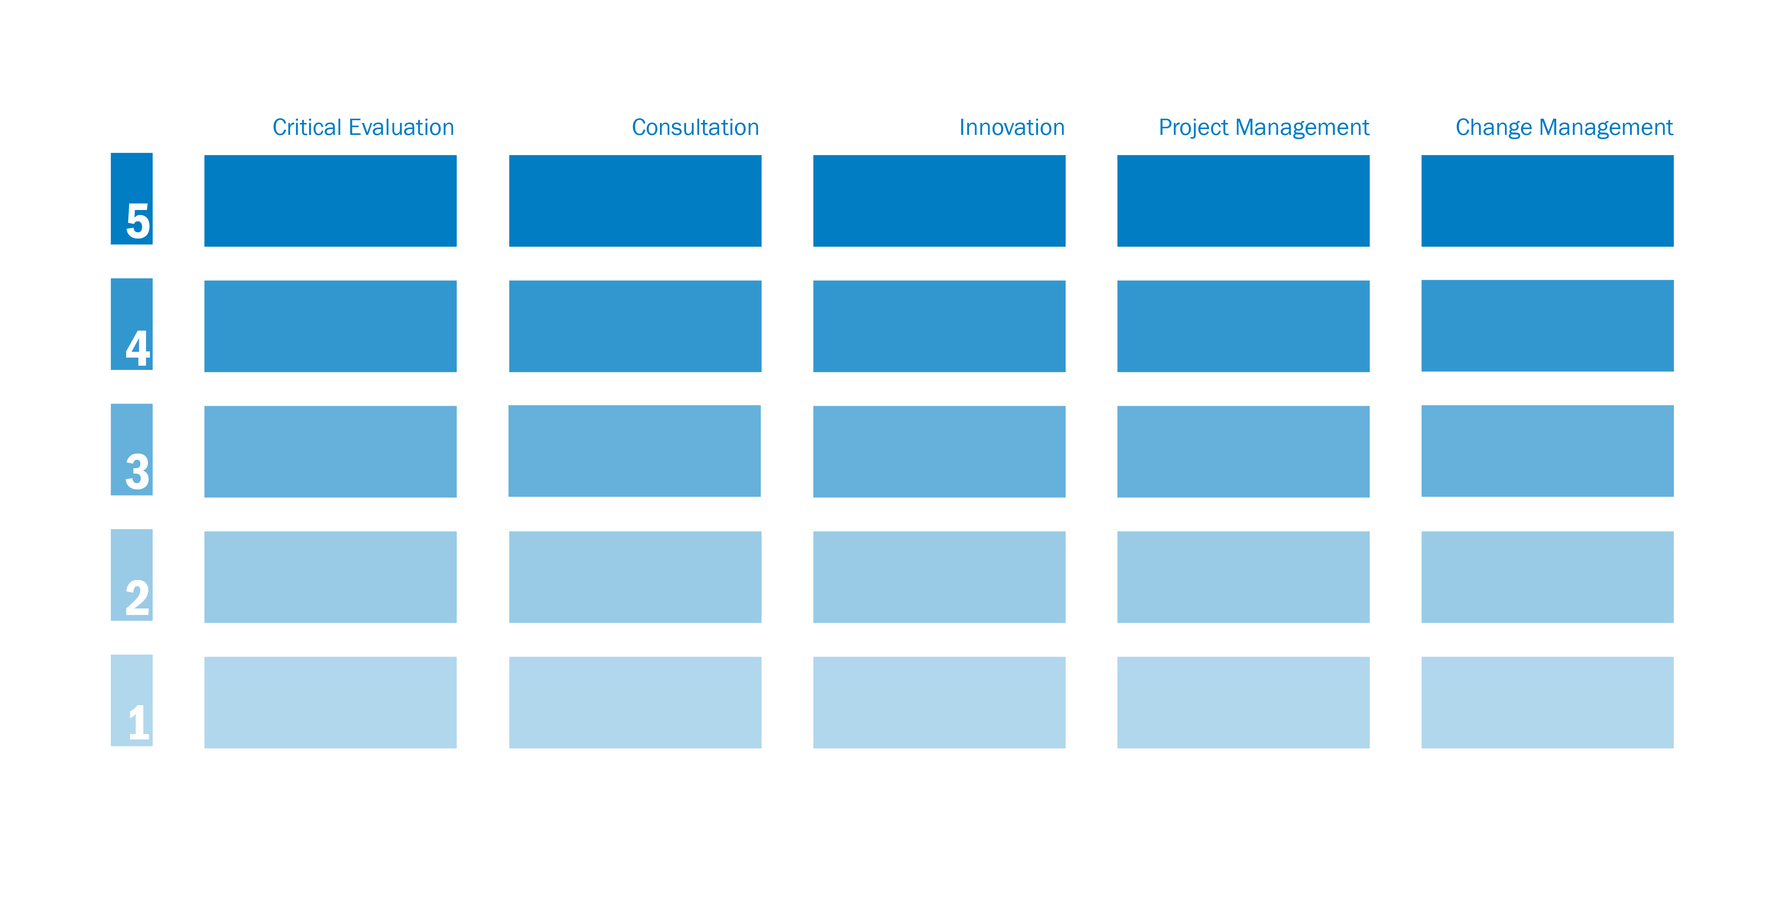
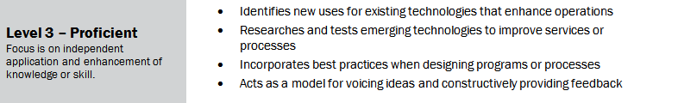
Performance Appraisal
Identifying development opportunities
This is an area for development
These are the target proficiency levels for an employee
You can evaluate what level an employee is at by comparing to the example behaviors
This employee might be ready for a new challenge or opportunity
Let’s look at an example…
Notes:
EWP has partnered with learning and development staff in HRS identify development resources for each competency, so that all staff have tools for professional development available.

Slide 34
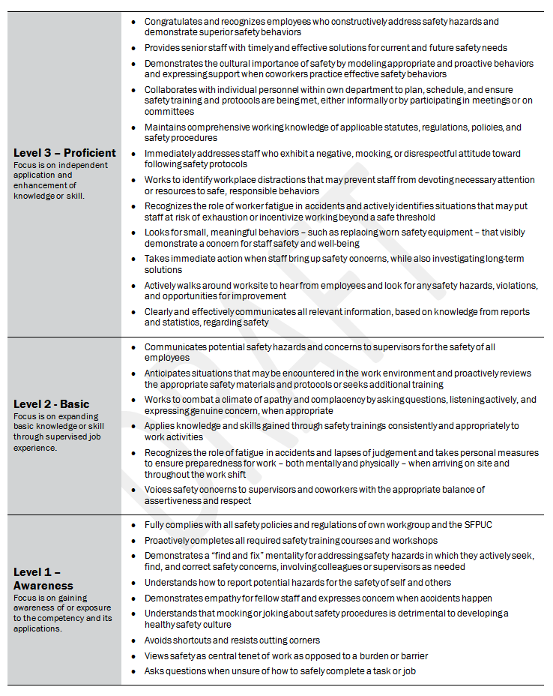
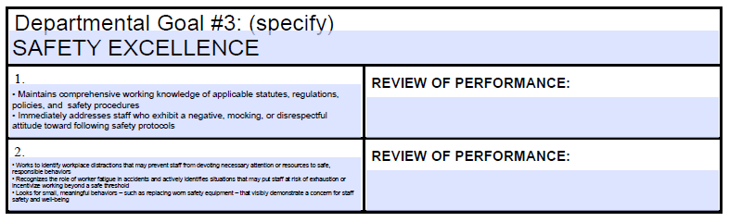
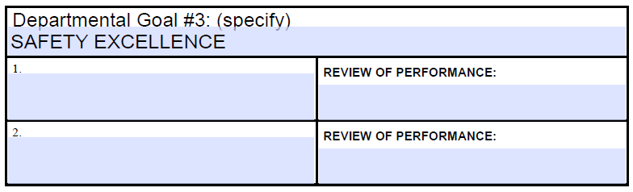
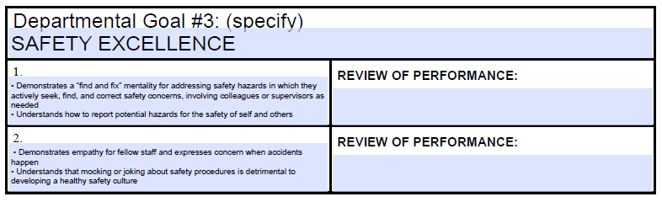
Easy to incorporate into formal performance appraisals
Using the Safety Competency in Performance Appraisal
“Safety Excellence” Competency
Employee with target level of PROFICIENT
Employee with target level of AWARE

Slide 35
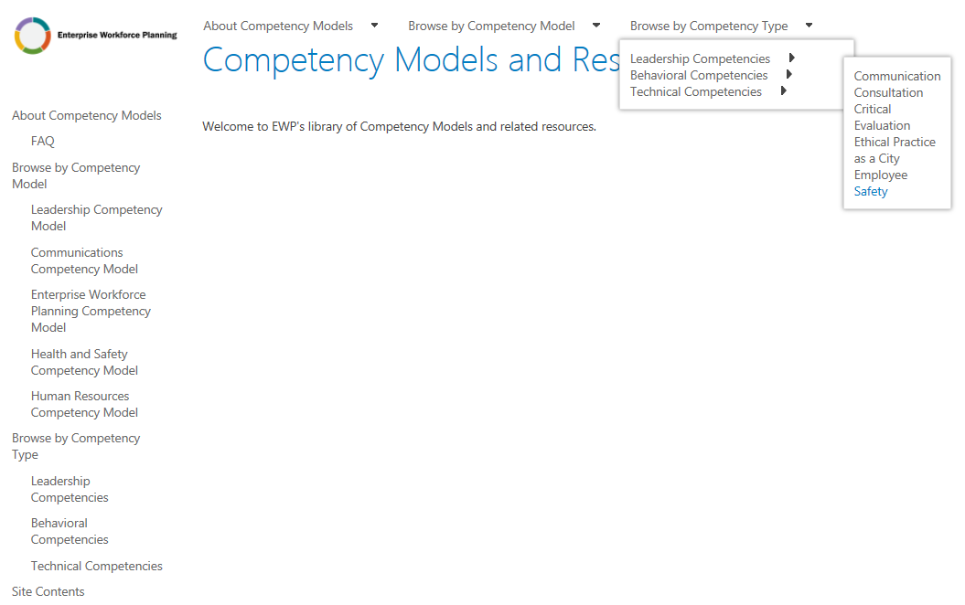
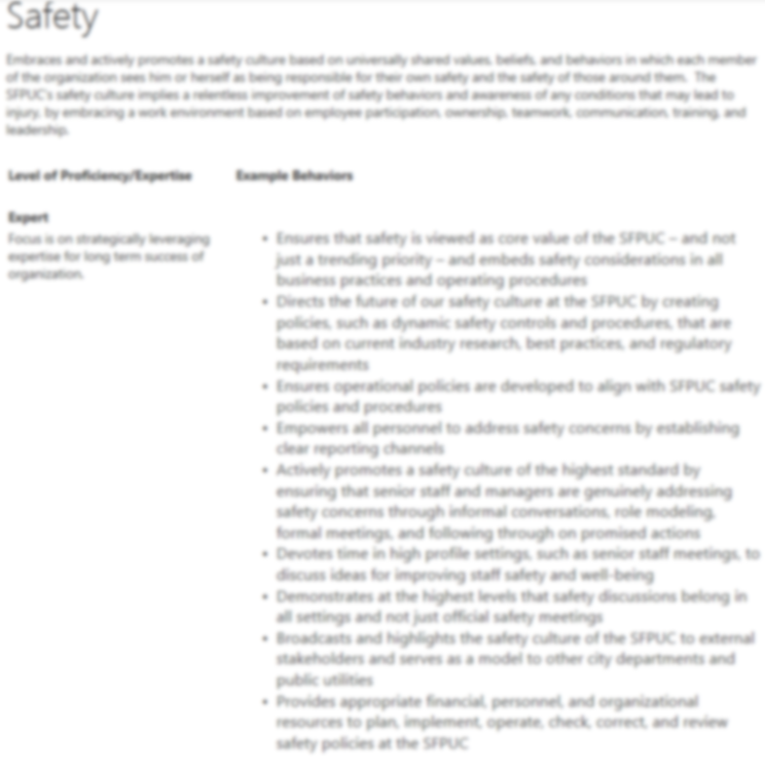


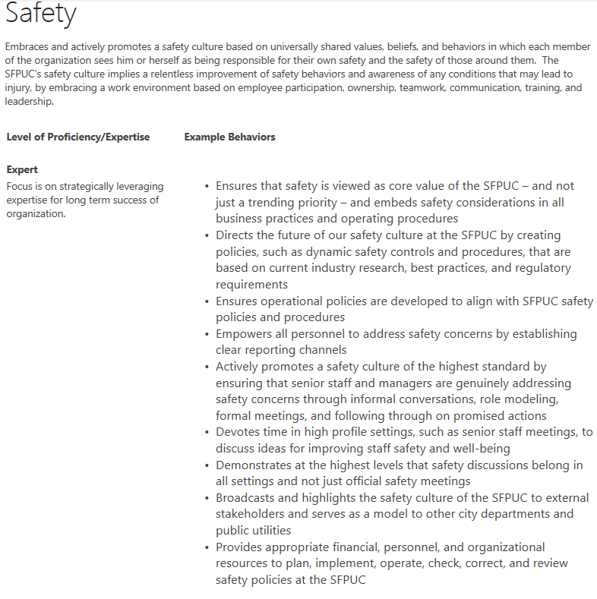
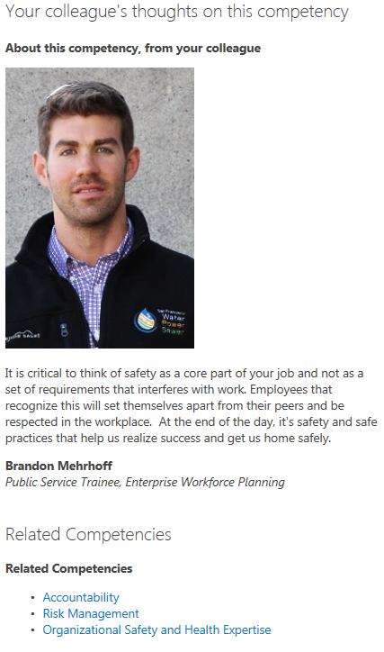
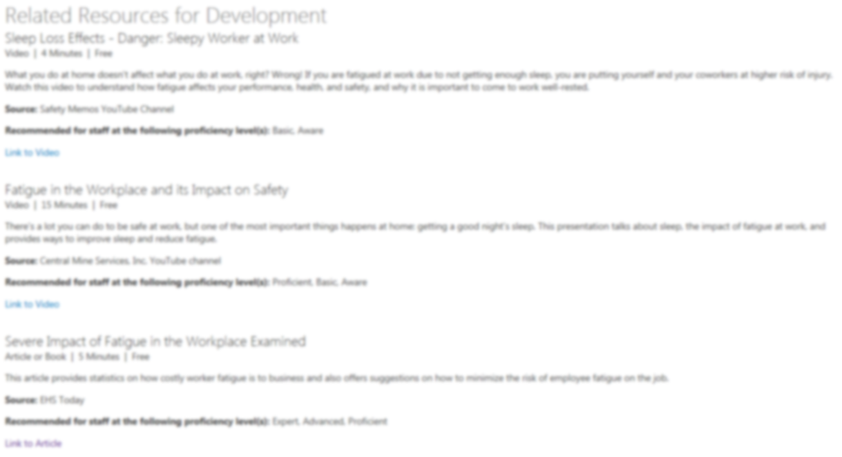
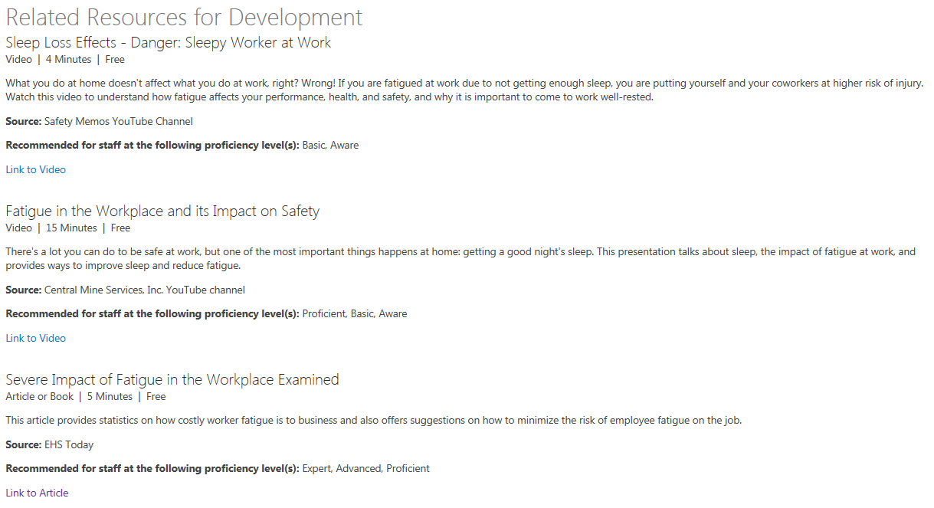

Staff Development
Enterprise Workforce Planning is developing a SharePoint site that employees can access to reference the competencies and find developmental tools
Testimonials from coworkers
Easy to navigate menu
Provides opportunities for employees and subject matter experts to contribute
Development resources for each competency
including Videos, Articles, Podcasts, Webinars, and courses from our LMS
Database of Competencies and example behaviors

Slide 36
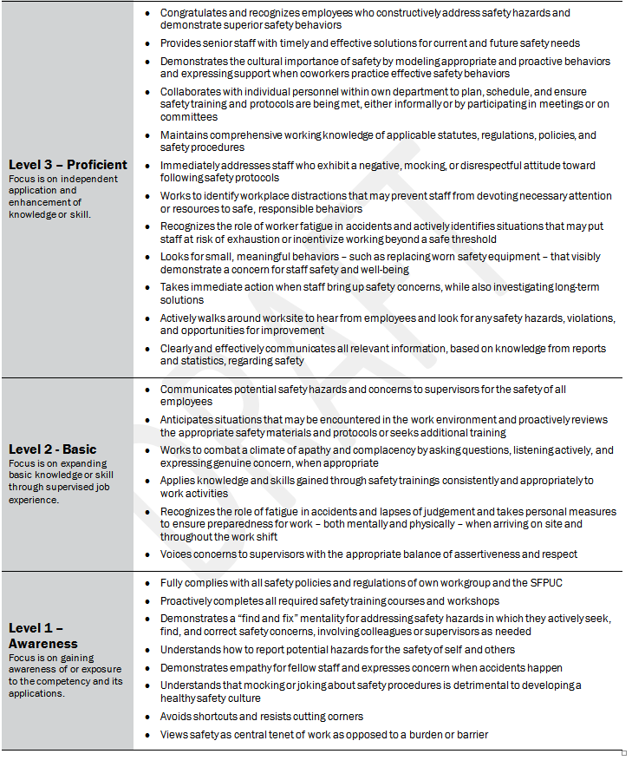
Using the Safety Competency in Job Announcements and Interviews
Selection
Competencies can be assessed and rated by using example behaviors as a guide for interviews
Example behaviors can be incorporated into job announcements to ensure all job seekers know what competencies are valued at the SFPUC
Example behaviors can be used to develop interview questions or evaluate answers
Please tell us about a time when a staff member brought a safety concern to your attention? How did you react? What actions did you take?
**Competency model must be validated before being used in selection!
The nature of our work sometimes involves hazardous working conditions. How will you ensure that you are following safe work practices on the job?
Let’s look at an example…
Notes:
Recruitment - Example behaviors can be incorporated into job announcements to ensure all job seekers know that we value safety
Selection - Easy to envision using the competency to use for developing questions for assessing performance, whether its in a interview setting, a promotional settings, etc.
If you know the proficiency level you need staff to be operating at, you can develop behavioral questions tied to that level… and you can also use the sample behaviors to help you interpret their response and understand what level they’re operating at
Please note that this is something that we are working toward – we are currently in the process of validating our methods (which you have a part in) so that our process will be defensible and backed up by best practices methodology… if you are interested in using this application of the competency, let’s meet first to discuss further (or something like this)

Slide 37
Strategic Workforce Planning
Competency models make it easy to link work to strategic goals because they are future oriented
Strategic Goal #1
Rolling out new technology
Strategic Goal #2
Increase revenue, decrease spending
Critical Evaluation
Communication
Business Acumen
Strategic Planning
Supporting Competencies
Innovation
Maximizing Use of Technology
Set Vision and Direction
Change Management
You can develop your employees so they have the competencies needed to execute the strategy, or
hire new employees who already possess the required proficiency with these competencies

Slide 38
SFPUC Competency Modeling created by
SFPUC Workforce Planning
EWP@SFWATER.ORG
Kving@sfwater.org

