Slide 1
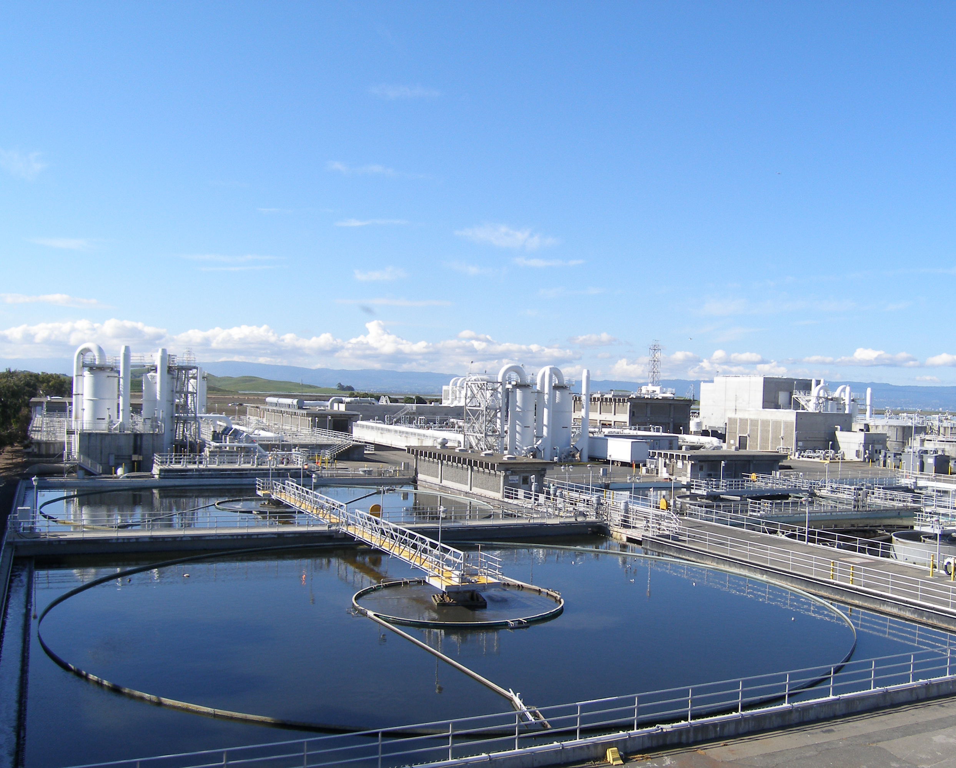

Creating a Win-Win for your School Outreach
Union Sanitary District
Doug Dattawalker
Notes:
10 years of school outreach, 700+ presentations. I have been involved for almost 3 years and given 200+ presentations. Standing on the shoulders of giants

Slide 2

Why do school outreach?
Municipal Regional Stormwater Permit (MRP)
C.7. Public Information and Outreach
f. School-Age Children Outreach
East Bay Discharge Authority (EBDA) NPDES Permit
VI. Provisions. C.3. Best Management Practices and Pollution Minimization Program.
Time Spent – approximately 1:45 per 1 hr class. 175 hrs for a school year.
Notes:
City of Fremont contract which is where our stormwater component comes from as we do not have our own stormwater permit.

Slide 3
Our Goals
Educating students about storm drains vs. sewer drains
Reducing pollution to storm drains and sewers
Water conservation
Wastewater treatment
Goals vs. time vs. retention
Notes:
Think about the goals you have but remember that kids only have a limited attention span and can only remember one, maybe two things from a presentation. So, don’t load up on lofty goals

Slide 4
Curriculum
Next Generation Science Standards (NGSS) approved in September 2013
http://www.cde.ca.gov/ci/sc/cf/
Science Framework for the implementation of NGSS adopted in November 2016.
Notes:
Not all of California has rolled out the framework and the new standards but they will have to soon as the field testing starts in 2018

Slide 5
Curriculum
NGSS - 3 Dimensions of Science
Science and Engineering Practices (SEPs) | Behaviors that scientists engage in as they investigate and build models and theories about the natural world and the key set of engineering practices that engineers use as they design and build models and systems.
Disciplinary Core Ideas (DCIs) | Key organizing concepts, problem solving tools, or underlying principles of a discipline.
Crosscutting Concepts (CCCs) | Underlying themes that have value in all disciplines of science.
Notes:
The SEP’s are like the tools or skills needed to build a house. The DCI’s are the wood or materials needed to build it and the CCC’s are the plans that will be followed. Not all teaching elements are covered by all three dimensions but each element may be pulled from one.

Slide 6
Curriculum
NGSS emphasizes a deeper understanding of science concepts and engaging in scientific thinking than it predecessor.
It also encourages addressing big ideas and cross cutting concepts, the idea that much of science is interrelated.
For example the idea that drinking water and sewer water are related and linked with the natural water cycle.
Notes:
NGSS want students to understand a bigger picture view of science and how it is all related

Slide 7
Curriculum Goals
Grade 5 – Instructional Segment 3: Interacting Earth Systems
Guiding questions
How can we represent systems as complicated as the entire planet?
Where does my tap water come from and where does it go?
How much water do we need to live, to irrigate plants? How much water do we have?
What can we do to protect Earth’s resources?
Notes:
This is where our goals are best matched to the curriculum

Slide 8
Developing activities
Imperfect science
Creativity
Variety of activities
Example. 5-ESS2-1. Develop a model using an example to describe ways the geosphere, biosphere, hydrosphere, and/or atmosphere interact.
Notes:
When planning activities, there is no golden bullet, perfect activity for a curriculum goal. Get creative, try different activities and respond to feedback from kids and teachers both formal and informal feedback.
Ask for some ideas.

Slide 9
Activities
5-ESS2-2. Describe and graph the amounts and percentages of water and fresh water in various reservoirs to provide evidence about the distribution of water on Earth
Printable graphing exercise in our Teachers Workbook
Notes:
Ask for some ideas.

Slide 10
Activities
5-ESS3-1. Obtain and combine information about ways individual communities use science ideas to protect the Earth’s resources and environment.
Discuss during class our wastewater treatment process (if it comes up as a question)
Activity in teachers workbook, creating cards for treatment processes and putting them in order.
Notes:
Ask for some ideas.

Slide 11
Activities
5-PS1-4. Conduct an investigation to determine whether the mixing of two or more substances results in a new substance. From Instructional Segment 1. What is Matter Made Of?
Group activity
Equipment
Water and food coloring as a model for storm drain pollution
Notes:
Hands on activity – our weakest link to curriculum but receives most positive feedback.

Slide 12
Outreach
Check with School District for advice and contacting schools
Letter to principals
  Meeting curriculum goals
  Easy to set-up
Attending staff meetings
  Early in program
Email/letter to teachers
  School websites/staff directories
  Examples

Slide 13
Giveaways
Teachers workbook
Erasers / Rulers / Placemats / Workbooks
Survey/Evaluation
Gift Card drawing

Slide 14
Opportunities
Plant Tours
“Students can obtain information [SEP-8] about the source of their local tap water and which human activities are the primary users of the local water sources. What measures are taken to protect these sources? A field trip to a local wastewater treatment plant can help students think about problems and solutions that help us protect our resources”
Notes:
Our future plans for plant tours – making it more interactive with activities and sign boards.

Slide 15
Questions ?
Doug Dattawalker
Environmental Outreach Representative
Union Sanitary District
dougd@unionsanitary.ca.gov
(510) 477 7637
Thankyou

