Slide 1
Contaminants of Emerging Concern
Rebecca Sutton, PhD
San Francisco Estuary Institute

Slide 2

Regional Monitoring Program
Partnership to understand the health of San Francisco Bay
Implemented by
Stakeholders
Industry
Govern-ment
Scientists
Celebrating
our 25th year!

Slide 3
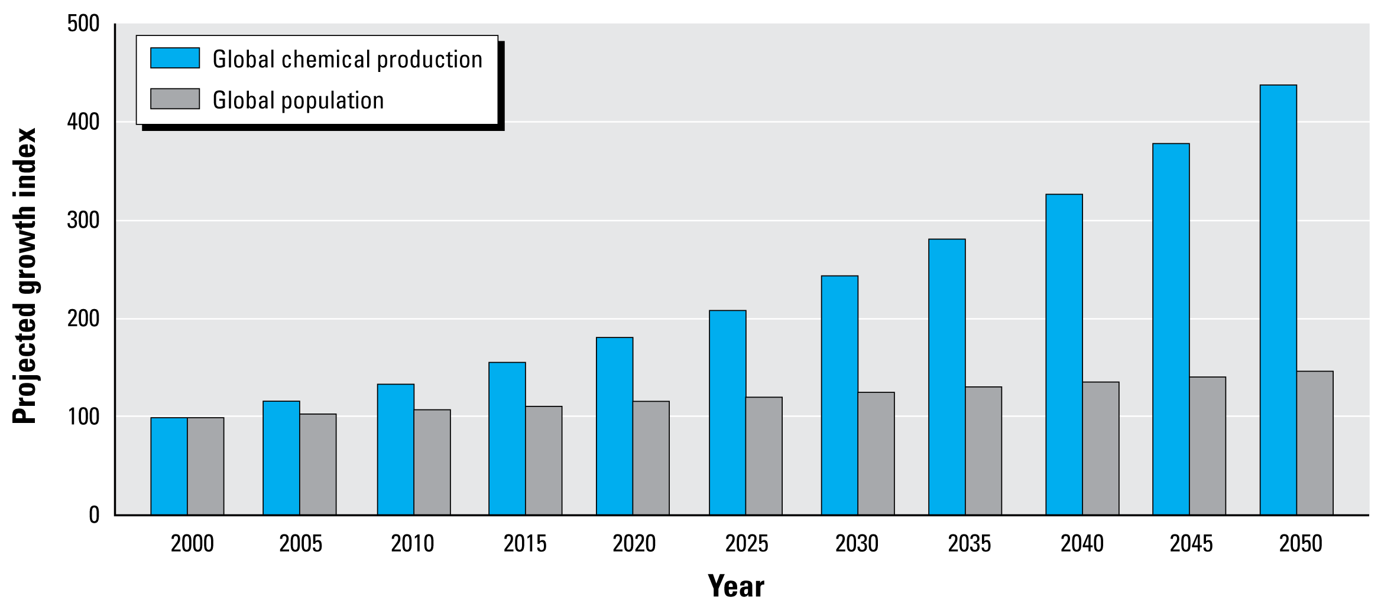
What are emerging contaminants?
Wilson and Schwarzman 2009
Notes:
Global chemical production is projected to grow at a rate of 3% per year, rapidly outpacing the rate of global population growth, estimated at 0.77% per year. On this trajectory, chemical production will double by 2024, indexed to 2000 (American Chemistry Council 2003; OECD 2001; United Nations 2004).
Wilson MP, Schwarzman MR. 2009. Toward a New U.S. Chemicals Policy: Rebuilding the Foundation to Advance New Science, Green Chemistry, and Environmental Health. Environmental Health Perspectives 117: 1202-1209.

Slide 4



Three-Element CEC Strategy
CEC monitoring,
evaluating risk
Learning from others,
sharing expertise
Non-targeted monitoring (bioassays, broadscans)

Slide 5
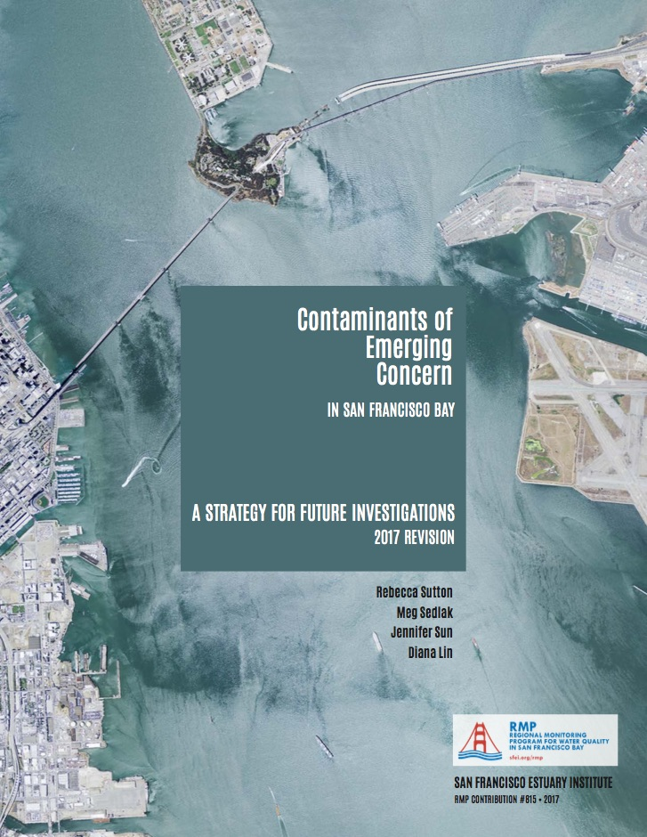
CEC Strategy 2017 Revision: Major Changes
New Management Questions
Revised Risk Evaluations for CECs
Multi-Year Plan

Slide 6

RMP CECs Activities: Coming Soon
Pesticides
Pharmaceuticals
Triclosan
Pathways Monitoring Strategy
ECWG Meeting: April 12-13, 2018

Slide 7
New Management Questions
Which CECs have the potential to adversely impact beneficial uses in San Francisco Bay?
What are the sources, pathways and loadings?
What are the physical, chemical, and biological processes that may affect transport and fate?
Have Bay concentrations increased or decreased?
Are CECs predicted to increase or decrease in the future?
What are the effects of management actions?

Slide 8
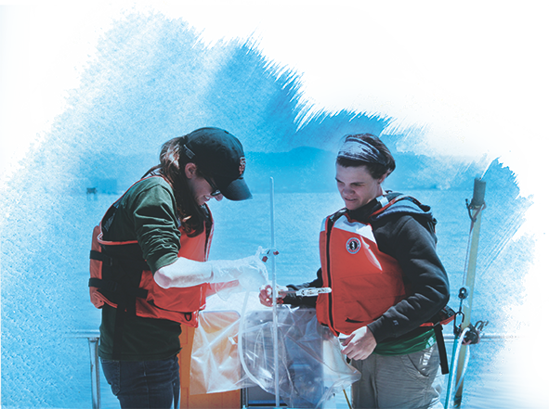
Tiered Risk Framework
High Concern
moderate or
high impact
CEC monitoring,
evaluating risk
4
Moderate Concern
low impact
Low Concern
no impact
Possible Concern
uncertainty as
to impact

Slide 9
Monitoring
Management
High Concern
moderate or
high impact
Studies to support cleanup plan
303(d) listing
Cleanup plan (e.g., TMDL)
Aggressive control
Moderate Concern
low impact
Status & trends
Studies of fate, effects, sources, pathways, loadings
Action plan
Aggressive pollution prevention
Low-cost control
Low Concern
no impact
Reduced screening in Bay; maintain S&T for two cycles
Periodic screening in pathways, track trends
Low-cost source ID and control
Low-level pollution prevention
Track use trends
Possible Concern
uncertainty as
to impact
Screening in water, sediment, biota, wastewater, stormwater
Prioritize contaminants of potential concern, track other efforts
Develop analytical methods

Slide 10
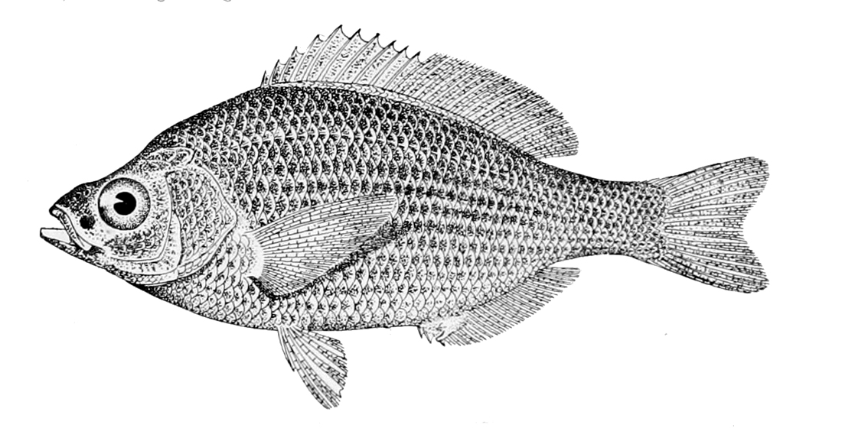
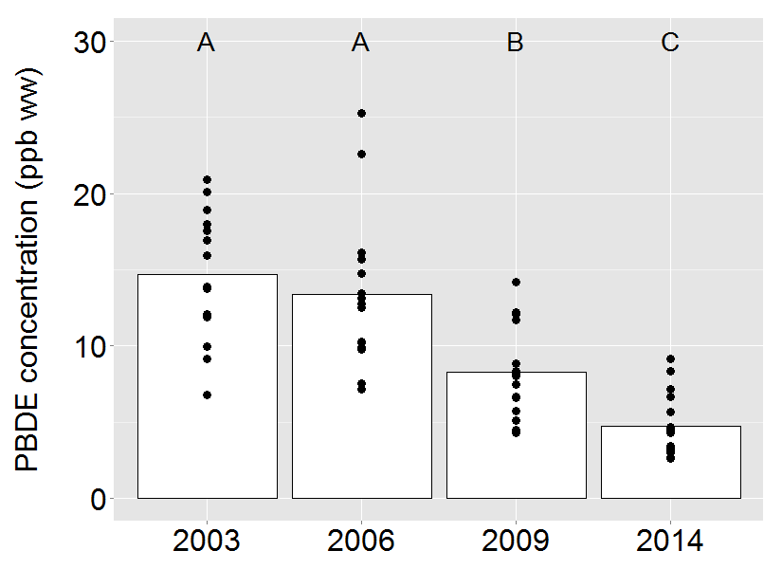
PBDEs: From Moderate to Low Concern
Declining Penta congener (BDE-47)

Slide 11
High Concern
moderate or
high impact
None currently
Moderate Concern
low impact
PFOS
PFOA, Long-Chain Carboxylates
Fipronil
Nonylphenol
Low Concern
no impact
PBDEs and HBCD
Pyrethroids*
Pharmaceuticals and
Personal Care Products
PBDDs / PBDFs
Possible Concern
uncertainty as
to impact
Alternative Flame Retardants
Other PFASs (Fluorinated Chemicals)
Pesticides, Plasticizers
Microplastic
PCB 11, PHCZs, others

Slide 12
Multi-Year Plan: 2019 Special Studies
PFASs in stormwater - $147.5k*
Roadway contaminants in stormwater (informed by 2016 non-targeted analysis) - $82.5k*
Alternative flame retardants conceptual model - $40k (co-sponsored with STLS, +$40k)
Fipronil in sport & prey fish - $70k
Sunscreen chemicals in water & fish - $100k
Bisphenols in archived sediment - $50k
CEC strategy - $65k
ECWG Meeting: April 12-13, 2018

Slide 13
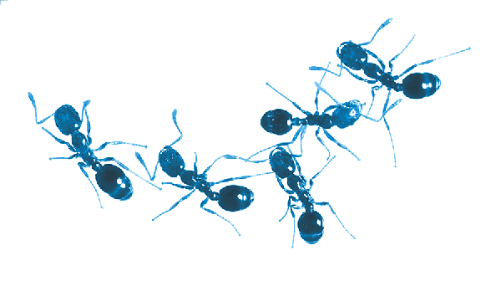
BAPPG Priorities: Pesticides
Fipronil
2018 ambient Bay sediment monitoring
Imidacloprid and other neonics
2017 ambient Bay water monitoring
Pyrethroids and many other pesticides
2017 margin South/Lower South Bay water & sediment monitoring

Slide 14
BAPPG Priorities: Pharmaceuticals
7 BACWA facilities
104 pharmaceutical analytes
Influent & effluent, 2016-2017
RMP Report:
QA/QC review
Synthesize data (anonymous)
Comparison to thresholds of concern
ECWG Meeting: April 12-13, 2018

Slide 15
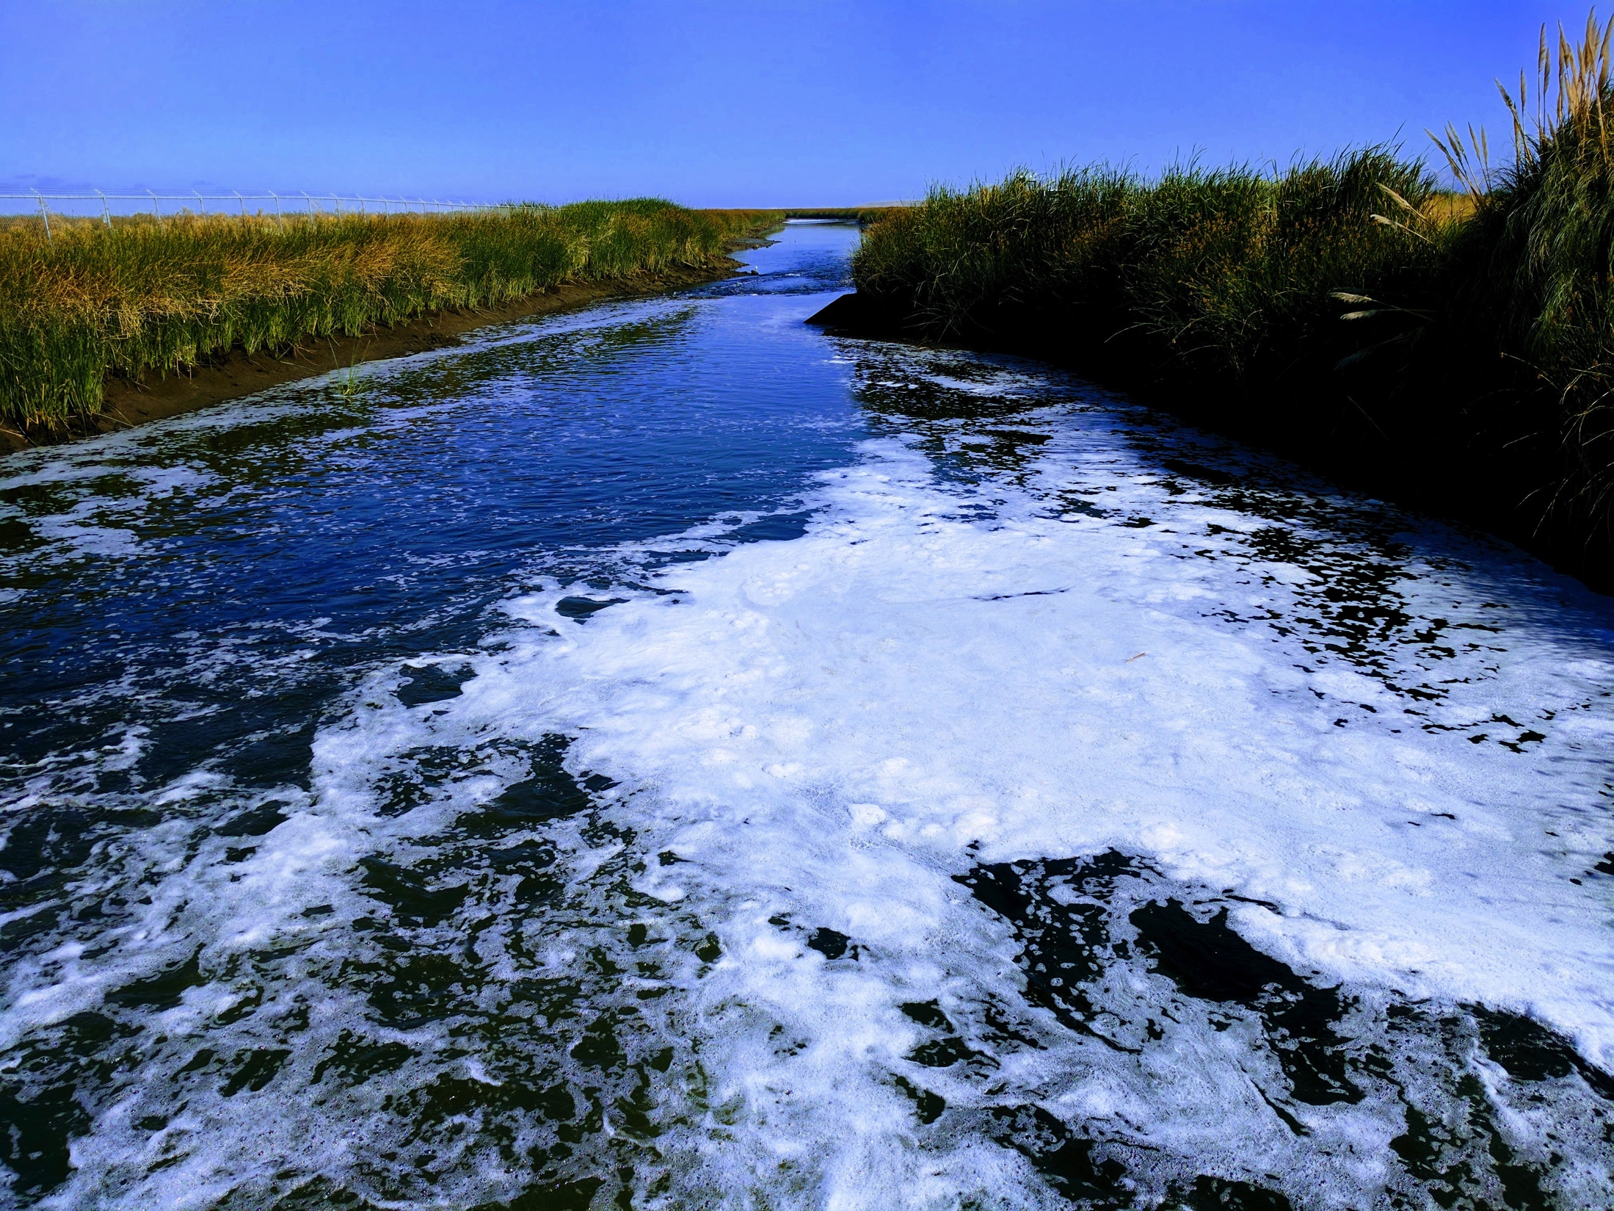
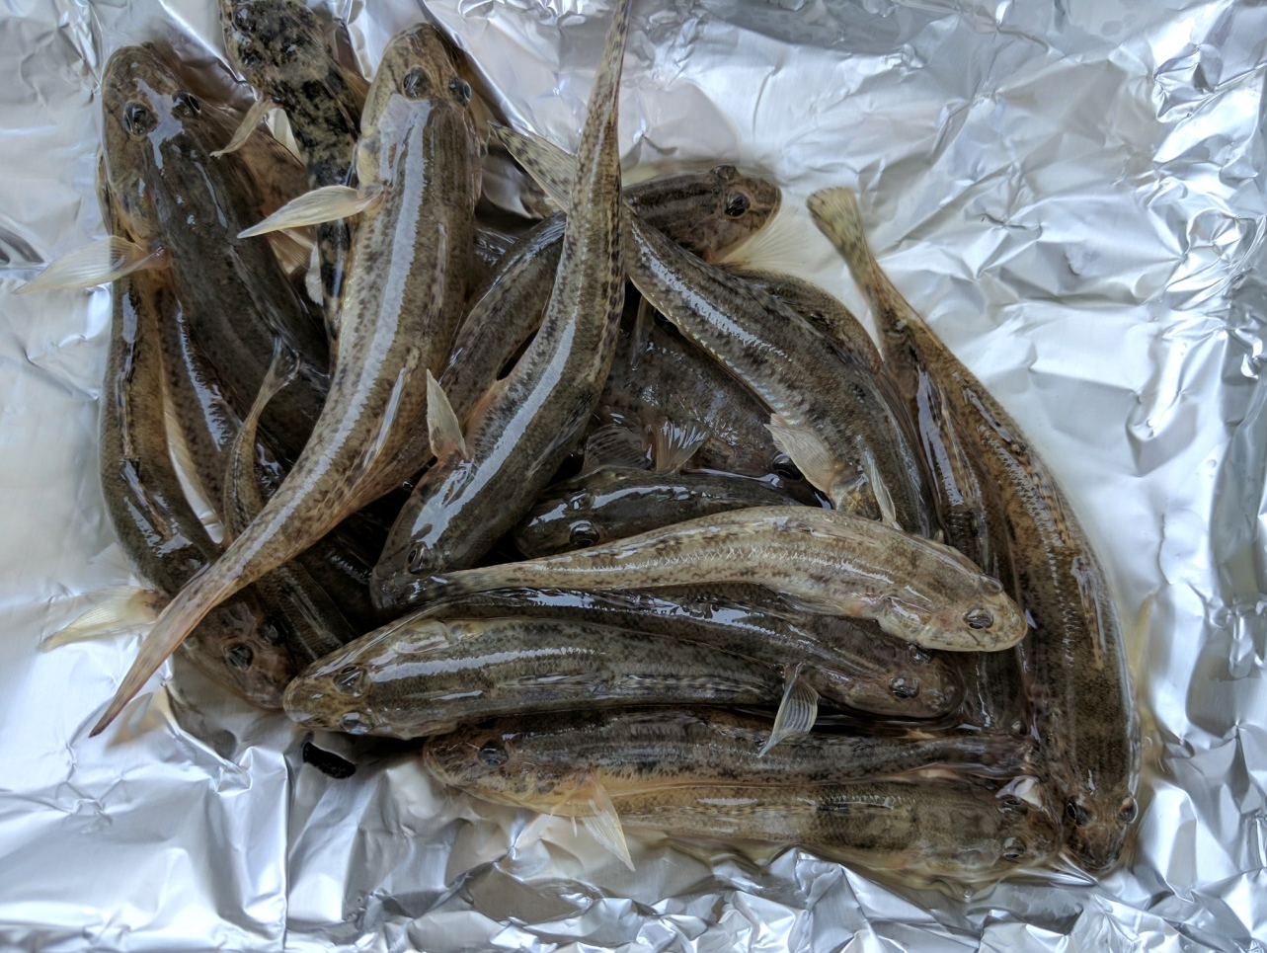
BAPPG Priorities: Triclosan

Slide 16
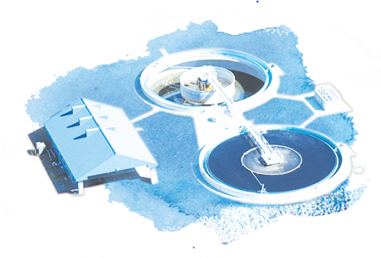
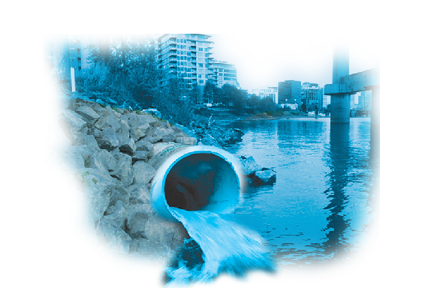
Next Steps: Pathways Monitoring Strategy
Wastewater
Stormwater
ECWG Meeting: April 12-13, 2018

Slide 17
For more information: www.sfei.org/CECs
RebeccaS@sfei.org

Slide 18
PFOA, long-chain carboxylates: Moderate Concern (with PFOS)
Previous:
PFOS Moderate Concern
Other PFASs Possible Concern

Slide 19
PFOA, long-chain carboxylates: Moderate Concern (with PFOS)
Previous:
PFOS Moderate Concern
Other PFASs Possible Concern
Outcome of PFAS Synthesis and Strategy:
Worldwide, regulation & monitoring of these compounds as a group
Experts agree: PFOA, long-chain carboxylates are Moderate Concern

