Slide 1

MEAT, POULTRY AND EGG SAFETY BRANCH PRESENTS:
INEDIBLE KITCHEN GREASE (IKG)

Slide 2
What is Inedible Kitchen Grease?
F&A Code sec. 19216: "Inedible kitchen grease" means any fat or used cooking greases and oils obtained from any source.
The By-Product of Straight Vegetable Oil or Pure Plant Oil that is Used to Fry/Cook Foods
Cooking Oil that is No Longer Sustainable as a Cooking Source

Slide 3
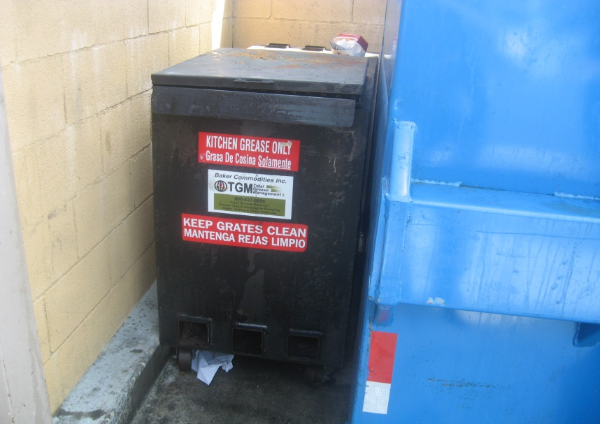
Why Is Inedible Kitchen Grease Collected?
Used cooking oil (IKG) is most often collected at restaurants that have fryers.
When needed, a restaurant employee will transfer the IKG into IKG collection bins/containers.
A registered IKG transporter will periodically collect the IKG from the restaurant.
The IKG bin/container is NOT owned by the restaurant, but is owned and placed at the location by the IKG transporter/renderer.

Slide 4
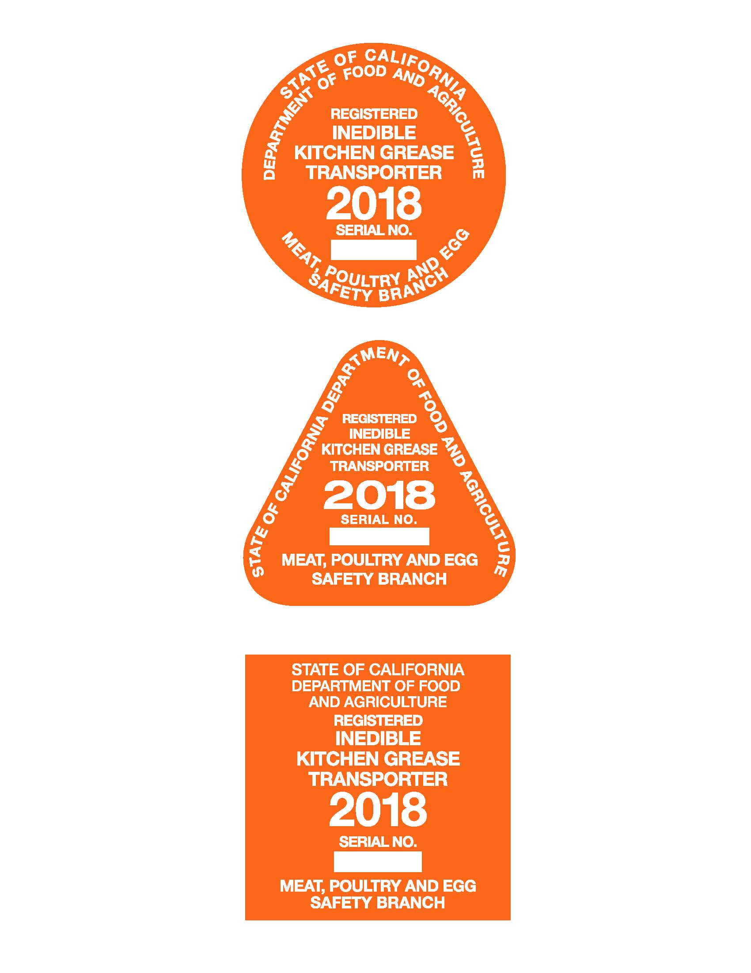
IKG Registered Transporter Decals for 2018. All IKG Decals follow the California DMV Color Codes for Current Year Decals.
Truck Decal, Placed in Upper Right corner of the Windshield
Trailer Decal, Placed on Right Front Side of Trailer
Personal Use Decal, Placed in Upper Right corner of the Windshield

Slide 5
Requirements of IKG Transportation and Collection
All Renderers and Collection Centers Must Maintain Valid Licenses.
Licenses Must be Prominently Displayed at Place of Business.
All Vehicles Must Meet DOT Requirements and CHP Safety Inspections
All Transporters of IKG, including Interceptor Trap Grease Haulers, must have valid IKG Registration Documentation.
Note: Renderers and Collection Centers have IKG Licenses, IKG Transporters have Registration Certificates.

Slide 6
IKG Manifest Generator Form
IKG Generator Information. This form must be carried in the vehicle at all times. This Manifest is from the Generators i.e. restaurants, etc.. that generate the waste oil, and the IKG transporter documents each pickup on this form or their own form.

Slide 7
IKG Manifest Instruction Sheet Continued:
What must be done with this information?
The transporter must give the generator the information in 1-7, 9 & 15 above, either at the time of IKG collection or within 45 calendar days. The transporter must keep this information in the transporting vehicle while transporting IKG to the receiving facility.
The transporter must give the receiving facility the information in 1 & 7-15 above, either at the time of IKG delivery or within 15 business days. The receiving facility must maintain this information for two years.
The transporter must keep all of the information in 1-15 above and must maintain this information for two years. The information in 1-15 above makes up a complete manifest.

Slide 8
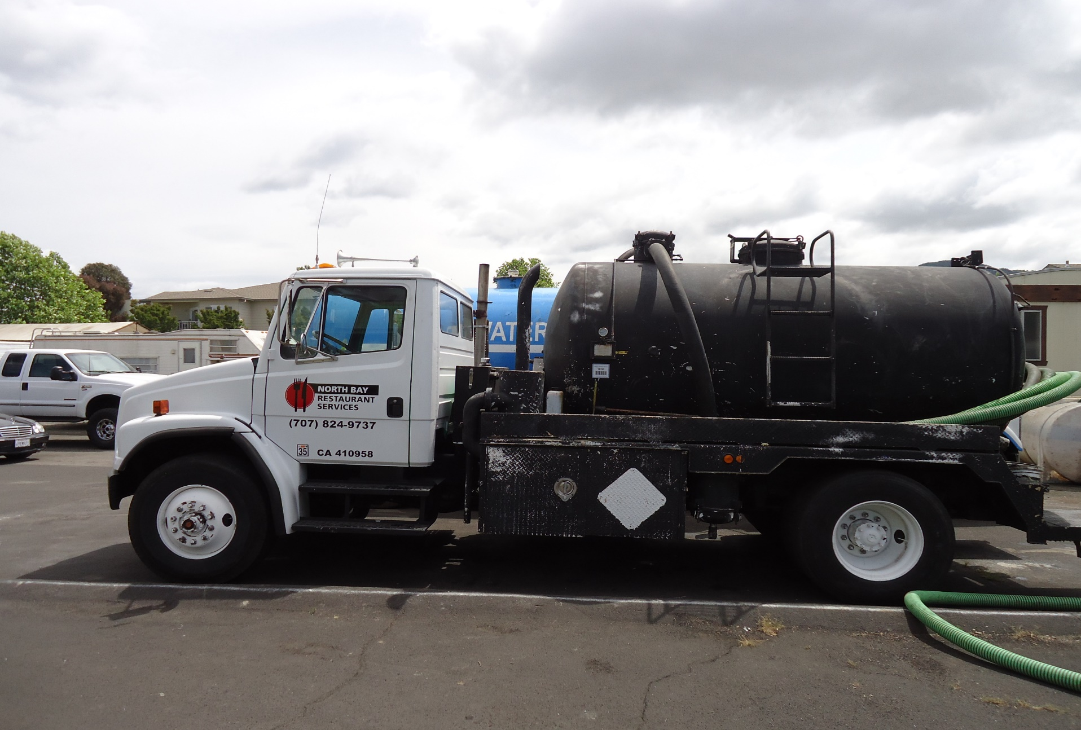
IKG Transporter Vehicle with Proper Signage

Slide 9
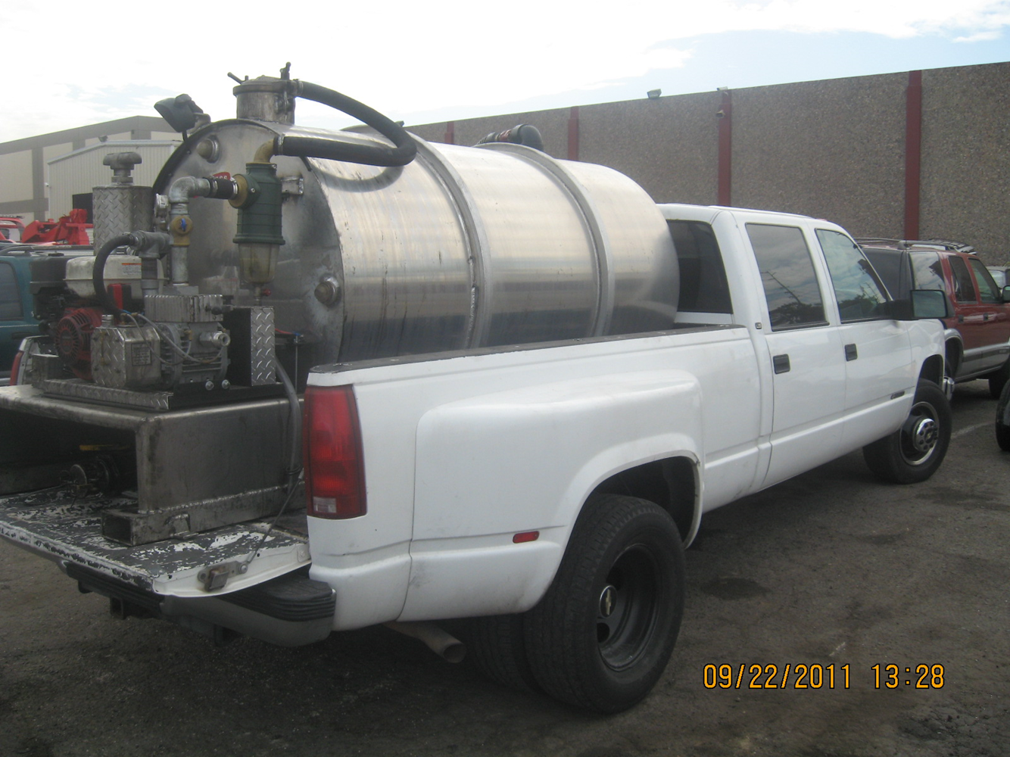
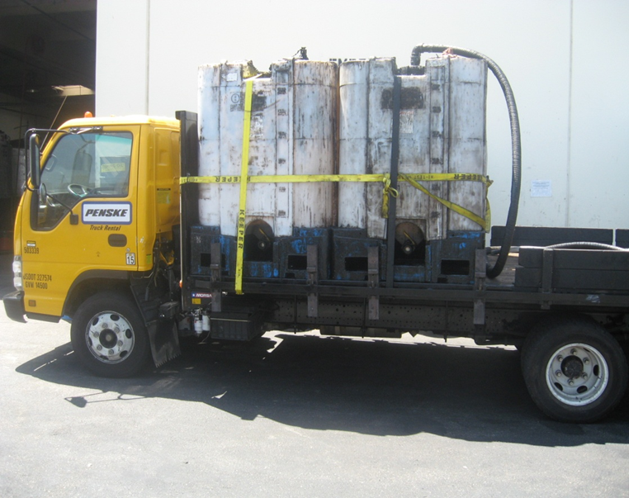
Illegal IKG Transport Vehicles
Red Flags:
Vehicles have no “signage” or CDFA issued registration decal

Slide 10
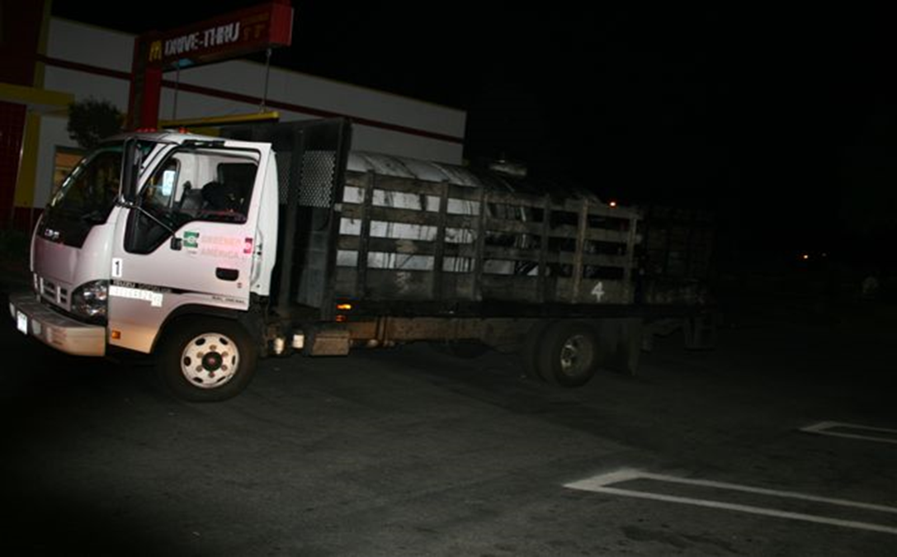
Illegal Transport Vehicles
Red Flags: Transporters operating between the hours of 11 pm and 4 am

Slide 11
IKG Resources for Enforcement
CDFA-MPES Rendering Enforcement maintains an Electronic Database of all Licensed and Registered IKG Transporters, Collections Centers, IKG Renderers and traditional Renderers.
CDFA-MPES has an IKG Grease Theft reporting website, that has real time access to all currently licensed and registered transporters that operate in the state of California. It does not list Out of State transporters that operate inside California.
The website can be called up from any internet enabled device.
The website is www.HitGreaseTheft.cdfa.ca.gov
It can also be accessed directly from the CDFA website, which is: cdfa.ca.gov under the Animal Health & Food Safety tab.
The Hit Grease Theft website is updated weekly, and all registrants and licensees can be located under the “Transporters” tab.

Slide 12
The CDFA Thanks you for your time!
Feel Free to Contact the CDFA MPES Rendering Enforcement Unit if you have any questions regarding IKG Manifest Documentation, Enforcement of the IKG Industry, or any other issues that may arise in the field.
The CDFA MPES Rendering Enforcement Unit can be reached at:
CDFA-Meat, Poultry and Egg Safety Branch, Rendering Enforcement
2800 Gateway Oaks Drive,
Sacramento, CA 95833
Phone: 916-900-5004, Extensions 5262, 5063
CDFA Northern Area Investigator: Michael Abbott, or Paul San Gregorio
Southern Division Area Office located at:
1910 S. Archibald, Ste. X,
Ontario, CA 91761
Phone: 909-773-0079
CDFA Southern Area Investigator: Rhett Dunn

Slide 13
My Contact Information
Michael Abbott
Office: 916-900-5262
Cell: 916-628-1761
Fax: 916-900-5334
eMail: Michael.abbott@cdfa.ca.gov

