Slide 1
Averaging Period for Setting Planning Level Targets

Slide 2
Status
The impact of nutrients on the Bay is unclear and being investigated by SFEI.
Nitrogen load caps are anticipated under the 3rd Watershed Permit. The averaging period is undecided.
Notes:
General status update to get everyone on the same page as we dive into the averaging periods discussion

Slide 3
Impact of Nutrient Limit Averaging Periods on Design
The Issue: The basis for setting nutrient limits (e.g. max month) can have a profound impact on the facilities/costs at treatment plants. Plants design facilities to the “critical permit condition”
BACWA’s Position: Any nutrient limit (i.e. planning level target, load caps) should be based on annual or dry season loadings (preferred)
Notes:
The issue lays out how utilities/designers use the permit information and translate it into a design. BACWA considered the issue into it’s position as it prefers longer averaging periods with a preference for the dry season over average annual

Slide 4
Basis for Averaging Period
Unlike priority pollutants, that often have an acute effect on the aquatic environment resulting in max day limits, nutrients are very complex and the result of having too much or too little is observed over seasons or even years (i.e. eutrophication or lack of primary production) and thus limits recognizing their chronic impact are appropriate.

Slide 5
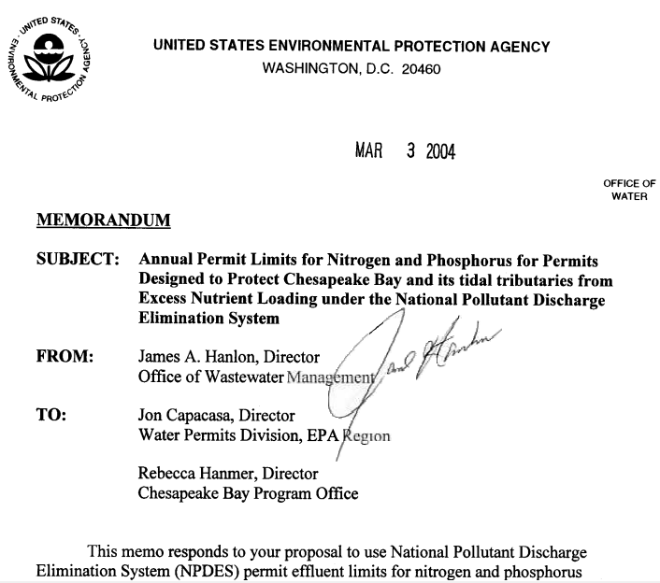
Deviation from
Federal Regulations
(Chesapeake Bay)
Average weekly and monthly effluent limits are required for POTWs (40 CFR 122.45(d)), unless “impracticable”.
Chesapeake Bay: EPA found that annual nutrient permit limits were appropriate because is impracticable to express limits on a shorter time scale (Hanlon, 2004).
Notes:
This 2004 memo from Jim Hanlon essentially says that average weekly and monthly limits are required unless “impracticable”. So what is “impracticable”. My understanding is that if a case can be made that such short averaging periods are NOT required and supported by science, the EPA will support as long as there is supporting science/documentation.
This memo by Hanlon is focused on the Chesapeake and it supports an annual average averaging period

Slide 6
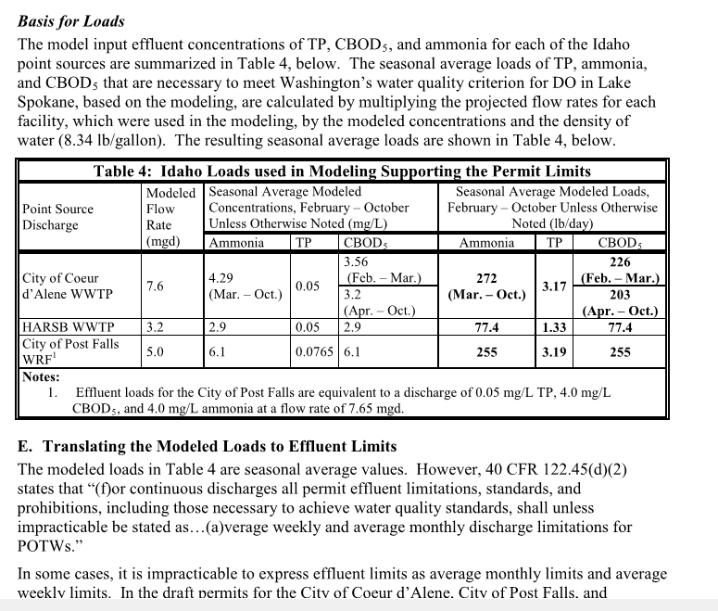
Permit Case Studies
Permit | Nutrient Target | Season
Spokane River* | Ammonia/ Phosphorus | Dry
Metropolitan Council Environ. Services** | Phosphorus | Year-Round
Chesapeake Bay* | Nitrogen | Year-Round
* Deemed “impracticable” based on modeling results
** TMDL to inform TP limits and averaging period
Notes:
I have this slide to merely showcase that making the case for a year round or seasonal averaging permit is not new and that as long as the science supports it the EPA is typically on board as they realize that nutrients are not priority pollutants and that longer averaging periods might be sufficient to protect water quality.
This permit listed on the right is from the Spokane River and each major discharger has seasonal limits (not necessarily the same periods) for ammonia, TP, and cBOD5. This was supported by extensive modeling. The next case study is from Newport Bay where temperature was the fundamental driver that supported a seasonal averaging period.

Slide 7

Mississippi River “Umbrella” Discharge Permit for Phosphorus
Minneapolis Met Council (MCES)
Total Phosphorus Limit 5 Facilities
Facility Name | Average Wet Weather Design Flow, mgd | Treatment Process Description
Eagles Point | 11.9 | Biological Phosphorus Removal
Empire | 28.6 | Biological Phosphorus Removal
Hastings | 2.69 | Conventional Activated Sludge
Metropolitan | 314 | Biological Phosphorus Removal
Hastings | 38 | Biological Phosphorus Removal
Parameter | Limit | Limit Type | Effective Period | Sample Frequency
Total P | 159,349 kg/yr | 12 Month Moving Total | Jan - Dec | 1X per Month
Total P | 916.8 kg/day | Calendar Monthly Ave. | Jan - Dec | 1X per Month
Notes:
Permit is determined from the sum of the monthly average and 12-month moving total loadings discharged by the MCES WWTPs included in this Permit.
If the Permittee does not exceed the monthly and annual TP limits as outlined in the limits and monitoring section of the Permit, the MCES WWTPs are in compliance with the TP limits. If the TP limits are exceeded in any month, the Permittee is out of compliance and shall follow the additional reporting requirements as outlined in Chapter 2, Section 1.1 of this Permit.
MPCA) prepared Lake Pepin Site Specific Eutrophication Criteria
Total Phosphorus 100 ug/L
Chlorophyll-a 28 ug/L

Slide 8
BACWA: Dry Season over Average Annual
Science will inform the need for future nutrient limits and the corresponding averaging periods.
What averaging period should be used for setting planning level targets?
  Water Quality/Regulatory:
    Lack of modeling results to support average annual vs dry season
    (Newport Bay Example).
    Opinion: excess phytoplankton growth has the greatest potential in the dry season as there is more sunlight and higher temperatures.
    Dry season targets have less variability since they exclude wet weather flows.
    How different are discharge loads for dry and average annual
    (see Group Annual Report slide)?
Notes:
The plan is to make sure that the science will inform the eventual results, followed by walking them through a section on water quality/regulatory, followed by treatment plant impacts (2 slides ahead)

Slide 9
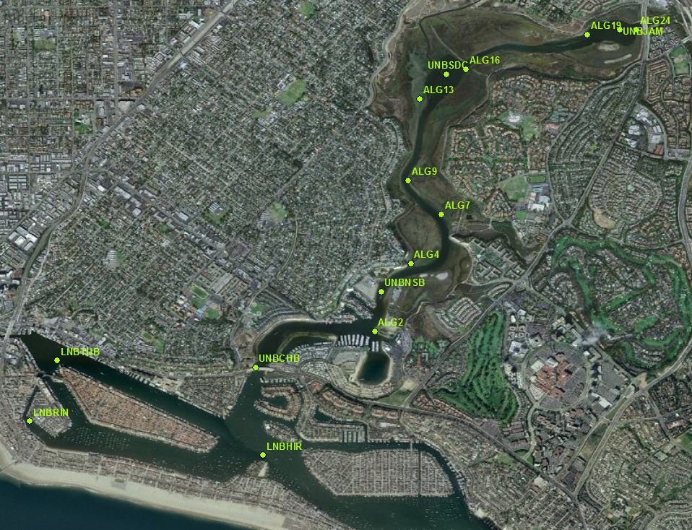
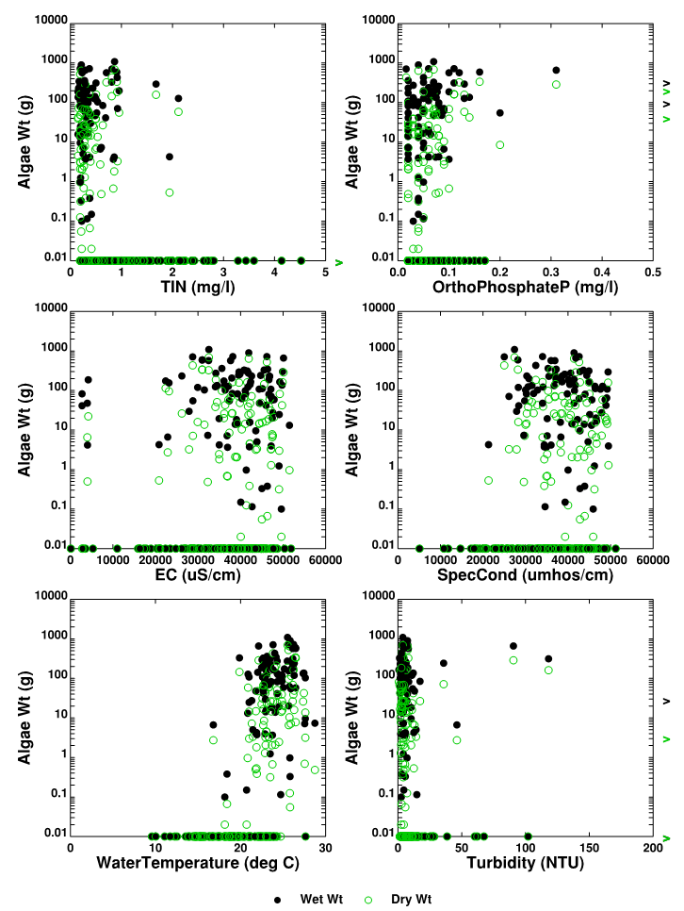
Example: Newport Bay Winter Macroalgal Growth Potential is Limited Due to Factors Other Than Nutrients
Macroalgal growth potential is limited during diversion (winter storm periods)
  Low temperature, low salinity, high flushing
Salinity, water temperature and flushing time are unfavorable to algal growth during storm events when diversions may occur
  Algal blooms typical in summer (Jul-Aug) not in colder water when diversions may occur
  Lower salinity also not supportive of algal growth, which will be present during diversions
High creek flows during diversions (winter storms) result in shorter upper bay flushing times
  Minimizes potential for nutrient processing & algal growth
Data from 3 most upstream ALG stations in the Bay
Notes:
The Newport Bay example is a recent one where the science found that algal growth potential was limited during winter storm events when the water was relatively cold. A relatively simple model was constructed that considered salinity, algal growth, turbidity, temperature, etc.. The results supported a seasonal averaging period.

Slide 10
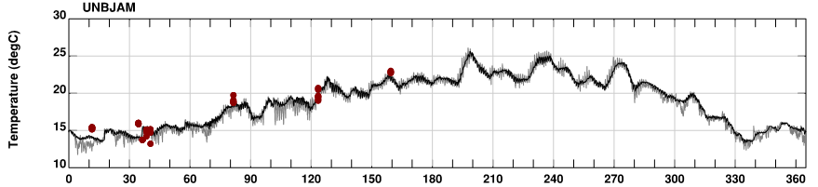
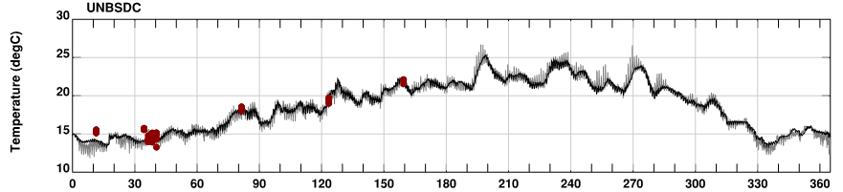
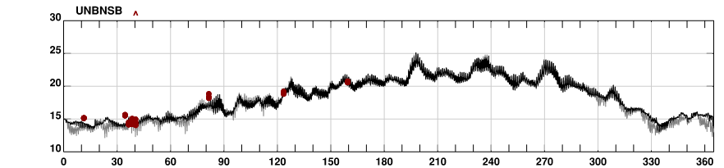
Model Calculated Temperature
Jamboree Rd.
Peak Algal Period
Diversion Periods
Santa Ana Delhi Channel
Jamboree Rd.
Santa Ana-Delhi Channel
Northstar Beach
Northstar Beach
Notes:
This is some follow-up data from Newport Bay that showcases the importance of temperature on algal production for 3 different locations. In all 3 instances, algal production was minimal during the colder wet season and supported a seasonal averaging period.

Slide 11
Group Annual Report: Daily Ave. Loading
Notes:
The dry season vs ave annual data is within 10% of each other on average each year. A similar exercise was done with ammonia and the results were similar (albeit a bit tighter)

Slide 12
BACWA: Dry Season over Average Annual (Continued)
What averaging period should be used for setting planning level targets?
  Treatment Plants:
    Designed to meet “critical permit condition” (Pinole example;
    potential for plants to over-design now based on an uncertain future)
    Biological treatment works best during consistent loadings at warm temperatures (more aggressive design criteria)
    Agencies can maximize use of existing assets for transitioning from secondary to nitrogen removal (more aggressive design criteria; OCSD example)
    Opportunity to implement newer innovative technologies (e.g., nitrite shunt) that might struggle initially during the wet season until technology advances
When the nutrient loadings and water quality responses relationship is not well defined, it is advisable to not overly specify effluent limits at the outset as this may result in over investment.
Notes:
For the treatment plant piece, I plan to walk them through each bullet and verbalize case studies for each, as follows:
Plants have the potential to over-design as they will be worried about having a wet year and violating an annual limit. For example, plants that have the ability to perform seasonal nit/denite but not year round nit/denite would need to construct new facilities. Also, plants would be less prone to move towards technologies that might suffer during wet weather events at meeting nutrient load targets (e.g., contact stabilization process as they might bleed more ammonia/TN which can result in additional tankage and additional secondaries).
Biological processes work best with steady loading and warmer temperatures.
The poster child for this is OCSD where HDR was able to convert one of their plants from secondary treatment to nit/denite as there were no limits per se so the criteria was aggressive PLUS they have warm water)

