Slide 1
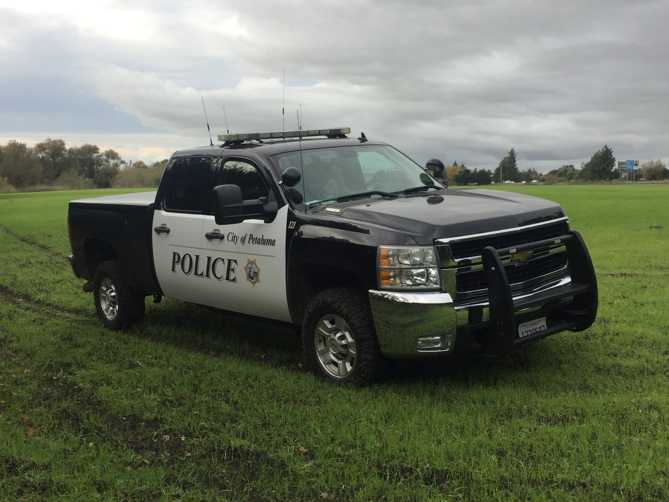
PETALUMA POLICE DEPARTMENT
Homeless Outreach Services Team

Slide 2
PETALUMA’S HOMELESS
Over the last few years, the City of Petaluma has seen an explosion in the population of homeless and transients who have made Petaluma their home. Some of these individuals are native to Petaluma and some are not. A number of homeless contacted in town are referred to as travelers and have found their way here from all across the United States. Others arrive from neighboring cities such as San Rafael and Santa Rosa.

Slide 3
Homelessness in Sonoma County by numbers
In 2013, 4280 homeless persons were counted in Sonoma County in a single day. 909 were contacted in the City of Petaluma accounting for 21.2% of the total.
In 2015, 3107 were counted with 361 living in the City of Petaluma dropping the percentage to 11.6.
In 2016, 2906 were counted with 298 living in Petaluma.
In 2017, 2835 were counted with 283 in Petaluma .
In 2018, 2996 with 285 in Petaluma.

Slide 4
An Estimated 5574 Sonoma County Residents experience homelessness every year.
The Sonoma County Homelessness rate is almost three times the national rate.

Slide 5
One of the nation’s least affordable housing markets
In July of 2016 Sonoma County made the top ten list of least affordable places to live. 82% of the average Sonoma County resident’s salary on a median priced home went to the mortgage.
The national average is 35%
7 of the top ten are in California.

Slide 6
Along with the homeless population in Sonoma County comes the problem of illegal encampments that become dump sites for rotting food and human waste, refuse, debris, furniture, contraband and hazardous materials. They are often also the site of drug and alcohol abuse and contribute to the pollution of public and private land and water ways.

Slide 7
HOMELESSNESS IN PETALUMA
In 2015, 34 large scale homeless encampment sites in Petaluma that pose a significant threat to public health, public safety, and the environment were documented. Over 100 smaller scale locations were also documented.

Slide 8
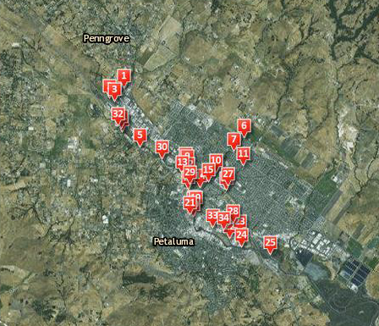

Slide 9
Many of the people in these encampments suffer from severe illness, mental and physical and contagious diseases. As seen in the previous slide, the majority of these sites are located along the Petaluma River and creeks that connect to it, walking paths and parks, elementary and pre-schools and the SMART rail tracks.

Slide 10
WHY PETALUMA?
The most common reasons homeless and travelers settle in Petaluma:
The person heard from a friend who has been here or is homeless here that Petaluma is the place to be.
Mild temperatures
The Cops are “Nice” (Meaning we leave homeless alone)
Our resources-
  The Petaluma Health Center
  The Mary Isaak Center (MIC)
  Rural land within the city of Petaluma along the Petaluma River and the SMART railroad tracks is also a draw to transients as it allows the opportunity to create homeless camps out of site but inside the city near these resources.

Slide 11
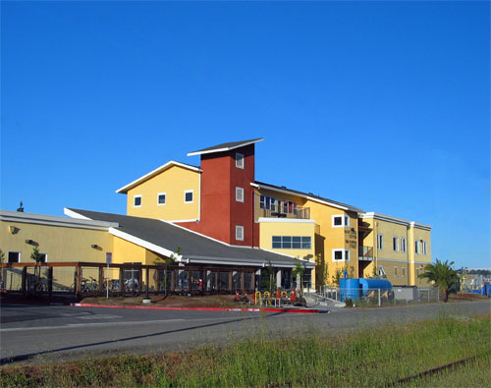
THE MARY ISAAC CENTER
Located at 900 Hopper St Between the Petaluma River and Lakeville

Slide 12
WHAT THE SHELTER OFFERS
The MIC has approximately 100 beds to shelter the homeless not including smaller multi-bed rooms on upper levels of the facility that accommodate family's.
The MIC provides lunch to anyone regardless if you’re a resident of the facility or not.
They provide access to the internet and assistance with resumes and job applications.
The MIC offers other things such as access to a showering and laundry facility and the use of telephones.
Cold weather Beds ( “Code Blue” seasonal)

Slide 13
The Mary Isaak Center employs one full time outreach worker who commonly teams up with the PPD HOST Officers to contact homeless individuals on the streets and in encampments throughout town. The main goal is to offer services and alternatives to living on the streets including treatment for addiction and mental illness.

Slide 14
WHY HOMELESS CHOOSE ILLEGAL CAMPING OVER THE MIC
The MIC on average has a wait list usually 2 weeks to a month long requiring applicants to call and check in for a spot every morning until they are accepted.
The MIC runs warrant checks on applicants and those with outstanding warrants are denied until they are cleared.
The MIC has rules of conduct including a curfew that some homeless refuse to abide by.
Some homeless choose to live alone rather than in a crowded facility.
An abundance of homeless have dogs they are unwilling to part with and the shelter can only take service animals /3 at a time.

Slide 15
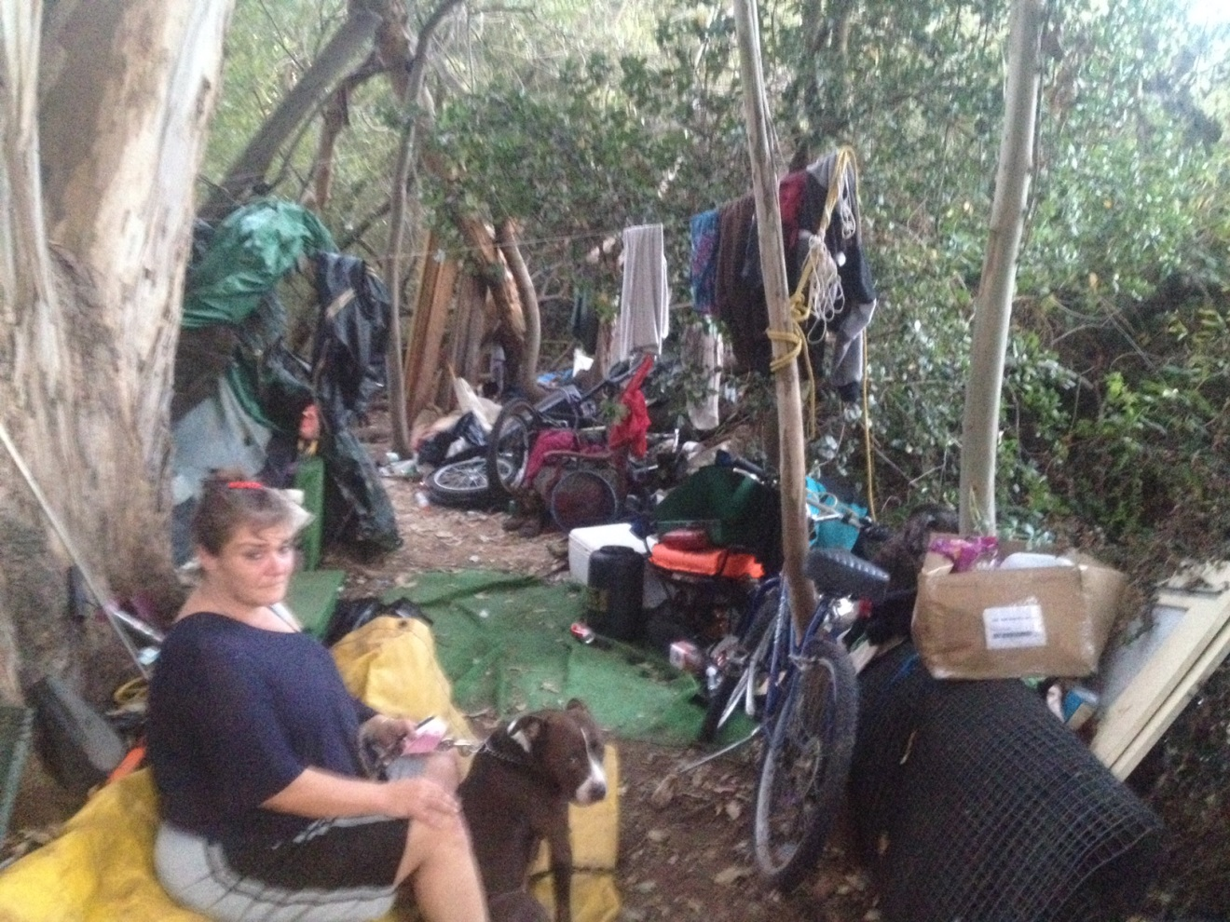
CAMPING IN PETALUMA
What happens when camping becomes the reality for Petaluma’s homeless and travelers

Slide 16
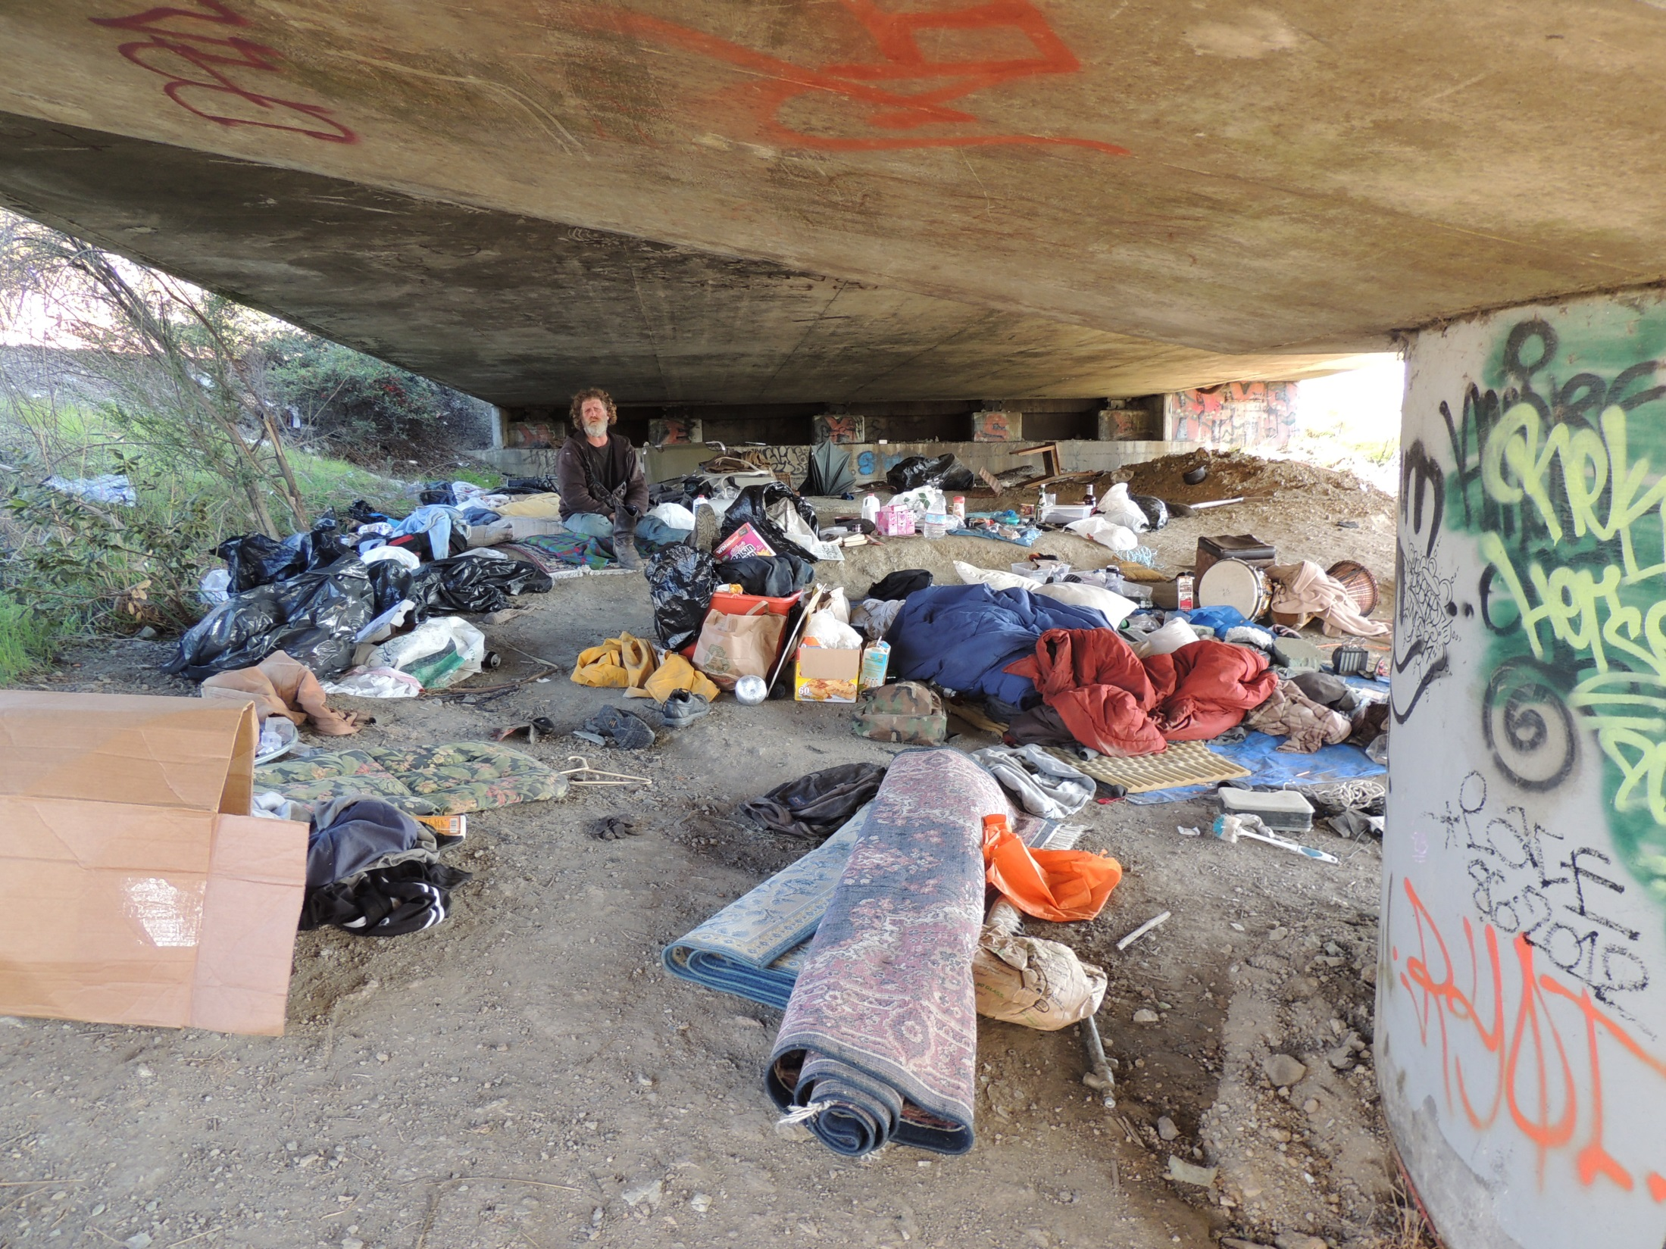

Slide 17
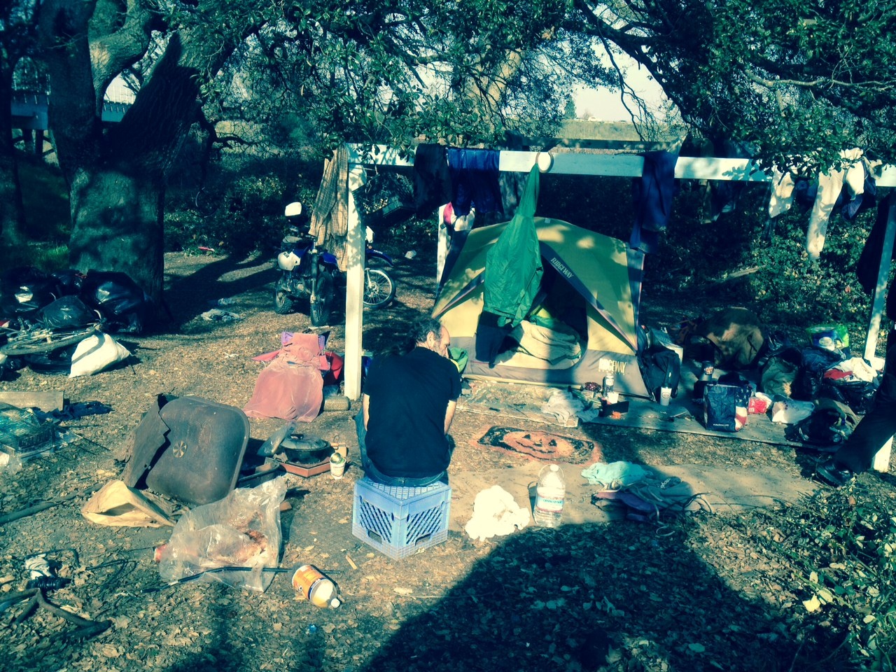

Slide 18
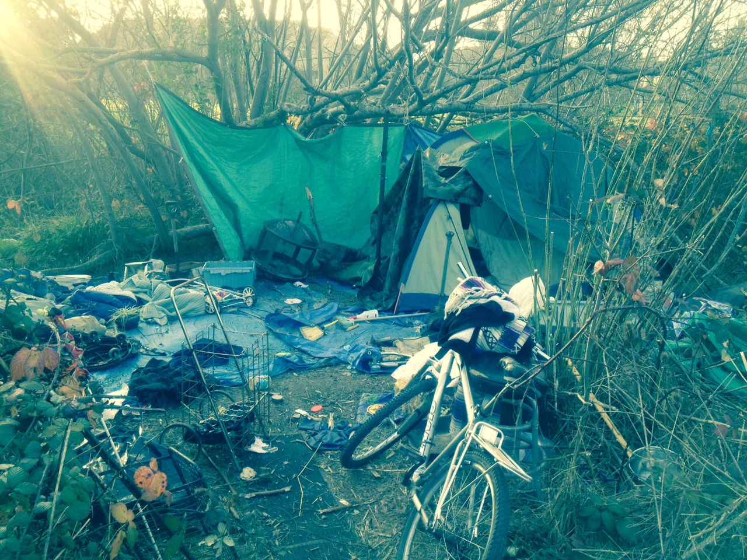

Slide 19
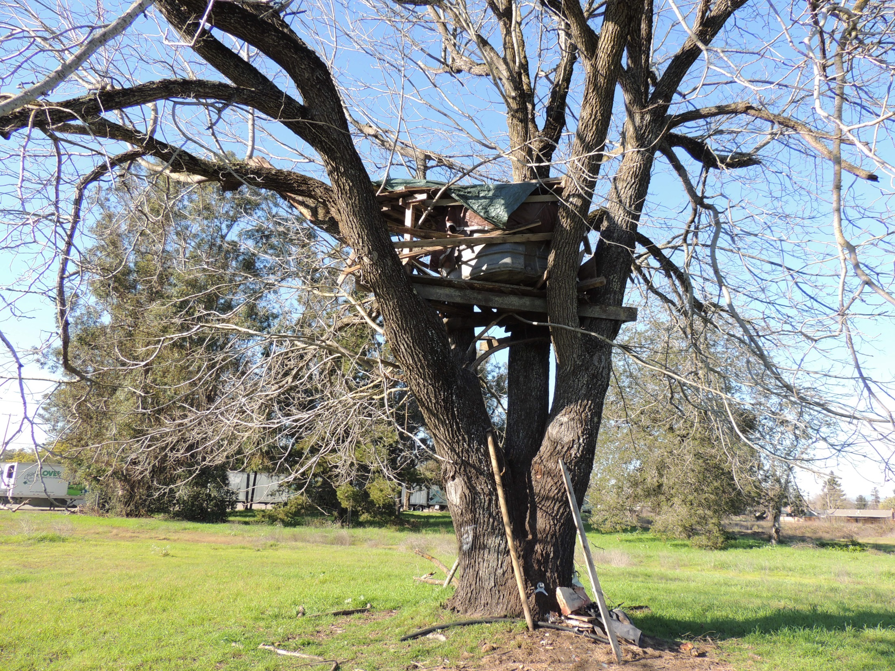

Slide 20
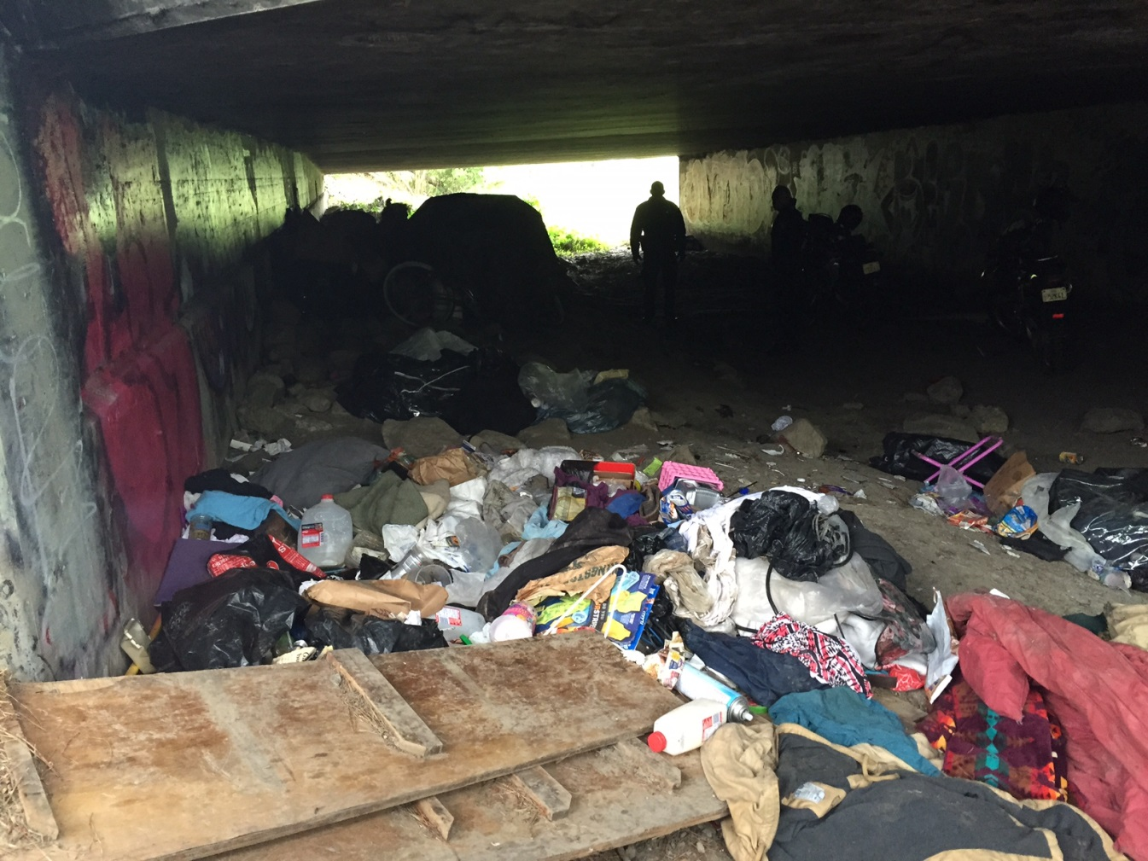
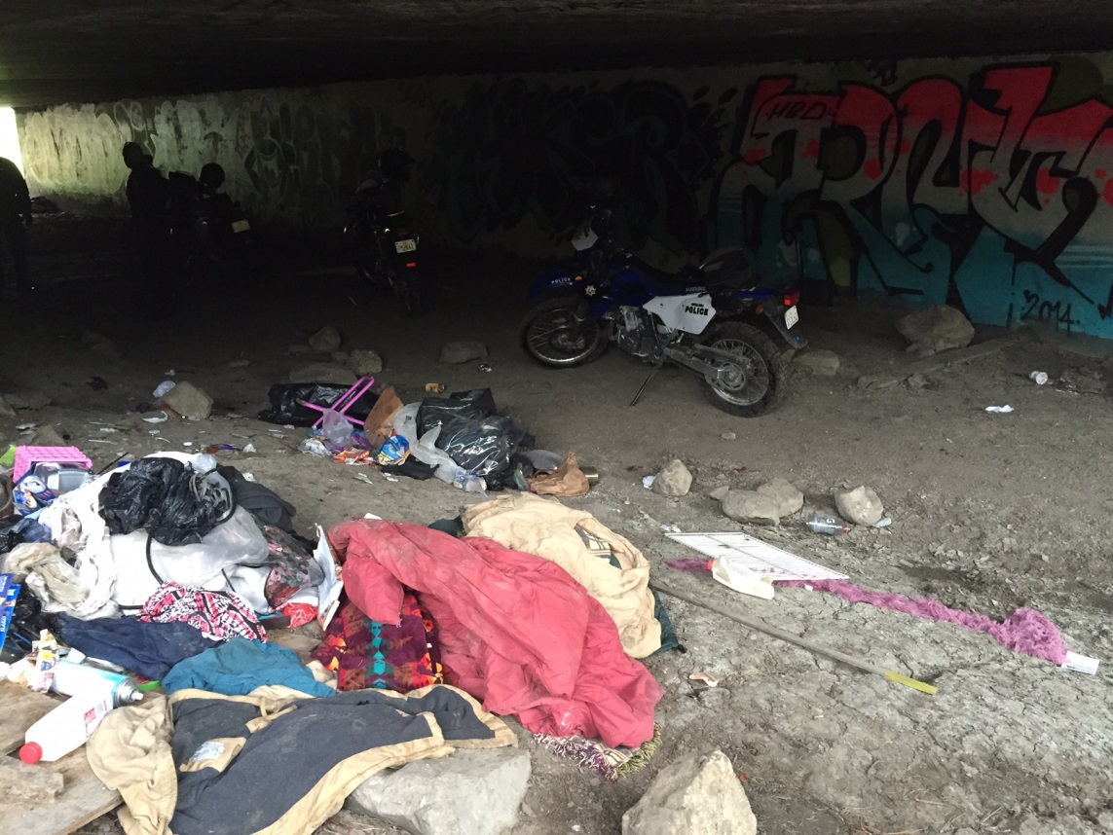

Slide 21
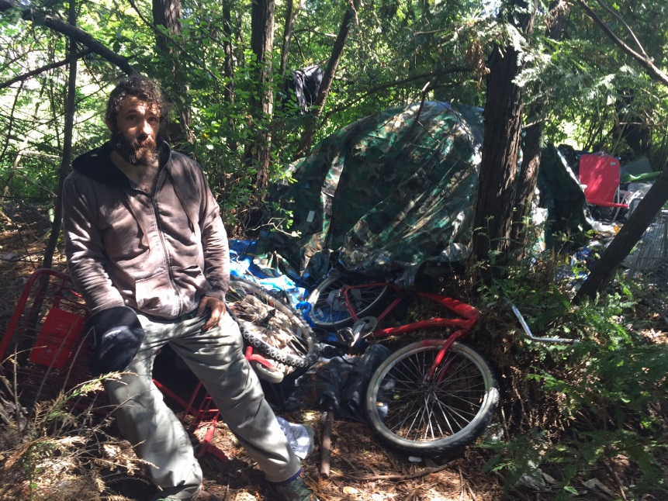
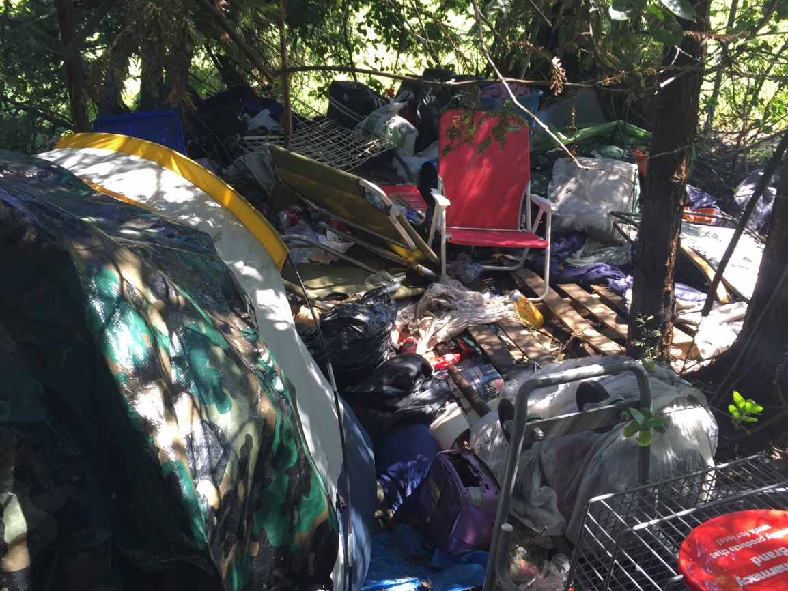

Slide 22
SCHOLLENBERGER PARK CLEANUP EFFORT
In March of 2015 – Approximately fifty workers including volunteers from the Mary Isaak Center shelter, various volunteer groups and supervised adult probationers gathered in Schollenberger Park to dismantle and remove a multi-level/ multi bedroom homeless encampment dug into the ground of the wildlife sanctuary of Alman Marsh. The removal took workers from 8AM to 3PM.

Slide 23
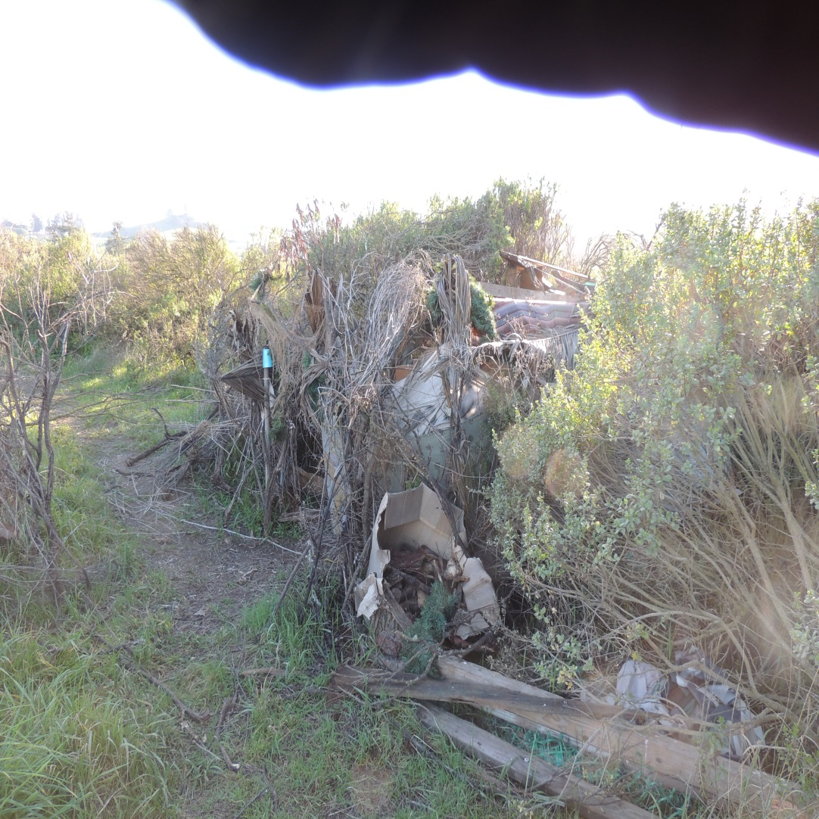
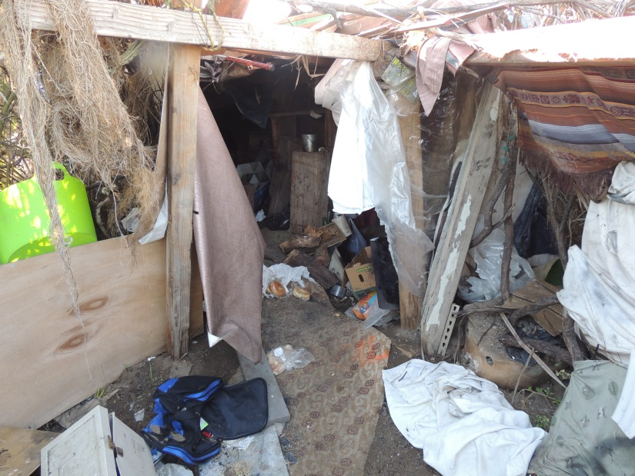
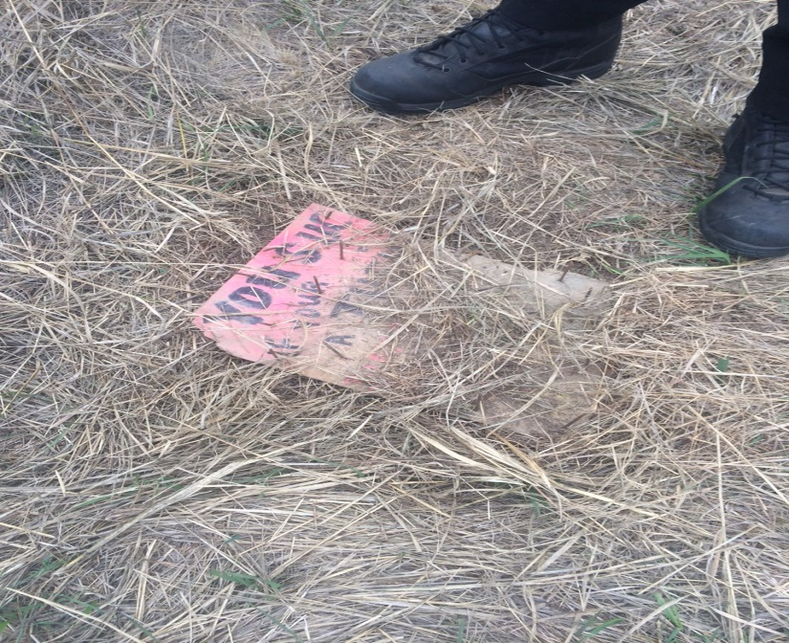

Slide 24
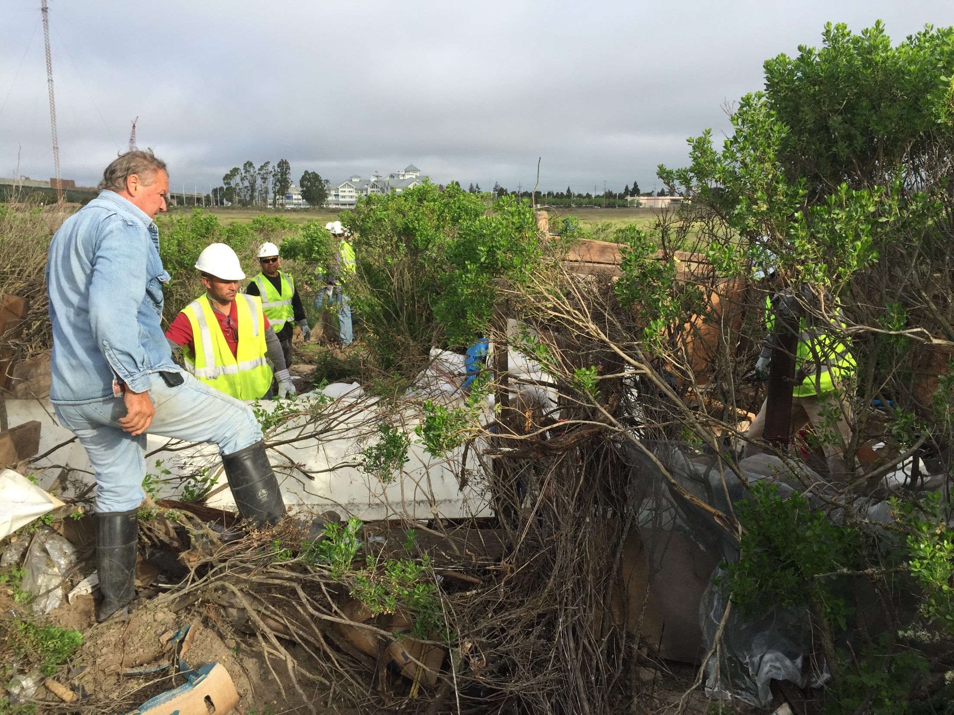

Slide 25
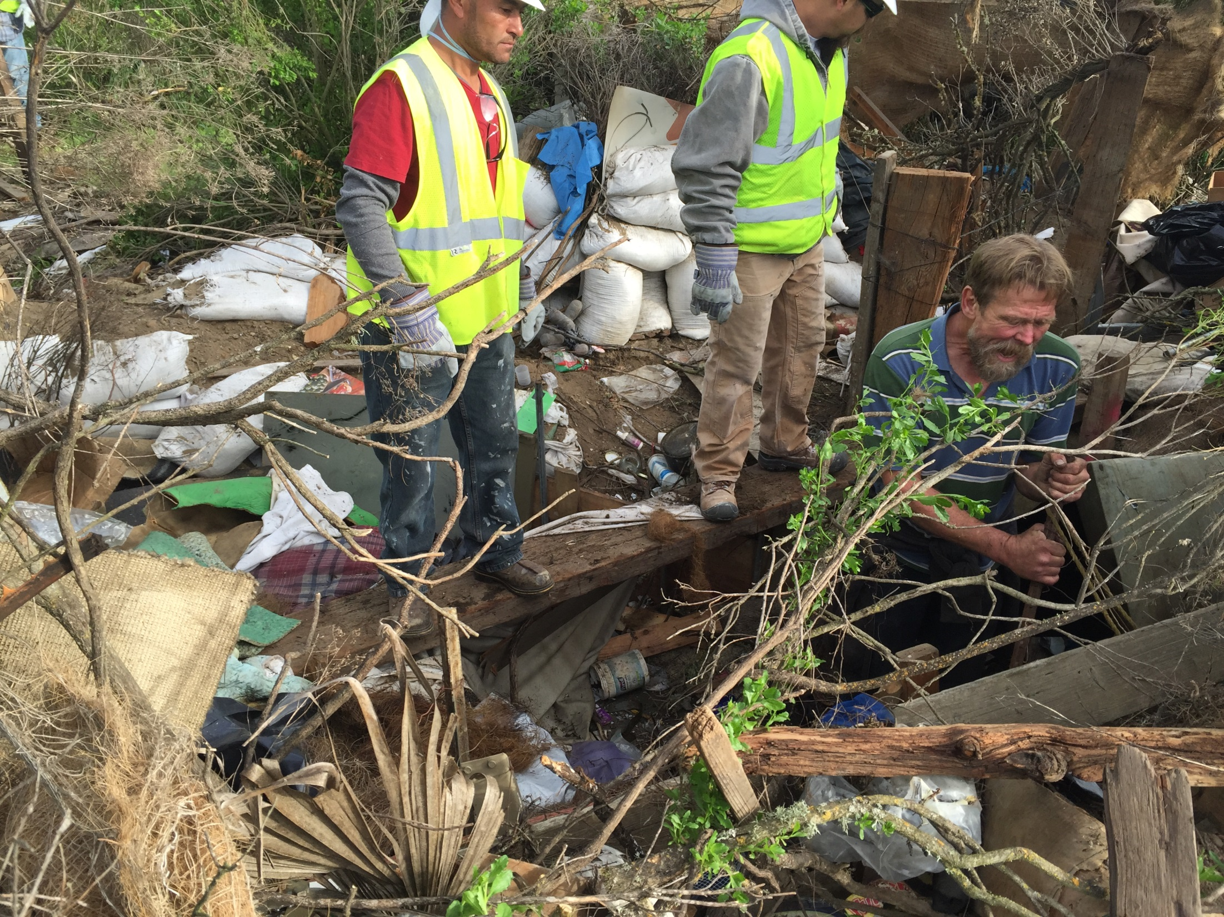

Slide 26
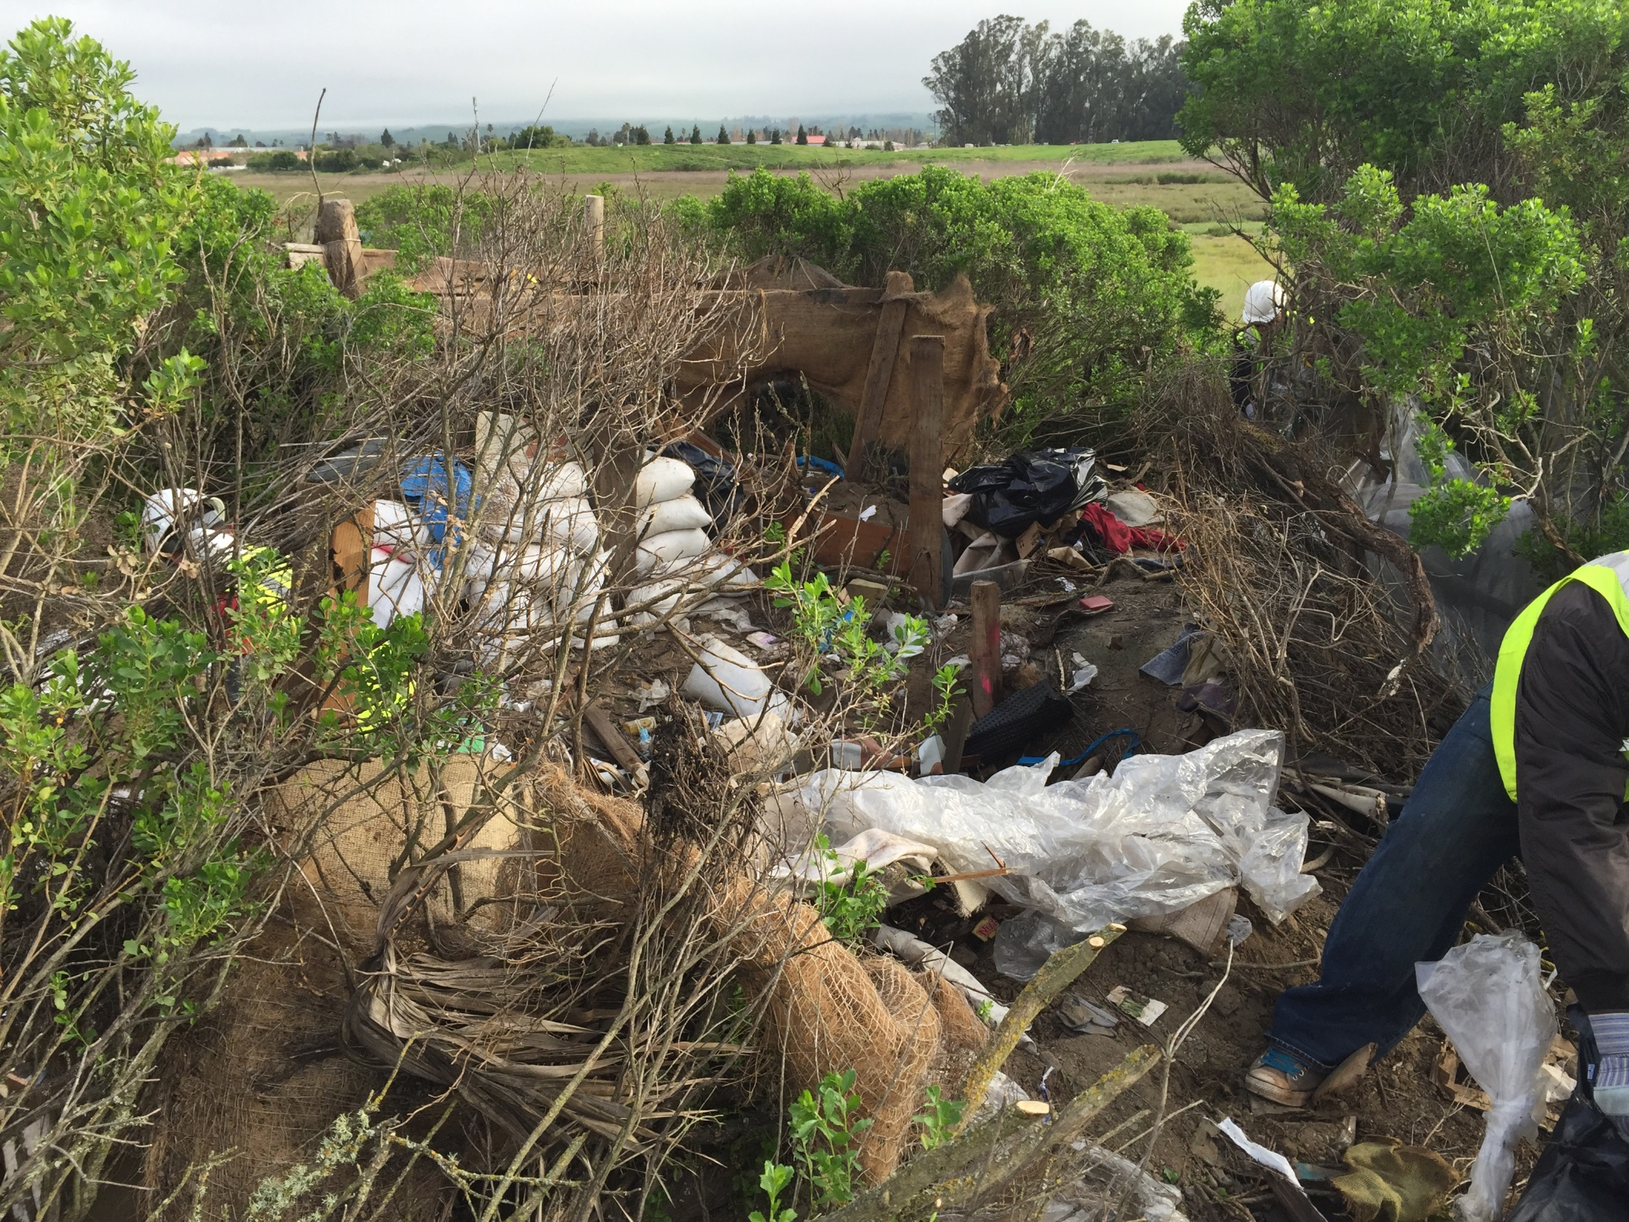

Slide 27
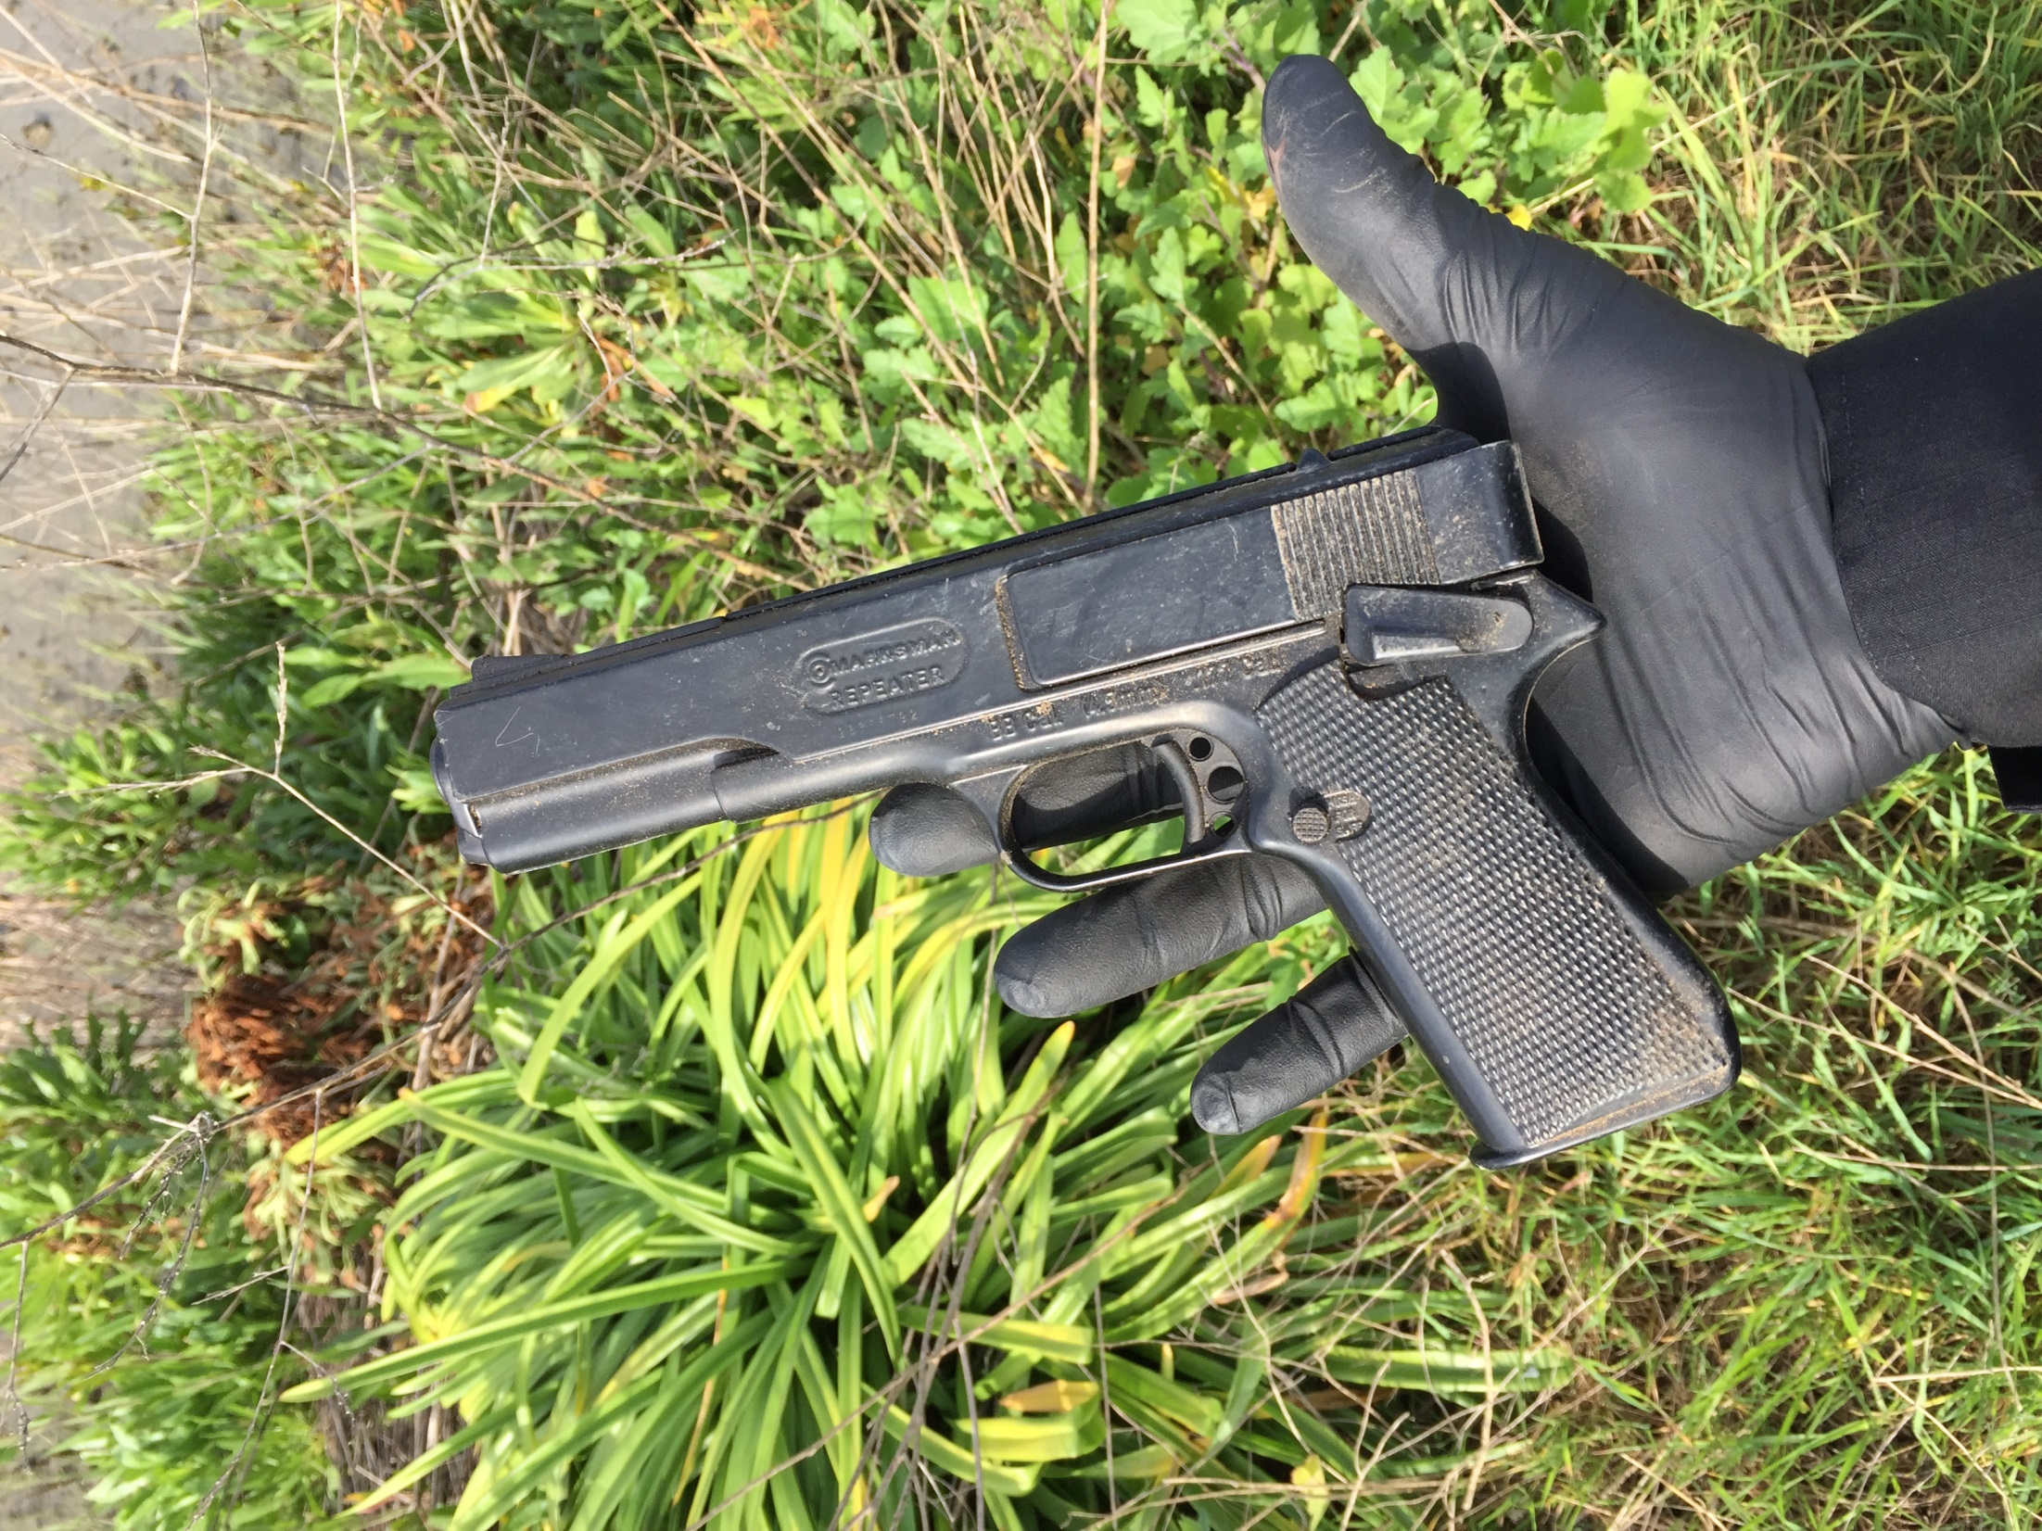

Slide 28
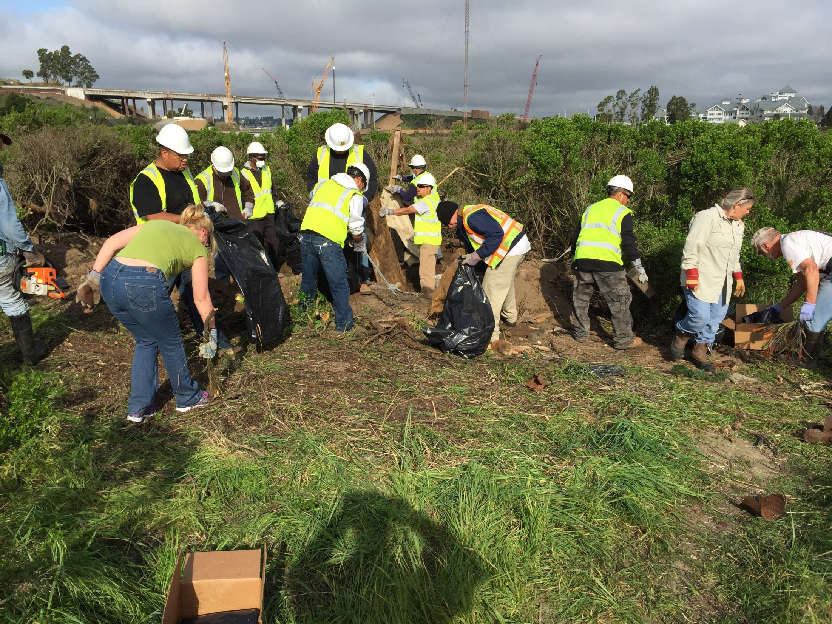

Slide 29
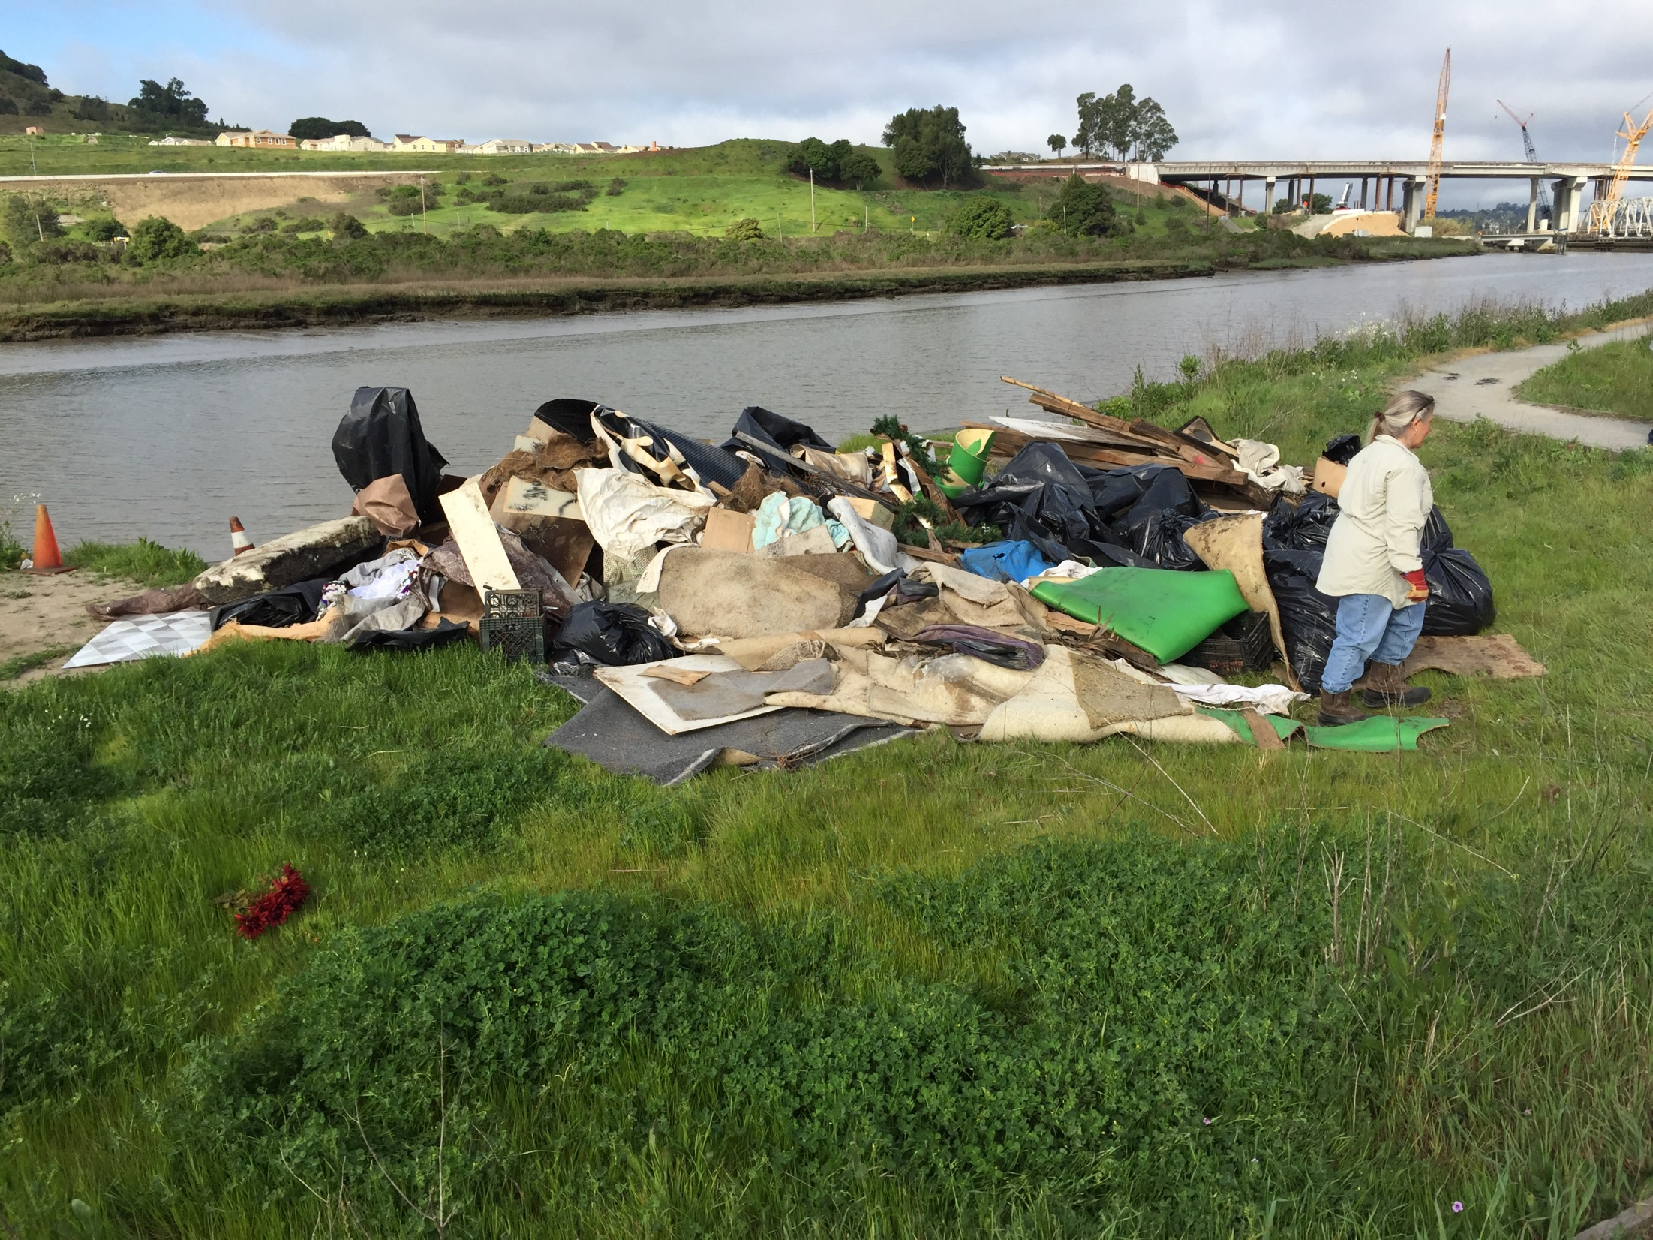

Slide 30
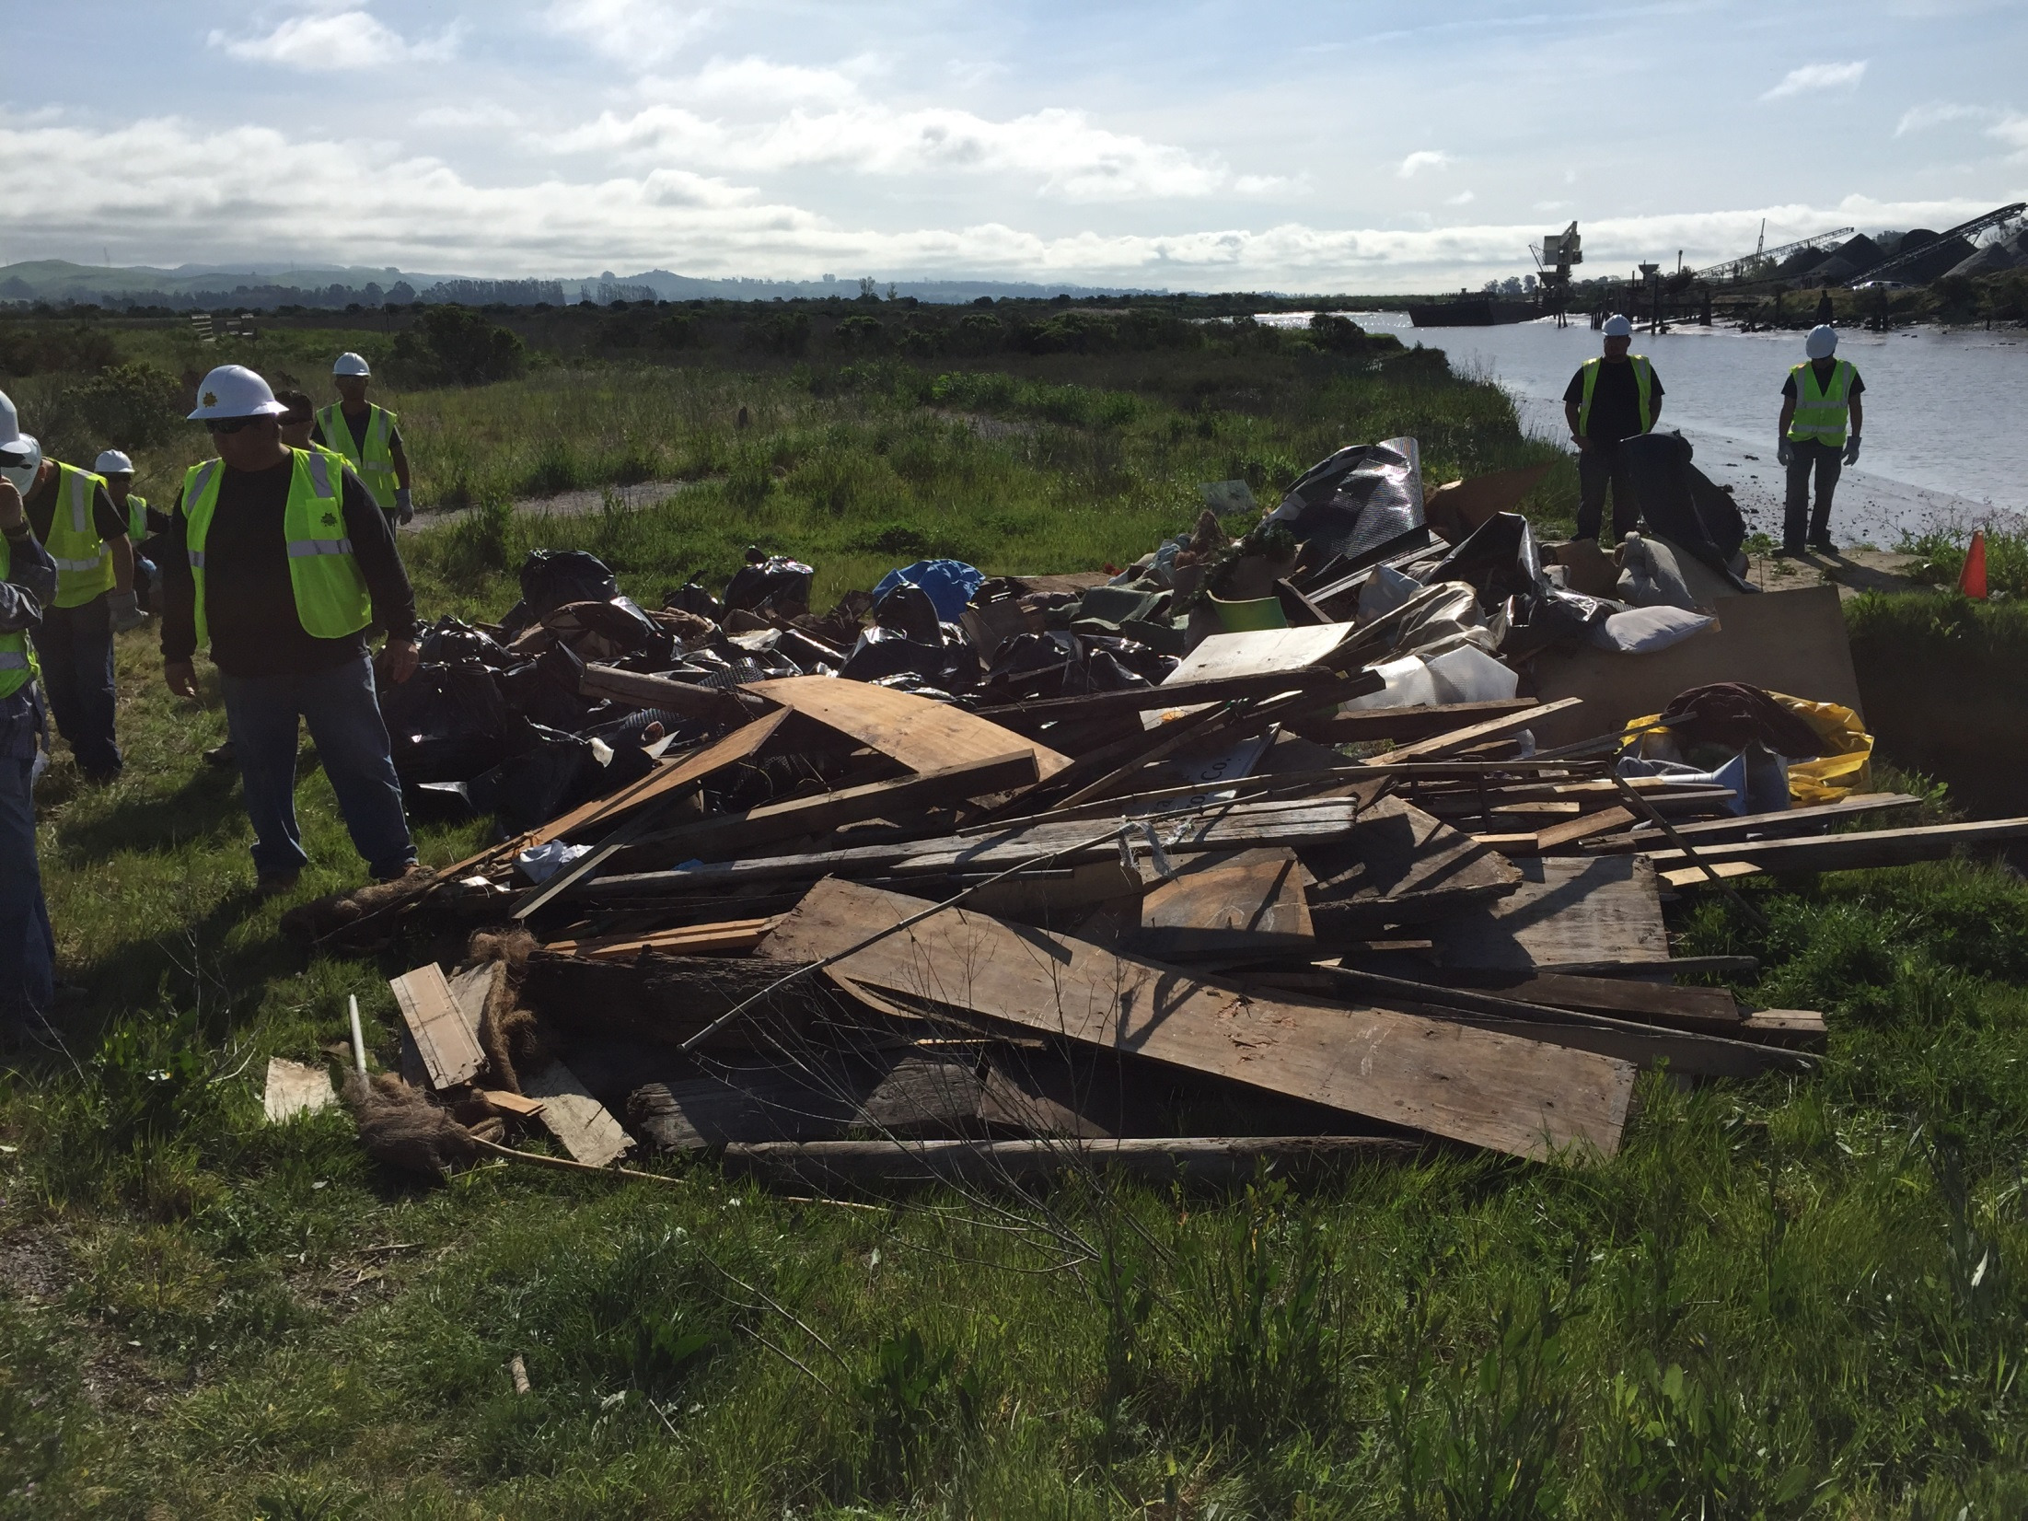

Slide 31
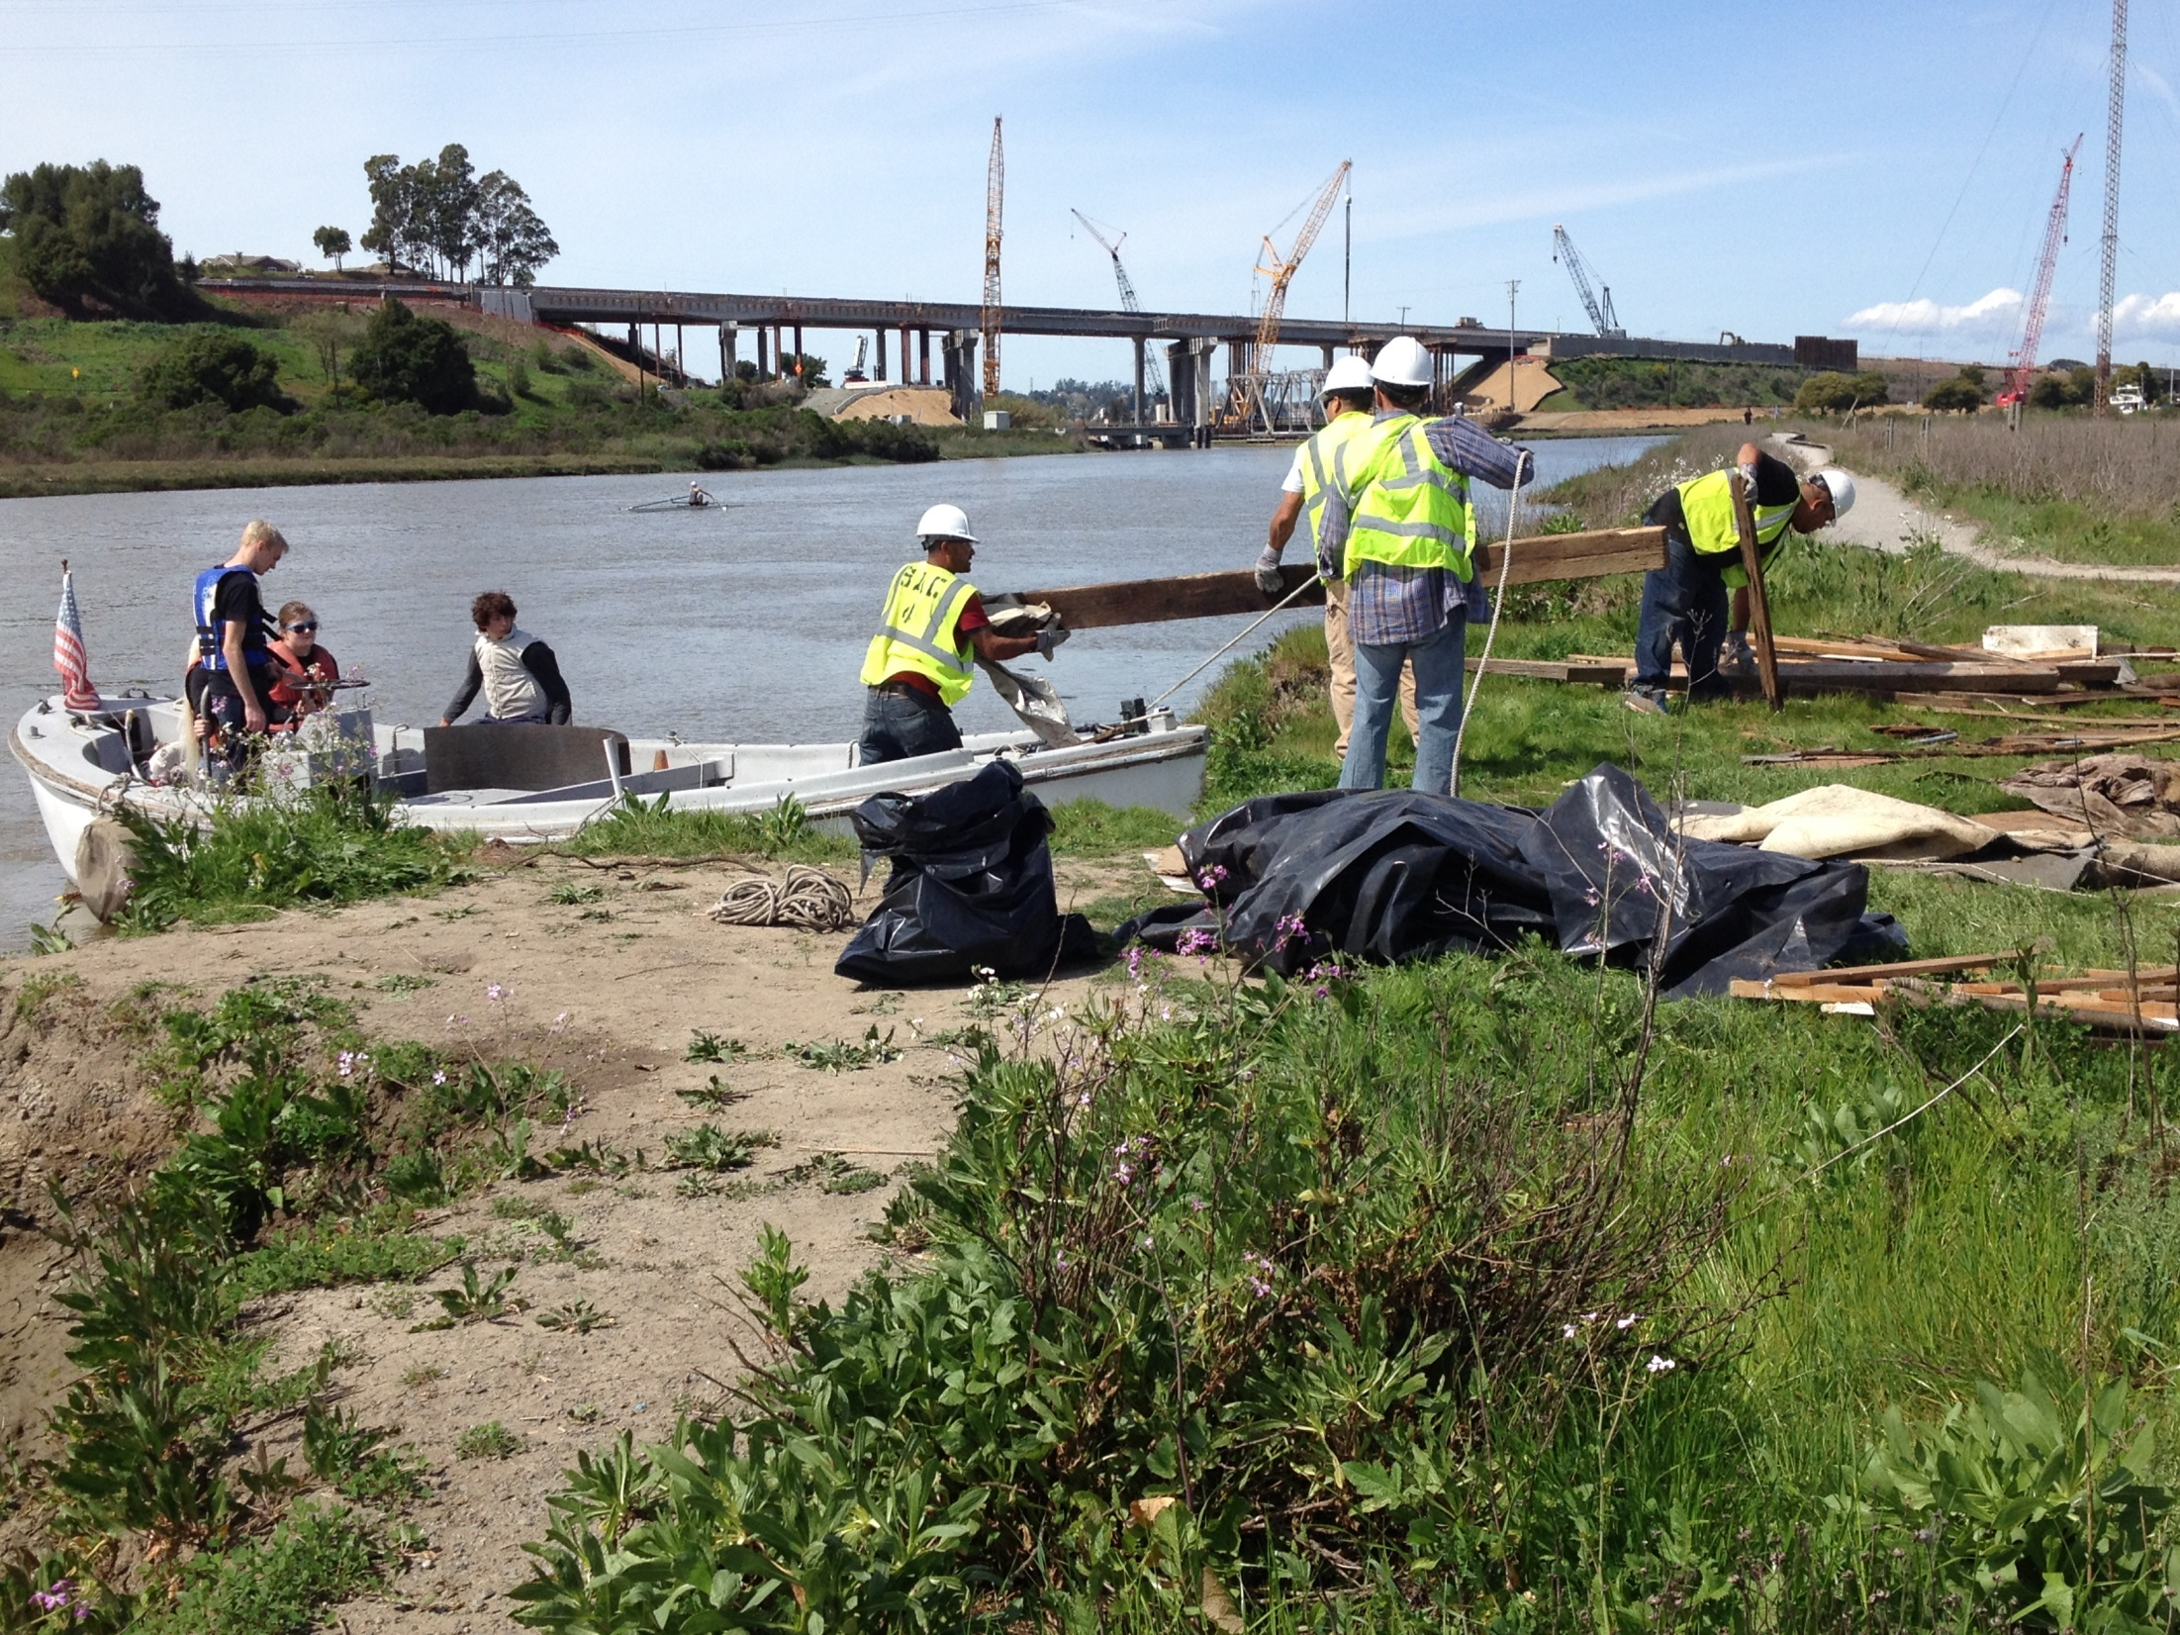

Slide 32
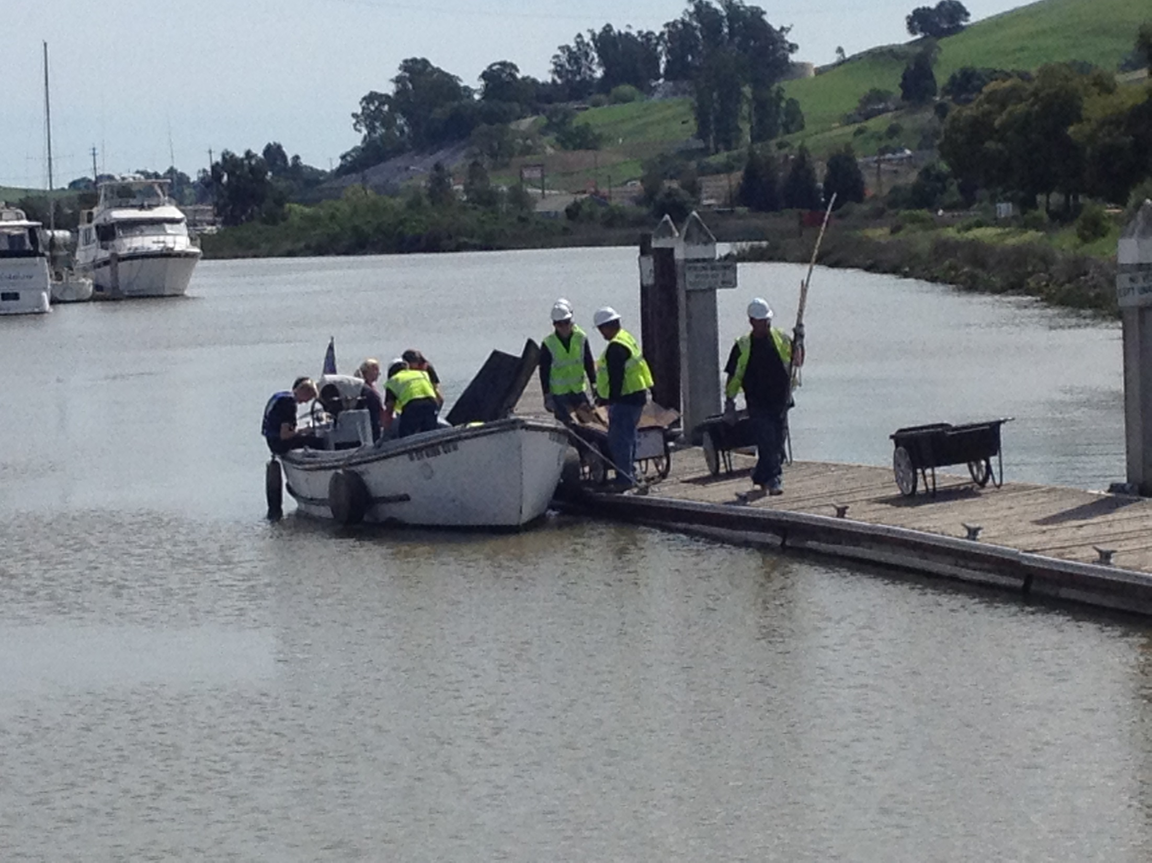

Slide 33
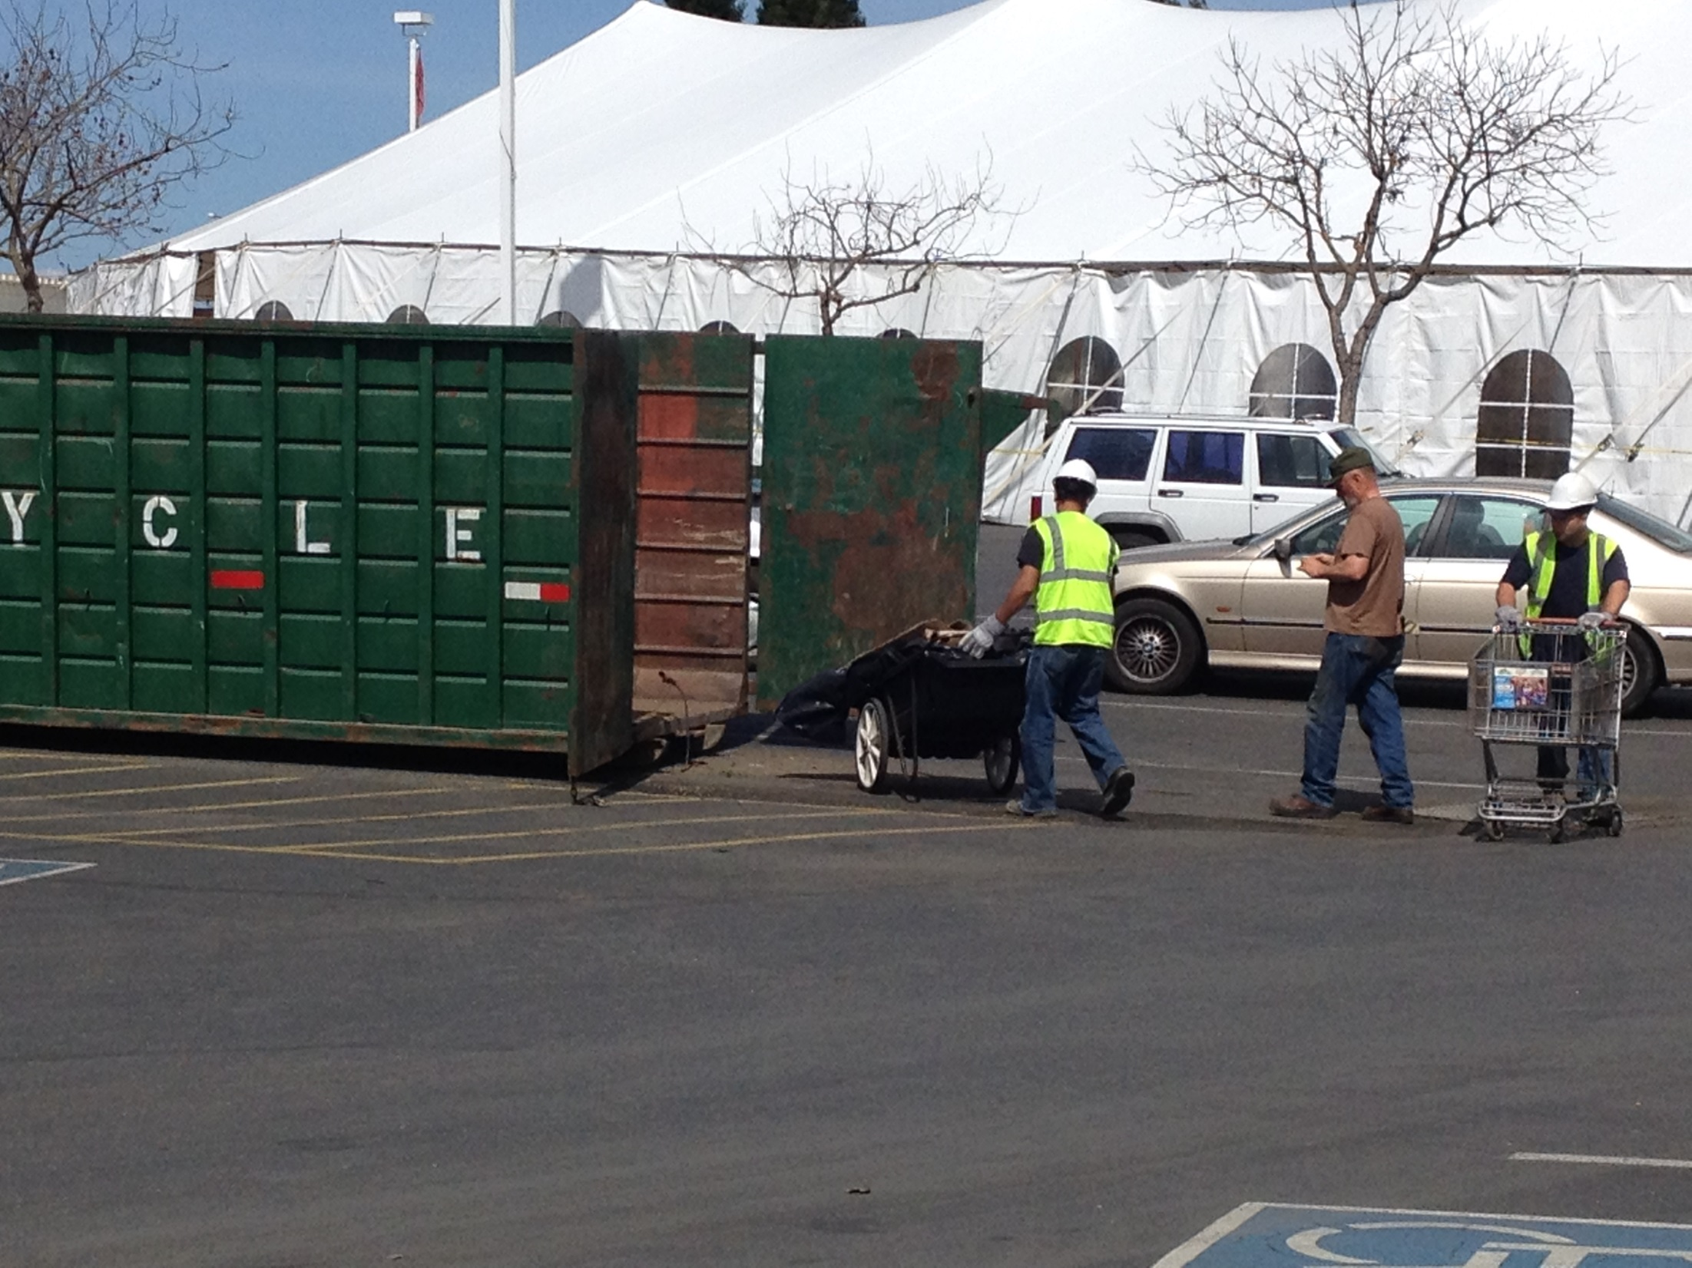

Slide 34
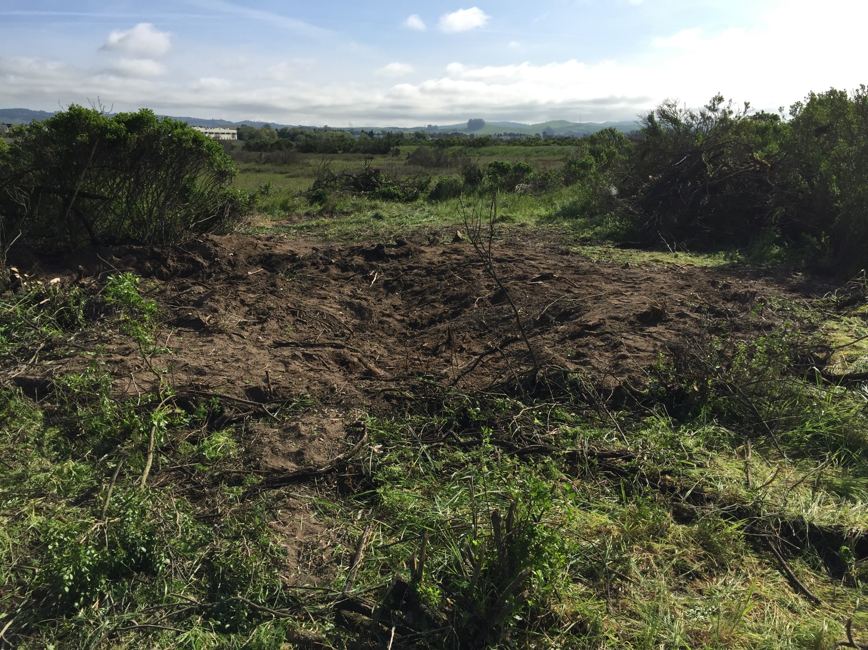

Slide 35
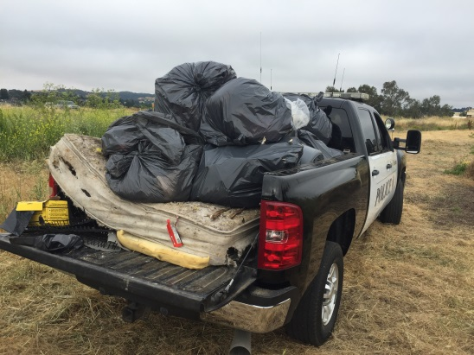

Slide 36
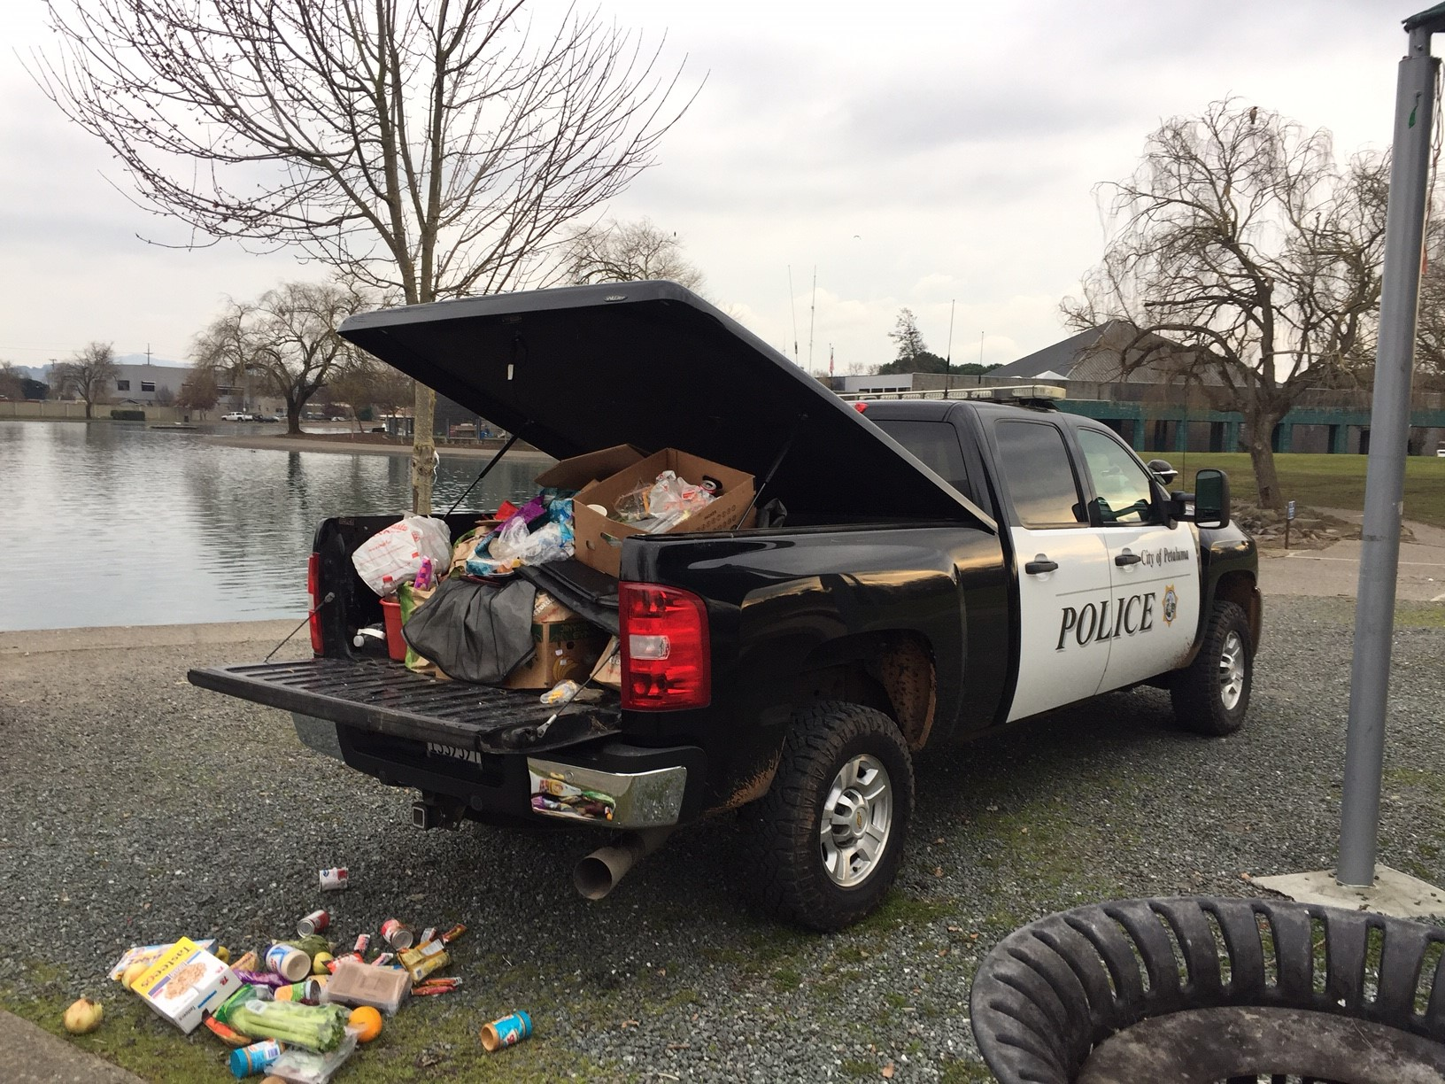

Slide 37
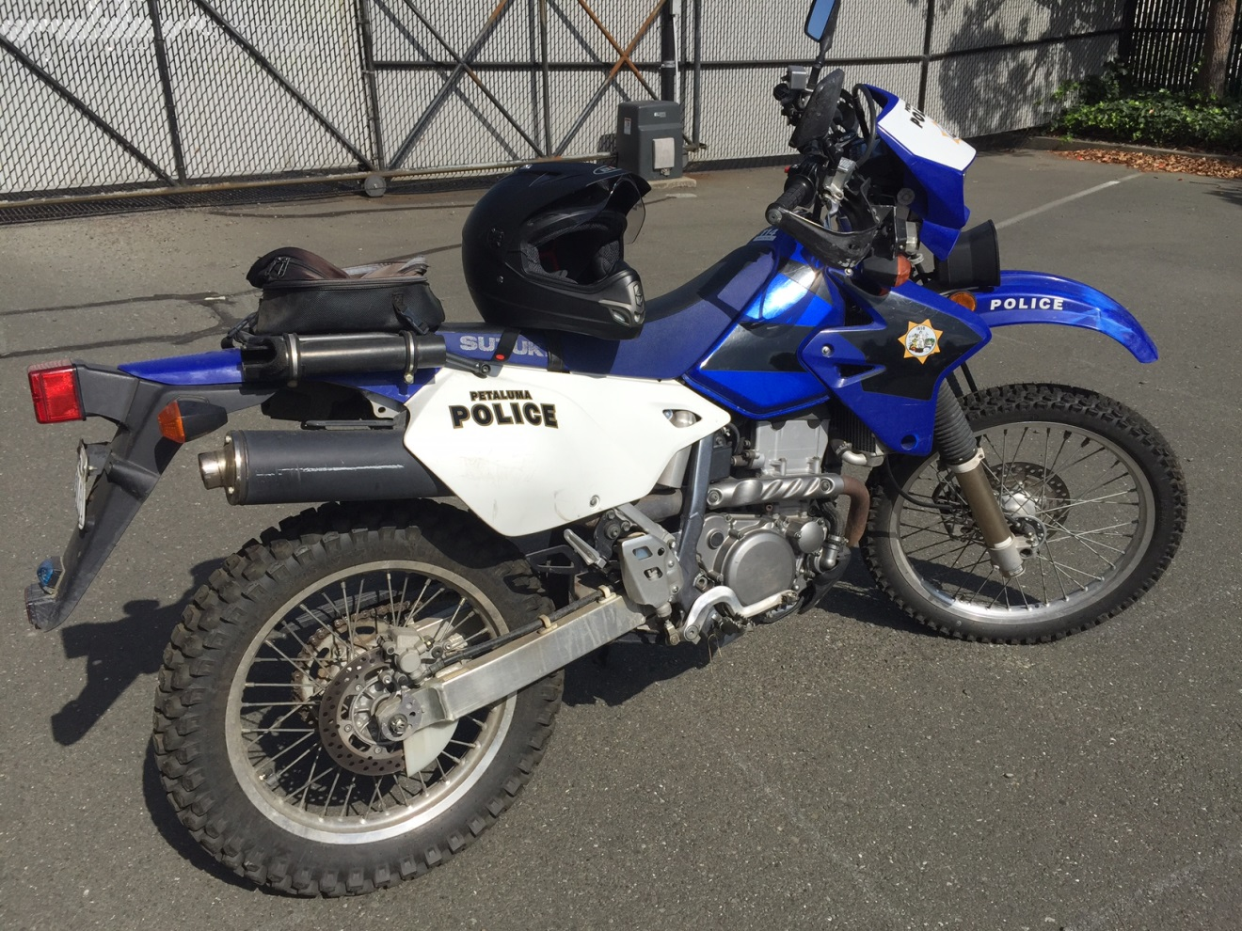
ENCAMPMENT CONTACTS AND ENFORCEMENT

Slide 38
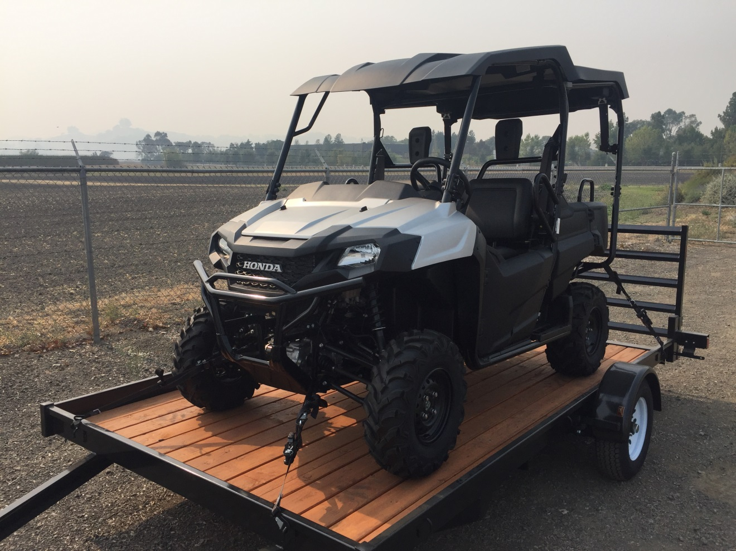
2017 Honda Pioneer 700

Slide 39
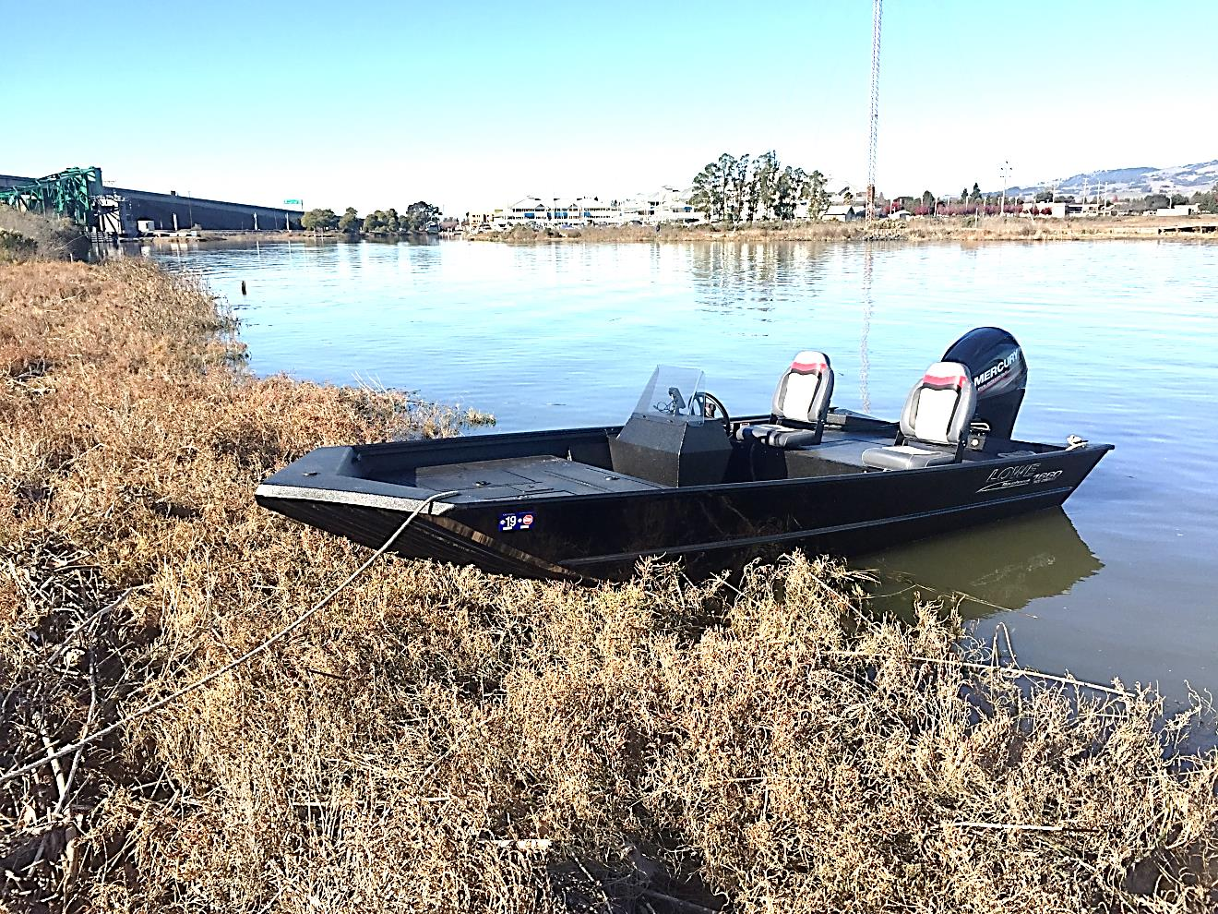
2017 Lowe 1650 SC

Slide 40
DP MOTORCYCLES/ UTILITY TASK VEHICLE (UTV) AND BOAT
PPD’s HOST Team utilizes Dual Purpose motorcycles, a UTV and the newly acquired HOST boat to handle a portion of camp contacts, cleanups and enforcement in the following ways:
Every new camp gets posted with a 72 hour notice to vacate.
Every new face receives a warning and they are informed of what is allowed and not allowed in Petaluma.
A Field Interview Card is completed with subjects information for our local database (Most new faces have no local record of contact)
Information on the Mary Isaak Center is provided as well as the latest pocket reference guide of all Sonoma County services available to assist the homeless.
Emergency blankets are provided if needed.
Citations issued and Arrests are made if necessary.

Slide 41
WHAT PPD IS ARRESTING AND CITING FOR
647(e) PC Lodge in any building, structure, vehicle or place, public or private without permission of the owner or person in possession or control of it.
22435.2 (a) BP Remove any shopping cart from property of retail premises or parking area.
5652 (a) FG Litter within 150’ of any state waters (any waterway).
21954 (a) VC Pedestrian in the roadway not in crosswalk. (Example: panhandling on a center island)
22520.5 (a)(1),(2),(3) VC Freeway vending permit required to sell, display, offer or solicit. Includes any off ramp, sidewalk or shoulder within 500’ of a freeway. (Example Washington off ramp from 101SB panhandlers)
117555 HS Anyone who places, deposits, or dumps sewage, sludge, septic tank effluent, accumulation of human excrement, or solid waste, in or upon a street, alley, public highway, or road in common use or upon a public park or other public property
8.12.010 PMC Littering
8.16.340 PMC Dumpster diving
8.24.040 PMC No Smoking Ordinances
9.16.010 PMC Dog license required (A portion of our travelling transients have dogs)
10.16.020(a)&(b) PMC Urinating in public or exposing oneself to do so.
10.20.010 PMC Consume alcohol in public and parks without a permit
10.24.02 PMC Standing on a street, sidewalk, or public way in a manner which interferes or
obstructs pedestrians.
10.24.040 PMC Sitting, lying or sleeping on any street, alley, sidewalk or public way.
10.24.061 PMC No sleeping in vehicles.
10.28.020 PMC No spitting on the sidewalk.

Slide 42
OTHER COMMON CRIMES COMMITED BY PETALUMA’S HOMELESS POPULATION
647(F) PC Public Intoxication
Upon contact with homeless in their camps it is common to find them severely intoxicated surrounded by alcoholic beverage cans and bottles.
488/487 PC Theft and Grand Theft
The PPD receives numerous calls daily of thefts occurring from our supermarkets and department stores. Video surveillance usually assists us in identifying repeat offenders and stolen property is often recovered from homeless encampments.
11377/11350/11364/11550 HS Possession of controlled substances, paraphernalia, being under the influence of a controlled substance
Entering and contacting subjects in these camps can be particularly dangerous due to the presence of drug paraphernalia such as used hypodermic needles and broken glass pipes.
1203.2 PC Violation of probation.
The majority of subjects we contact are currently on probation for a previous offense with terms such as “Be of Good Conduct, Obey all Laws, Submit to warrantless search and seizure and do not possess or use alcohol” among others.

Slide 43
RESULT OF ARRESTS AND CITES
Some subjects are cited with a court date to appear in court on a later date and some are transported directly to the Sonoma County Main Jail in Santa Rosa and booked.
Once the subject is arrested, usually they vacate the camp and leave the City of Petaluma with their camp to clean up. On occasion, the person is handed trash bags and given the option to bag up their own garbage in lieu of booking at CJ.

Slide 44
WHO CLEANS UP THE CAMP WHEN ITS ABANDONED
The Petaluma Police Department does not have a single “go to” clean up option for homeless camps. PPD works with collaboratively with different groups, public and private and evaluates the best method of cleanup for each site.
Private property owners such as SMART (Who’s railroad tracks run the length of the city and are a popular location to camp) and others located through information obtained in the Parcel Viewer program on the city’s website are the first resource.
Public property camps will be cleaned up by whichever agency controls the land such as the City of Petaluma (Public Works and the Water Dept), The Harbor Master’s Office, County of Sonoma, Sonoma County Water Agency or Cal Trans to name a few.
Volunteers groups such as Santa Rosa Catholic Charities, Friends of the Petaluma River, The Petaluma Wetlands Alliance, The Sea Scouts and volunteers from the Mary Isaac Center often assist when called upon when all other options are exhausted.

Slide 45
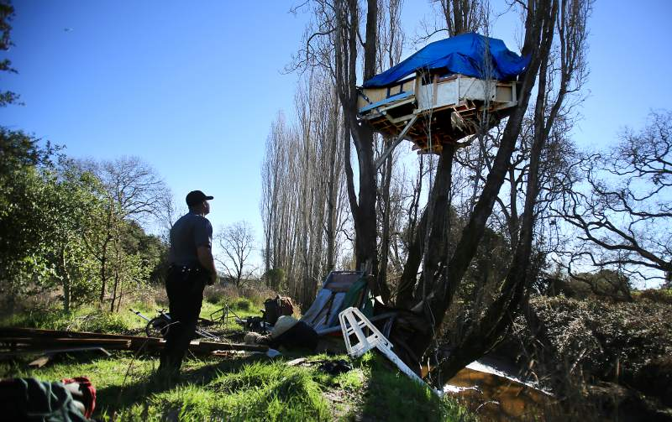

Slide 46
Tree House Removal
Resources Required for the 8 hour operation
3 Petaluma Police Officers and 1 Sergeant
15 volunteers from the Mary Isaac Center and Santa Rosa Catholic Charities
1 Fish and Game Warden
2 Homeless Outreach workers
1 Factory Outlets Maintenance Supervisor
2 Tree Removal Specialists with heavy equipment
2 Forty yard debris boxes (overflowing) delivered and picked up by Petaluma Refuse and Recycling
3 Weeks of planning and coordination
Total cost to cut down the 3 supporting poplar trees and tree house and haul the garbage waste and debris away….
4500.00$

Slide 47
THESE CAMPS CAN TAKE MONTHS TO GET CLEANED UP AND OFTEN GET WASHED INTO THE PETALUMA RIVER BY RAIN. SOME CAMPS REMAIN YEARS LATER DUE TO INACCESSIBILITY TO CLEANUP CREWS AND EQUIPMENT.
For every camp we clean up it is common for a new one to be created elsewhere

Slide 48
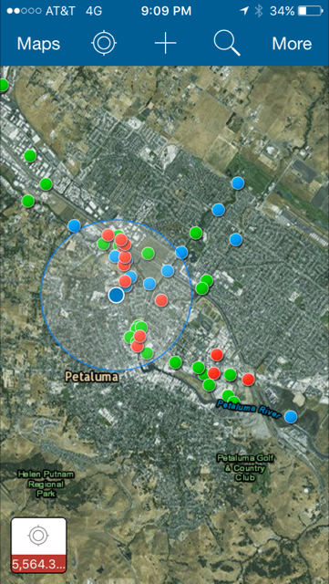
ARC GIS
GPS BASED SMARTPHONE APP

Slide 49
The Petaluma Police Department has been overwhelmed with Homeless related calls for service. Research over the last few years has shown homeless related calls for service can account for 30-40% of the total call volume. Homelessness has been identified time and time again by Petaluma Citizens at town hall meetings as a top issue requiring immediate attention.

Slide 50
Homeless Outreach Services Team (HOST)
Funding for one full time officer was found within the departments budget by redefining another positions duties and goals. This officer began addressing the city’s homeless problem full time in 1/2016.
PPD was awarded a grant for $500k by Cal-Recycle to fund a second officer also in 1/2016. The position was filled by Officer Zilverio “Zeus” Rivera the following July

Slide 51
PPD HOST Team
Stats 1/16 to 9/18
ABATEMENTS: 377
TOTAL CUBIC YARDAGE OF WASTE ABATED: 1323
HOST RESPONSES TO CAMPS/ TRESPASSING (POST 72 HOUR NOTICE) 2838
MEETINGS ATTENDED: 916
ARRESTS: 311
CITATIONS: 51
FIELD CONTACTS: 40
TOTAL HOMELESS CAMP WASTE REMOVED IN TONS…………………..

Slide 52
165.4
TONS

Slide 53


