Slide 1
P2 Reports
The LIFE-HACKS
Edition V1.0
Debbie Phan
Notes:
Last year, I just gave a quick speal on what I wanted to include in the P2 reports, so I thought that I’d up my game this year and create a PowerPoint for everyone. I’m calling this one (click) “The life-hacks edition”

Slide 2
General Program Reporting
A+
Brief Description of the treatment plant/ processes and service area
Discussion of the current pollutants of concern
Identification of sources for the pollutants of concern
Identification of tasks to reduce the sources of the pollutants of concerns
Outreach to employees
Continuation if public outreach program
Discussion of criteria used to measure Pollutant Minimization Program
Documentation of efforts and progress
Evaluation of Pollutant Minimization Program and task effectiveness
Identification of specific tasks and time schedule for future efforts
Notes:
Rather than explain how I want the report written, especially since the reports are due soon, I thought it’d be better to show examples of how I look at a report and things that I like to see. A lot of this is more of what is my preference. The only requirements are really need be to addressed are these 10 points. I’m going to go over each one, except for the first bullet, because lets be real (click), I think everyone gets an A+ there

Slide 3
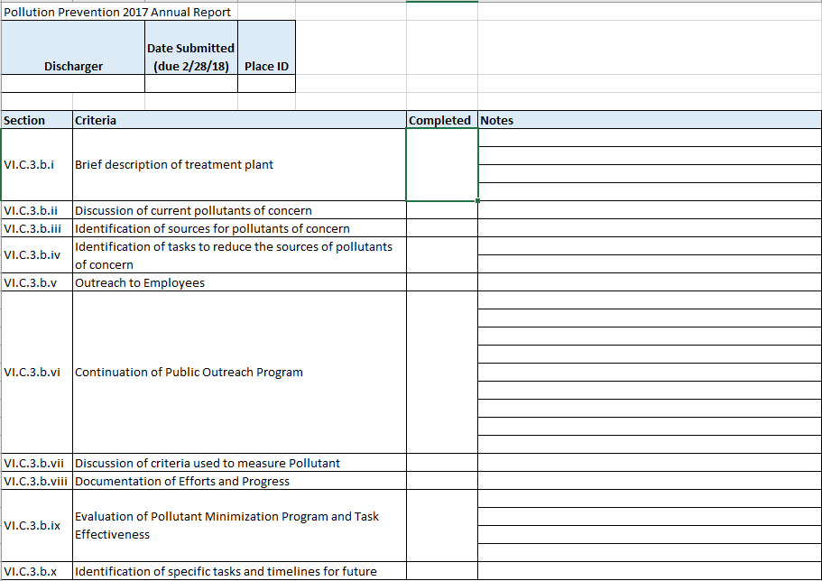

How I look at the reports
Submitted on time
Notes:
This is no secret. Basically, the way I look at a report is really simple. I have an excel sheet with all the requirements. The first thing I check (click) is that it’s submitted on time. Then, I put a (click) checkmark to what I see is include, and (click) write a quick little summary that addresses the requirement. When I finish with this checklist, (click) I start to highlight things that stood out to me such as public outreach events or pounds of hazardous waste collected, and start to compile this information in my review letter.

Slide 4
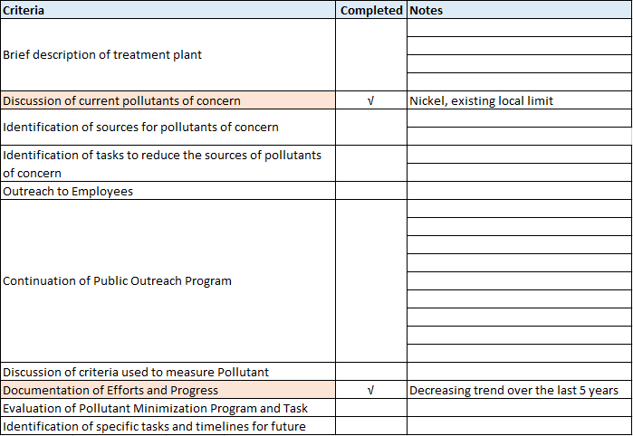
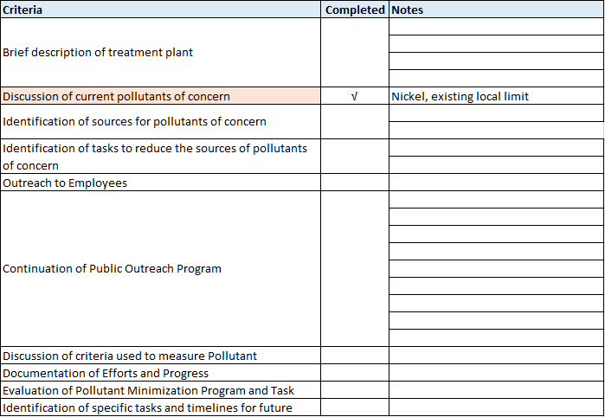
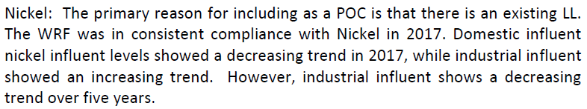
Pollutants of Concern
City of American Canyon
Notes:
A lot of the requirements are closely related when it comes to pollutants of concern. Here I have an example from American Canyon’s P2 report regarding nickle. The facility include this three sentence, “The primary reason for including as a POC is that there is an existing Local Limit” This addresses the “Discussion of current pollutants of concern. The last sentence, “Industrial influent shows a decreasing trend over 5 years” documents the efforts and progress of their P2 program. I chose this example because it’s short and straight to the point.

Slide 5

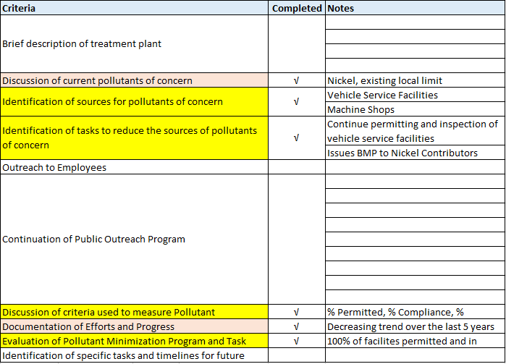
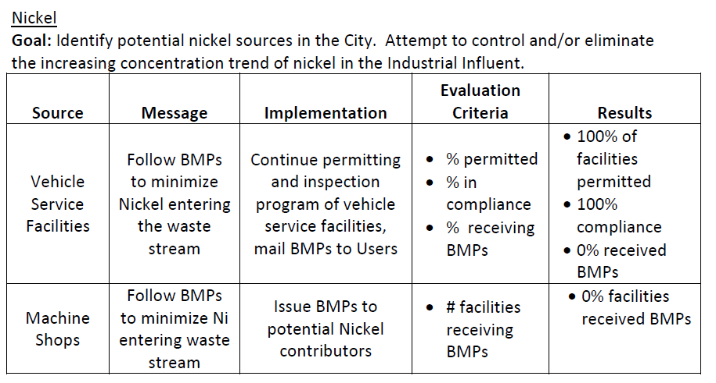
I like Tables
City of American Canyon
2017 P2 Report
Notes:
Also, (click), I like tables (click). (click)Tables are a good way to organize information. Here, the facility listed the Sources, how they plan to reduce it, the criteria's used to measure their efforts, as well as how well they did.

Slide 6
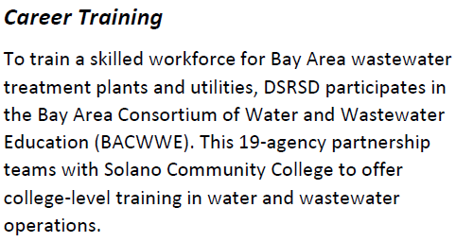
5. Outreach to Employees
Delta Diablo- newsletter, e-mail listings
Dublin San Ramon- trainings
Notes:
A few of these slides are text heavy, but I’m going to just summarize the context. This is the one I think a lot of districts struggle with is outreach to employees. A lot of this can also be incorporated with public outreach. There are a few examples of employee specific outreach that I’ve come across, such Delta Diablo as sending newsletters, Dublin San Ramon including trainings,

Slide 7
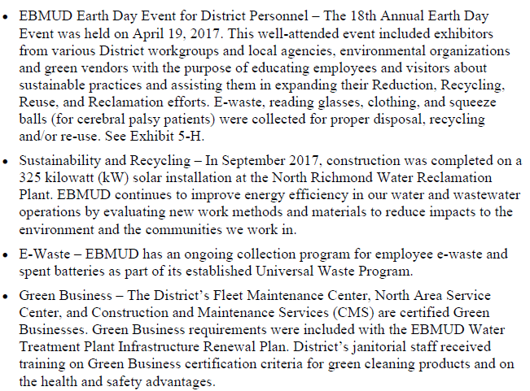
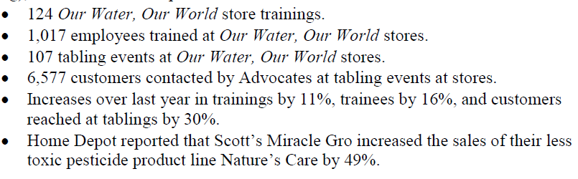
5. Outreach to Employees
EBMUD- events
City of Pacifica- OWOW
Notes:
EBMUD listing events that they’ve hosted, and City of Pacifica including their OWOW results.

Slide 8
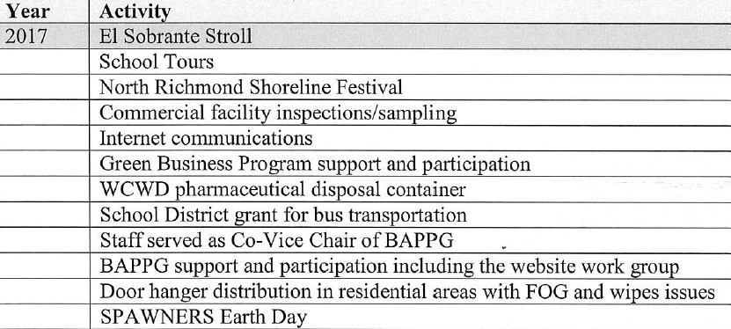
6. Continuation of Public Outreach Program
West County- listing events
Notes:
Moving on to continuation of public outreach, there so much that you can include here. In addition to liking tables, I also like lists. And here West County clearly listed what they did for their public outreach.

Slide 9
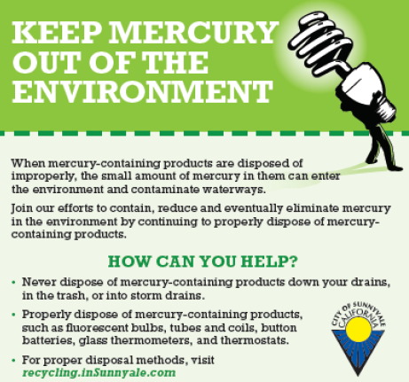

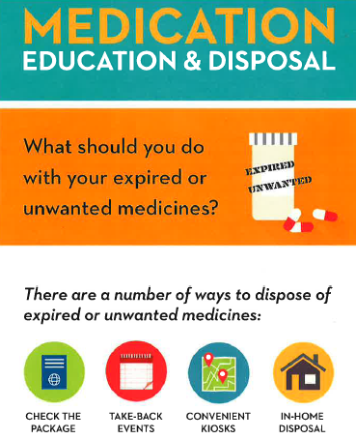

6. Continuation of Public Outreach Program (appendix references)
Palo Alto
Union Sanitary District
Mt. View Sanitary District and
Central Contra Costa Sanitary District
Sunnyvale
Notes:
Another thing you can do is incorporate graphics used in your public outreach. I thought that I’d highlight a few here, such as Union San and their pharmaceutical outreach, Mt. View and Central Contra Costa on their hazardous waste outreach, Sunnyvale and their mercury outreach, and Palo Alto with their recycled water outreach. Also, when including graphics, it’s best to attach them as an appendix.

Slide 10
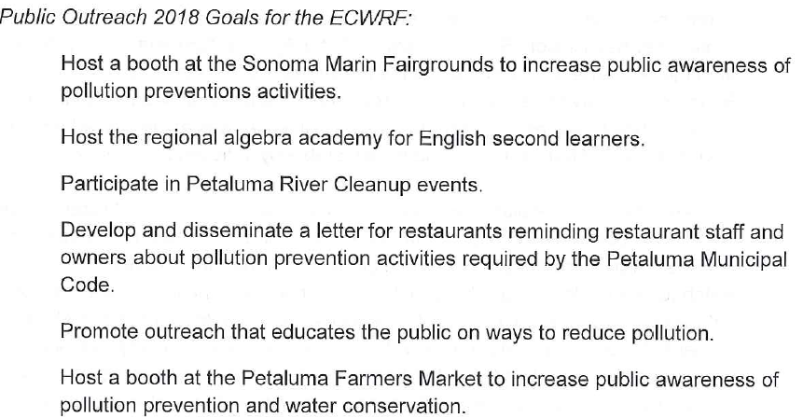
10. Identifications of specific tasks and timelines for the future
Petaluma
Notes:
For the last requirement, you can just list the events that you plan to keep on doing or new events that are in the works.

Slide 11
More P2 Life-hacks
Do not attach the BACWA annual report
  Instead, have it referenced where applicable
Include a table of contents
Include a point of contact (full name and e-mail)
Prefer reports to be < 50 pages (not including appendixes/ images)
Define acronyms and abbreviations
Saving reports from word → PDF (not scanning)
Notes:
Do not attach the BACWA annual report
Instead, have it referenced in your where applicable
Include a table of contents
Include a point of contact (full name and e-mail)
This is good to include since I do write letters in response to every P2 report that I read, and I would want you to get credit if your facility is doing a great job
Prefer reports to be < 50 pages (not including appendixes/ images)
This is not a hard rule, but I do take time to reach each P2 report and it does get a bit overwhelming when it’s more than 50 pages.
Define acronyms and abbreviations
Saving reports from word → PDF (not scanning)
This one is me just being very nit picky, but when a report is printed and rescanned, I can’t use “control + F” to find a specific section that I’m looking for. Like if I wanted to see where someone was talking about mercury previously, it’s easy for me to just quickly find the word in a document when it’s directly saved into a PDF fine.

Slide 12
Debbie.Phan@waterboards.ca.gov
Notes:
If you’re having difficulties uploading your P2 report to CIWQS, feel free to e-mail me.

