Slide 1
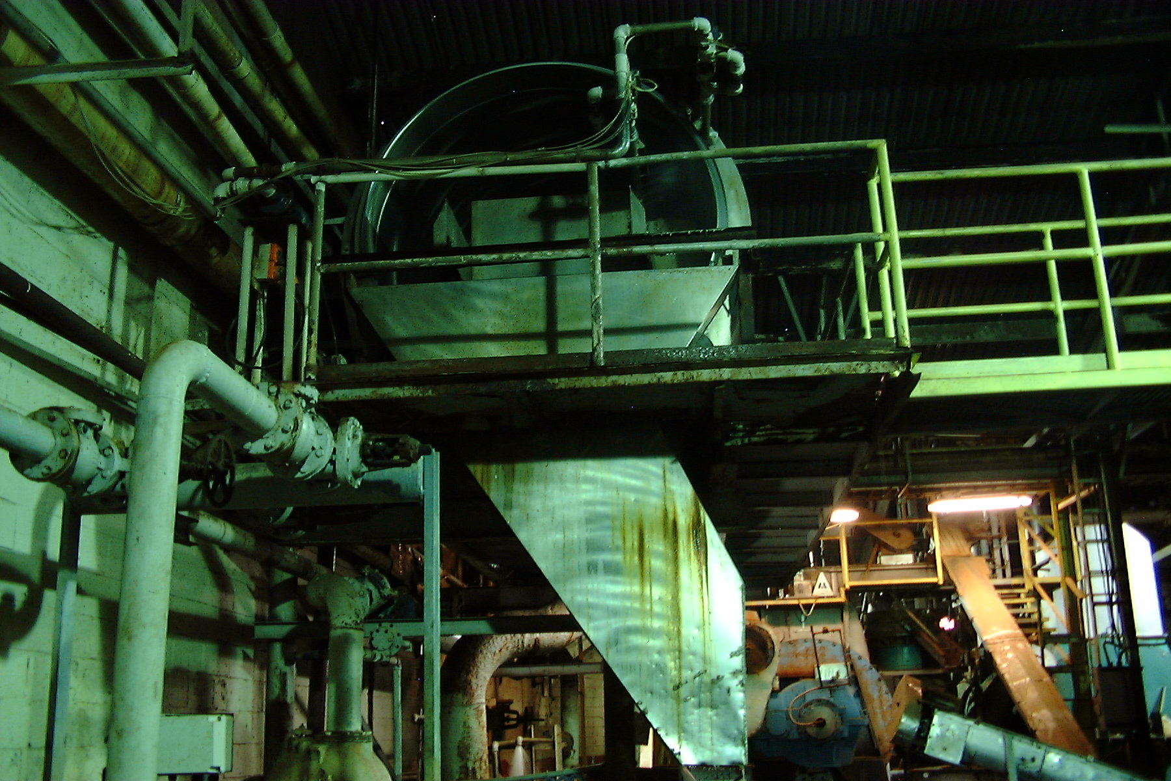
Pretreatment “Master Class” Training
BACWA/EBMUD Pretreatment Training
March 11, 2019
Greg V. Arthur - (510) 967-8411 - gva@gvaarthur.com
2015-2019 Creekside Community Church
2013-2015 Former Senior Project Engineer
EEC Environmental
1983-2013 Now Long Since Retired Environmental Engineer
Region 9, Clean Water Act Compliance Office
U.S. Environmental Protection Agency

Slide 2
Industrial User Inspections
BACWA/EBMUD Pretreatment Training
March 11, 2019
Greg V. Arthur - (510) 967-8411 - gva@gvarthur.com

Slide 3
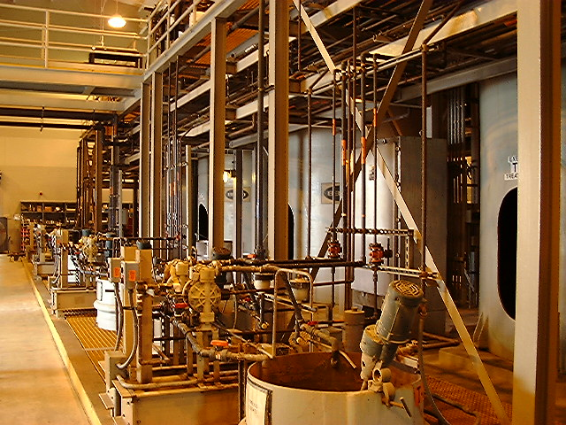
Industrial User Inspections
Key is to find the sources of variability in discharge quality
Fed Requirements
Inspection Types
Conducting the
Inspections
Documentation
Inspection Reports
Permit Fact Sheets
Finding Sources of
Variability
Representativeness
Bypass / Dilution
C
batch industrial wastewater treatment unit for oil and toxic shipyard process waters

Slide 4
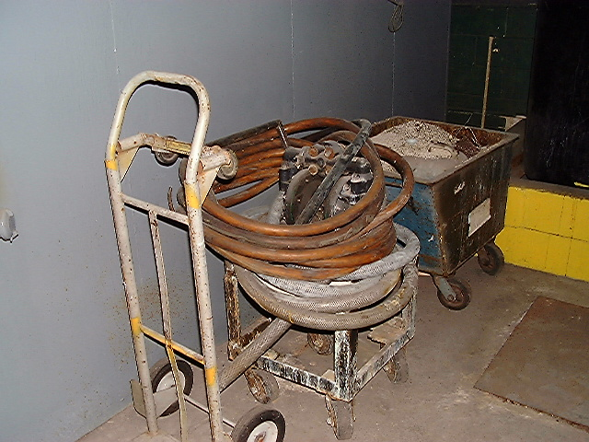
Industrial User Inspections
Key is to find the sources of variability in discharge quality
Fed Requirements
40 CFR 403.8(f)(2)(v)
POTWs must
determine compliance
independent of the
information provided
by the discharger
sampling
inspection
verification
D
portable pump with long extension hoses in an electroplating shop

Slide 5
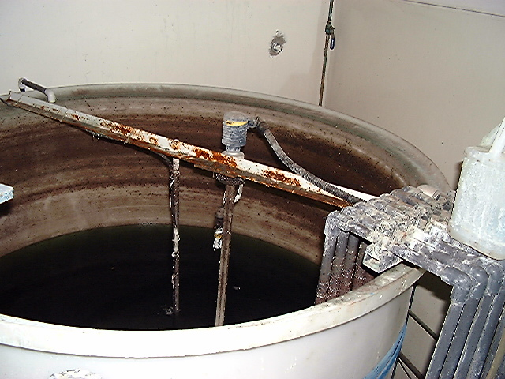
Industrial User Inspections
Key is to find the sources of the variability in discharge quality
Inspections Types
Unannounced
Announced
Sampling
Non-Sampling
Walk-Through
Comprehensive
Civil Enforcement
Criminal Investigation
C
batch industrial wastewater treatment unit for spent solutions and IX regenerant

Slide 6
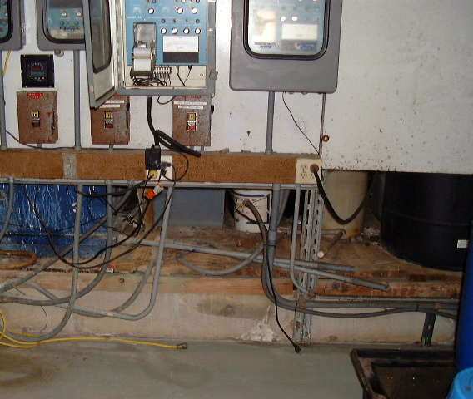
Industrial User Inspections
Key is to find the sources of the variability in discharge quality
Conducting Inspections
Step 1 - Entry
always present
credentials
always explain the
inspection purpose
always explain use
of confidential info
always explain
use of photographs
always stay in
public in plain sight
“I am Greg Arthur, an inspector with US EPA Region 9 in the Clean Water Act Compliance Office. I am conducting routine inspections of certain industrial users in order to verify the basis of the municipal permit and to make findings toward the determination of compliance. This is a routine inspection and not one in which you were singled out. I’m required to always present my credentials upon setting foot on facility property and so here are my credentials. My intention is to walk-through the facility, verify the configuration of wastewater handling, and set-up a 24-hour composite sampler at the permitted sample point. I would like to take pictures during this inspection strictly of valves and pipes and things like that, that depict wastewater generation sources, delivery methods, treatment, and disposal, and I will ask you for permission before each picture. If you believe that anything I ask is confidential, please notify me of this, as it is not my intention to handle any confidential information. However, effluent data, and flow or production rates needed to determine compliance are expressly not confidential. Do you have any questions of me before we start?”
continuous pH and ORP metering for treatment found not in service

Slide 7
Industrial User Inspections
Key is to find the sources of the variability in discharge quality
Conducting Inspections
Step 1 - Entry
write all this in the
field notebook
prepare but don’t
overprepare - know:
1 - the permit
2 - permit fact sheet
3 - IU submissions
4 - current permitting
compliance issues
opening conference
announced inspection
I always said and did the same thing so that if I ever had to testify I could say, “I know I presented my credentials and announced my purpose for the inspection because I always present my credentials and announce my purpose for the inspection”.
Unannounced inspections to collect samples, for example, should simply involve the presentation of credentials.
Announced inspections would involve an opening conference, followed by the escorted inspection of the facility. The opening conference should also lay out which samples are going to be collected during the inspection – splits, dupes, blanks. In my opinion, for routine POTW sampling, it must be assumed the results could be used in an enforcement action. Therefore, at each facility per day, there should be one sample duplicate, one field blank, and an offer to split a sample. The rule of thumb at EPA was one dupe and one blank for every ten samples taken in a day.

Slide 8
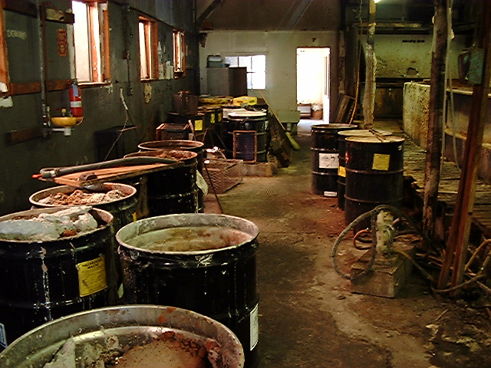
Industrial User Inspections
Key is to find the sources of the variability in discharge quality
Conducting Inspections
Step 2 - Process
First follow the indus-
trial processing steps
(raw materials in to
final products out).
“If you could lead me from the start of the process to the end, as if we are raw materials. Along the way I will note where wastewaters and wastes are generated, and how they are delivered to their points of disposal. Only after following the process from raw materials in to finished products out, would I then like to double back and see the points of delivery, treatment, and disposal. This way I am able to first understand the sources in order to better grasp the layout and configuration of the wastewater handling on-site.”
open drums, portable pump and hosing, floor staining – general uncontrolled mess

Slide 9
Industrial User Inspections
Key is to find the sources of the variability in discharge quality
Conducting Inspections
Step 2 - Along the way
identify all
wastestreams
determine
controls for each
determine all
methods of delivery
verify the
pollutants present
verify process
and start-up dates
DD
open drums, portable pump and hosing, floor staining – general uncontrolled mess

Slide 10
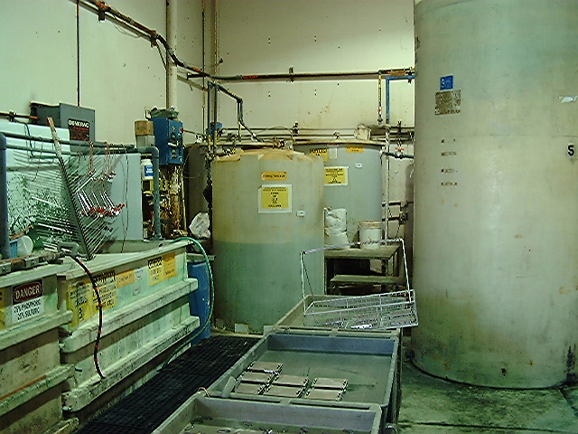
Industrial User Inspections
Key is to find the sources of the variability in discharge quality
Conducting Inspections
Step 3 – Control
Inspect all treatment
units and methods of
pollution control and
wastewater handling
practices
industrial wastewater treatment unit with final storage and equalization

Slide 11
Industrial User Inspections
Key is to find the sources of the variability in discharge quality
Conducting Inspections
Step 3 – At Each Point
identify all
incoming sources
identify reaction
end-point controls
determine methods
of internal delivery
verify reagents and
pollutants present
identify all outgoing
wastestreams
C
industrial wastewater treatment unit with final storage and equalization

Slide 12
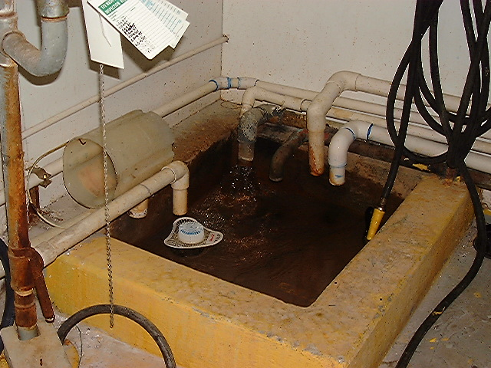
Industrial User Inspections
Key is to find the sources of the variability in discharge quality
Conducting Inspections
Step 4 - Disposal
Verify sample points,
sampling frequencies,
and pollutants
sampled against
pollutants present
sewer connection discharge point with multiple wastewater inlets

Slide 13
Industrial User Inspections
Key is to find the sources of the variability in discharge quality
Conducting Inspections
Step 4 - Disposal
determine if sampling
accounts for all flows
verify sample day
representativeness
verify representativ-
ness over time
determine
methods of disposal
verify sampling covers
pollutants present
D
sewer connection discharge point with multiple wastewater inlets

Slide 14
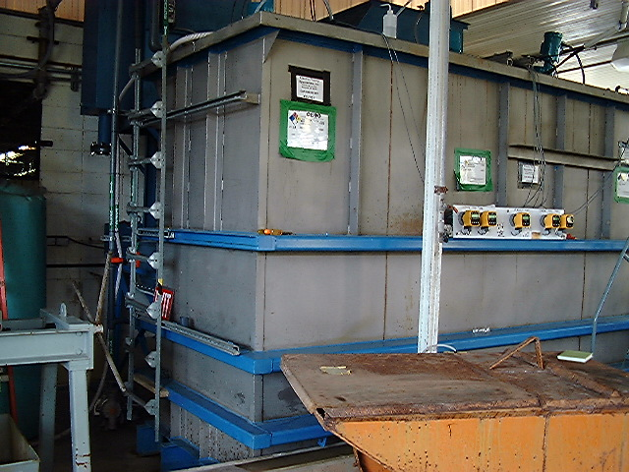
Industrial User Inspections
Key is to find the sources of the variability in discharge quality
Conducting Inspections
Step 5 - Schematic
Get enough detail to
draw a wastewater
control schematic
industrial wastewater treatment unit with continuous reaction end-point metering

Slide 15

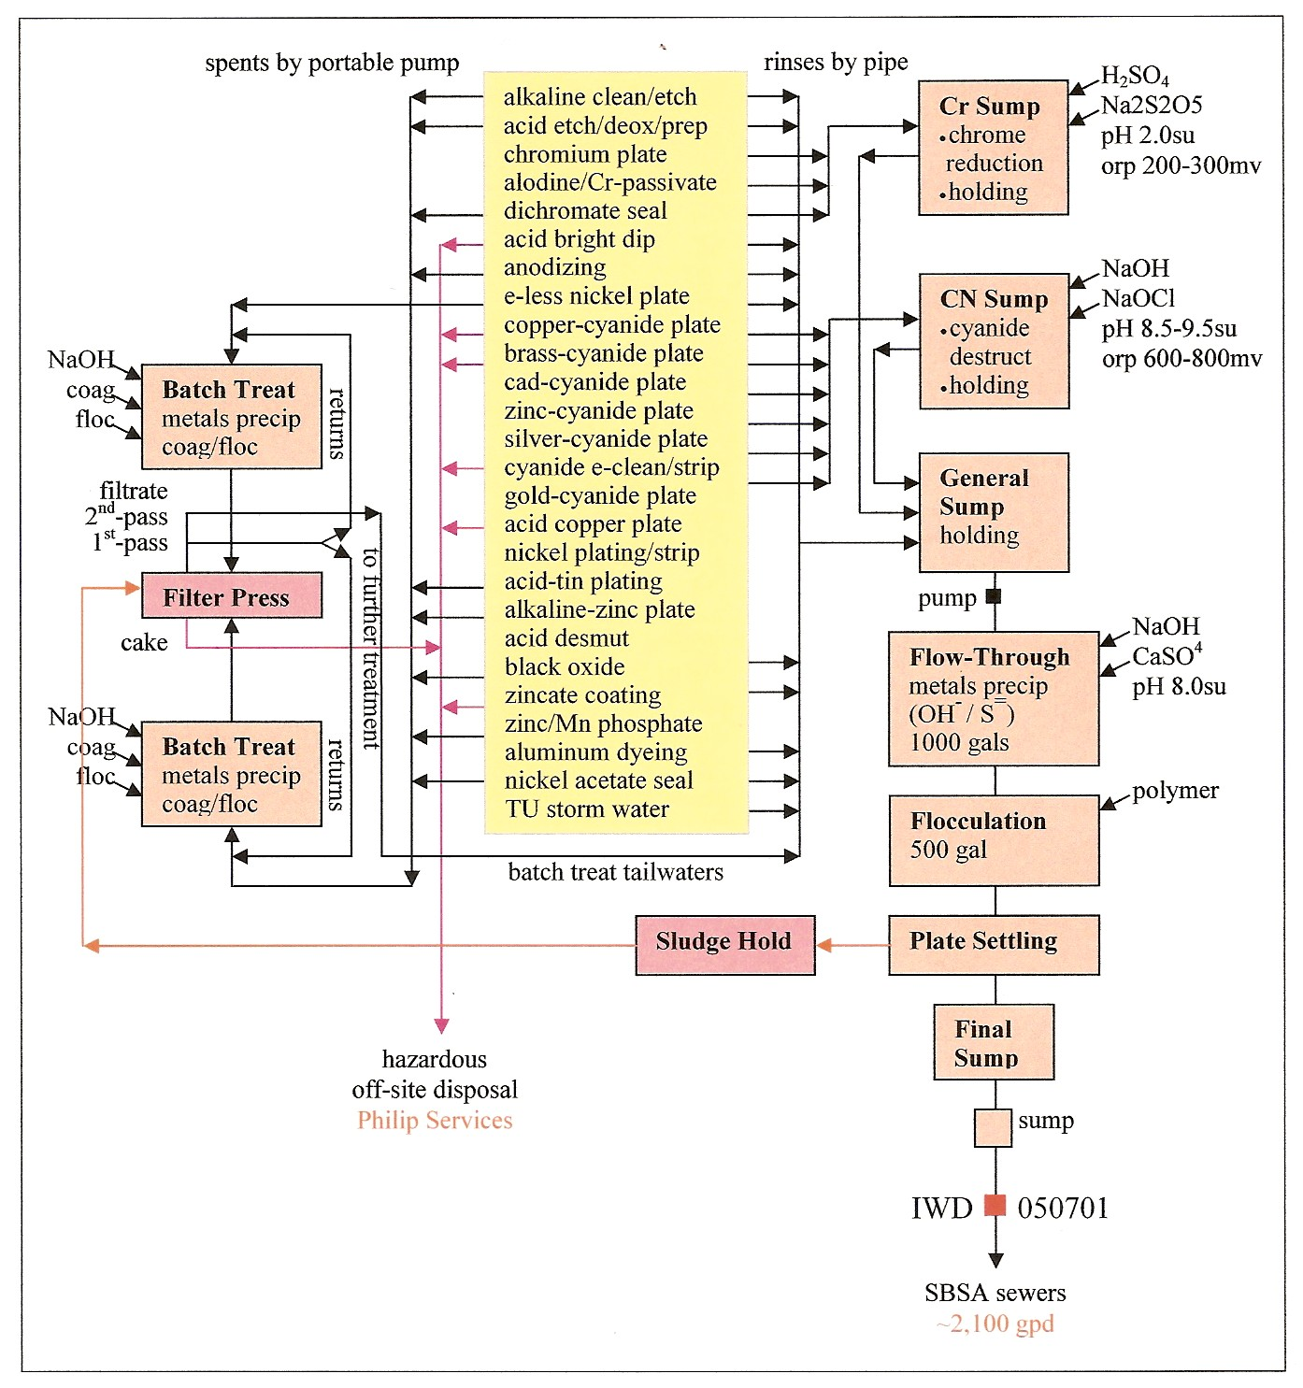
Wastewater
Control
Schematic
Level of Detail
sources
and schedules
methods of
delivery
methods of
control
unit process
monitoring
methods of
disposal

Slide 16
Industrial User Inspections
Key is to find the sources of the variability in discharge quality
Conducting Inspections
Step 5 - Schematic
Completing a waste
water schematic on-
site gives the best
understanding of the
facility by far!
Metering for
chrome reduction
metals precipitation
cyanide destruction
C
industrial wastewater treatment unit with continuous reaction end-point metering

Slide 17
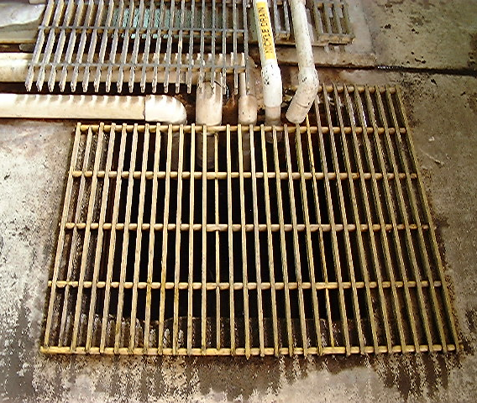
Industrial User Inspections
Key is to find the sources of the variability in discharge quality
Field Notes
and Documentation
Should Stand Alone
all findings clearly
described and dated
attribution of all
sources of information
all statements made
recorded and dated
all conclusions clearly
marked as such
multiple discharges from continuous and batch treatment units to single outlet

Slide 18
Industrial User Inspections
Key is to find the sources of the variability in discharge quality
Field Notes
and Documentation
Should Stand Alone
questions to yourself
for further investigation
opening conference
statements recorded
close-out interview
statements recorded
collected documents
and photos listed
multiple discharges from continuous and batch treatment units to single outlet

Slide 19
Field Notebook
Valley Plating 2009

Slide 20
Industrial User Inspections
Key is to find the sources of the variability in discharge quality
Field Notes
and Documentation
It’s Your Testimony
so write it down even
if you already know it
multiple discharges from continuous and batch treatment units to single outlet

Slide 21
Industrial User Inspections
Key is to find the sources of the variability in discharge quality
Inspection Reports
and Permit Fact Sheets
Administrative Record
all findings clearly
described and dated
attribution of all
sources of information
citation of pertinent
ordinances and rules
itemize requirements
and recommendations
multiple discharges from continuous and batch treatment units to single outlet

Slide 22
Industrial User Inspections
Key is to find the sources of the variability in discharge quality
Inspection Reports
and Permit Fact Sheets
Administrative Record
use “shall” for all
requirements
use “should”, or better
yet, “should consider”
for recommendations
use to document
photos (used/unused)
include a wastewater
control schematic
multiple discharges from continuous and batch treatment units to single outlet

Slide 23
Industrial User Inspections
Key is to find the sources of the variability in discharge quality
Inspection Reports
and Permit Fact Sheets
Administrative Record
keep administrative
information up to date
(1) phone numbers
(2) e-mail addresses
(3) names / job titles
(4) permit numbers
(5) permit dates
(6) sewer service area
and NPDES permit
(7) addresses
D
multiple discharges from continuous and batch treatment units to single outlet

Slide 24
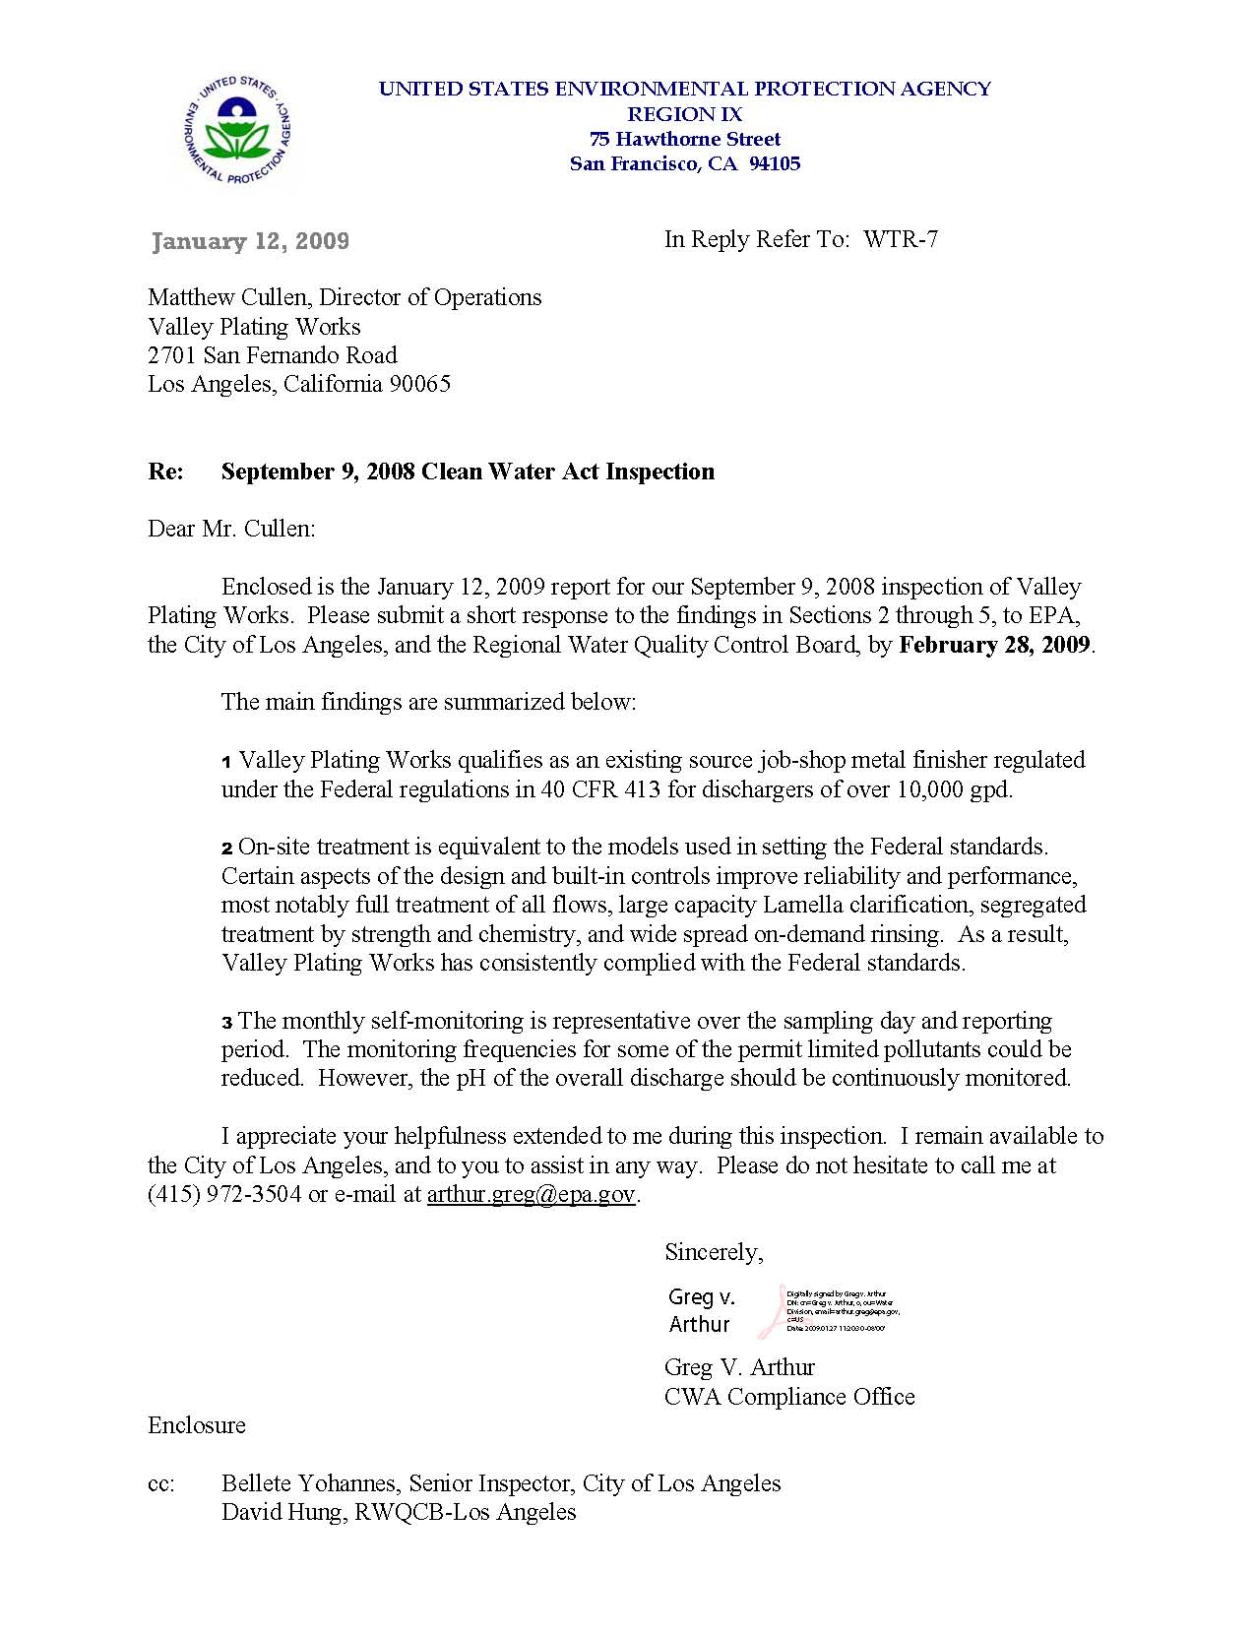
Inspection Report
Cover Letter

Slide 25
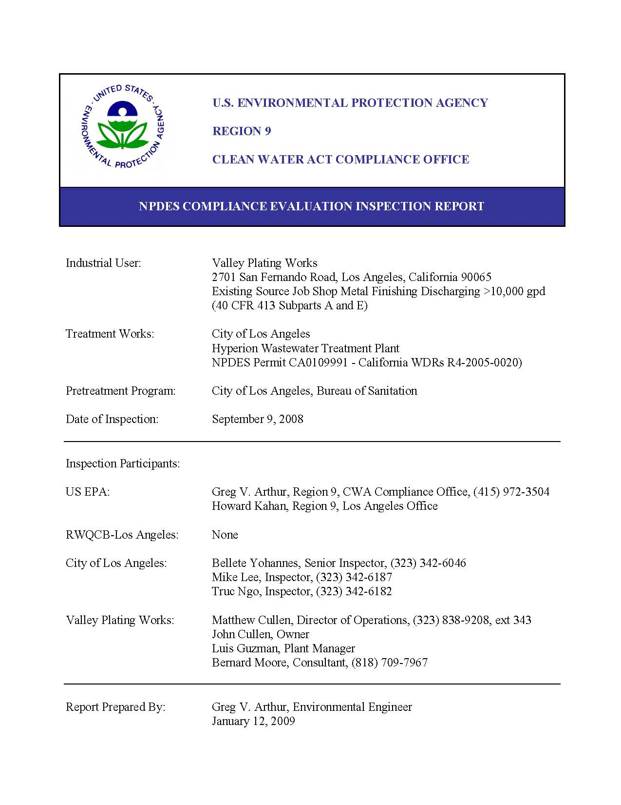
Inspection Report
Title Page

Slide 26
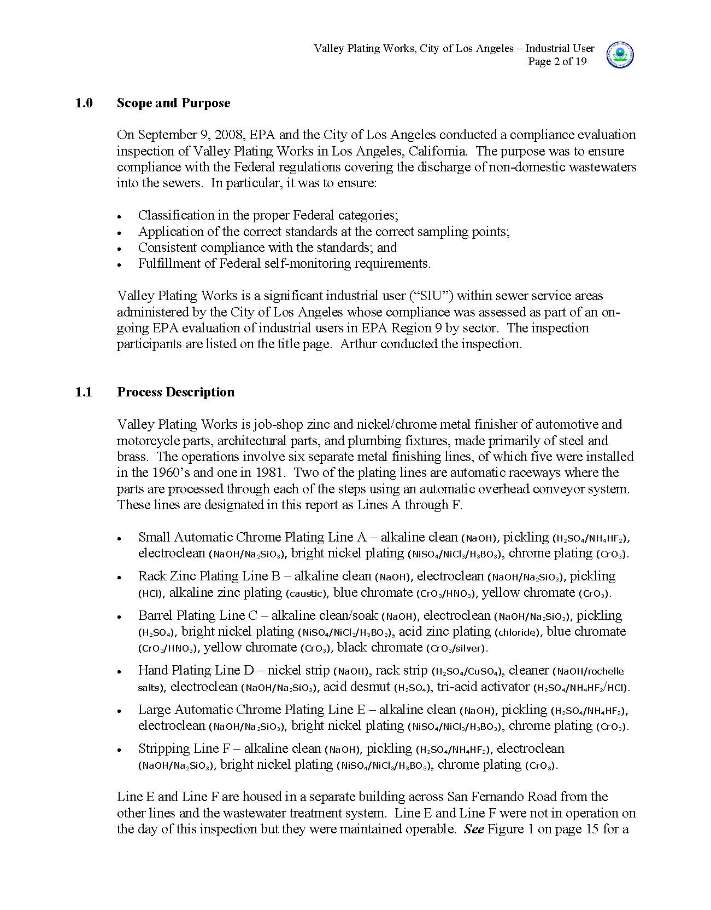
Inspection Report
Facility Description

Slide 27
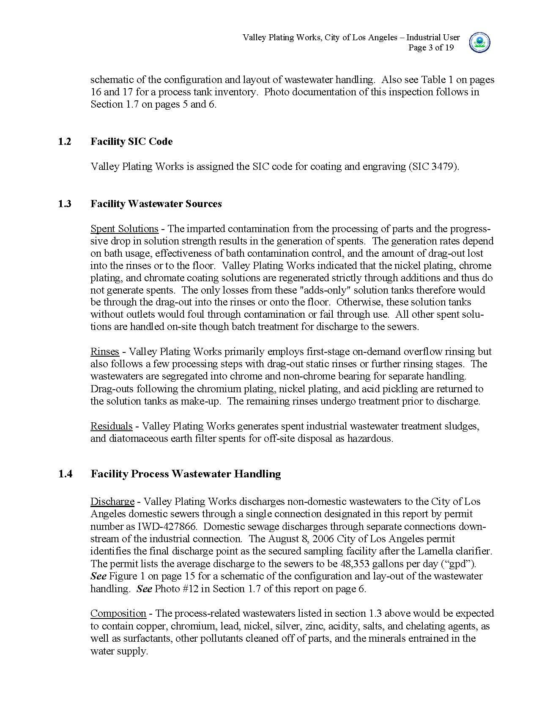
Inspection Report
Facility Description

Slide 28
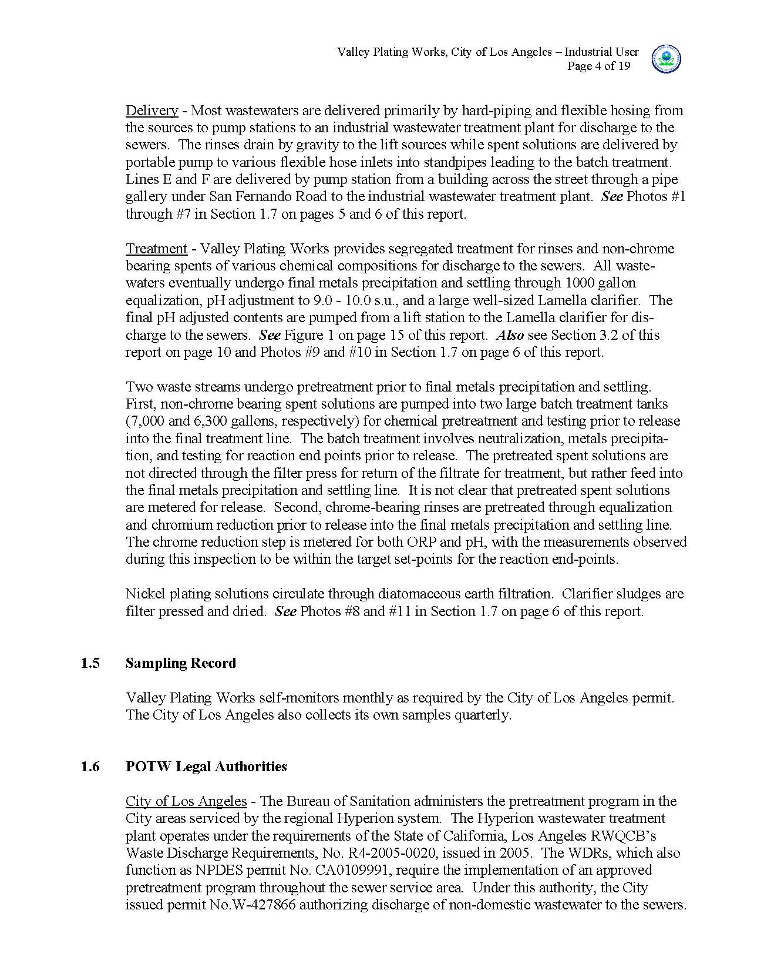
Inspection Report
Facility Description

Slide 29
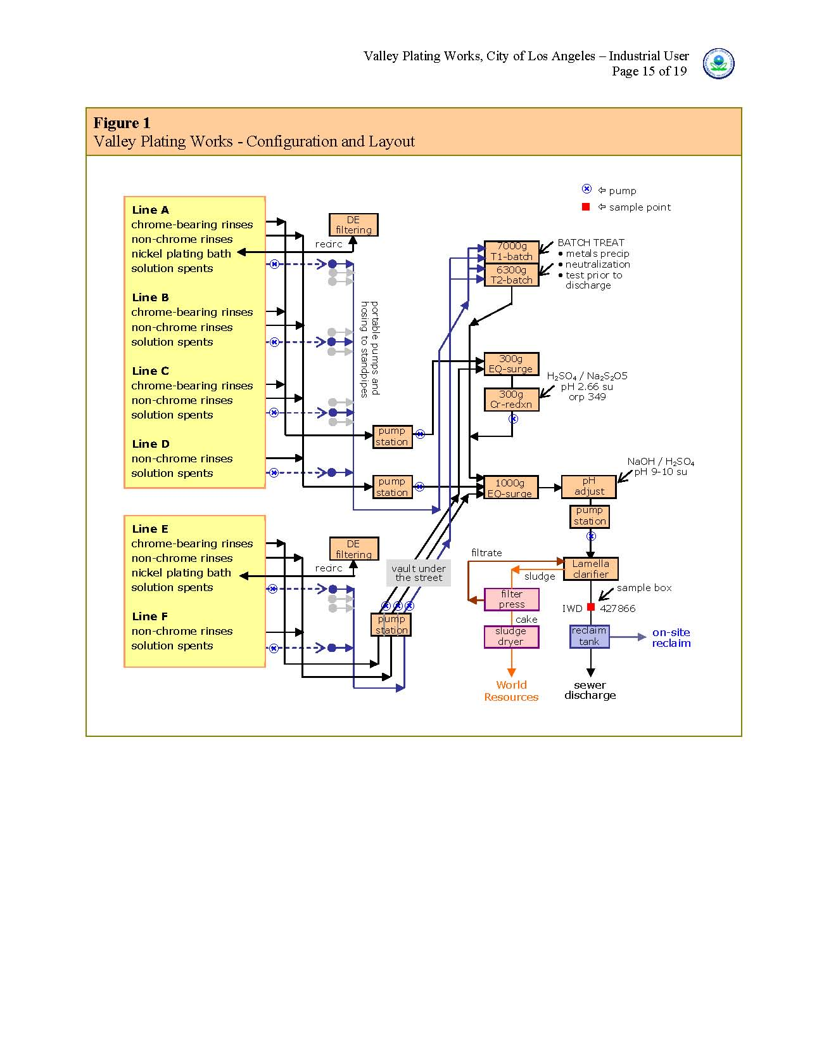
Inspection Report
Wastewater
Control Schematic

Slide 30
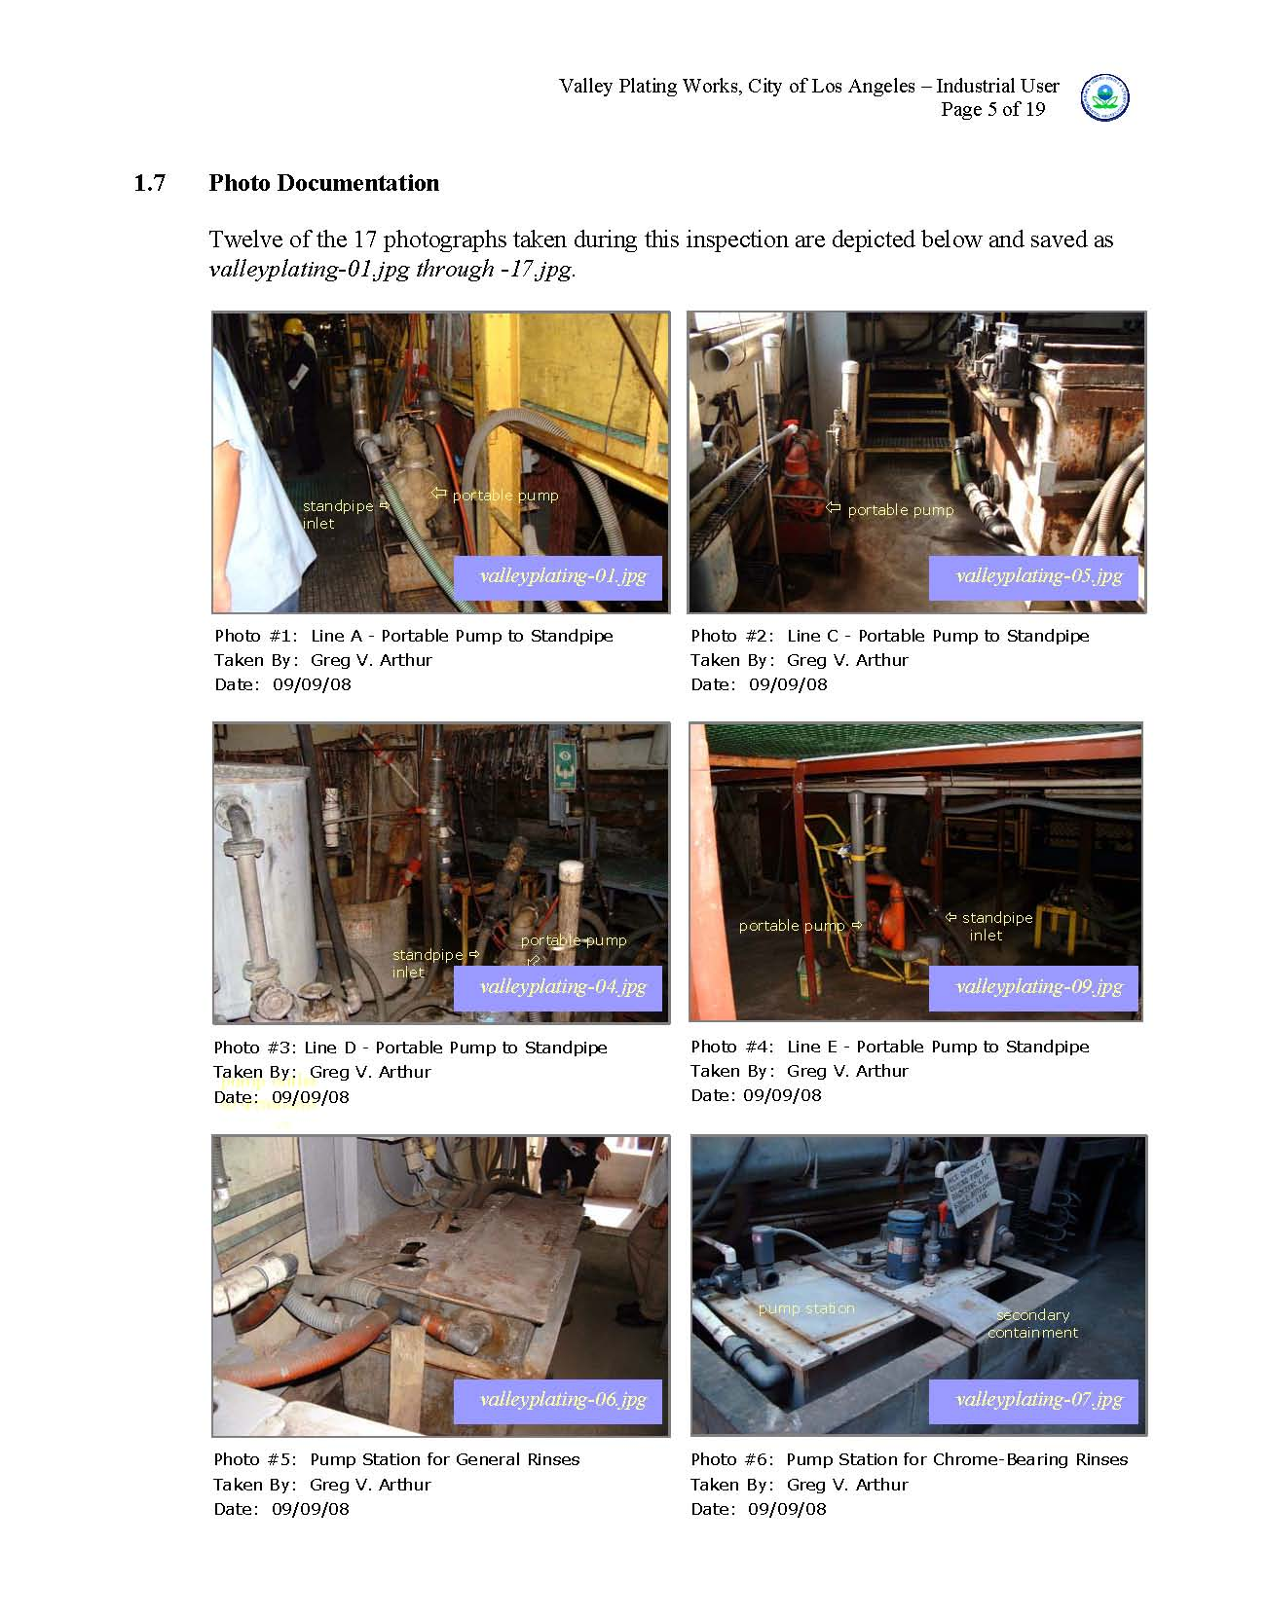
Inspection Report
Facility Photo
Documentation

Slide 31
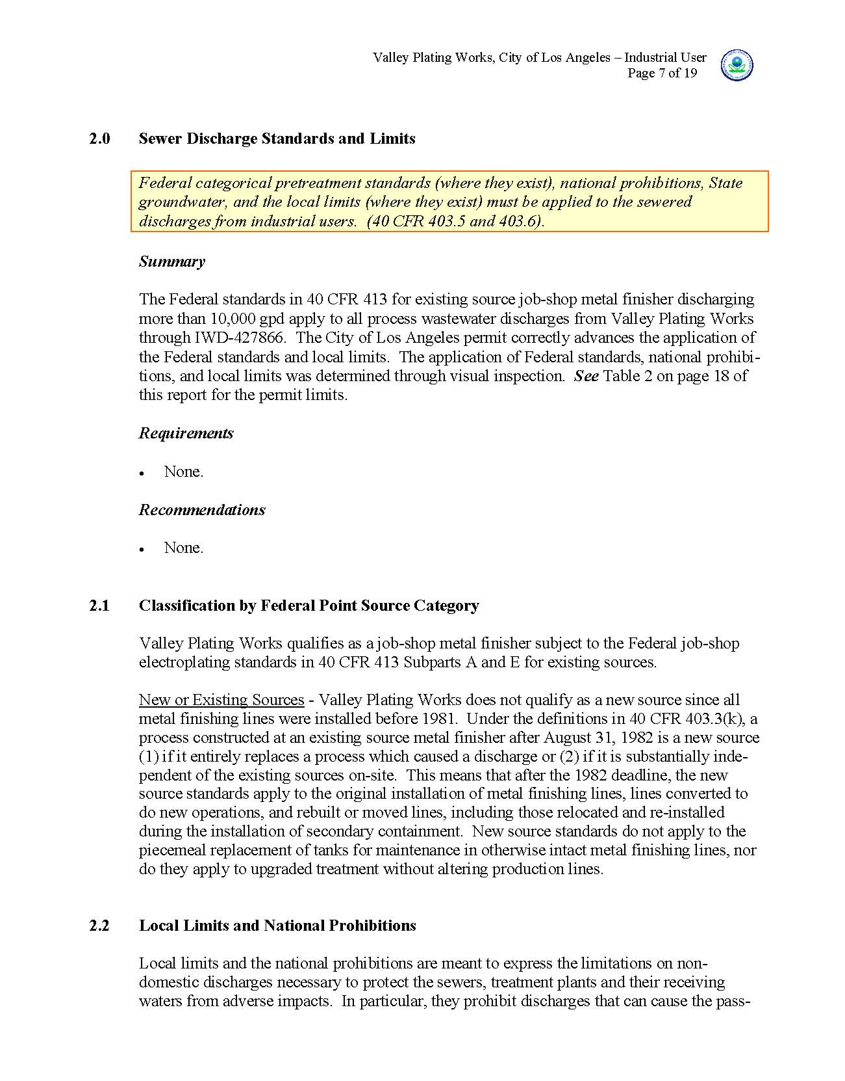
Inspection Report
Permit Verification

Slide 32
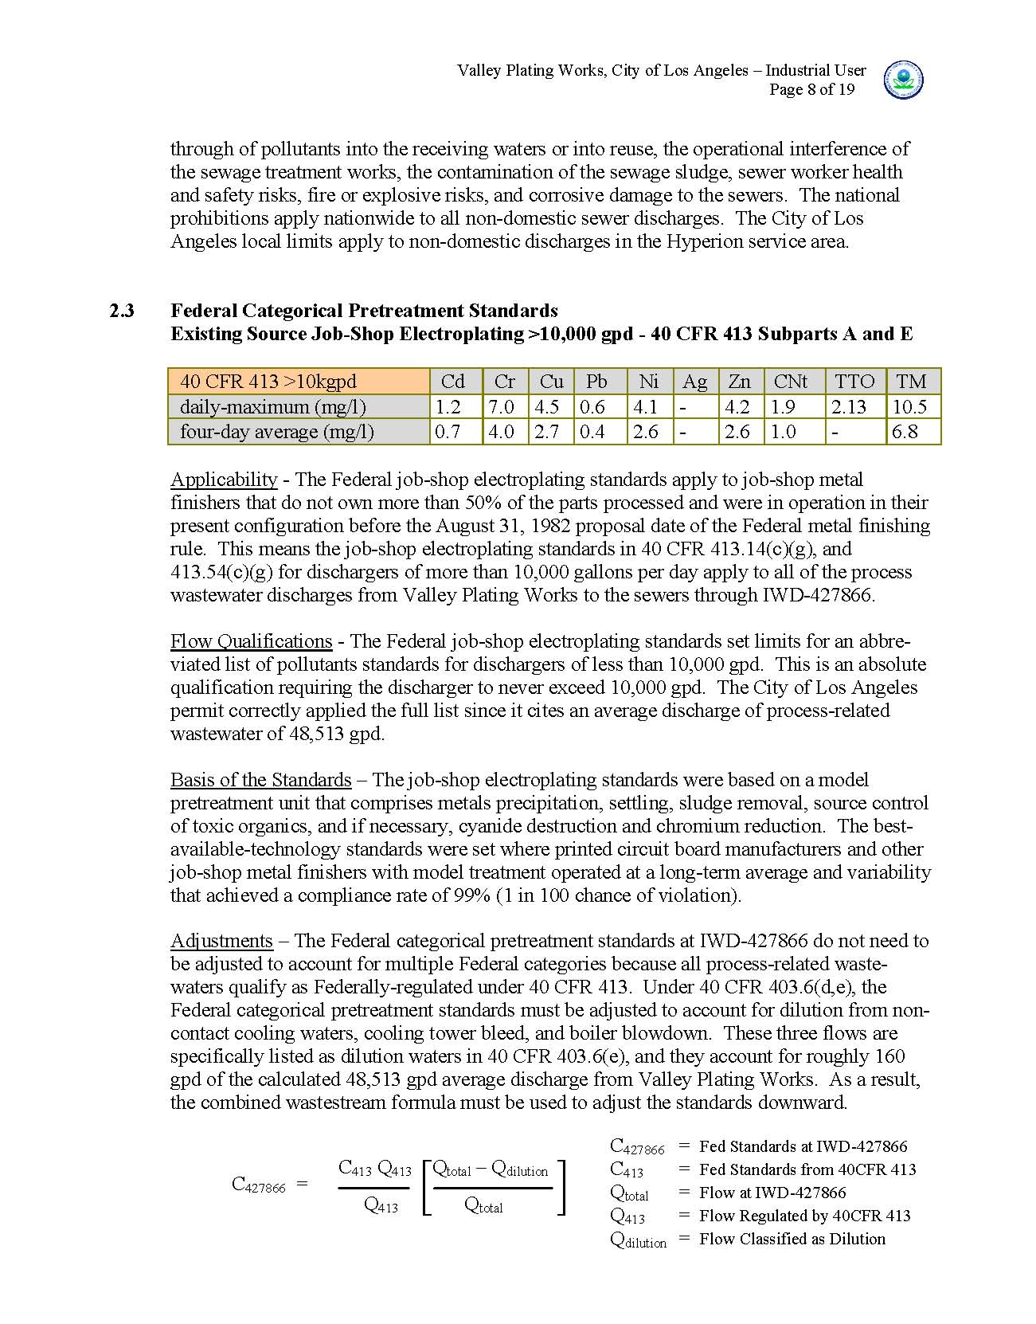
Inspection Report
Permit Verification

Slide 33
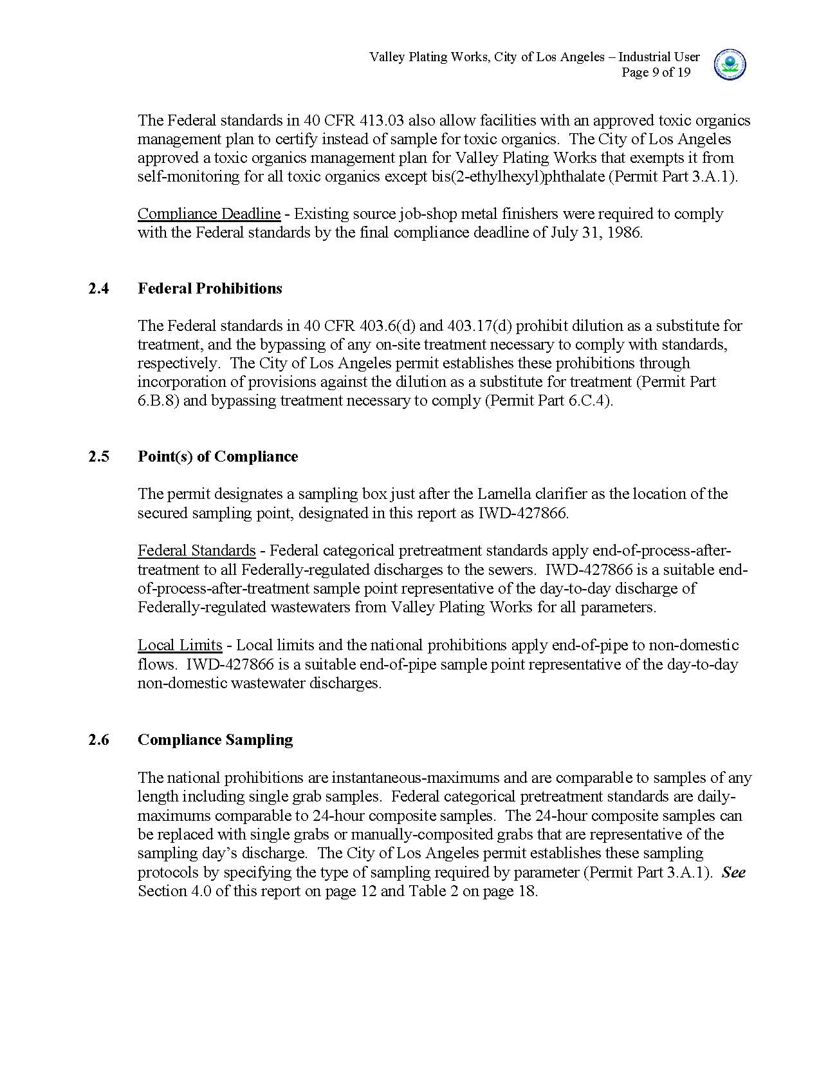
Inspection Report
Permit Verification

Slide 34
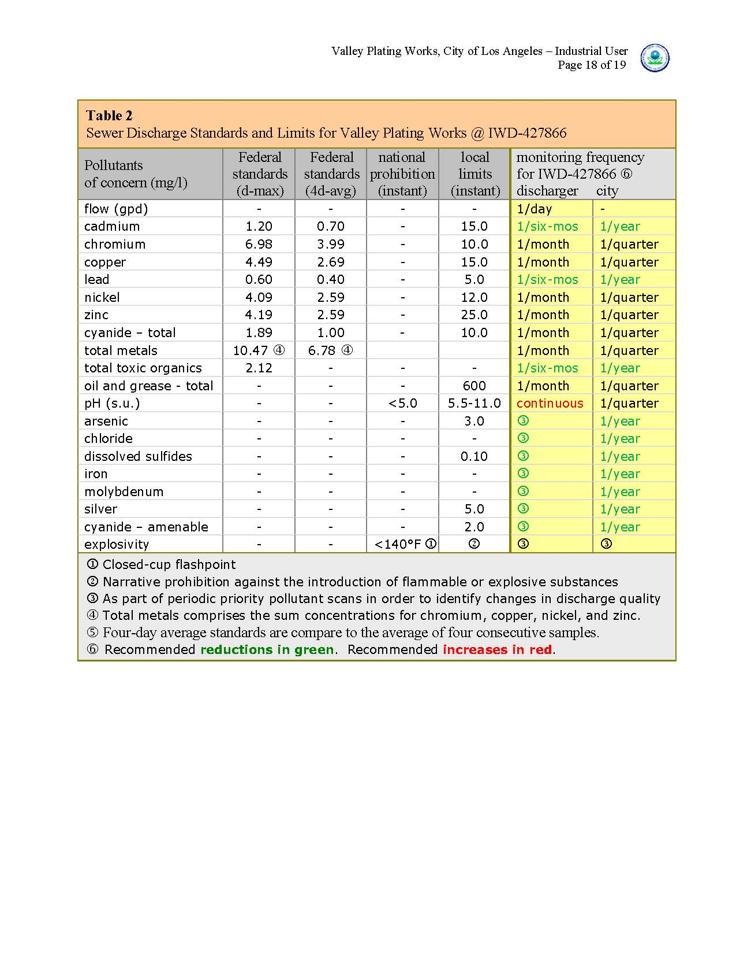
Inspection Report
Permit Verification

Slide 35
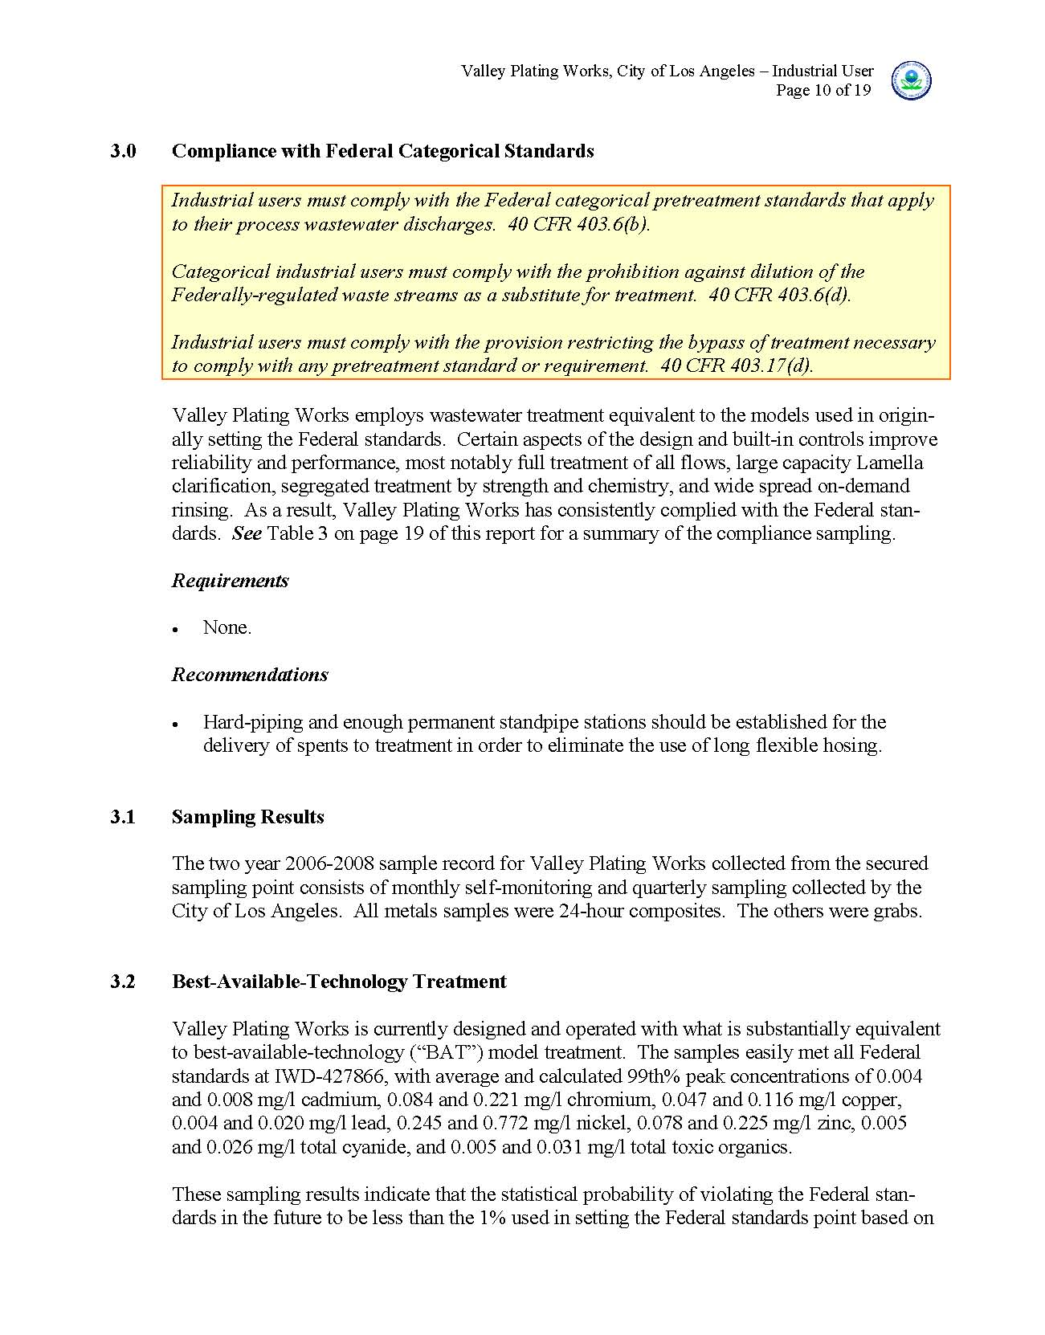
Inspection Report
Compliance
Determinations

Slide 36
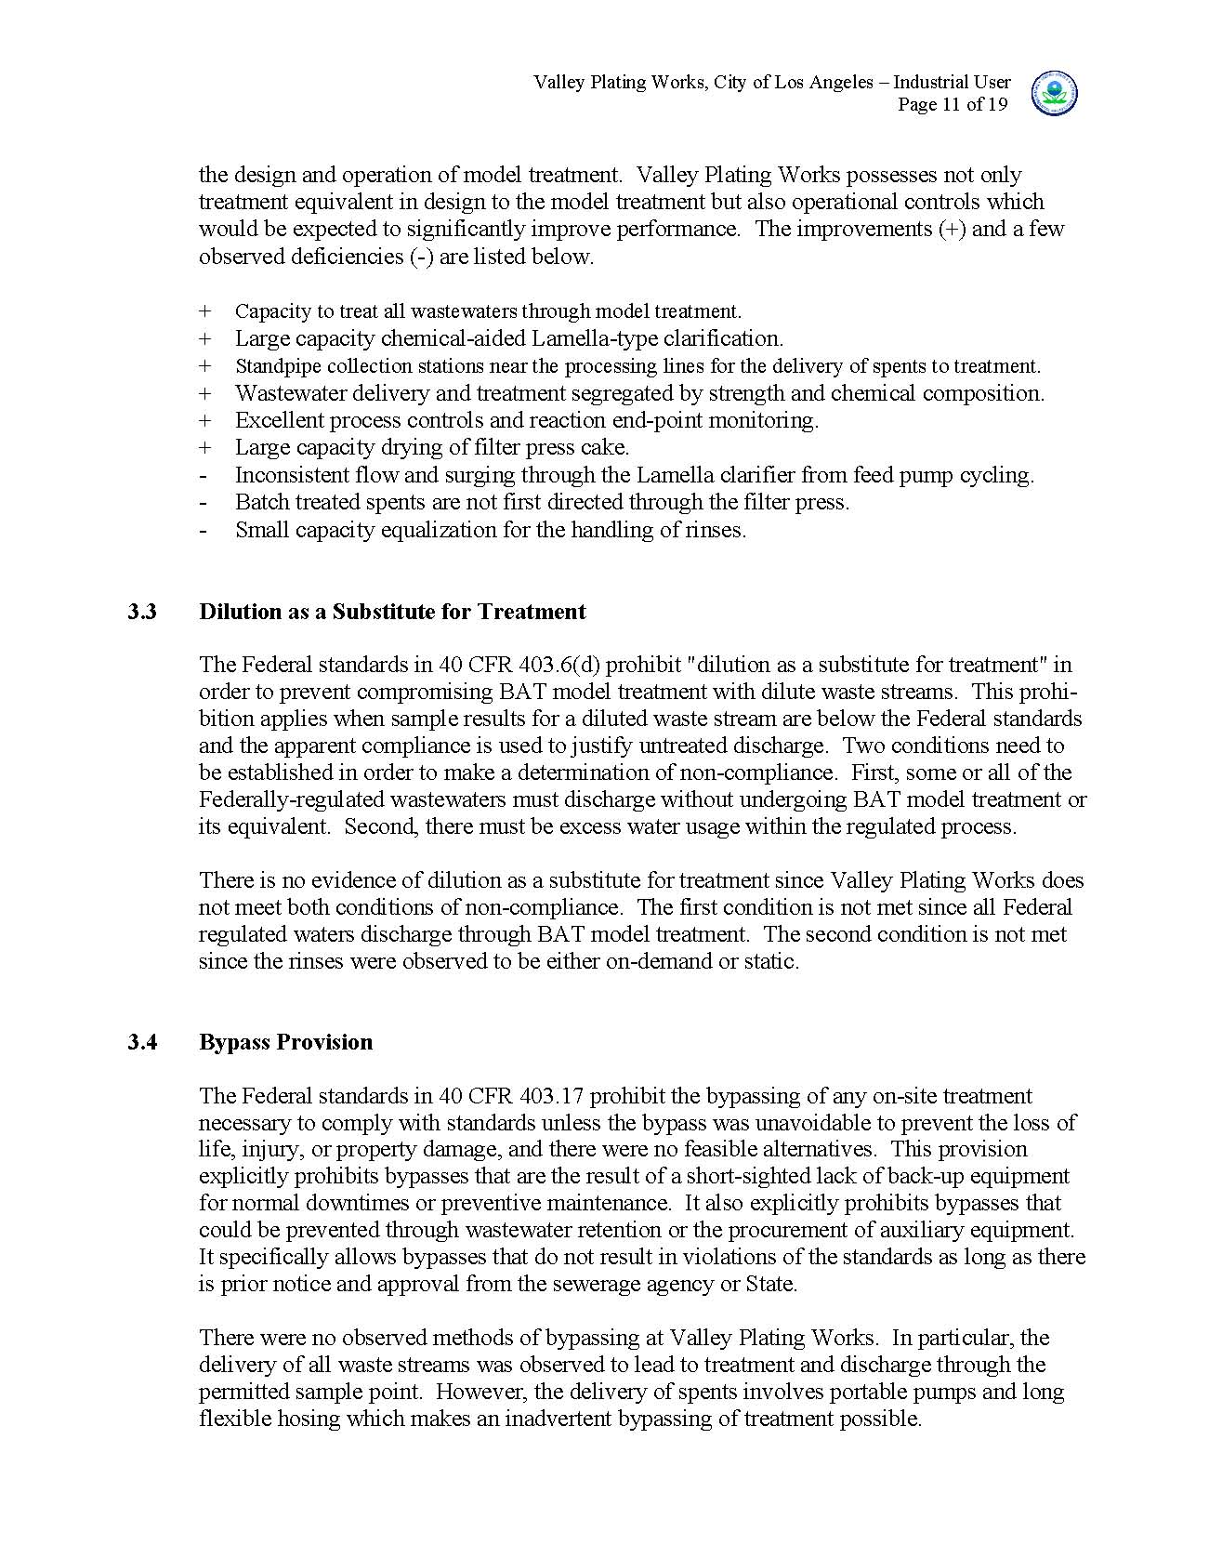
Inspection Report
Compliance
Determinations

Slide 37
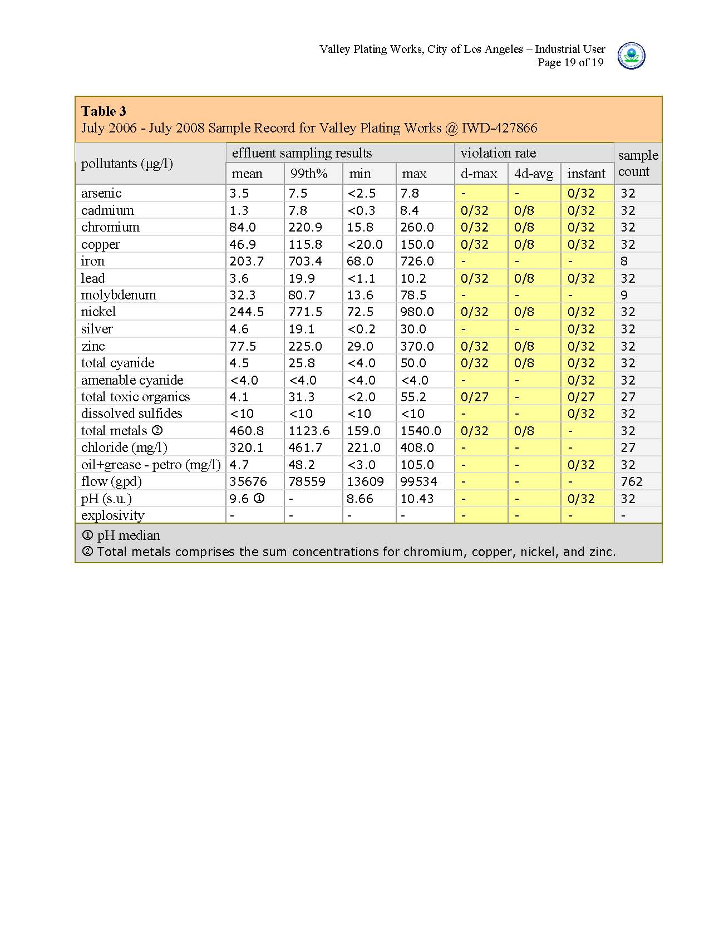
Inspection Report
Compliance
Determinations

Slide 38
Finding Sources of Variability
Key is to find the sources of the variability in discharge quality
Conducting Inspections
Ultimately industrial
users meet effluent
limits by controlling
the variabilities
inherent in the design
and operations, that
effect wastewater
quality.
continuous pH and ORP metering for treatment found not in service

Slide 39
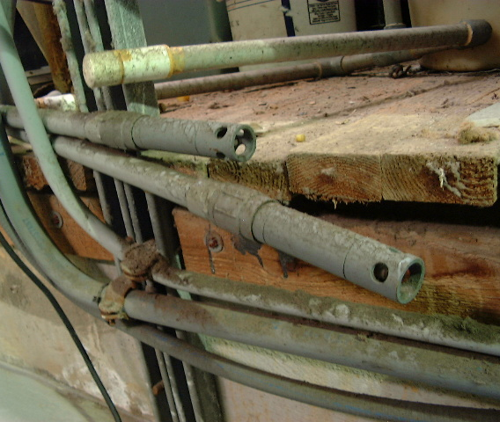
Finding Sources of Variability
Key is to find the sources of the variability in discharge quality
Conducting Inspections
So … focus field work
on identifying and
quantifying sources
and controls of
variabilities from
operations
treatment
discharge
evidently not used recently
pH and ORP probes
D
continuous pH and ORP metering for treatment found not in service

Slide 40
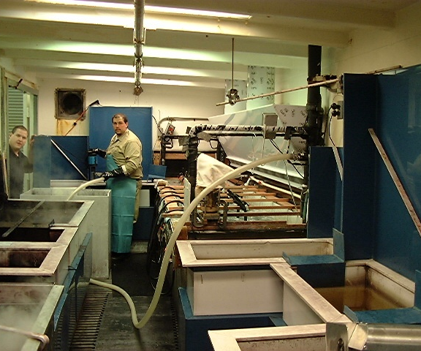
Finding Sources of Variability
Key is to find the sources of the variability in discharge quality
Operational
Sources of Variability
Variabilities in waste-
water generation are
the result of the way
the industry operates
and in how the wastes
are then collected,
delivered, treated, and
conveyed for disposal.
bosses - operators - contractors - grunts
and a couple of plating shop dudes

Slide 41
Finding Sources of Variability
Examples of variabilities related to operations
Variability in Flow
seasonal
weekends
swing shift
timer
scheduled overhaul
CIP
D
bosses - operators - contractors - grunts
and a couple of plating shop dudes

Slide 42
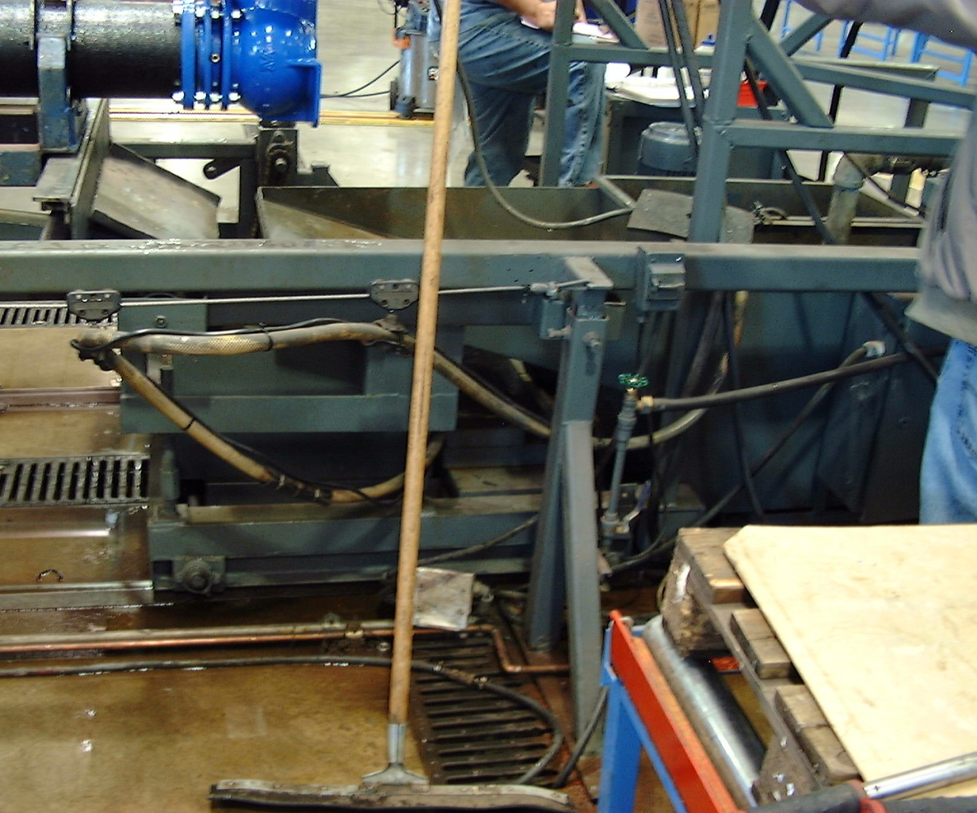
Finding Sources of Variability
Examples of variabilities related to operations
Variability in
Pollutant Loadings
spents
circulation bleeds
regenerant / reject
concentrates
CIP tank flush
sump drainage
treatment unit
tailwaters
D
floor drains - wet floors

Slide 43
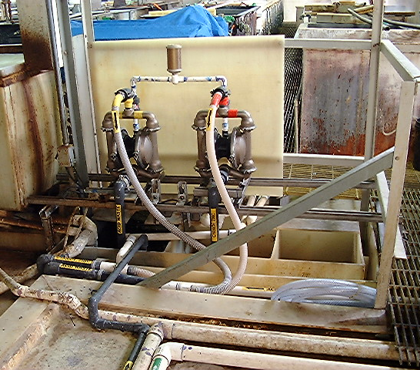
Finding Sources of Variability
Examples of variabilities related to operations
Wastewater Segregation
by Strength
high-strength
spents
drag-out spents
IX regenerant
low-strength
overflow rinses
washdown
hydrotest
uncontaminated
RO/IX brines
domestic sources
C
hardpiping of spents by type to segre-gated batch treatment + clear labeling

Slide 44
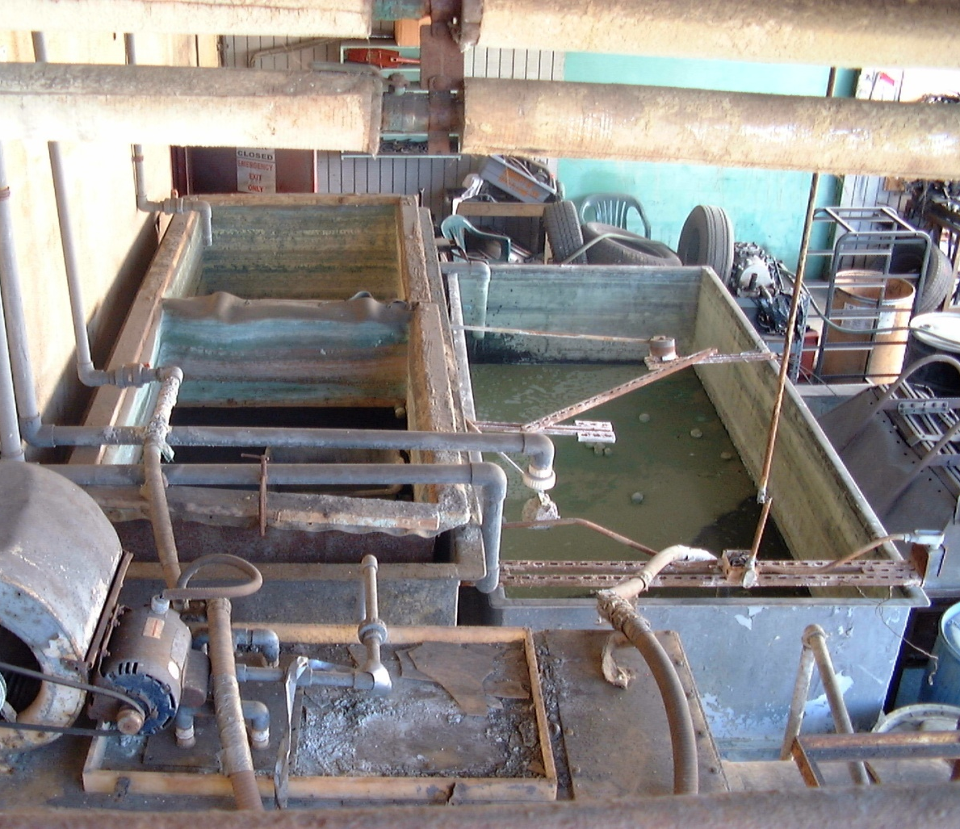
Finding Sources of Variability
Examples of variabilities related to operations
Wastewater Segregation
by Treatability
cyanide-bearing
acids
alkalines
oily emulsions
brines
solids and slurries
insoluble organics
soluble organics
volatile organics
C
separate tanks for different types of batch treatment steps

Slide 45
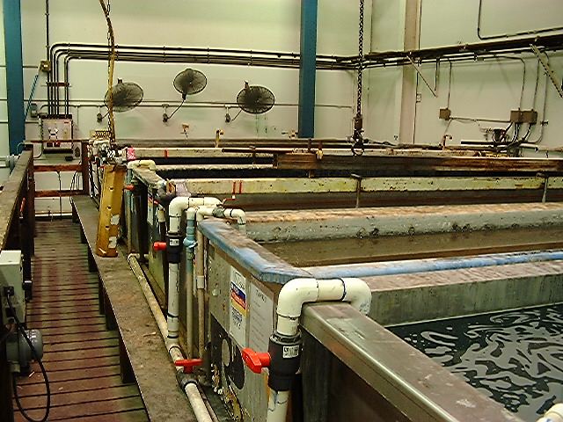
Finding Sources of Variability
Examples of variabilities related to operations
Process Water
Consumption Practices
on-demand
countercurrent
dilution
DI make-up
IX in-tank circulation
CIP schedules
C
on-demand low-overflow rinsing

Slide 46
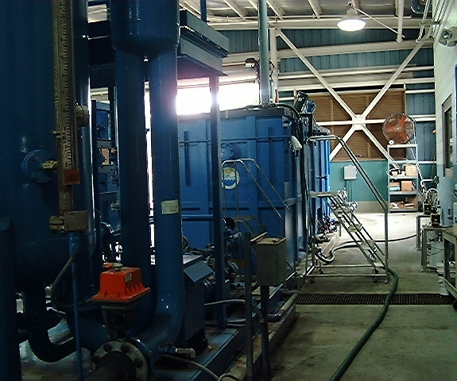
Finding Sources of Variability
Key is to find the sources of the variability in discharge quality
Treatment-Related
Sources of Variability
Treatment reduces
variability in effluent
quality (1) by reducing
mean concentrations
and (2) because effec-
tive treatment requires
control of the influent
quality, delivery, and
treatment processes.
oily wastewater treatment unit for oily bilge and ships wastewater

Slide 47

Finding Sources of Variability
Examples of variabilities related to treatment
separate treatment
by strength
reaction end-points
reaction interference
settling / filtration
design capacity
surges
short-circuiting
clogging
solids handling
variability controls
equalization
metering
C
oily wastewater treatment unit for oily bilge and ships wastewater

Slide 48
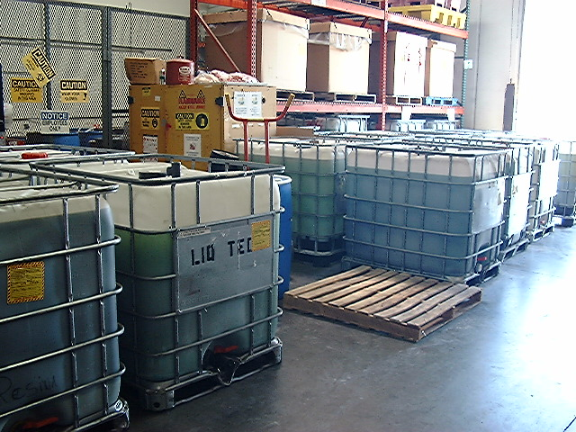
Finding Sources of Variability
Key is to find the sources of the variability in discharge quality
Discharge-Related
Sources of Variability
The methods of dis-
charge and disposal
can significantly reduce
the variabilities in the
effluent quality.
segregated wastewaters collected for off-site disposal

Slide 49
Finding Sources of Variability
Examples of variabilities related to the method of discharge
combined discharge
batch discharge
metered discharge
final equalization
test prior to discharge
off-site disposal
C
segregated wastewaters collected for off-site disposal

Slide 50
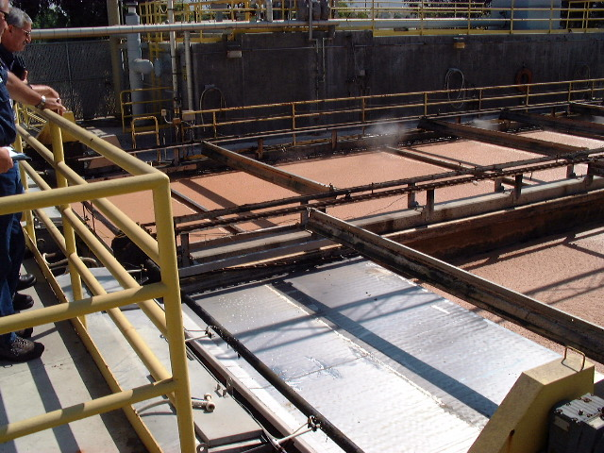
Industrial User Inspections
BACWA/EBMUD Pretreatment Training
March 11, 2019
Questions or Comments
Greg V. Arthur - (510) 967-8411 - gva@gvarthur.com

