Slide 1
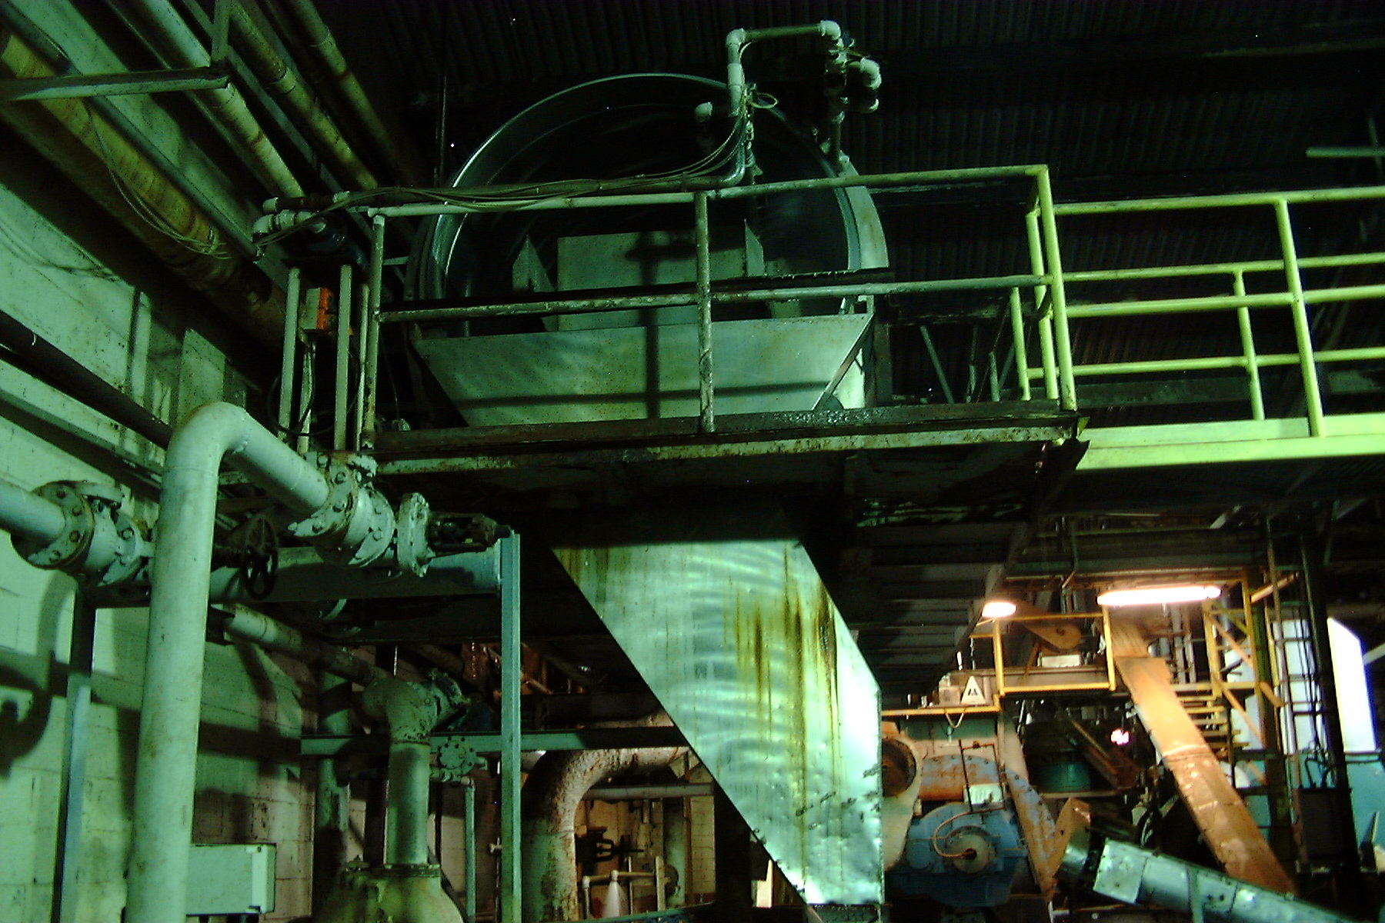
Clean Water Act Basics
BACWA/EBMUD Pretreatment Training
March 11, 2019
Greg V. Arthur - (510) 967-8411 - gva@gvarthur.com

Slide 2
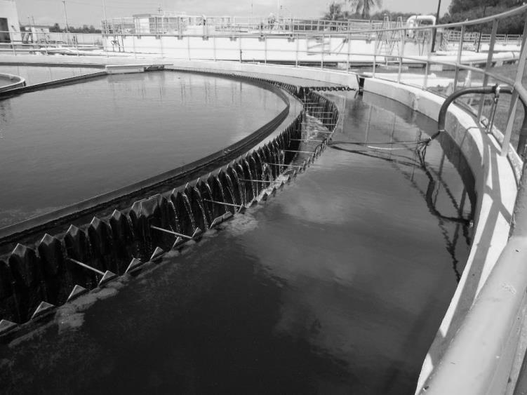
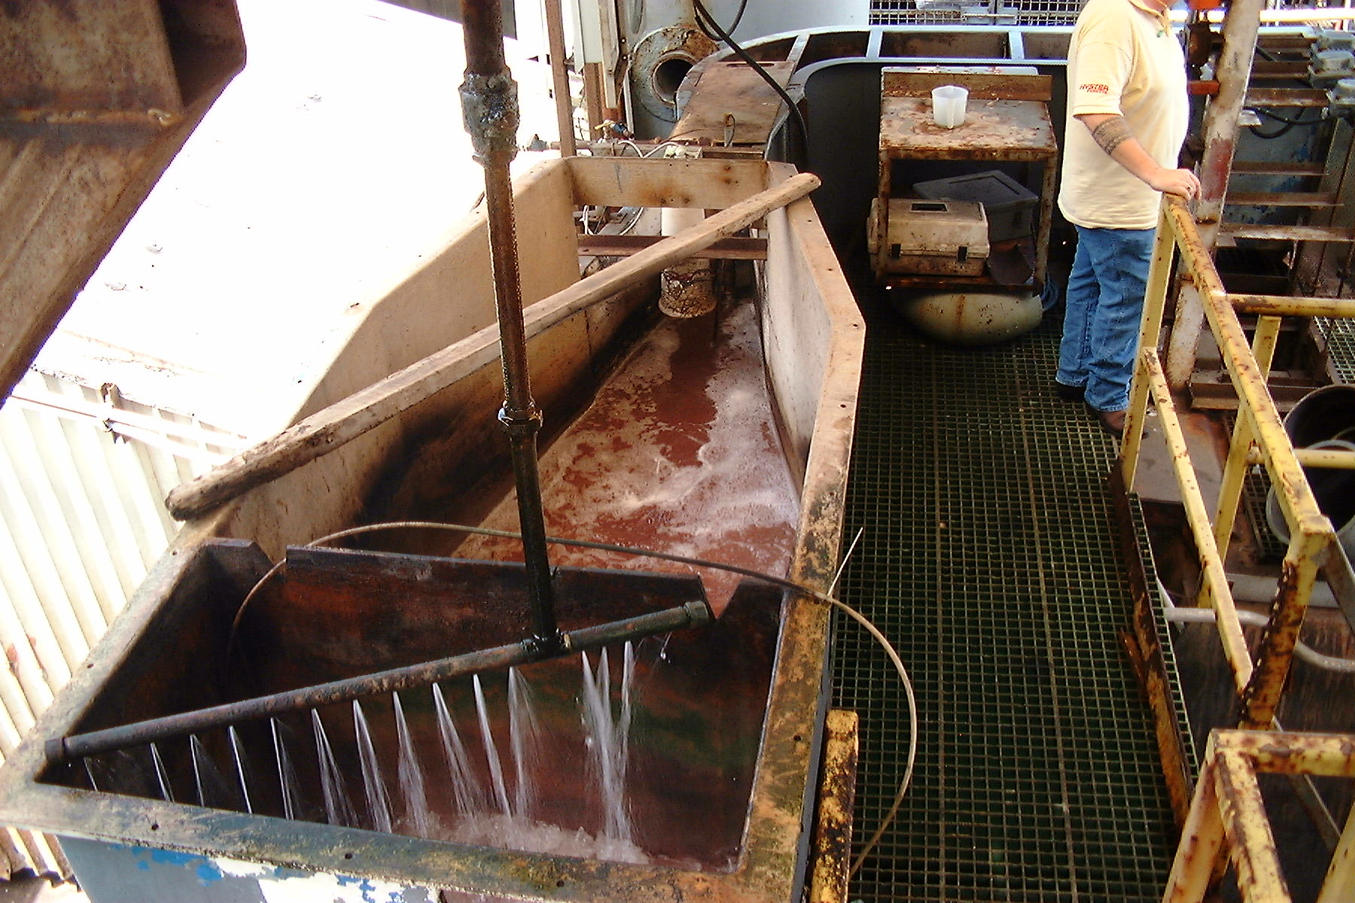
Clean Water Act Basics
Involving the Federal, State and local governments
EPA HQ
EPA Regions
DOJ
State Water
State AGs
DAs
Sewer Districts
Municipals
Counties
tuna cannery final effluent for discharge through a deep-water ocean outfall

Slide 3
The Clean Water Act
NPDES Permitting involves Federal, State, local governments
Federal Technology-Based Effluent Limits
301(h) Waivers
State Receiving Water Quality Standards
Water Quality-Based Effluent Limits
State 401 Certification
Pretreatment Regulations
Sewage Sludge Regulations
General Storm Water BMPs
Anti-backsliding / Antidegredation

Slide 4
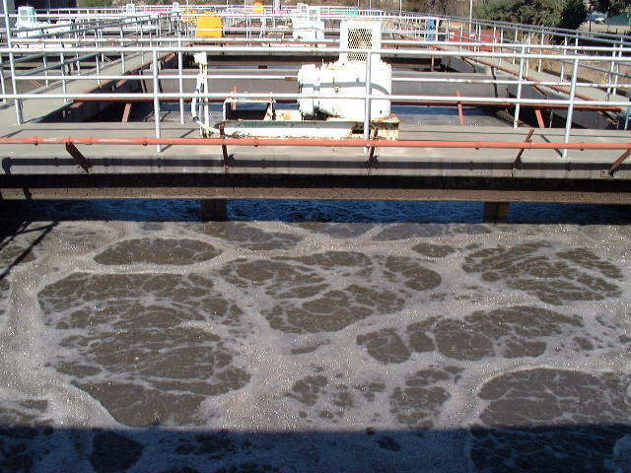
NPDES Permits
Technology-Based (Categorical) Standards
National Standards
Best-Available-
Technology
treatment (BAT)
BAT defined for
high-strength
wastewaters
End result wide-
spread treatment
BPJ Standards
activated sludge aeration tanks at a municipal sewage treatment plant

Slide 5
NPDES Permits
Technology-Based (Categorical) Standards
Section 133 Municipal Secondary Treatment
301(h) Waivers
Sections 407-471 Industrial Effluent Guidelines
Best Available Treatment Technology (BPT/BAT)
New Source Performance Standards (NSPS)
Section 403 Pretreatment Regulations
Pretreatment Standards Existing Sources (PSES)
Pretreatment Standards New Sources (PSNS)
Prohibitions Against Interference / Dilution / Bypassing

Slide 6
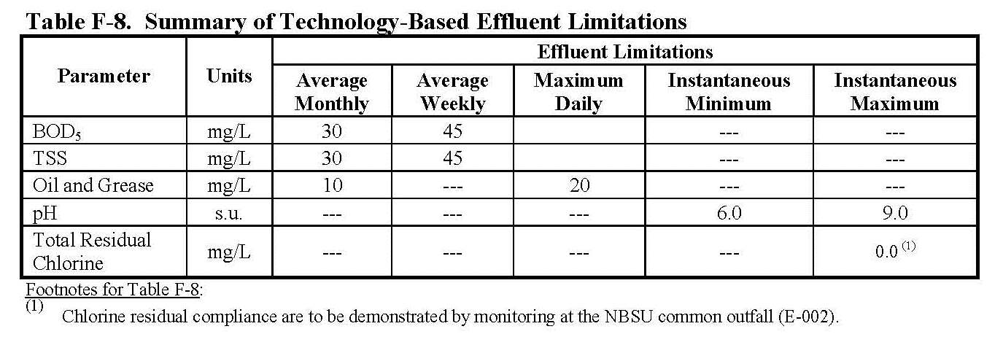
NPDES Permits
Technology-Based (Categorical) Standards
Section 133 Secondary Treatment
BPJ Standards

Slide 7
NPDES Permits
Technology-Based (Categorical) Standards
Sections 407-471 Effluent Guidelines
Direct Discharge Standards Only
405 – Dairy Products 406 – Grain Mills
407 – Fruit/Veg Canning 408 – Seafood Canning
409 – Sugar Processing 410 – Textile Mills
411 – Cement (BC) 412 – Feedlots
415 – Inorg Chem (33 of 47) 417 – Soap Mfg (A-N,S)
418 – Fertilizer (PSES) 422 – Phosphate Mfg
424 – Ferroalloy Mn/Cr 426 – Glass Mfg (A-G)

Slide 8
NPDES Permits
Technology-Based (Categorical) Standards
Sections 407-471 Effluent Guidelines
Direct Discharge Standards Only
427 – Asbestos Mfg 429 – Timber Products
432 – Meat Products 434 – Coal Mining
435 – Oil Gas Extraction 436 – Mineral Mining
440 – Ore Mining Dressing 445 – Landfills
454 – Gum, Wood Chems 457 – Explosives MFG
458 – Carbon Black (BCD) 459 – Photo Processing
460 – Hospitals 463 – Plastics Molding

Slide 9
NPDES Permits
Technology-Based (Categorical) Standards
Sections 407-471 Effluent Guidelines
Concentration, Flow-based Mass, or pH Pretreatment Stds
411 – Cement Mfg (A) 413 – Job-shop Electroplating
414 – Organic Chemicals 415 – Inorg Chem (14 of 47)
417 – Detergents (ORQR) 418 – Fertilizer Mfg (EG PSNS)
419 – Petroleum Refining 423 – Steam Electric
425 – Leather Tanning 426 – Blown Glass (M)
428 – Rubber (EFGIJ) 429 – Wood Preserving (GH)
433 – Metal Finishing 437 – Centralized Waste Treat

Slide 10
NPDES Permits
Technology-Based (Categorical) Standards
Sections 407-471 Effluent Guidelines
Concentration, Flow-based Mass, or pH Pretreatment Stds
439 – Pharmaceutical Mfg 442 –Transport Equip Cleaning
443 – Asphalt Emulsion 444 – Waste Combustors
455 – Pesticide Chems 458 – Carbon Black Mfg
466 – Porcelain Enameling 469 – E/E Components

Slide 11
NPDES Permits
Technology-Based (Categorical) Standards
Sections 407-471 Effluent Guidelines
Production-based Mass Pretreatment Standards
411 – Nonleach Cement (A) 418 – Fertilizer (BCDE PSNS)
420 – Iron and Steel Mfg 421 – Non-Ferrous Metals
426 – Glass Mfg (HKL) 428 – Rubber Mfg
430 – Pulp Paper Paprbrd 461 – Battery Mfg
464 – Metals Mold/Casting 465 – Coil Coat/Canmaking
466 – Porcelain Enameling 467 – Aluminum Forming
468 – Copper Forming 471 – NonFerrous Forming

Slide 12
NPDES Permits
Technology-Based (Categorical) Standards
Sections 407-471 Effluent Guidelines
Prohibitions Against Discharge to the Sewers
415 – Inorganic Chem Mfg (21 of 47 PSNS, all wastewaters)
418 – Fertilizer (A PSNS, all wastewaters)
423 – Steam Electric (PCBs, fly ash water)
446 – Paint Formulation (oil-based wastewaters)
447 – Ink Formulation (oil-based wastewaters)
454 – Char and Charcoal Briquets (all wastewaters)
455 – Repackaging Ag Pesticides (all wastewaters)

Slide 13
NPDES Permits
Technology-Based (Categorical) Standards
Sections 407-471 Effluent Guidelines
Prohibitions Against Discharge to the Sewers
461 – Calcium Anode Battery Mfg (PSNS all wastewaters)
464 – Metal Mold/Casting (grinder scrubber wwaters)
466 – Porcelain Enameling (iron prep wastewaters)
471 – NonFerrous Metals Forming (spent oils, lubricants)
http://www.gpo.gov/fdsys/granule/CFR-2012-title40-vol30/CFR-2012-title40-vol30-part403-appE/content-detail.html

Slide 14
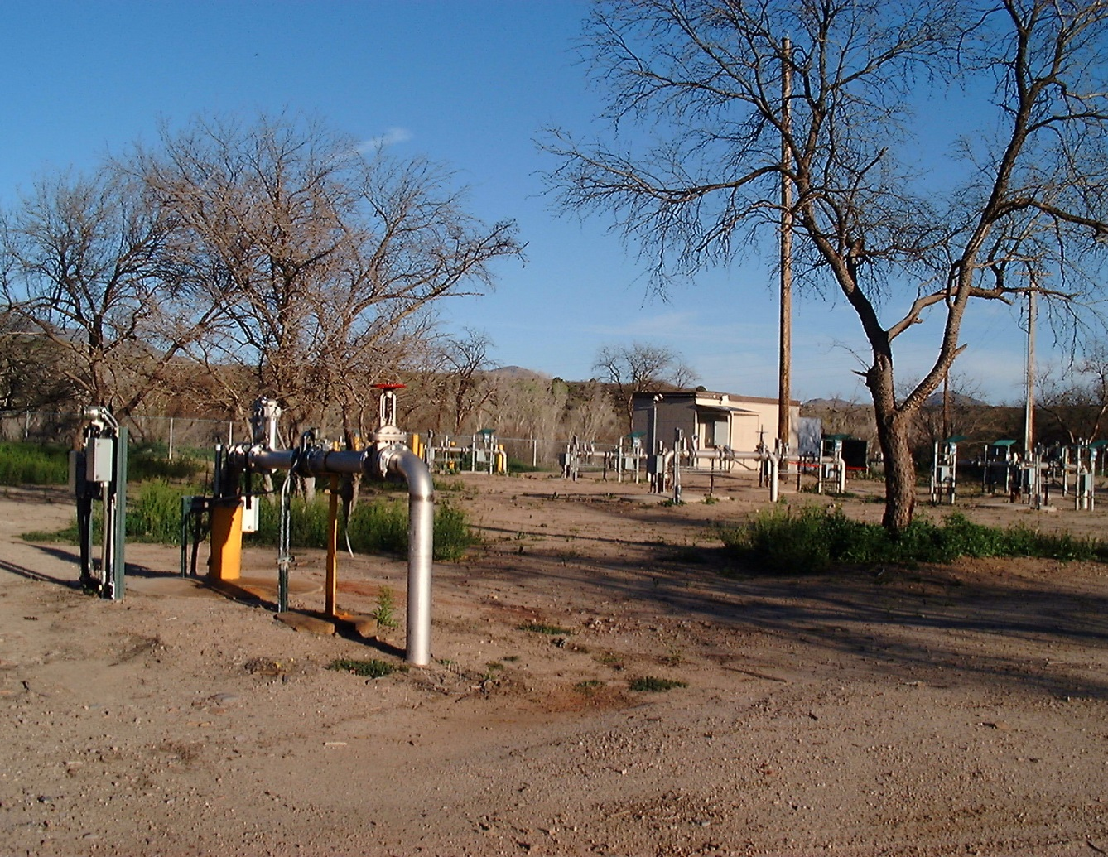
NPDES Permits
Water Quality Standards
WQBELs
WQ Pollutants
of Concern
Discharge
Prohibitions
Whole-effluent
Toxicity Limits
Acute / Chronic
Best Mgmt
Practices (BMPs)
barrier well field to capture contaminated mine drainage for treatment and discharge

Slide 15
NPDES Permits
Water Quality Standards
Contaminants of Emerging Concern (CECs)
antibiotics antimicrobials – bacterial resistance, biotoxicity
hormones – endocrine disruptors
pesticides – aquatic biotoxicity,
surfactants detergents – aquatic biotoxicity
antifoulant biocides – aquatic biotoxicity
disinfection by-products – carcenogenics
cyanotoxins – algal bloom induced fish kills
pharmaceuticals (PiEs) and personal care products (PPCPs)

Slide 16
NPDES Permits
Water Quality Standards
State Water Quality Standards for Receiving Waters
CWA 303(d) Impaired Waters Lists – The “Gold Book”
TMDL Waste Load Allocations
Basin Plans – Implementation Plans – Triennial Reviews
Conversion to WQBELs for NPDES Permitted Discharges
Reasonable Potential Analysis – Critical Dilution Factors
Whole-Effluent Toxicity
Section 403 Pretreatment Regulations
National Prohibitions Against Pass-Through

Slide 17
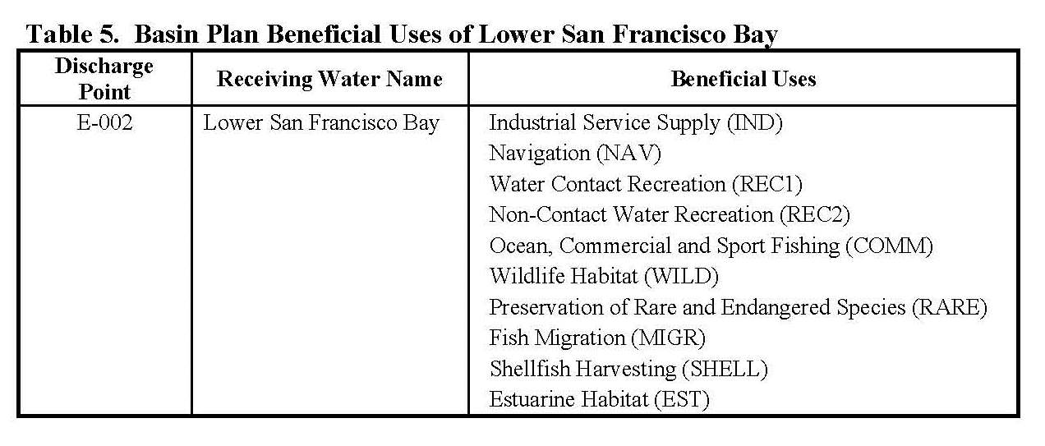
NPDES Permits
Water Quality Standards
State Water Quality Standards for Receiving Waters

Slide 18
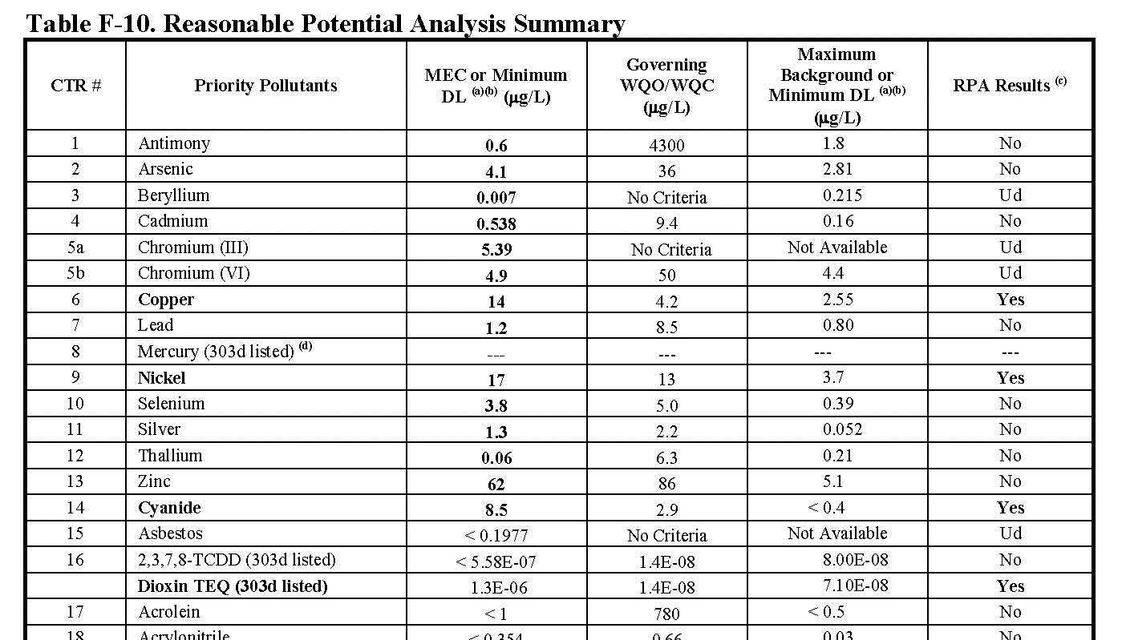
NPDES Permits
Water Quality Standards
Conversion to WQBELs for a POTW’s NPDES Discharge

Slide 19
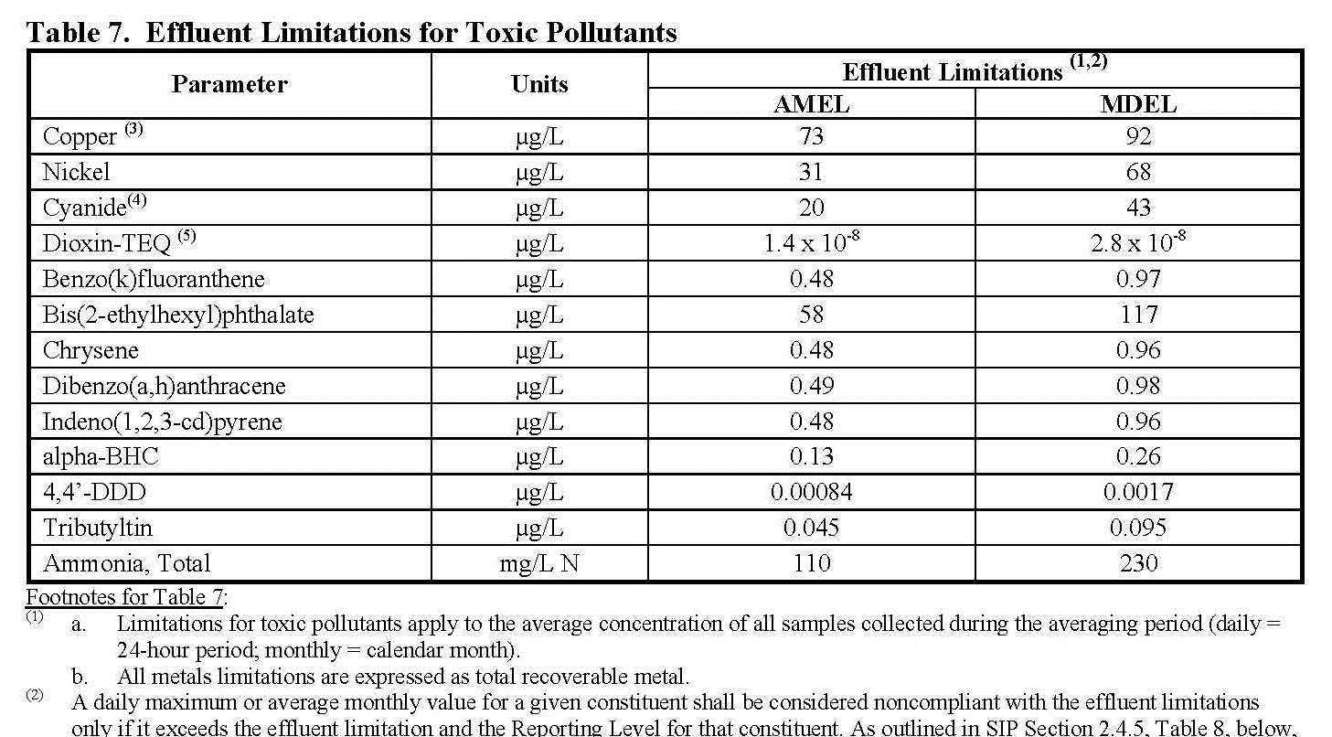
NPDES Permits
Water Quality Standards
Conversion to WQBELs for a POTW’s NPDES Discharge

Slide 20
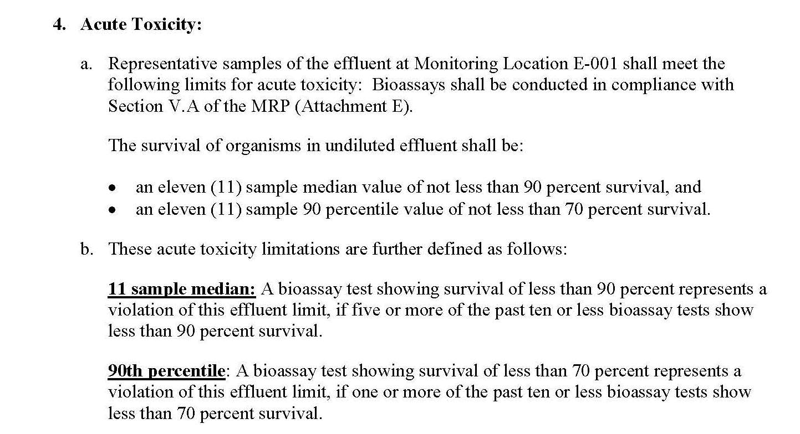
NPDES Permits
Water Quality Standards
WQBELs for a POTW’s NPDES Discharge

Slide 21
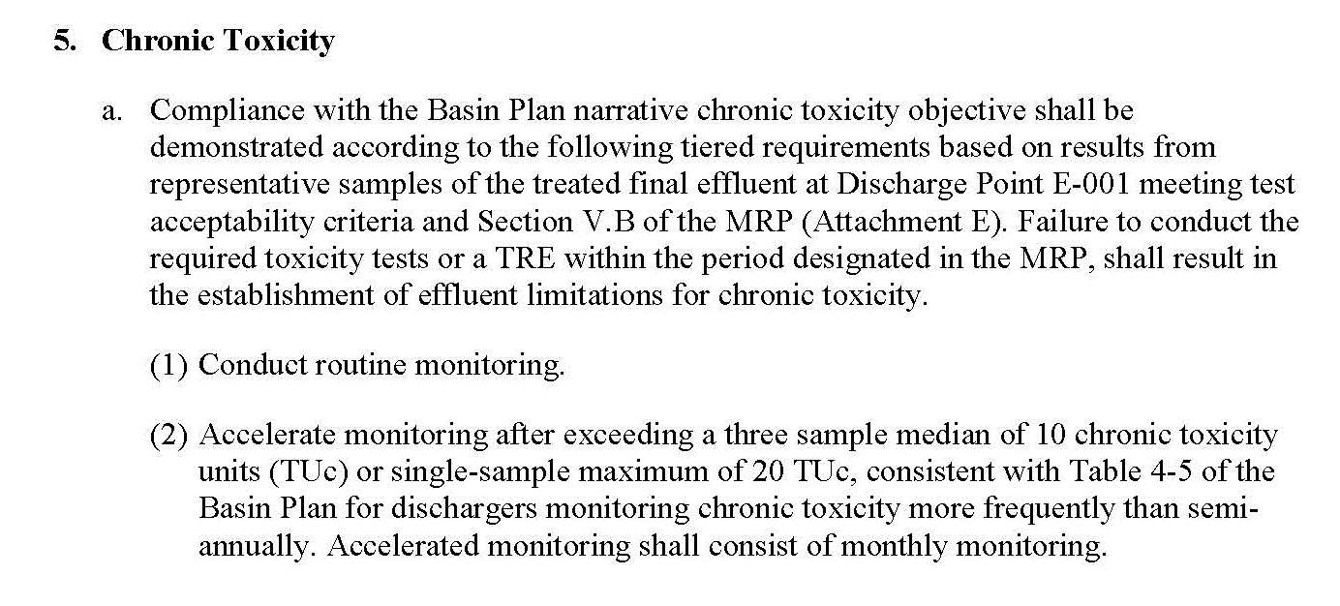
NPDES Permits
Water Quality Standards
WQBELs for a POTW’s NPDES Discharge

Slide 22
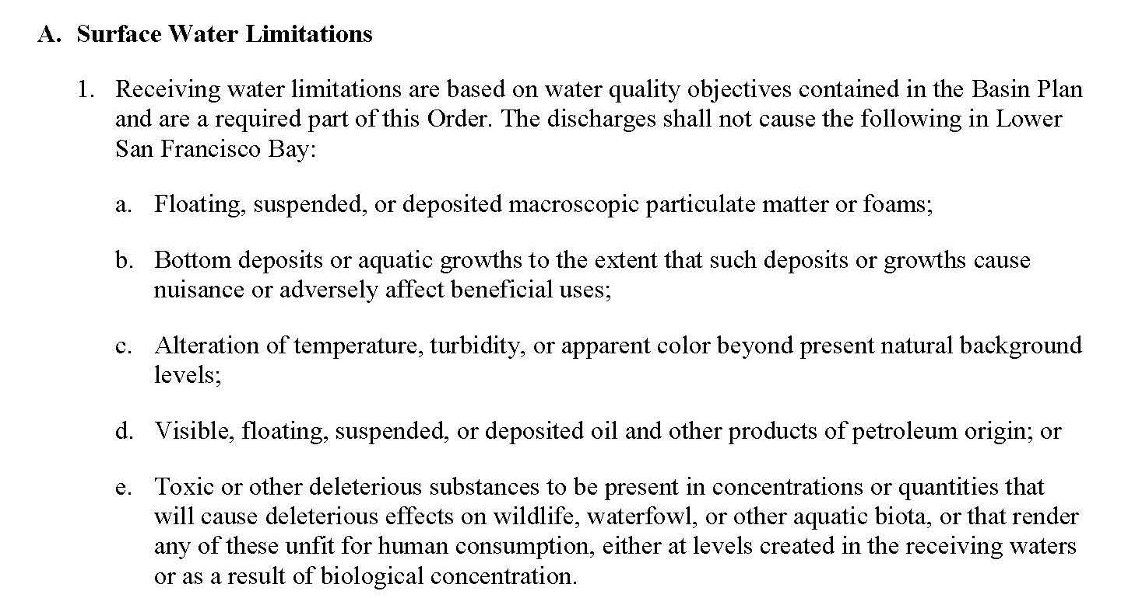
NPDES Permits
Water Quality Standards
Receiving Water Limits for a POTW’s NPDES Discharge

Slide 23
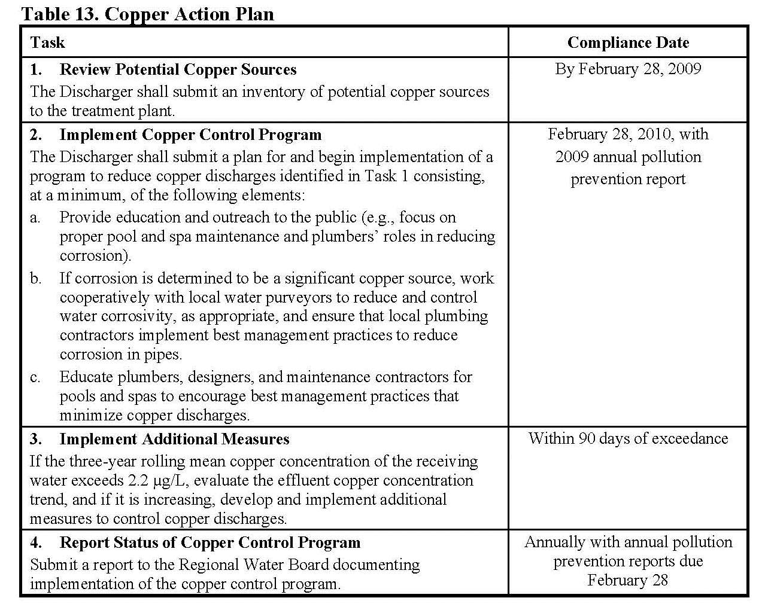
NPDES Permits
Water Quality Standards
Compliance
Schedules for
a POTW’s
NPDES
Permitted
Discharge
copper
cyanide
dioxin

Slide 24
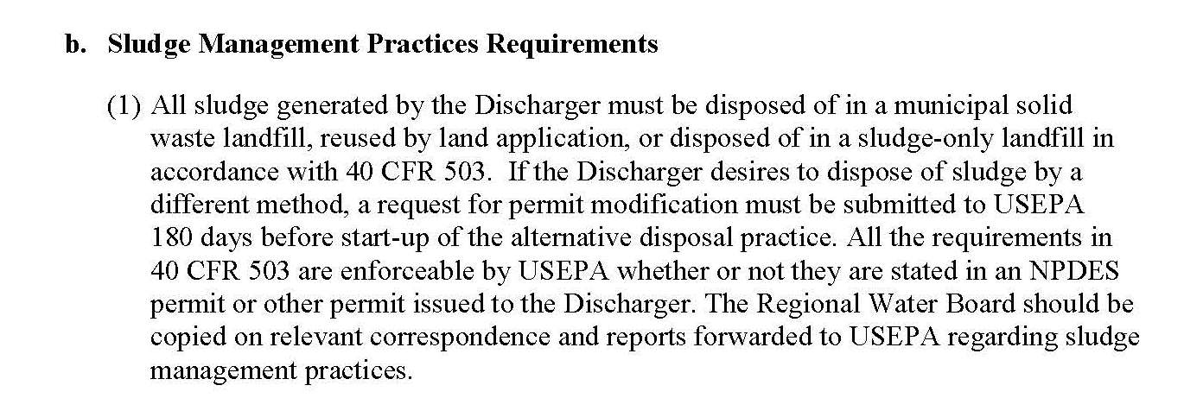
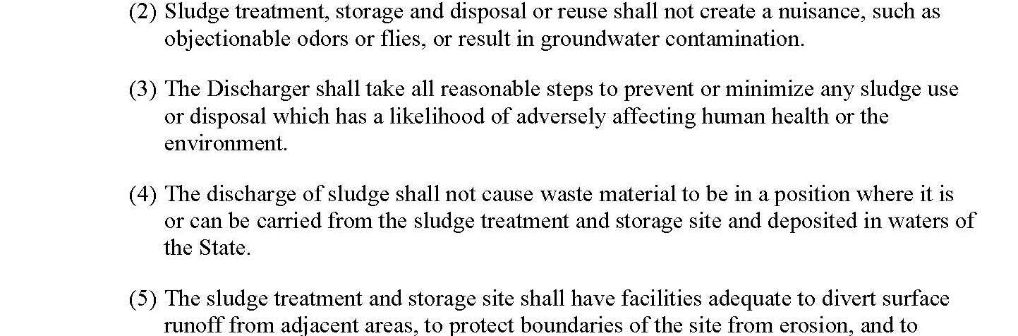
NPDES Permits
Biosolids (Sludge) Limits 40 CFR 503
Sludge Requirements for a POTW’s NPDES Discharge

Slide 25
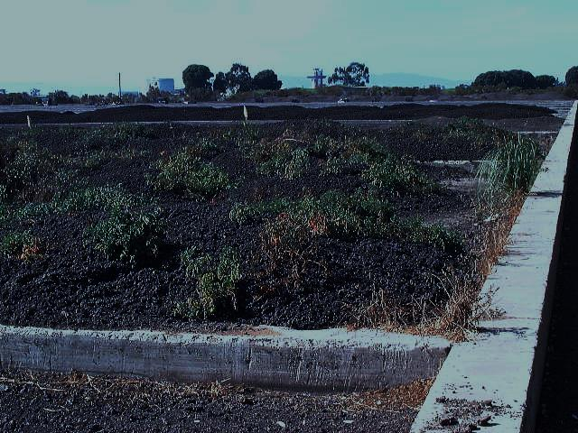
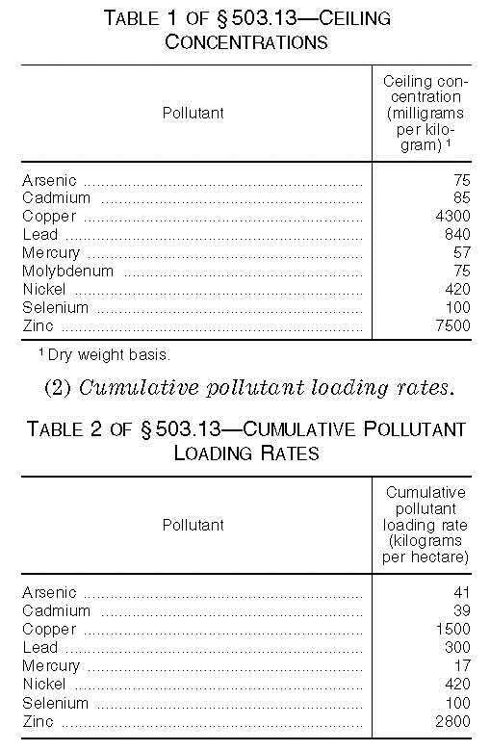
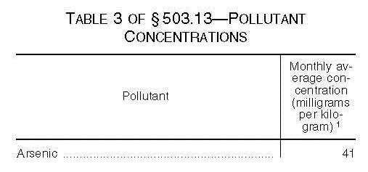
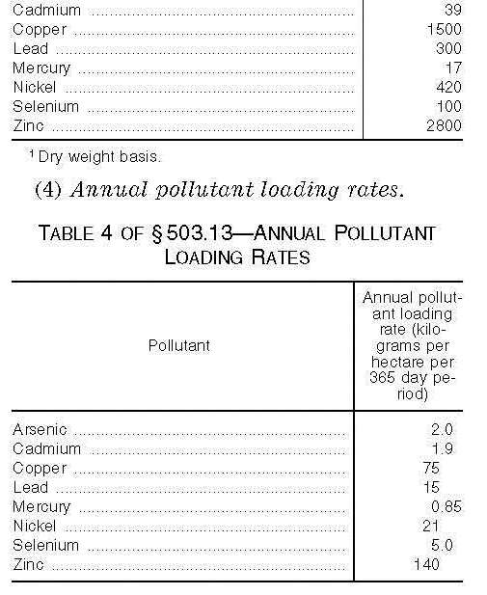
NPDES Permits
Federal Biosolids (Sludge) Requirements
Sludge Requirements for a POTW’s NPDES Discharge
Table 1
landfill disposal
Table 2-3
land application
bulk product
Table 4
sold product

Slide 26
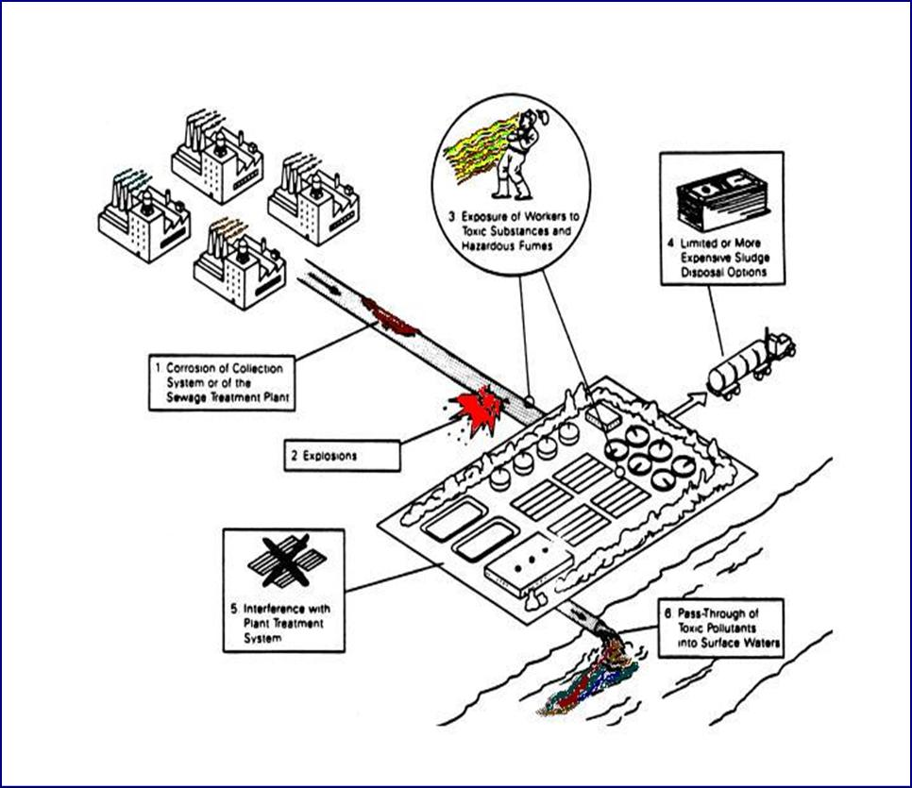
NPDES Permits
M
M
B
M
M
BAT
B
S
M
WQBELs
W
Sludge
S
Q
MAHLs
M
B
W
Q
WQS
Q
Q
Q

Slide 27
Clean Water Act Basics
BACWA/EBMUD Pretreatment Training
March 11, 2019
Questions or Comments
Greg V. Arthur - (510) 967-8411 - gva@gvarthur.com

Slide 28
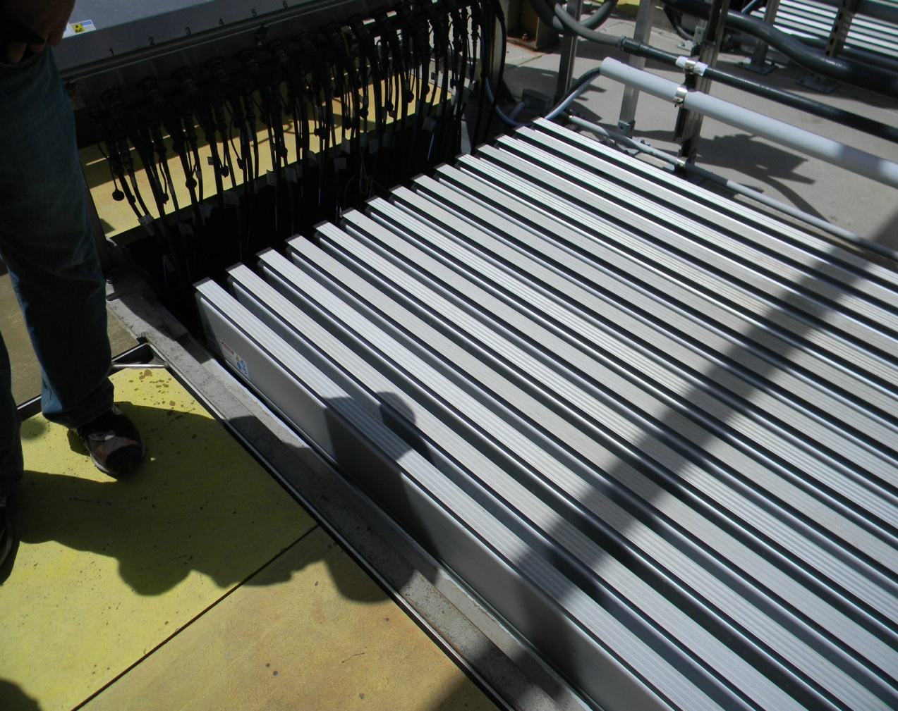
The Clean Water Act
Reasons for effective environmental compliance
Mostly Above Board
Little corruption
Diffused power
Defined compliance
achievable
clear pathways
measurable
consistent
Open records
ultraviolet disinfection at an ocean
discharging wastewater treatment plant

Slide 29
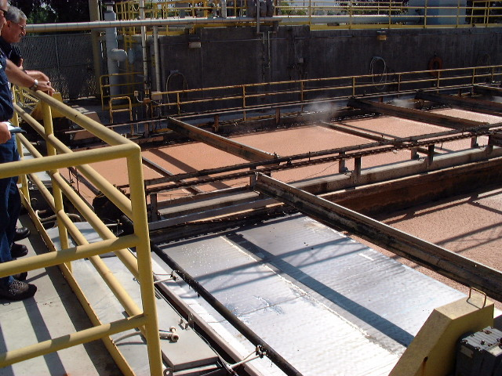
The Clean Water Act
Reasons for effective environmental compliance
Level Playing Field
national standards
national enforce-
ment policies
recovery of the
economic benefit
of non-compliance
states and local
agencies must be
as stringent
deep shaft bioreactors with dissolved air flotation of solids from cheese wastes

Slide 30
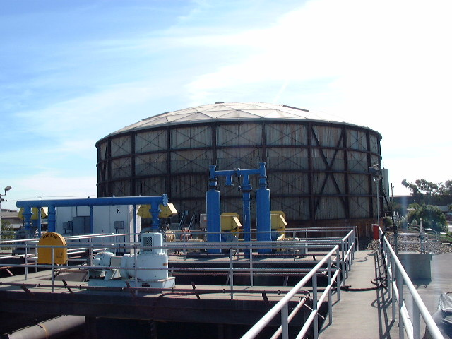
The Clean Water Act
Reasons for effective environmental compliance
Data-driven and
Predictable
compliance
determined by
sampling
national
guidelines
for test methods
not sampling is
equal to a failure
to meet standards
biotower preceding sludge contact at a municipal sewage treatment plant

Slide 31
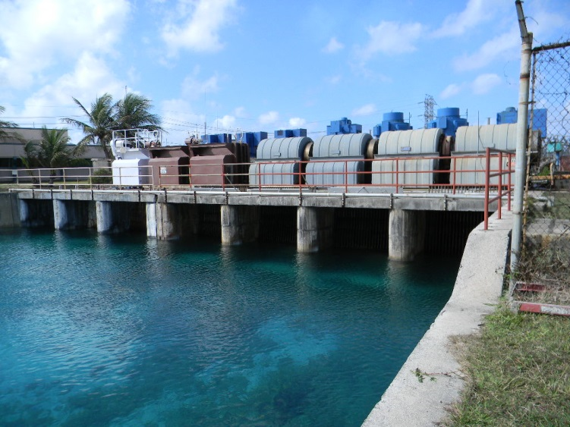
The Clean Water Act
Reasons for effective environmental compliance
Most Work Done
By State / Locals
delegation of
authorities
partial national
funding for states
national oversight
national reporting
mandated
requirements
single-pass cooling water intake at a ocean discharging power plant

Slide 32
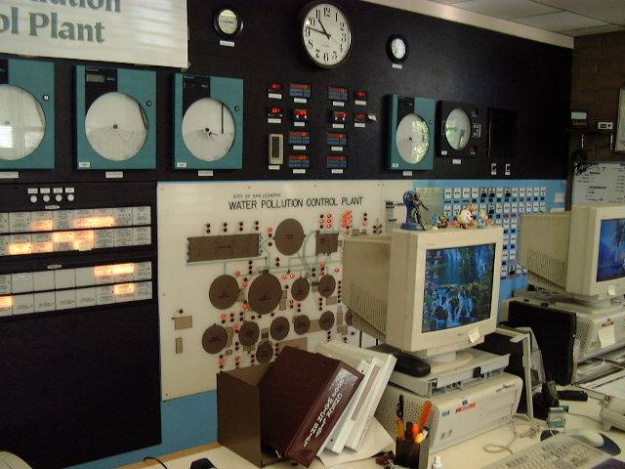
The Clean Water Act
Reasons for effective environmental compliance
Little corruption
National standards
Broad public support
Level playing field
Protection of
public investment
Data-driven and
predictable
State and local
delegation
someone needs new slides

Slide 33
The Clean Water Act
Reasons for effective environmental compliance
Most compliance
is achieved through
voluntary compliance
Some is achieved
administratively
Use of governmental
power through courts
is rarely necessary
Almost no criminal
prosecution
someone needs new slides

Slide 34
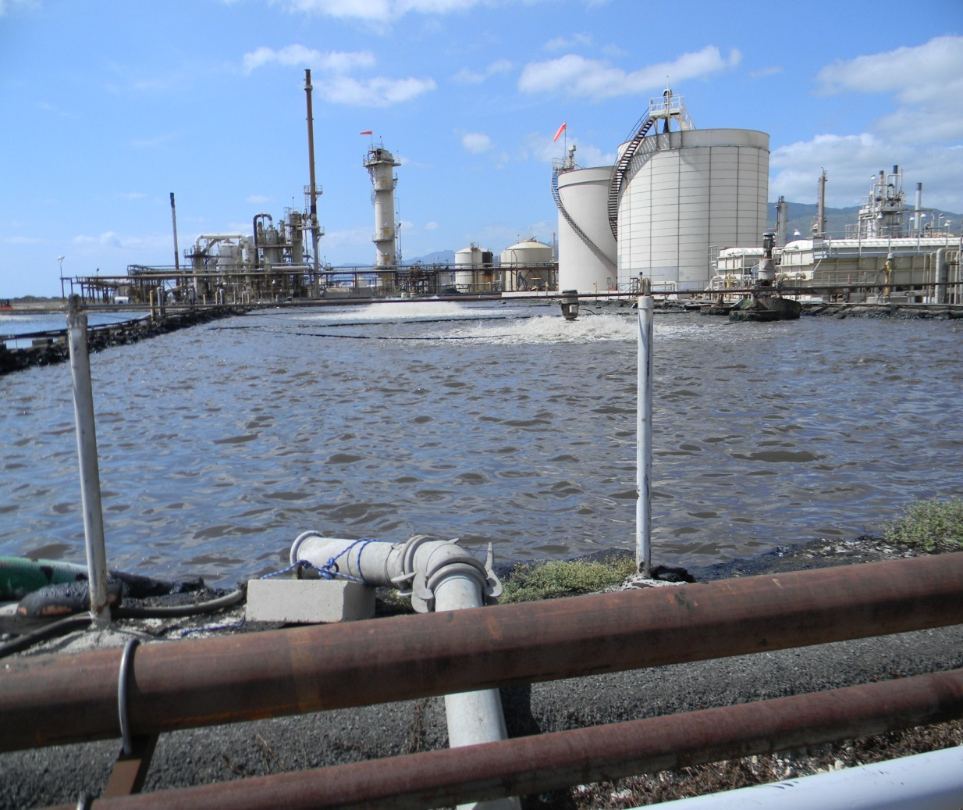
The Clean Water Act
Some weaknesses in environmental compliance
Data management
Governmental
sources of pollution
Federal installations
State agencies
City utilities
Developing
regulatory capability
Complexity
Ever-moving target
aerated lagoons for treatment of oil refinery wastewater

Slide 35
Clean Water Act Basics
BACWA/EBMUD Pretreatment Training
March 11, 2019
Questions or Comments
Greg V. Arthur - (510) 967-8411 - gva@gvarthur.com

