Slide 1
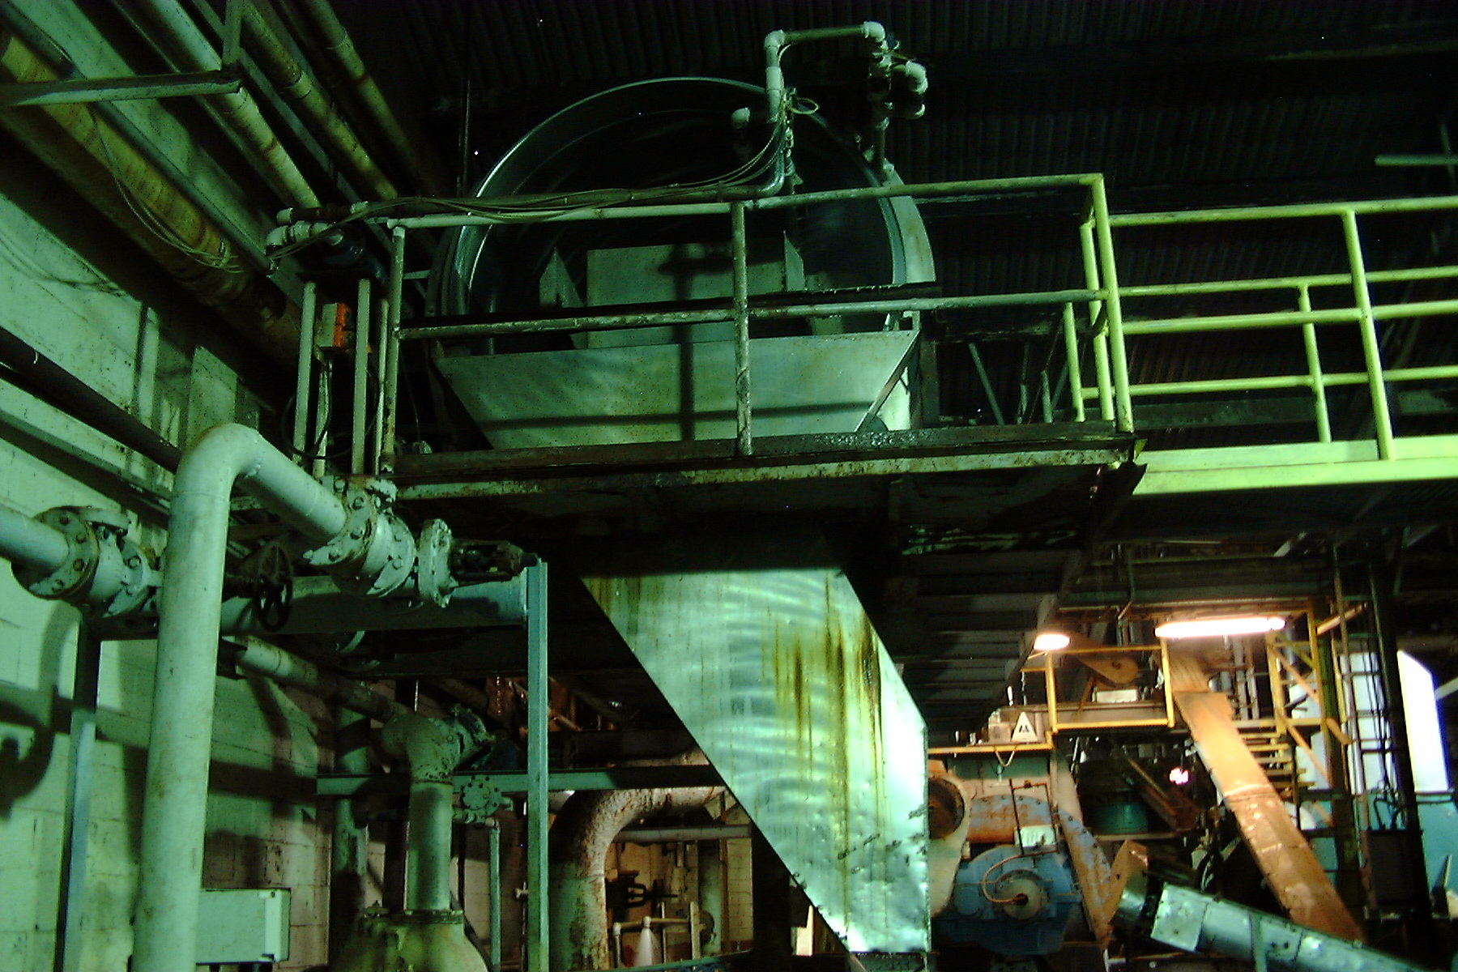
Pretreatment Program Basics
BACWA/EBMUD Pretreatment Training
March 11, 2019
Greg V. Arthur - (510) 967-8411 - gva@gvarthur.com

Slide 2
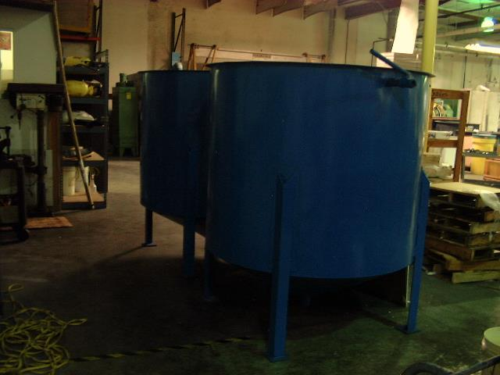
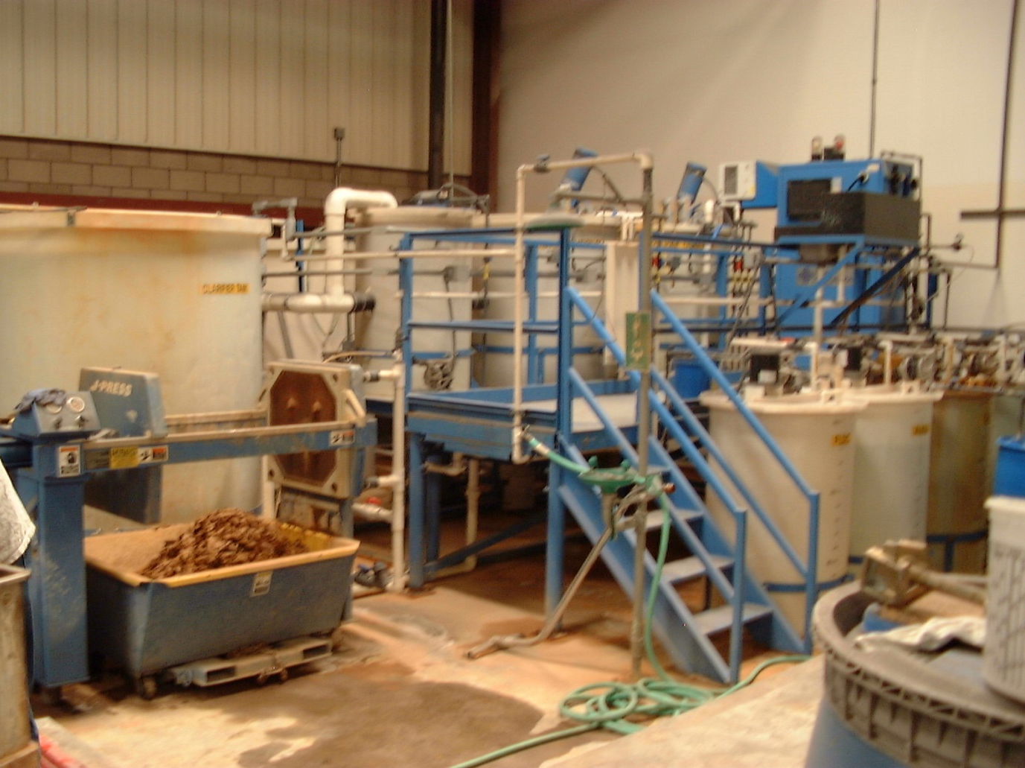
Pretreatment Program Basics
Clean Water Act applied to indirect non-domestic discharges
EPA
DOJ
State Water
State AGs
DAs
Sewer Districts
Municipals
JPAs
Counties
treatment unit to remove metals at a metal finisher

Slide 3
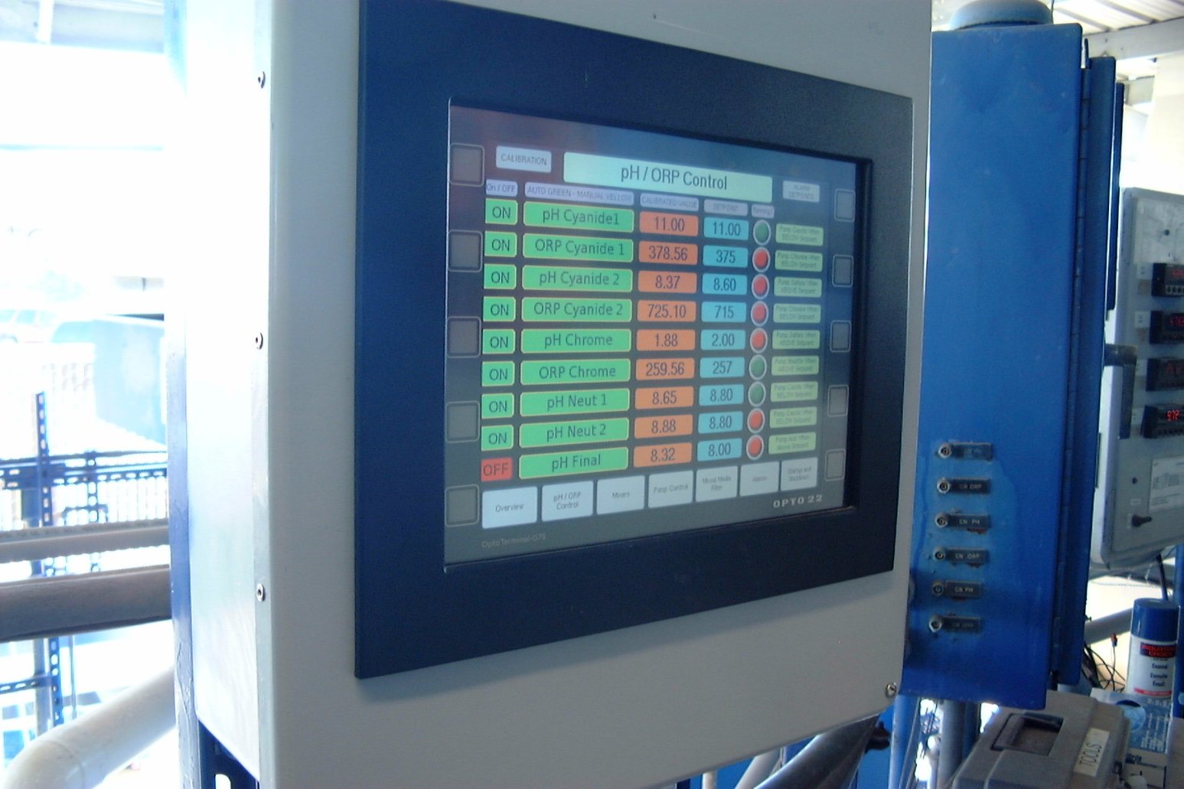
40 CFR 403.2
Purpose and Objectives
Prevent
interference
Prevent
pass-through
Improve
reclaim/recycle
wastewater
and sludges
reaction end-point monitoring for metals precip, Cr-reduction, CN-destruction

Slide 4
40 CFR 403.3
Pretreatment Program Definitions
POTW – publicly-owned treatment works
Industrial User (IU) – non-domestic indirect discharger
Interference – discharge that causes or contributes to a
treatment works inhibition, resulting in a violation by POTW
Pass-Through – discharge of pollutants that passes through
a treatment works, resulting in a violation by the POTW
New Source – new facility or replacement of existing facility
Significant Industrial User (SIU) – IU determined to be high
flow (25k gpd), high load (5%), high risk, or categorical
Approval Authority – State or EPA approves PT Programs

Slide 5
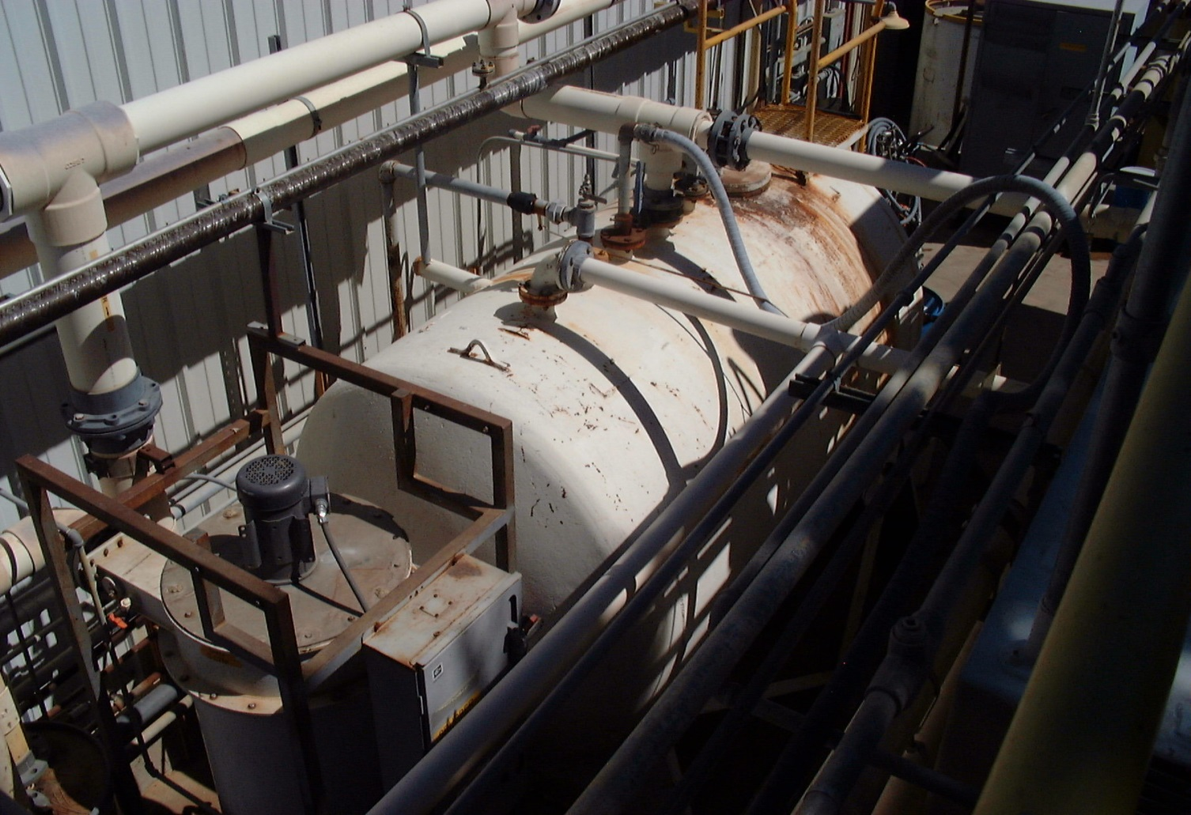
40 CFR 403.4
State and Local Law
The Federal
pretreatment
rules do not
preclude States
or local govern-
ments from
establishing
additional and
more stringent
law
final settling tank following aerobic bioreactors at a surfactant manufacturer

Slide 6
40 CFR 403.5
National Prohibitions and Local Limits
General Prohibitions
pass-through or interference
Specific Prohibitions
fire or explosion hazards (flashpoint <140°F)
causing corrosive structural damage to treatment works
solids or viscous pollutants causing obstructions
oxygen demanding pollutants which will cause interference
heat which will inhibit biological activity (<104°F influent)

Slide 7
40 CFR 403.5
National Prohibitions and Local Limits
Specific Prohibitions
petroleum and non-biodegradable oils that will cause
interference or pass-through
trucked or hauled wastes except at designated points
Local Limits
numerical expression of general and specific prohibitions
technically-based treatment works MAHLs
defensible allocations and/or BMPs to IUs
enacted through local sewer use ordinance

Slide 8
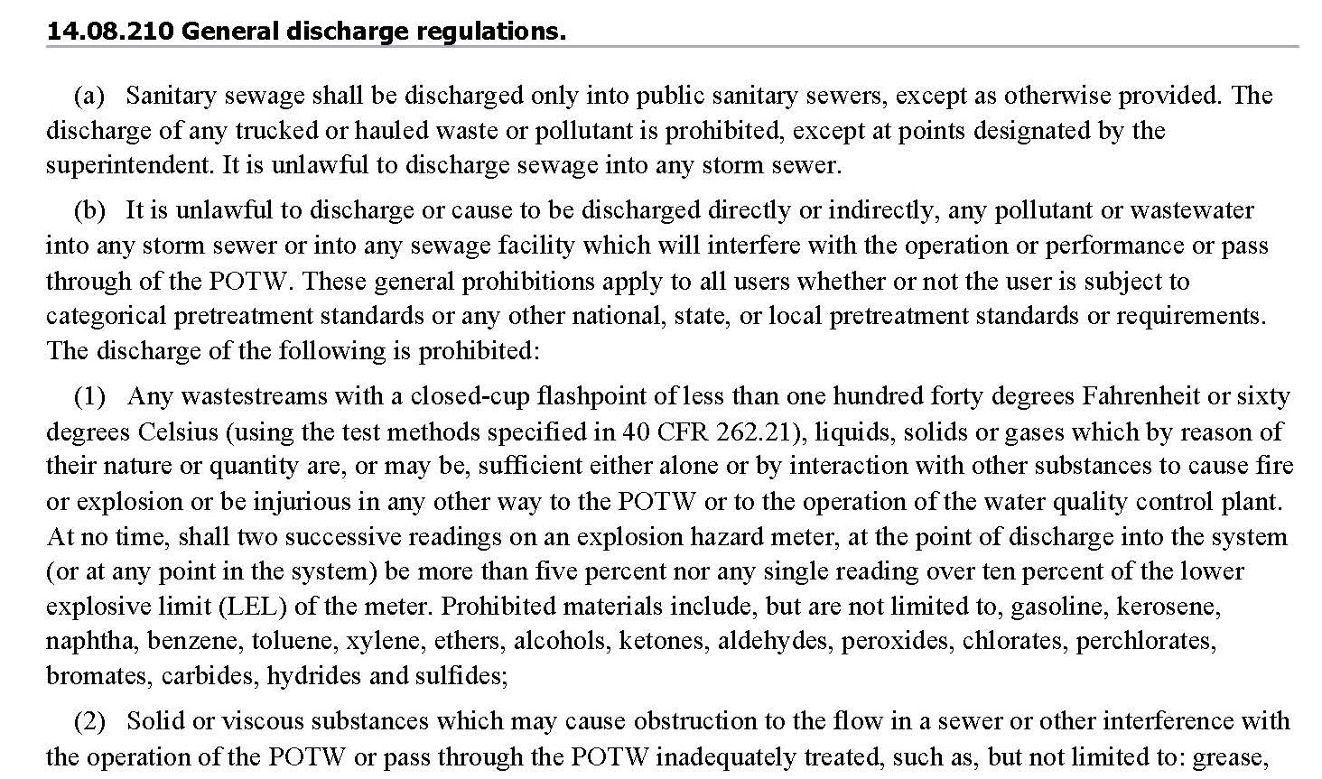
40 CFR 403.5
National Prohibitions and Local Limits
Municipal Local Limits

Slide 9
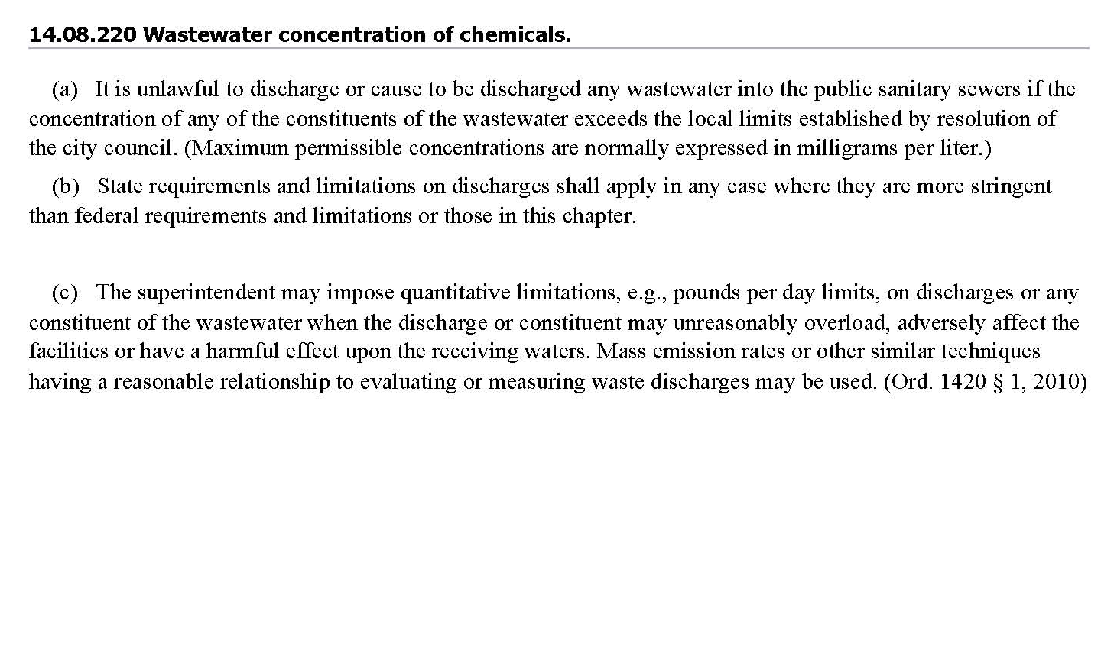
40 CFR 403.5
National Prohibitions and Local Limits
Municipal Local Limits

Slide 10
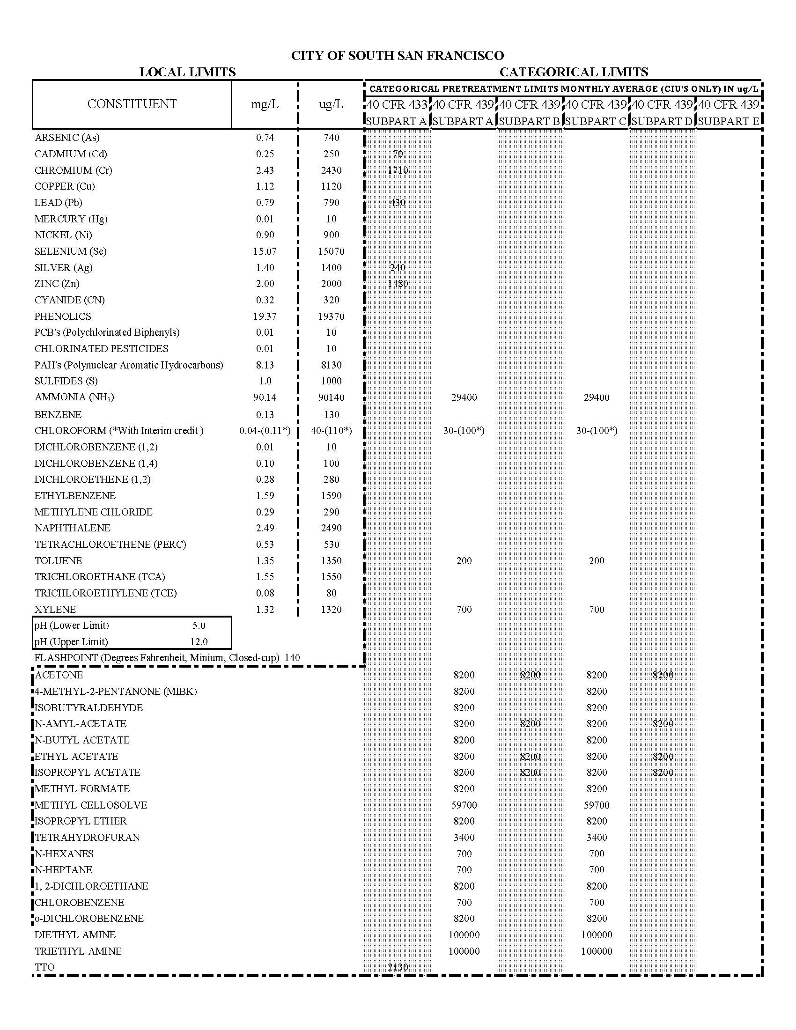
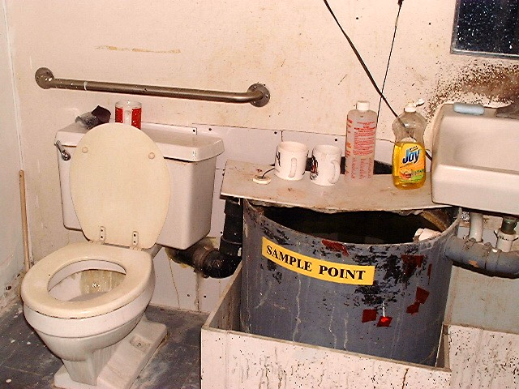
40 CFR 403.5
National Prohibitions / Local Limits
Municipal Local Limits
official permitted sample point

Slide 11
40 CFR 403.6
Technology-based Categorical Standards
Sections 407-471 Effluent Guidelines
compliance deadlines
concentration to flow-based mass limits
production-based mass to concentration limits
prohibition against dilution as a substitute for treatment
combined wastestream formula
definition of regulated, unregulated, and dilution waters
end-of-process-after-treatment sampling

Slide 12
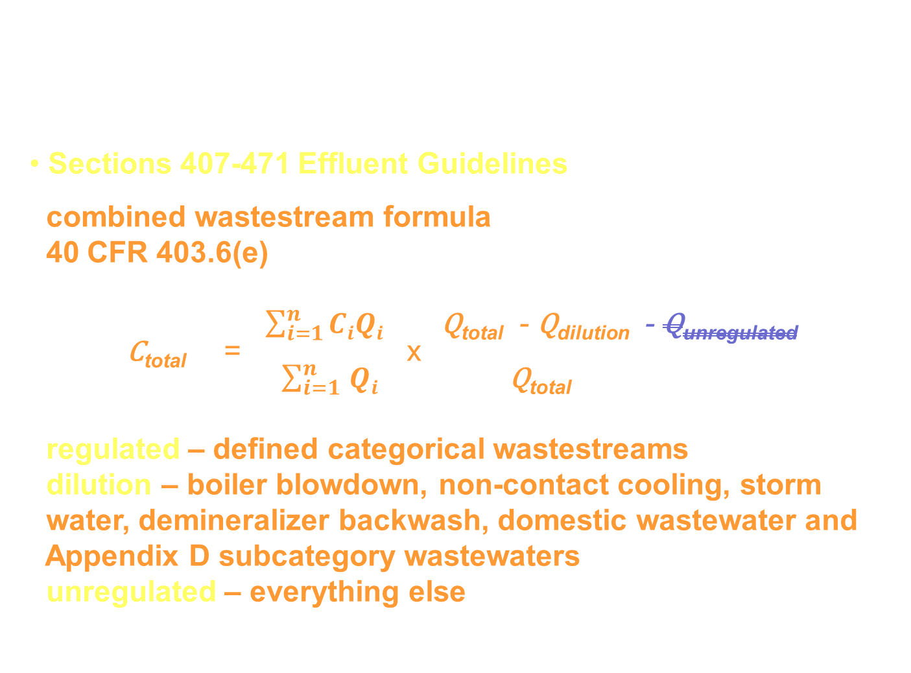
40 CFR 403.6
Technology-based Categorical Standards
Sections 407-471 Effluent Guidelines
combined wastestream formula
40 CFR 403.6(e)
$\sum_{i=1}^{n}{CiQi}$ Q_{total} - Q_{dilution} - Q_{unregulated}
C_{total} = x
$\sum_{i=1 }^{n}{Qi}$ Q_{total}
regulated – defined categorical wastestreams
dilution – boiler blowdown, non-contact cooling, storm
water, demineralizer backwash, domestic wastewater and
Appendix D subcategory wastewaters
unregulated – everything else

Slide 13
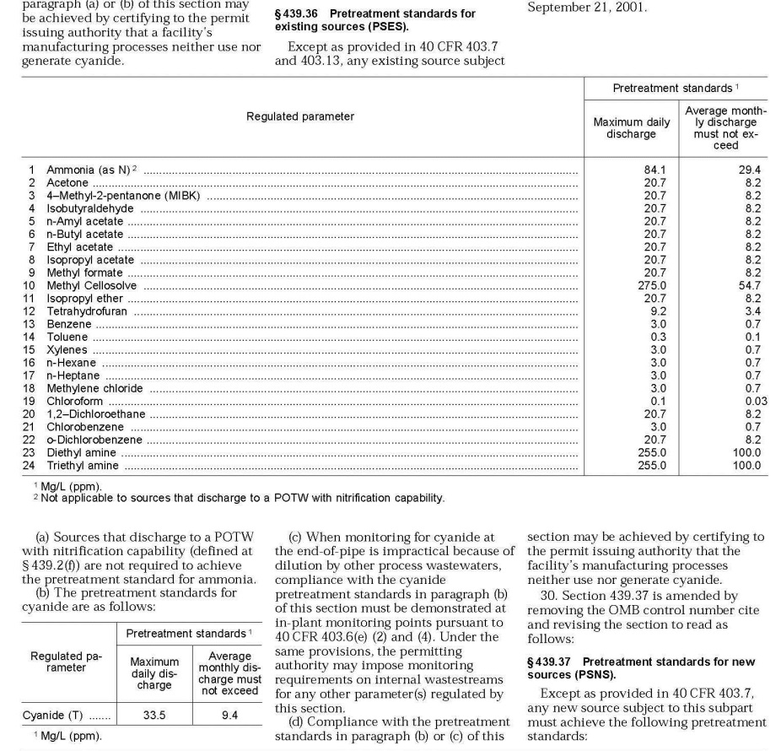
40 CFR 403.6
Technology-based Categorical Standards
Pharmaceuticals 40 CFR 437
applicability
regulated pollutants
basis of standards
new vs existing source
dilution as sub for treatment
combined wastestream formula
sampling locations
compliance deadline

Slide 14
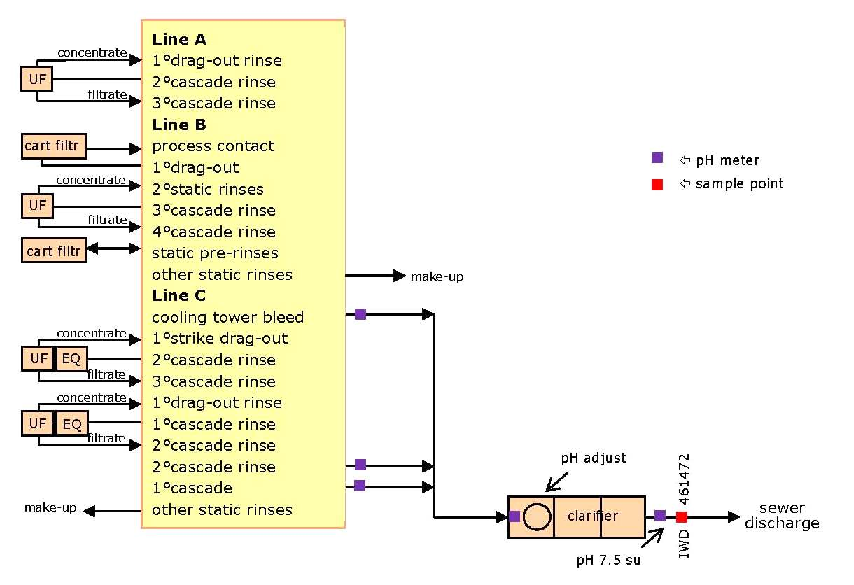
40 CFR 403.6
Technology-based Categorical Standards
end of process after treatment

Slide 15
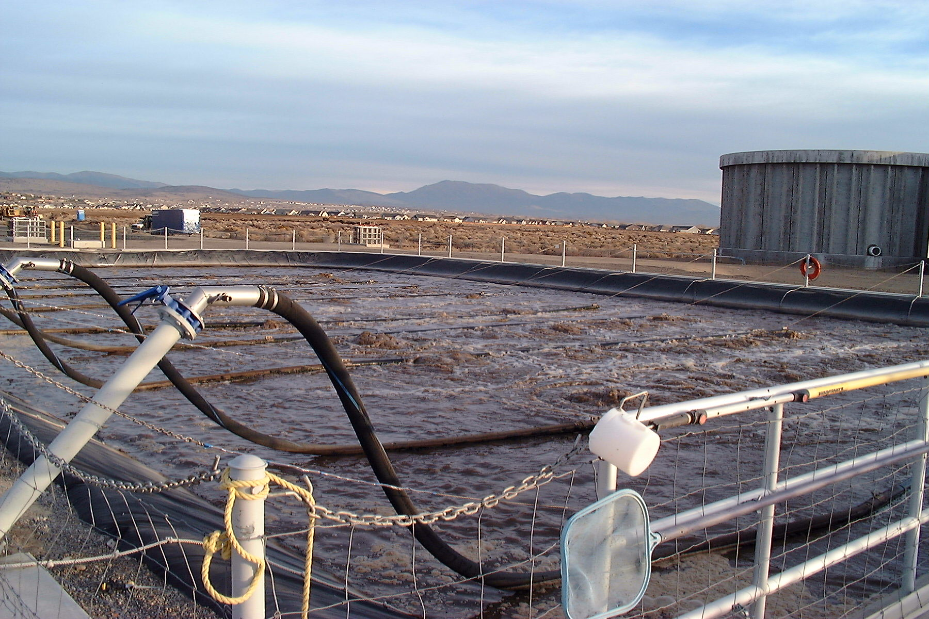
40 CFR 403.7 and 403.11
Removal Credits for Categorical Standards
Sections 407-471 Effluent Guidelines
Alternate Federal
standards based
on treatment
plants removals
None in Region 9
ever approved by
EPA or States
activated sludge aeration raceways at a municipal sewage treatment plant

Slide 16
40 CFR 403.8
POTW Pretreatment Program Requirements
8(a) – POTWs with WWTPs total design flow > 5 mgd
8(b) – Administered to ensure compliance by IUs
8(f)1 – Legal authority (including MJPA)
issue permits (duration, non-transferability, effluent limits,
self-monitoring, penalties, slug discharge control)
conduct inspections and monitoring to determine com-
pliance independent of information supplied by the IUs
obtain injunctive relief, and civil and criminal penalties
halt or prevent discharges which pose or may pose immi-
nent endangerment to health, welfare, envr, or POTW

Slide 17
40 CFR 403.8
POTW Pretreatment Program Requirements
8(f)2 – Implement Procedures
compile inventory of IUs and identify the character and
volume of pollutants discharged
notify IUs of requirements and SIUs of their status
receive and analyze self-monitoring
inspect and sample to obtain results independent of
information from the IUs (at least once per year for SIUs)
require slug control plans
investigate non-compliance
publish annually the SIUs in significant non-compliance

Slide 18
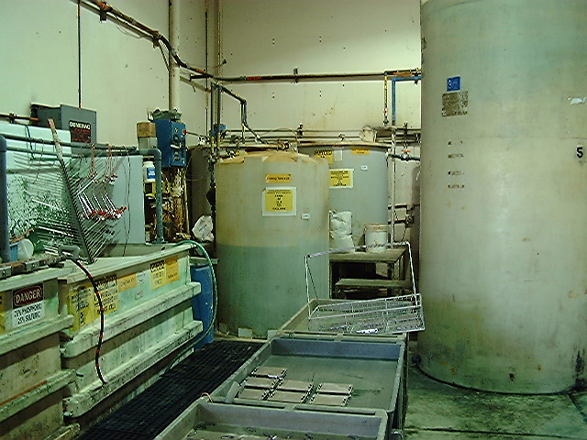
40 CFR 403.8
POTW Pretreatment Program Requirements
8(f)3 – Funding
sufficient re-
sources and
qualified person-
nel to enact the
legal authority
and implement
the procedures
8(f)4 – Local Limits
develop local
limits
batch treatment for chromium reduction, metals precipitation, settling

Slide 19
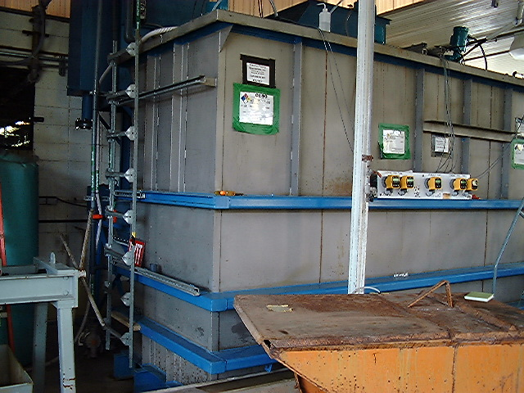
40 CFR 403.8
POTW Pretreatment Program Requirements
8(f)5 – ERP
implement
an enforcement
response plan
SUO Checklist
8(f)6 – SIU List
maintain and
submit list of SIUs
industrial wastewater treatment unit for toxic metals and acids at a plating shop

Slide 20
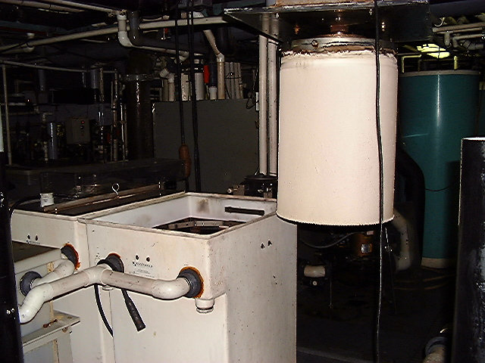
40 CFR 403.9 and 403.18
Pretreatment Program Approval and Modification
9(b) – Contents
of POTW Program
Submittal
certifying state-
ment of legal
authority
local limits
IU inventory
permitting
monitoring
ERP
rotating-drum electrowinning silver recovery for movie film processing plant

Slide 21
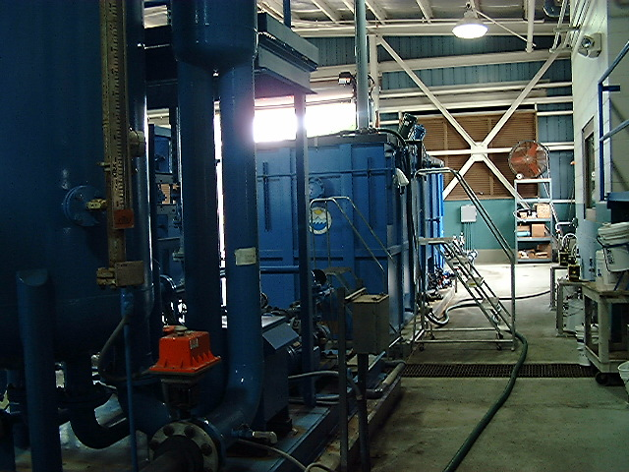
40 CFR 403.10
State Pretreatment Programs
10(e) – State PT
Program in lieu of
POTW Programs
Connecticut
Vermont
Alabama
Mississippi
Nebraska
chem-aided de-emulsion oil water separator unit for oily ships bilge waters

Slide 22
40 CFR 403.12
Monitoring and Reporting for POTWs and IUs
12(b) – CIU Baseline Monitoring Reports
12(d) – CIU 90-day Compliance Report
12(e) – CIU Periodic Compliance Reports
self-monitoring at least twice per year
self-certification in lieu of sampling for pollutants not
present, if waived by permit
12(h) – SIU Periodic Compliance Reports
self-monitoring at least twice per year
12(f) – Notification of potential slug load discharges

Slide 23
40 CFR 403.12
Monitoring and Reporting for POTWs and IUs
12(g) – Monitoring and Analysis for CIUs, SIUs, POTWs
monitoring by the POTW in lieu of self-monitoring
24-hour notification upon becoming aware of a violation
resample in 30 days of becoming aware of a violation
sample record representative over the reporting period
samples representative the sampling period
grab samples for pH, CN, S⁼, phenols, VOAs as also
defined in Appendix E
24-hour composite sampling for all other pollutants
analyses in accordance with 40 CFR 136
more frequent self-monitoring must be reported

Slide 24
40 CFR 403.12
Monitoring and Reporting for POTWs and IUs
12(i) – POTW Annual Report
updated IU inventory
summary of IU compliance status
summary of enforcement activities
summary of changes to the POTW Pretreatment Program
12(j) – IU Notification of substantial changes in discharge
12(l) – IU Signatory Requirements
12(m) – POTW Signatory Requirements

Slide 25
40 CFR 403.12
Monitoring and Reporting for POTWs and IUs
12(o) – POTW and IU Record-keeping requirements
updated IU inventory
summary of IU compliance status
summary of enforcement activities
summary of changes to the POTW Pretreatment Program
12(p) – IU notification of discharges that would otherwise be
hazardous waste under 40 CFR 261
Domestic Sewage Exclusion
DTSC Permit-by-Rule
12(r) – Electronic reporting in 40 CFR 3

Slide 26
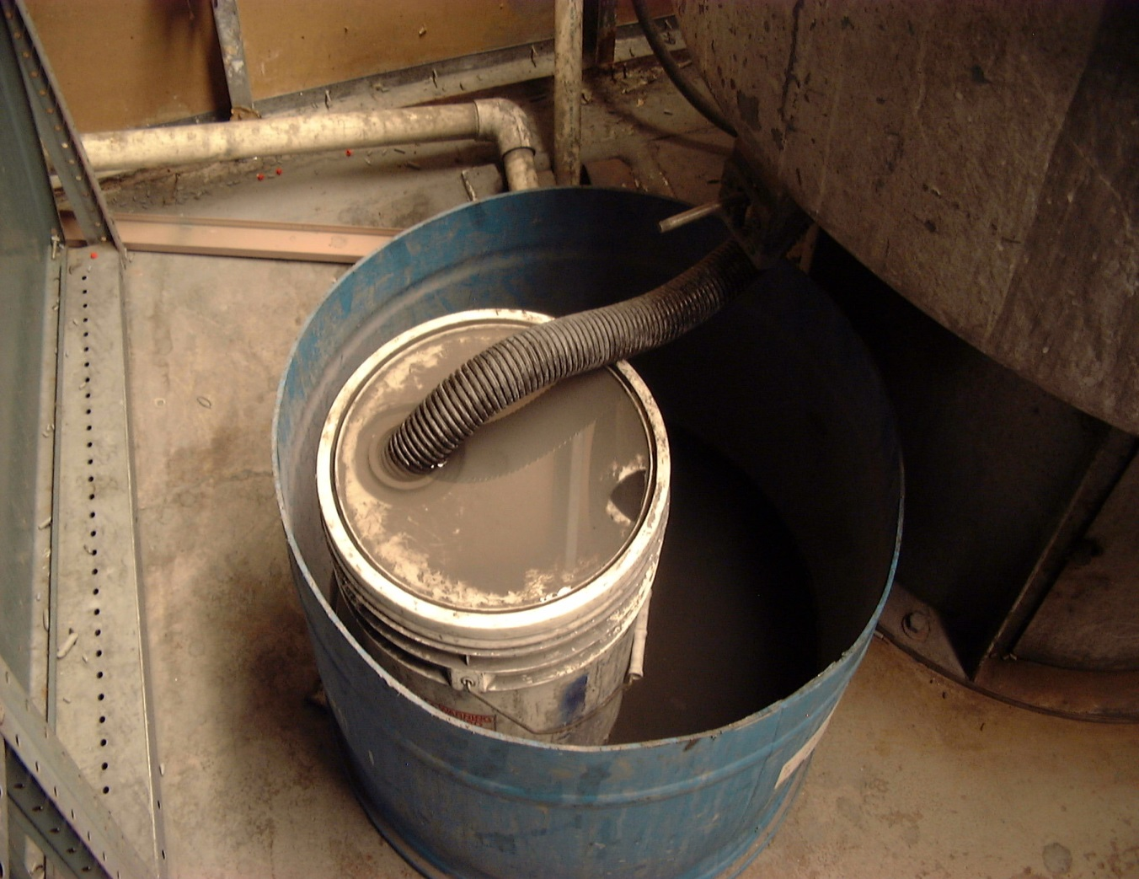
40 CFR 403.13
Fundamental Different Factors
Case by Case
Variance of
Categorical Stds
CIU request 180
days after pub-
lication date of
categorical std
Not Applicable
vibratory deburring silt catchment prior to discharge to the sewers

Slide 27
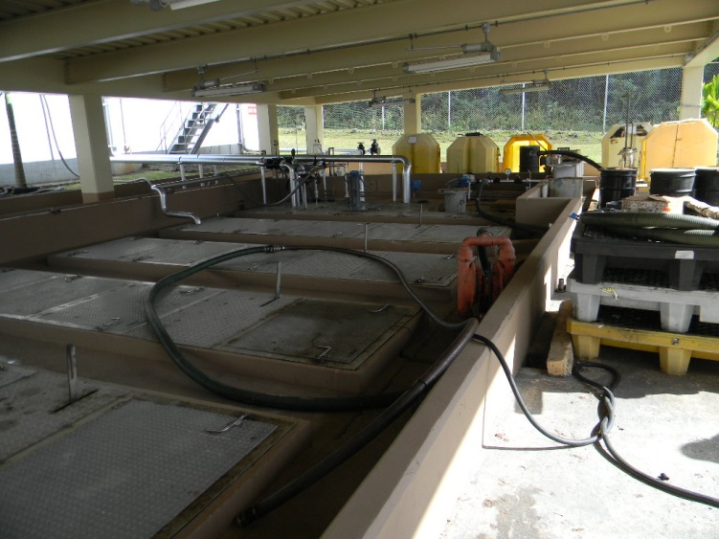
40 CFR 403.14
Confidentiality
IU Submittals
No – production
data to determine
limits
No – effluent or
flow data
Maybe – All other
data claimed as
“confidential”
under 40 CFR 2
No – Any data
not claimed
oily drainage skimming and equalization for tank farm flows

Slide 28
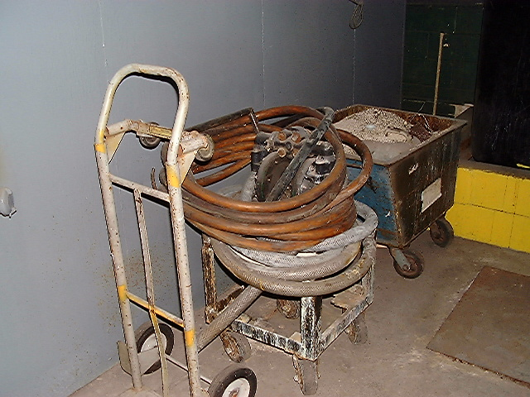
40 CFR 403.15
Net/Gross Calculations
Adjustment of
categorical stds
to account for
intake water
Intake from same
water body that
the POTW dis-
charges into
Treatment would
meet standards
without intake
concentrations
portable pump and hose delivery at a metal finishing shop

Slide 29
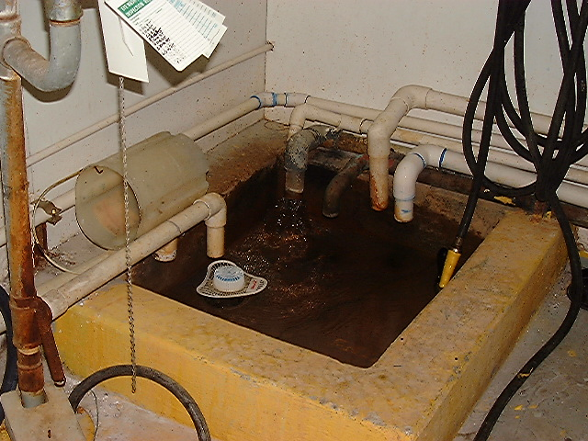
40 CFR 403.16
Upset Provision
Affirmative
defense for IU
violations
Entirely outside
of IU’s control
unworkable sample point with too many contributing discharges

Slide 30
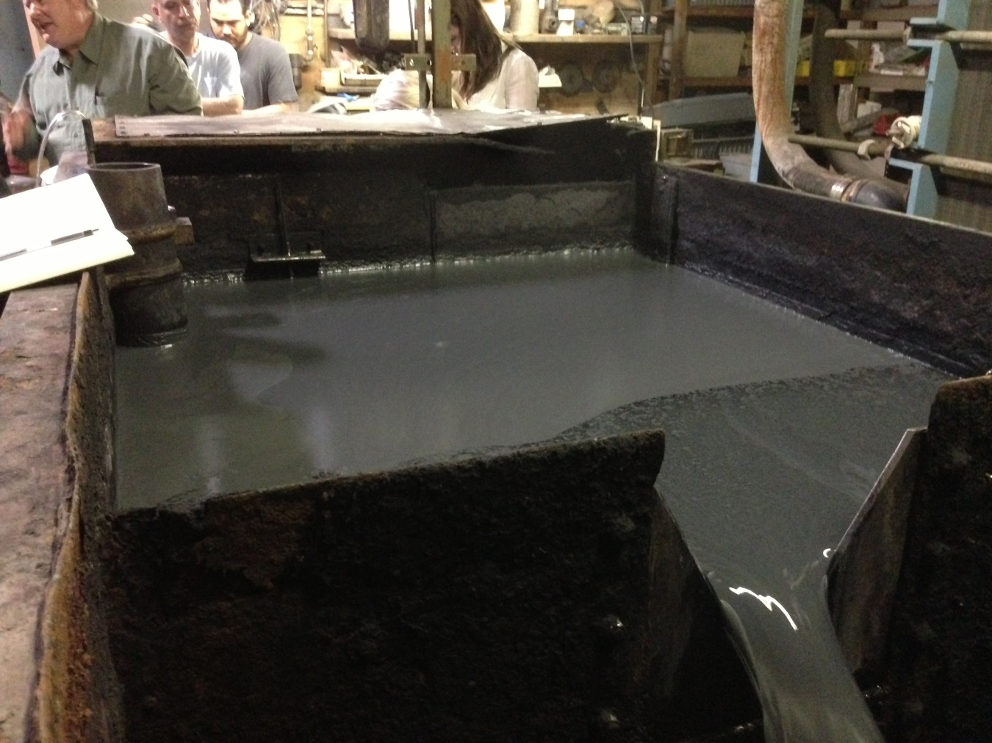
40 CFR 403.17
Bypass Provision
17(d) – Prohibi-
tion against the
bypassing of
treatment neces-
sary to comply
Unless …
no feasible
alternative
unavoidable to
prevent loss of
life, injury, or
severe damage.
final effluent flume flow meter

Slide 31
Pretreatment Program Basics
BACWA/EBMUD Pretreatment Training
March 11, 2019
Questions or Comments
Greg V. Arthur - (510) 967-8411 - gva@gvarthur.com

