Slide 1
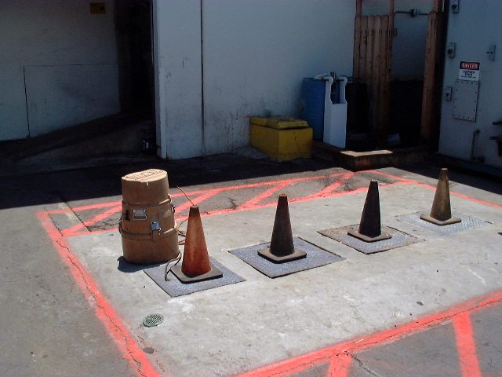
Representative Sampling
BACWA/EBMUD Pretreatment Training
March 11, 2019
Greg V. Arthur - (510) 967-8411 - gva@gvarthur.com

Slide 2
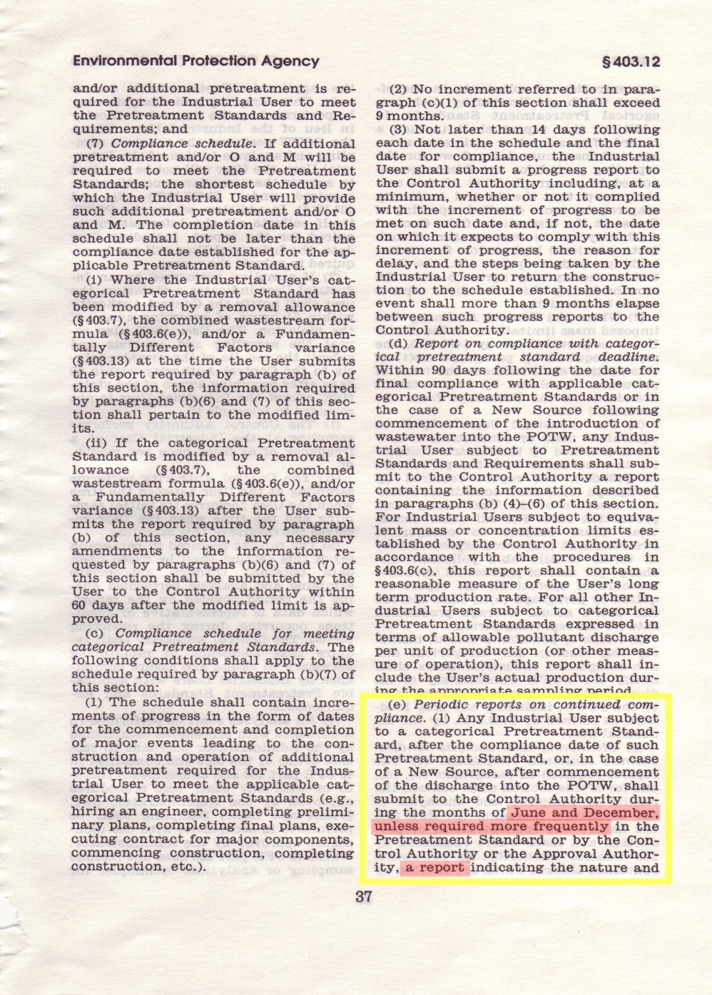
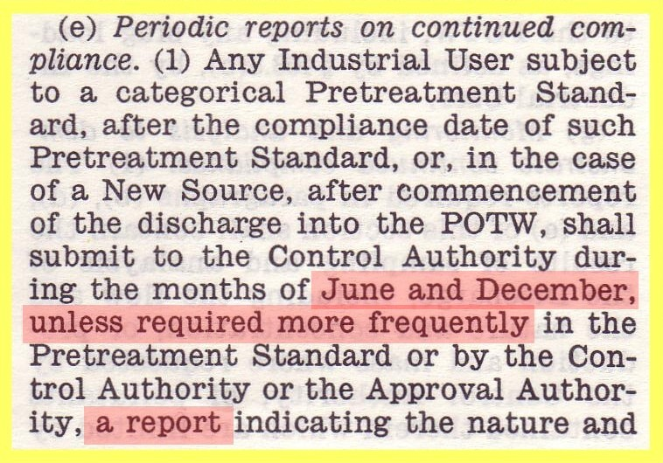
Self-Monitoring
Requirements
40 CFR 403.12(e)(1)

Slide 3
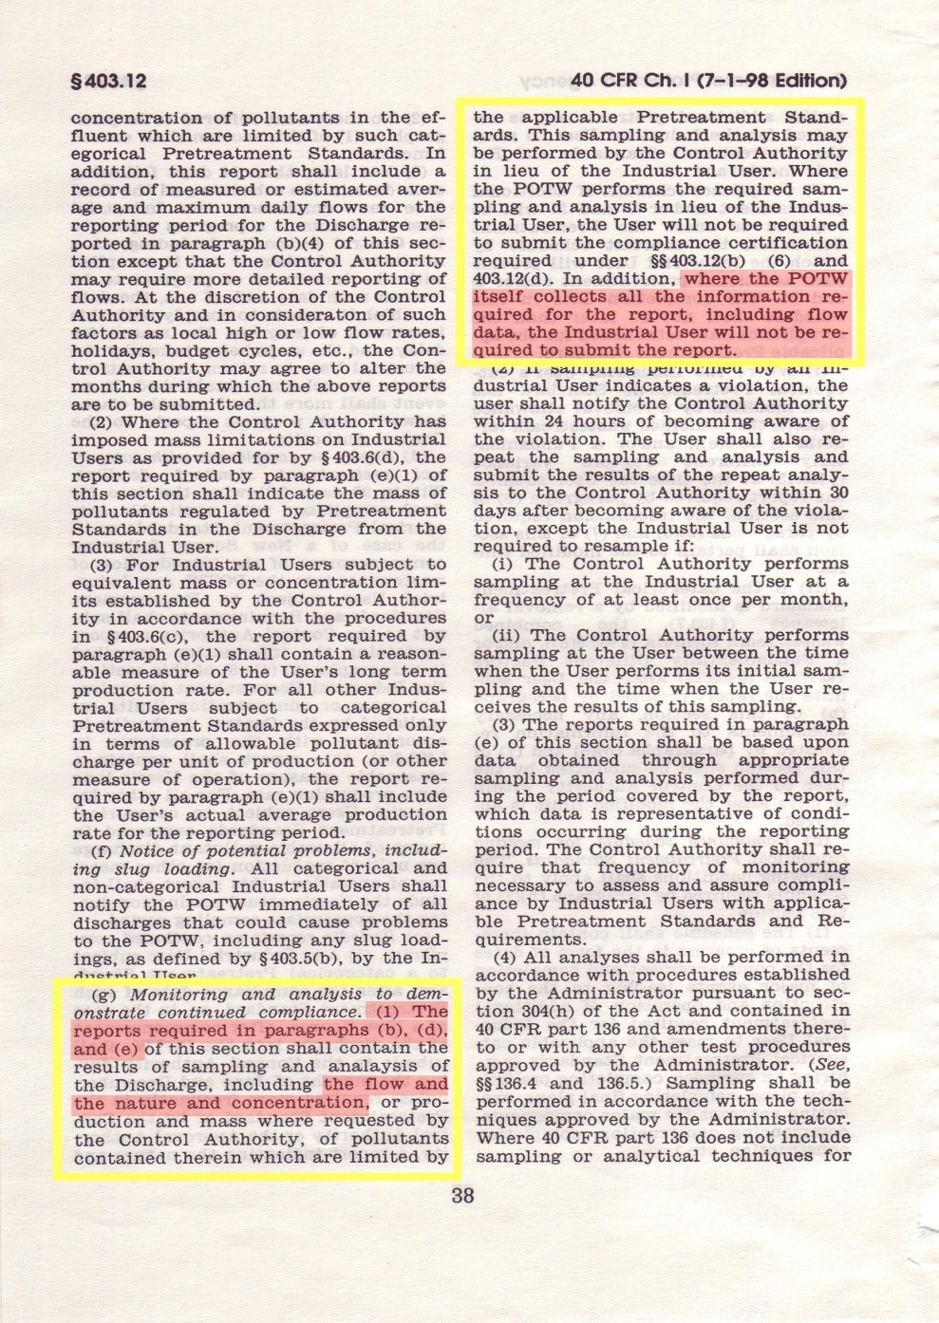
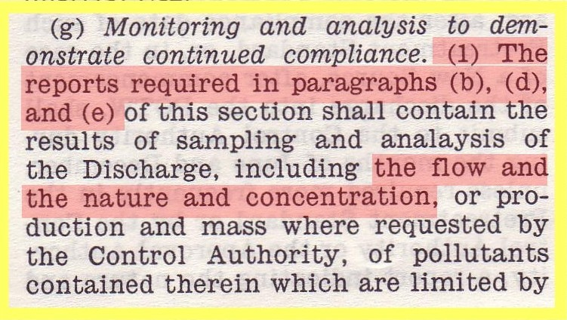
40 CFR 403.12(g)(1)

Slide 4
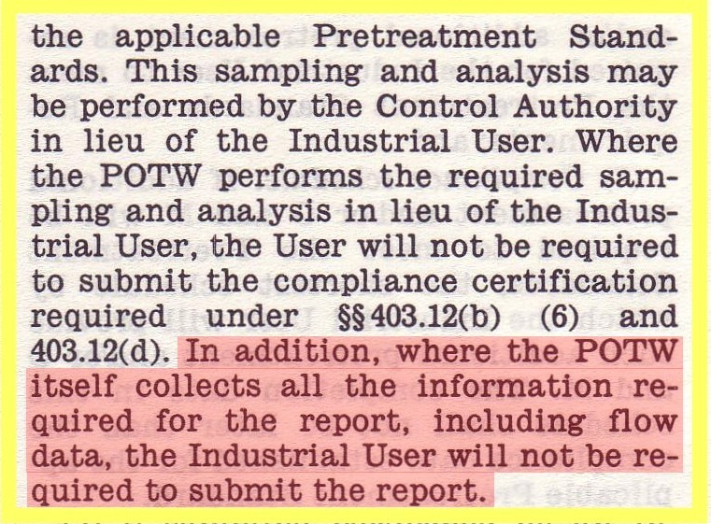
40 CFR 403.12(g)(1)

Slide 5
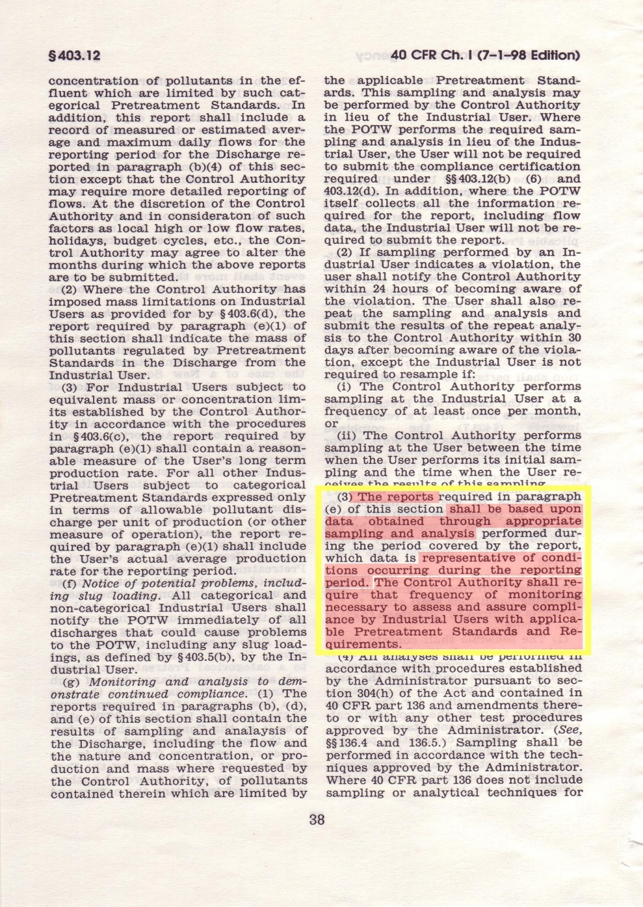
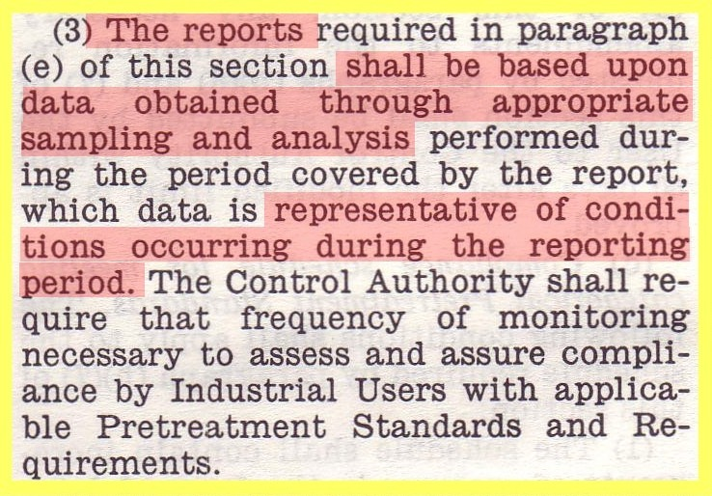
40 CFR 403.12(g)(3)

Slide 6
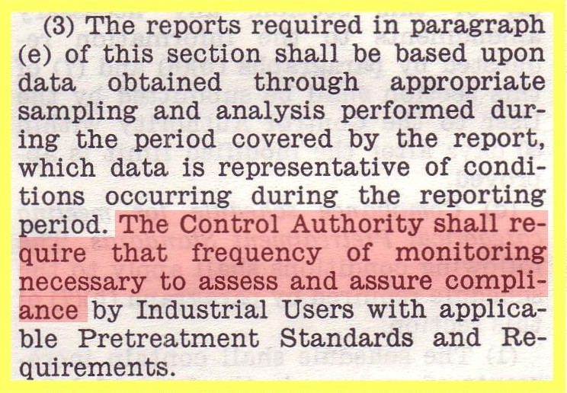
40 CFR 403.12(g)(3)

Slide 7
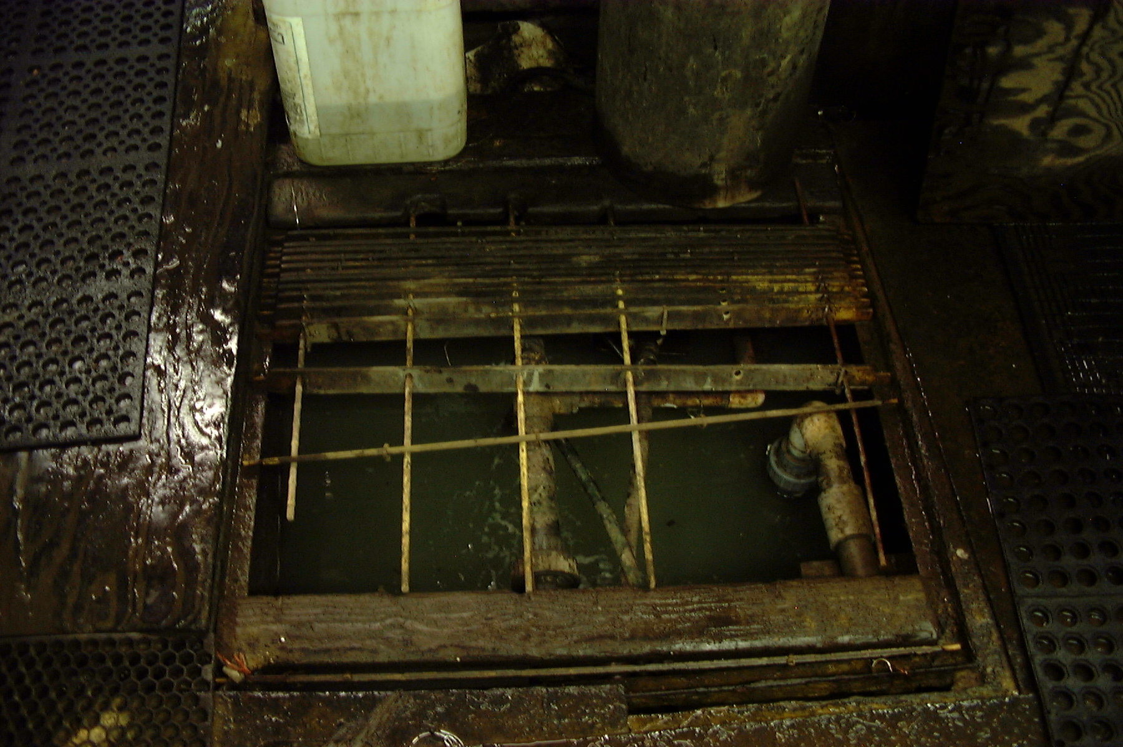
The Bottom Line
Twice per year reports of
self-monitoring.
Each sample must be
representative over the
sampling day.
Sampling must be repre-
sentative of all regulated
discharges.
The sample record must be
representative over the six-
month reporting period.
Self-Monitoring
Requirements
40 CFR 403.12

Slide 8
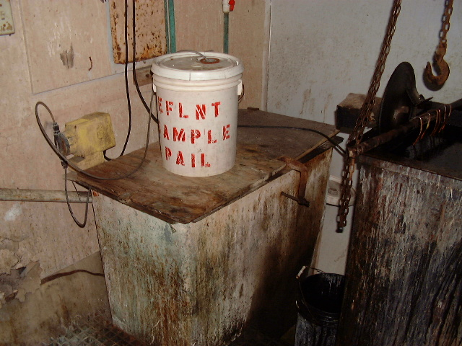
So …
Self-Monitoring
Complies with Federal
Regulations
If …
All samples together are representative of the flow, nature, and concentration of the discharge over the entire six-month
reporting period.
Self-Monitoring
Requirements
40 CFR 403.12

Slide 9
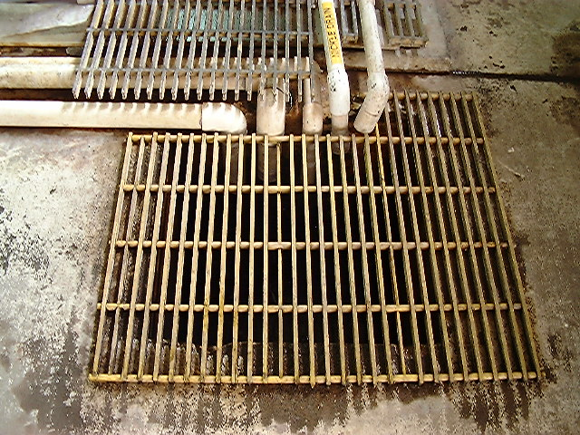
The Test for
Representative Sampling
Are there enough samples taken at the right times from the right locations to be representative of the discharge over the entire six-month reporting period?

Slide 10
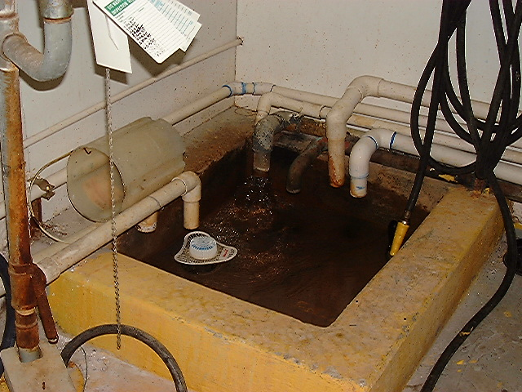
Federal Minimum
Can one 24-hr comp sample be representative over a six-month reporting period?
Yes, but only if …
consistent flow and
nature
random distribution
variability only from BAT
little variability from ops

Slide 11
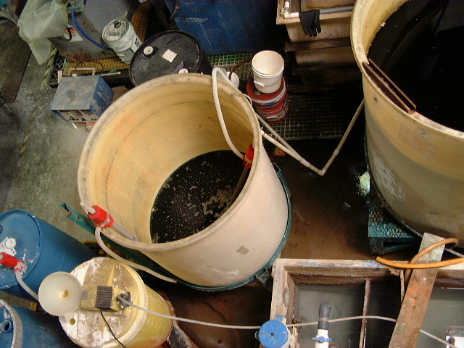
Complication #1
Independent events
batch treatment
spent solutions
intermittent operations
Are there enough samples taken at the right times and locations to be representative of the discharge over the six-month reporting period?

Slide 12
batch treat
for metals
spents
batch treat
for CN
spents
lamella
clarifier
continuous treat
for metals rinses

Slide 13
intermittent
spents spents
rinses
batch treat
for CN
spents
batch treat
for metals
spents
intermittent
~7 days
continuous
lamella
clarifier
continuous treat
for metals rinses
sample point
How many samples are necessary to capture both independent events (continuous & 7day)?

Slide 14
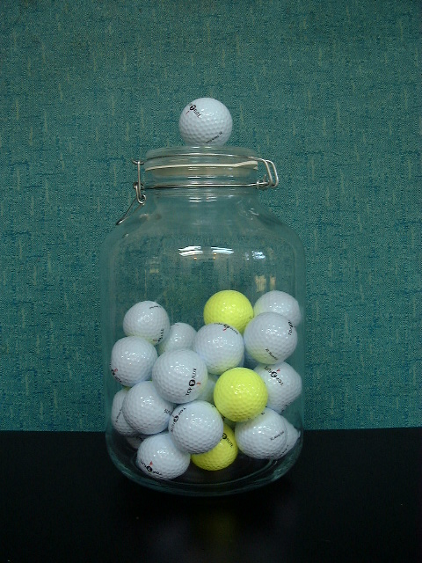
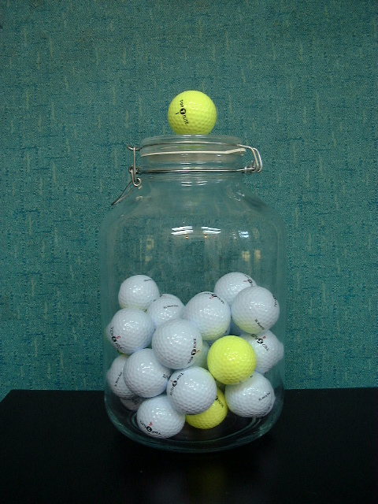
continuous
only
continuous
plus ~7day batch
How many samples are necessary to capture both independent events (continuous & 7day)?

Slide 15
Runs 1 - 10
ooooo
oooooooooooooooooooooo
oo
oooooooo
oooooooooooooo
ooooo
ooooooooo
oooooooooo
oooooooo
o
How many samples are necessary to capture both independent events (continuous & 7day)?

Slide 16
Runs 11 - 20
ooooooooooooooo
ooo
ooooooooooooooooooooooooo
ooooooooo
oooooo
oo
oooooooooooooooo
oooooooooooooooo
o
oooooo
How many samples are necessary to capture both independent events (continuous & 7day)?

Slide 17
Runs 21 - 30
oooooo
oooooo
oo
oooooo
ooo
ooooooooo
ooooooooooo
ooooo
ooo
oooo
How many samples are necessary to capture both independent events (continuous & 7day)?

Slide 18
Runs 31 - 40
oo
o
oo
ooooo
ooooooo
oooo
ooo
ooooo
o
oooo
How many samples are necessary to capture both independent events (continuous & 7day)?

Slide 19
Runs 41 - 50
o
oooooooo
oooooooooooo
oooo
oooooooo
oo
ooo
ooooooooooo
ooooooooooooo
o
How many samples are necessary to capture both independent events (continuous & 7day)?

Slide 20
Mean = 7.0 StDev = 5.4
Probability of capturing both
independent events in:
1 sample – 15%
2 samples – 20%
3 samples – 25%
6 samples – 43% (monthly)
7 samples – 50%
12 samples – 80%
20 samples – 99%
How many samples are necessary to capture both independent events (continuous & 7day)?

Slide 21
Mean = 3.0 StDev = 2.5
Probability of capturing both
independent events in:
1 sample – 21%
2 samples – 34%
3 samples – 50%
4 samples – 66%
5 samples – 79%
6 samples – 88% (monthly)
9 samples – 99%
How many samples are necessary to capture both independent events (continuous & 7day)?

Slide 22
An Independent Event is any significant source of variability in the discharge quality or flow
Likely significant sources
Process spent solutions
seasonal
O&M
blowdowns
Treatment batch treatment
dewatering
Discharge combined sources
How many samples are necessary to capture both independent events (continuous & 7day)?

Slide 23
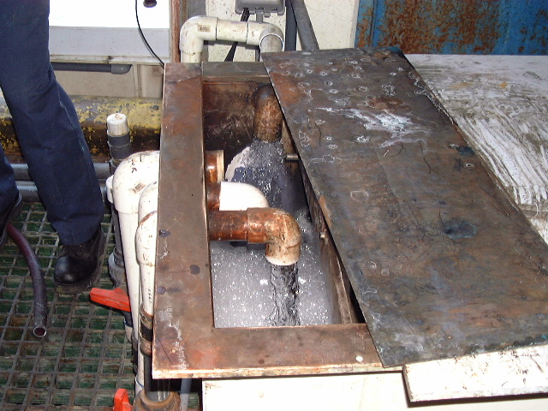
Complication #2
Non-random Bias
weekend operations
periodic contributions
scheduled blowdowns
Are there enough samples taken at the right times and locations to be representative of the discharge over the six-month reporting period?

Slide 24
Runs Mon – Sun
Mon ooooooooooooooo
Tue ooo
Wed oooooooooooooooooo
Thu ooooooooooo
Fri ooooooo
Sat oo
Sun oooooooooooooooo
1 Mon-Fri and 1 Sat-Sun
How many samples are necessary to capture both independent events (continuous & 7day)?

Slide 25
Complication #1
Independent events
test prior to discharge
sampling to cover all events
determine if on schedules
metering
equalization
Complication #2
Non-random Bias
scheduled sampling
equalization

Slide 26
Representative Sampling
BACWA/EBMUD Pretreatment Training
March 11, 2019
Questions or Comments
Greg V. Arthur - (510) 967-8411 - gva@gvarthur.com

