Slide 1
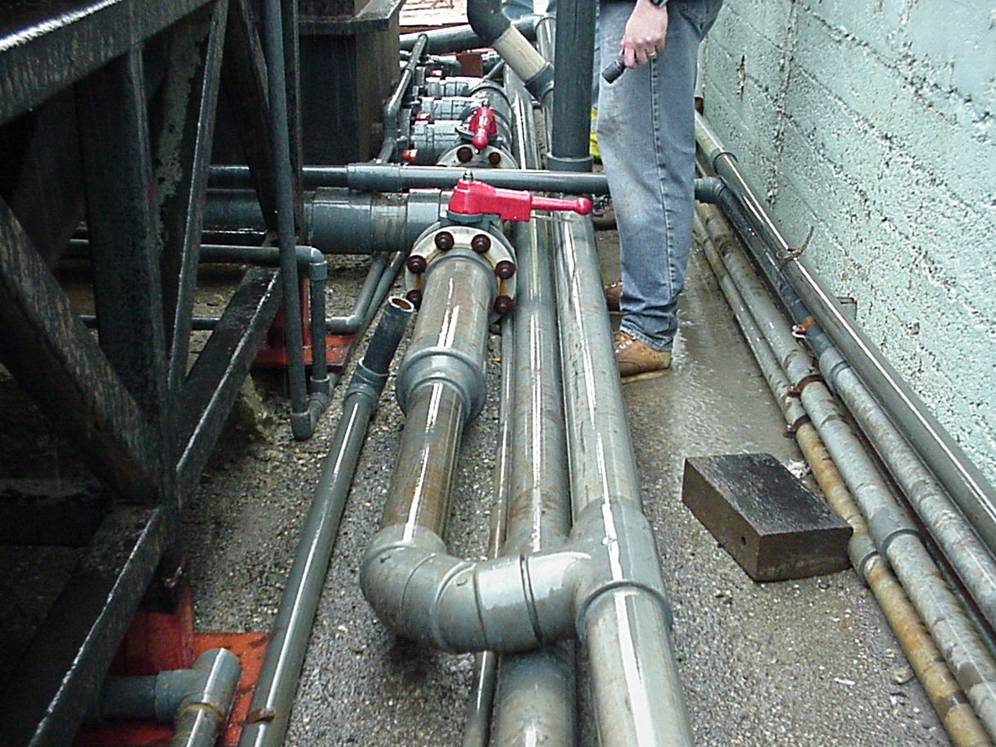
Bypassing and Dilution
BACWA/EBMUD Pretreatment Training
March 11, 2019
Greg V. Arthur - (510) 967-8411 - gva@gvarthur.com

Slide 2
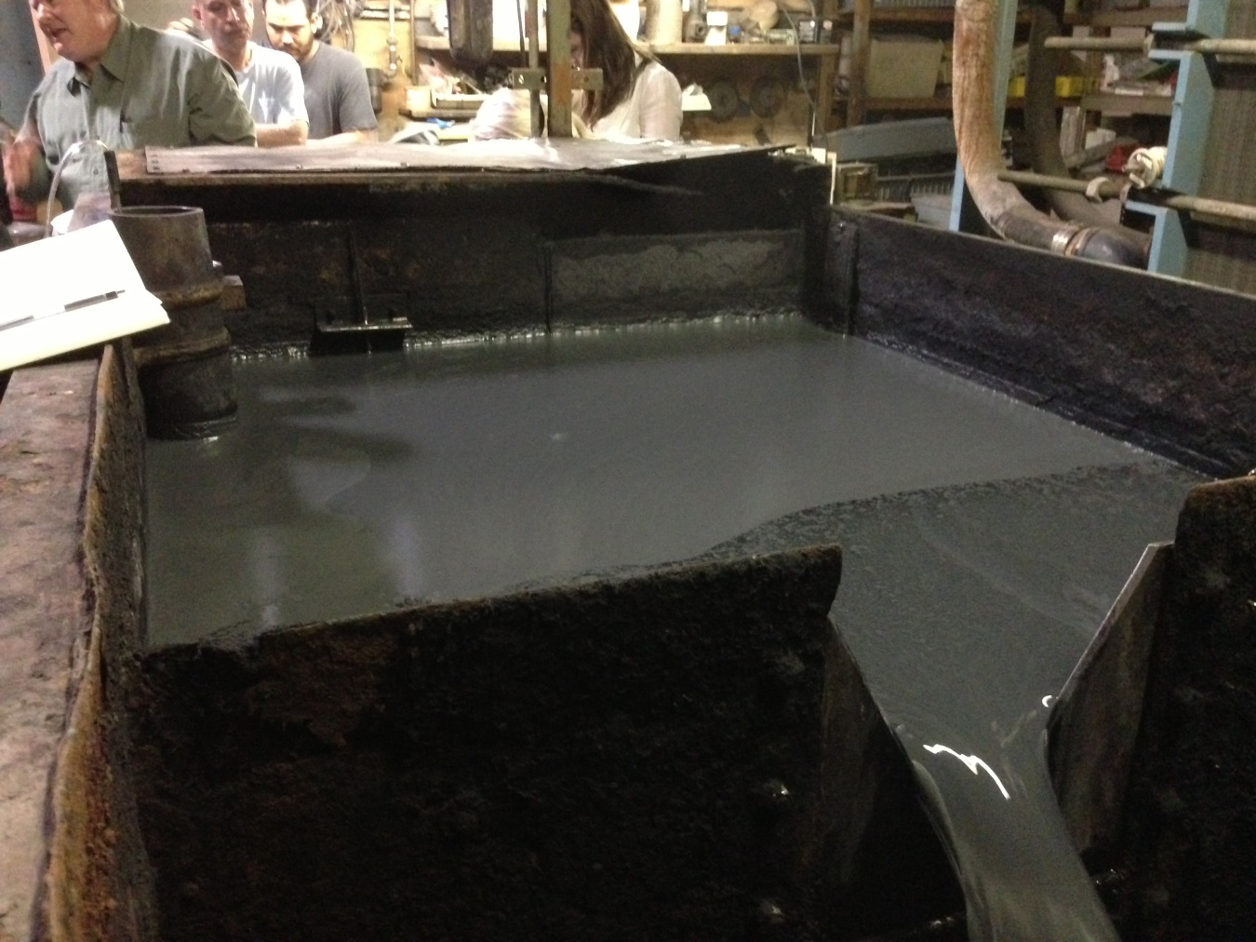
40 CFR 403.17(d)
Bypass Provision
17(d) – Prohibi-
tion against the
bypassing of
treatment neces-
sary to comply
Unless …
no feasible
alternative
unavoidable to
prevent loss of
life, injury, or
severe damage.
final effluent flume flow meter

Slide 3
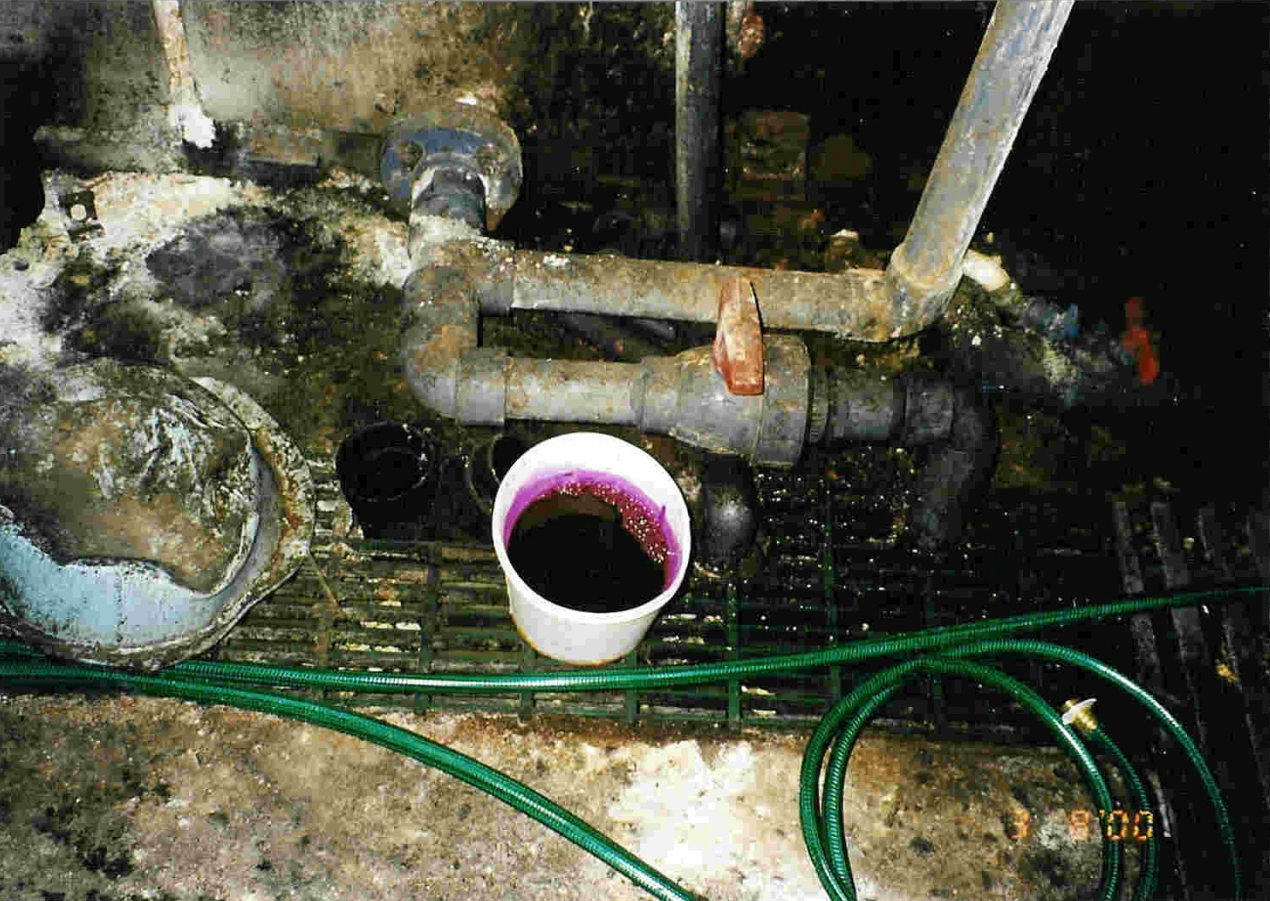
Question - What qualifies as a bypass of treatment (necessary to comply with pretreatment standards) as prohibited by 40 CFR 403.17(d)?
concealed
standpipe
The intentional diversion of wastestreams from any portion of an IUs treatment facility is prohibited … unless
unavoidable to prevent loss
of life, injury, or severe damage
no feasible alternatives
meets limits
prior notice and approval
dye bypassed treatment
standpipe cover

Slide 4
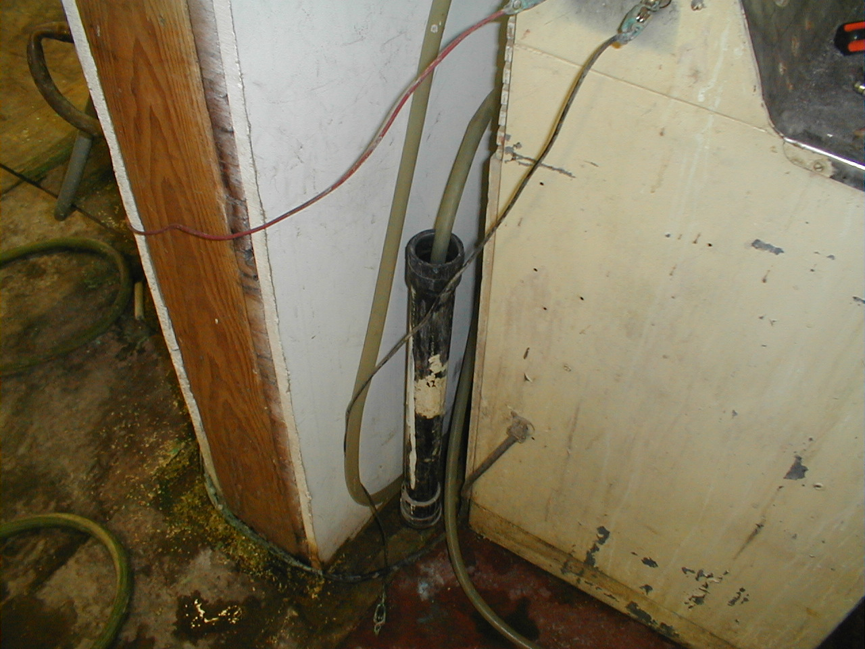
Question - What does “no feasible alternative” mean?
hose from pump
in plating shop
rinse tank
standpipe 10’
from bathroom
plating room
storage room

Slide 5
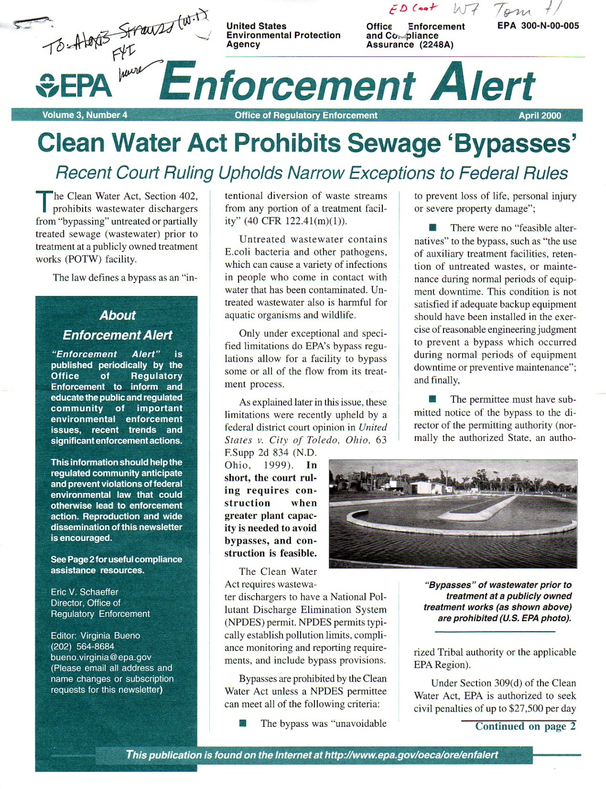

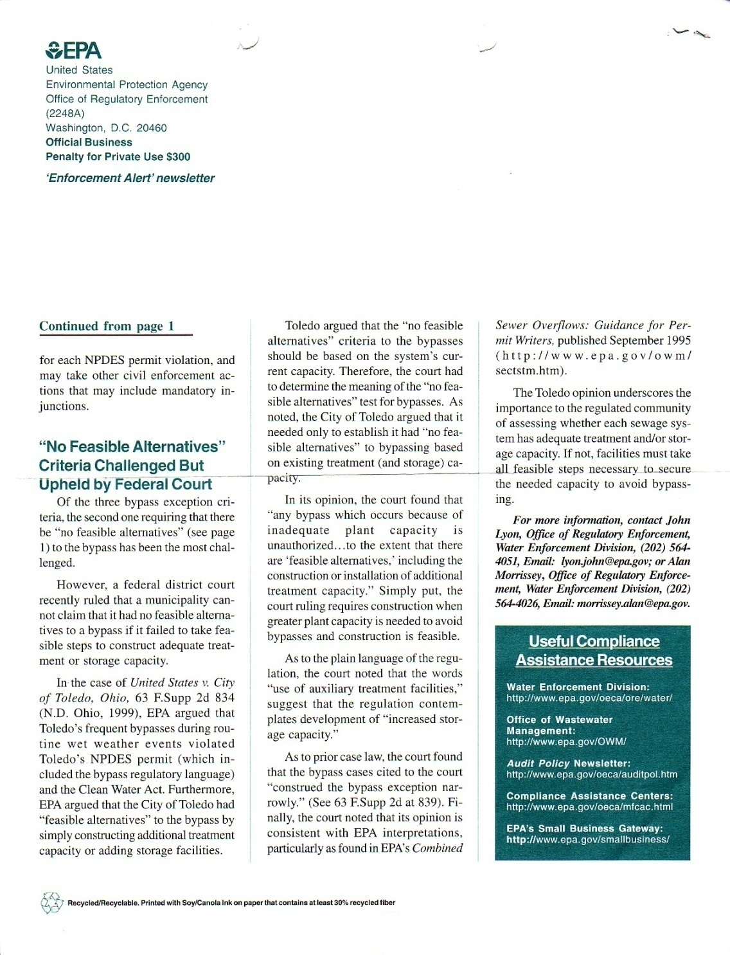
Question - What does “no feasible alternative” mean?
The Toledo opinion under-scores the importance to the regulated community of assessing whether each sewage system has adequate treatment and/or storage capacity. If not, facilities must take all feasible steps necessary to secure the needed capacity to avoid bypassing.
hose from pump
in plating shop
rinse tank
A federal district court recently ruled that a municipality cannot claim that it had no feasible alternatives to a bypass if it failed to take feasible steps to construct adequate treatment or storage capacity.
standpipe 10’
from bathroom
plating room
storage room

Slide 6
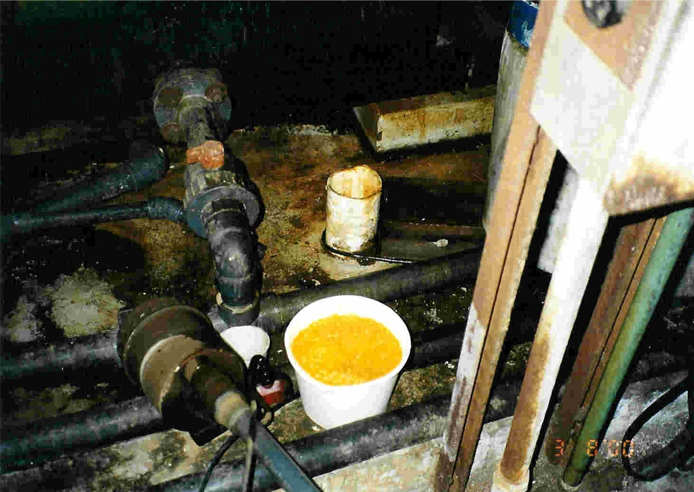
Conclusion – Essentially no such thing as “no feasible alternative” for IUs.
Conclusion – Essentially no such thing as “no feasible alternative” for IUs. This means IUs are prohibited from bypassing any treatment necessary to comply with any standards.
concealed
standpipe
dye bypassed treatment

Slide 7
Conclusion – The bypass prohibitions particularly applies to intentional dumping and illegal dis-charges from IUs.
concealed
standpipe
Easy to Determine Compliance
all wastewaters treated
Harder to Determine Violations
establish BAT equivalent necessary
to comply with Fed standards
establish treatment necessary to
comply with local limits
proof of untreated discharge
dye bypassed treatment

Slide 8
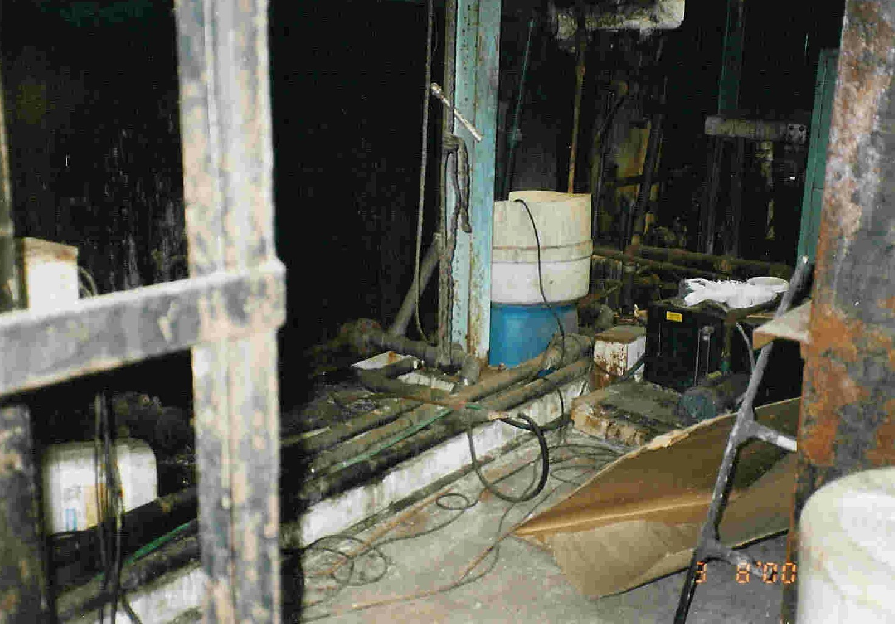
Question – How can POTWs detect illegal dis-charges that violate the bypass prohibition?
Detection
downstream surveillance
anonymous tips
unannounced inspections
automated sewer monitoring
stations
fume clouds, sewer collapse,
explosions, other calamities
plain good old-fashioned luck
bypass standpipe
concealed under
pump assembly

Slide 9
Case Study
sample
point
filter
press
dryer
cyanide destruct
influent wastewaters
sludge hold
acid-sump
gen-sump
cn-sump
chrome
reduxn
metals
precip
cyanide
destruct
sand
filt
floc
clarifier

Slide 10
diversion valve
closed
discharge line
cyanide return line

Slide 11
With Diversion Valve Closed
sample
point
filter
press
dryer
cyanide destruct
influent wastewaters
sludge hold
acid-sump
gen-sump
cn-sump
chrome
reduxn
metals
precip
cyanide
destruct
sand
filt
floc
clarifier

Slide 12
Diversion Valve
In the open position, cyanide-treated return flows bypass the treatment for metals
sewer
cyanide return line

Slide 13
With Diversion Valve Open
sample
point
filter
press
dryer
cyanide destruct
influent wastewaters
sludge hold
acid-sump
gen-sump
cn-sump
chrome
reduxn
metals
precip
cyanide
destruct
sand
filt
floc
clarifier

Slide 14
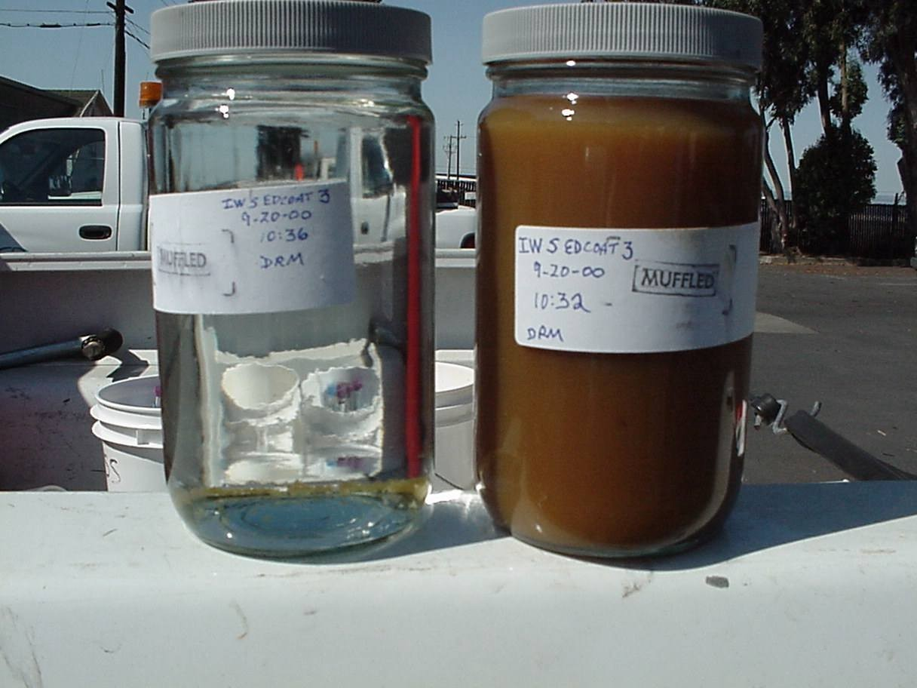
diversion valve open
Cd – 48.0 mg/l
Zn – 2490. mg/l
CN – 18.0 mg/l
Pb -2.07 mg/l
Cr – 67.6 mg/l
Cu – 10.9 mg/l
Ni – 2.36 mg/l
diversion valve closed
Cd – 0.7 mg/l
Zn – 1.3 mg/l

Slide 15
Question – How can POTWs establish violations of the bypass prohibition?
Establishing Violations
inspect to find the method of
bypassing treatment
inspect to establish what treatment
was bypassed
sample potential sources to establish
the discharge quality of the bypass
field verify to eliminate other
possible explanations
link downstream surveillance to
bypassing
sewer
If the diversion valve is in the open position
cyanide return line

Slide 16
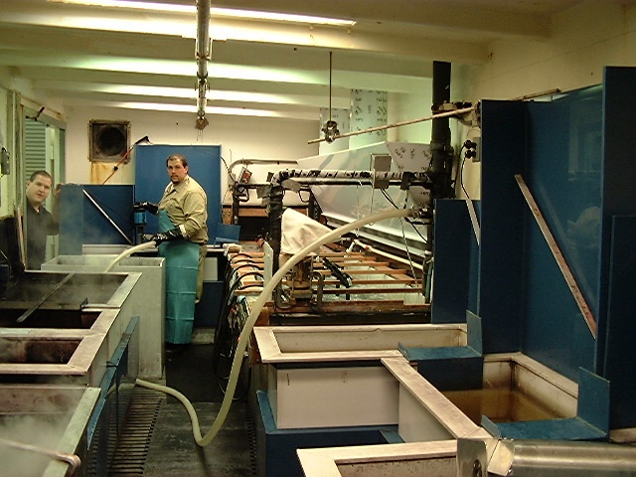
Question – What can POTWs do to prevent illegal discharges that violate the bypass prohibition?
Prevention Through Permit
Application Requirements
no connections after
treatment
locked-out tagged-out
inlets
above ground hard piping
minimize or eliminate
portable pumps and hose
lengths
hard-piped
wastewater
collection
above-ground
visually
traceable
piping
minimum
hose lengths
blind sump
containment

Slide 17
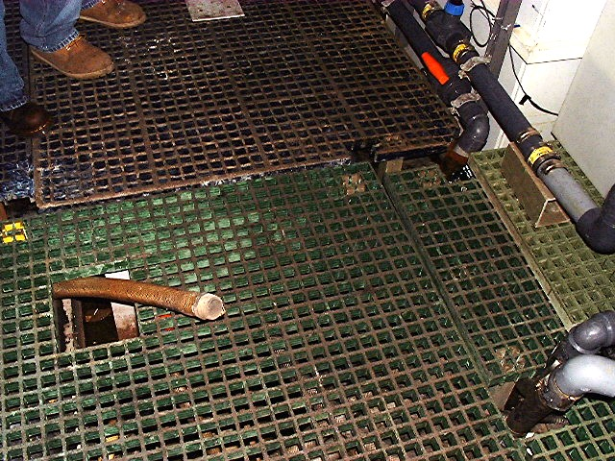
Question – Is prevention through permitting enough to ensure IUs do not bypass?
from treatment unit
Motivations Behind Bypassing
saves money
possibility provides insurance
low risk because easy to hide
operating costs exceed capital
easy for disgruntled employees
to sabotage the business
Determined by Facility’s Culture
inlet 1
inlet 2
inlet 3
flexible hose
to inlet 3

Slide 18
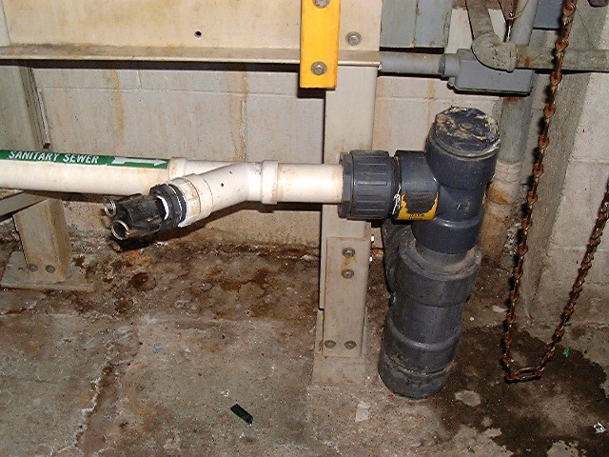
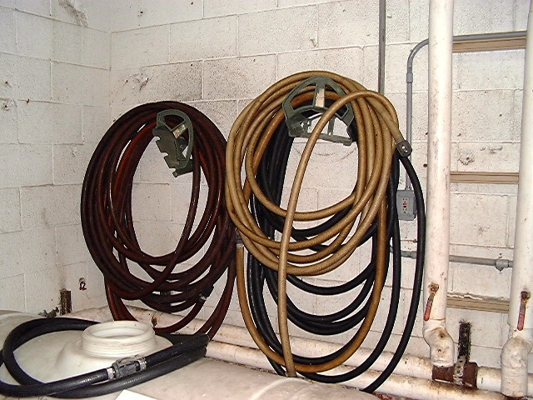
Question – So, how can POTWs administer their programs to ensure compliance by the IUs with the bypass prohibition of 40 CFR 403.17(d)?
inspections to find potential
methods of bypassing
permit application require-
ments to eliminate built-ins
detection through surveillance
monitoring program
tip line
unannounced inspections in
off-hours
others
long hoses with quick-connect fittings
from treatment unit
quick-connect
tee clean-out
sewer
connection

Slide 19
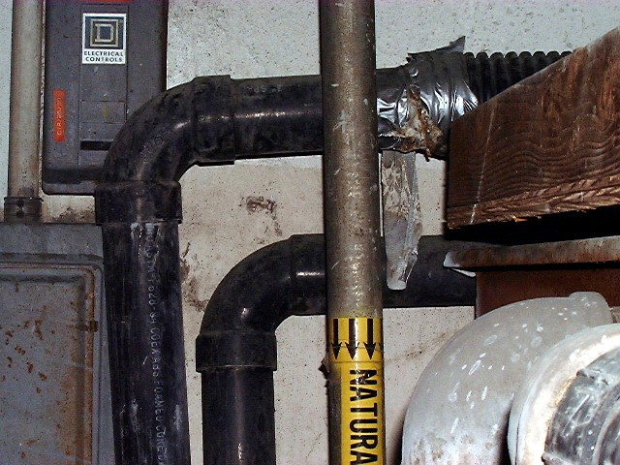
Question – Do the regulations require POTWs to perform these functions?
weird flexible
inlet into the
treatment unit
EPA would argue - YES
inspections to find potential
bypasses
permit application requirements
ments to eliminate built-ins
detection through surveillance
monitoring program
tip line
unannounced inspection in
off-hours
allows bypass
of treatment
steps

Slide 20
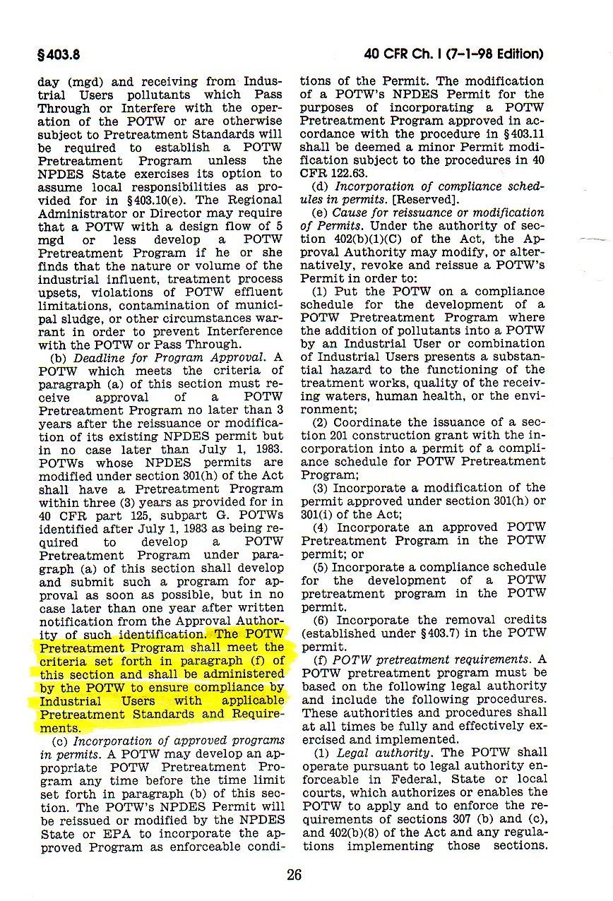
Question – Do the regulations require POTWs to perform these functions?
40 CFR 403.8(b)
weird flexible
inlet into the
treatment unit
The POTW Pretreatment Program shall meet the criteria set forth in paragraph (f) of this section and shall be administered by the POTW to ensure compliance by Industrial Users with applicable Pretreatment Standards and Requirements.
allows bypass
of treatment
steps

Slide 21
40 CFR 403.6(d)
Technology-based Categorical Standards
Sections 407-471 Effluent Guidelines
compliance deadlines
concentration to flow-based mass limits
production-based mass to concentration limits
prohibition against dilution as a substitute for treatment
combined wastestream formula
definition of regulated, unregulated, and dilution waters
end-of-process-after-treatment sampling

Slide 22
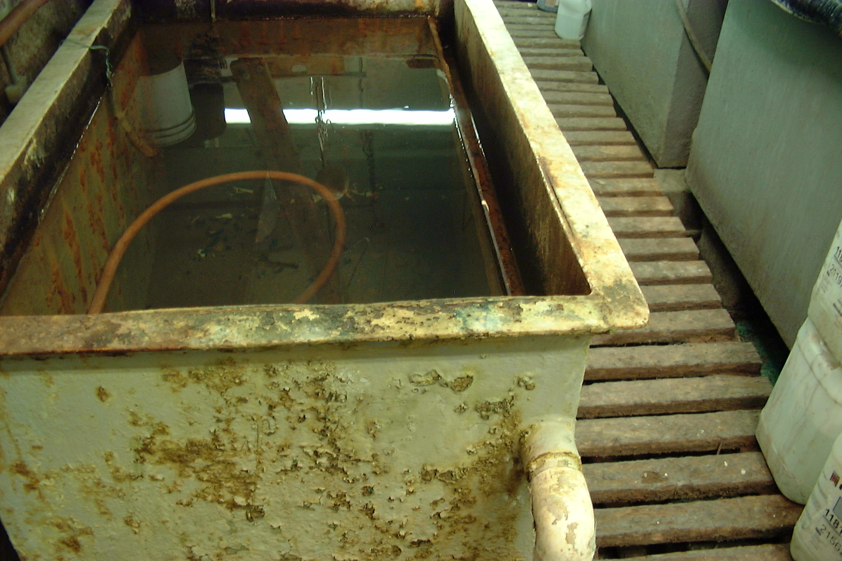
Question – How can POTWs administer their pro- grams to ensure IUs comply with the prohibition against dilution as a substitute for treatment in 40 CFR 403.6(d)?
inspect to establish
excess generation of Fed-
regulated wastewater
inspect to determine
untreated flows
require cessation of
dilution as a substitute for
treatment
others?

Slide 23
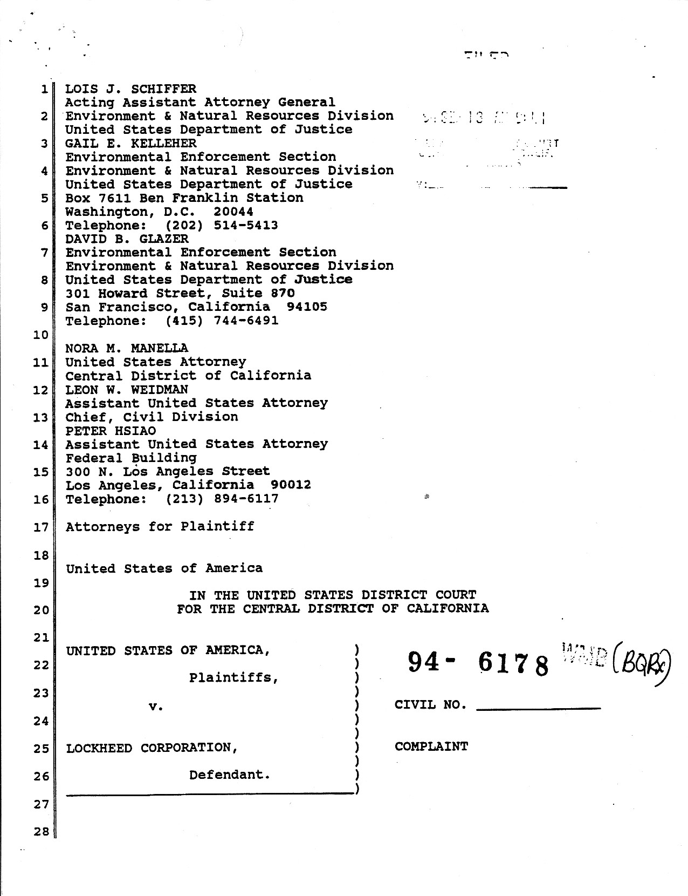
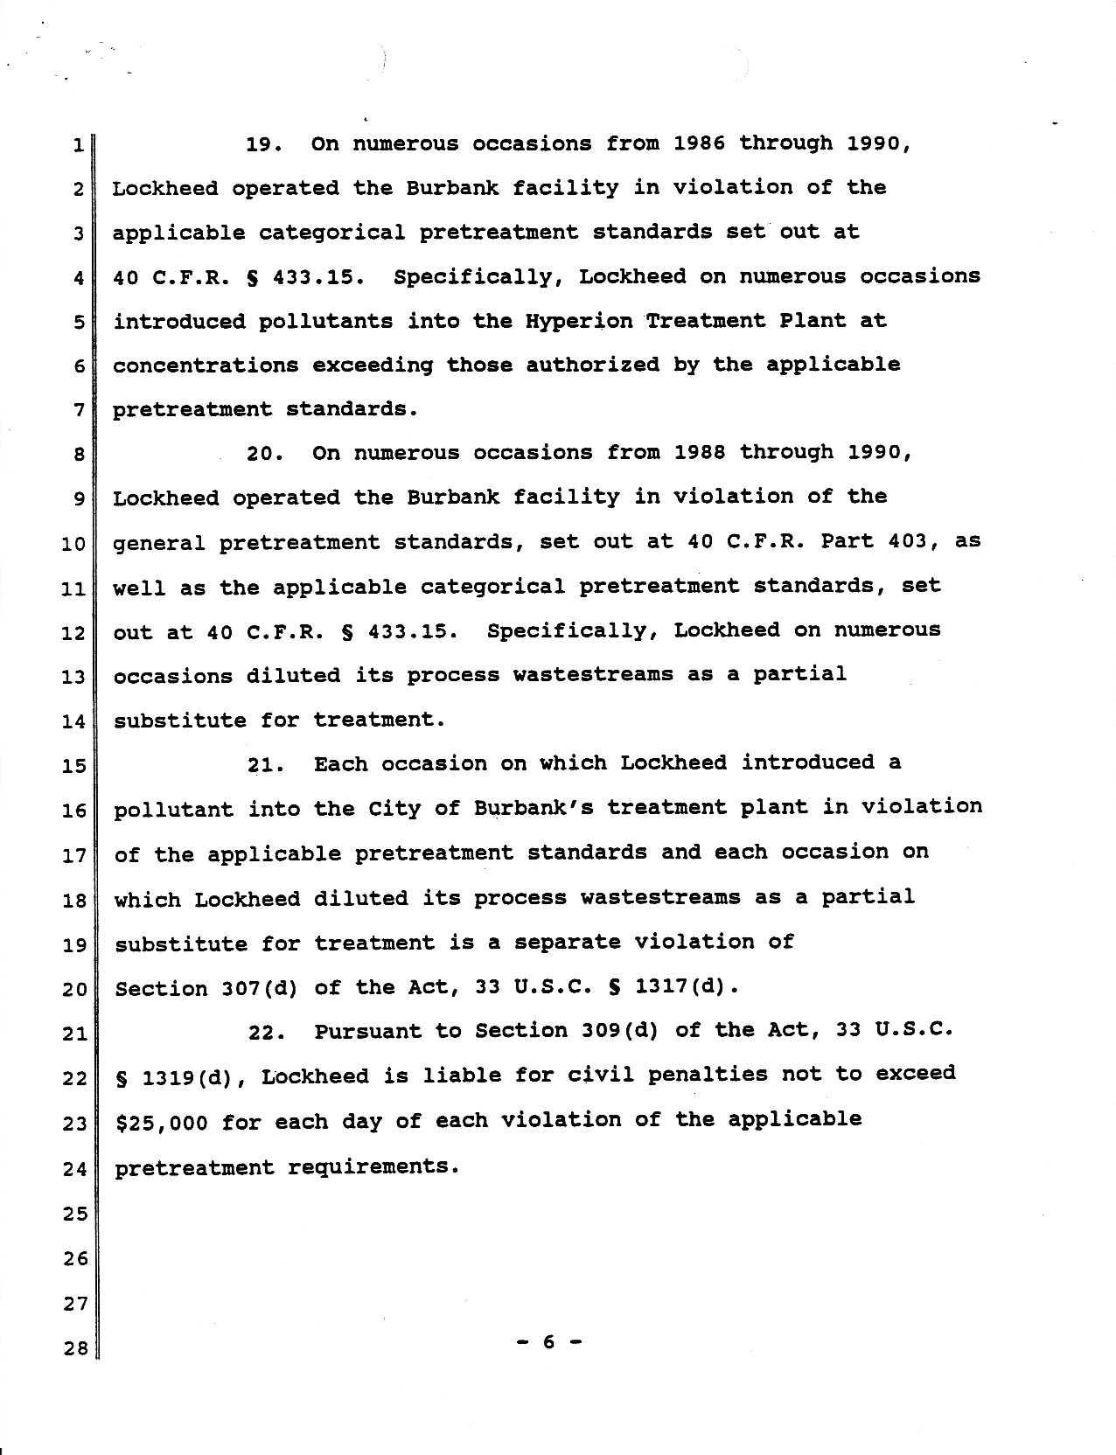
Question – How can POTWs administer their pro- grams to ensure IUs comply with the prohibition against dilution as a substitute for treatment in 40 CFR 403.6(d)?
… and each occasion on which Lockheed diluted its process wastestreams as a partial substitute for treatment is a separate violation of Section 307(d) of the Act.

Slide 24
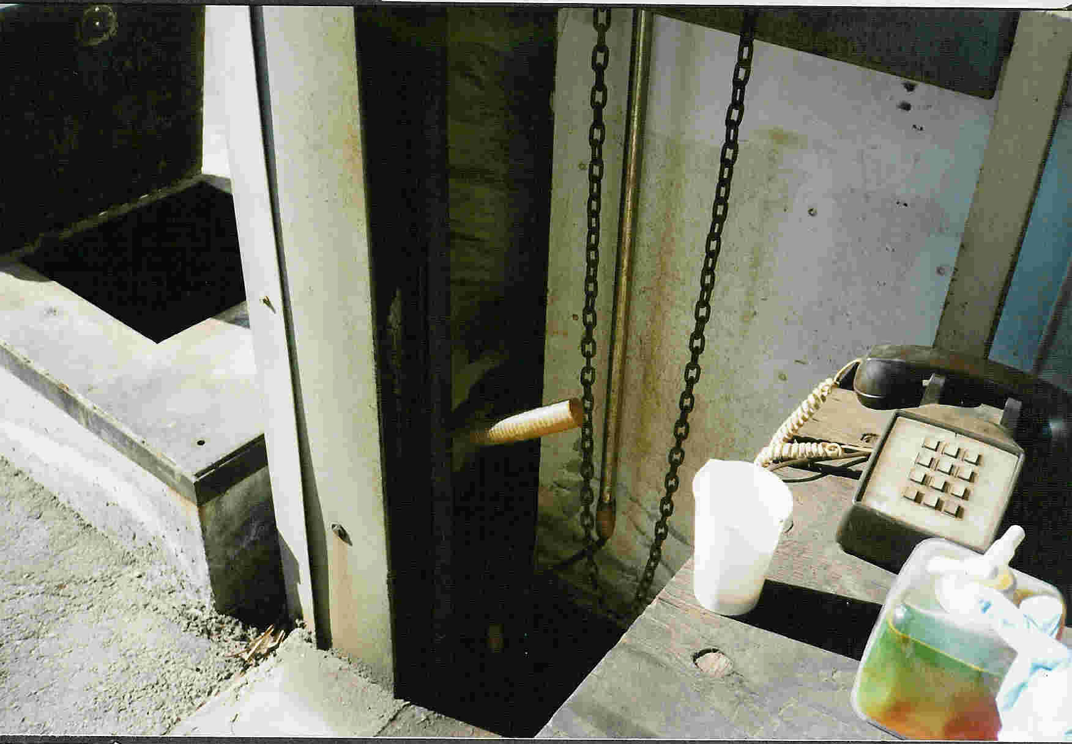
Bypassing and Dilution
BACWA/EBMUD Pretreatment Training
March 11, 2019
Questions or Comments
open sewer clean-out
between bathroom and exterior walls
sealed industrial
sewer connection
at a zero-discharger
Greg V. Arthur - (510) 967-8411 - gva@gvarthur.com

