Slide 1
2nd Nutrient Watershed Permit Summary

Slide 2
Agenda
Background
  Why are we concerned with nutrients in SF Bay?
  First Watershed Permit
Second Watershed Permit
  Key Elements
  Schedule

Slide 3
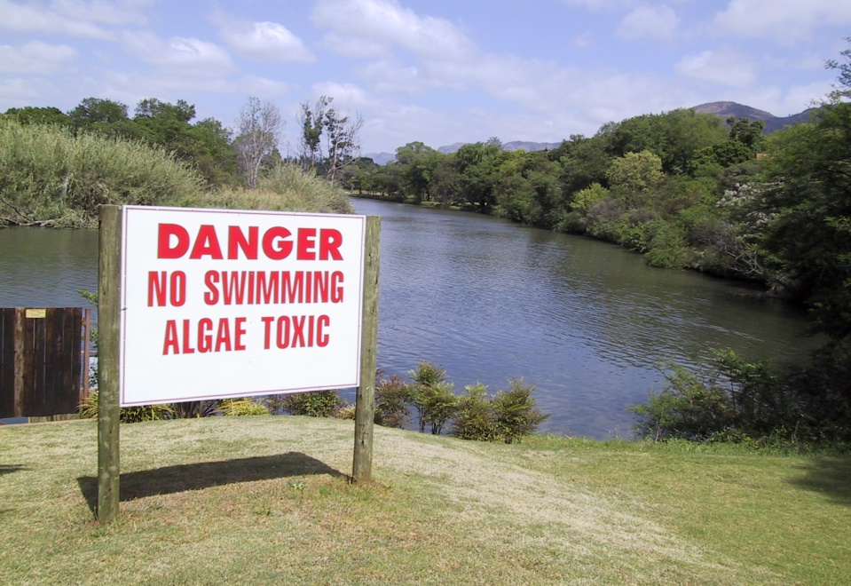
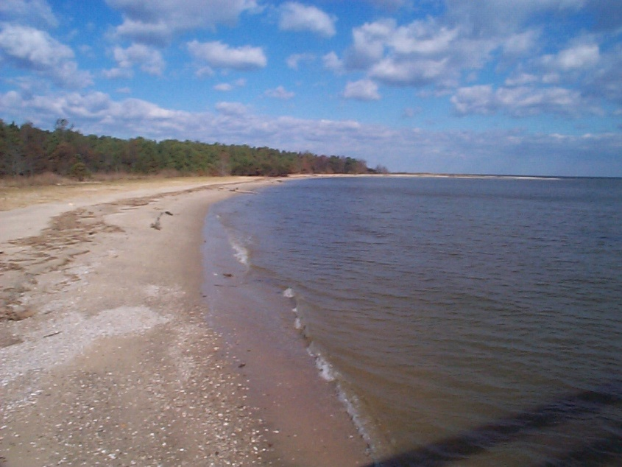
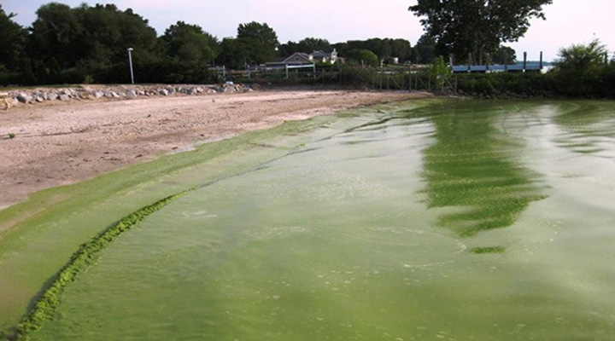

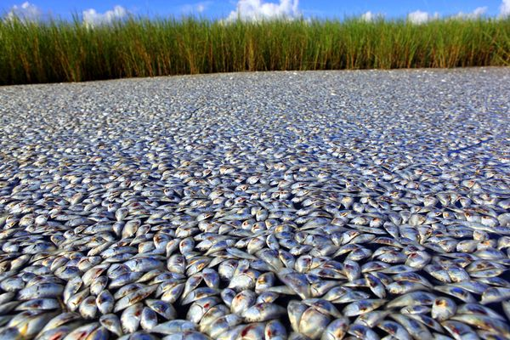
Background
Why the concern about nutrients?
Potential environmental impacts of nitrogen and phosphorus
Harmful
Algal
Blooms
Excessive algal growth
Hypoxia (low dissolved oxygen)
Altered Species Composition
Notes:
Nitrogen and phosphorus compounds are the two types of nutrients of concern in aquatic ecosystems. The San Francisco Bay ecosystem is nitrogen-limited, and therefore nitrogen is the element of primary concern. There has also been some concern that if the nitrogen to phosphorus ratio is imbalanced, it can disrupt the food web.

Slide 4
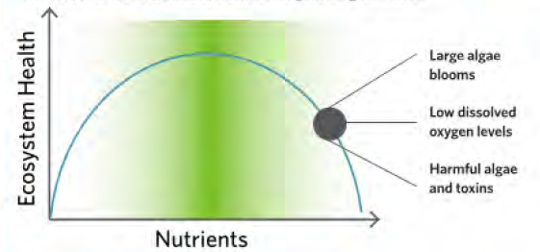
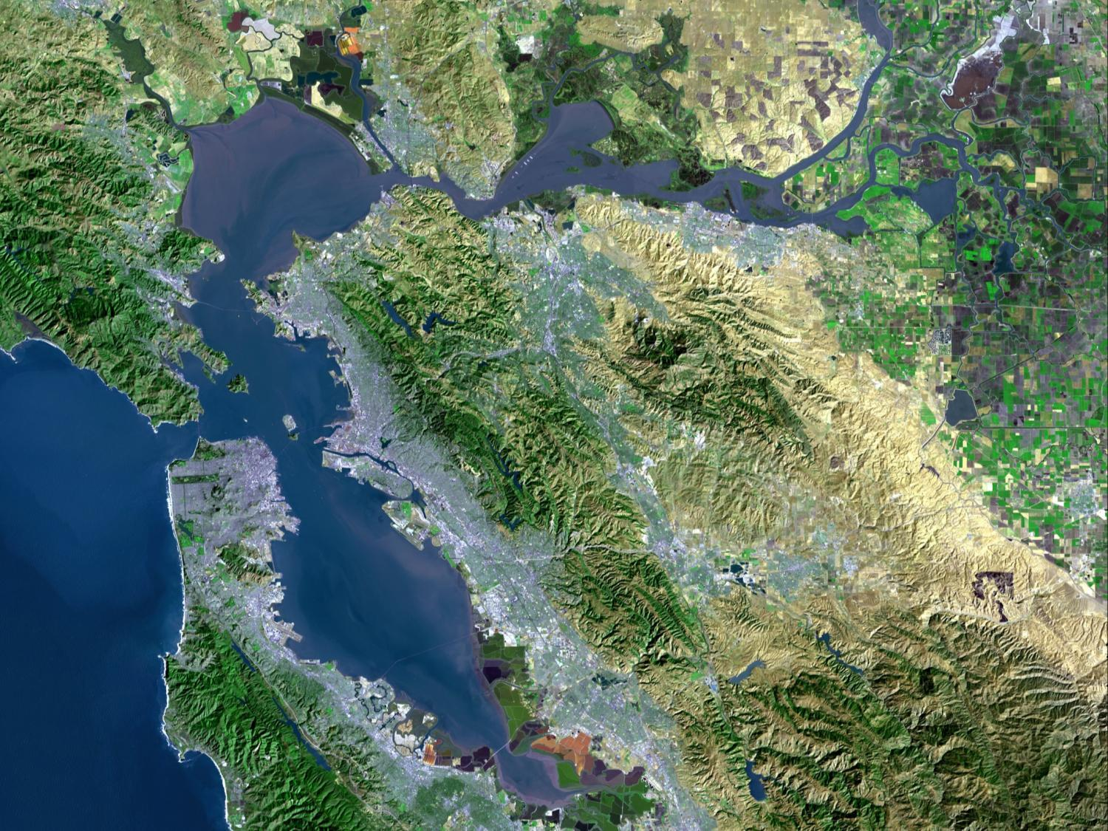
Background
SF Bay looks OK – is it?
Nitrogen and Phosphorus Loads to the Bay
San Pablo
Suisun
Ag
Largest CA estuary
Population = 7.6 M
37 WWTPs
Drains 40% of CA
Nitrogen and Phosphorus
  Large loads
  High concentrations
Central
WWTPs
Urban runoff
South
Lower South
Notes:
POTWs are the largest sources of nutrients to the South Bay. In the North Bay, upstream sources are more significant.

Slide 5

Background
High direct Nitrogen loads, but low impacts
Chesapeake
SPB
SUI
CEN
SOU
Delaware
LSB
Chl-a (µg L⁻¹) during average bloom
MD Coastal Bays
Barnegat
LSB
Florida Bay
Pensacola
Narragansett
CEN
SUI
SOU
SPB
SPB
National Estuarine Experts Workgroup (2010)
Nitrogen Load (g N m⁻² yr⁻¹)
SFEI (2013)
Notes:
Chl-a = chlorophyll a, which is a surrogate for levels of phytoplankton/algae
While nutrient loads are very high in Suisun Bay and the Lower South Bay, we haven’t seen the same impacts as in other areas of the country.

Slide 6
Background
Why has San Francisco Bay been resilient to nutrients?
High turbidity blocks the light phytoplankton needs to grow
Strong tidal mixing reduces nutrient concentrations
Filter-feeding clams reduces phytoplankton concentrations
BUT
There has been a recent reduction in turbidity due to sediment capture by upstream dams, and clam populations are on the decline.

Slide 7
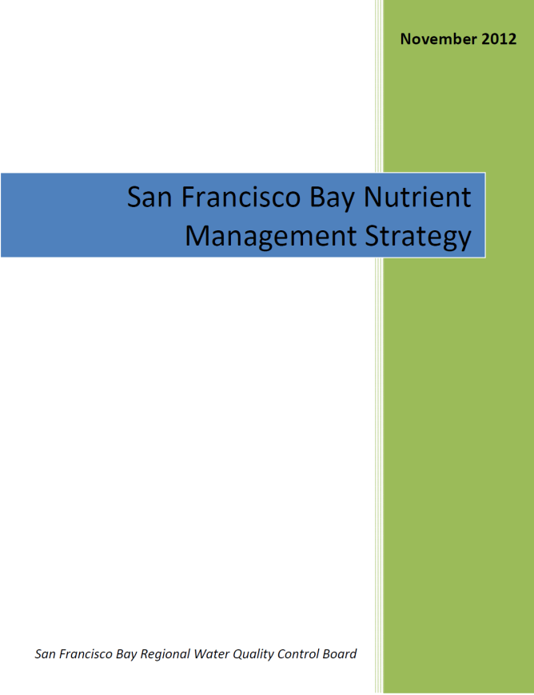
Background
What do we do in the face of uncertainty?
Collaborate with regulators to ward off reactionary limits
Fund scientific research to better understand any potential problems for the Bay and their causes
Plan for incremental reductions in nutrient loads

Slide 8
Background
First Watershed Permit
In the spirit of collaboration, the Bay Area Clean Water Agencies (BACWA), representing the Bay’s 37 wastewater treatment plants, and the Regional Water Board negotiated a watershed permit in 2014
Analysis of Loading Trends
Influent and Effluent Monitoring
Support for Scientific Studies
Treatment Optimization and Upgrade Studies

Slide 9
Second Watershed Permit
Over the past several years, BACWA and the Water Board have been negotiating a new Watershed Permit that will be in effect from 2019-2024.
The following key tenets were agreed to:
  Individual treatment plant nutrient monitoring and reporting;
  Group Annual Reporting of nutrient loads to the Bay;
  Funding for Nutrient Management Strategy’s scientific investigations;
  A regional assessment of the feasibility and cost for reducing nutrients through means other than treatment and discharge at POTWs;
  Establishing a baseline for POTWs that undertake early actions to reduce nutrients; and
  Funding for Monitoring and Modeling at the end of the second Nutrient Watershed Permit

Slide 10
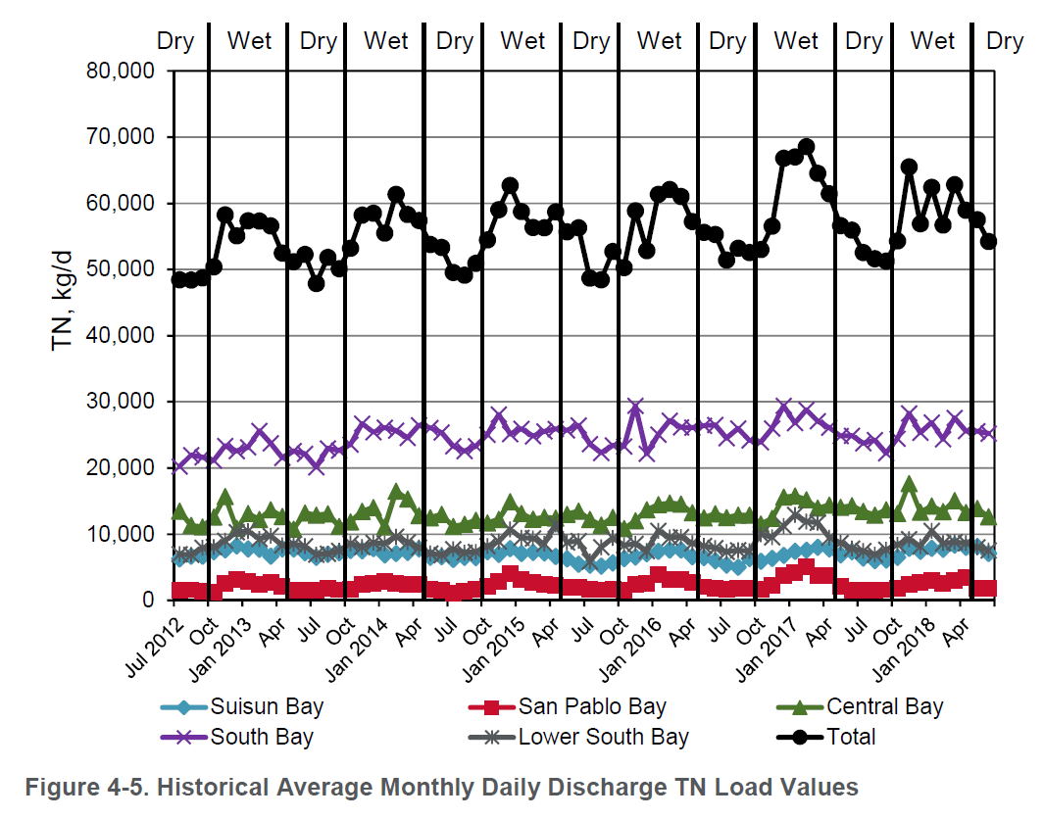
Second Watershed Permit
Monitoring and Reporting
New Influent monitoring for plants >10 MGD
  Quarterly
Effluent monitoring twice per month (EBDA Outfall)
  No longer includes TKN or Ortho-P which are more difficult tests
Continued Group Annual Reporting through BACWA

Slide 11
Second Watershed Permit
Science Funding
$2.2M per year (up from $880k) to San Francisco Estuary Institute
  EBDA contribution is $277k
Key questions:
  What constitutes impairment? Which areas are impaired?
  Does the Bay’s trajectory signal future impairment?
  Are nutrient load reductions are needed? where? how much?
  How much time is needed for science, planning, and implementation?
Desired certainty
Cumulative
confidence
Time or Cost

Slide 12
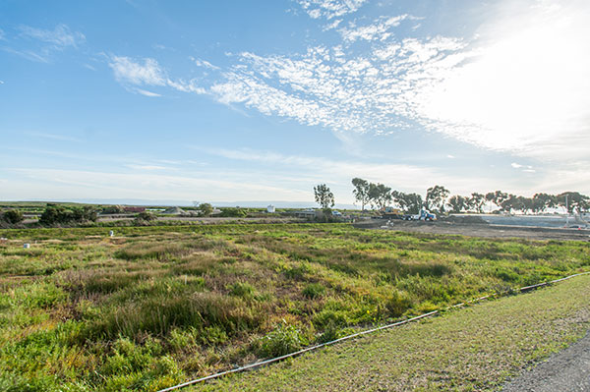
Second Watershed Permit
Regional Study
Study will evaluate non-traditional, multi-benefit approaches to reducing nutrients
  Includes wetlands and horizontal levees
  Complements Nutrient Reduction Study under first Watershed Permit which looked at traditional treatment approaches
Plan is to integrate with ongoing sea level rise resilience work by San Francisco Estuary Institute
A regional summary of nitrogen reductions associated with water recycling will also be developed

Slide 13
Second Watershed Permit
2024 Load Targets
Current permit does not have effluent limits, but it does include targets for likely limits in 2024 permit
  Target is for EBDA, not individual plants
  Based on 2014-2018 performance plus buffer to account for growth and variability
  EBDA’s target assumes loads currently going to Hayward Marsh are returned to EBDA
Provides a basis for planning nutrient reductions
Opportunity to readjust in 2024 if significant changes occur, e.g. loss of recycled water customers or increase in trucked organic waste

Slide 14
Second Watershed Permit
2024 Load Targets
EBDA Baseline: 8100-8600 kg/day inorganic N
EBDA Target: 9400-9800 kg/day inorganic N
  Ranges represent continuing discussion regarding calculation methodology
Agency | 2017-18 Dry Season Average TIN (kg/day)* | Relative Contribution
City of Hayward | 1241 | 16%
City of San Leandro | 641 | 8%
Oro Loma Sanitary District | 1712 | 23%
Union Sanitary District | 3391 | 45%
Dublin San Ramon Services District | 100 | 1%
City of Livermore | 521 | 7%
Total | 7605
*For comparison purposes only.
Does not include Hayward Marsh.

Slide 15
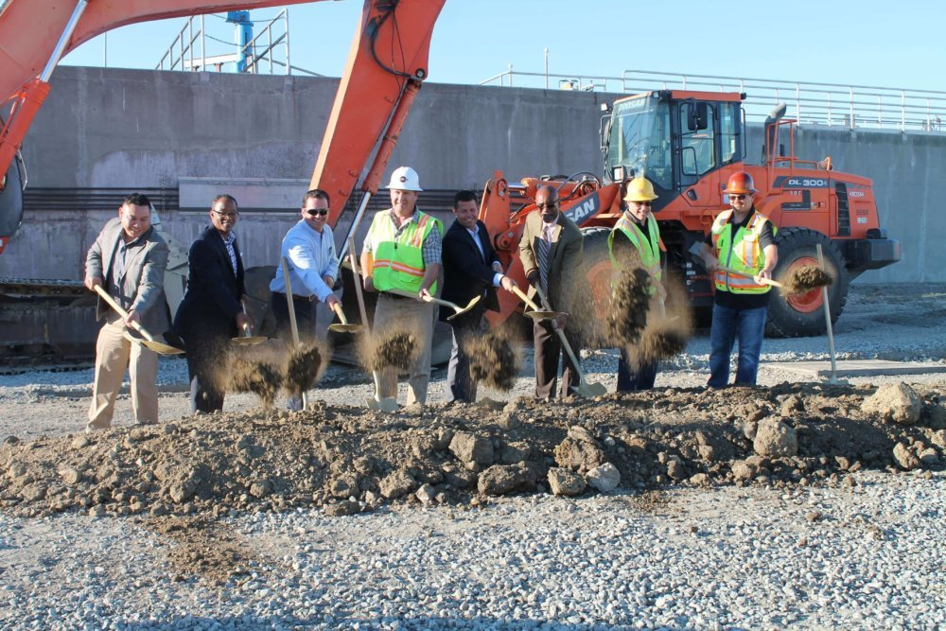
Second Watershed Permit
Early Action
Plants implementing projects that will result in significant nitrogen reductions during this permit cycle are listed in permit as “Early Actors”
  Includes Oro Loma and Hayward
  Plants that aren’t listed but achieve significant reductions will receive same consideration
If further reductions are required,
  Early Actors will be moved to the back of the line
  Others will be considered for Compliance Schedules, which can be up to 10 years
    Demonstrating robust planning for nutrient reductions will be key to obtaining reasonable compliance schedules

Slide 16
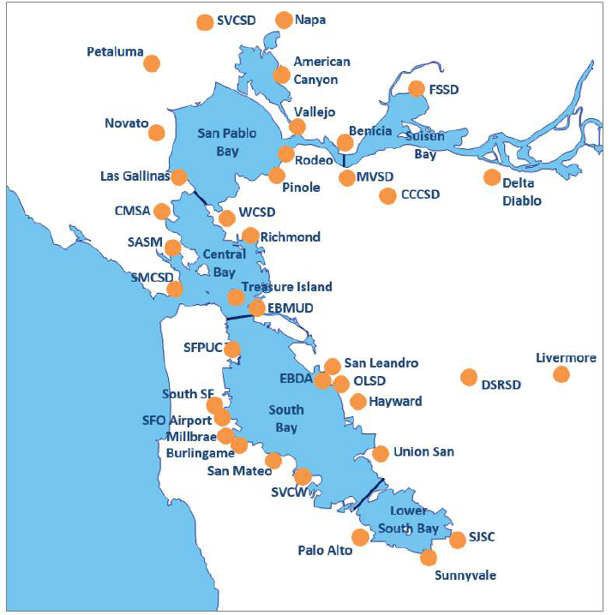
Second Watershed Permit
Compliance and Trading
Compliance anticipated to be measured on a subembayment basis
  If subembayment exceeds limit, enforcement is on individual discharger that exceeds their target
  EBDA Plants not expected to have individual targets for compliance purposes
Water Board open to considering a trading scheme in future permits

Slide 17
Second Watershed Permit
Permit Schedule
Administrative Drafts (AD) provided January 2 and 31, 2019
Tentative Order scheduled for March 2019
Public comments received and responses made in April 2019
Public hearing May 8, 2019
Adoption June 12, 2019
Effective July 1, 2019 - June 30, 2024

Slide 18
Questions?

