Slide 1
Main Elements
Regional Evaluation Provisions
Natural Systems
Water Recycling
Funding Monitoring and Modeling Studies
Load Targets
Recognition of Early Actors

Slide 2
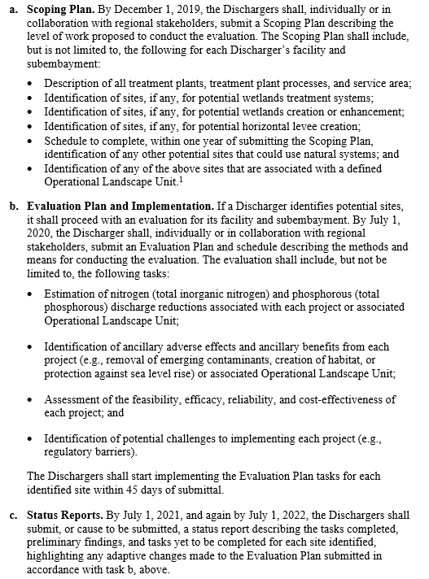


Slide 3
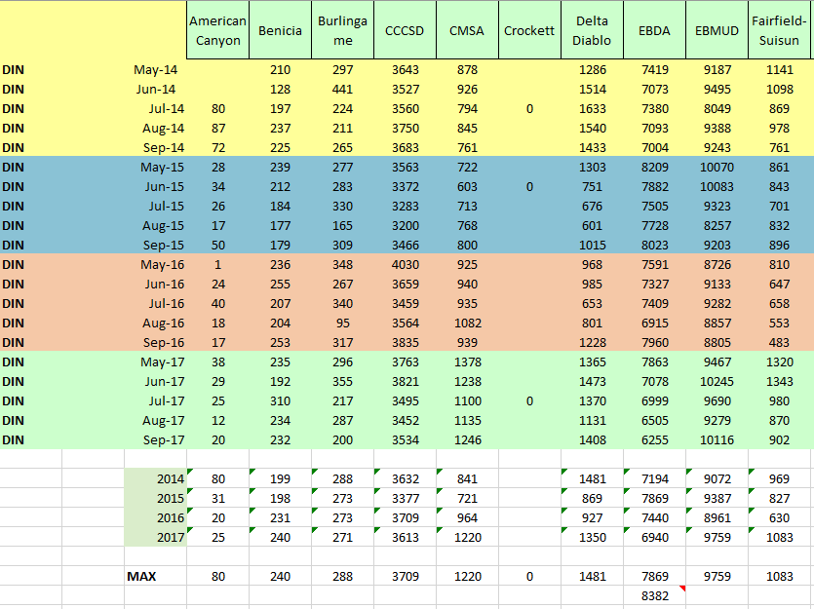

Slide 4
