Slide 1

Nutrient Management in the Bay

Slide 2
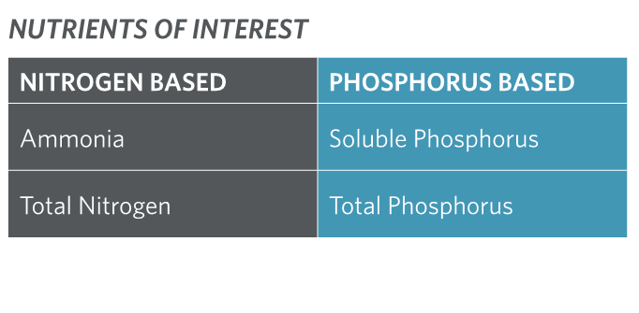
Nutrients and their Role in Ecosystem Health
Nutrients are naturally present and essential for a properly functioning biological community
Too much or too little can impact ecosystem health
Historically, the Bay has been resilient, but recent concerns have prompted scientific / engineering investigations
Under some conditions, too much can lead to:
Large algae blooms
Low dissolved oxygen levels
Harmful algae and toxins
Ecosystem Health
Nutrients
Notes:
Nutrients, such as nitrogen and phosphorus, are naturally present in estuaries and are essential for a properly functioning biological community. The effects of nutrient level changes on a local ecosystem are gauged by a multitude of factors, and determining the appropriate level is a site-specific exercise.
San Francisco Bay receives some of the highest nitrogen loads among estuaries worldwide, but has yet to exhibit problems typical of nutrient-enriched estuaries. It is not known whether this level of nitrogen loading, which will continue to rise in proportion to human population increase, is sustainable over the long-term. A broad coalition of scientists, engineers, and policy-makers is in the process of evaluating the factors that cause the Bay’s resilience, conditions that may lead to a decline in the Bay’s health, and potential impacts on human and ecological health. A wide range of monitoring and special studies are underway to understand the implications on Bay water quality associated with changes in nutrient levels and other factors.
While nutrients are essential for a healthy biological community, too much or too little can be bad. There has been concern that the Bay’s historic resilience is waning and that that the high nutrient loads could lead to more:
Large algae blooms
Low dissolved oxygen levels
Harmful algae and toxins

Slide 3
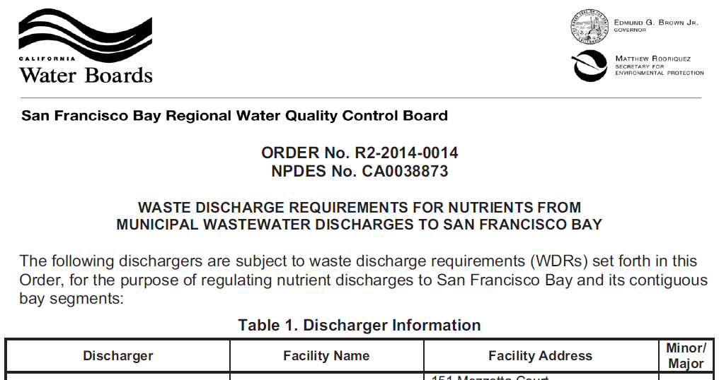

2014 Nutrient Watershed Permit
The Water Board issued the Nutrient Watershed Permit in 2014 to better understand the role of nutrients in the Bay:
Better understand nutrient loads through monitoring, modeling and embayment studies
  Develop and implement a science plan
  Monitor nutrient loads to the receiving water
  This work is ongoing
Evaluate potential nutrient discharge reduction opportunities at each plant
  Potential load reduction
  Costs
  Adverse/Ancillary Impacts
  Summary report was submitted in June 2018
Permit re-issuance every 5 years
(scheduled for April 2019)
The Watershed Permit Required Each Wastewater Treatment Plant to Develop Strategies and Costs for 10-20%, 60%, and 80% Nutrient Load Reduction
This effort was coordinated by BACWA
Notes:
Due to the uncertainty of nutrient impairment, the Water Board issued the Nutrient Watershed Permit in April 2014 to conduct special studies to:
Better understand nutrient loads through monitoring, modeling and embayment studies
Support science plan development and implementation
Support receiving water monitoring for nutrients
This work is ongoing
Evaluate potential nutrient discharge reduction opportunities at each plant
Potential load reduction
Costs
Adverse/Ancillary Impacts
Summary report was submitted in June 2018
Ultimately, the Watershed Permit Required Each Wastewater Treatment Plant to Develop Strategies and Costs for Low-, Medium-, and High-Level Nutrient Load Reduction. The study was coordinated by BACWA, the Bay Area Clean Water Agencies, a joint powers agency that represents the wastewater treatment agencies in the San Francisco Bay Area on various regulatory issues.
The Watershed Permit will be considered for re-issuance every 5 years. The next one is anticipated in April 2019.

Slide 4
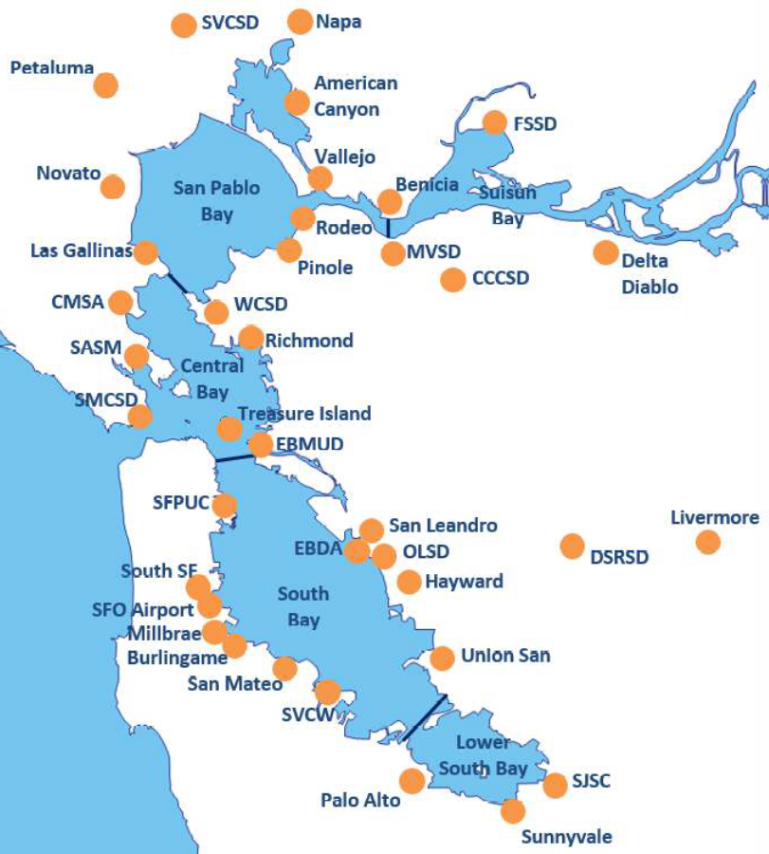

Wastewater Treatment Plants Represent the Largest Source of Nutrient Loads to the Bay
37 plants currently discharge 450 Mil gals per day on average
Plant sizes range from 1–167 Mil gals per day
Approx. half of the plants treat
less than 10 Mil gals per day
Each plant is unique
Plants were not originally designed to remove nutrients
Notes:
The 37 agencies that participated in the nutrient reduction study treat the wastewater for over 7 million people in the San Francisco region. These wastewater treatment plants, which range in capacity from 1-167 million gallons per day, have the ability to treat a total of about 450 million gallons per day. Approximately half of the plants are less than 10 mgd and each one of the plants is unique.
The plants were not originally designed to remove nutrients. As a result, the treated effluent from these plants represents about 2/3’s of the nutrient load discharged to the Bay.

Slide 5
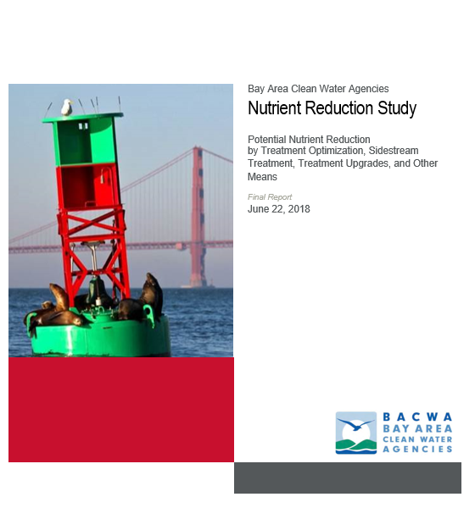
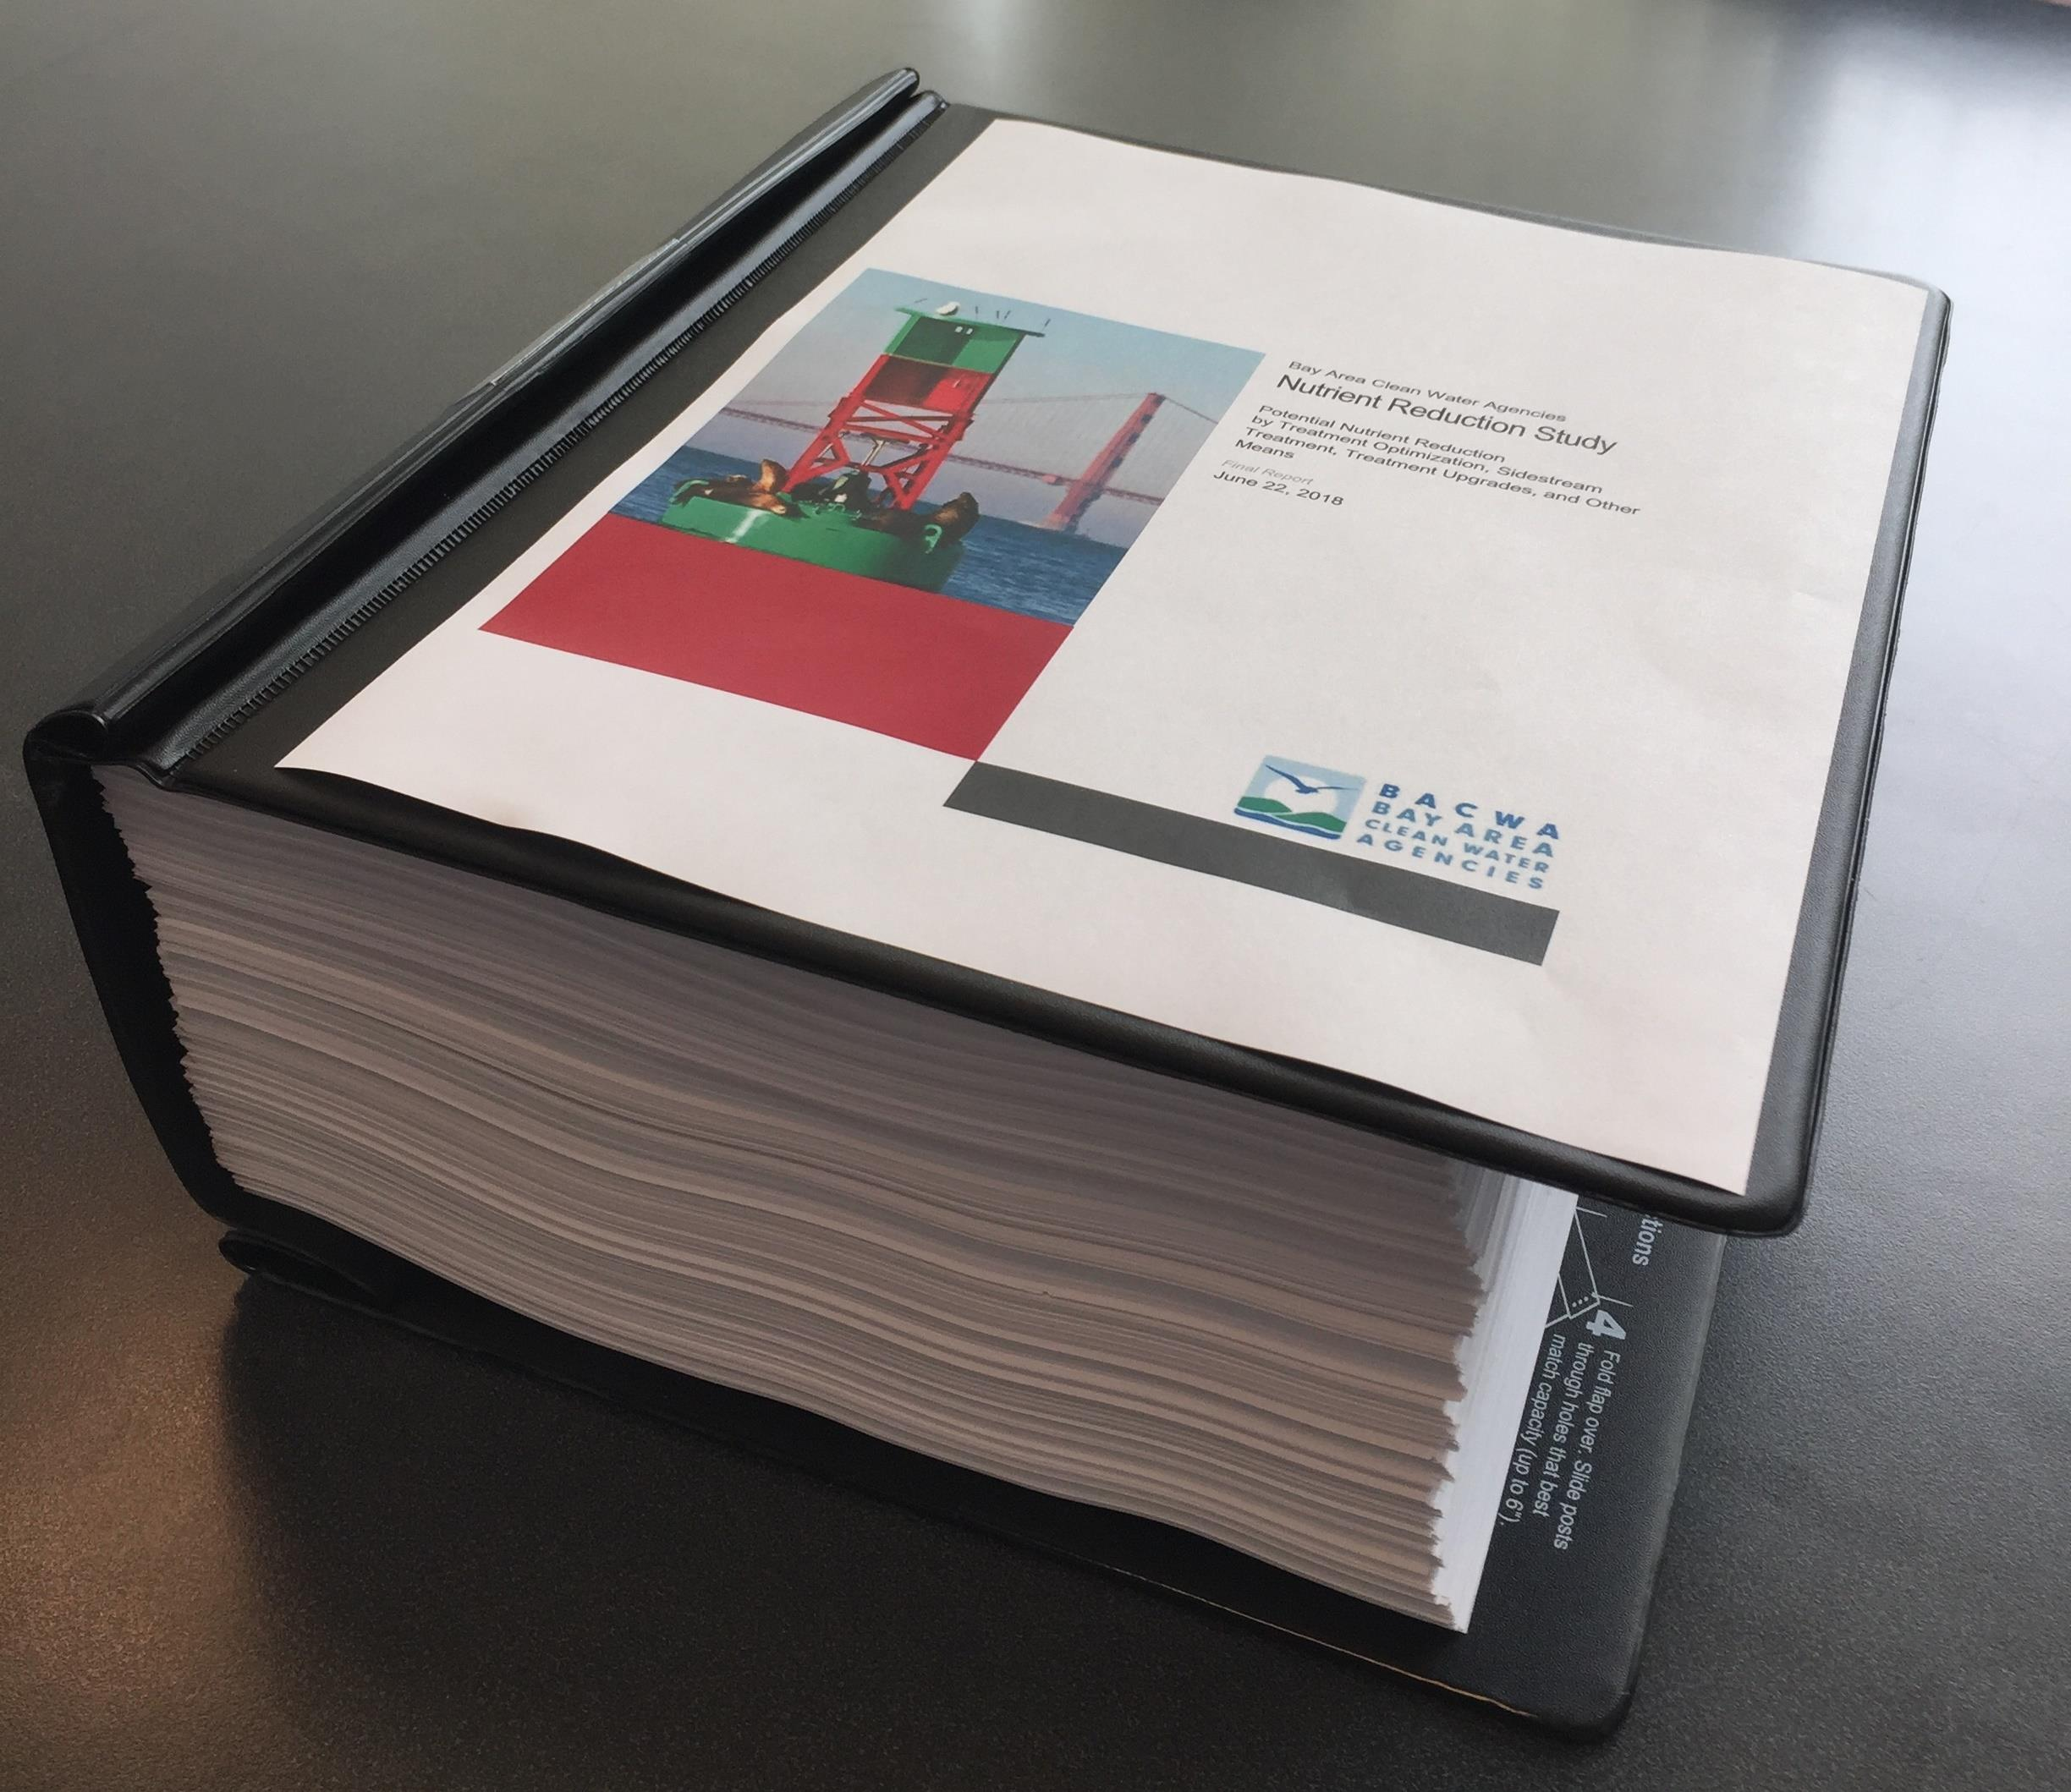
Nutrient Reduction Study Report (June 2018)
Main report: summarizes study findings for all plants
Individual plant reports were prepared for all 37 participating plants (Appendices):
    Summary of historical plant data
    Reduction strategies for all treatment levels (10-20%, 60%, and 80% nutrient load reduction)
    Costs
    Adverse/Ancillary Impacts
    Emerging technologies that could be employed to reduce costs
Notes:
The results of the Nutrient Reduction Study were summarized in a report. An individual report was also prepared for each one of the 37 participating plants that detailed the results of the analyses for each of the nutrient reduction scenarios. The reports also include capital, O&M and present value costs, as well as advantages and disadvantages associated with the scenarios, including for example impacts to greenhouse gas emissions (or GHGs). For each plant, various emerging technologies were also identified for further investigation and consideration. Many of the emerging technologies have the potential for cost savings and/or a small footprint.

Slide 6
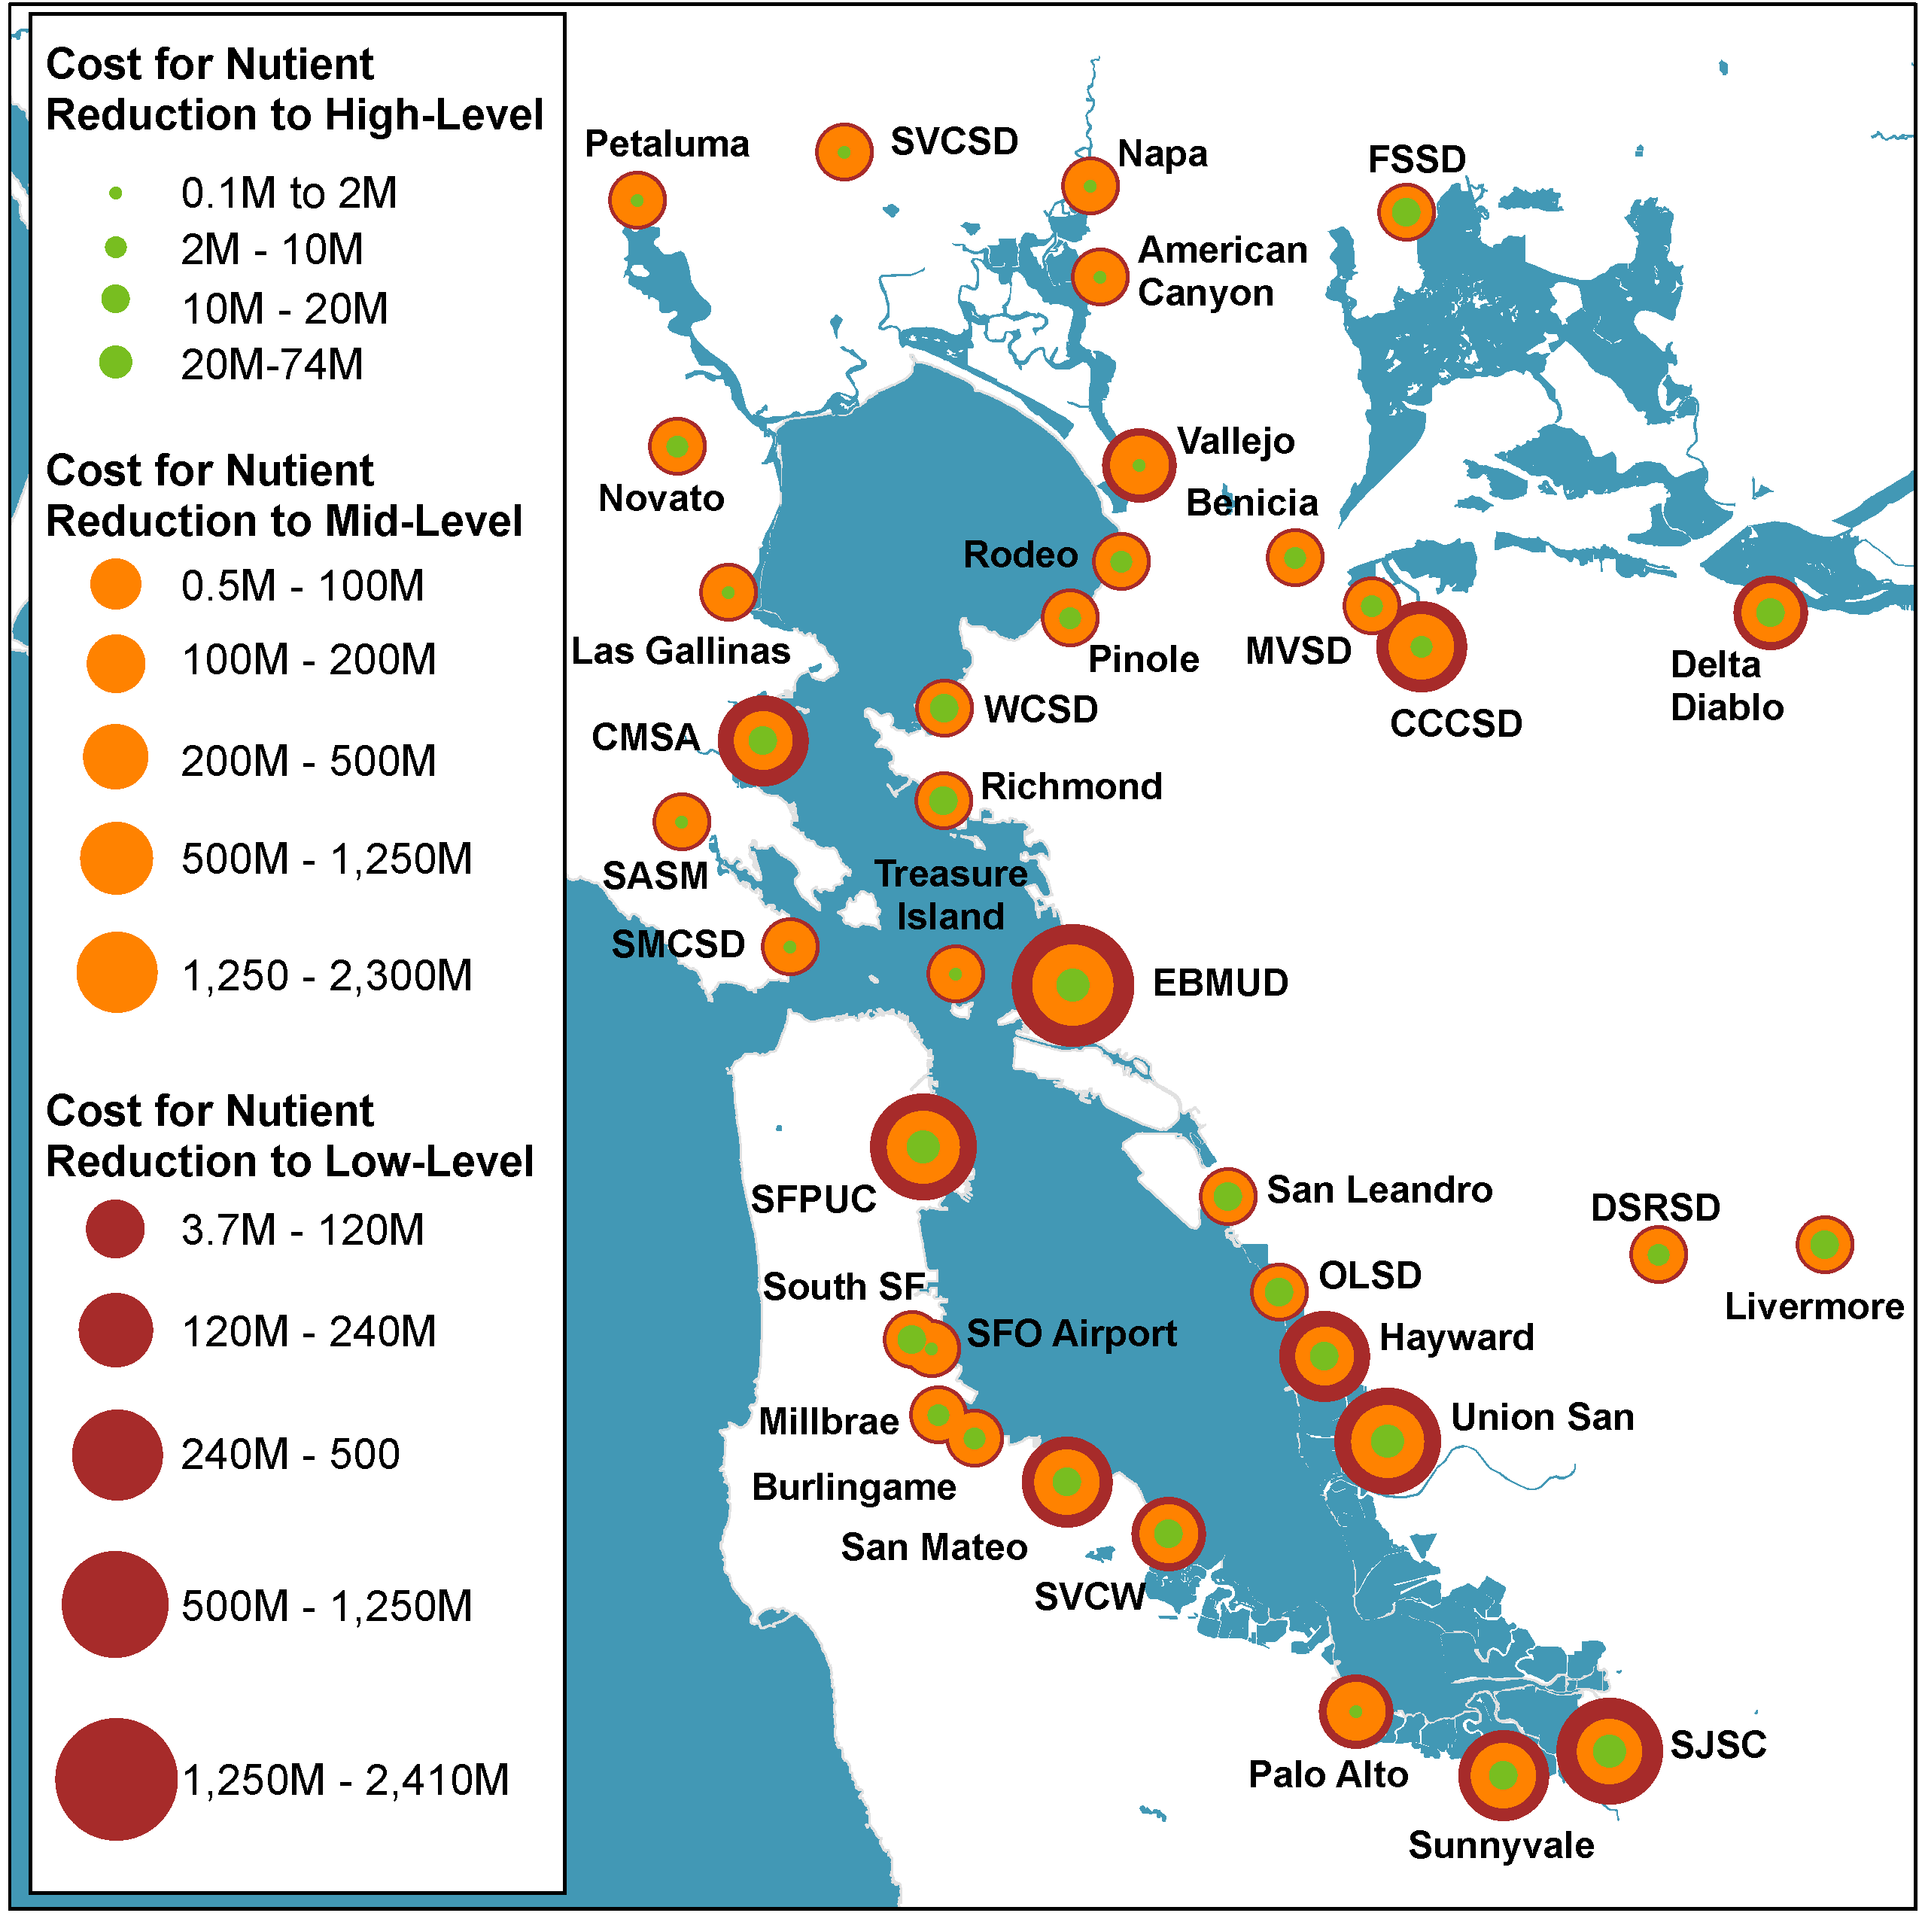
Study Findings for Nutrient Load Reduction
Total Nitrogen Load Reduction | Total Nitrogen Concentration | Estimated Total Capital Cost
0% | 32 mg/l | $0
10-20% | 26 mg/l | $119 - $391M
60% | <15 mg/l | $7 Billion
80% | <6 mg/l | $8.5 Billion
Legend (Circle Size Increases with Cost)
Cost for 10-20% Nutrient Reduction
Cost for 60% Nutrient Reduction
Cost for 80% Nutrient Reduction
Data by BACWA/HDR; graph by SFEI
Notes:
Here is a summary of the results for each of the nutrient reduction scenarios evaluated in the study. As you can see, with low level nutrient reduction, we may be able to achieve up to about 20% reduction in total nitrogen loads discharged to the bay at a capital cost of $119M - $391M. The range represents optimization of existing plant facilities on the low end to construction of sidestream treatment on the higher end.
To achieve a roughly 60% reduction in nutrient loads, the costs increase to $7 Billion. And to achieve a roughly 80% reduction, the capital costs further increase to as much as $8.5 Billion.
The slide also shows the relative magnitude of costs for each of the 37 agencies. Notably, the capital costs for some of the largest plants are the highest.

Slide 7
Note to Presenter: The next 5 slides are intended to provide agency specific information. Please edit as appropriate
If desired, an agency can extract information from their Nutrient Reduction Report to populate the subsequent 5 slides.
An example is provided for Delta Diablo. The presenter should replace the agency-specific information provided for Delta Diablo with the information from your plant-specific report.
Delete this slide

Slide 8
Delta Diablo Results in Comparison to Baywide Results
Parameter | Units | 10-20% Average Load Reduction |  | 60% Average Load Reduction |  | 80% Average Load Reduction A
 |  | Delta Diablo | Baywide Results | Delta Diablo | Baywide Results | Delta Diablo | Baywide Results
Total N Load Reduction | % | 20 – 25 | 10-20 | 59 | 60 | 84 | 80
Total Capital Cost | $ | $6.1M - $14.5M | $119M – 391M | $134M | $7 Billion | $167M | $8.5 Billion
Unit Cost | $/gpd | 0.9 – 1.2 | 0.5 – 0.8 | 12.1 | 10.8 | 14.0 | 14.3
Note to Presenter: Edit the information in red text with your data
Notes:
This example slide should be updated with agency-specific results. Talking points should be specific to your plant. The idea is that each agency could populate the first column of data per heading group as a means to compare against the overall findings.
This table could be followed with a summary of the concepts that showcases the capital cost, reduction, and a visual depiction. For facilities that had both an optimization/sidestream concepts, the agency can either show both or the one that seems to make the most sense for their facility. Given the difference in reliability between optimization (interim solution) and sidestream (up to permitted capacity), it probably makes the most sense for the agency to limit the presentation to 1 high level concept.

Slide 9
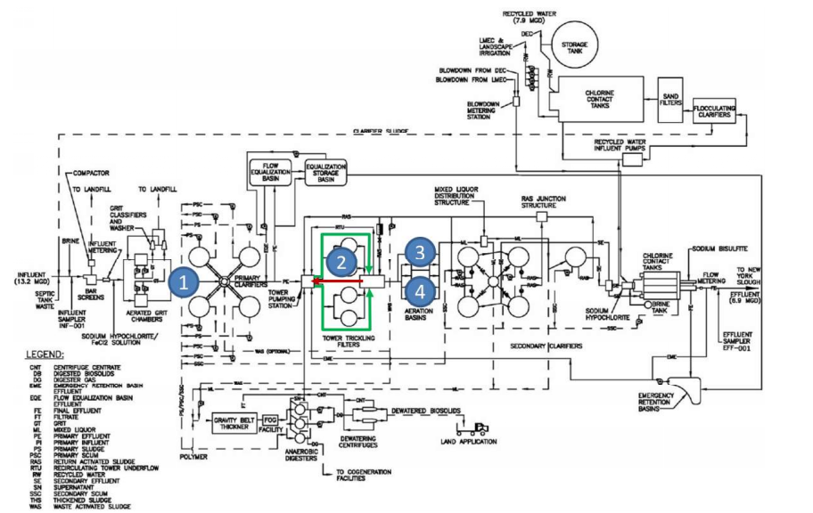
Delta Diablo 20% Total N Load Reduction: $6.1 Mil Capital
Note to the user: I would limit the 10-20% load reduction presentation to either optimization OR sidestream (not both) as it will result in potential confusion and further questions.
(1) Metal salt; (2) split treatment at biotowers; (3) increase blower capacity; (4) add anoxic zone in aeration basins for season Total N load reduction
Notes:
NOTE: I chose Delta Diablo as they have both Optimization and Sidestream. Rather than confuse the audience by showing both 10-20% load reduction options and needing additional technical insights, it is better to choose optimization or sidestream for such instances.
Possible explanation:
This graphic presents the 10-20% load reduction in the brochure and it is referred to as “optimization”. It is important to note that while the capital cost is lower than the other 10-20% load reduction option (see the next slide), it is not as reliable as the other option and it would only be an interim solution. The other 10-20% load reduction option is proven and has capacity through upgrades.

Slide 10
Delta Diablo 25% Total N Load Reduction: $14.5 Mil Capital
(1) Sidestream treatment facility
Notes:
NOTE: I chose Delta Diablo as they have both Optimization and Sidestream. Rather than confuse the audience by showing both 10-20% load reduction options and needing additional technical insights, it is better to choose optimization or sidestream for such instances.
Possible explanation:
This graphic presents the 10-20% in the brochure and it is known as sidestream treatment. It is important to note that while the capital cost is higher than optimization, it is more reliable and it is viewed as long-term solution as it has capacity through upgrades.

Slide 11
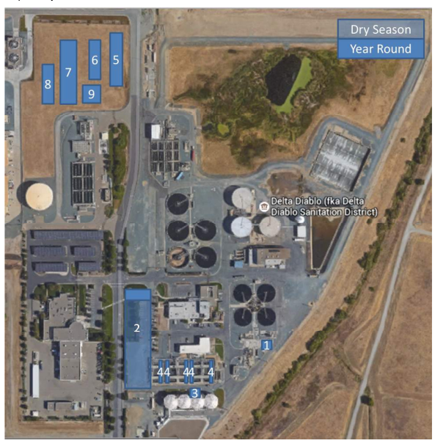
Delta Diablo 59% Total N Load Reduction: $134 Mil Capital
Flow split structure
New membrane bioreactor (MBR)
Bypass around biotowers
(portion of flow)
Construction of anoxic zones
Ammonia removal filters
Alkalinity chemical feed
Total N removal filters
Supplemental carbon chem feed
Metal salt/polymer chem feed
Notes:
Possible explanation:
This graphic presents the 60% load reduction range. The new and modified facilities is listed. The graphic has the footprint for each new unit process and highlights the facility needs differences between the dry and year-round limits. These upgrades would be a long-term, reliable solution, designed for at least 30 years.

Slide 12
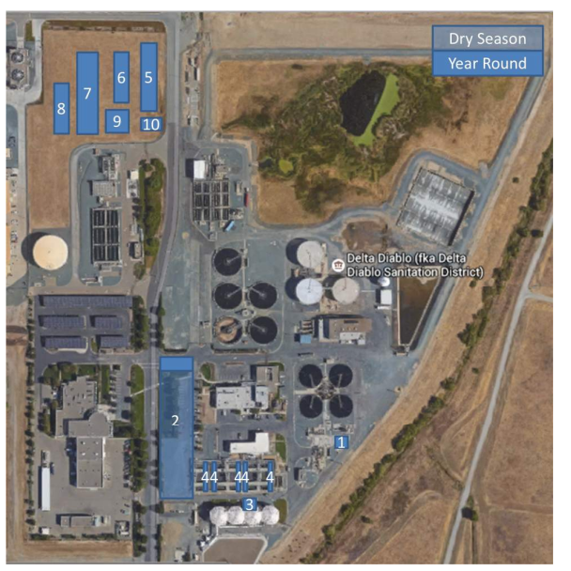
Delta Diablo 84% Total N Load Reduction: $167 Mil Capital
Flow split structure
New membrane bioreactor (MBR)
Bypass around biotowers
(portion of flow)
Construction of anoxic zones
Ammonia removal filters
Alkalinity chemical feed
Total N removal filters
Supplemental carbon chem feed
Metal salt/polymer chem feed
Rapid mix/flocculation tanks
Notes:
Possible explanation:
This graphic presents the 80% load reduction range. The new and modified facilities is listed. The graphic has the footprint for each new unit process and highlights the facility needs differences between the dry and year-round limits. These upgrades would be a long-term, reliable solution, designed for at least 30 years.

Slide 13
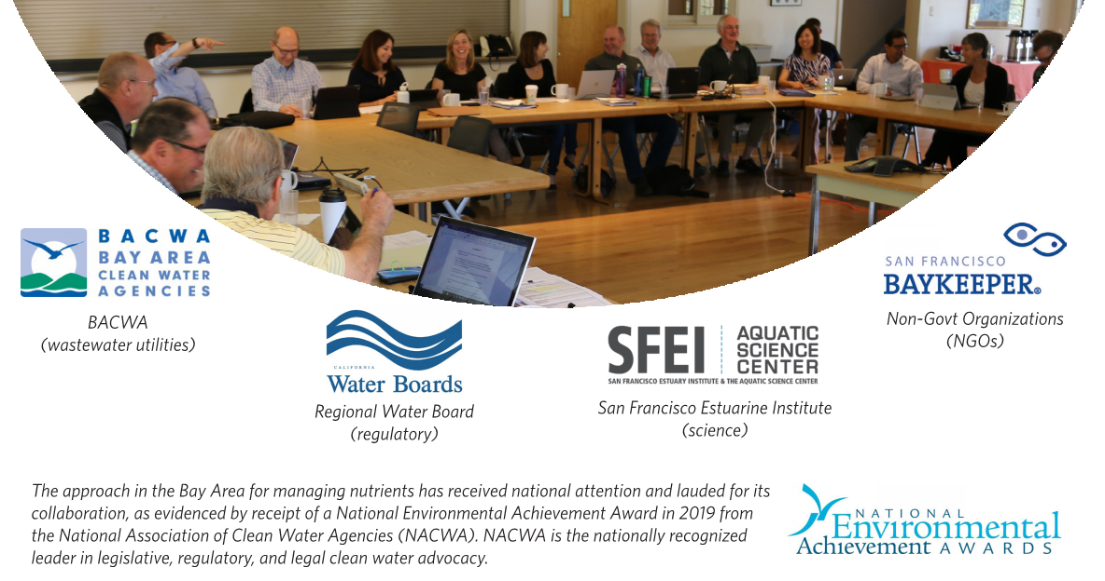
Collaboration is Key for Implementing the Watershed Permit Requirements and Long-Term Nutrient Management
The approach in the Bay Area for managing nutrients has received national attention and praised for its collaboration, as evidenced by receipt of a National Environmental Achievement Award in 2019 from the National Association of Clean Water Agencies (NACWA). NACWA is the nationally recognized leader in legislative, regulatory, and legal clean water advocacy.
Notes:
While the impact of nutrients on Bay health is yet unclear, a collaborative partnership that includes BACWA, the Regional Water Quality Control Board, San Francisco Estuary Institute (SFEI), Baykeeper, and others exists to better understand this situation. This collaborative effort is essential for developing a transparent and effective strategy for managing nutrients in the Bay.
Recently, the collaborative approach has garnered national attention by receiving the National Environmental Achievement Award in 2019 from the National Association of Clean Water Agencies (NACWA). NACWA is the nationally recognized leader in legislative, regulatory, and legal clean water advocacy.

Slide 14
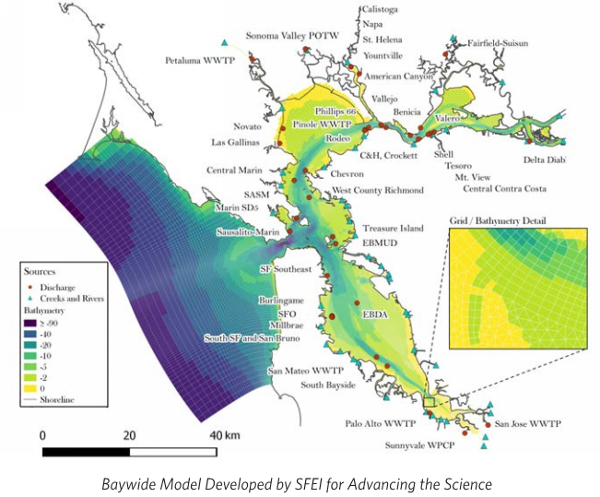
Next Steps for Nutrients in San Francisco Bay
Next Watershed Permit expected in April 2019
Ongoing science to inform policy by 2024
Treatment plants to continue evaluating and implement nutrient management solutions
Continue stakeholder involvement
Notes:
The adoption of next Watershed Permit is anticipated in April 2019. It will include:
Additional work on the scientific studies being led by SFEI
And two additional special studies to further evaluate opportunities for nutrient discharge reduction.

Slide 15
2nd Watershed Permit in 2019, requirements
Continued monitoring by individual agencies, with some changes:
  New influent monitoring requirements for agencies rated >10 mgd
  No more TKN or soluble reactive phosphorus monitoring in effluent
  Reporting year now lines up with water year (October 1 to September 30), whereas previously it was permit year (July 1 to June 30)
Increased support for scientific studies (from $880K/yr in 1st Watershed Permit, to $2.2M/yr in 2nd Watershed Permit)
Special Studies:
  Regional Evaluation of Potential Nutrient Discharge Reduction by Natural Systems – Study to be conducted by SFEI
  Regional Evaluation of Potential Nutrient Discharge Reduction by Water Recycling – BACWA to issue RFP for consultant support
  All permit compliance activities, other than individual monitoring, to be funded by BACWA through the Nutrient Surcharge.

Slide 16
2nd Watershed Permit in 2019, baseline and load targets
The Tentative Order Fact Sheet establishes a baseline against which early actions can be measured. The baseline for each agency is its maximum (from past four years) dry season average of total inorganic nitrogen.
The Fact Sheet also includes “Load Targets”, which reflect loads 15% higher than the baseline, and which agencies are expected to be able to meet in 2024.
Depending on the results of the Science Program, the Regional Water Board may establish load caps in the 2024 permit. If the loads caps are based on the Load Targets, the Regional Water Board may adjust them if necessary to account for decreased recycled water demand, increased biosolids management, increased daytime worker population, or new or expanded waste-to-energy programs.
“Early Actors” are identified, which are agencies committed to taking action to reduce nutrients by 2024. These agencies will likely not be required to further reduce nutrients prior to actions taken by other agencies in their subembayment.

Slide 17
2nd Watershed Permit in 2019, timeline
Tentative Order issued March 1, 2019
Comments Due April 2, 2019
Adoption expected May 8, 2019
Effective date July 1, 2019
First Group Annual Report February 1, 2020

Slide 18

Please Visit www.BACWA.org/Nutrients
BACWA Site:
Nutrient Reduction Study
Other Relevant Presentations/
Reports
Brochure (see Cover)

