Slide 1

P2 for PFASs
Jen Jackson, Toxics Reduction & Healthy Ecosystems Program Manager
Notes:
About three years ago, the Toxics Reduction Program began researching fluorinated chemicals.

Slide 2
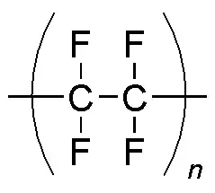
Persistent
Notes:
Fluorinated chemicals we are concerned with have similar structures across an entire class and are characterized by at least one F-C, which is the strongest bond in chemistry and does not degrade in the natural environment. It takes the energy of a lightning bolt to break this bond. That makes them persistent.

Slide 3

Highly Mobile
Notes:
Very good surfactants, which are kind of like soaps – they spread easily. These molecules move around the globe and are found even in the most remote places on the planet. Since they don’t ever degrade, they don’t go away and will just continue to accumulate in the environment.

Slide 4
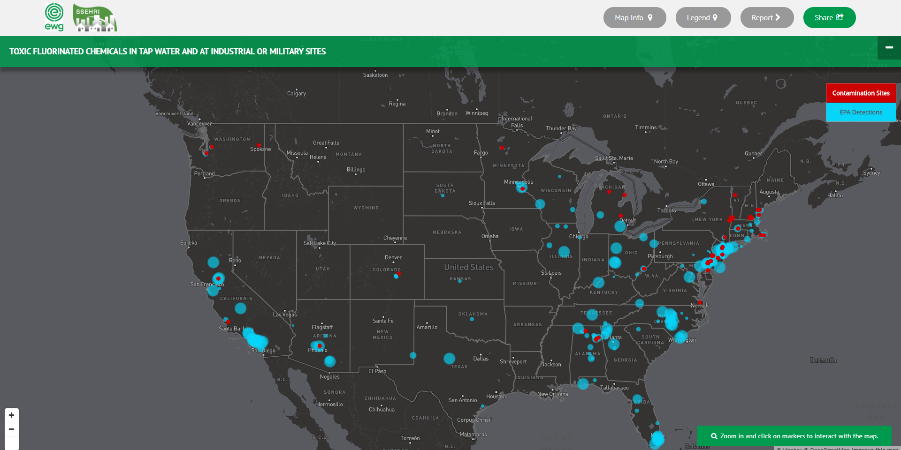
Ubiquitous
Copyright © Environmental Working Group, www.ewg.org. https://www.ewg.org/reprintpermission#.Wqa9k62ZOcZ. Reproduced with permission.
Notes:
Because of their persistence, wherever they have been manufactured and/or used to manufacture other products, these chemicals are showing up in water sources. They are infamous for contaminating water in the Ohio River Valley, near a 3M plant in Minnesota, and numerous other locations around the United States. Many of these companies are being sued by local or state authorities over the contamination. The liability associated with working with PFAS is extremely high.

Slide 5
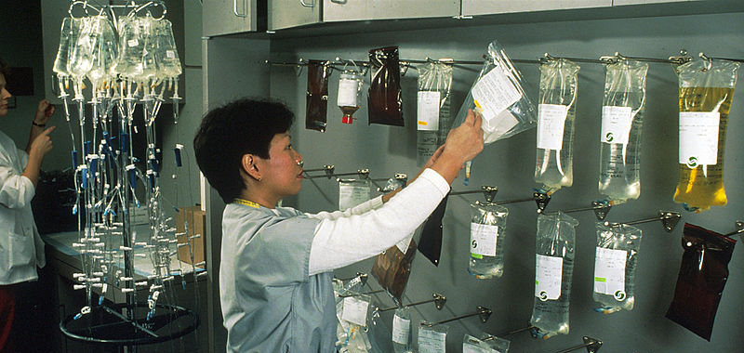
Known Impacts
Notes:
Because of a well-known lawsuit in the OH River Valley and subsequent settlement that involved epidemiological studies, we know a lot about the human health effects of two fluorinated chemicals called PFOA and PFOS. Several cancers are well documented, along with high cholesterol.

Slide 6
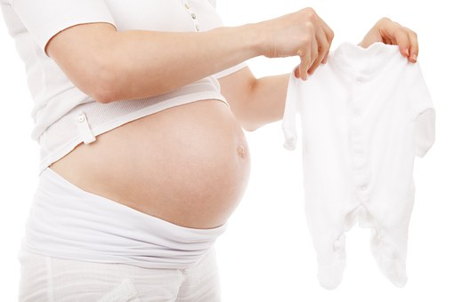
Possible Impacts
Notes:
And possibly reproductive harm including birth defects.

Slide 7
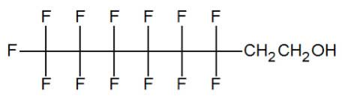
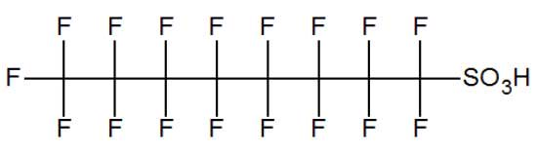
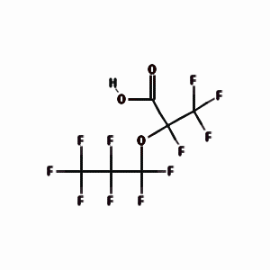
Long-chain ≈ Short-chain?
PFOA – C8
6:2 FTOH
PFOS – C8
GenX
PFHxA – C6
Notes:
You’ve heard me mention long chain chemicals. The nomenclature is being updated all the time, but PFOA and PFOS are among those that have many F-C bonds. The original chemicals used to make Teflon and Scotch Guard had at least 8 of these bonds. Because they were turning up everywhere, manufacturers agreed to phase them out, but just started manufacturing similar chemical cousins with fewer F-C bonds. These are the so-called short-chains. And now there are the next generation chemicals that have side chains like GenX and more. They all have this F-C bond though, which as we know doesn’t break down. Toxicologists, when evaluating a chemical without a lot of data will look for similar structures to other chemicals to predict whether they may be harmful. With such similar structures, there is a lot of concern.
Because of that, we try to talk about these chemicals as a class – either by just saying fluorinated chemicals or PFASs, which includes more than 5000 chemical structures.

Slide 8
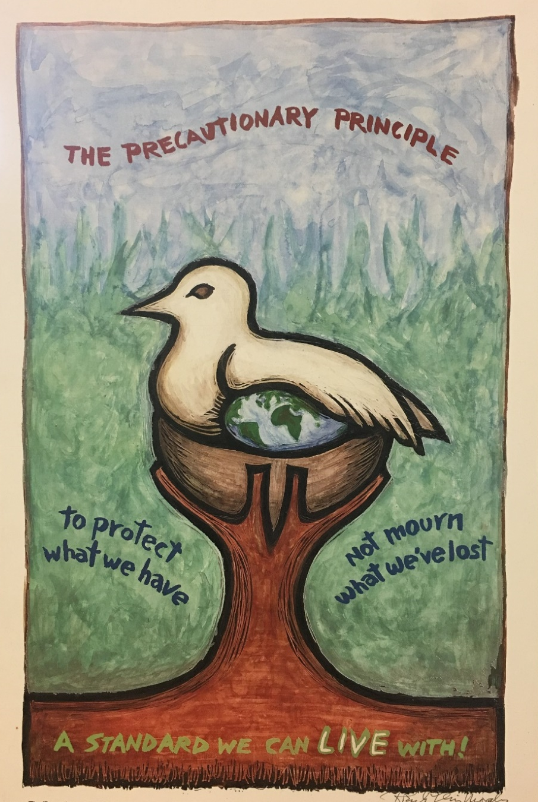
Precautionary Principle
Take anticipatory action to prevent harm, even if there is lack of full scientific certainty.
Notes:
In 2005, the City adopted a Precautionary Purchasing Ordinance which seeks to minimize harm by using the best available science to make choices that take into account the least harmful alternatives.
With that in mind, here’s what we are doing in SF.

Slide 9

Possible Local Action
Source: Green Science Policy Institute, www.greensciencepolicy.org. Reproduced with permission.
Notes:
They are being found everywhere because we use them in many consumer products.

Slide 10
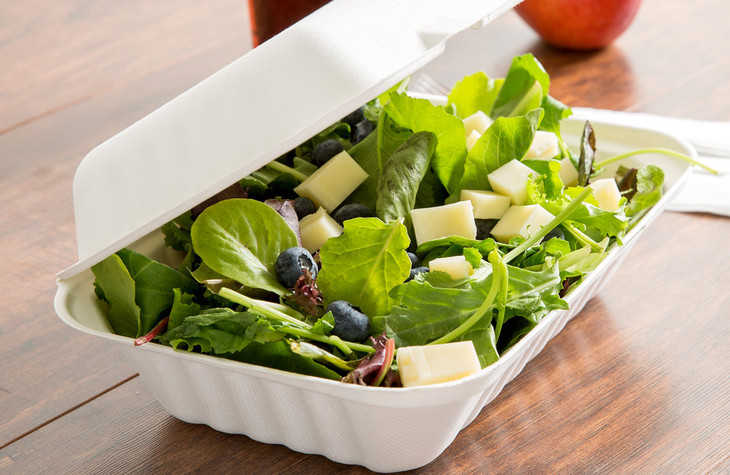
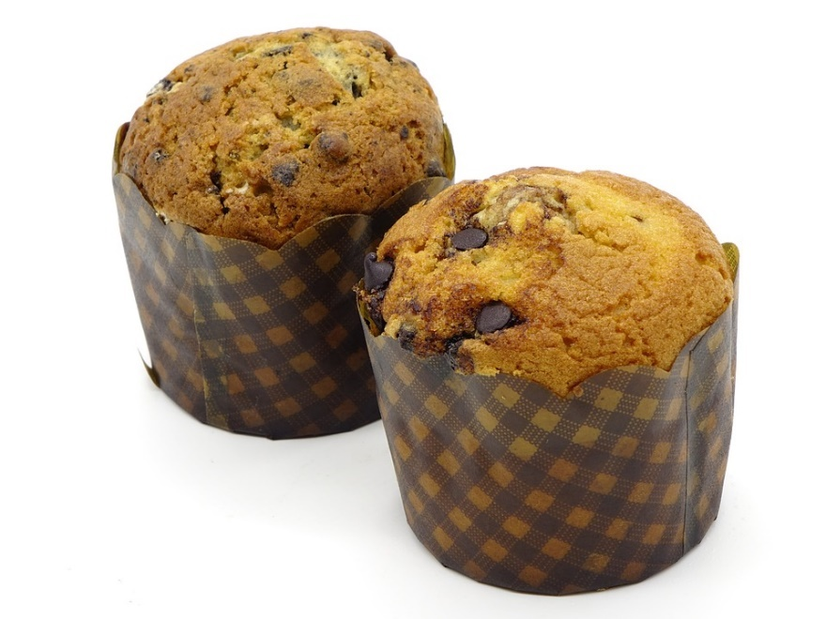


Foodware
Notes:
Unfortunately, we have learned there are fluorinated compounds in most alternative fiber food service ware and some paper food service ware. Alternative fibers include “bagasse,” sugar cane, wheat straw and other agricultural wastes.

Slide 11

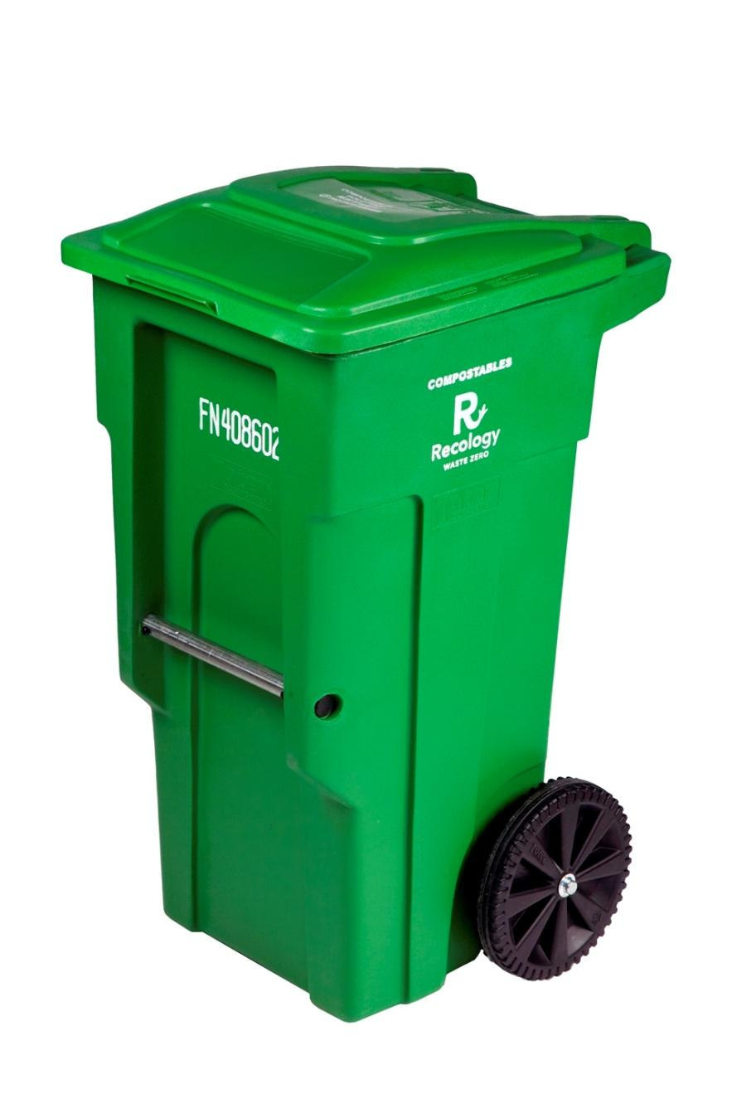
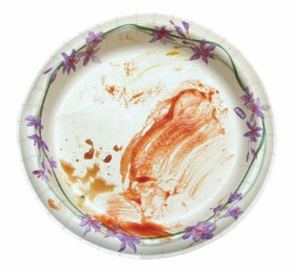

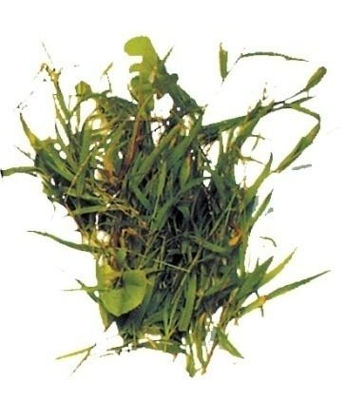
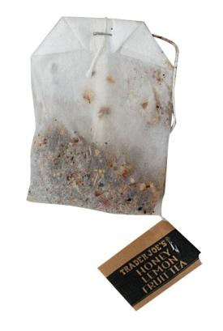
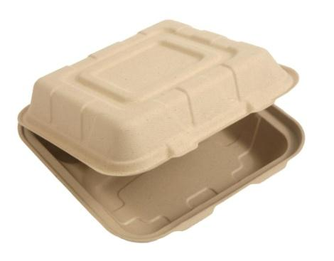
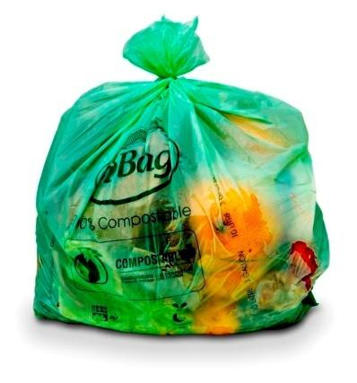
Food and food-soiled paper to green bin
Notes:
Since 2006, we have required all food service ware to either be compostable or recyclable, and we banned the Styrofoam food service ware. To increase compliance, and to increase the amount of food going to the green bin, we allow used paper-based and fiber-based food service ware to go to compost. Food-soiled paper and fiber products can’t be recycled, and we didn’t want them to go to landfill.

Slide 12
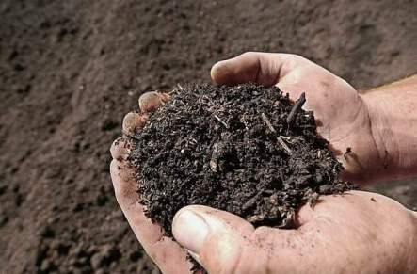
Implications for Compost?
Photo courtesy of Recology
Notes:
So of course, we are concerned that PFASs in foodware could contaminate compost. We have to do everything we can to protect final compost product that is applied to farms and vineyards….
A small study of commercial compost showed that compost from foodwaste sources does contain PFAS.

Slide 13
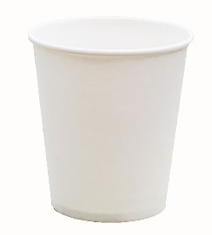
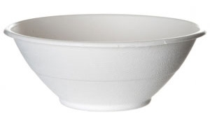
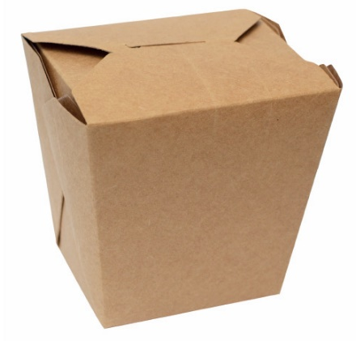
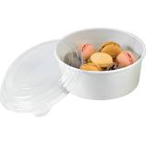
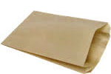
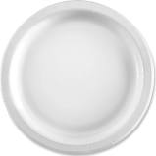
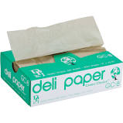
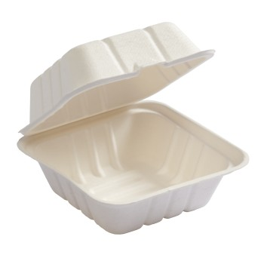
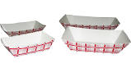
Testing
Notes:
So, we decided to see if at a City level we could eliminate PFASs from our foodware that we as a City purchase. We found that every product made with bagasse or alternative fibers was fluorinated. Products made with paper were generally F-free or had very low fluorine content (less than 100 ppm).

Slide 14

New City Foodware Contract
No PFAS
Notes:
We found alternatives to the products that were fluorinated and in early 2018, we updated our food service supplies contract to add a specification for PFAS-free compostable foodware. We had four bidders and awarded the contract. We are mostly moving toward paper coated with PLA or uncoated paper, but it was difficult and implementation isn’t perfect because there’s no single source of information for PFAS-free compostables.

Slide 15

Third-Party Certification & Product List
Notes:
What we really needed to make our contracting process easier was a robust third-party standard and certification with a list of compliant products. We approached BPI in 2016 about the fact that some of the compostable foodware they were certifying contained non-compostable PFAS ingredients. They weren’t aware of this problem, but tackled it quickly and announced changes to their standard. Starting in 2020, all products certified by BPI will have less than 100 ppm of total fluorine, and will also require a declaration of no intentionally added PFAS.

Slide 16
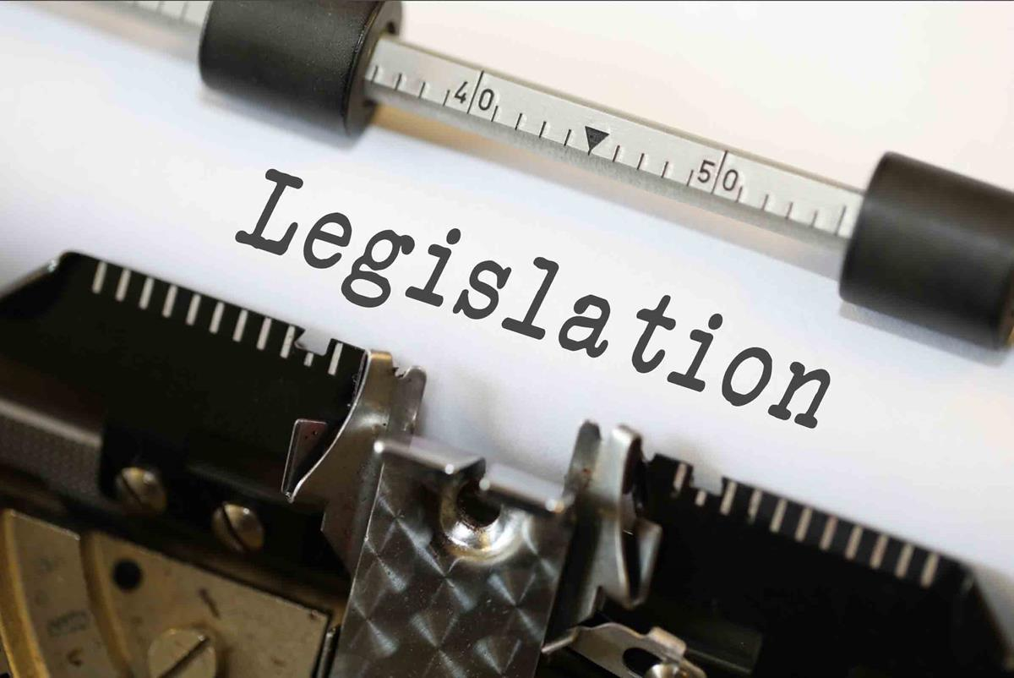
Citywide Ban on PFAS in Food Ware (Jan 1, 2020)
Notes:
Because BPI made that change, we were able to pass legislation in SF that bans PFAS in foodware. This was the unsung part of our much publicized straw ban. By pointing to the BPI certification, there is a list of products that are PFAS-free and compostable that restaurants, delis and grocers can use to ensure they are complying with the ban.

Slide 17

City Purchases - Furniture & Carpet
No
PFASs
Flame Retardants
Antimicrobials
VOCs/Formaldehyde
Heavy Metals
PVC
Notes:
Then we moved on to work on carpet and furniture purchases. We conducted a survey of manufacturers to better understand what was available on the market and also to indicate that we wanted PFAS-free products. We created new requirements for City purchases of carpet and furniture to eliminate stain guards. In order to ensure performance though, we included other provisions, such as carpet has to be in tiles in case a tile becomes stained, it is easily replaceable. We also required certain kinds of fiber that are more resilient to stains vs using PFAS treatments.

Slide 18
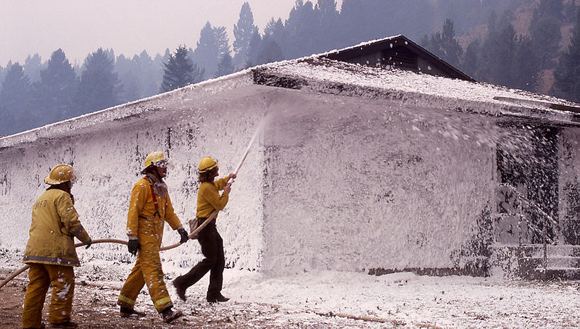
Fire Fighting Foam
Notes:
And more recently we have been working on fire fighting foam. This is a much more difficult product because of needing to meet safety standards. But the potential environmental contamination from these foams is huge. Many of the known 1500 contamination sites on the US map I showed earlier are from using fire fighting foams.

Slide 19
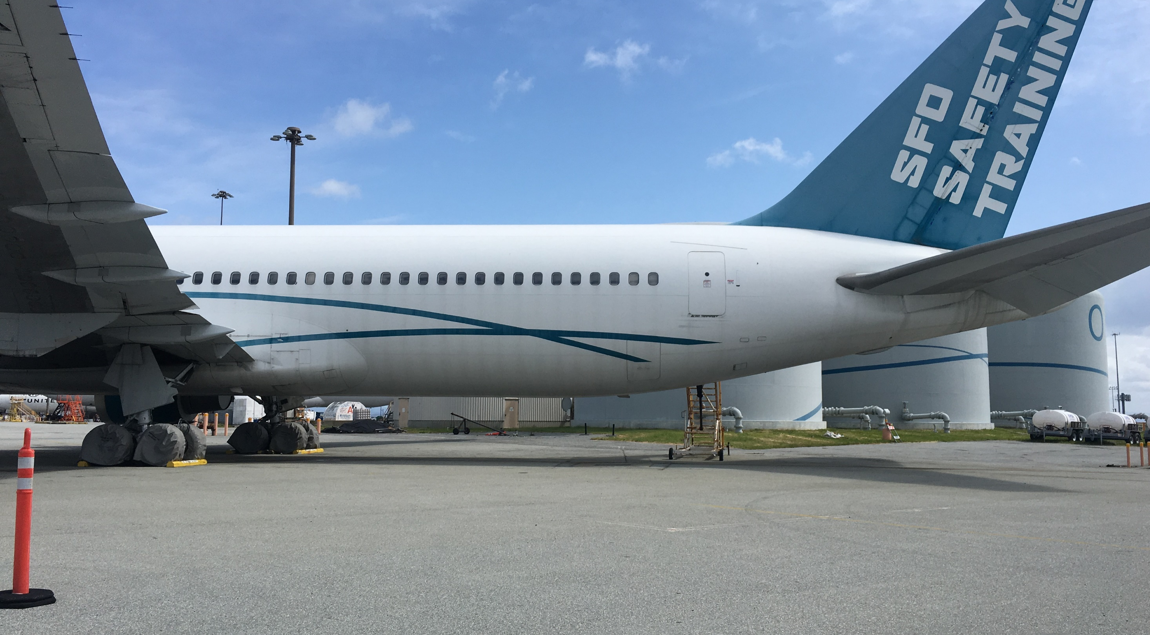
Airports Required to Use Fluorinated Foams
Notes:
Fluorinated foams are are required at airports by the FAA, which requires testing of equipment 1-3x/year. The vast majority of airports have long discharged the foam on the ground and do not contain it. However, with the issue of PFAS contamination of surface and groundwater near airports, many have advocated for changes to these requirements. Congress has passed legislation that requires FAA to eliminate its requirement that foam be fluorinated within 3 years so that airports have other choices. In addition, FAA has offered other means of testing equipment so that discharges are no longer necessary.

Slide 20
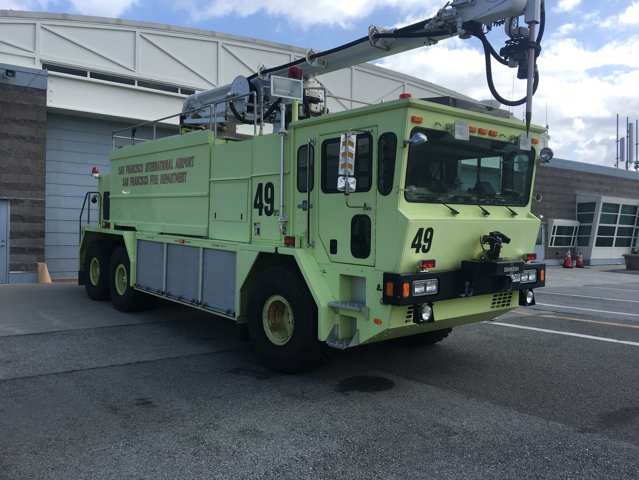
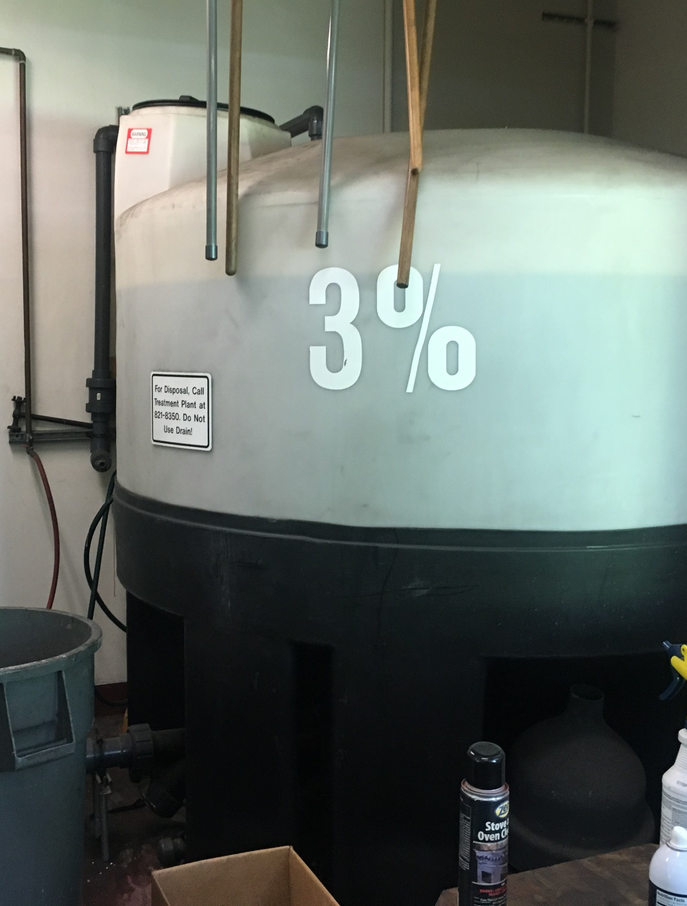
Airports Required to Use Fluorinated Foams
Notes:
Airports in CA will also now be required by the Water Board to test for PFAS contamination both where they have historically stored firefighting foams as well as where they discharged it.

Slide 21
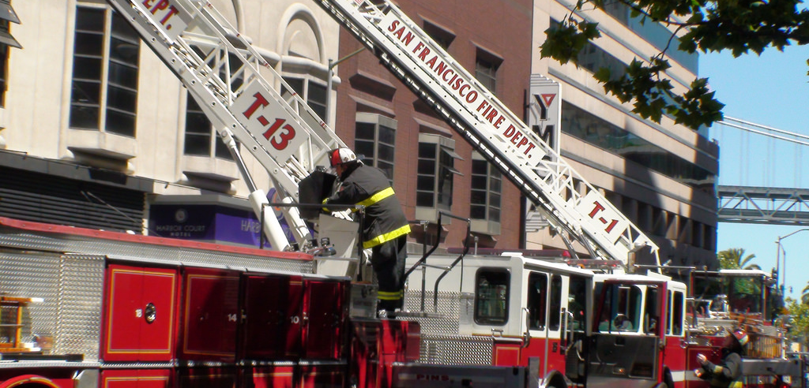
Municipal Firefighting
Notes:
There is no requirement in municipal firefighting for foams to contain PFASs. There are many products on the market that don’t contain PFASs. We are working to understand whether they are available in the US, what the replacement chemicals are, whether there are implications for equipment, and whether there are differences in cost. In June, an analysis of three of the alternative products will be available so that hopefully we can shift to a safer product.

Slide 22
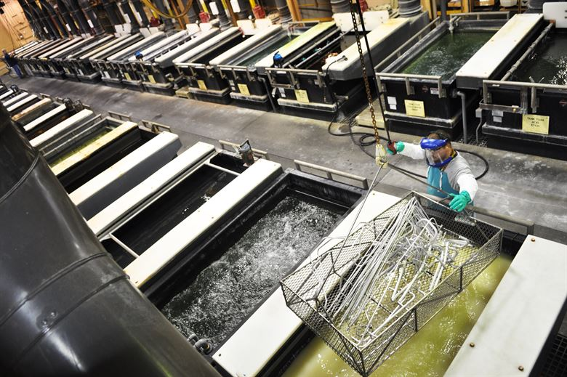
Chrome Plating
Notes:
Chrome plating has historically used PFASs for mist suppression. Mists containing chromium can be emitted from chrome plating facilities, and since chromium is extremely toxic, the CA Air Resources Board has required either mist suppression systems or advanced ventilation systems with HEPA filters. Most metal finishers are small operations for decorative plating, and probably are using PFAS-containing mist suppressants.

Slide 23
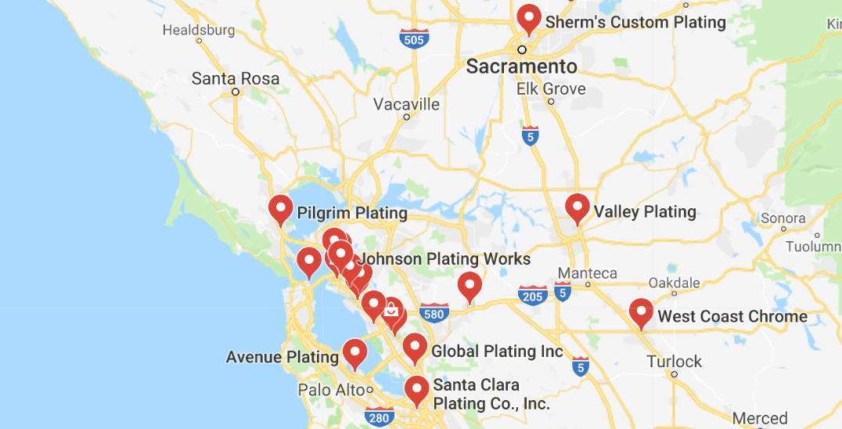
Numerous Platers in Bay Area
Notes:
In the Bay Area, a quick Google search revealed quite a few metal finishing companies, some of which may do chrome plating. There is a great opportunity to work with this industry to move toward ventilation systems rather than PFAS-containing mist suppressants.

Slide 24
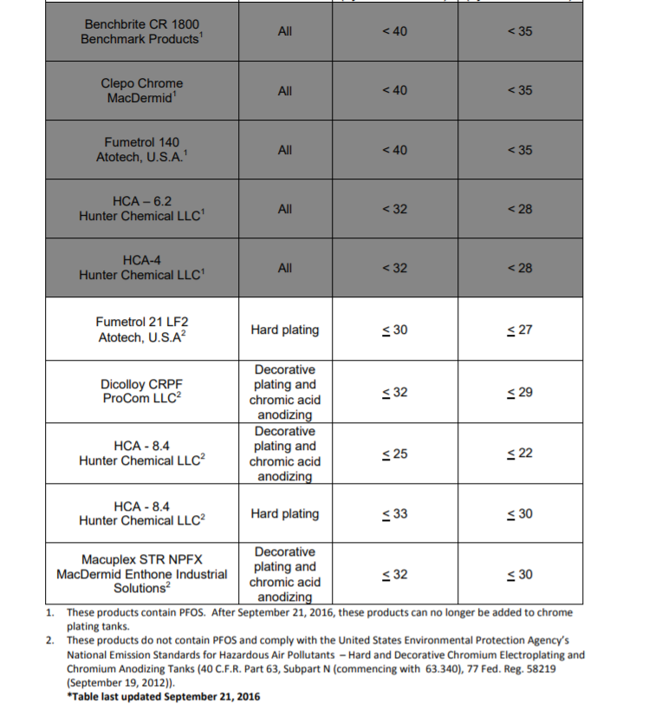
No Longer Using PFOS but maybe other PFASs
Flumetrol – polyfluorosulfonic acid
Dicolloy – German company, no SDS easily found online
HCA 8.4 – proprietary
Macuplex STR NPFX – proprietary surfactant and organic acid; MI Dept of Environmenta Quality Inspection report indicates may be closely related to PFOS but isn’t PFOS
Notes:
CARB underwent a process of reviewing its list of allowed mist suppressants after PFOS-containing mist suppressants were banned by EPA in 2015. However, the products that CARB is allowing may very likely contain fluorochemicals. Again, an opportunity to work with a fellow agency to avoid regrettable substitutes as well as eliminating pollutants.

Slide 25

Cosmetics – AB 495

Slide 26
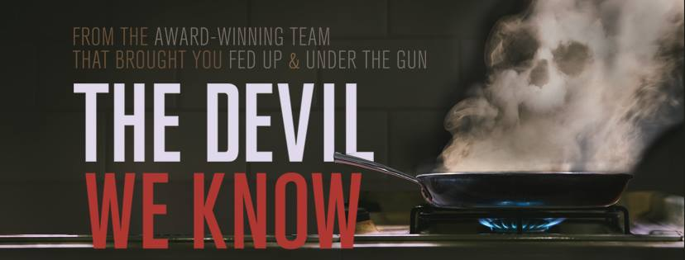
Thursday, April 4, 5pm @ SF Environment
Notes:
Want to know more about this class of chemicals? Come see this Sundance Film Festival documentary that gives the incredible story of how we got where we are. It is also available for live streaming.

Slide 27
Questions? Thank you!
Jen Jackson
SF Department of the Environment
Jen.Jackson@sfgov.org
© 2018

Slide 28
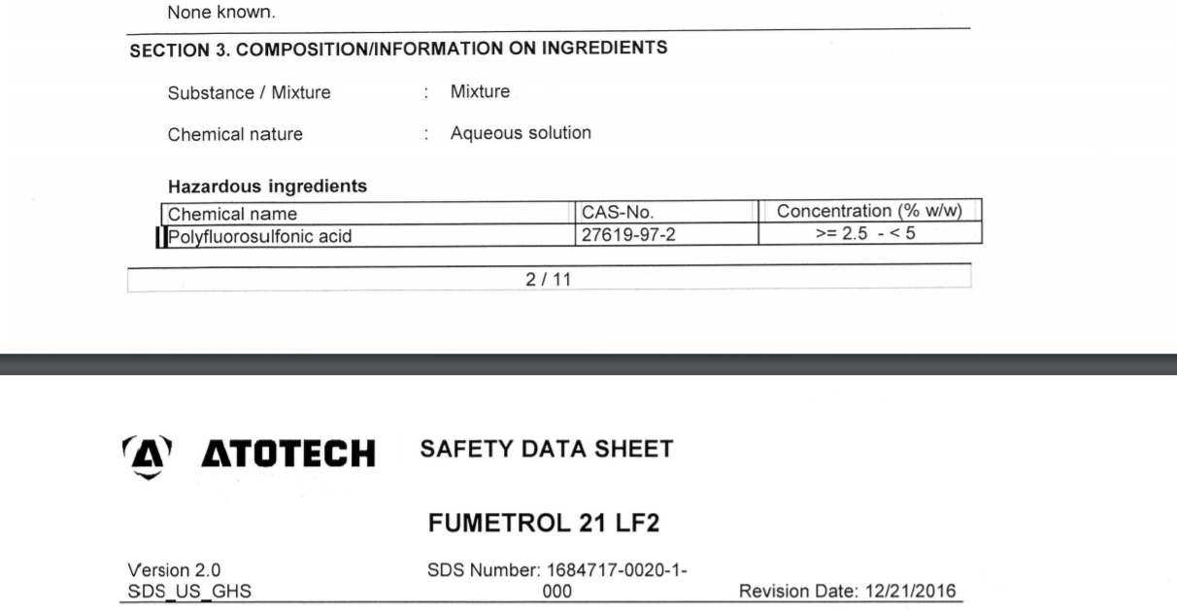
Fumetrol
Notes:
SDS screen shot for Fumetrol, one of the CARB-approved replacements for mist suppression in chrome plating facilities.

Slide 29
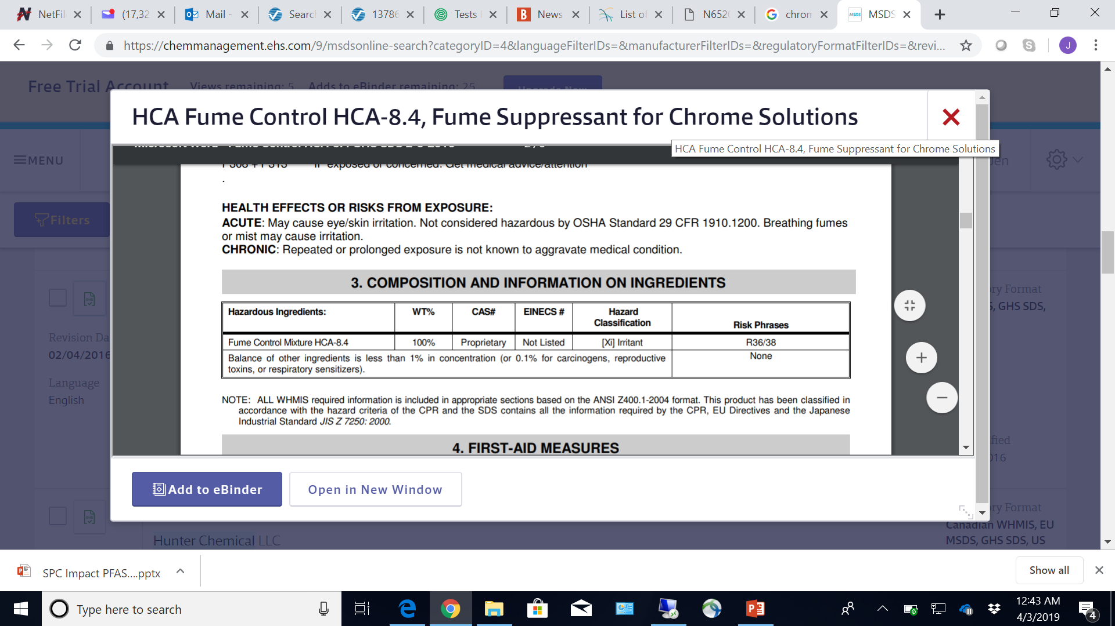
Notes:
SDS screen shot for HCA-8.4, one of the CARB-approved replacements for mist suppression in chrome plating facilities.

Slide 30
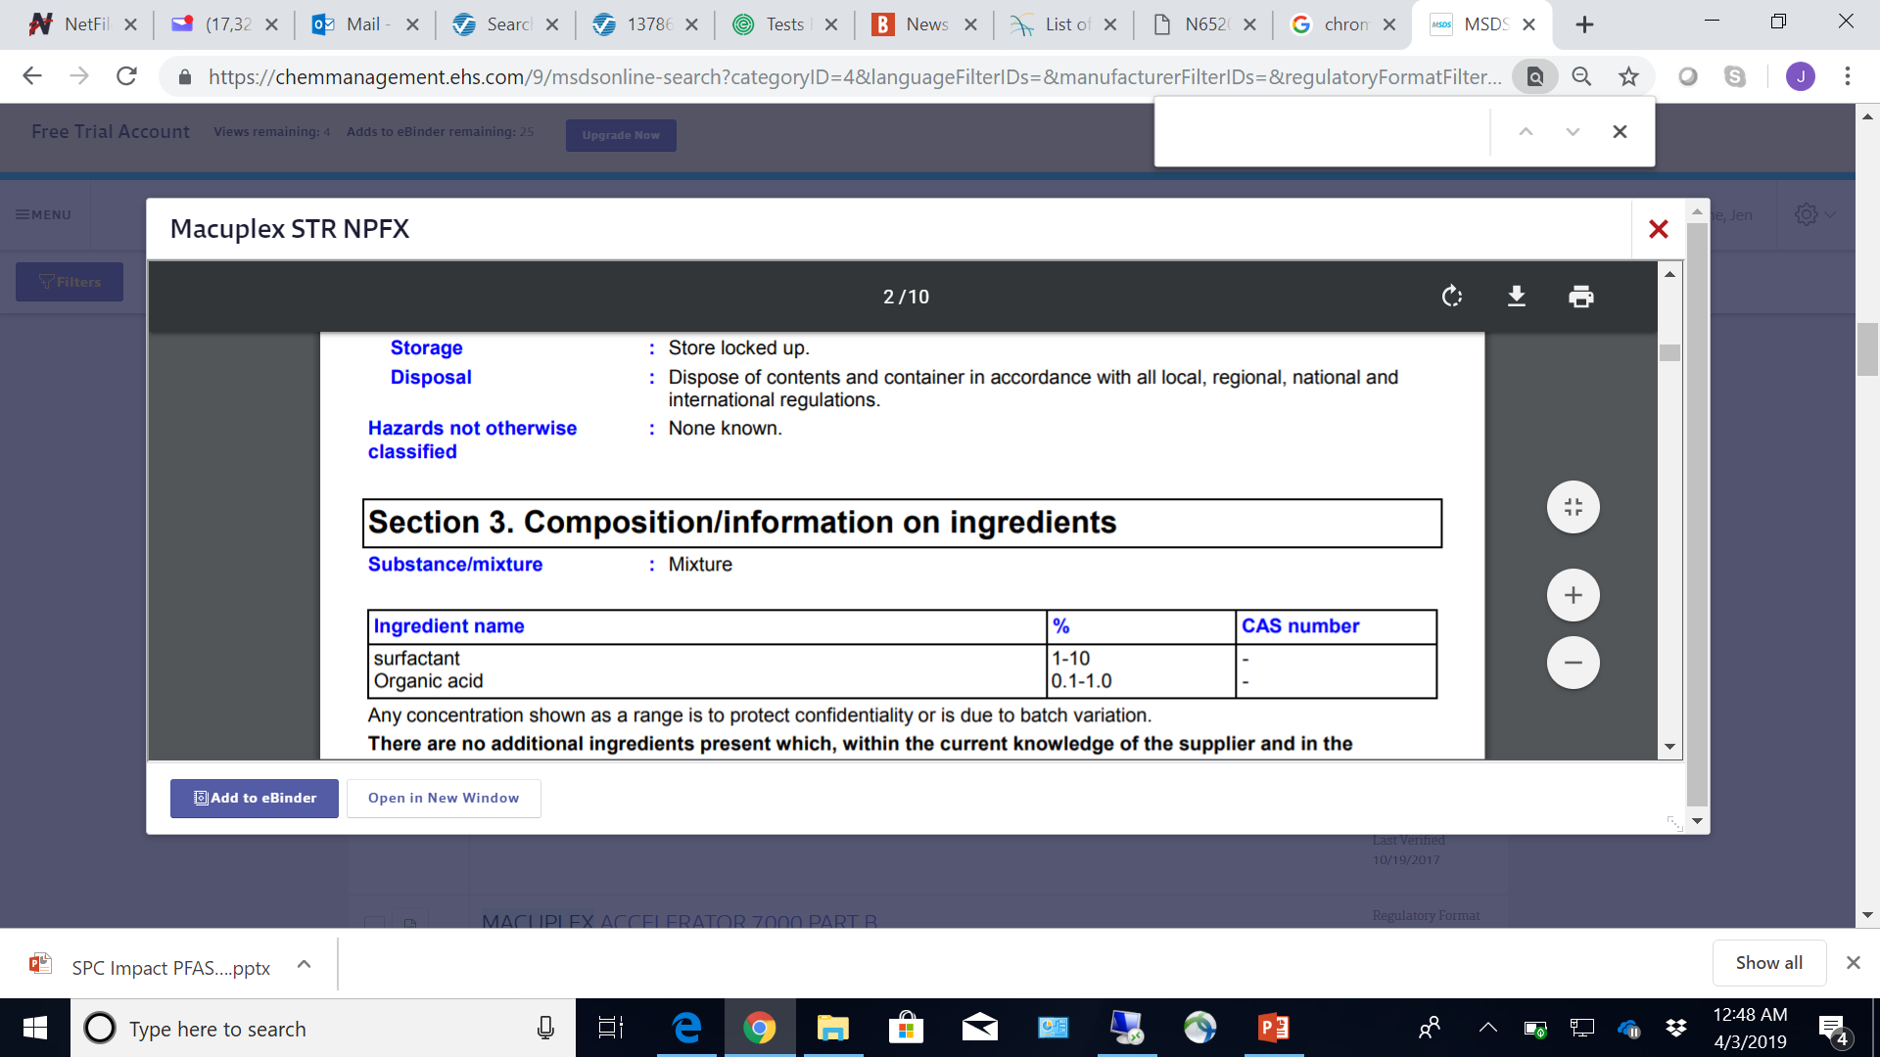
Notes:
SDS screen shot for Macuplex STR NPFX, one of the CARB-approved replacements for mist suppression in chrome plating facilities.

Slide 31
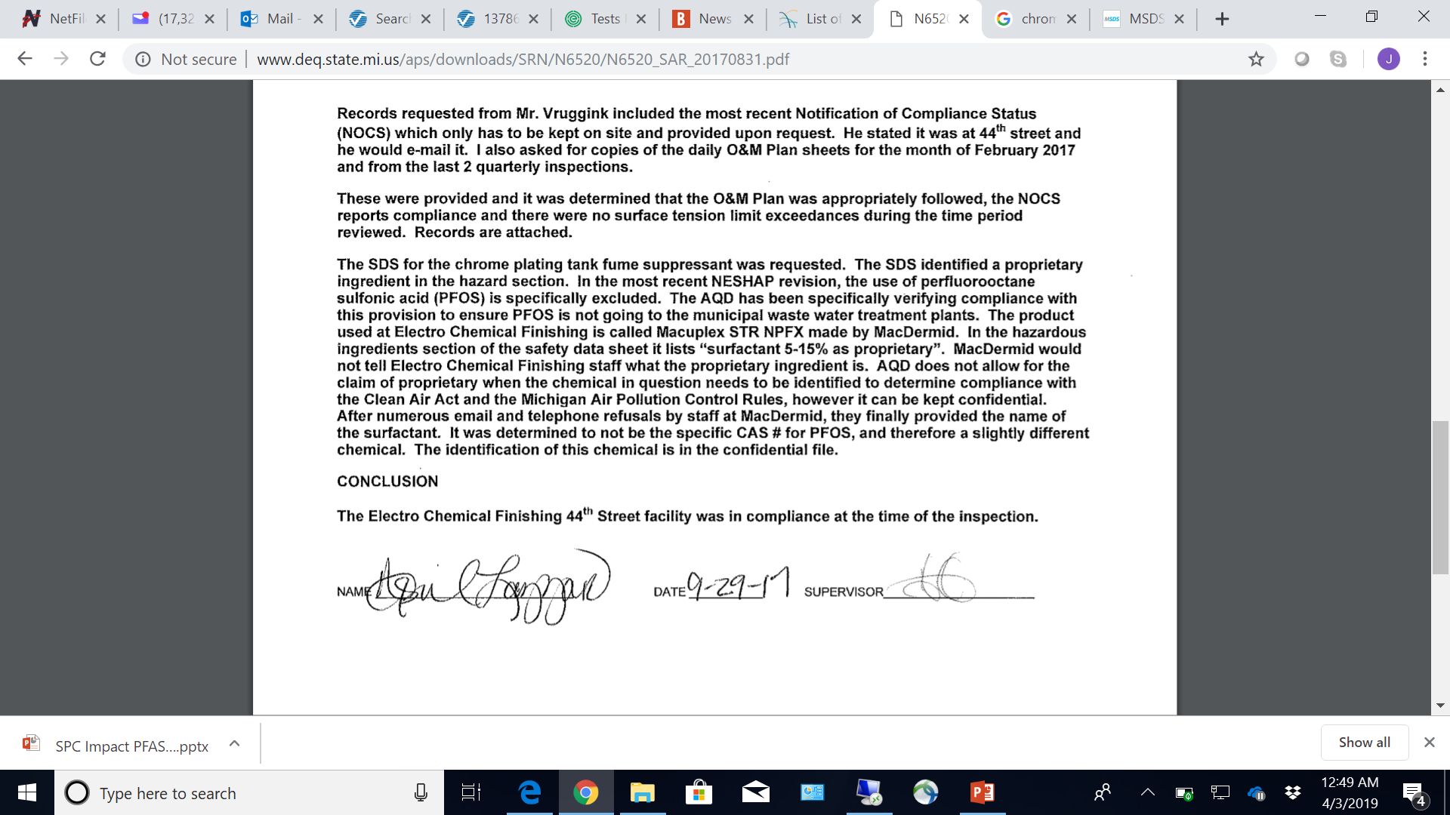
Notes:
A bit more info on Macuplex

