Slide 1
BAAQMD-BACWA Annual Meeting Agenda
September 9th, 10 am – 2 pm – BAAQMD Headquarters
Rule 11-18: Reduction of Risk from Air Toxic Emissions at Existing Facilities
Health Risk Screening & Assessments Update
(Presenter: Carol Allen, BAAQMD)
Basin-Wide Methane Strategy (Climate Pollutants) Update -
Regulatory Development
(Presenter: Misha Nishiki, BAAQMD)
New Source Review – Standard Permit Condition Revisions
(Presenters: TBD, BACWA; Ryan Atterbury, BAAQMD)
Technology Implementation Loan Program
(Presenter: Chad White, BAAQMD)
EBMUD Flare Update/SCAQMD Rule Development
(Presenter: Chris Dembiczak, BACWA)
SWRCB Co-Digestion Capacity Analysis
(Presenter: Sarah Deslauriers, BACWA)

Slide 2
Air Quality, Climate Change, &
Energy (ACE) Workgroup Update
August 16, 2019 – BACWA Executive Board Meeting
Sarah A. Deslauriers, P.E., ENV SP
Climate Change Program Manager

Slide 3
2019-2020 Priority Issues
Active Now
  SB 1383: Short-Lived Climate Pollutant (Methane) Reduction
  BAAQMD Regulation 13: Climate Pollutants & Odors & VOCs & TACs &...
  SWRCB Co-Digestion Capacity Analysis
  AB 617: Community Air Protection Program
  Vulnerability to Climate Change – SWRCB, Coastal Commission
  America’s Water Infrastructure Act of 2018
Upcoming
  Carbon Neutrality by 2045
  Using Land Management (and Biosolids?) to Meet GHG Targets
  Offset Protocol Development – American Carbon Registry

Slide 4

SB 1383: Short-Lived Climate Pollutant (SLCP) Reduction Implementation
40% methane reduction by 2030
(relative to 2013 levels)
Organic waste diversion from landfills
(includes biosolids, digestate, and sludges)
  50% by 2020 (relative to 2014 levels)
  75% by 2025 (relative to 2014 levels)
CEC/CPUC to incentivize biogas production/use
To be adopted by January 18, 2020
State to start enforcement on Jurisdictions January 1, 2022
Jurisdictions to start enforcement January 1, 2024
Notes:
For more information:
http://www.calrecycle.ca.gov/Climate/SLCP/

Slide 5
SB 1383: Proposed Organic Waste Reduction Regulations
Emergency disposal to landfills for 90 days
Land application qualifies as a reduction pathway
Limit on local ordinances
Procurement of compost
Procurement of “renewable gas” for multiple uses
Next version to be released in September
Notes:
The California Accidental Release Prevention (Cal-ARP) Program regulations regulate the owner or operator of a stationary source with more than a threshold quantity of a regulated substance in a process. The regulation was developed to prevent the release of an extremely hazardous or flammable substance such as occurred in Bhopal, India. A stationary source is a building , structure, equipment where the substance is stored, used, manufactured, and handled, i.e. the process. Therefore, if you exceed the threshold quantity, the company must prepare a Risk Management Plan and implement the risk management program.
There are three program levels and the most stringent is the Program 3 where the facility needs to comply with the OSHA process safety management standard (California it is California Code of Regulations, Title 8, Section 5189). Cal-ARP compliance is required based on the following excerpt from 8 CCR Section 5189: These regulations shall apply to a process which involves a chemical at or above the specified threshold quantities listed in Appendix A or a process which involves a Category 1 flammable gas (as defined in Section 5194) or a flammable liquid with a flashpoint below 100 ºF (37.8 ºC) on site in one location, in a quantity of 10,000 pounds (4535.9 kg) or more. The exemption for flammable gas is if the gas is sold at a retail facility.
Yes the process of developing the Risk Management Plan is long, most often requiring a plant engineer, safety professional and a regulator. Following the development of the risk management plan, it requires implementation and it requires time and money. Approximate cost for developing a plan is $40 K.

Slide 6
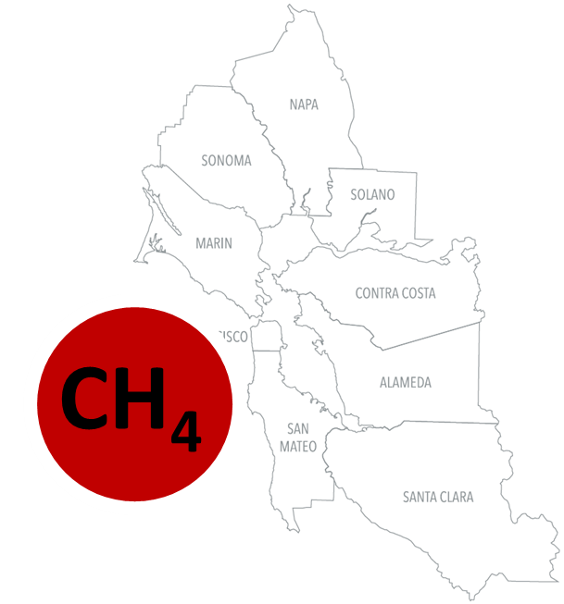
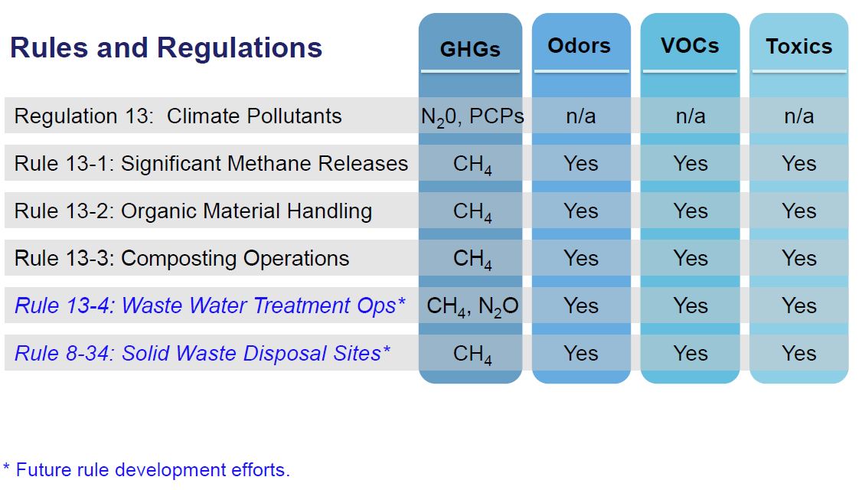
3. Regional Hot Topic:
BAAQMD Climate Pollutants
Rule 13-4: Wastewater Operations*
Rule 8-34: Solids Waste Disposal Sites*

Slide 7
3. Regional Hot Topic:
BAAQMD Climate Pollutants
Next Steps
  Rule 13-1 was to go to Board by end of 2019 – on hold
  Workshops on Rules 13-2 and 13-4 being held next week
  Rule 13-2: Organic Material Handling and Composting Operations
    Draft regulation released and Workshop Summary Report
  Rule 13-4: Sewage Treatment and Anaerobic Digestion
    Concept paper released
    Draft regulation to be released end of 2019/early 2020
Comments submitted July 12th

Slide 8
3. Regional Hot Topic:
BAAQMD Climate Pollutants
Comments included…
  Provided a reminder that composting and anaerobic digestion are viable paths
  to methane reduction
  Provided a definition of anaerobic digestion and biosolids
  Specified issues with the proposed composting regulations that threaten
  existing operations (e.g., in-vessel, organic material processing, biosolids
  storage, pile dimensions, moisture content test methods
  Excluding biosolids from the definition of putrescible material
  Excluding anaerobic digestion from the definition of handling
  Requested access to the list of 70 sewage treatment facilities

Slide 9
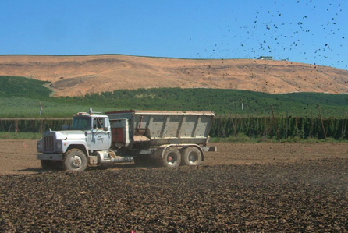
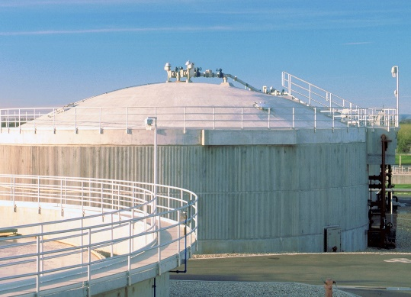
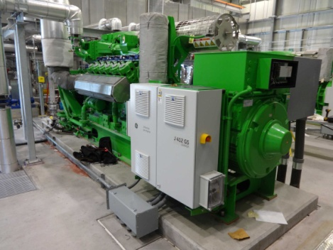
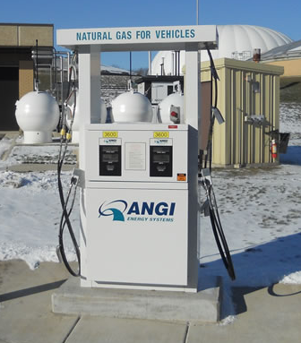
SWRCB: CA POTW Co-Digestion Capacity Analysis
Purpose: “Enable the Water Board to work with wastewater agencies, local governments, community members and other stakeholders to inform approaches to better coordinate and cost-effectively maximize organic waste diversion from landfills, co-digestion at wastewater treatment plants, and beneficial biogas and biosolids utilization.”

Slide 10

SWRCB Co-Digestion Capacity Analysis
Additional state agency staff are reviewing the report
  Estimate organics generation in 2025 and 2030
  Assess existing capacity (without rehab/modifications)
  Assess future capacity in 2025 and 2030 (without & with rehab/modifications)
  Assess methane emissions
  Additional Topics:
    Investigate opportunities and barriers
    at small- to medium- sized facilities
    Examine pilot/demonstration facilities
    that have already operated
Release of report to the public is expected by the end of the year

Slide 11
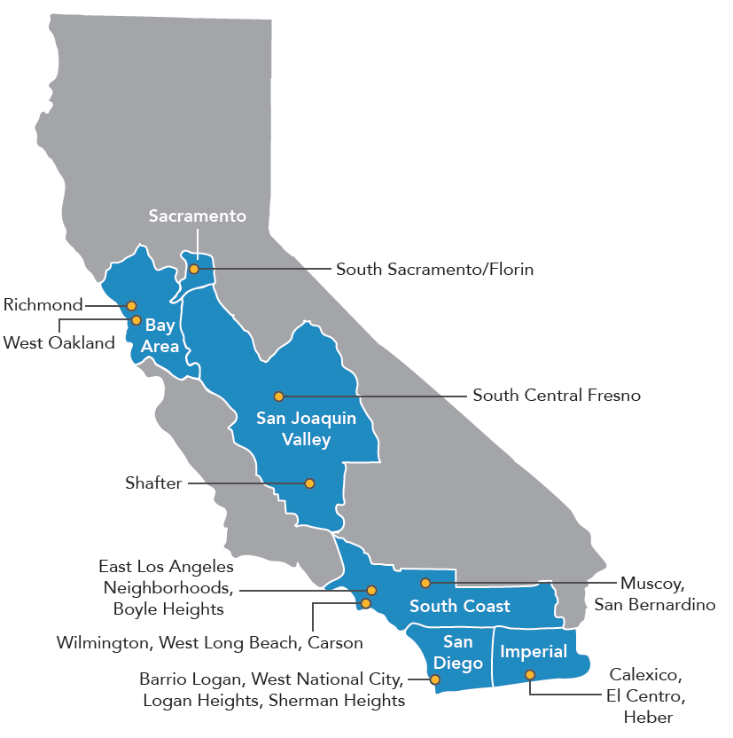
AB 617: Community Air Protection Program
CARB to harmonize community air monitoring, reporting, & local
emissions reduction programs for CAPs and TACs (and GHGs).
October 2018
  Assess community exposure
  Establish criteria for air monitoring
  Identify source contributions and
  strategies for emissions reduction
October 2019
  Establish emission reduction targets,
  schedule, & enforcement programs
  Air Districts to submit annual progress
  reports to CARB in 2019 for 2018

Slide 12
AB 617: Stationary Source Applicability
Report GHGs to CARB
Criteria air pollutant emissions >250 tpy of applicable nonattainment pollutant(s) or precursor(s)
Elevated prioritization toxics applicability (categorized by air district)
Additional applicability – facility with 1+ permits issued by air district with actual emissions or activity levels greater than or equal to:
  ≥4 tpy of any criteria air pollutant (except CO)
  ≥ 100 tpy of CO
  Activity levels published in Appendix A, Table A-3 includes:
    Open (primary) WWTPs >5 MGD, closed WWTPs >10 MGD
    Combustion of crude, residual, distillate, or diesel oil

Slide 13
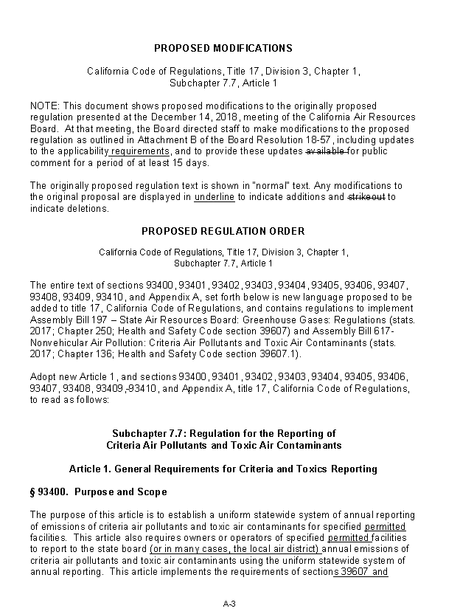
AB 617: Proposed Regulation Criteria Air Pollutant & Toxic Air Contaminant Reporting
Dave Edwards/ARB stated:
  Recommended we participate in update to
  AB 2588 Air Toxics Hot Spots Program –
  amendments necessary to update the
  Regulation including changes to the chemical
  list, test and modeling methods, and references
  Expanded AB 2588 list of compounds to be
  distributed shortly
  Open to adopt short list of Toxics for WW sector!
Implementation delayed to next year!
Next: Develop approach to work on
updating default emission factors
Notes:
Comments submitted March 29th
Original applicability thresholds should be maintained for Phase I
Focus on sources of high risk compounds
Future phases, consider program expansion
Unfunded mandate, consider cost-effectiveness
Wastewater sector approach - current & accurate process
Air District default emission factors are not accurate
Monitoring/reporting full AB 2588 list of compounds is unnecessary, unrealistic, and costly (collecting examples of testing/sampling costs to reflect this and will comment on the overall cost-ineffectiveness)
Take step-wise approach to determine facility size and short-list of compounds

Slide 14
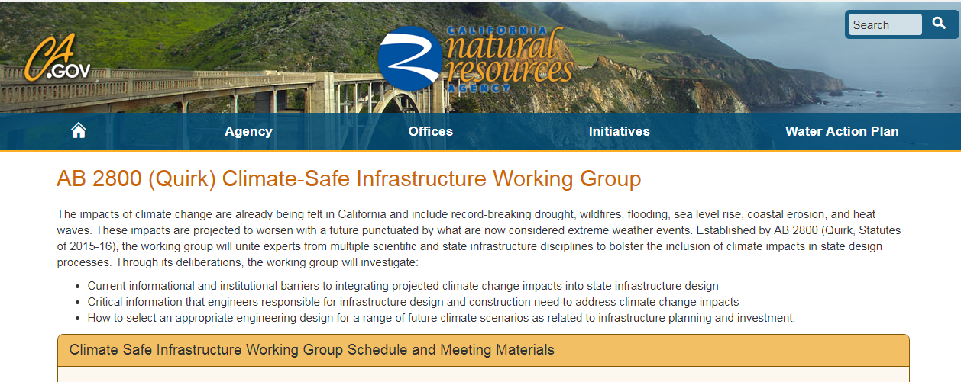
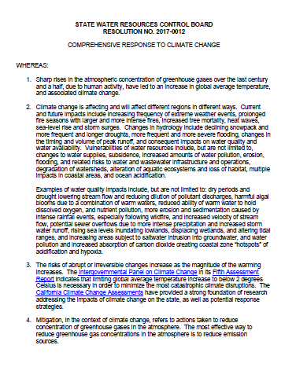


State/regional initiatives looking at how CA will adapt to impacts of climate change

Slide 15
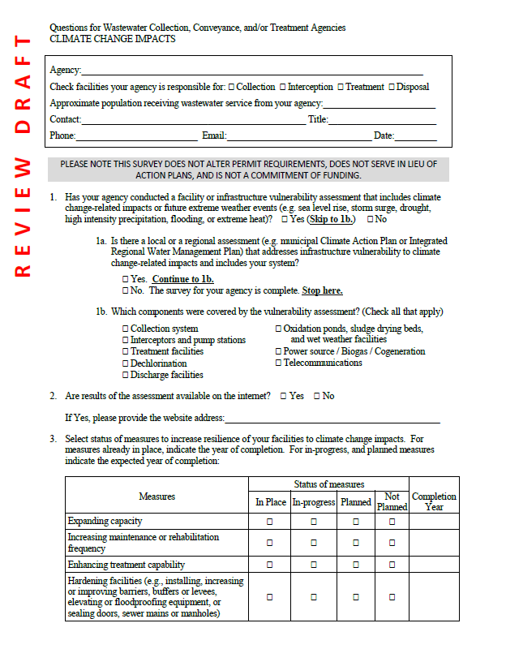
SWRCB Climate Change Resolution
State Water Board seeks feedback on:
  Permit modifications and other regulatory requirements to reduce vulnerability to flooding, storm surge, and sea level rise.
  Use of U.S. EPA’s Climate Resilience
  Evaluation and Awareness Tool (CREAT) or a
  comparable approach to identify
  vulnerabilities to climate change impacts
  at water and wastewater utilities.
State Water Board to distribute
revised survey, pushback from
RWQCBs
RWQCBs going forward

Slide 16
Coastal Commission: Critical Coastal Infrastructure & Climate Change
Seeking input on local planning needs with regard to built community assets along the coast:
  Roads
  Utility lines
  Water supply storage/conveyance
  Wastewater treatment systems
Various smaller coastal WWTPs in discussions regarding “managed retreat” and permit negotiations

Slide 17
America’s Water Infrastructure Act 2018
S. 3021 Signed into law Oct 23, 2018
Statutory requirements for “community water systems”,
not wastewater at this time
Requires community water systems conduct:
  Risk & Resilience Assessment
  Prepare/Revise an Emergency Response Plan
Malevolent acts and natural hazards in the context of physical
security and cybersecurity
Utility must submit letter to US EPA certifying both are complete,
every five years thereafter
Failure to submit results in enforcement & penalty up to
$25,000/day

Slide 18
America’s Water Infrastructure Act 2018
Community Water System (population served) | Risk & Resilience Assessment | Emergency Response Plan
>100,000 | Mar 31, 2020 | Sept 30, 2020
50,000–100,000 | Dec 31, 2020 | June 30, 2021
3,300–50,000 | June 30, 2021 | Dec 30, 2021
Does not define how a utility must complete the RRA or ERP, but does support the use of voluntary consensus standards recognized by USEPA for purposes of compliance

Slide 19
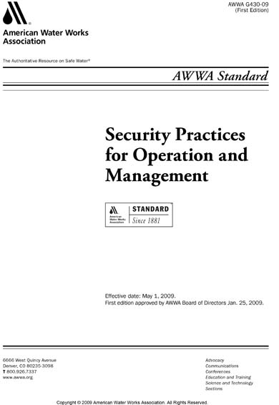
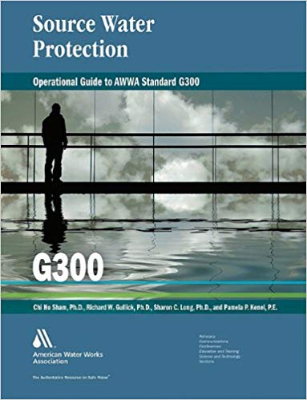
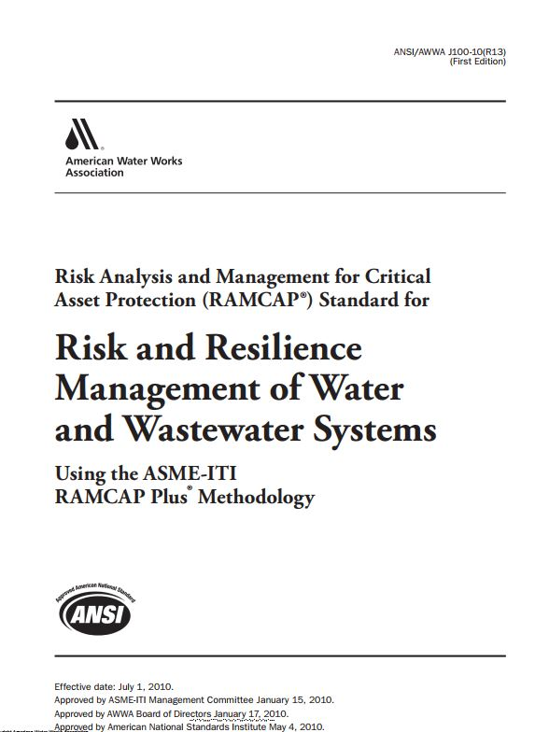
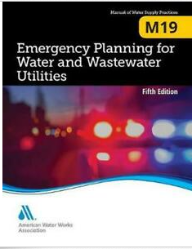
Guidance documents & standards provide compliance framework for RRAs & ERPs
AWWA G430
AWWA G300
AWWA J100
AWWA G440

Slide 20
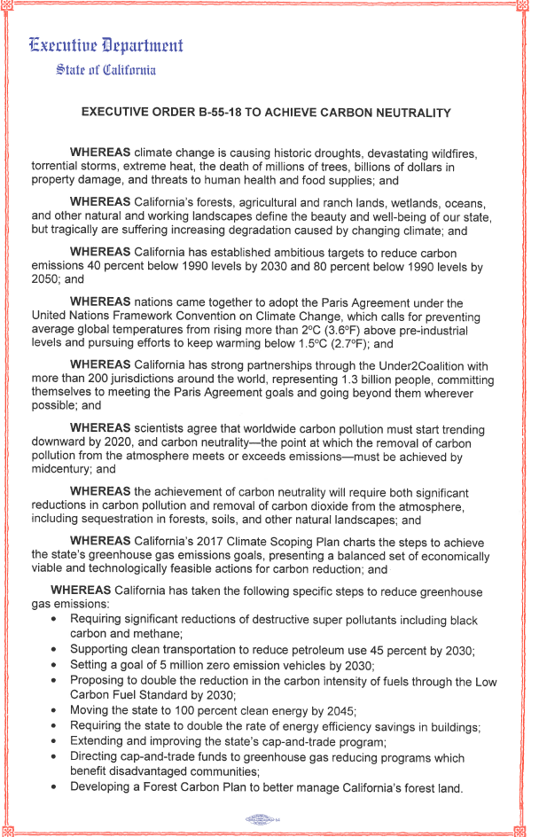
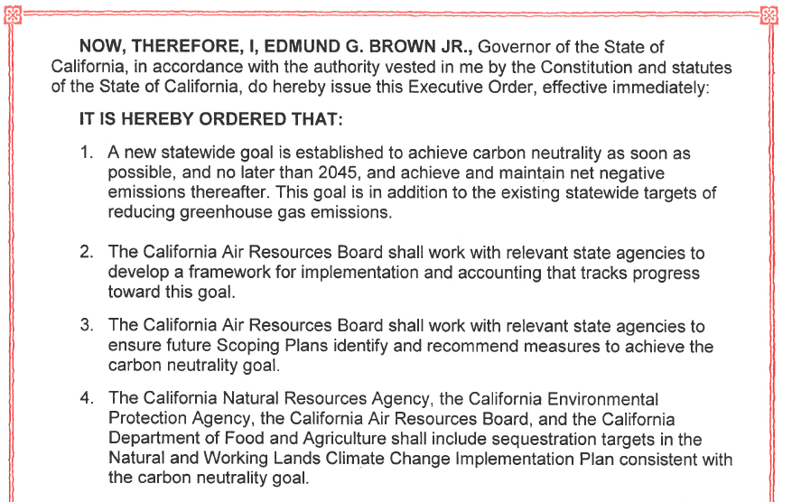
California to be Carbon Neutral by 2045!
Executive Order B-55-18
SB 100:
100% Clean Energy Act
  50% by 2026 (no longer 2030)
  60% by 2030
  100% by 2045 (w/out increasing
  GHG emissions in Western Grid)
SB 1440:
Biomethane Procurement
  Requires PUC to consider
  adopting policies & incentives

Slide 21
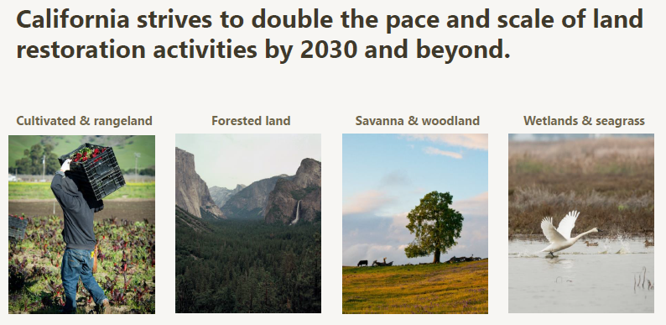
Using Land Management (and Biosolids?) to Meet GHG Targets
Health Soils Initiative
Forest Carbon Plan
Natural & Working Lands Climate Change
Implementation Plan

Slide 22
New Offset Protocol Development –
ARB mandated efforts under AB 398
Forming Task Force to establish new protocols for use in post-2020 Cap-and-Trade Program (only four exist)
Looking for representatives from the following sectors:
  Scientists
  Air pollution control / air quality management districts
  Carbon market experts
  Tribal representatives
  Environmental Justice advocates
  Labor and Workforce representatives
  Forestry experts
  Agriculture experts
  Environmental advocates
  Conservation advocates
  Dairy experts

Slide 23
New Offset Protocol Development –
American Carbon Registry (ACR), Voluntary
ACR serves as a resource to ARB
Interest in municipal wastewater (Karen Fligger, EPA)
Junior staff building excel-based tool Treatment of Wastewater
No wastewater experience or exposure to a treatment plant
Reached out to CASA to understand variables, specifically COD (Chemical Oxygen Demand), electricity consumption, and fossil fuel use onsite (not transportation)
Reviewing preliminary spreadsheet tool

Slide 24
Thank You!...Questions?
Next Meeting:
Air Quality, Climate Change, & Energy -
ACE Workgroup
September 12th, noon – 3 pm
In-Person/Conference Call
Sarah Deslauriers sdeslauriers@Carollo.com
925-705-6404

Slide 25
7. Biogas/Biomethane Management
EPA Renewable Fuel Standard RINs
CPUC Pipeline Biomethane
Biogas Accidental Release Prevention & Risk
Management impacts
LCFS
Utility-Specific Biomethane Specifications
for Pipeline Injection

Slide 26
7. EPA Renewable Fuel Standard RINs –
Sludge & Food Waste Derived Biogas
Renewable Identification Number (RIN)
  Biogas derived from digestion of sludge = D3 (cellulosic, highest value)
  Biogas derived from digestion of food waste = D5 (advanced biofuel, lower value)
  If co-digesting with food waste, all biogas eligible for D5 RINs only
Federal efforts re-opening discussions
  DOE Secretary (Rick Perry) announces "grand challenge" in water-energy nexus space through competition seeking to double resources—nitrogen, phosphorus, energy and reuse water – recovered from municipal wastewater by 2030.
  New joint initiative “Winning on Reducing Food Waste” signed Oct 18th by USEPA, FDA, and USDA - acting EPA Administrator Andrew Wheeler stated, "Redirecting excess food to people, animals, or energy production has tremendous economic and social benefits.“
CASA met with EPA leaders June 3rd - No response to inquiries

Slide 27
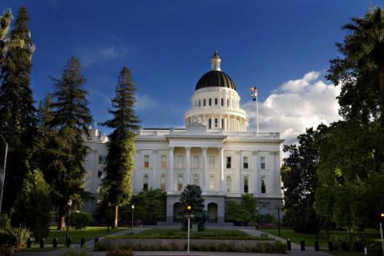

State legislation is driving change in biosolids & biogas management at WWTPs
2019
Final regulation mandating diversion
of 75% of organic
waste from landfills
(SB 1383)
2022
Final regulation becomes effective
(SB 1383)
2045
Statewide
Carbon
Neutrality
(Executive Order
B-55-18)
2030
40% below
1990 GHG
levels
(SB 32)
2024
SB 1383
enforceable
2025
Landfills no longer guarantee to accept biosolids for alternative daily cover or disposal
(SB 1383)
2020
Diversion
credit for
Green Waste
expires
(AB 1594)
Notes:
>50% of Bay Area biosolids sent to landfills during dry weather
Up to 90% during wet weather

Slide 28







Cross-Media Regulatory Issues
AB 617 (ARB)
Headworks
Primary
Secondary
Tertiary
Disinfection
Discharge/Reuse
SWRCB/RWQCB standards
(Watershed/Nutrient Permit)
Regs 7, 11
(BAAQMD)
Regs 2, 9, 11, 13 (BAAQMD)
AB 617 (ARB)
Onsite Energy Generation –
AB 32 & AB 617 (ARB)
SB 1122, AB 1900 (CPUC)
Rule 11-18, Reg 9 (BAAQMD)
Pipeline Injection –
SB 1122, AB 1900 (CPUC)
Transportation Fuel –
LCFS (ARB)
Solids
Anaerobic Digestion
Biogas
Regs 7, 13 (BAAQMD)
SB 1383
(CPUC, CEC)
FOG/
Organic Waste
SB 1383
(CalRecycle)
Land Application
EPA, SB 1383 (ARB/CalRecycle),
Healthy Soils Initiative (CNRA, CDFA)
Forest Carbon Plan (CNRA)
Alternative Daily Cover
AB 341 & 1594 (CalRecycle)
SB 1383 (ARB/CalRecycle)
Landfill
EPA, AB 341 (CalRecycle)
SB 1383 (ARB/CalRecycle)
Biosolids
SB 1383
(CalRecycle)
Notes:
Address increased nutrient load from organic waste in light of nutrient removal requirements and BAAQMD rules
Rule 2-2: new source review, includes BACT, offsets
Rule 2-5: new source review for toxics, includes T-BACT, project health risk limits
Rule 2-6; major facilities (Title V)
Regulation 7: odors
Rule 9-2: H2S
Rule 9-7: NOx and CO from boilers/steam generators/process heaters
Rule 9-8: NOx and CO from stationary IC Engines
Rule 9-9: NOx and CO from stationary gas turbines
assorted Regulation 11 related to metal emissions (mostly impacting incinerator at CCCSD)
Rule 11-18: risk reduction at existing facilities
pending Regulation 13, especially 13-4

Slide 29
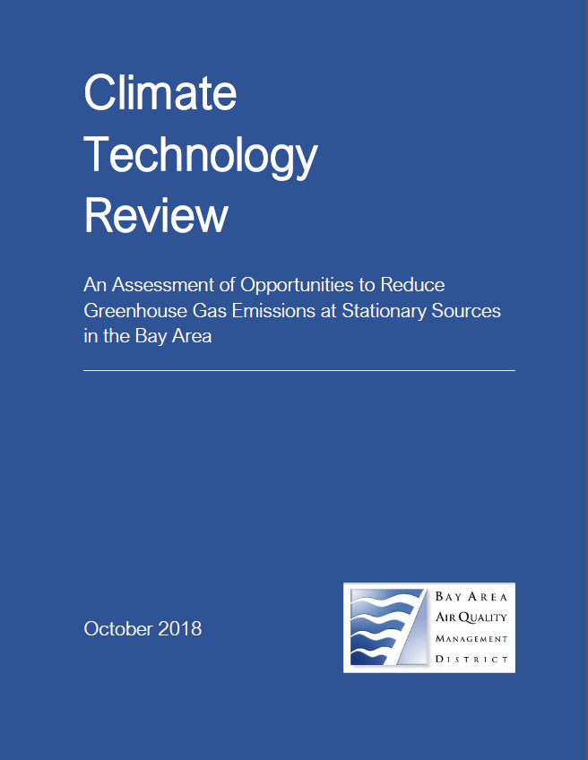
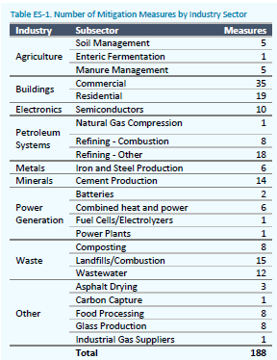
BAAQMD Climate Technology Review
Notes:
In 2015, it was estimated that over 50% of GHG emissions are attributable to bay area industry, energy, buildings, waste (including wastewater, although it is a small portion of the total), and agriculture.
The Clean Air Plan targets 40% reduction below 1990 levels by 2030, and 80% below 1990 levels by 2050. To achieve these targets, BAAQMD performed this assessment.

Slide 30
BAAQMD Climate Technology Review
12 wastewater sector mitigation measures (Table 16)
  Annamox
  Microalgae to replace denitrification
  Nitrification tank gas capture/co-firing
  Adjust operations to reduce GHGs in sludge path
  Geomembrane cover for AD
  Methane capture/flare from activated sludge
  Bioscrubber for N₂O process emissions
  Microalgae cultivation for CO₂ capture in sludge stream
  Thermophilic AD
  Bioprocesses for oxidation of CH₄
  Temperature-phased AD
  CANDO process
Climate Tech Kick-Off at BAAQMD: January 22nd
RSVP by January 15th

Slide 31
Climate Tech Kick-Off at BAAQMD: Jan 22nd
Target sources falling below cap-and-trade threshold that
together “make a big chunk of the pie”
Pentagon for assessing projects – Emissions Reduction
Potential, Economic Viability, Barriers (Favorability),
Investment Scale (Affordability), Maturity (TRL/Company)
Presentations by EBMUD & CMSA
Climate Tech Finance - IBank
  Loans for Public Agencies
  Loan Guarantees for Small Businesses
  CLEEN Center (CA Lending for Energy and Environmental Needs)
  ISRF – Infrastructure State Revolving Fund Program
Looking for feedback on how the TIO can support project implementation

Slide 32
Water-Energy GHG Guidance Initiative, WEG 2.0
Goal: Develop methodology to quantify, compare, and analyze
the GHG emissions embedded in delivered water
Cool Planet Project in partnership with SCE & The Climate
Registry, began in 2015
2018 - include operations related to WW & RW, including
emissions tracking
Voluntary Water-Energy Nexus (WEN) Registry
Goal: Develop suite of protocols/guidance enabling measurement, reporting, & tracking of entity-wide emissions
  Looking to IPCC 2019 Refinement for a N₂O emission factor update
Next Steps: To receive responses to edits/comments provided & in-person meeting in Sacramento May 13th

