Slide 1
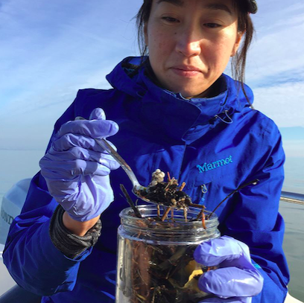
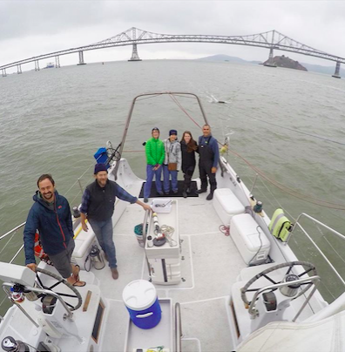
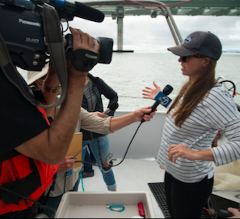

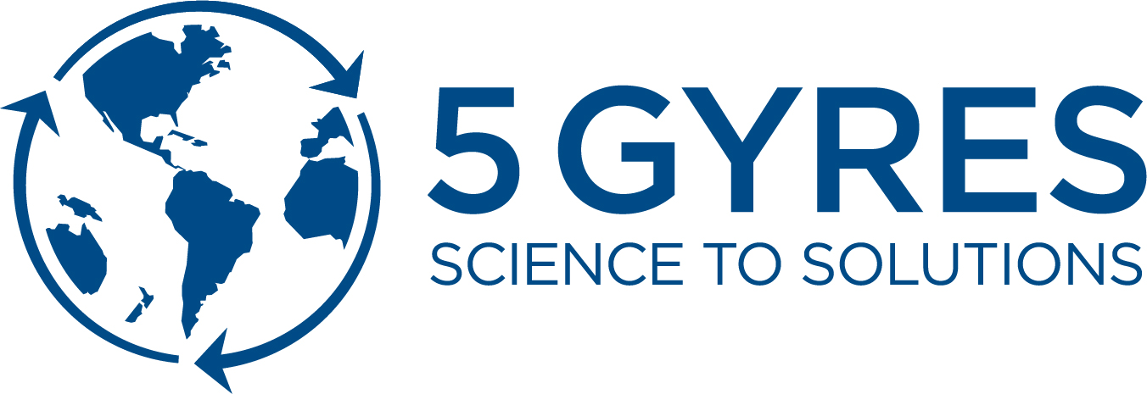
SF BAY MICROPLASTICS
PROJECT
CAROLYNN BOX
5 GYRES SCIENCE PROGRAMS DIRECTOR
carolynn@5gyres.org
Notes:
Carolynn Box, 5 Gyres Science Programs Director
Here to talk about SF Bay Microplastics Project, muti-year program to understand sources and pathways of microplatsics in San Francisco, while also identifying policy recommendations
Partnership with San Francisco Estuary Institute

Slide 2
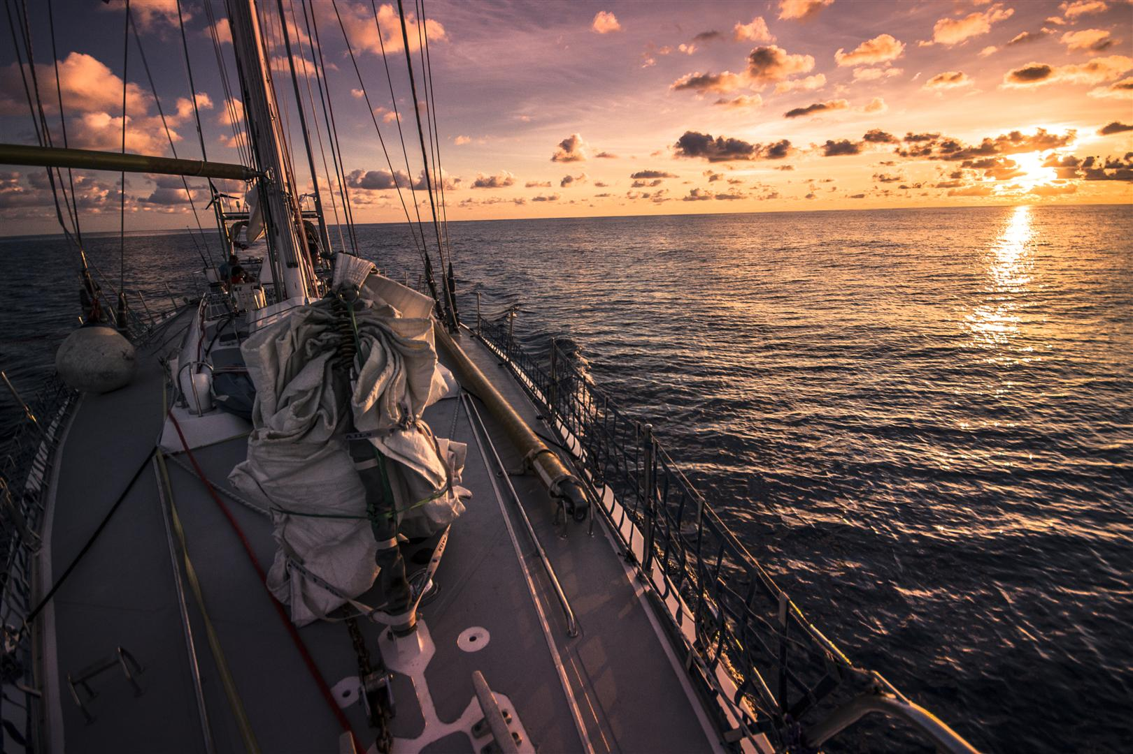
OUR MISSION IS TO EMPOWER
ACTION
AGAINST THE GLOBAL HEALTH CRISIS OF
PLASTIC POLLUTION
THROUGH SCIENCE,
EDUCATION AND ADVENTURE
Notes:
Quickly, I work for an organization called 5 Gyres.
5 Gyres mission is to empower action against the global health crisis of plastic pollution through science, education and adventure. Our vision is a planet free of plastic pollution. We are an environmental organization out of Los Angeles with a focus on turning science into action.
We are based out of LA, I live in San Francisco
Our organization began in 2009 when the plastic movement was really growing and became one of the leading organization in the movment.
5 Gyres is known for a series of large scale research expeditions that helped bring the issue of plastic pollution into the global eye
These early trips were exploratory and exciting. In a world where its very hard to truly be an explorer of new things, I felt like this was my chance.

Slide 3
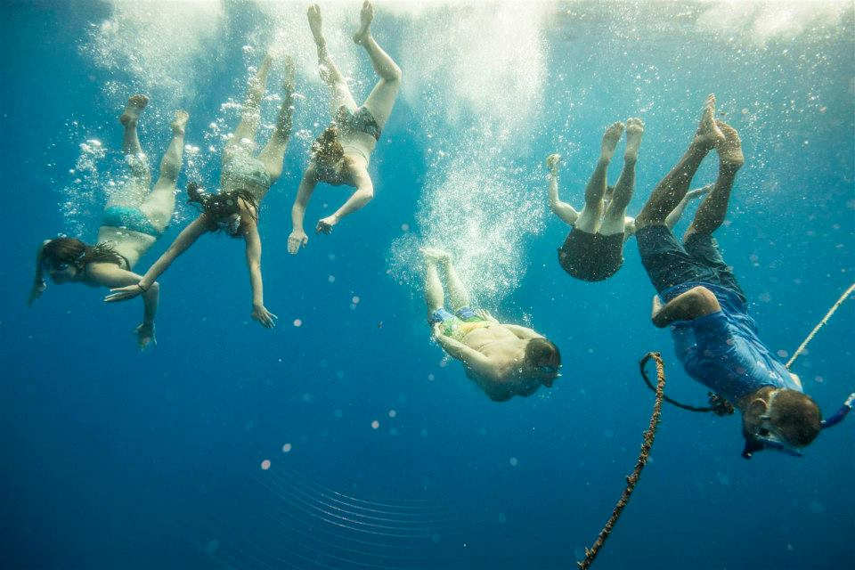
269,000 METRIC TONS
5.25 TRILLION PARTICLES
Notes:
I joined 5 Gyres in 2011 on their 3rd Expedition across the South Atlantic Ocean.
This Expedition changed my life and resulted in me changing my career to focus on plastic pollution.
More than 400 people have joined our Expeditions, to many different areas around the world.
All of our data is used to look at plastic pollution at a global level, used to estimate plastic pollution floating on the surface of the oceans.
5.25 trillion pieces of plastic have been estimated to be floating on the oceans surface.
The organization as helped lead several campaigns towards solutions.
All of these campaigns point to focusing on solutions upstream and on land.
We need to design better products and reduce the use of single use plastics

Slide 4
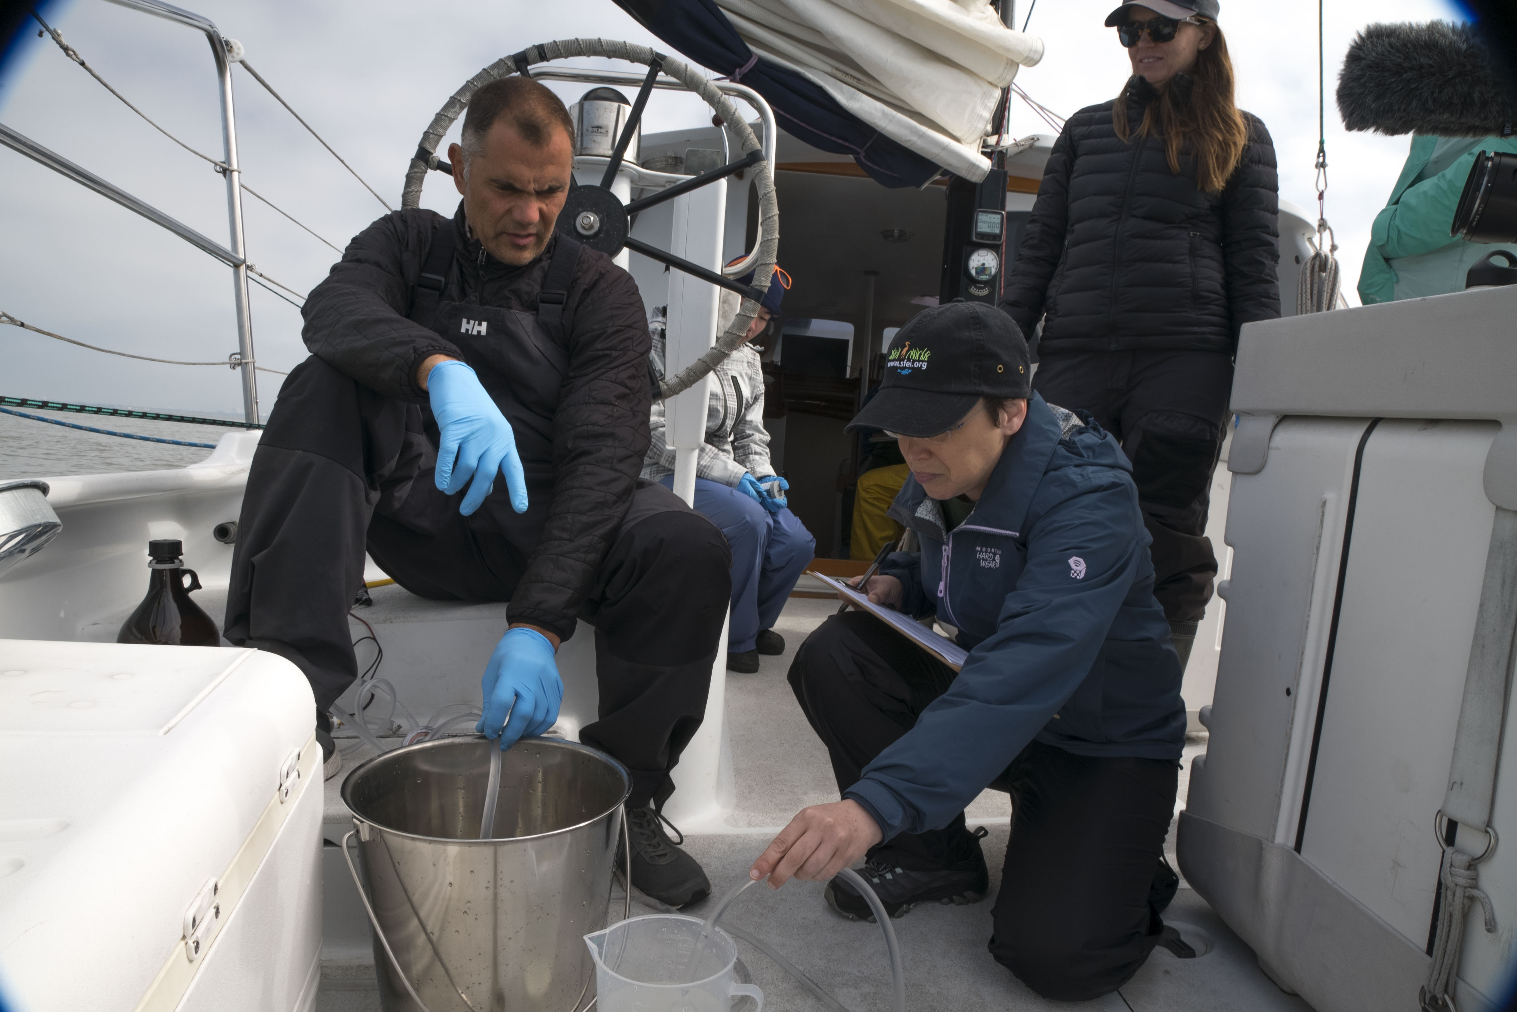
SAN FRANCISCO BAY
S. Bezalel
Notes:
This leads us to work in San Francisco Bay, the San Francisco Bay Microplastics Project
Move closer to land
I often think of this as a SF Bay expedition

Slide 5
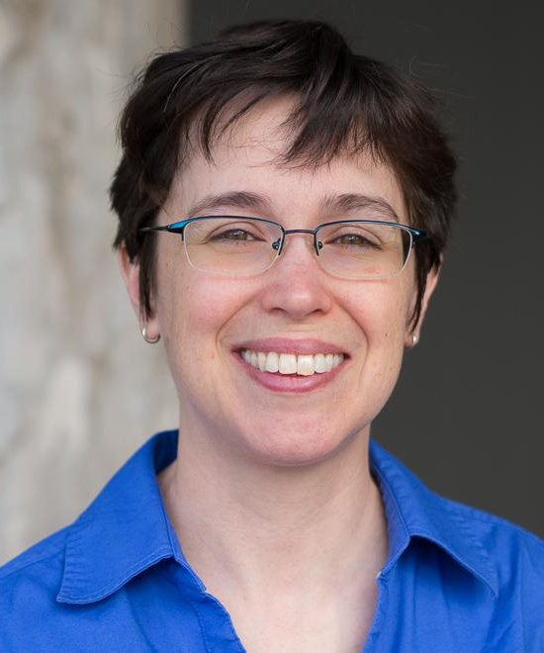

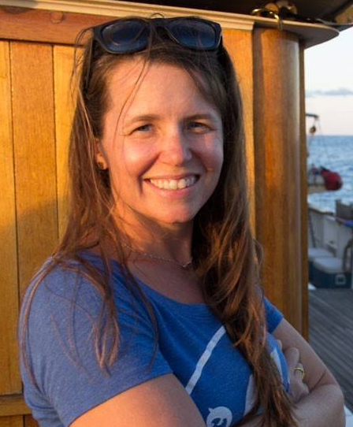
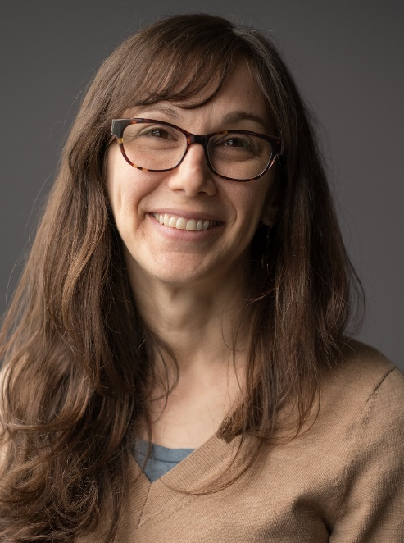
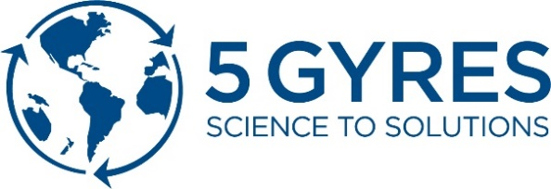

SF BAY MICROPLASTICS PROJECT
TEAM LEADERS
S. Bezalel
Notes:
Three groups involved: SFEI, 5 Gyres, U of toronto

Slide 6
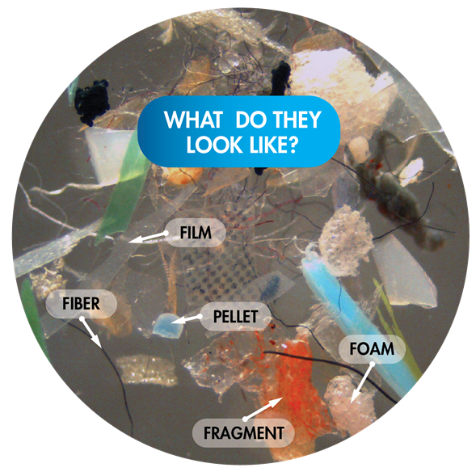
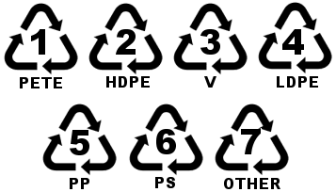
Microplastics are plastic particles <5mm
~350 million tons of plastic produced annually
Notes:
Microplastics are tiny particles of plastic approximately the size of coarse grains of sand,
Microplastics are a subset of microparticles that are confirmed to be plastic.
Analytical methods can used to identify the type of plastic polymer type, including commonly used plastics like polyethylene (PE), polypropylene (PP), polystyrene (PS), polyester and polyvinyl chloride (PVC)
Broad range in size and shapes (show picture)
Fibers that can shed from clothes and materials used in industries such as ropes, netting, textiles etc.
Fragments that result from the fragmentation of larger pieces of plastic, such as plastic bottles,
Film that can result from single-use packaging materials around food or other items and plastic bags and
Pellets from industries that make plastics or use abrasives. In addition, personal care products can contain microplastic beads although some uses have been restricted.
Microplastics are the detritus of modern day society in which approximately 350 million tons of plastic is produced and used globally by consumers and industries for such diverse sectors such as food-packaging, clothing and textiles, building and construction, and transportation.

Slide 7
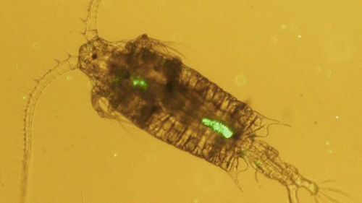
ELEVATED CONCERN FOR MICROPLASTICS
Cole et al., Env Sci Technol, 2013
Notes:
Concerns
Physical blockage of gut or gills
Vector for toxic chemicals, including sorbed chemicals and chemical additives
Ecological impacts not yet well understood
Meanwhile plastic use will continue to increase
Logistically impossible to remove – persistent
Transition: Therefore, we are concerned about microplastic contamination, particularly in areas like the San Francisco Bay which drains a large part of California, and where contaminants can accumulate.

Slide 8
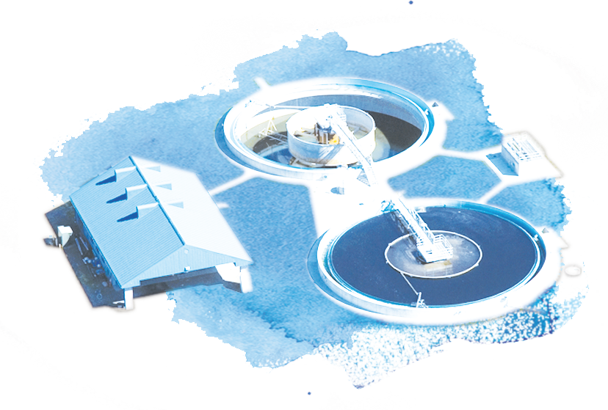
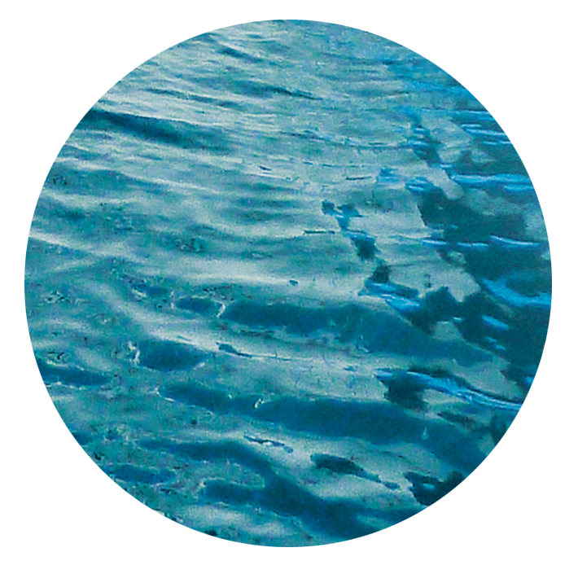
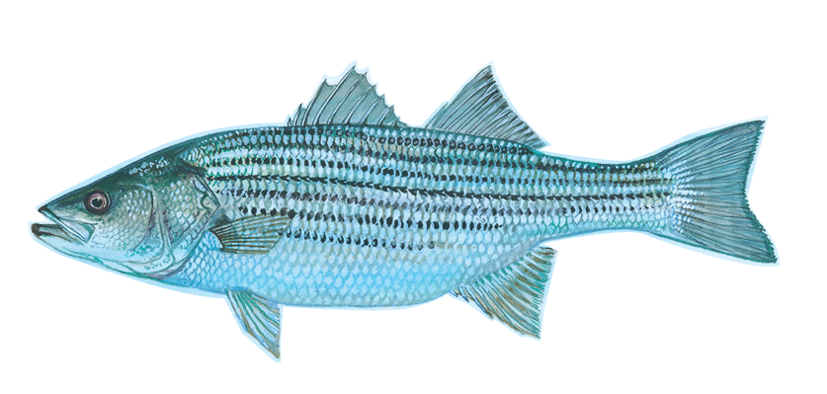
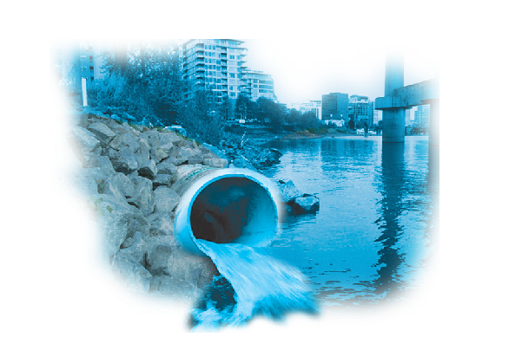
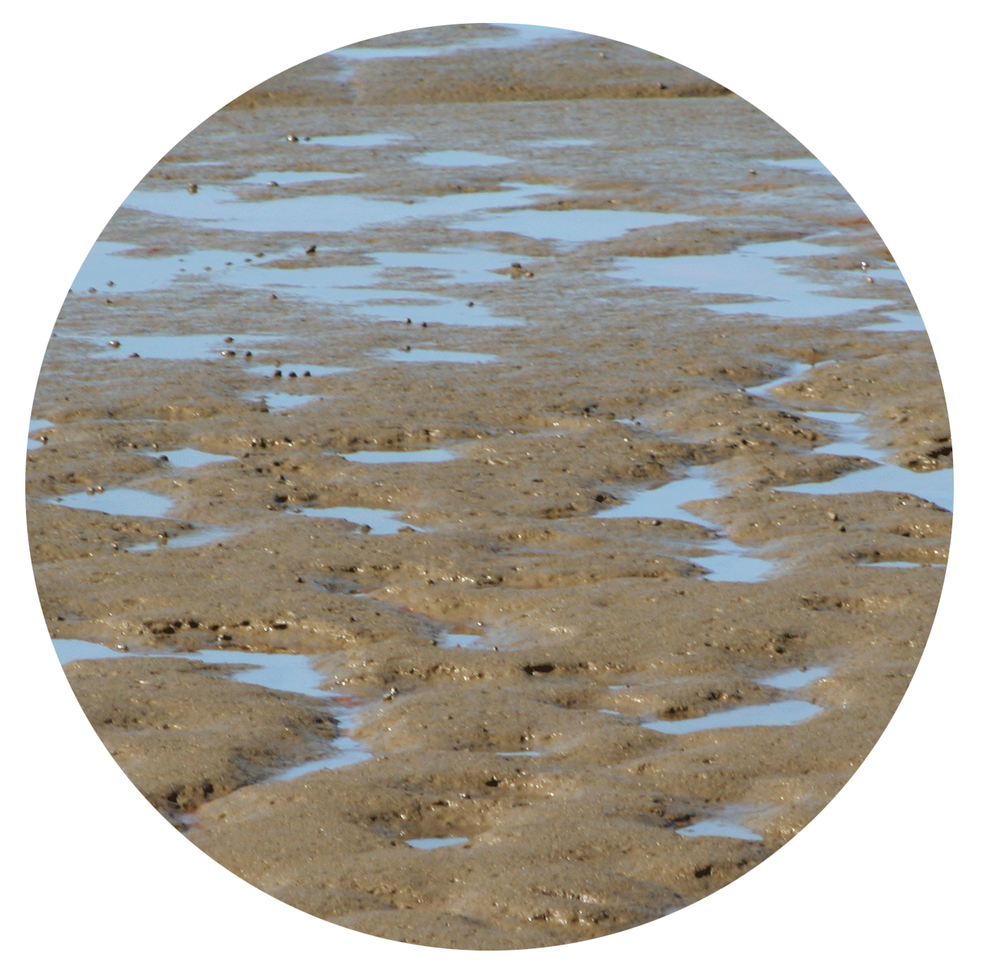
MICROPLASTICS MONITORING
TO INFORM MANAGEMENT ACTION
Pollution Pathways
Bay Monitoring
Wastewater
(BACWA)
Marine
Monitoring
& Science
Water
Fish
Sediment
Stormwater
(BASMAA)
Notes:
350+ samples
Here’s how we set up the San Francisco Bay Project
The SF Bay Microplastics Project is a large scale project that was developed and funded in 2016. The funding comes from Gordon and Betty Moore Foundation.
The project is unique for several reasons:
First, this is the most comprehensive regional study to date
New field and lab protocols are coming out of this project, that I will focus on later in my talk.
And lastly, the project was designed to inform policy. We will be generating policy recommendations and educational materials that will be used to support policy to reduce microplastic pollution.
My talk will focus on the surface water sampling that was done for the project. This dataset is robust and an example of 1 of the 5 large datasets that were collected during the project.

Slide 9
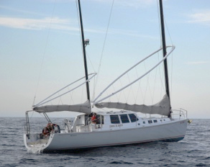
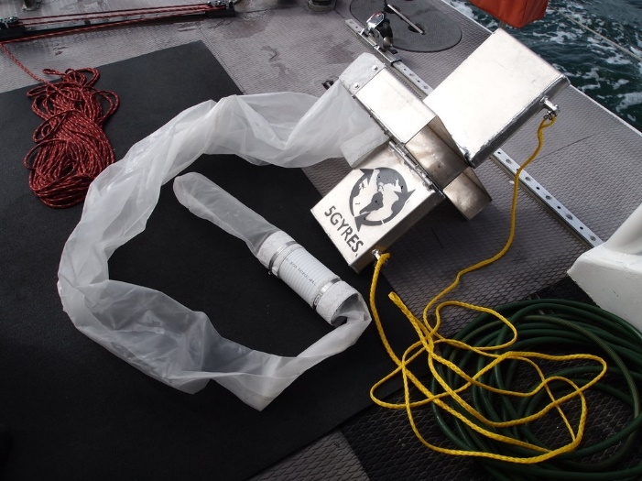
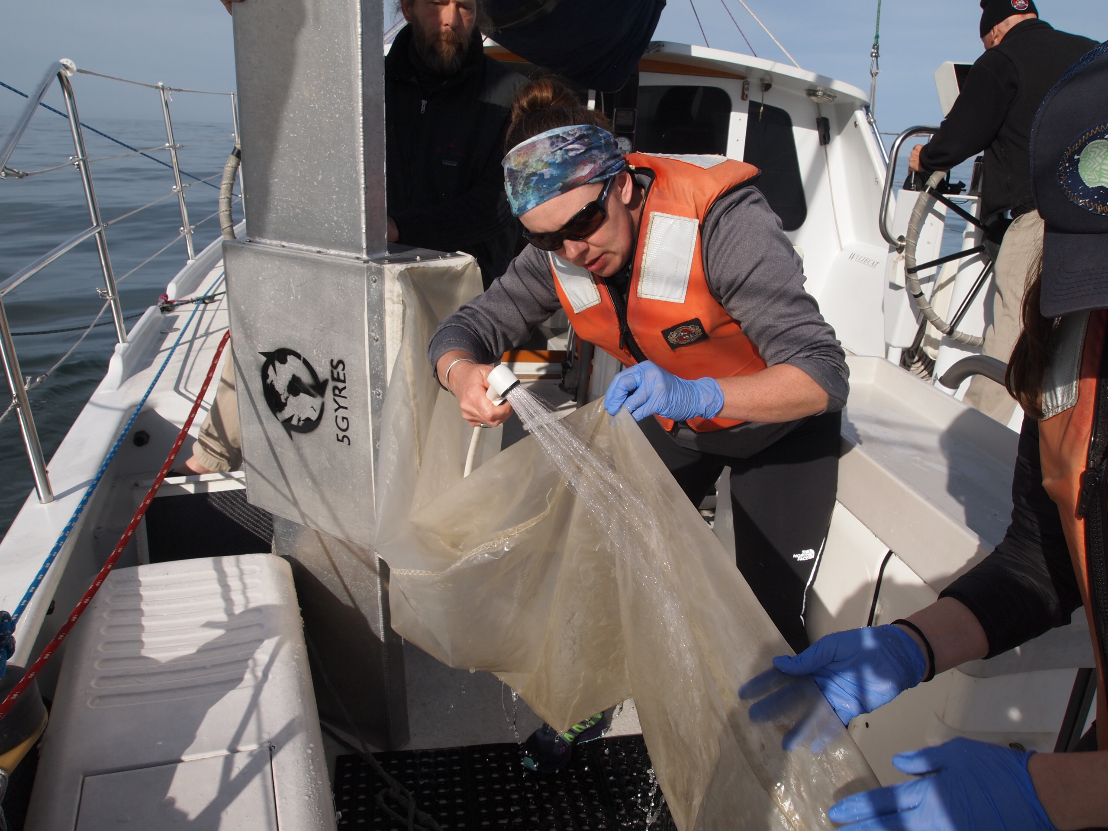
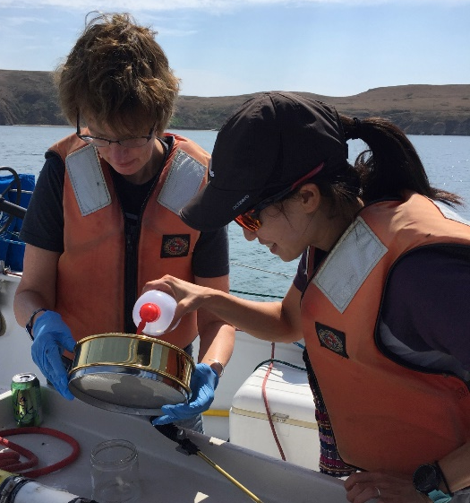
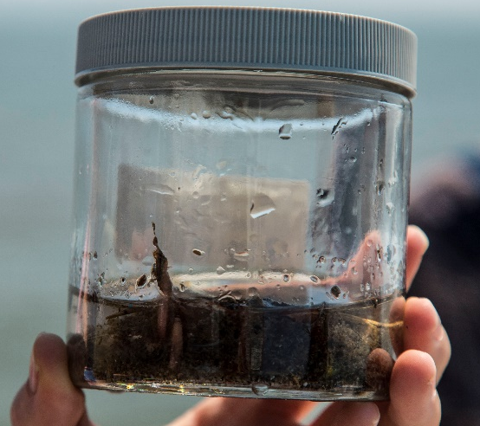
BAY AND SANCTUARY SURFACE WATERS
Bay vs. Sanctuary
Dry vs. Wet season
In-Bay regional variation
Notes:
For Surface waters, we tested out three different methods to analyze microplastics, trying to look at a range of size fractions:
Manta Trawl to analyze down to 355 microns. This is an aluminum box with wings that has been widely accepted for measuring microplastics in aquatic environments. We towed this piece of equipment for 30 minutes behind the vessel.
A pump system that filtered 10 liters of surface waters, aimed at analyzing down to 20 microns.
A 1 liter grab that was collected to analyze nano plastics.
Our sample locations were distributed throughout the Bay and outside the GG Bridge to assess ambient conditions and bay vs. sanctuaries
We collected samples in dry weather and within days after rain events to asses seasonality.
Duplicates and blanks were also collected. Duplicates are easy but we collecting a blank on a manta trawl is not as easy. We designed a way to take a blank where we rinsed the manta trawl and sieved the water that was rinsed.
Also noteworthy, our pump needs to be modified bc of blank contamination. Luckily, the 1L grab samples were originally sent to the University of Michigan but the samples were non detect, so these samples are being analyzed for microplastics, hopefully we can use these to better estimate the smaller microplastic fractions, like microfibers.

Slide 10
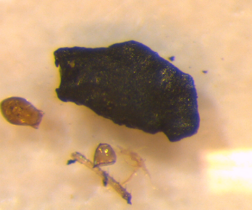
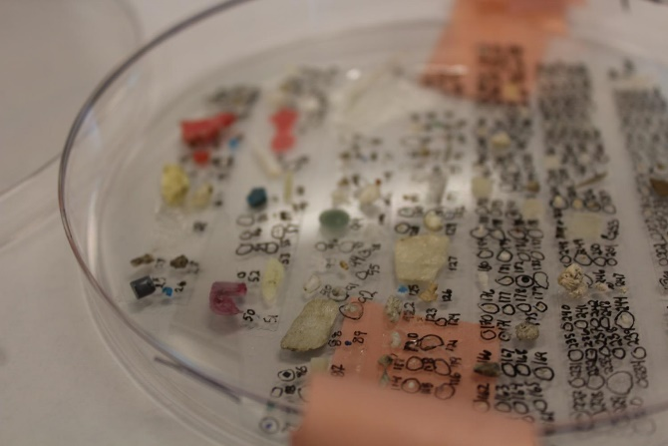
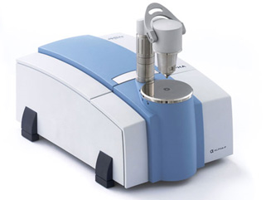
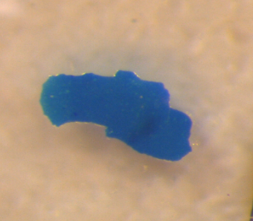
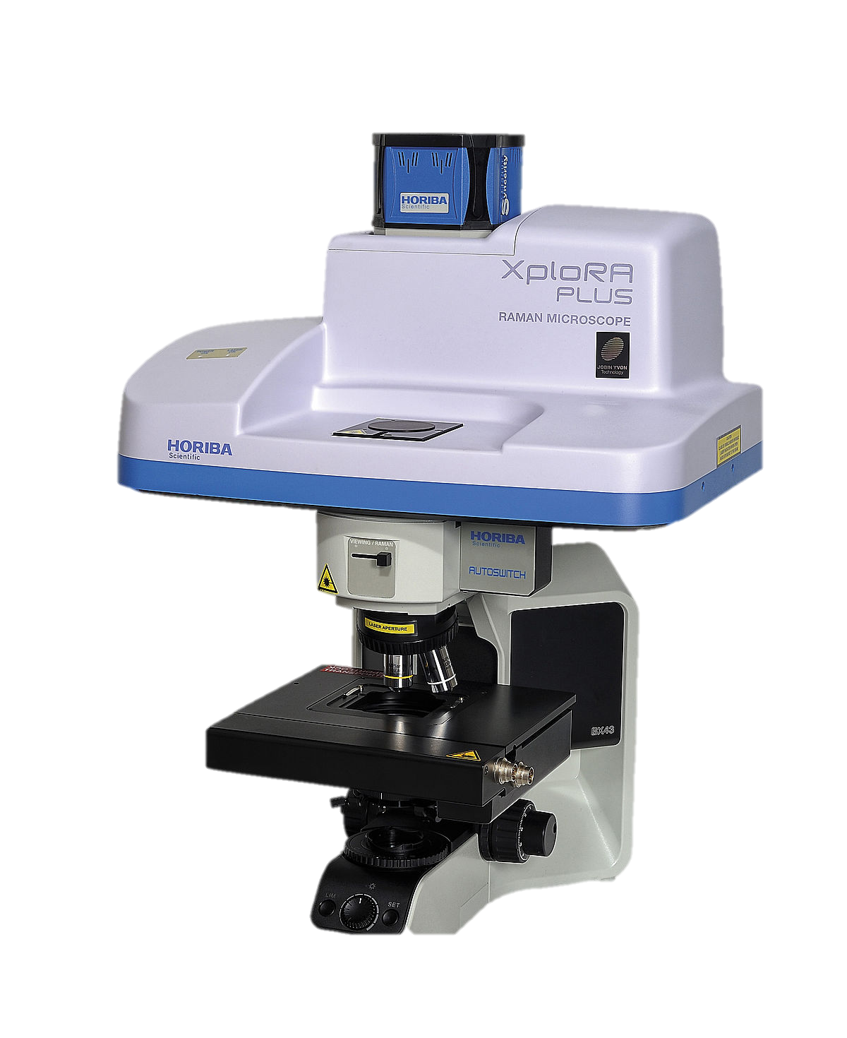
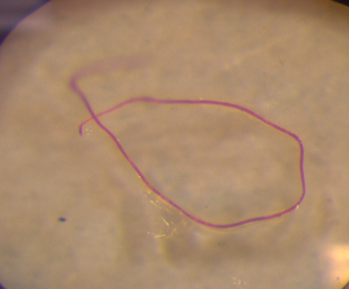

Characterized
Microparticles
FTIR / Raman
Microplastics
Sorted
Notes:
Trained staff picked out particles that visually looked like plastics
Samples on average took 30 hours of labor for analysis – representing thousands of hours of laboratory analysis work. Challenging work, laboratory methods were developed and optimized to analyze different matrices.
When we examined microparticle fragments – most were plastic. Most microfibers were confirmed to be anthropogenic. The lab also has been developing spectral library for environmental microplastic samples.

Slide 11
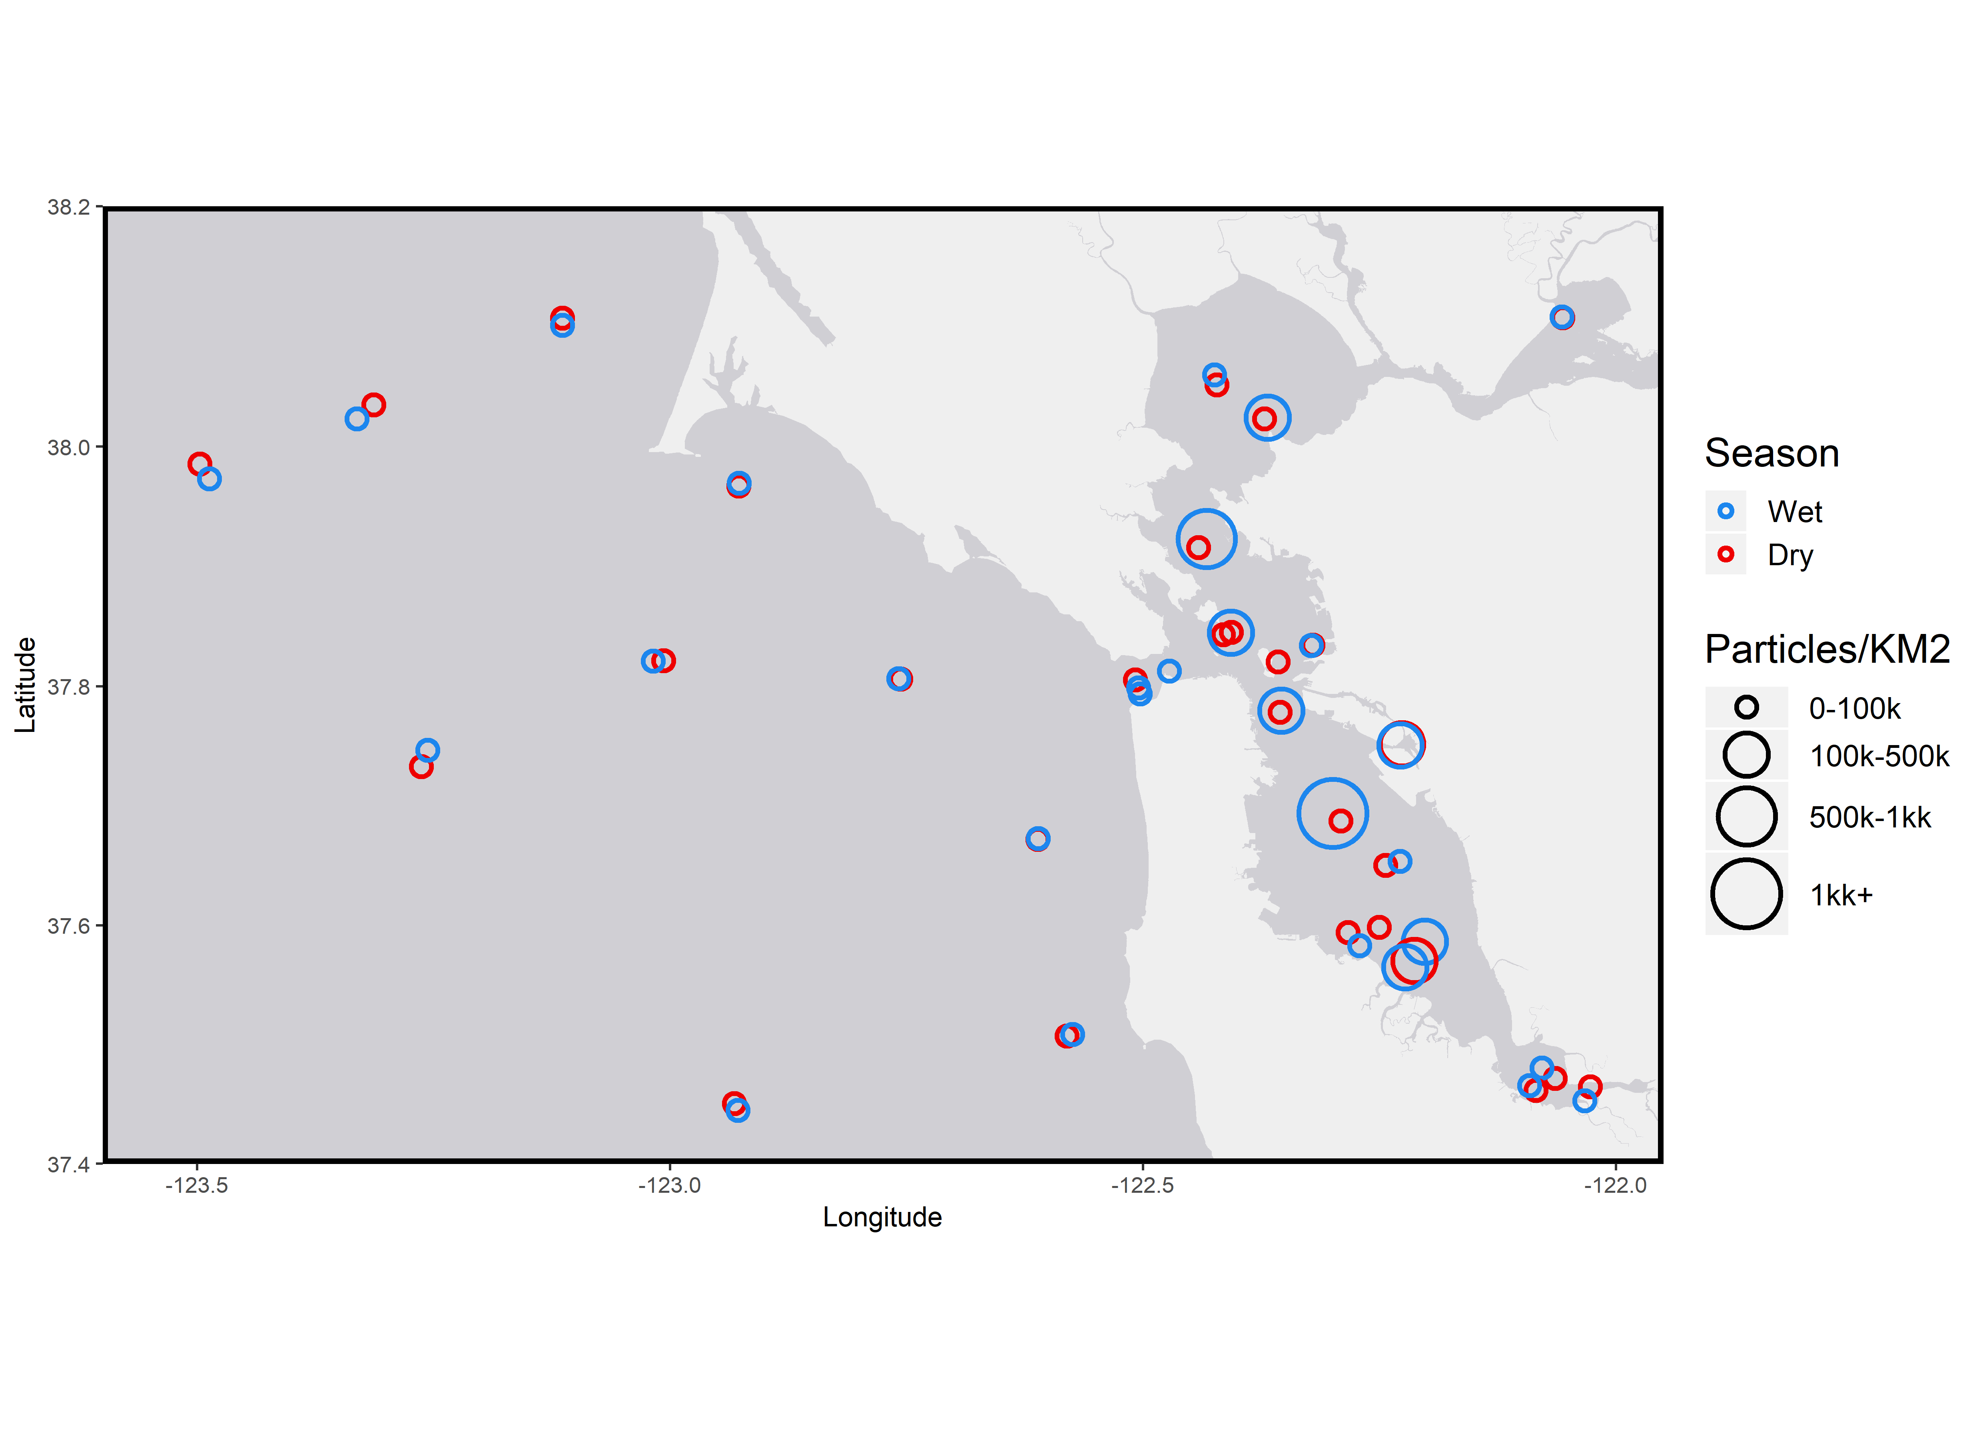
MICROPARTICLES ABUNDANT IN
BAY WATER
Significant heterogeneity
<10,000 to 6 million particles/km²
Wet season > Dry Season
Bay > Sanctuary
Fibers > fragments > foam
47% of fibers / 80% of fragments were determined to be plastic through spectroscopy
Notes:
Variability throughout samples
Ranging from 10K in sanctuary to 6M particles / km2 in South Bay.
Higher microplastic levels in wet season
Higher microplastic level in Bay
Fibers were the most abundance morphology, followed by fragments and then foam.
Of those particles, a subset were analyzed and found that 47% of fibers were plastic, 80% of fragments…

Slide 12
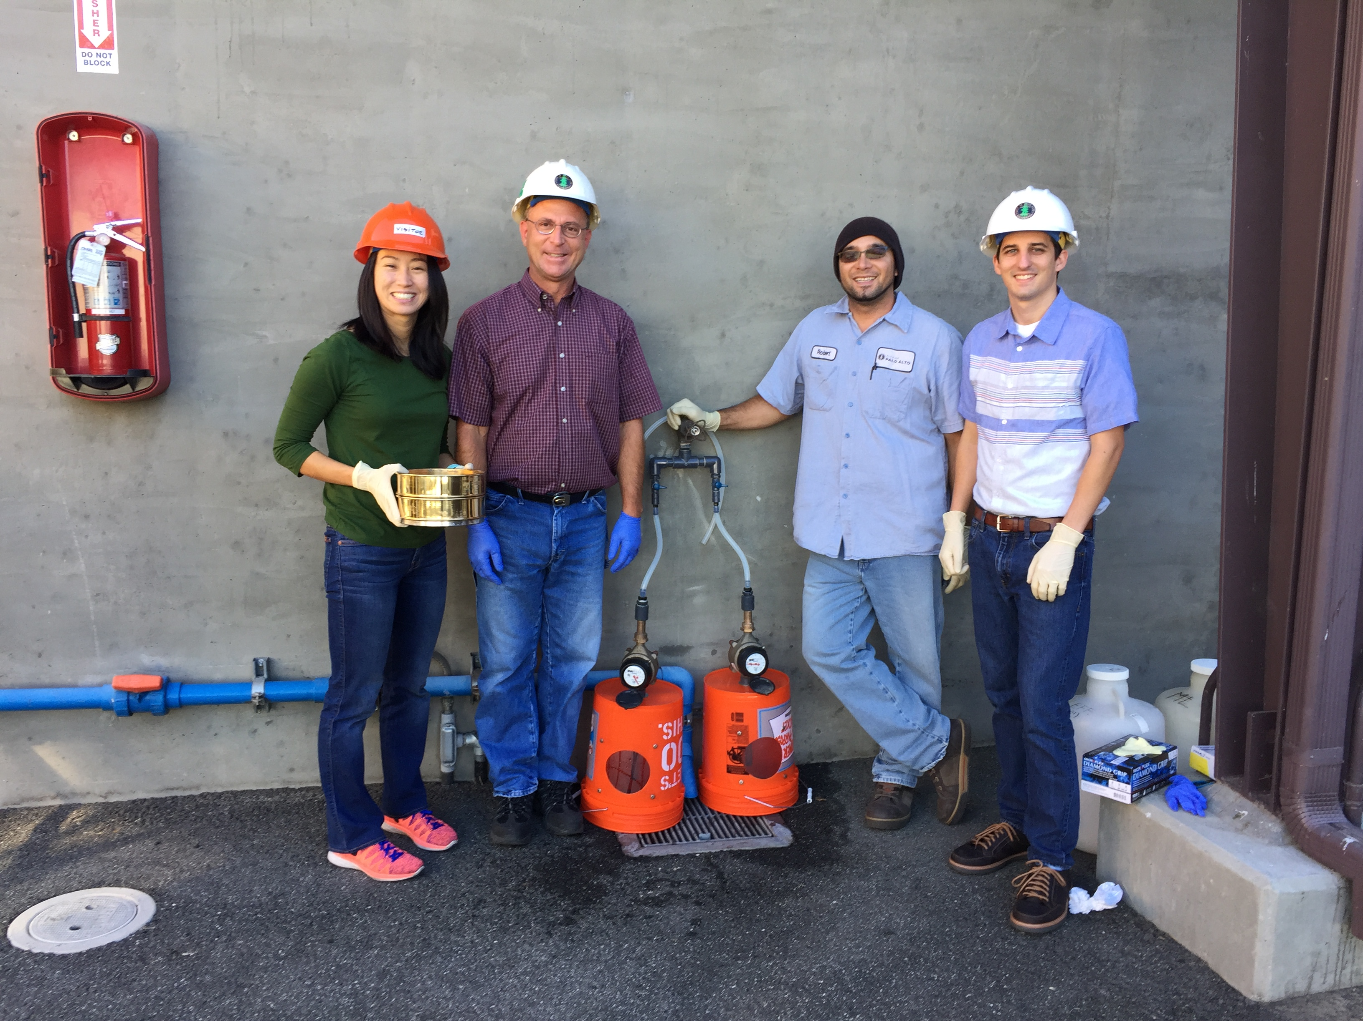
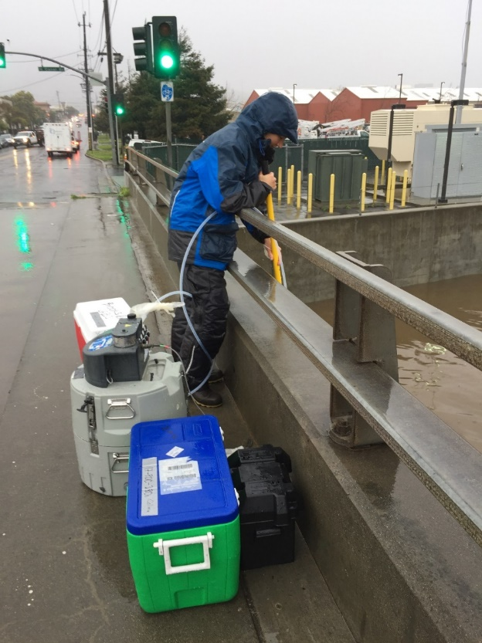
WASTEWATER AND STORMWATER PATHWAYS
Notes:
This project analyzed the wastewater and stormwater pathways
For wastwater, we analyzed effluent at 8 facilities, capturing 60% of flow into the Bay
For stormwater, we built upon SFEI’s stormwater monitoring program and analyzed 12 rivers and streams around the bay. We selected our sites based on location, drainage area, and known hotspot area.
Monitoring was done off bridgeway, just prior to a storm system passing through
Fibers look a like – cannot determine without spectroscopic methods
Recommendations from the BACWA work.
Additional work by East Bay Municipal Utilities District has identified significant differences in particle loads based on 2-hour grab samples versus 24-hour composites (Dyanchenko et al in press); much higher particle concentrations were identified in the 2-hour grab during peak flows.

Slide 13
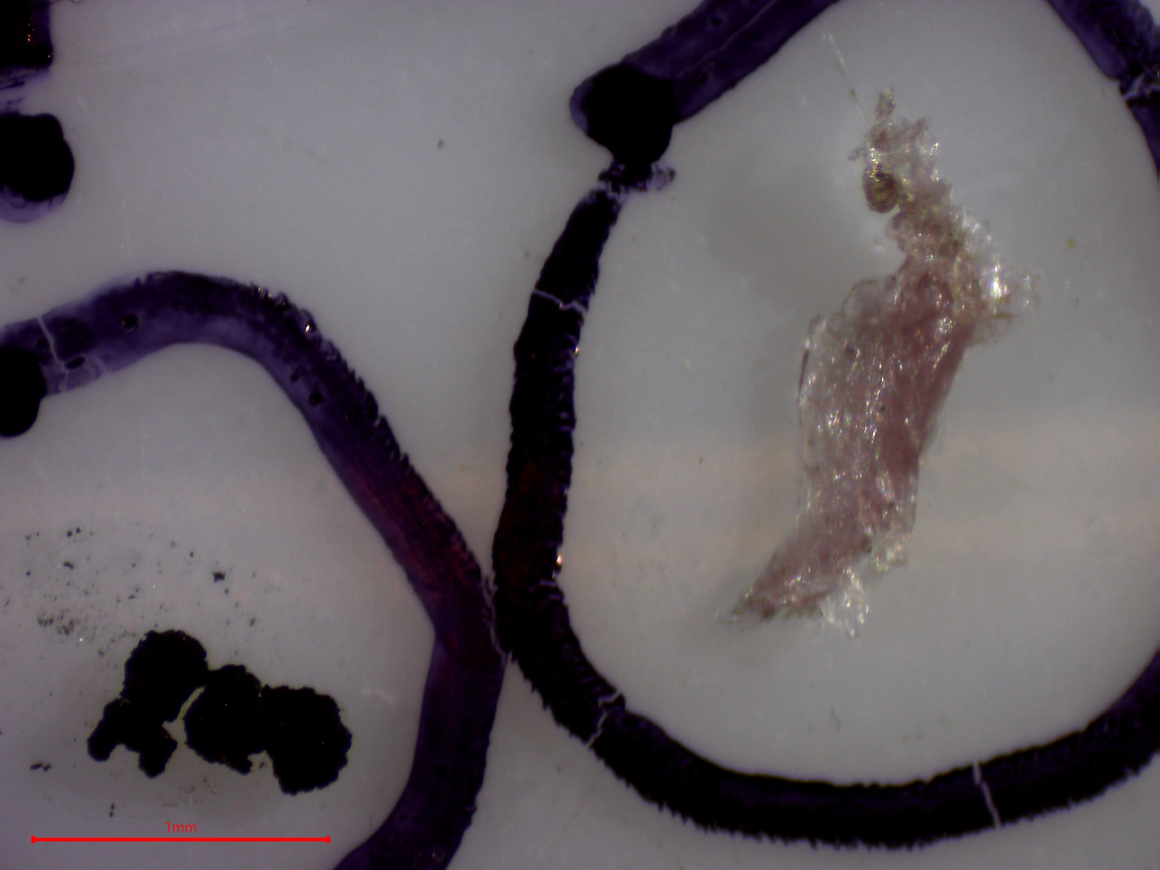
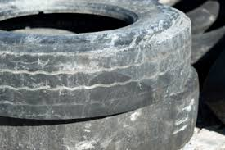
MICROPLASTICS ABUNDANCE IN STORMWATER
Black rubber fragments
Fragments > fibers
  Contrast to wastewater
Stormwater load 200 times greater than wastewater
Conceptual model of stormwater
Notes:
Almost half of the stormwater particles were black rubber fragments
Fragments (55%) > fibers (39%)
Contrast to wastewater, where fibers made up
200 times microplastic loads estimated from wastewater

Slide 14
SCIENCE TO SOLUTIONS
Organize Policy Committee with experts
Identify science-based recommendations
Consider policy options, source reduction, innovation, research needs, and household interventions
SF BAY MICROPLASTICS
POLICY RECOMMENDATIONS
REPORT
POLICY BRIEF
FACTSHEET
EDUCATIONAL
POLICY TOOLS
OCT 2
SYMPOSIUM

Slide 15
POLICY ADVISORY COMMITTEE
  Patagonia
  Textile experts
  Association of Home Appliances
  Manufacturers
  Save the Bay
  Upstream
  California CoastKeeper
  Californians Against Waste
  Surfrider Foundation
Industry
Government
Environmental Groups
  SF Environment Department
  Wastewater treatment plants
  Stormwater agencies
  NOAA
  Ocean Protection Council
Foundations
  Schmidt Marine Tech
  Microfiber Solutions
Notes:
Convene policy committee
Develop science-based recommendations
Over 25 participants from diverse sectors in Industry, Government, Foundations, and environmental groups + project scientists
The group has drafted 10 recommendations during last meeting.

Slide 16
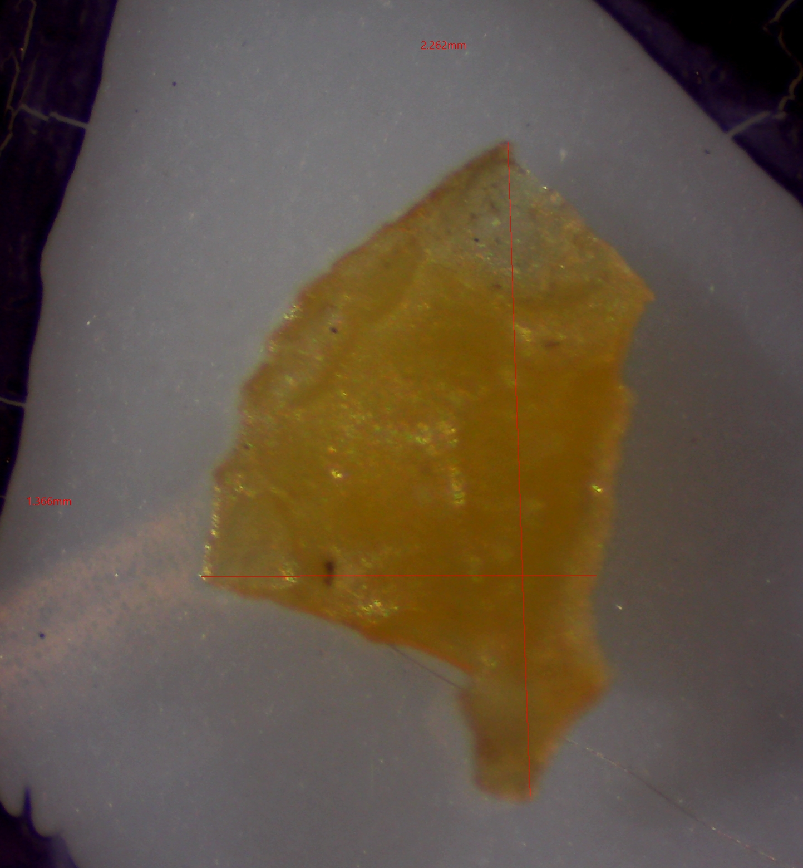

RECOMMENDATIONS #1 & #7
Policy & collaboration
Project Results:
Foam & plastic fragments in surface waters and stormwater
More microparticles entering Bay by stormwater over wastewater
Recommendation #1: Support comprehensive source reduction legislation in Bay Area and statewide
Recommendation #7: Better collaboration between trash (>5mm) and microplastics (<5mm) efforts
Key Suggestions:
Source reduction
Open source data on plastic pollution
Build collaborative campaigns to encourage reuse
Notes:
All of our data supports source reduction efforts

Slide 17
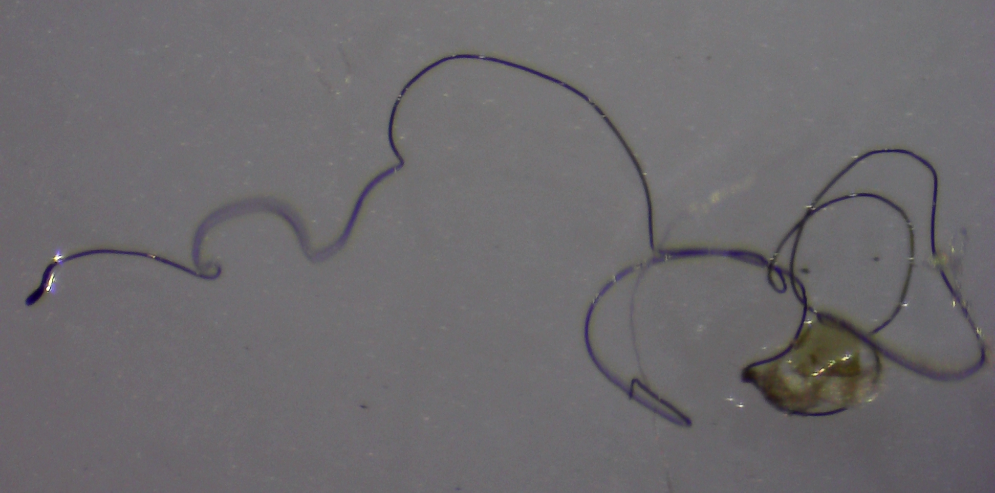
RECOMMENDATIONS #2, #5 & #10
Filtration, standardization & education
Project Results:
Microfibers widely detected in samples
Spectroscopy identified 18%-78% plastic
Recommendation #2: Identify and prioritize intervention points for microfibers around filtration
Recommendation #5: Distribute project results to support standardization in microfiber monitoring methods
Recommendation #10: Education to consumers on ways to reduce microfibers from entering San Francisco Bay
Key Suggestions:
Filtration on Commercial vs. Industrial vs. Residential
Work with new stakeholders (Carpet, Washing Machine/ Dryer trade associations)
Provide resources / info to stakeholders and public
~12 mm
Notes:
Microfibers were detected in all of our samples, including our blanks.
One recommendation looks to filtration, at the washing machine levels.
One looks to make sure our data is shared and incorporated into the already existing fiber resaerch. Many stakeholders are beginning to monitor and explore options for reducing microfibers in the environment. There is movement to design fabrics that shed less, there are more and more proects looking at fibers in the environment. And it was clear that there needs to be more collaboration and standardization in this space.
Also, the media has been communicating about the issue of microfibers so its important to make sure the public knows how to take action them selves.

Slide 18

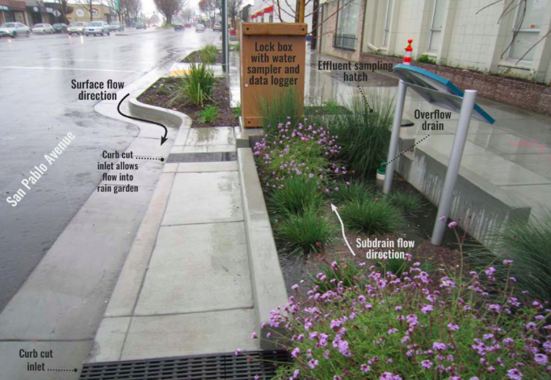
RECOMMENDATIONS #3 & #5
Stormwater pathways & green infrastructure
Project Results:
Stormwater systems may be discharging more microparticles than wastewater
Rubber particles = ~50%
SFEI found rain gardens can eliminate ~90% microparticles
Recommendation #3: Explore green stormwater infrastructure management options to reduce microplastics from entering San Francisco Bay
Recommendation #6: Further identify and quantify microplastics sources and pathways within stormwater systems
Key Suggestions:
Develop stormwater conceptual model
More research on green stormwater infrastructures
Notes:
Stormwater results were really interesting and caused a lot of discussion.
Green stormwater infrastructure
Need more work on stormwater conceptual model

Slide 19
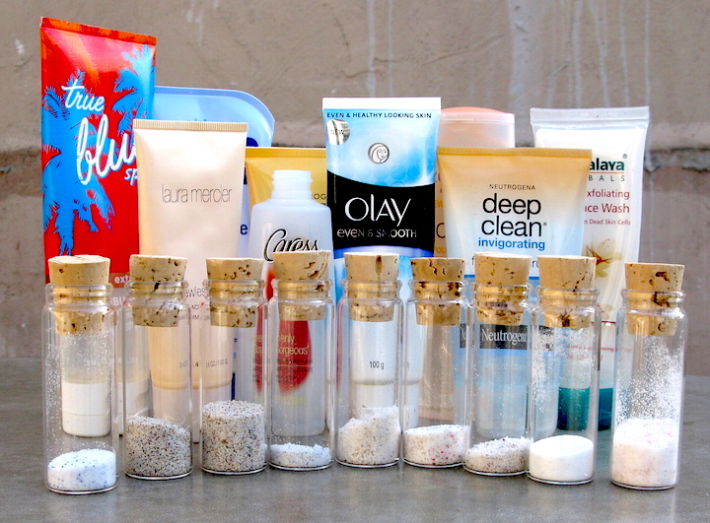

RECOMMENDATIONS #6, #8 & #9
Advancing research, innovation & management
Project Results:
Microbeads in samples
Blank contamination
Microplastics in fish
Recommendation #4: Support San Francisco Bay Microplastics Management Strategy to reduce microplastics
Recommendation #8: Support innovation to address microplastic pollution in San Francisco Bay
Recommendation #9: Address additional research needs
Suggestions:
Long-term monitoring to evaluate management actions
Airborne microparticles
Ecological impacts
Local funding sources for innovation
SF Bay Management Strategy
Notes:
Research
Innovation
Management

Slide 20
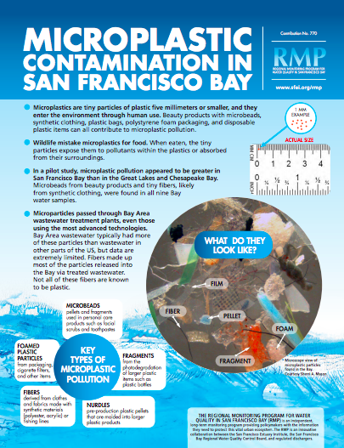
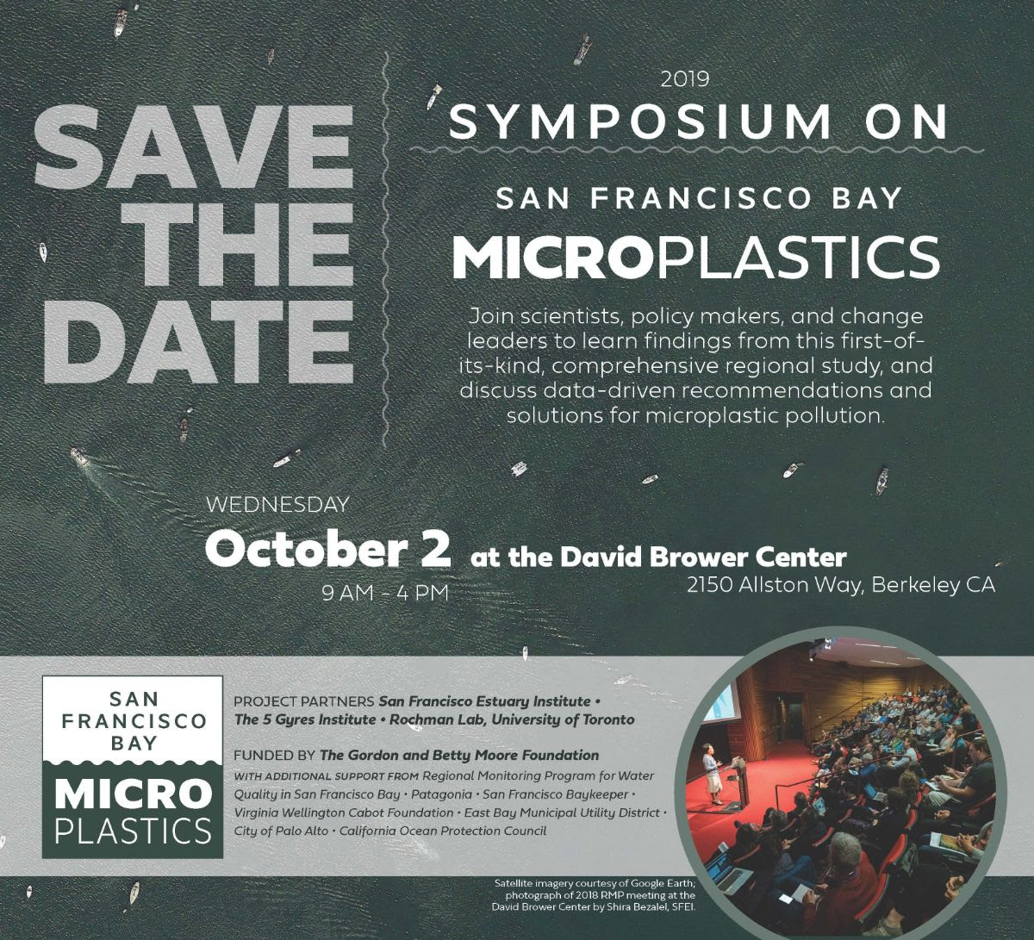
NEXT STEPS
Distribution / Partners
Social media
Press
Notes:
Our next steps are:
First we are bringing stakeholders together for a symposium on Oct 2. The purpose of this meeting is to distribute results to policy makers and NGOS who can get this information into the hands of legislators
We’ll have a number of tools – a short documentary, factsheets, social media posts, that will be used to get the results out to a broad group as well.

Slide 21
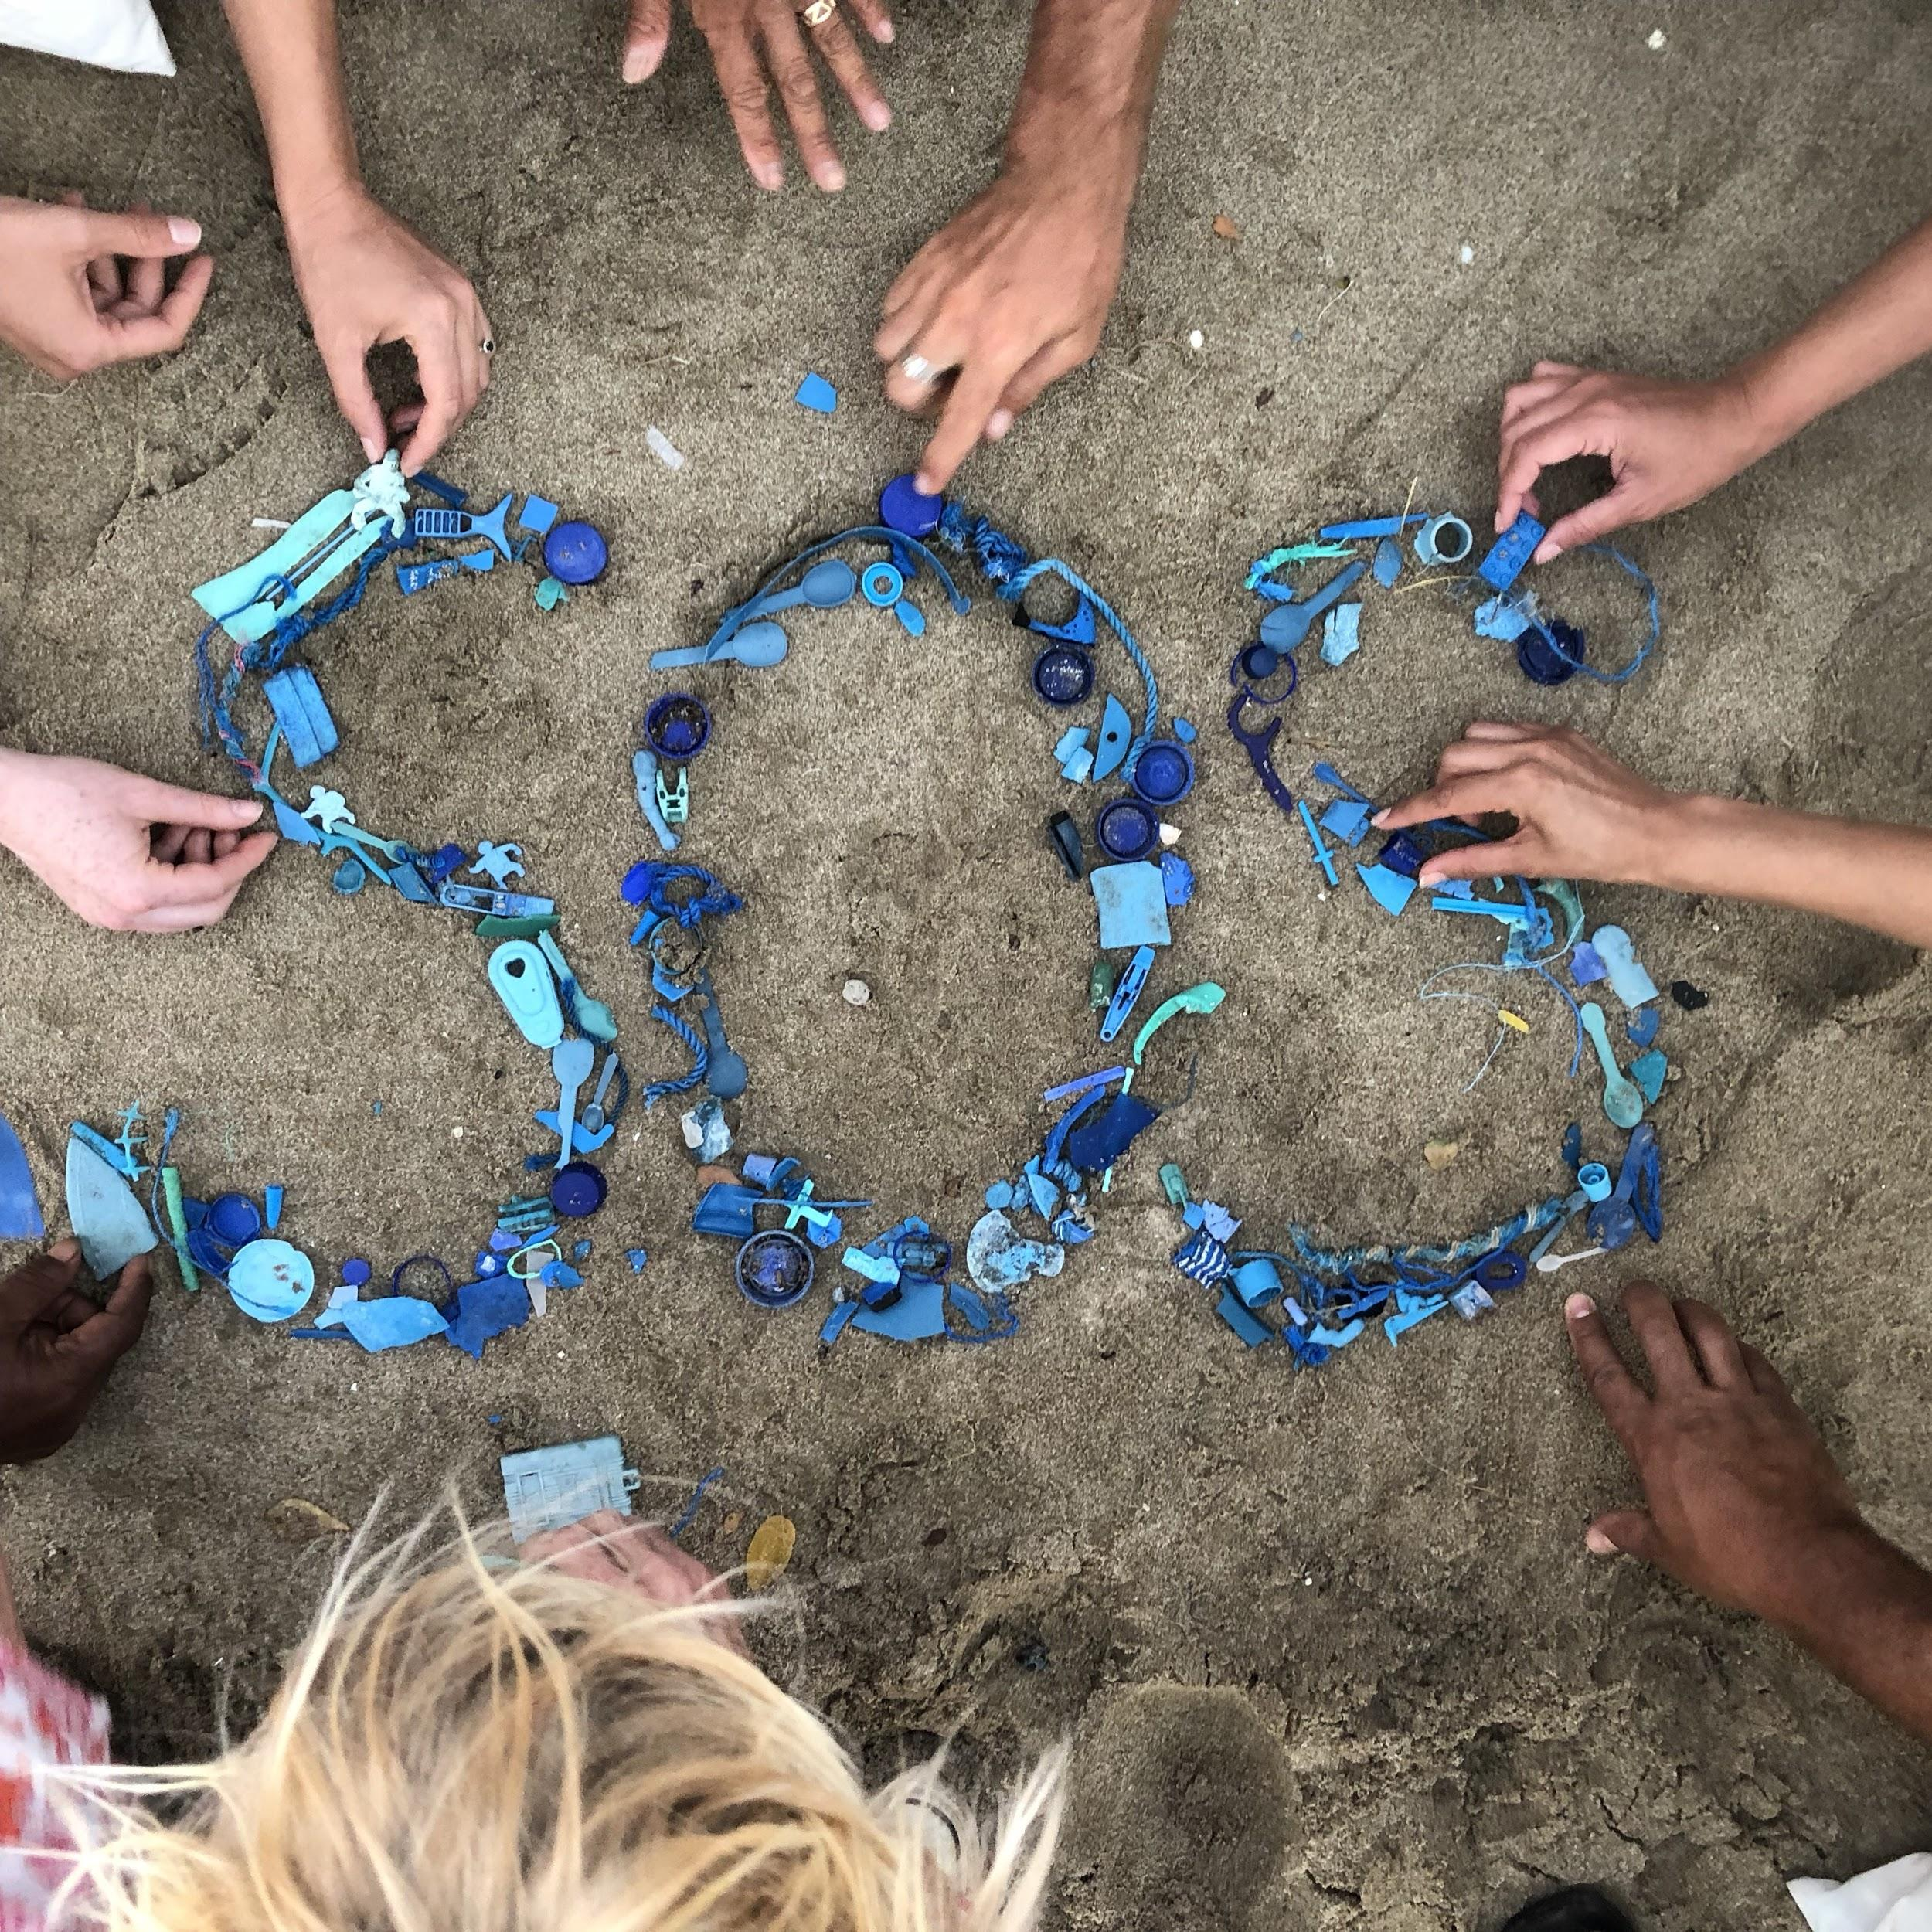
Carolynn Box
5 Gyres
carolynn@5gyres.org
Rebecca Sutton
SFEI
rebeccas@sfei.org
Notes:
Thank you for the opportunity to speak to you today. I believe we have time for some questions.

