Slide 1
Stanford University
Civil and Environmental Engineering
Potable Reuse Trains of the Future:
Synergies Between Reuse and Other Treatment Goals
Zhong Zhang
William Mitch
Notes:
Hi everyone! Thank you for coming to my phD defense. The topic of my dissertation is emerging applications of advanced oxidation processes for the potable reuse of municipal wastewater.

Slide 2
Competing Demands for Bay Area Utilities
Generate a water supply with potable reuse
…but also need to:
Lower energy usage/greenhouse gas emissions
Reduce nitrogen discharges to Bay
Limit discharges of contaminants of emerging concern (CECs)
Reduce plant footprint to provide space for these new treatment trains
Limited budgets ➔ Which to prioritize?
e.g., Nitrogen limits are a regulatory requirement. Potable reuse isn’t.
Focus on nitrogen removal?
Does it have to be either/or?
Are there opportunities for win-win?
3
Notes:
Municipal wastewater is increasing emphasized as a local and reliable source water supply for potable water in arid or semi-arid regions such as California. The process of using purified wastewater for drinking water called potable reuse. There are two types of potable reuse: indirect potable reuse and direct potable reuse. For indirect potable reuse, treated wastewater will first go into environmental buffer, such as a lake or groundwater before going into drinking water treatment plants. For direct potable reuse, treated water will go into drinking water treatment plants or directly blend with drinking water and go to the consumers. To date, most potable reuse plant is operating for indirect potable reuse but locations with severe drought conditions such as Texas have implemented direct potable reuse. In the future, more and more utilities are expected to implement direct potable reuse.

Slide 3
Current Treatment Trains
Challenges – energy and space intensive
Full Advanced Treatment
Potable Reuse Train
Primary
Secondary
Activated Sludge/
nitrification
Sec
Clarif.
Denitrifying
Biotowers?
MF
RO
AOP
Potable
water
RO
Concentrate
Discharge
3
Notes:
Municipal wastewater is increasing emphasized as a local and reliable source water supply for potable water in arid or semi-arid regions such as California. The process of using purified wastewater for drinking water called potable reuse. There are two types of potable reuse: indirect potable reuse and direct potable reuse. For indirect potable reuse, treated wastewater will first go into environmental buffer, such as a lake or groundwater before going into drinking water treatment plants. For direct potable reuse, treated water will go into drinking water treatment plants or directly blend with drinking water and go to the consumers. To date, most potable reuse plant is operating for indirect potable reuse but locations with severe drought conditions such as Texas have implemented direct potable reuse. In the future, more and more utilities are expected to implement direct potable reuse.

Slide 4
Efficient Treatment Trains – Pilot-test at SVCW via California Energy Commission
Anaerobic secondary advantages
energy savings
- no aeration
- methane generation ➔ harvest for energy
space savings
- no secondary clarifiers
- reduce secondary biosolids by 50% ➔ smaller solids handling
Aerobic MBR – Nitr/Denitr:
energy savings: only aeration for nitrogen removal, not DOC
space savings: MBR ➔ no need for microfiltration in reuse train
Primary
Anaerobic
Secondary
Aerobic MBR
Nitr/Denitr
RO
AOP
Potable
water
Potable Reuse Train
RO
Concentrate
Discharge
3
Notes:
Municipal wastewater is increasing emphasized as a local and reliable source water supply for potable water in arid or semi-arid regions such as California. The process of using purified wastewater for drinking water called potable reuse. There are two types of potable reuse: indirect potable reuse and direct potable reuse. For indirect potable reuse, treated wastewater will first go into environmental buffer, such as a lake or groundwater before going into drinking water treatment plants. For direct potable reuse, treated water will go into drinking water treatment plants or directly blend with drinking water and go to the consumers. To date, most potable reuse plant is operating for indirect potable reuse but locations with severe drought conditions such as Texas have implemented direct potable reuse. In the future, more and more utilities are expected to implement direct potable reuse.

Slide 5
Efficient Treatment Trains – Pilot-test at SVCW via California Energy Commission
Anaerobic secondary advantages
effluent quality
- lower CECs
- lower DOC ➔ less membrane fouling (reuse energy demand)
3.5 mg/L vs. ~7 mg/L for activated sludge
30% lower RO water flux decline than activated sludge
Notes:
Municipal wastewater is increasing emphasized as a local and reliable source water supply for potable water in arid or semi-arid regions such as California. The process of using purified wastewater for drinking water called potable reuse. There are two types of potable reuse: indirect potable reuse and direct potable reuse. For indirect potable reuse, treated wastewater will first go into environmental buffer, such as a lake or groundwater before going into drinking water treatment plants. For direct potable reuse, treated water will go into drinking water treatment plants or directly blend with drinking water and go to the consumers. To date, most potable reuse plant is operating for indirect potable reuse but locations with severe drought conditions such as Texas have implemented direct potable reuse. In the future, more and more utilities are expected to implement direct potable reuse.

Slide 6


Efficient Treatment Trains – Pilot-test at Valley Water
6.7-fold concentrated
Is RO concentrate treatment a burden or a benefit?
~15%
Concentrate
High salinity (~4000 mg/L TDS, 35000 mg/L in sea water);
Elevated organics (~40 mg/L DOC) and inorganics (~70 mg/L nitrate);
Inland: high salinity is main challenge for disposal
Coastal: high concentration of pollutants hinders disposal to ocean ➔ concerns over toxicity
BUT… contaminants and nutrients concentrated 6.7-fold ➔ treat ~1/7 the flow!
shrink the capital cost and footprint to eliminate nutrients/contaminants?
~85%
Permeate
Primary
Anaerobic
Secondary
Aerobic MBR
Nitr/Denitr
RO
AOP
Potable
water
Potable Reuse Train
RO
Concentrate
Discharge
3
Notes:
Municipal wastewater is increasing emphasized as a local and reliable source water supply for potable water in arid or semi-arid regions such as California. The process of using purified wastewater for drinking water called potable reuse. There are two types of potable reuse: indirect potable reuse and direct potable reuse. For indirect potable reuse, treated wastewater will first go into environmental buffer, such as a lake or groundwater before going into drinking water treatment plants. For direct potable reuse, treated water will go into drinking water treatment plants or directly blend with drinking water and go to the consumers. To date, most potable reuse plant is operating for indirect potable reuse but locations with severe drought conditions such as Texas have implemented direct potable reuse. In the future, more and more utilities are expected to implement direct potable reuse.

Slide 7
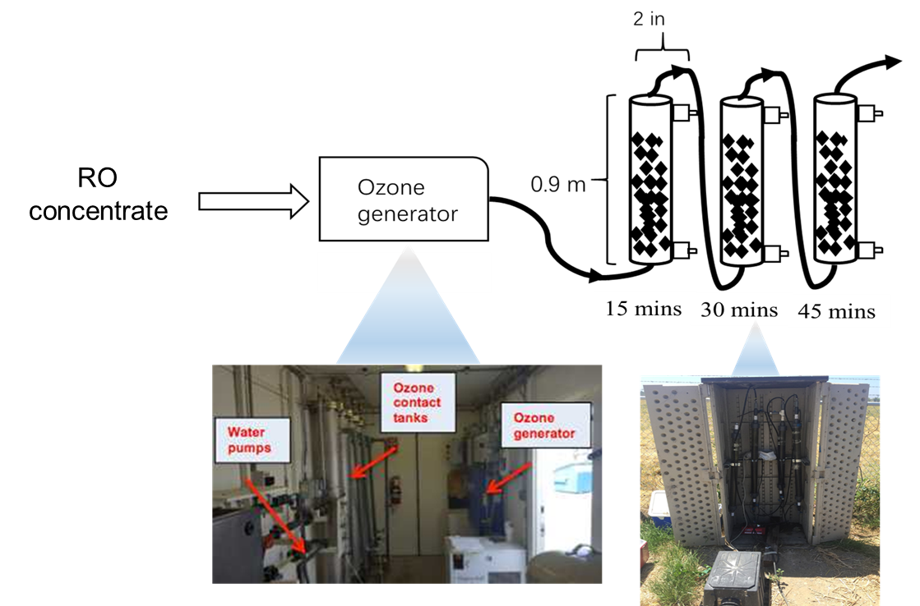
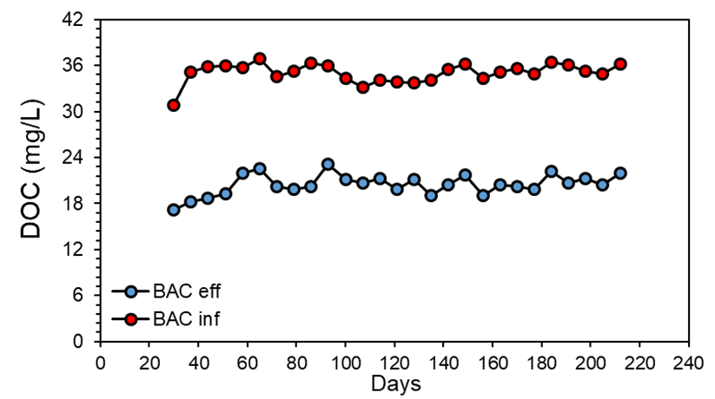
Pilot-scale O₃/BAC unit
01
Fed with ozonated RO concentrate (20 mg/L O₃) for 7 months
Analyzed organic pollutants and inorganics removal at different EBCTs and ozone dose (0, 20 and 40 mg/L)
02
11
Notes:
A pilot-scale O3/BAC unit is set up at SCVWD. The RO concentrate will contact with ozone at the contact tanks for around 20 mins and then it will go into the BAC columns operating up flow. Initially BAC columns were fed with ozonated RO concentrate for 7 months to establish stable biofilms. The stable bioactivity can be indicated by constant DOC removal as shown in this figure. Then we analyzed the organic pollutants (including pahrmaceuticals and pesticides) and nitrate removal at different EBCT and also ozone doses.

Slide 8
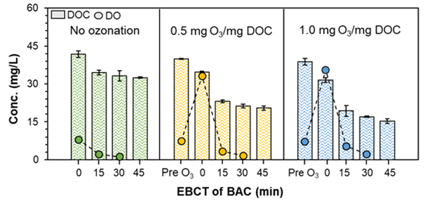
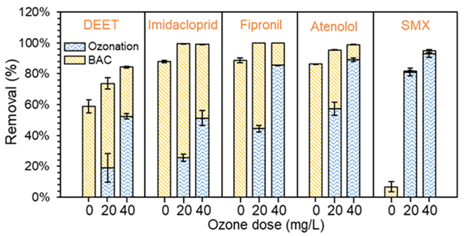
O₃/BAC removal of DOC and organic pollutants
01
22% DOC removal without O₃
< 20% DOC removal by O₃ and 40% by BAC
02
03
No DO after 30 min
> 74% removal of these pollutants at 20 mg/L O₃ after 45 min
04
12
Notes:
The upper figure shows the DOC and dissolved oxygen level. The bars represent DOC and the circles represents the DO.
The following figures show the removal of five pharaceuticals and pesticides at different ozone doses. The blue color represents the removal by ozone and yellow color represents by BAC.

Slide 9
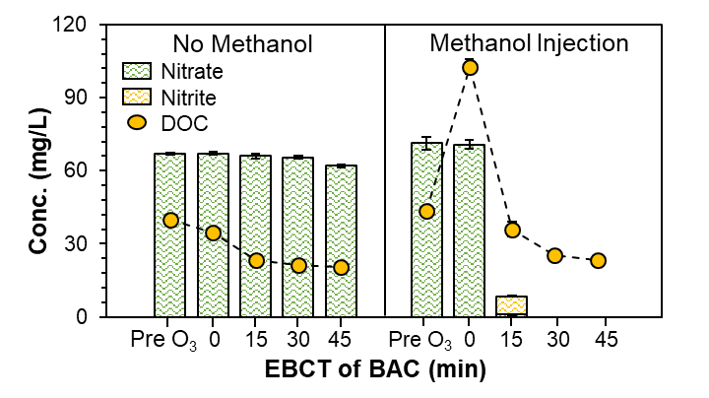
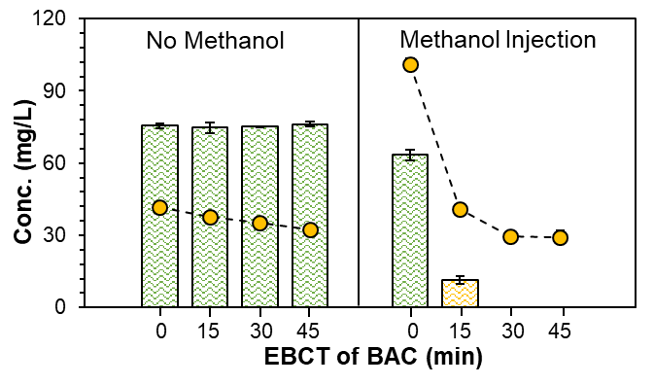
O₃/BAC removal of nitrate
20 mg/L O₃
01
7% nitrate removal after 45 min
Complete nitrate removal with 60 mg-C/L methanol after 30 min
02
No O₃
Complete nitrate removal with 60 mg-C/L methanol after 30 min without O₃
03
13
Notes:
This figure shows the removal of nitrate by O3/BAC. The bars represents nitrite and nitrate and circles represents DOC. There is little nitrate removal after 45 mins. Although we can reach anaerobic condition after 30 mins, but all the biodegradable carbon is also depleted. Thus we added methanol to provide carbon source to remove nitrate. O3/BAC can completely remove 70 mg/L nitrate after 30 mins with supplement of 60 mg-C/l methanol. Withoug O3, BAC alone can also remove nitrate after injection methanol.

Slide 10
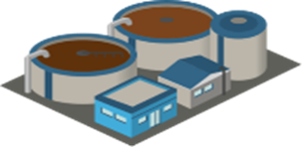
Synergy between potable reuse and nitrogen removal
Removing nitrogen from RO concentrate rather than the conventional discharge can reduce cost and space requirements due to the reduction of treatment volume
70 MGD Wastewater
Treatment plant
100% Eff
$ 44.8 million
Space 2,870 m²
Denitrifying biofilters
14
Notes:
Indeed FAT train is expensive, but first it can recover water and it can also provide other opportunities for these utilities to remove pollutants in RO concentrate in much smaller treatment volume. For example, utilities may need to meet regulations to remove nitrate in their wastewater effluent.

Slide 11
Synergy between potable reuse and nitrogen removal
Removing nitrogen from RO concentrate rather than the conventional discharge can reduce cost and space requirements due to the reduction of treatment volume
70 MGD Wastewater
Treatment plant
100% Eff
$ 44.8 million
Space 2,870 m²
Denitrifying biofilters
$ 25 million
Space 323 m²
BAC
+
O₃
~15% Eff
BAC alone removes nitrogen and
most of the contaminants
Denitrifying biofilters don’t remove CECs!
$ 8.9 million
Space 91 m²
$ 365 million
Space 2434 m²
~85% Eff
Drinking water
Plumlee et al. 2014
14
Notes:
For the 14.5 MGD facility, construction of 4 denitrifying biofilters, each with dimensions of 40 ft x 40 ft x 25 ft, was considered. Tank construction costs (including labor, materials and contingencies, but not biofilter equipment) were at $4/gallon. The total equipment cost for the 4 biofilters was estimated to be $4.5 million. To treat 70 MGD, we scaled the number of denitrifying biofilters to 19. The total tank construction cost would be $23.1 million. The total equipment cost would be $21.7 million, for a total capital cost of $44.8 million

Slide 12
O₃/BAC to treat RO concentrate
01
O₃/BAC can remove organic pollutants
Denitrification can be achieved within BAC despite high salinity
02
Treatment of RO concentrate can partially offset the cost and save space for FAT train
03
15

Slide 13
Synergies Between Potable Reuse and Concurrent Challenges
Anaerobic secondary/aerobic MBR helps potable reuse
saves space, energy/GHG emissions and cost
reduces CECs and nutrients
Potable reuse helps other goals by concentrating contaminants
more efficient contaminant/nutrient removal
lower space and capital costs
Primary
Anaerobic
Secondary
Aerobic MBR
Nitr/Denitr
RO
AOP
Potable
water
RO
Concentrate
Potable Reuse Train
O₃/BAC
discharge
15

Slide 14
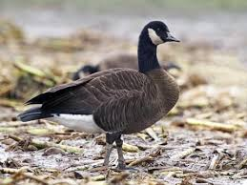
Source apportionment for fecal indicator bacteria
Local beaches fail to meet fecal indicator bacteria (FIB) limits
Is it the WWTP or the birds?
Use sucralose (artificial sweetener) as conservative tracer of WWTP
Do FIB correlate with WWTP?
16

