Slide 1





Re-inventing the Nation’s Urban Water Infrastructure (ReNUWIt)
Update to BACWA
Sebastien Tilmans, CR2C Exec Dir.
Richard G. Luthy, Stanford Univ.
ReNUWIt Director
Notes:
Welcome all,
Skip to highlights, they will have seen the agenda

Slide 2
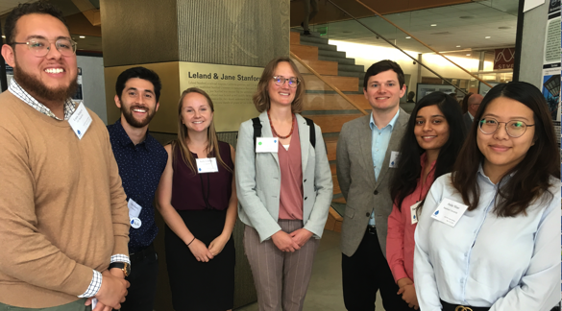
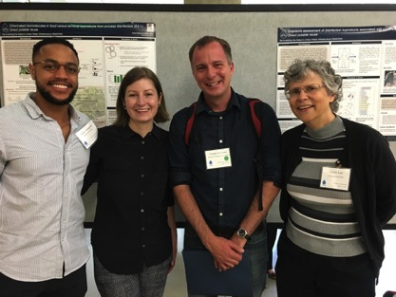
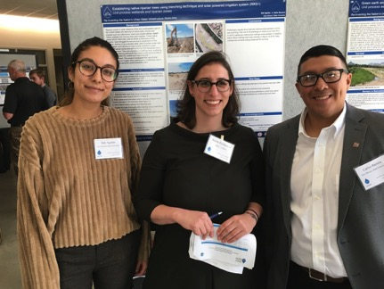
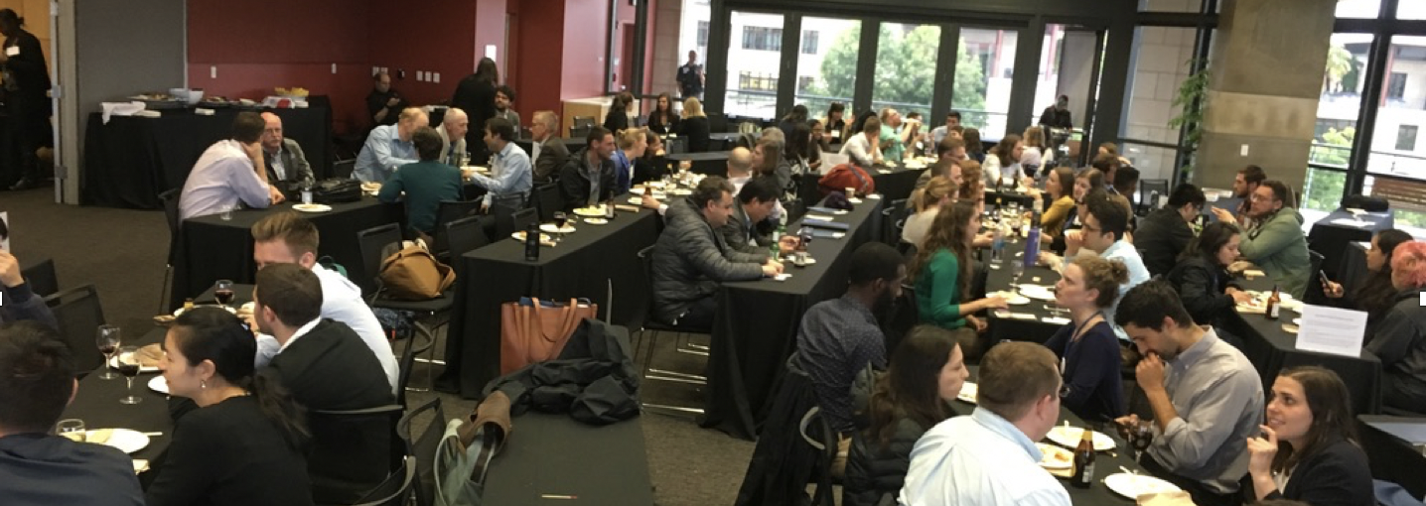
NSF Site Visit May 22-23, 2019
IAB support is invaluable!
Notes:
We

Slide 3
NSF Site Visit May 22-23, 2019
“At the end of Year 8 of this ERC, the testbeds contain a good mixture of developing and mature testbeds and there is significant potential for a number of these technologies to continue to move towards implementation by different stakeholders.”
“The majority of the testbeds are on public utility sites, which makes the testbeds more relevant to stakeholders. A related strength is how engaged the IAB members are in the testbed partnerships.”
IAB support is invaluable!

Slide 4
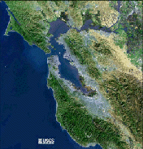
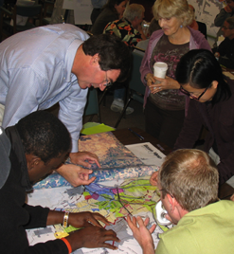
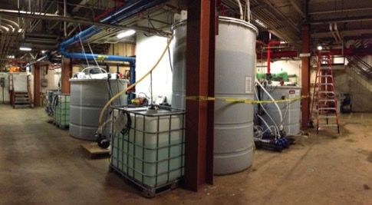
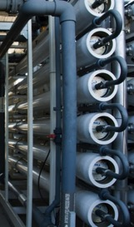
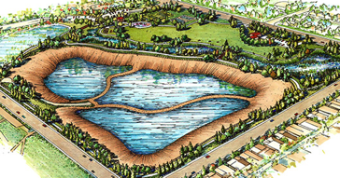
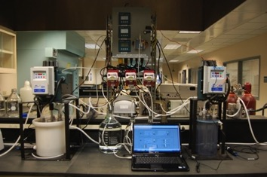
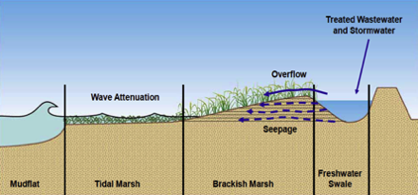
Systems-level Vision
Urban Systems Integration and Institutions
CO Front Range
Decision tools
for utilities
Regional
planning
Technology diffusion
SF Bay Area
Natural Water
Efficient Engineered
Systems
Infrastructure Systems
Tailored Water Test Bed
CO Front Range
Energy and resource recovery, potable reuse
Wetlands & riparian zones,
managed recharge, stormwater use
Water Reuse &
Ecosystem Benefits
Notes:
Our work isn’t siloed in these thrusts—rather we look to integrate and transcend these categories. Here are examples ….
I’d like to highlight a few projects and starting with those that relate to decision making.

Slide 5
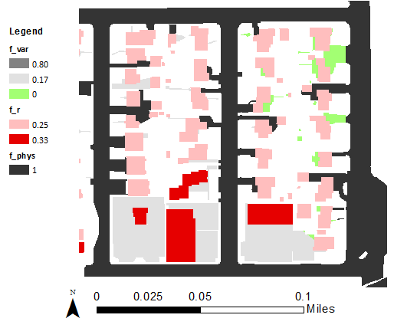
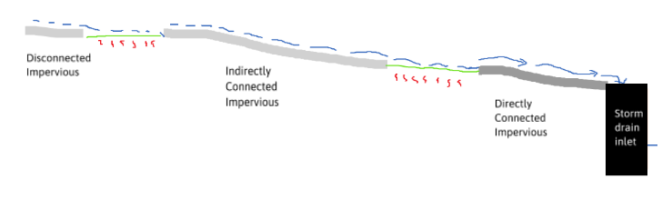
U1.7 Mapping impervious connectivity
Case studies from Petaluma, CA, and Denver, CO
Key feature is mapping connected impervious area for siting distributed infrastructure; improved SWMM model and incorporation into GIS tool
CO Front Range
f_{r}
A_{r}
f_{var}
A_{var}
f_{phys}
A_{phys}
CO Front Range
Water Reuse &
Ecosystem Benefits
Notes:
U1.7 Mapping connected impervious surface for distributed stormwater technology optimization
Simulate infiltration and runoff in PySWMM using different scenarios of impervious routes to pervious
Develop classification regression tree based on PySWMM outcomes to predict infiltration based on measurable characteristics of landscape and impervious/pervious areas.
Incorporate classification regression tree into GIS tool

Slide 6
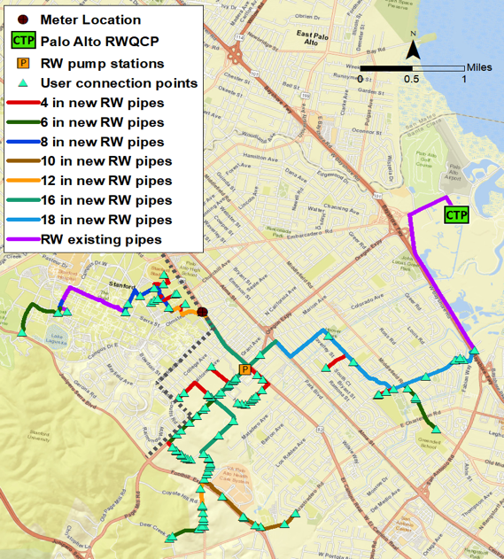
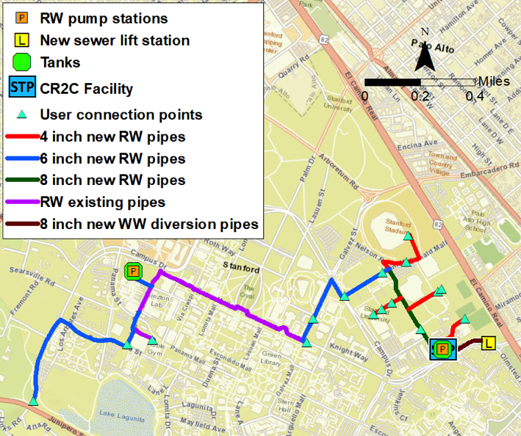
U1.2 Centralized vs. on-site water reuse
Case study of Palo Alto and Stanford University
Develop decision tool for non-potable reuse
CO Front Range
New
facility
Existing
Existing
New pipelines
New on-site
facility
CO Front Range
Treatment at Palo Alto
Treatment at Stanford
Notes:
For the available records (2013-2017), August, 2017, was the month of highest water demand.
Peak day demand = average daily demand for August, 2017 = 0.48 MGD
Available sewer flow to produce recycled water for irrigation use = 0.48 MGD
Average daily demand during month of peak demand for irrigation: 0.48 MGD
Peak day demand for irrigation: 0.48 MGD
Peak hour demand for irrigation: 1000 gpm
Annual recycled water demand (irrigation and toilet flushing): 0.25 MGD

Slide 7
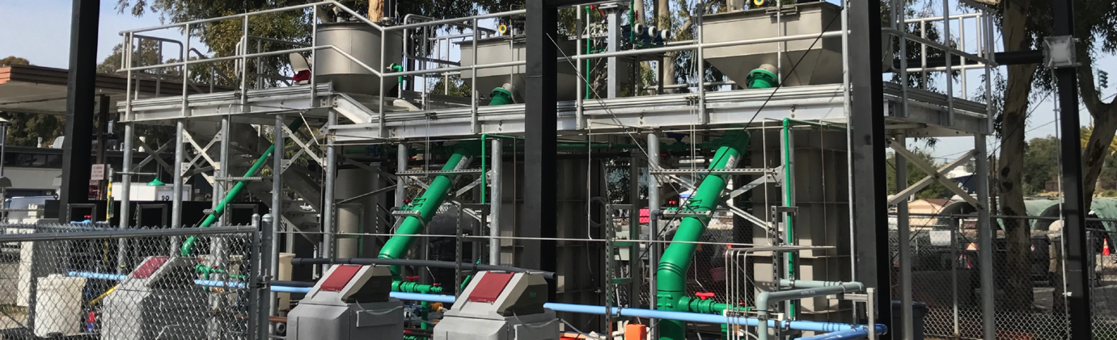
E2.11 Staged anaerobic fluidized bed MBR
Silicon Valley Clean Water, Suez, Singapore PUB (further scale-up in construction)
    86% COD removal at energy consumption of 0.27 kWh/m³ and produced biogas with an electrical energy value of 0.27 kWh/m³ (~Energy Neutral)
    When coupled with disinfection, RO, and UV/AOP, SAF-MBR effluent exhibits lower flux decline than aerobic effluents & 3-6 fold lower concentrations of disinfection byproducts
CO Front Range
Green refers to method that have been used
at WWTPs
Water Reuse &
Ecosystem Benefits
Notes:
Szczuka et. al. 2019 (10.1021/acs.est.8b05473)
The SAF-MBR, a treatment process at CR2C that could transform treatment
plants from energy hogs into green power plants

Slide 8
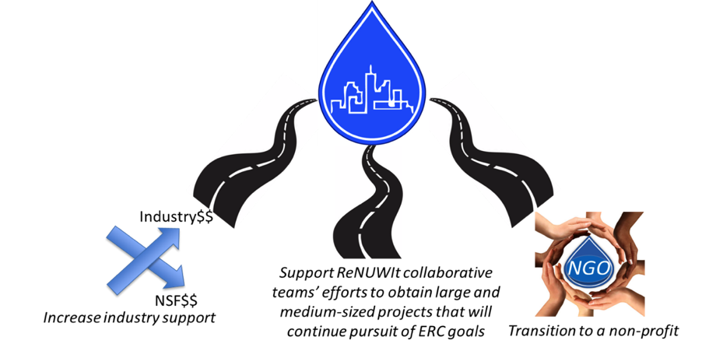


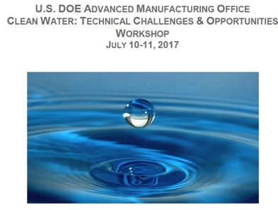
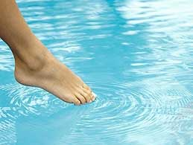


Planning for the Post-ERC Funding Era
Sources of Support
IAB Members
NSF Programs
SERDP (DoD)
USGS
Notes:
In the report we discuss the three paths for ReNUWIt in the post NSF ERC era. As you will see in the presentations of the thrust leaders we have made great progress with projects that support 1-4 students or postdocs; the big opportunity on the large center front is the DOE effort. We are also dipping our toes into the water for the non-profit/annual conference mechanism and have had some good discussions with NWRI. May link it to the Bay Area Partnerships effort.

Slide 9
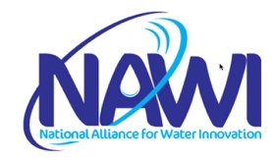

National Alliance for Water Innovation
NAWI is a research alliance headquartered at Lawrence Berkeley Lab to advance technologies in which 90% of nontraditional water sources – such as seawater, brackish water, and produced waters – can be cost-competitive with existing water sources within 10 years.
LBL-ReNUWIt team driving force for this initiative
Notes:
NAWI is a research alliance headquartered at Berkeley Lab and includes Oak Ridge National Laboratory, the National Renewable Energy Laboratory, the National Energy Technology Laboratory, and 19 founding university partners, and 10 founding industry partners. NAWI’s goal is to advance a portfolio of novel technologies that will secure a circular water economy in which 90% of nontraditional water sources – such as seawater, brackish water, and produced waters – can be cost-competitive with existing water sources within 10 years.

