Slide 1

API SF Bay Fish Education & Engagement Project
APA Family Support Services, San Francisco, CA.
Funded by Bay Area Clean Water Agencies (BACWA)
Mercury/PCB Watershed Permit Risk Reduction Compliance

Slide 2
About APA Family Support Services www.apafss.org
APA’s mission is to promote healthy children and families….

Slide 3
Project Goals and Activities
Goals:
Promote awareness and understanding of the SF Bay Fish consumption advisories (developed by OEHHA/ Office of Environmental Health Hazard Assessment); contamination issues, and health risks and benefits associated with eating SF Bay fish
Engage the community to reduce human exposure to mercury and PCBs from eating SF Bay fish

Slide 4
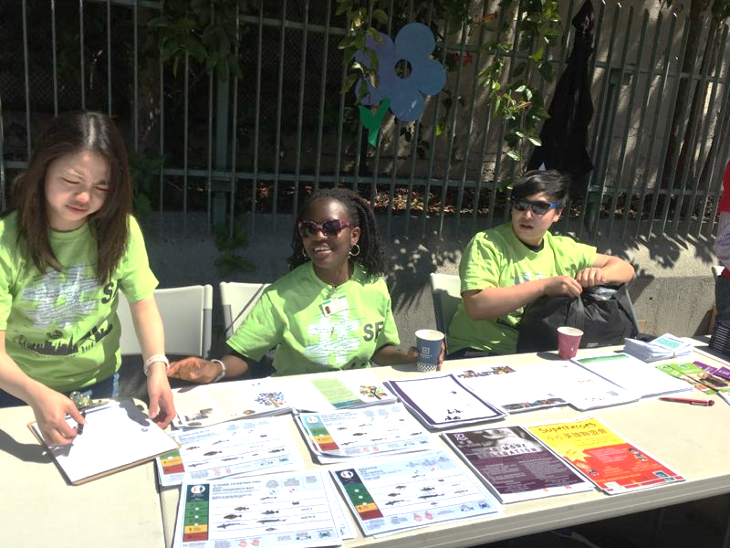
Project Goals and Activities (cont.)
Targeting at-risk moderate to high SF consumers, children, childbearing age women and pregnant women.
Bilingual Educational Workshops (Chinese, Vietnamese, Filipino, Lao, Cambodian, Samoan, Japanese, Korean, Thai and Mongolian community)
Case Management
Community Forum

Slide 5
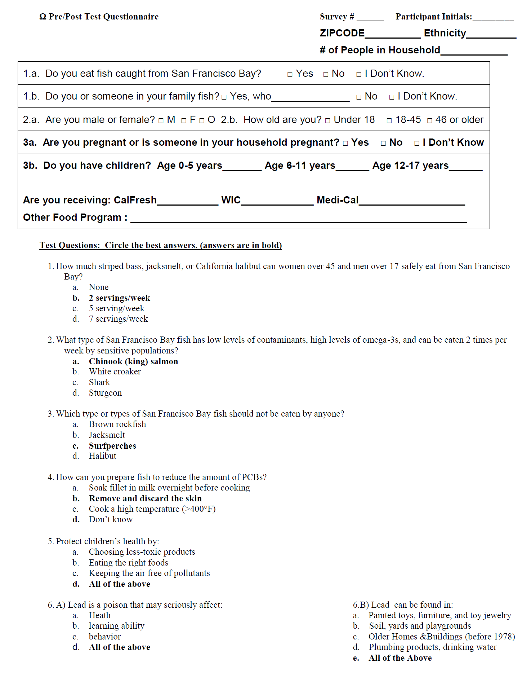

Slide 6
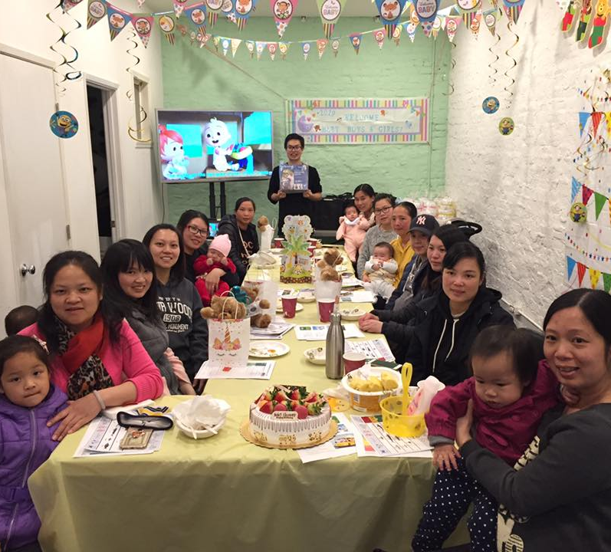
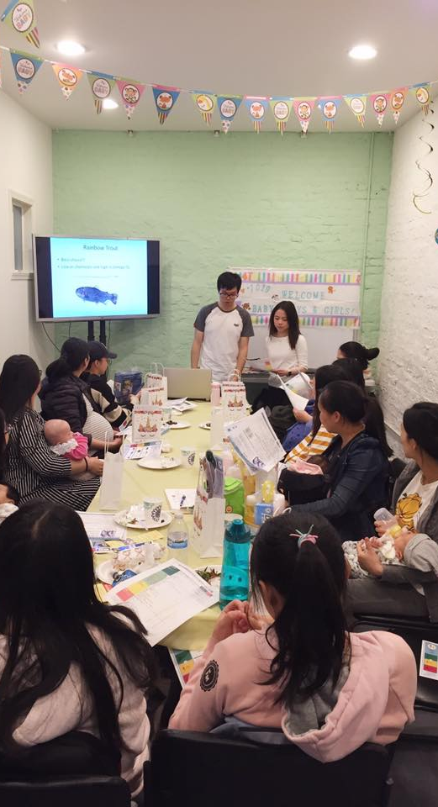
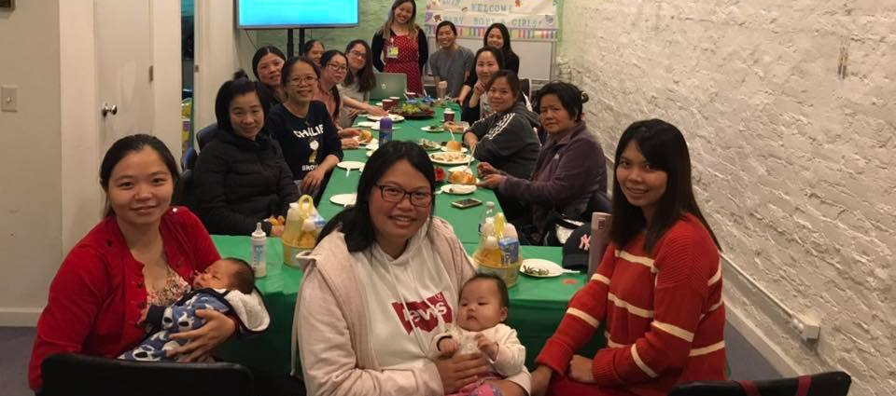
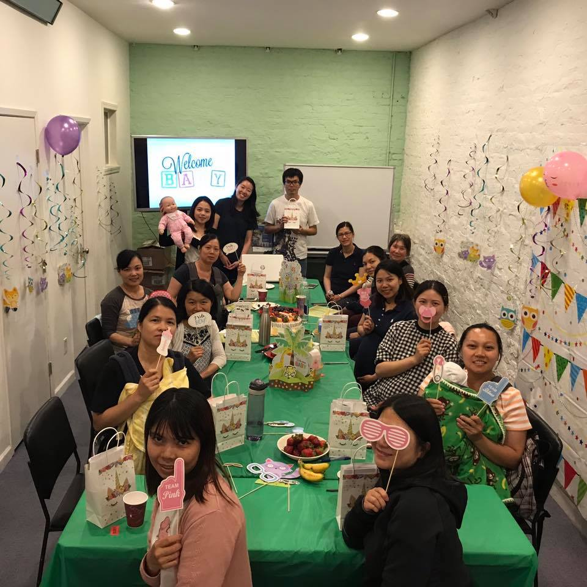



Slide 7
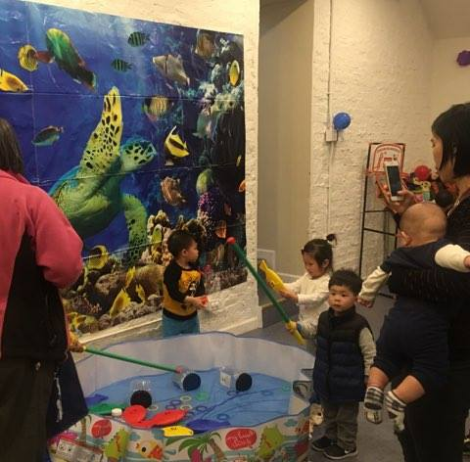
Summary of Findings & Accomplishments
50% of the participants reported about their food running out and 73% of the participants reported that the food they bought didn’t last.
29 out of 38 of the participants/families were connected to WIC, CalFresh, or food pantry/other food program.

Slide 8
Summary of Finding & Accomplishments (cont.)
All 38 participants/families selected for case management indicated moderate to high amount of SF Bay Fish Consumption at the initial assessment. (Eating more servings of SF Bay Fish per week over the guide and/or the type of fish consumed is identified to be more contaminated according to the SF Bay Fish Consumption Guide.)
31 out of 38 case management participants completed final assessments.
These 31 participants self-reported at the end/final assessment a reduction in consumption of SF Bay Fish and a responsive attitude to make healthier choices about their and their children food consumption and environment.
Participants reported that change in consumption habits and behavior require family and community support, consistent routine and resources or healthier options to make healthier choices.

Slide 9
Thank you. Questions…
Farmmary Saephan, Program Director
APA Family Support Services. www.apafss.org
farmmarysaephan@apafss.org

