Slide 1

PROPOSED ELAP REGULATIONS
Andrew Hamilton,
Senior Environmental Scientist (Specialist)
BACWA LABORATORY COMMITTEE MEETING
December 11, 2019

Slide 2
ENVIRONMENTAL LABORATORY ACCREDITATION PROGRAM
ELAP was established in the Environmental Laboratory Accreditation Act, 1988
ELAP accreditation required to perform analyses for regulatory programs in California
685 Environmental Laboratories are accredited by ELAP

Slide 3
SIZE AND SCOPE
Number of Laboratories

Slide 4
AREAS OF TESTING
ELAP offers accreditation in methods approved for use in California Regulatory Programs

Slide 5
Ensure that laboratories are competent in analyses required by California regulatory programs
Confirm compliance to the program’s accreditation standard
Program Elements:
Assess
Monitor
Accredit
Enforce
ELAP’S RESPONSIBILITY

Slide 6
WHAT DOES LABORATORY ACCREDITATION MEAN?
Participating Laboratories are compliant with the Program’s Accreditation Standards
The laboratory is competent to produce environmental data of known and documented quality.
An objective way of showing clients, the community and the government that an organization has the demonstrated capability to conduct the services they provide.

Slide 7
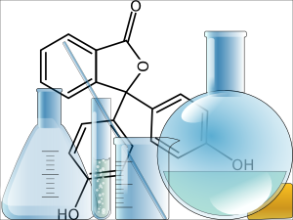
ELAP’S CURRENT REGULATIONS
California Code of Regulations, Title 22, Division, 4, Chapter 19
Contains requirements for the Accreditation Process and the program’s “Accreditation Standards”
Not Effective:
Lack Specificity and Detail
Misinterpreted
Not Auditable
Outdated Methods/Fields of Testing
Over 25 years Old
Not Consensus Based
Major Limitation for ELAP and Laboratories

Slide 8
NEED FOR REGULATIONS UPDATE
Amend Accreditation Process
Current language is administratively restrictive for laboratories and ELAP
Need for language more reflective of current processes
More description for laboratories
Adopt Accreditation Standards
Recommended by EPA and Expert Review Panel (program audits)
Supported by laboratory community

Slide 9
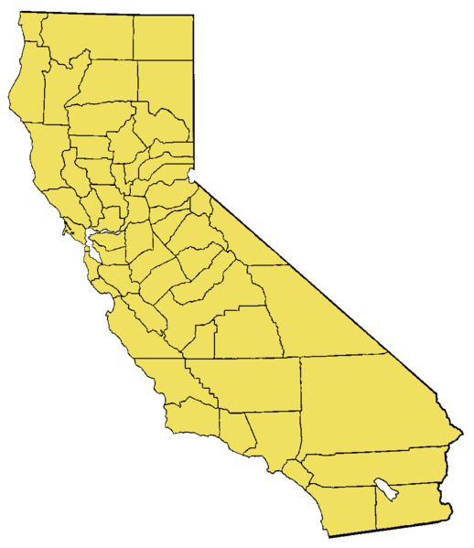
STAKEHOLDER INVOLVED PROCESS
2014 – 2019
16 ELTAC Meetings
13 State Agency Partner Meetings
9 Public Workshops
3 State Water Board Workshops
3 Draft Regulation Releases
Notes:
Need accurate numbers

Slide 10
Recommendation:
Add detail and specificity
More comprehensive
More direction for laboratories
Stakeholder Input:
Three draft releases
Incorporated many recommendations
What is New?:
Use of Third-Party Assessors (TPAs)
Shift in resource utilization
ACCREDITATION PROCESS
10

Slide 11
USE OF THIRD-PARTY ASSESSORS
Annual
OSA Demand
Labs that utilize Sophisticated Technologies shall use Third-Party Assessors (TPAs)
TPA ON-SITE ASSESSMENTS
~60 % of OSAs
Third-Party Assessors (TPAs) will help meet OSA demand
ELAP ON-SITE ASSESSMENTS
Notes:
Need accurate numbers

Slide 12
BENEFITS OF THIRD-PARTY ASSESSORS
Established industry of qualified assessors
Utilized by other state and federal laboratory programs (DoD, Florida, NJ, NY, CA Cannabis)
Allowable option in statute (H&SC 100837)

Slide 13
Stakeholder QUESTIONS about TPAs
Qualifications of TPAs
Assessor body recognized by TNI or federal agency (in H&SC)
Recognized by TNI, DoD, DoE or ELAP (in proposed regulations)
Memorandum of Understanding
Integrity of TPAs
Conflict of Interest Clauses

Slide 14
NEED FOR REGULATIONS UPDATE
Amend Accreditation Process
Current language is administratively restrictive for laboratories and ELAP
Need for language more reflective of current processes
More description for laboratories
Adopt Accreditation Standards
Recommended by EPA and Expert Review Panel (program audits)
Supported by laboratory community

Slide 15
CRITICAL CHARACTERISTICS OF ACCREDITATION STANDARDS
Applicable to All Laboratory Types and Sizes
Effective for State Regulatory Programs (Defensible Data)
Auditable – Can a lab be assessed to the standards?

Slide 16
PROPOSED ACCREDITATION STANDARDS
2016 TNI Standard with two exceptions:
One Proficiency Testing Study per year
Technical Manager (Laboratory Director) Qualifications
Consensus-Based Accreditation Standards
Recognized by the US EPA

Slide 17
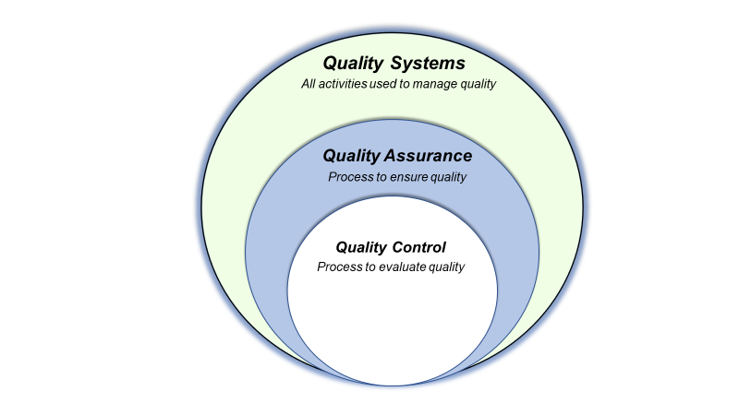
TNI provides access to:
Documentation Templates
Handbooks
Training
National Laboratory Community
2016 TNI STANDARD
Quality System Requirements:
Scalable Standard:
More robust not more complex
New to labs and ELAP
“How do you know?” approach

Slide 18

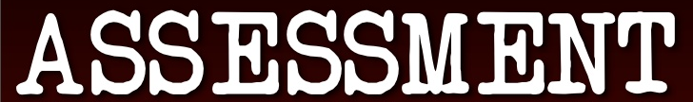
AUDITABLE STANDARDS
Detailed and Specific Criteria:
Roadmap for laboratories
ELAP and Labs are on the same page
Reduces variations in interpretation
Standardization of laboratory operations

Slide 19
New Proposed Fee Structure
ELAP published a Notice of Proposed Rulemaking on October 11, 2019.
Key features relating to fees:
Use of third-party assessors
Fees for laboratories located inside and outside California
Fee Categories
Base Fee
Per Field of Accreditation Fee
Assessment Fee
Reciprocity Fee
Amendment Fee
Late Fee

Slide 20
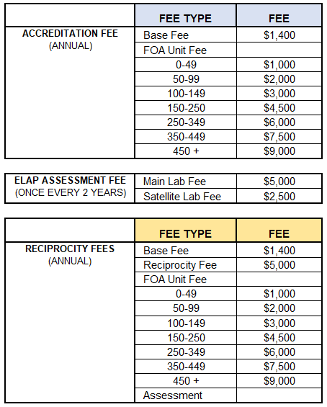
Proposed Fee Structure (Option 1)

Slide 21
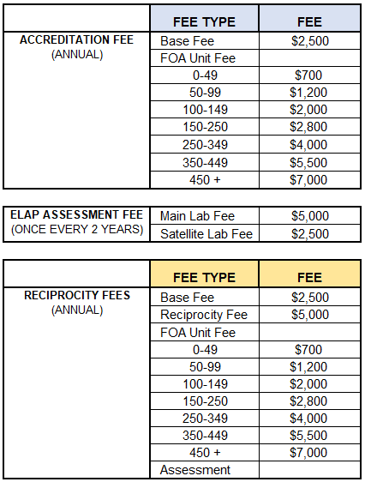
Proposed Fee Structure (Option 2)

Slide 22
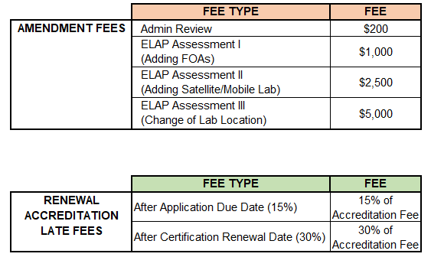
Proposed Fee Structure for Amendment and Late Fees (Options 1 & 2)
NOTE: Late Fees are detailed in Section 64808.05 of Proposed Regulations

Slide 23
Current Timeline (Subject to Change)
Oct. 2019
Entered Formal Rulemaking Process
Early 2020
Adoption Hearing
July 1, 2020
Target Effective Date of Regulations
Dec. 18, 2019
Board
Meeting

