Slide 1

Creating an Effective Mobile
Washer Program

Slide 2
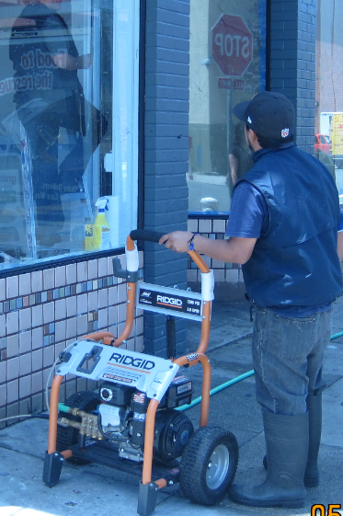
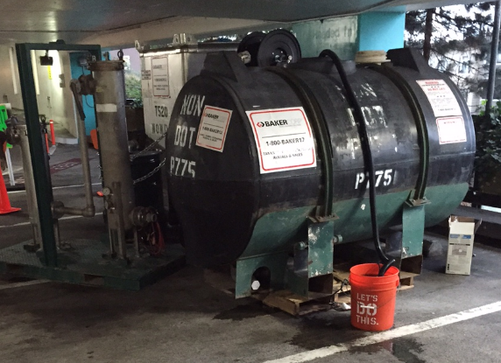
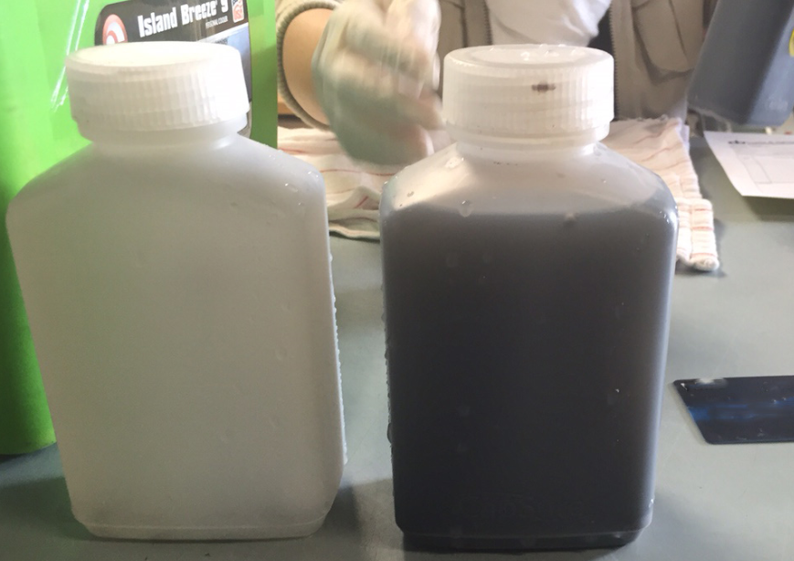
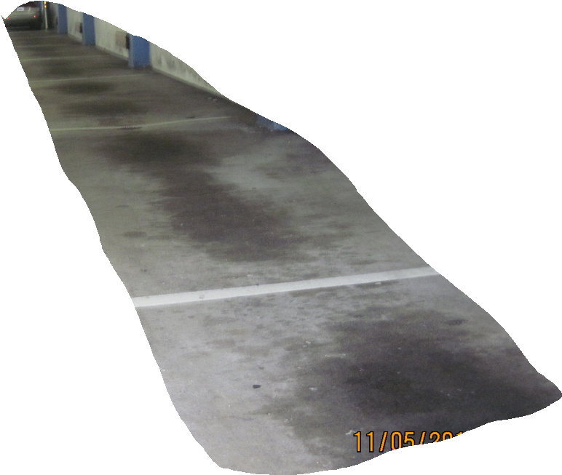
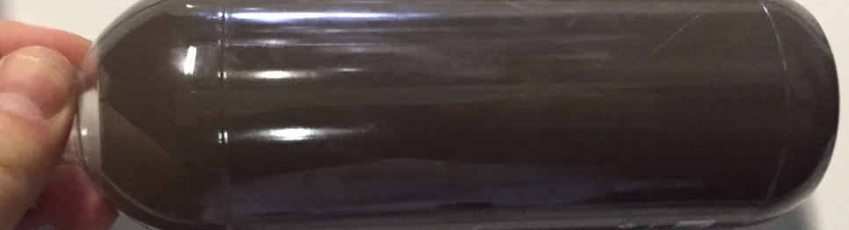
Why permit mobile washers?

Slide 3
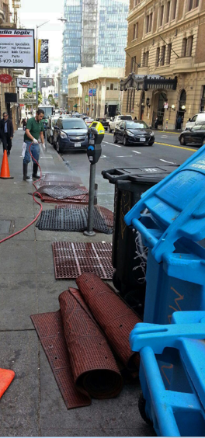
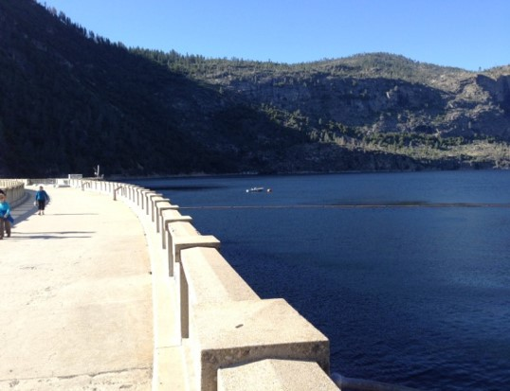
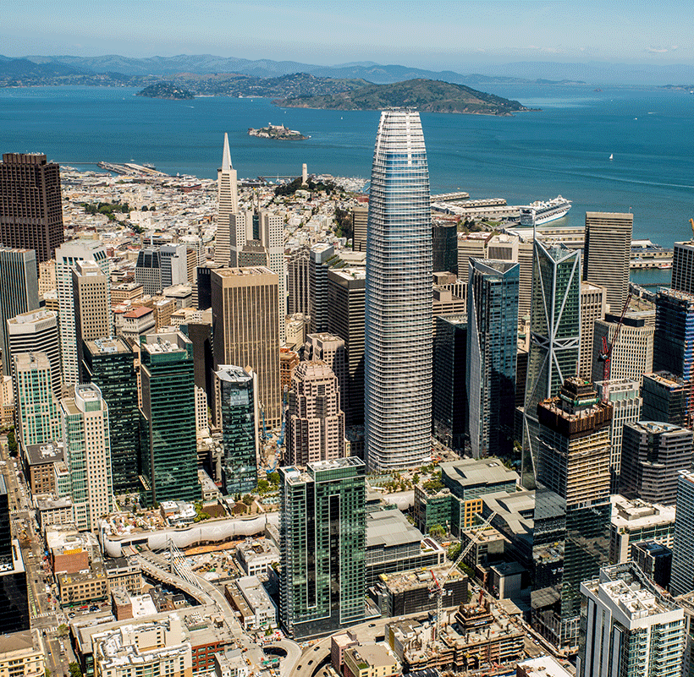
Why permit mobile washers?

Slide 4
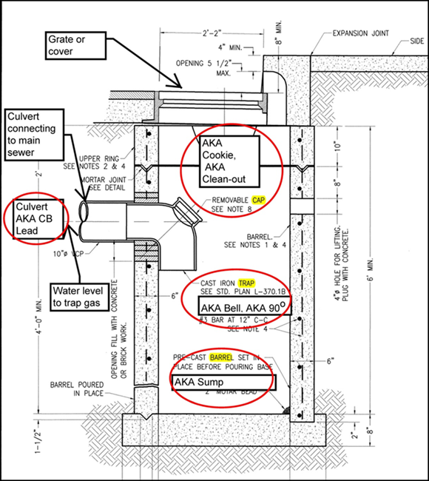
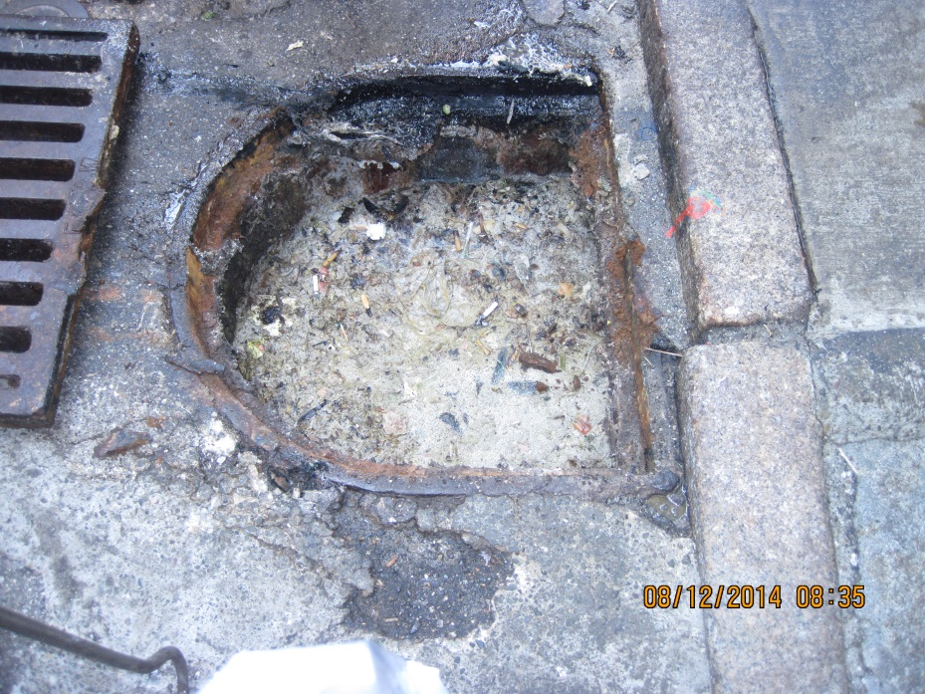
San Francisco is Unique
30,000 Catch basins to the combined system

Slide 5
How? A Review…
1996, BASMAA established an incentive based program for mobile cleaners to address discharges from their cleaning operations.
1999, BAPPG funded a study
To protect stormwater and the POTW
Early BMP’s included some discharge to storm sewers
Noted Issues:
Administrative burden
Surface cleaners discharge a small volume of wastewater overall
Monitoring burden

Slide 6
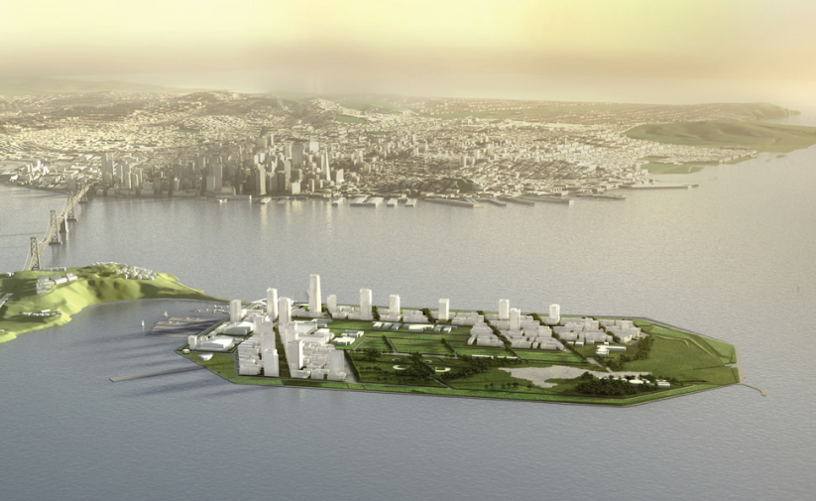
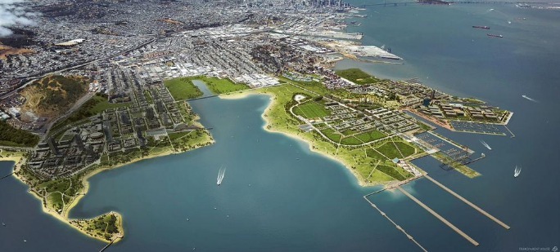
In the Present and Planned Future
Climate Change
Drought/Water Restriction
Mosquito Migration
Zika
San Francisco currently has a 95% Combined System with growing MS4 area

Slide 7
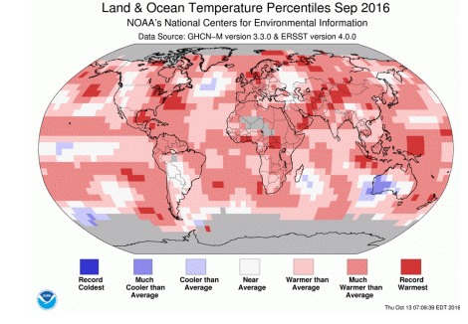
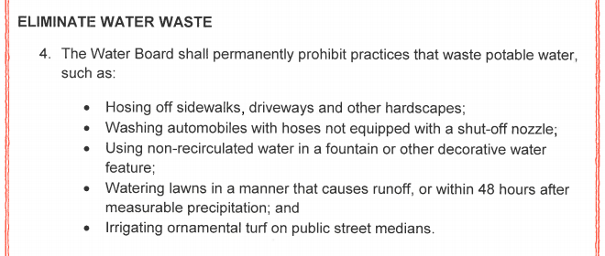
Drought/Water Restriction Executive Order B-37-16

Slide 8
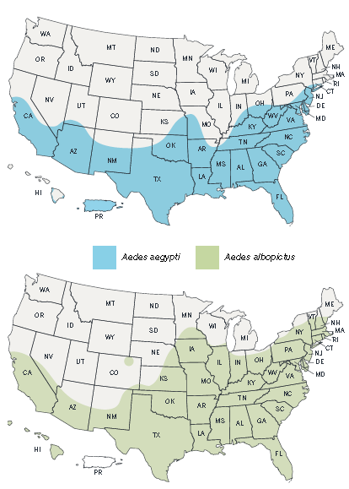
Mosquitos
Aedes aegypti mosquitoes are
more likely to spread viruses
than other types of mosquitoes such as Aedes albopictus mosquitoes.
Zika
Dengue
* Maps are not meant to represent risk for spread of disease.

Slide 9
Stakeholder Determination
Which Departments/Agencies are included in the Illicit Discharge Detection and Elimination dispatch and service requests?
Which City Agencies are under State orders to save water?
Which City Agencies and Contractors perform mobile washing?
Which City Agencies and Contractors require mobile washing?
What are other possible stakeholders?

Slide 10
Illicit Discharge Detection & Elimination Dispatch and Service Requests
SFPUC
Sewer Operations
Water Conservation
Department of Public Works (DPW)
Department of Public Health
Restaurants
Mosquito Abatement and Vector Control
Code Enforcement Task Force
Elected Officials
City Attorney's Office

Slide 11


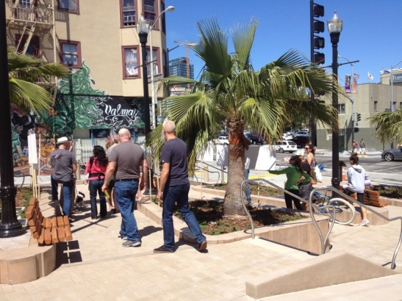
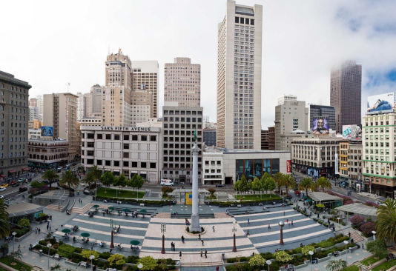
Which City Agencies and Contractors Perform Mobile Washing?
DPW
Recology – Contracted by DPW
Department of Real Estate – Contractors
Business Improvement District – Contractors

Slide 12

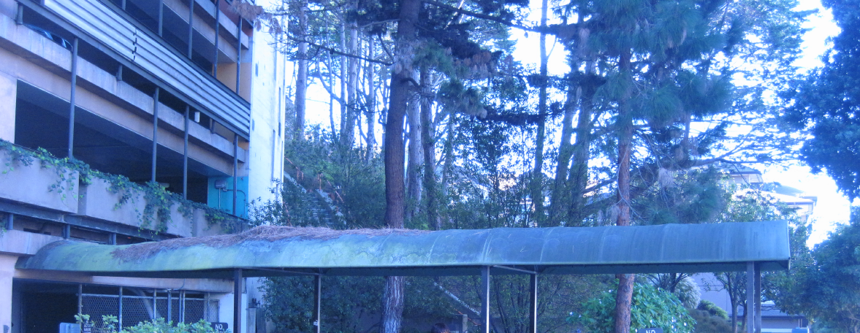
Which City Agencies and Contractors Require Mobile Washing?
Health Department
Sidewalks and awnings
Public Works
City streets

Slide 13
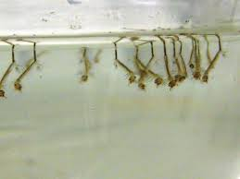
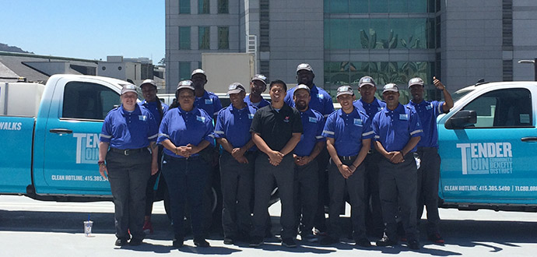
Missed Stakeholders
Mosquito Abatement
Mobile Washing Businesses
The Office of Economic and Workforce Development
Community Benefit Districts

Slide 14
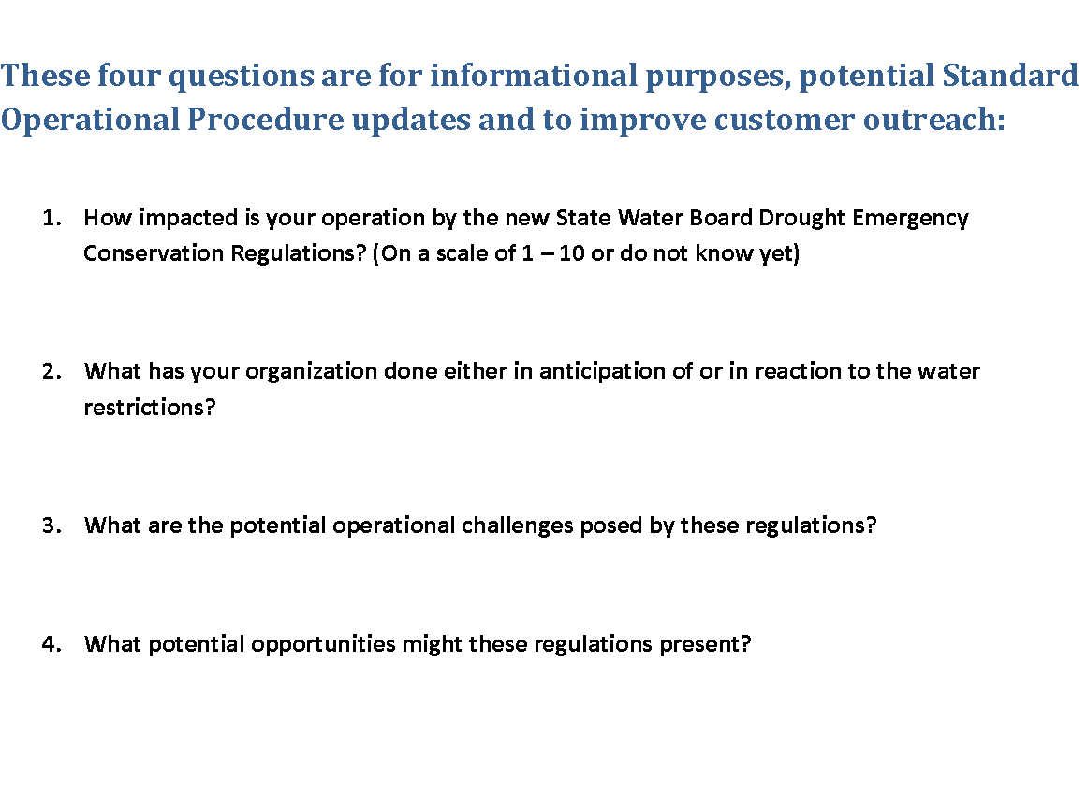
Stakeholder Survey

Slide 15
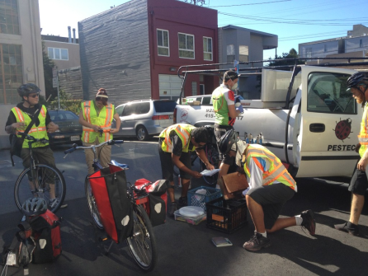
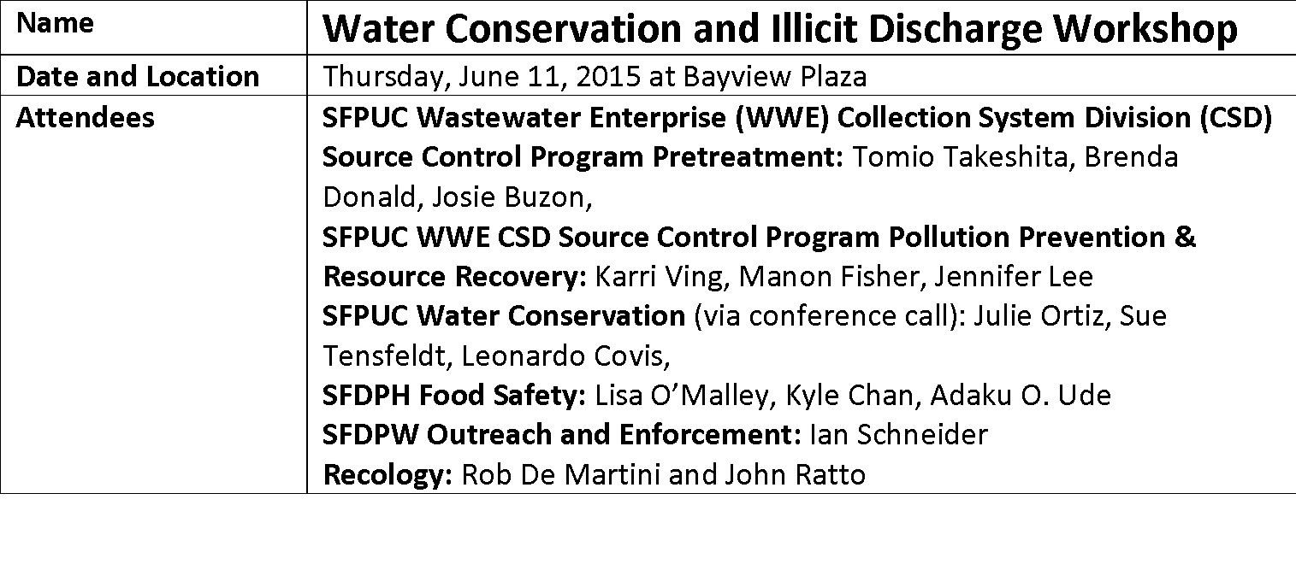
Invite all Stakeholders to a Workshop

Slide 16
Stakeholder Workshop
Need interdepartmental coordination of regulations and best practices for cleaning and discharge collection/disposal
SFPUC
SFDPW
Department of the Environment
SFDPH
Recology
SF Clean Streets Committee

Slide 17
City and State Regulations Wastewater
SFPUC Wastewater Enterprise has well established regulations:
“The requirements as described in Sections 118 – 140.7 of Chapter X (Public Works Code) of Part II of the San Francisco Municipal Code, Article 4.1 (hereinafter referred to as “Article 4.1”); “
From the State for stormwater:
“The Discharge Prohibitions and other applicable requirements as described in the State Water Resources Control Board Water Quality Order NO. 2013-0001-DWQ National Pollutant Discharge Elimination System (NPDES) NPDES General Permit CAS000004 WDRs for Storm Water Discharges from Small Municipal Separate Storm Sewer Systems ((hereinafter referred to as “MS4 Permit”); MS4 Permit”

Slide 18
Mobile Washer Permit and Application
The Application and General Permit are on the SFPUC Website
Individual ID numbers via the PIMS database.
Permit lists requirements, prohibitions and Best Management Practices for Mobile Washing.
Application questions include:
Type of equipment
Locations
Water use
Wastewater Treatment and Disposal

Slide 19
Administrative Staff Role
Assisted Management By:
Mailing letters to businesses informing them about the Mobile Washer Program.
Entering Mobile Washer Application into PIMS.
Scanning applications and uploading the documents onto SharePoint.

Slide 20
Citizen Water Sleuths get Results!
May 2015 311 water waste reports ≈ several a week
“…hosing down all kinds of things outside in back of building every night from about 1am to sun light when they stop so not to be noticed. they run the hose for hours nonstop.”
"RE: wasting water. The building is being painted and something was spilled into the street and they have been power washing the street for the past 2 hours. They started around 2:30pm today, 6/2/15, non stop. They are wasting a ton of water. The street is still a mess.”

Slide 21
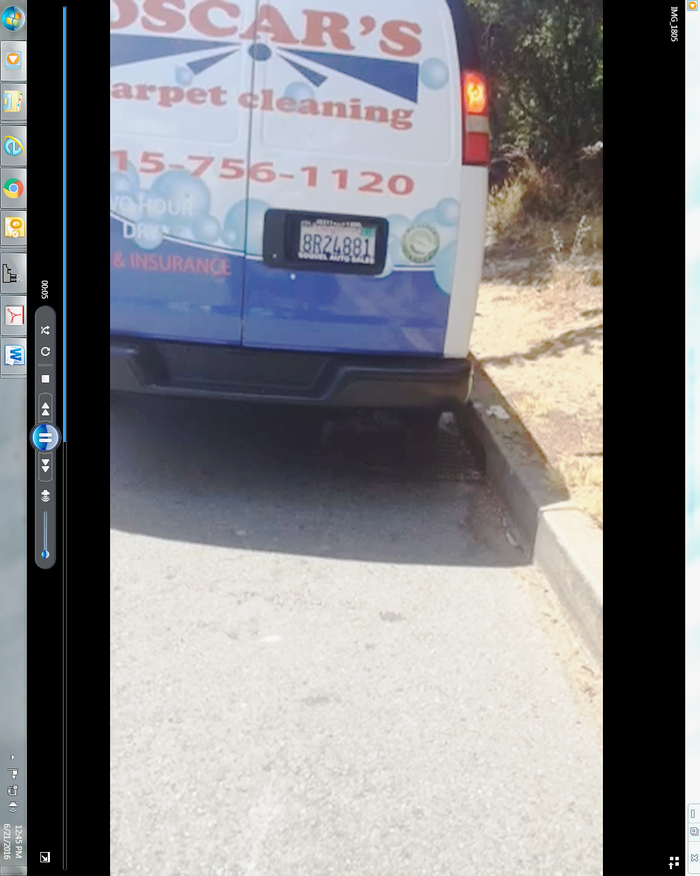
Water Waste Warriors
Video submitted via 311
Customized Van
Issued CDO
Permitted Business

Slide 22
Fewer Reports and 311 Update
Over about a year the 311 reports dwindled to a few every two weeks
311 started in 2008, has matured and continues to evolve!
“I've been meaning to file a complaint about our building as I see the maintenance staff washing down the sidewalk almost every morning when I come to work (6:30am), even if it doesn't need it. I've mentioned to the person that's doing it that we're still in the middle of a severe drought, but the reply is always that they're just "doing their job," etc.”

Slide 23
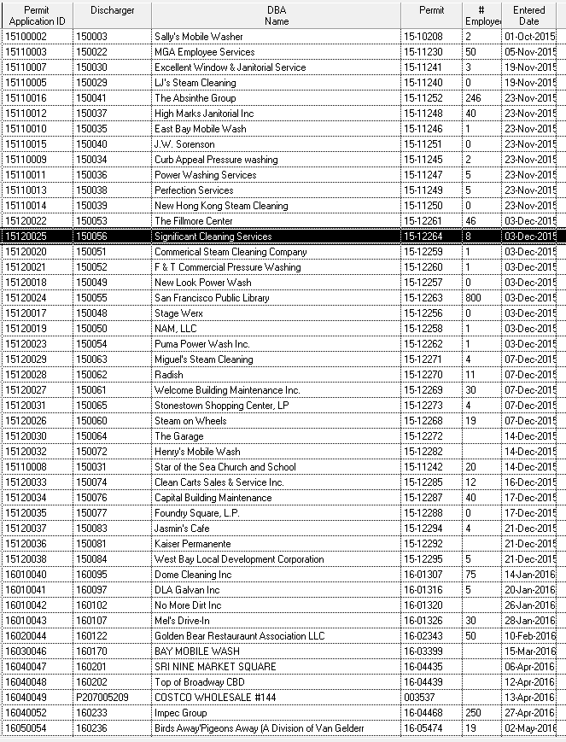
Marketing Tools-Permittee List
A mixed group
Sort the small business owners
Send a list to DPW for distribution to merchants requiring these services

Slide 24
Marketing Tools
Brochure and stickers
Logo for equipment
Hand-outs for customers

Slide 25
Business Response
99.5% positive
Adds to the business reputation
Free
Office visits to assist with paperwork

Slide 26
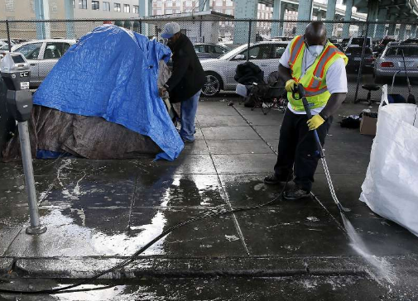
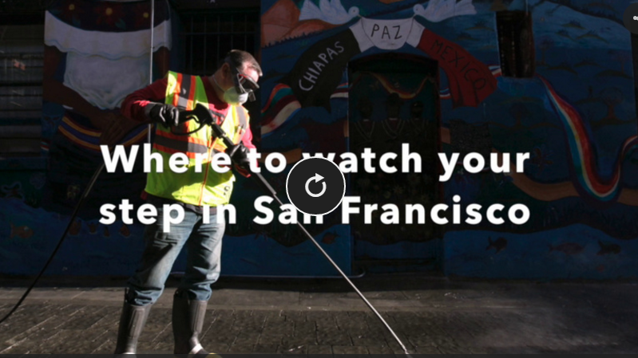
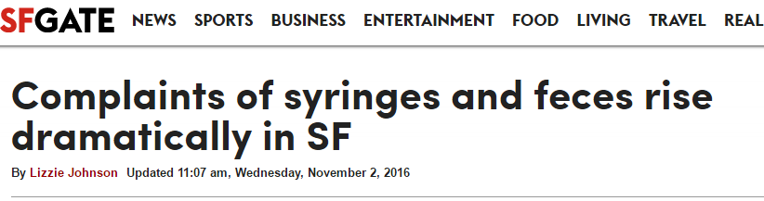
November 2016 Challenges

Slide 27
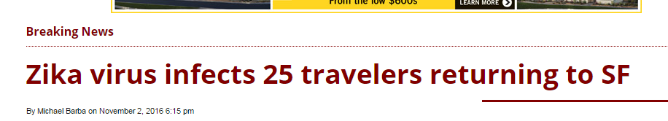
November 2016 Challenges
The first case of the Zika virus in The City was reported March 3, the San Francisco Examiner previously reported.

Slide 28
Lessons Learned
Keep engaged with other departments
The mobile business model not tied to infrastructure is a challenge
Food trucks and ride-sharing

Slide 29
Lessons Learned
The Program:
Primarily outreach with 311 driven enforcement
Protects infrastructure “Free Ridership” and receiving Waters
Protects mosquito abatement dosing
Helps keep the City in compliance with state restrictions

Slide 30
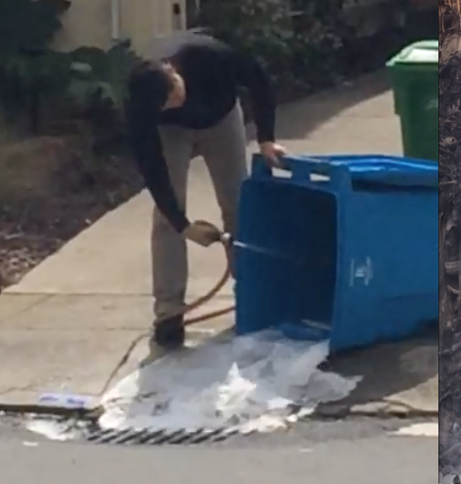
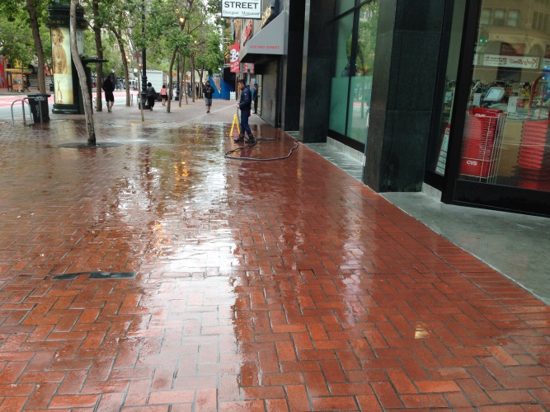
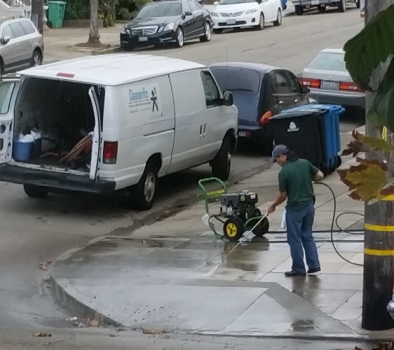
Mobile Washer Program
SFPUC Water Conservation Role:
Reports that involve sidewalk washing are sent to the Wastewater Pretreatment team for additional outreach

Slide 31
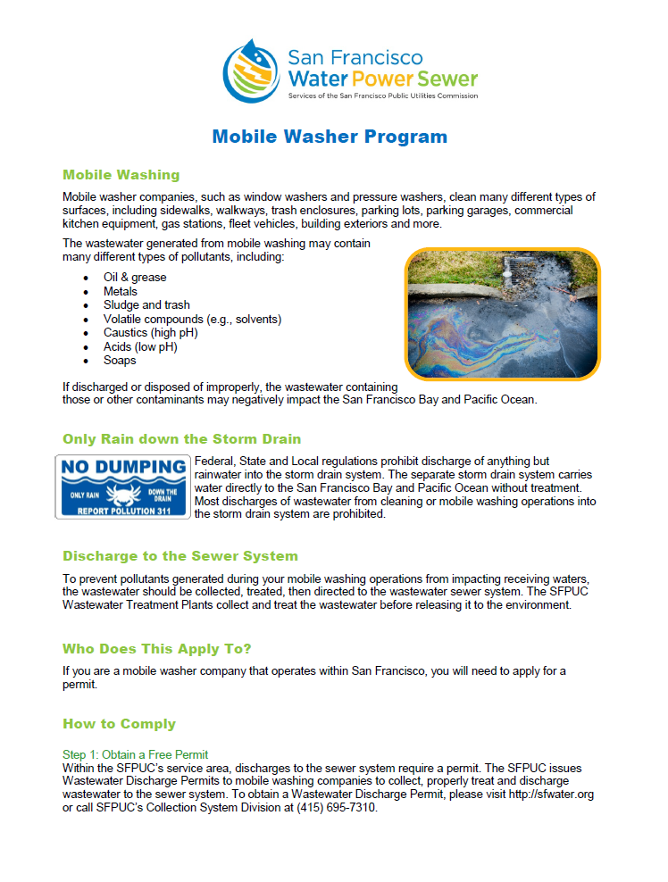
Mobile Washer Program
Successful
Renewal in 2020

Slide 32
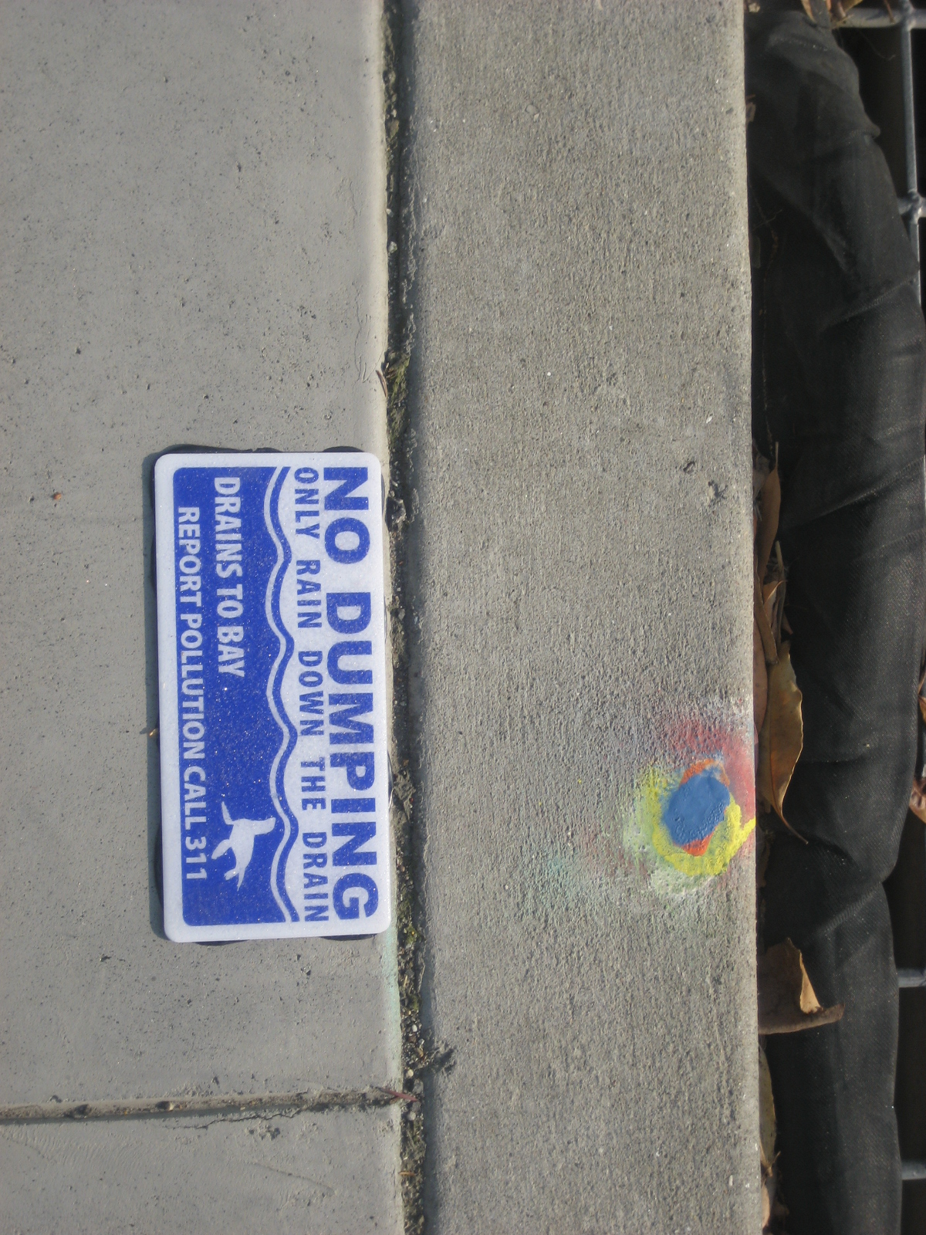
Thank you!
acleave@sfwater.org
(415) 695-7336

