Slide 1
Review of 2020 SFEI Pubs:
BACWA Advocacy
Mike Connor & Chris Werme

Slide 2
SF Bay Primary Production
Limiting Factors
Light
Grazing
Nutrients
  Is there a problem now?
  Future scenarios

Slide 3
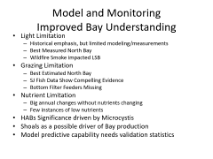
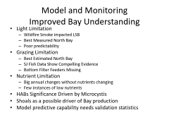
Model and Monitoring
Improved Bay Understanding
Light Limitation
  Historical emphasis, but limited modeling/measurements
  Best Measured North Bay
  Wildfire Smoke impacted LSB
Grazing Limitation
  Best Estimated North Bay
  SJ Fish Data Show Compelling Evidence
  Bottom Filter Feeders Missing
Nutrient Limitation
  Big annual changes without nutrients changing
  Few instances of low nutrients
HABs Significance driven by Microcystis
Shoals as a possible driver of Bay production
Model predictive capability needs validation statistics

Slide 4
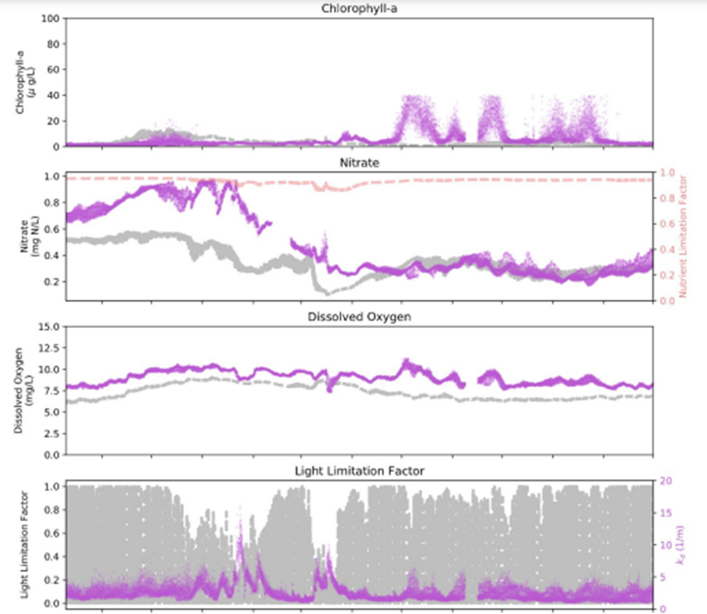
North Bay Light Drives vs DIN
(data in purple: model gray)

Slide 5
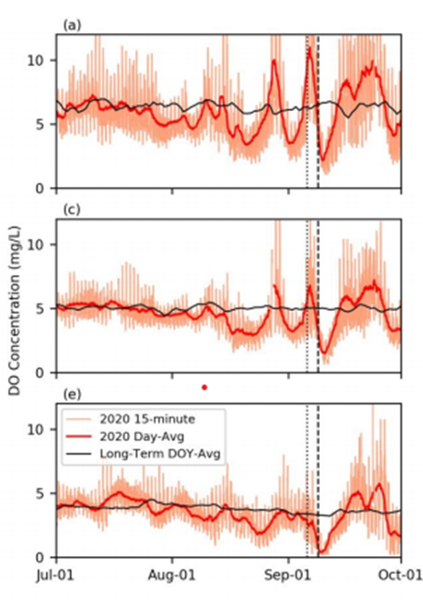
Wildfire Smoke DO Decline
Pond A8, Alviso, Guadelupe

Slide 6
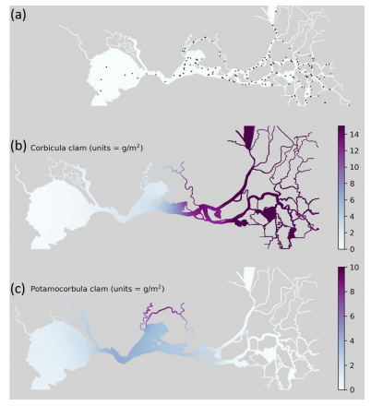
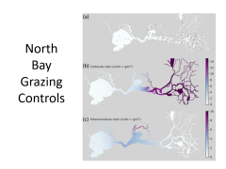
North Bay Grazing Controls

Slide 7
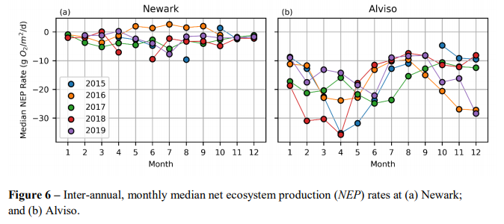
Big Interannual variability
Net Environmental Productivity (O₂)

Slide 8
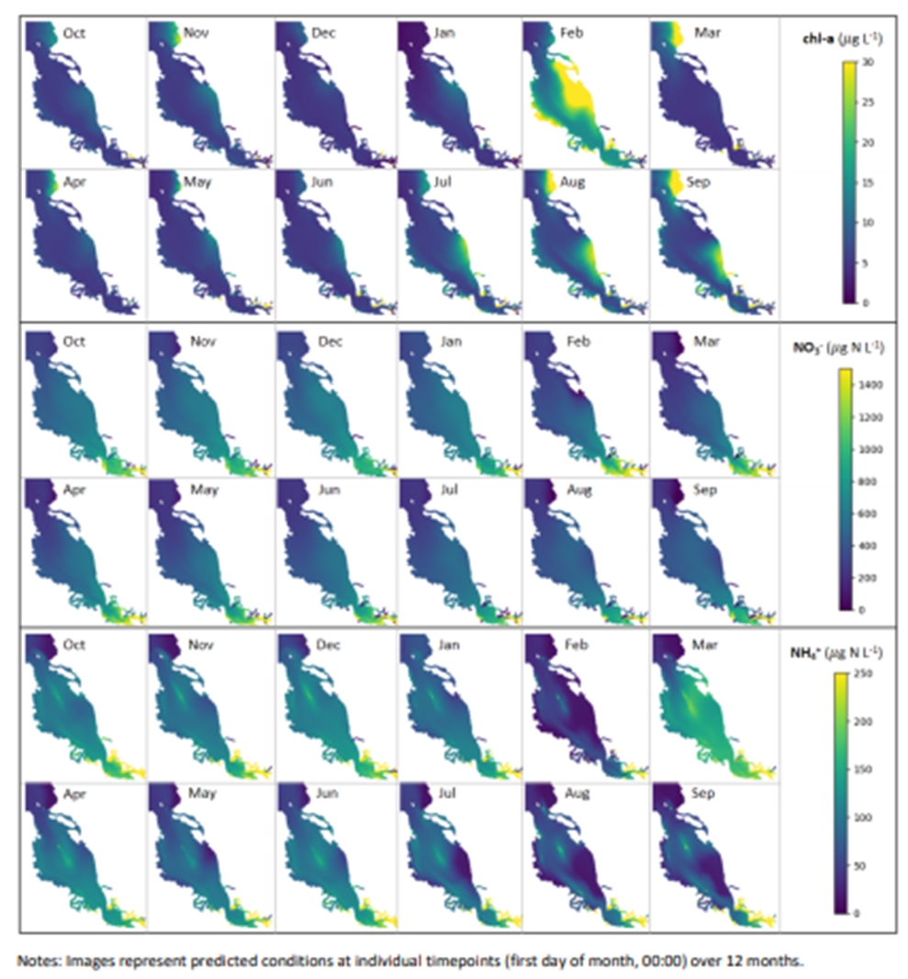
Model Shows Shoal Importance

Slide 9
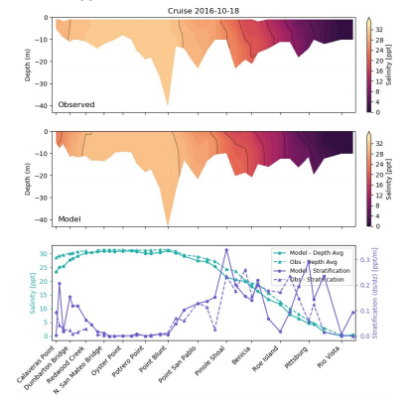
What Are Reasonable Model Expectations?

Slide 10
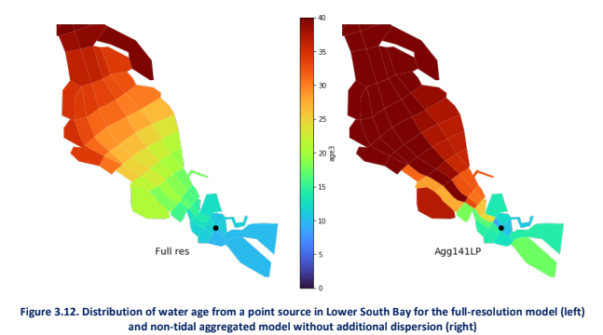
Water Quality Simplifications
(days Residence Time)

Slide 11
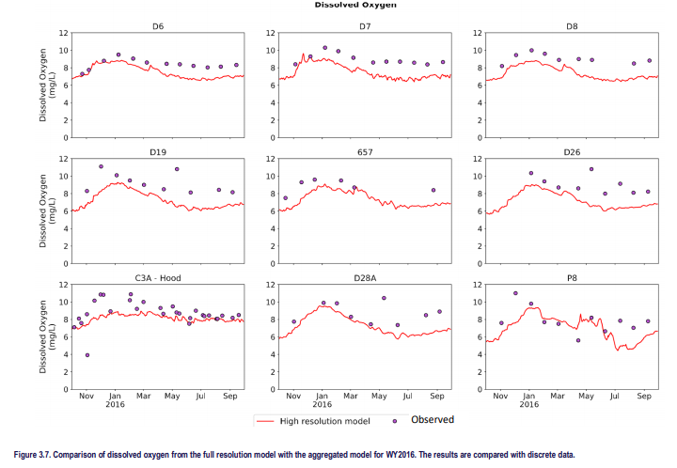
Validation Stats Needed for WQ Model
(North Bay comparison)

Slide 12
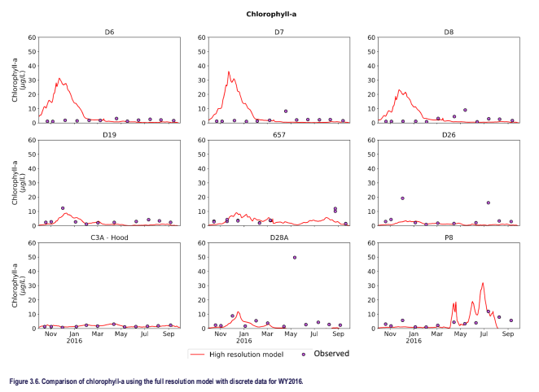
Good Model Performance?
Events vs Avg. (NBay chl)

Slide 13
Other Uncertainties?
Assessment Framework
  HABs
  Seasonal impacts of nutrients?
  Nutrient Concentrations vs Loads
External Drivers Assumptions Worst Case
  La Nina
  Freshwater Flow variation
Suspended Sediment Future Assumptions
  Sea Level Rise
Export of Nitrogen Causing Coastal Problems?

Slide 14
BACWA NTT Recommendations
RB2 /SFEI itemized, realistic timetable of specific science needs
Independent peer review panel of the model
Quantitative measures of model reliability.
Quantitative comparisons light limitation, grazing, nutrient limitation
Re-think monitoring design and modeling links.
Link “green engineering” solutions grazing, light, and denitrification controls of eutrophication impacts.

Slide 15
Possible Priorities
Clear Link to Permit Decisions
  Timing
  Predictive model outcomes
No Net Loading a Problem?
  Changes Model Strategic Use
  Contingency Strategy Based on Trends
Integrated strategies
  Green infrastructure
  Other stakeholder groups

Slide 16
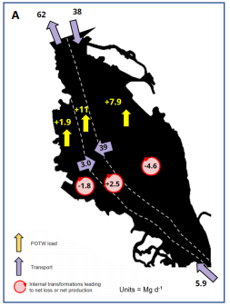
Shoal Impact on DIN Mass BAlance

Slide 17
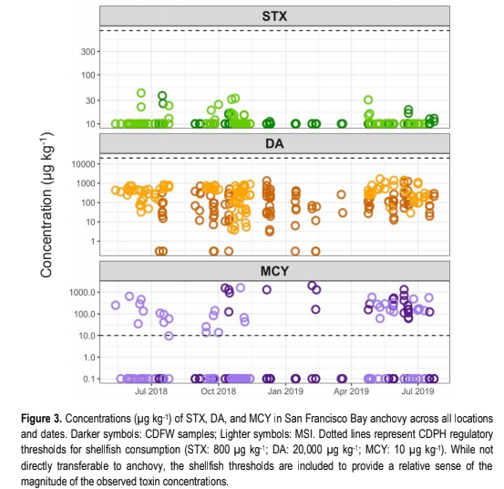
HABS Driven By Microcystis

Slide 18
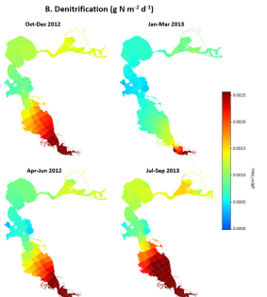
Denitrification’s dominant role

Slide 19
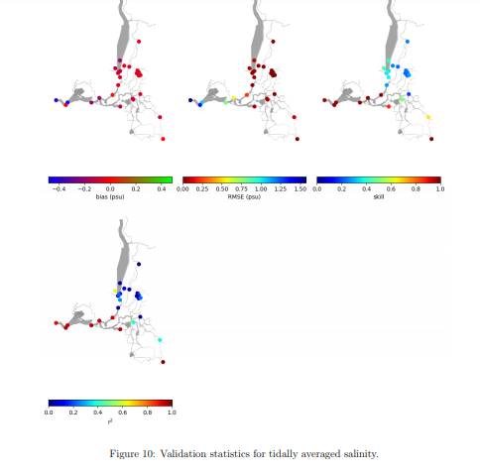
SFEI Uses Validation Statistics for Circulation Models

