Slide 1
Santa Rosa’s PFAS Sampling and Results
Robert C. Wilson
City of Santa Rosa
October 6, 2021

Slide 2
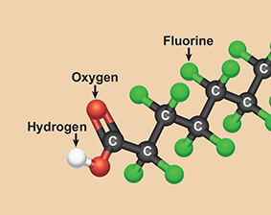
PFAS Background Inforamtion
What are Per and Polyfluorinated Substances (PFAS) and why are they in use?

Slide 3

What are they?
Human made chemicals that are used un manufacturing from various industries around the globe since the 1940s.
Used in
Food containers
Commercial household products
Electronics
Carpet
Paint, sealants, and varnishes
Personal Care Products
Firefighting foams

Slide 4

Why are they used?
The group of chemicals are used to make coatings and products that resist heat, oil, stains, grease, and water.
Some of the congeners are used and studied more than others.

Slide 5

In the media

Slide 6

ORDER WQ 2020-0015-DWQ
Signed July 9th, 2020
Required
Complete questionnaire
Conduct sampling and analysis for PFAS
Report data within 30 days of receiving the analytical report
Submit report summarizing data no later than 60 days following the receipt of the last analytical report

Slide 7
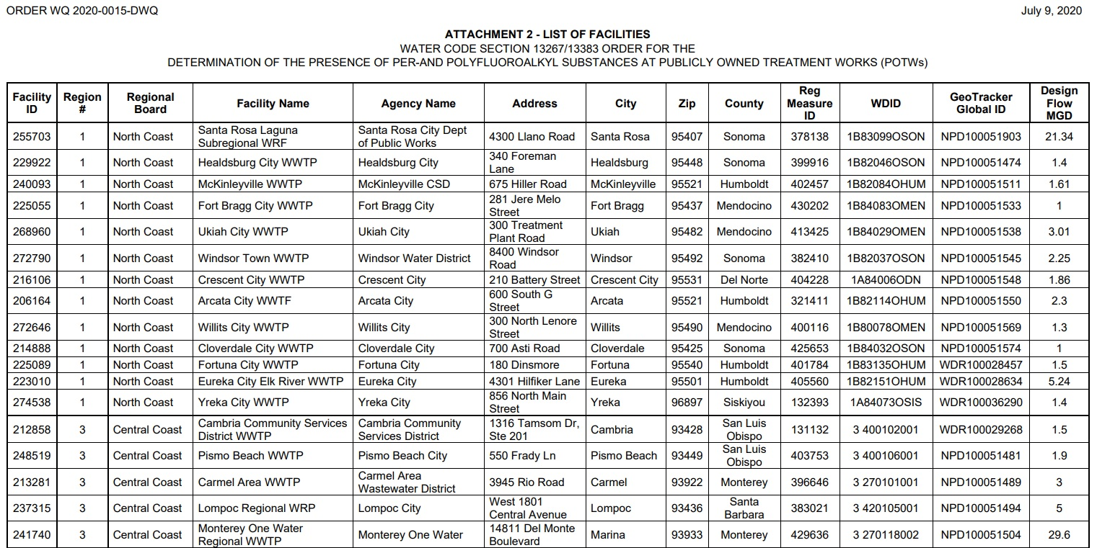


Slide 8
Preparation

Slide 9
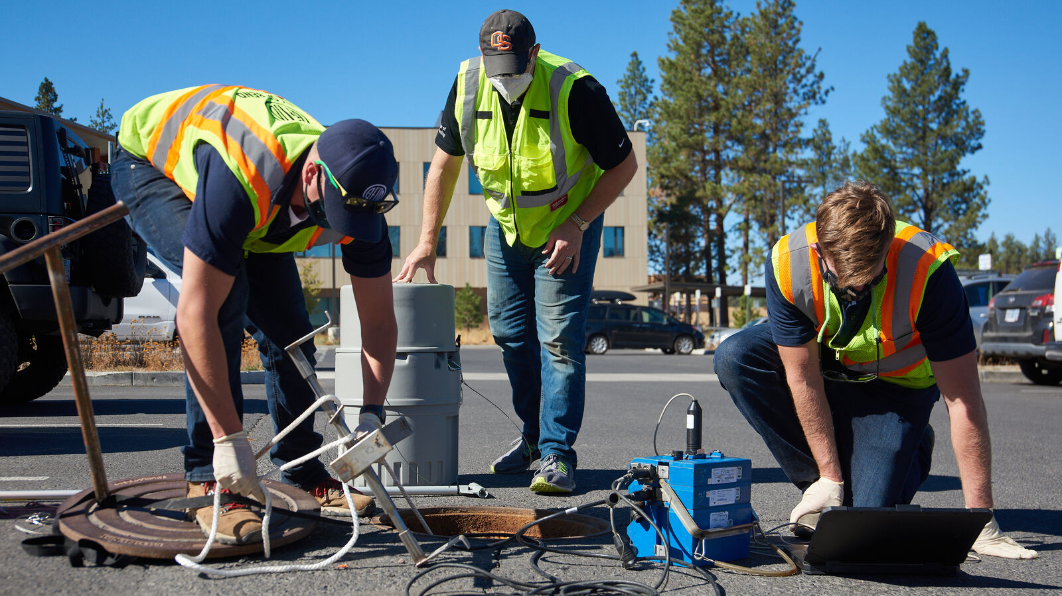
Preparation
The City of Santa Rosa worked with Larry Walker and Associates to develop a sampling plan
Draft plan was submitted to the RWQCB for review
Addressed
Separate spaces where only certain event activates will take place
Eating, Staging, and Sampling
Prohibited materials
Water/stain/dirt resistant clothing
Clothes recently washed with Fabric softeners
Clothes chemically treated for insect repellant or UV Protection
New unwashed clothing
First-aid adhesive wrappers.

Slide 10
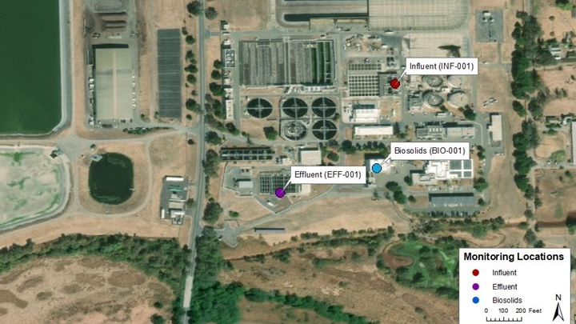

Slide 11
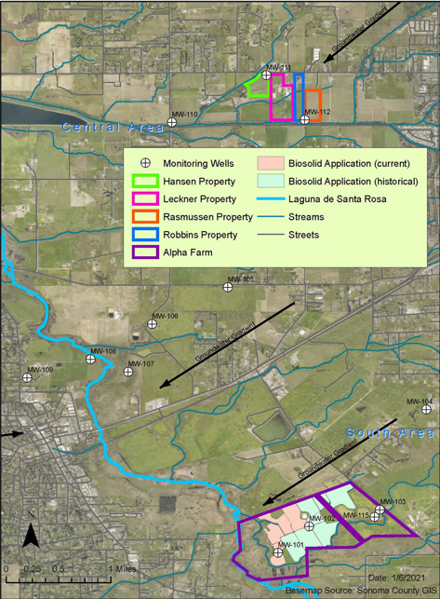

Slide 12
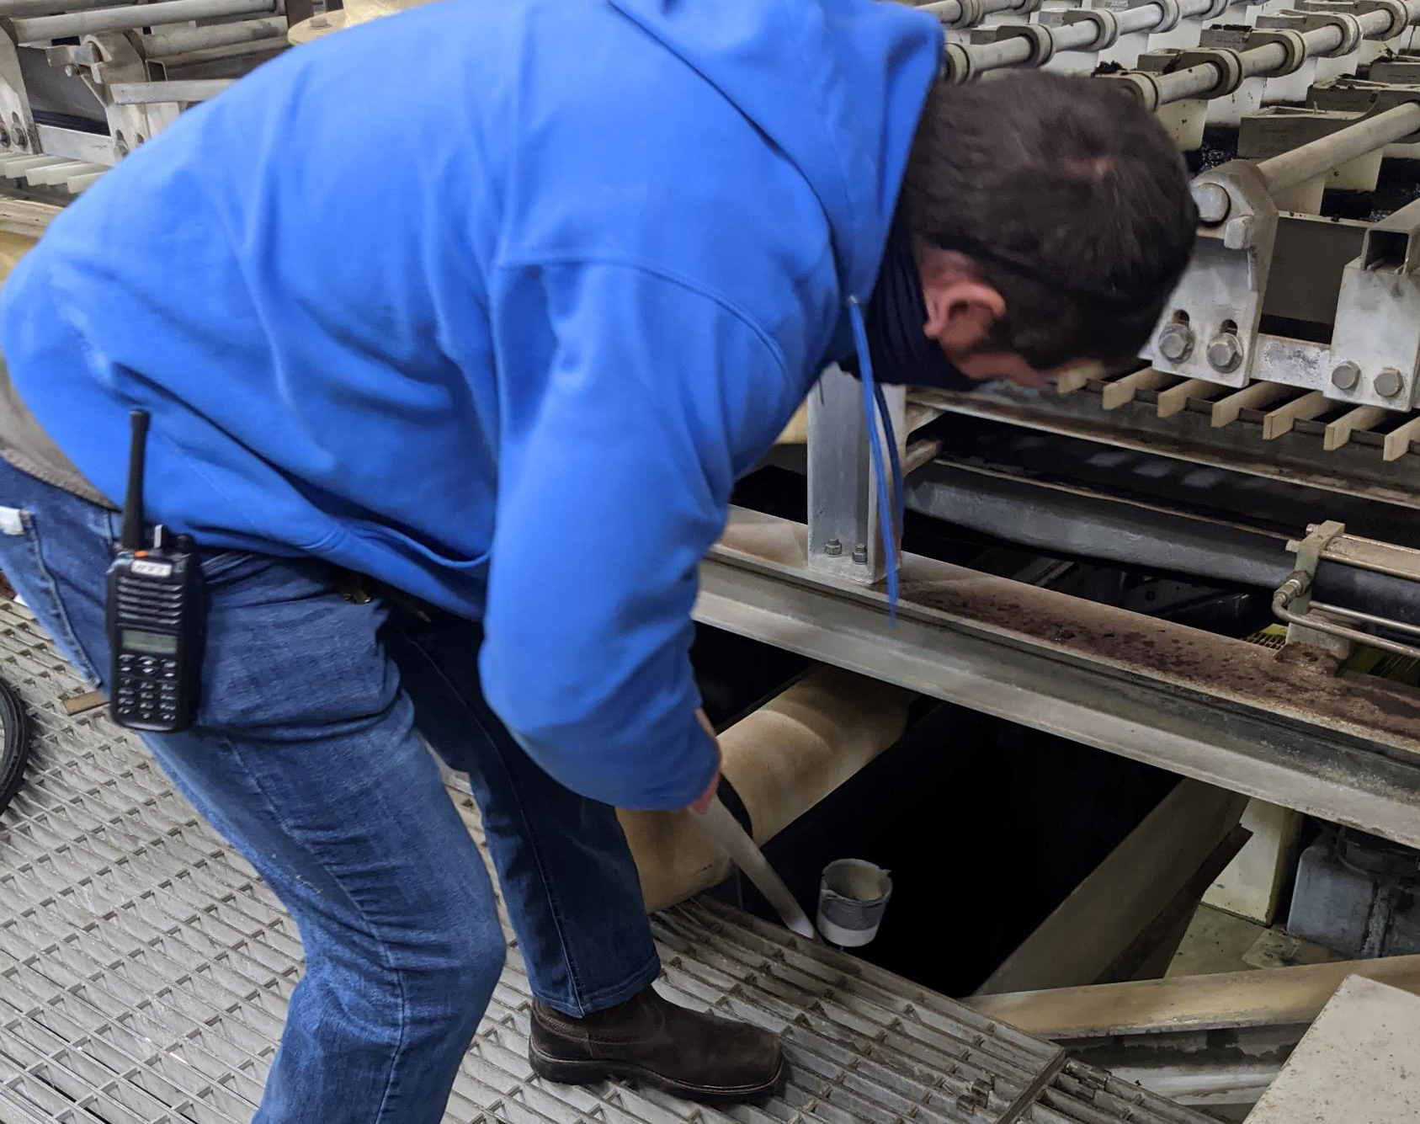
Preparation (Continued)

Slide 13
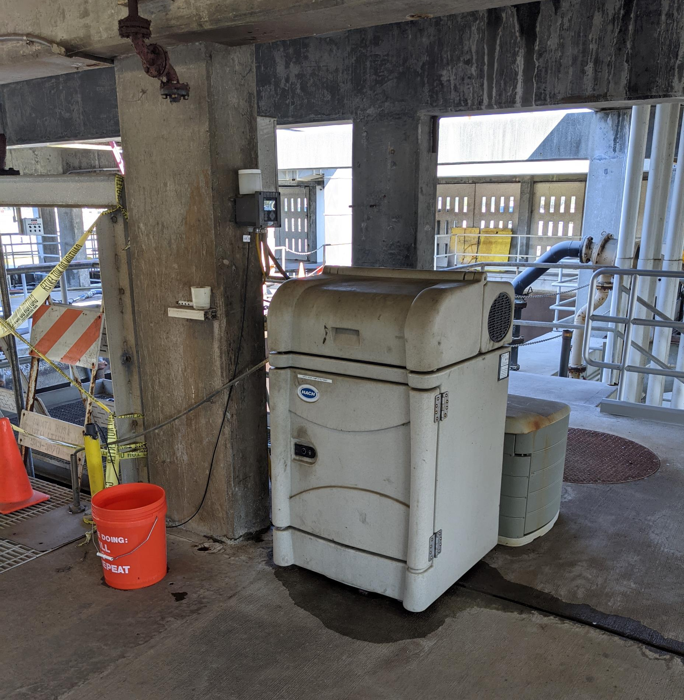
Influent Sampler

Slide 14
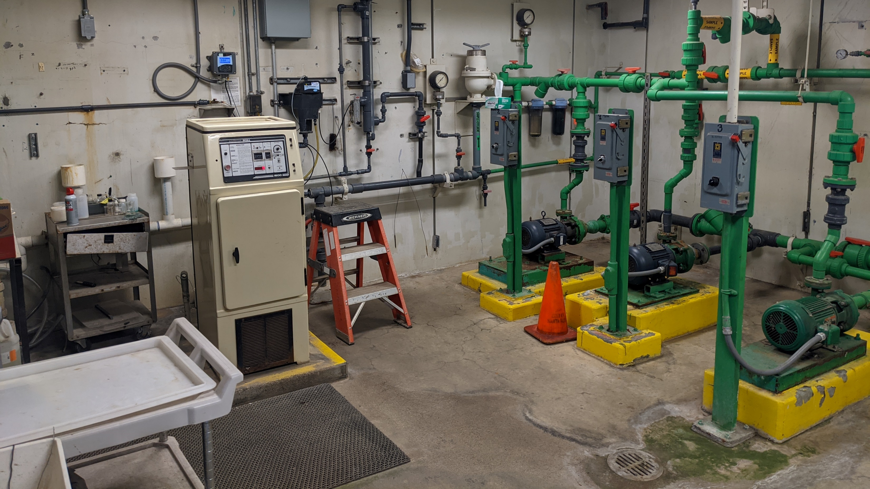
Effluent Sampler

Slide 15
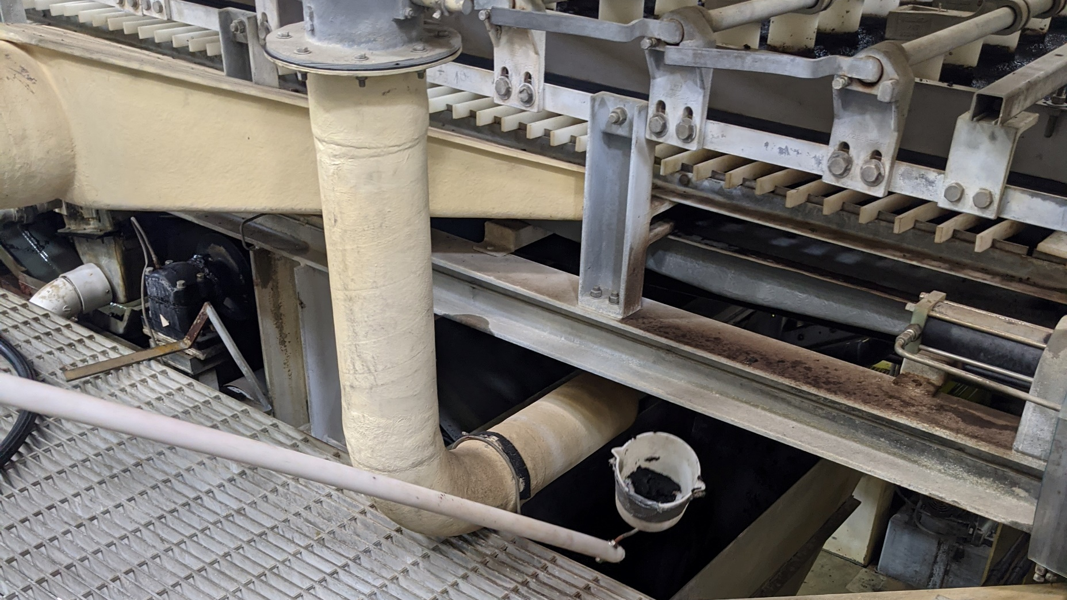
Original Biosolids Sample Cup

Slide 16
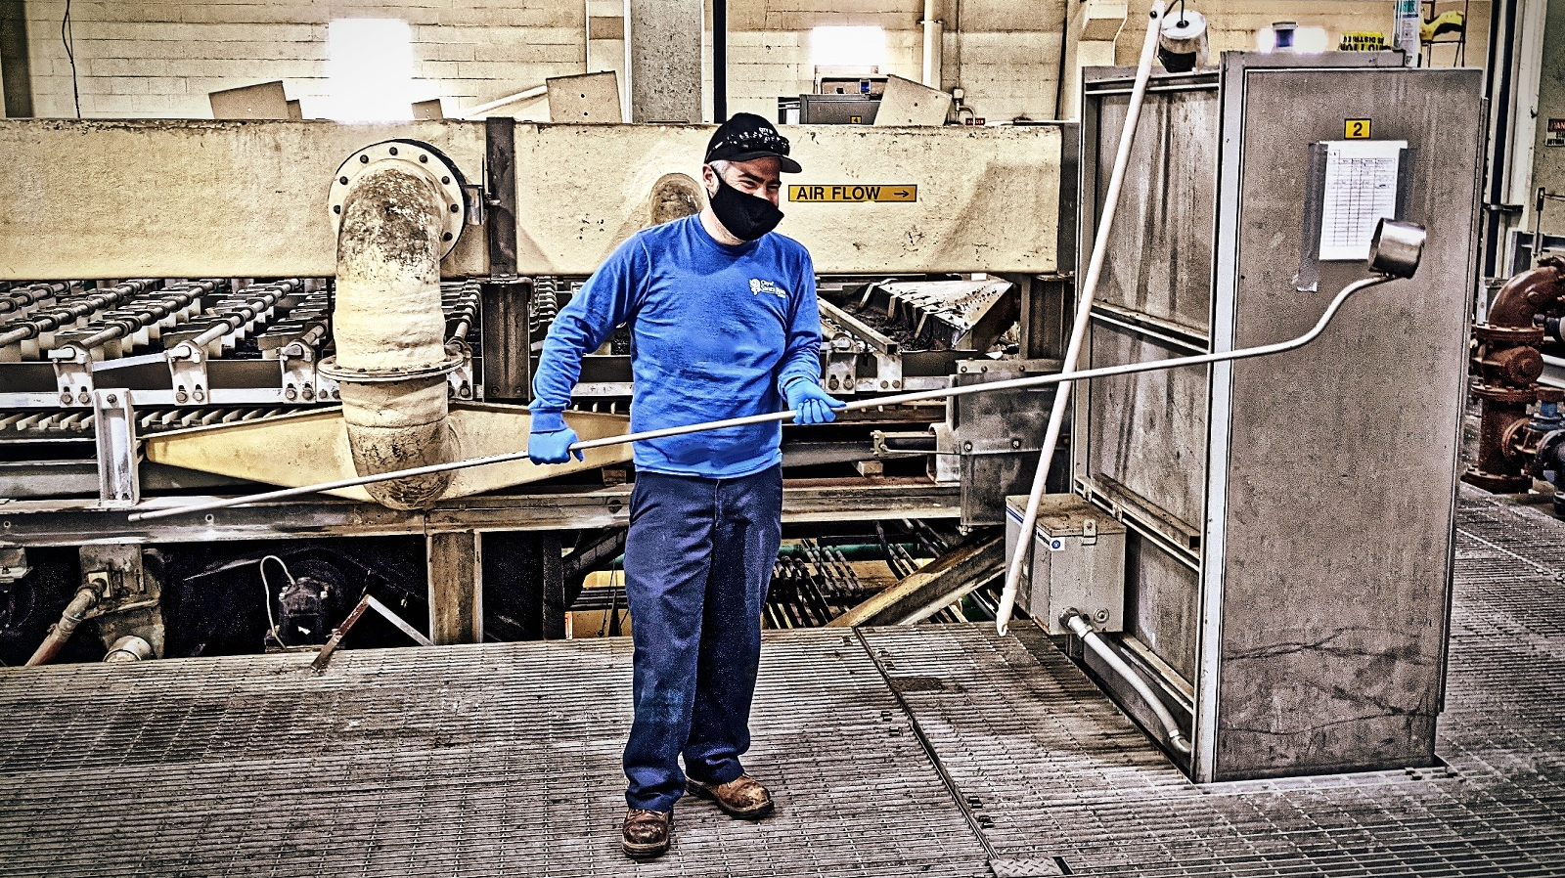
Replacement Biosolids Sample Cup

Slide 17
Results

Slide 18

So how did we do?
Worked with Vista laboratories (sub-contract) to analyze DI blanks to test equipment prior to sampling
Test blanks returned non-detect results
Required the shipment of blank water from Vista
Influent and Effluent first sampled November 2020 and Biosolids sampled December 2020
Blanks remained non-detect throughout the project

Slide 19
Influent Sample Data

Slide 20
Effluent Sample Data

Slide 21
Dewatered Biosolids Data

Slide 22
Biosolids Application Sites

Slide 24
Discussion
Understanding and making decisions from the data is challenging.
Influent had the most noticeable seasonal variation
As expected, the effluent had higher concentration compared to the influent
No Total Organic Precursors (TOPs) on data set
Results for the downgradient wells show higher levels of PFAS
The City is looking into the data and additional sampling to further the discussion.
We are careful to interpret this data to suggest that biosolids lead to increased PFAS concentrations in groundwater.

Slide 25
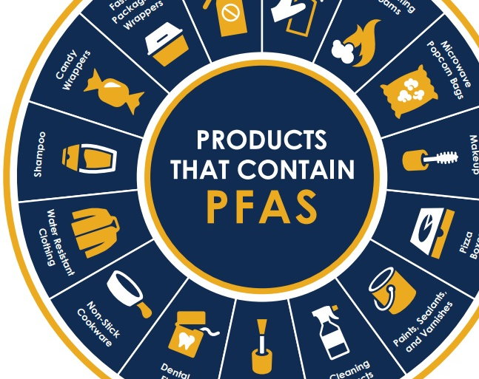
Questions?

