Slide 1

Pretreatment Committee Update
June 2, 2022

Slide 2
a. Blanket NPDES Permit Amendment for Monitoring and Reporting Programs
Background
2016 Order Needed Replacement
Order R2-2016-0008 Alternate Monitoring and Reporting Requirements for Municipal Wastewater Dischargers for the Purpose of Adding Support to the San Francisco Bay Regional Monitoring Program (RMP)
Opt-In by paying for RMP studies
Pretreatment: Reduced VOC & BNA (EPA 624/625) Monitoring in Effluent
In 2020 and 2021, BACWA Lab, Permits, and Pretreatment Committees worked to develop an updated version of the 2016 Order
Notes:
Back in 2016, the Regional Water Board adopted an order called the Alternate Monitoring and Reporting Requirements, which allowed dischargers to drop certain monitoring requirements if they also paid a supplemental fee to the San Francisco Estuary Institute for funding the Regional Monitoring Program. In effect this allowed individual plants to drop certain types of monitoring, but it provided for better regional monitoring of Constituents of emerging concern. For pretreatment programs, the main impact was that it reduced VOC and BNA monitoring requirements in plant effluent.
The way that the 2016 program was structured it was highly dependent on the toxicity monitoring requirements for funding, and due to new state requirements for toxicity testing, the program needed to be restructured. So, in 2020 and 2021, BACWA committees worked to develop a proposal to replace the 2016 order.

Slide 3
a. Blanket NPDES Permit Amendment for Monitoring and Reporting Programs
2021 Update
Pretreatment Committee assisted with reviewing the draft order
R2-2021-0028 was adopted in November 2021
Effective date was January 1, 2022
Permit amendment, not an opt-in program
Monitoring and Reporting Program Changes
Continues VOC and BNA effluent monitoring reductions from 2016 Order
Modifies VOC and BNA influent monitoring frequency for some dischargers (14 reduced, 2 increased)
Modifies VOC and BNA biosolids monitoring frequency for some dischargers (11 reduced, 3 increased)
Reduces influent and effluent mercury monitoring
Notes:
In 2021 the Regional Water Board issued a draft version of the replacement order, and this committee assisted with reviewing it. The order was adopted in November and it went into effect back in January. Unlike the previous 2016 order, this one was rolled out as a permit amendment rather than an opt-in program.
The new order continues to reduce the VOC and BNA monitoring frequencies in effluent. In addition, the VOC and BNA monitoring frequencies in influent and in biosolids were reduced for most agencies with pretreatment programs. The order also reduced influent and effluent mercury monitoring frequencies. The effluent monitoring is tied to the regional mercury and PCBs watershed permit rather than being tied to pretreatment program requirements. Influent monitoring of mercury is a pretreatment program monitoring requirement.

Slide 4
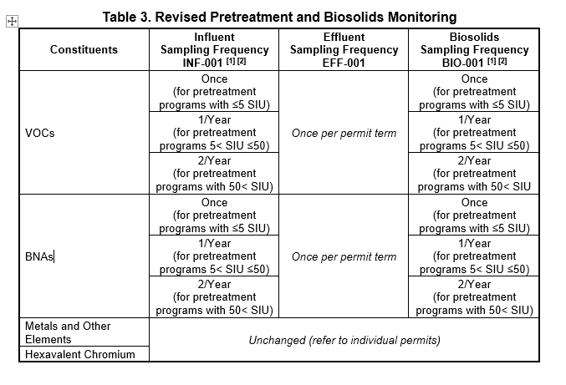
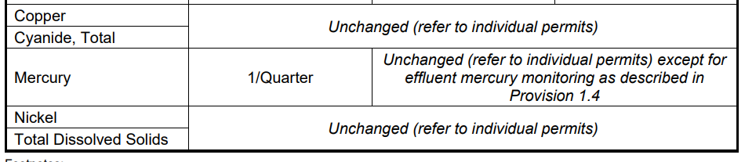
a. Blanket NPDES Permit Amendment for Monitoring and Reporting Programs
Summary
Your required influent, effluent, and biosolids monitoring frequencies have changed! Check out R2-2021-0028
If you have any questions, ask Mary (mcousins@bacwa.org)
Notes:
To summarize, your required pretreatment program monitoring frequencies have likely changed as a result of this order, so please check it out
There is a link to the new order in the agenda
(Optional – put this link in the Zoom chat)
https://www.waterboards.ca.gov/sanfranciscobay/board_decisions/adopted_orders/2021/R2-2021-0028.pdf

Slide 5

b. PFAS Regional Study
Excerpts from

Slide 6


BACWA Hot Topics
PFAS Study:
Phase 1 Results and Phase 2 Goals
Diana Lin and Miguel Mendez
BACWA Annual Meeting
May 6, 2022

Slide 7


SWB requires PFAS sampling in California
State Water Board has issued 13267/13383 Orders to:
Drinking water systems (& drinking water near military facilities
Airports and Landfills
Chrome platers
Bulk fuel terminals/refineries
POTWs: 4x influent, effluent, and biosolids ⇒ except in Region 2

Slide 8

Regional Monitoring Program (RMP)
Partnership to monitor the health of San Francisco Bay in support of management decisions
Stakeholders
Government
Scientists
Implemented by
Notes:
We wanted to leverage the experience and framework we have developed through the Regional Monitoring Program for the SF Bay.
The RMP is a partnership among stakeholders including all of our regional POTWs, government including our regional and state Water board, and independent scientists, like myself to collaboratively conduct the monitoring and science needed to ensure the health of the Bay. And through the last 30 years, we’ve developed one of the leading monitoring programs for emerging contaminants in the world.
All key decisions for the program are determined by by committee.

Slide 9





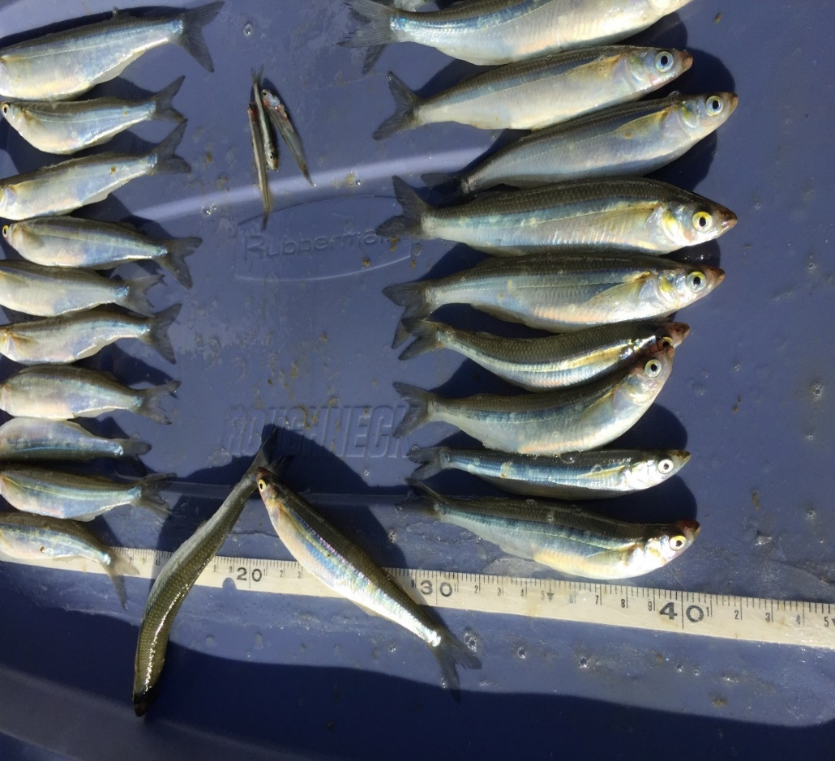
Monitoring San Francisco Bay
Water
Sediment
Bivalves
Fish
Bird Eggs
Mammals
Notes:
We have been monitoring and investigating PFAS in Bay water, sediment, bivalves, fish, brid eggs, and mammals.

Slide 10
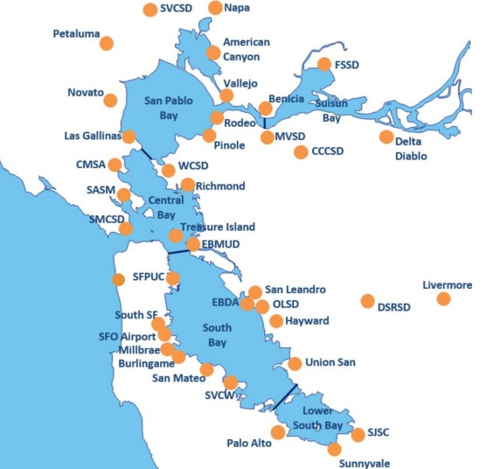
Advantages of R2/RMP Combined Study
Leverage RMP experience and inform region wide understanding
(Nearly) all effluent goes to the Bay
Develop study design that is efficient and informs management actions
Study design
QA/QC sample collection
Coordination with laboratory
Data QA
Data interpretation
Notes:
We proposed that we should leverage the resources and experiences of our RMP to conduct PFAS investigations in wastewater to address the SWB and RMP information needs.
This is particularly important for the SF Bay because almos all the effluent goes to the Bay, and generally not sources to drinking water, and therefore we should take a regional approach to understanding impacts.
By conducing a combined regional study, instead of one implemented by each facility we could implement a study more efficient. We would gain a lot of efficiency by designing the study regionally, coordinating needed QA/QC samples across the study, coordinate the with the laboratory, rigorously QA/QC the data, and interpret and report data results to inform management.
And most importantly, we could use the additional resources to carefully design and interpret the data, conduct more indepth investigations, to inform management.

Slide 11
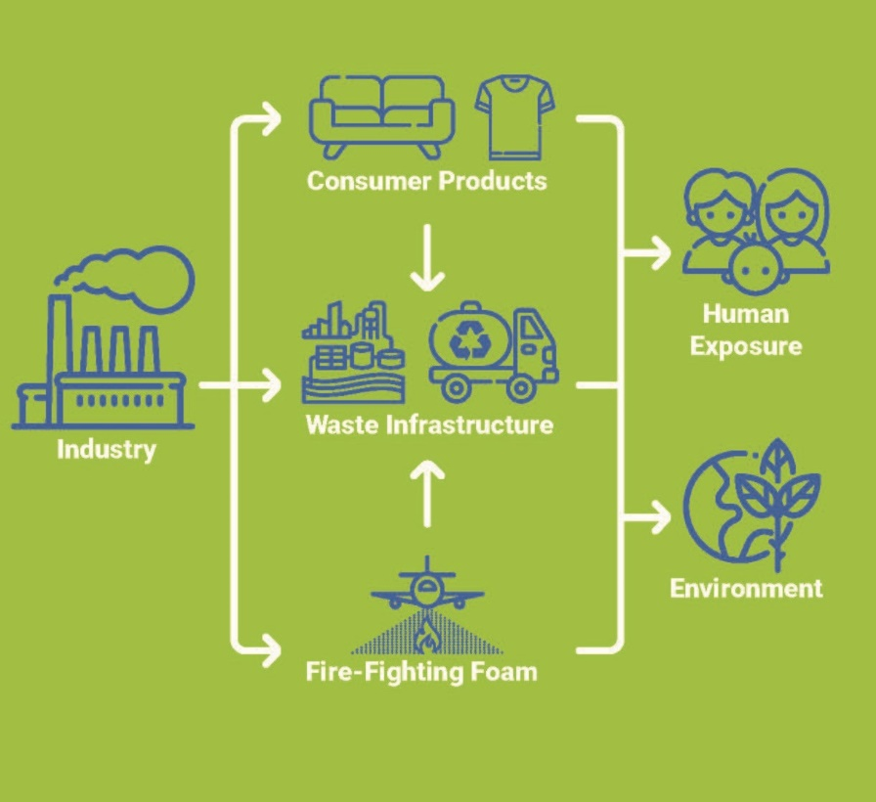
Why is the R2/RMP study important?
POTWs are PFAS receivers, not PFAS sources
POTWs have limited ability to control PFAS sources or destroy PFAS
We can use this study to better understand the sources, transport, and fate of PFAS to best target management actions and source control efforts
Image credit: CASA

Slide 12
Project Overview
Phase 1
Phase 2
Study design based on Statewide Investigation Order
Monitor representative subset of facilities in Q4 2020
Include additional analytes and analytical methods
Design study based on Phase 1 results
Conduct more in-depth investigations
in progress
Notes:
We planned the study as a two-phase approach.

Slide 13














Phase 1 Study Design: Sampling and Analysis
Monitor representative subset of facilities
Sample influent, effluent, biosolids at 15 facilities
Include diversity in size, service population, and treatment type
Apply Target PFAS method
40 PFAS compounds
Influent, effluent, biosolids, reverse osmosis concentrate
Apply Total Oxidizable Precursors (TOP) assay
Indirectly quantify PFAS precursors through oxidation of precursors to terminal PFAS
Influent, biosolids

Slide 14






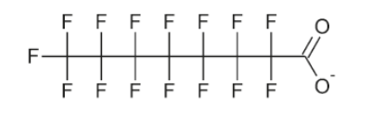
PFAS Analytical Methods
PFAS
TOP
(Total Oxidizable Precursors)
2
Target PFAS
1
PFOA
Perfluorooctanoic acid
Perfluorocarboxylates
(e.g. PFOA)
Notes:
PFAS includes a broad and diverse class of fluorinated compounds including thousands of possible chemical structures. These compounds are used in a wide variety of products shown here, and formulations continue to change.
PFOA and PFOS are long-chain fully fluorinated compounds that are the most.

Slide 15
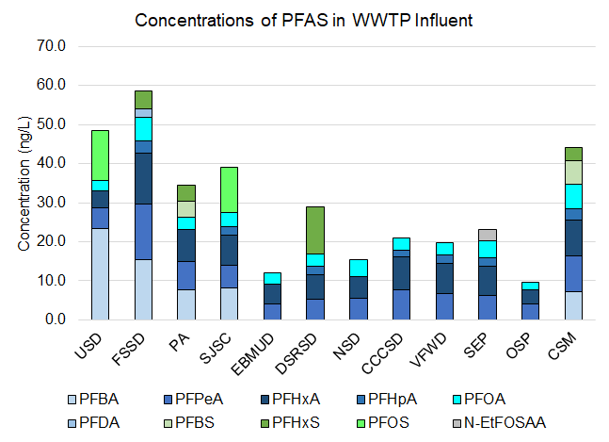
Influent Concentration (Target method)
Decreasing industrial flows
25%
No clear trend observed from industrial flows
25%
0%
6%
10%
6%
Median: 27 ng/L
2%
PFAS in municipal facilities generally comparable
4%
3%
5%
6%
1%

Slide 16
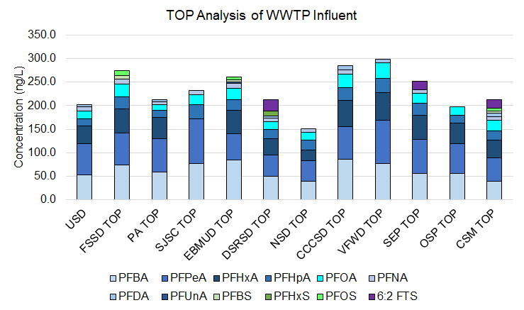
Influent Concentration (TOP method)
PFAS in municipal facilities generally comparable
TOP results indicate significant presence of precursors
Median = 231 ng/L
Influent Target Analysis Median = 27 ng/L

Slide 17
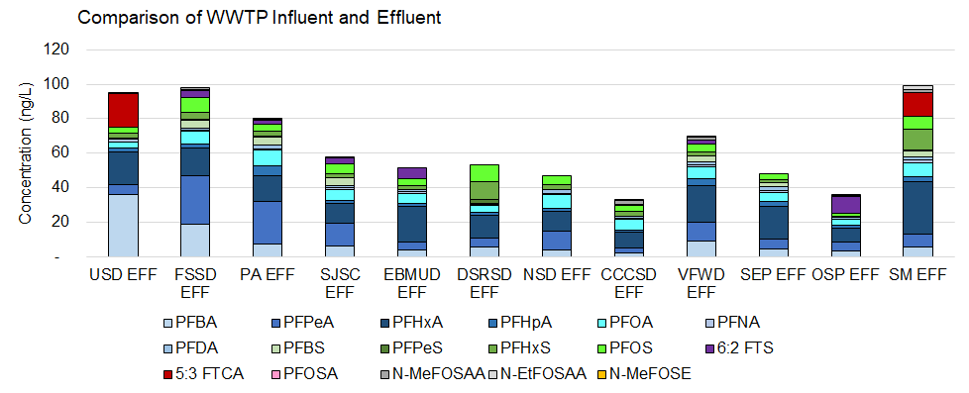
Effluent Concentration (Target method)
PFAS in municipal facilities generally comparable
Median = 58 ng/L
PFAS effluent concentration increase due to conversion of PFAS precursors
Notes:
Sum of PFAS in effluent concentration on average 2Xs greater than influent concentration
No clear trend in treatment efficiency for advanced tertiary treatment. Further evaluation needed.

Slide 18
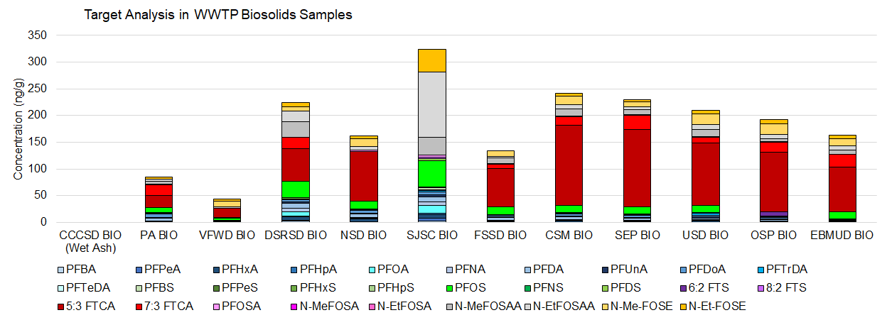
Biosolid Concentration (Target Method)
PFAS in municipal facilities generally comparable
Median: 178 ng/g
Notes:
Study question was whether we might seem significant variation in biosolid samples and whether our sampling was representative.

Slide 19
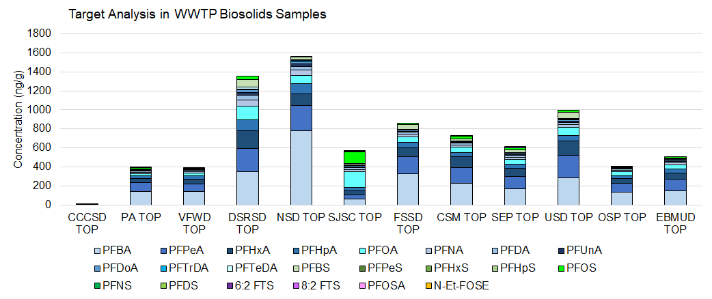
TOP results in Biosolids
TOP results indicate significant presence of PFAS precursors
Sum of target PFAS median was 178 ng/g
Median = 594 ng/g
Wet ash sample
Notes:
TOP analysis of Biosolid results also indicate significant presence of precursors. (sum of TOP about 3Xs higher than sum of target)

Slide 20
Main Takeaways from Phase 1
Sum of PFAS concentrations in municipal influent, effluent, and biosolids generally comparable for each matrix
Significant presence of unknown PFAS precursors in influent and biosolids
Gained experience
PFAS sample collection methods
Study design
QA/QC
Reporting to Geotracker

Slide 21
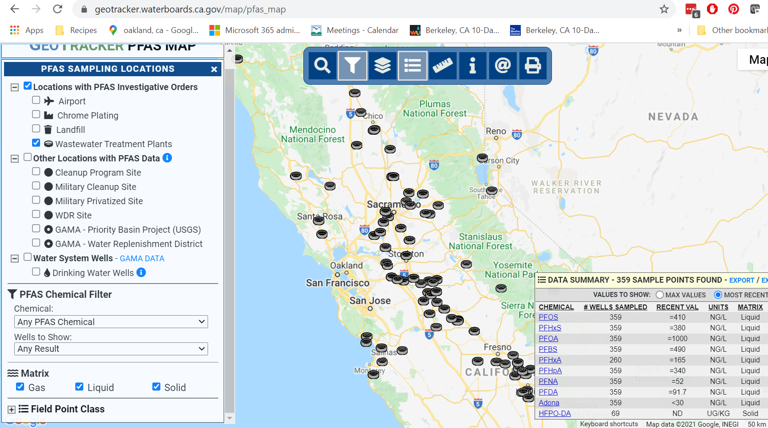
Reporting
SWB Geotracker database
Sampling and Analysis Plan
Monitoring Report, including QA/QC summary
Data
Technical report
Presentations:
>7 invited webinars/meetings
Model for collaborative, regional approach

Slide 22
Phase 2 Priority Study Questions to Inform Management of PFAS Entering Sewershed
Are residential flows an important source of PFAS?
Can specific industries (e.g., industrial laundry, food waste, semiconductor manufacturing) be identified as discharging higher than average concentrations of PFAS (including TOP) to POTWs?
Work with study participants to identify and prioritize upstream sewershed sampling locations.

Slide 23
Are residential flows an important source of PFAS to participating POTWs?
Sample diverse residential neighborhoods to screen for range of PFAS levels in residential wastewater
Includes single-family homes and multi-unit dwelling
Neighborhoods in diverse geographic locations
Sample during different dates to capture variation
Field blanks and duplicates (QA/QC) included
Results will be compared to average influent and industrial sources
14 residential neighborhoods included
Notes:
Sampling locations selected by you.

Slide 24
Can specific industries be identified as discharging higher than average concentrations of PFAS to POTWs?
Industrial laundry (6 facilities)
Manufacturing
Semiconductor/electronics (2 businesses)
Chemical (1 business)
Chrome reduction/chrome plating operations (3 facilities)
Hospital (4 sites)
Car wash (3 sites)
Military site/AFFF on-site (1 site)
Pulp paperboard (1 site)
Trucked food waste (combined from many businesses)
22 business operations included
Leverage ongoing compliance monitoring efforts
Notes:
We prioritized a number of industrial discharges that we could sample and analyze for PFAS. Our approach is meant to complement and not duplicate SWB investigation efforts, so we selected sites in coordination with State and Regional Water Board staff.
The types of industrial discharges that are being included are shown here. Where possible, we tried to include at least 3 sites of each type of industry shown here, but in some cases that was not possible. But results could inform larger state effort as well.
This was designed as a screening or exploration study of these industries (not representative for each industry). Results could highlight the need for further investigations.

Slide 25
PFAS Analytical Methods
PFAS
TOP
(Total Oxidizable Precursors)
2
3
Adsorbable Organofluorine Analysis
Additional sample collection at influent, effluent, biosolids (undigested and digested), groundwater
Target PFAS
1
Notes:
Samples currently being collected.

Slide 26
Adsorbable Organofluorine (AOF)
Sample adsorbed to activated carbon
Inorganic fluoride removed with nitrate
Analyzed via combustion ion chromatography (F-)
Advantage: may capture larger portion of PFAS present
Limitations
High detection limits
Low recovery of short-chain compounds
Includes F from non-PFAS including pesticides and pharmaceuticals
Included in limited scope for Phase 2
Influent and effluent
PFAS
TOP
(Total Oxidizable Precursors)
AOF
Target PFAS
Notes:
Currently collecting samples, and looking forward to analyzing data to sharing results.

Slide 27
Secondary study questions
How do TOP concentrations compare in influent, effluent, and biosolids from participating POTWs?
Are there significant amounts of adsorbable organofluorine in wastewater samples not captured by TOP?
AOF analysis in influent and effluent
How do biosolid digestion processes at POTWs affect the transformation and levels of measurable PFAS in biosolids
Compare target and TOP analysis in undigested to digested biosolids at 3 facilities
Evaluate potential PFAS transport from on-site biosolid disposal
3 sites at DSRSD
PFAS
TOP
(Total Oxidizable Precursors)
2
~460 Sample bottles
~230 Analytical samples
THANK YOU
AOF
3
Target PFAS
1
Notes:
Currently collecting samples, and looking forward to analyzing data to sharing results.

Slide 28
Project Timeline
2022
March – May: Sample Collection
September: SGS AXYS completes laboratory analysis
November: SFEI QA/QC data
2023:
February: Data analysis and interpretation; results reported to Geotracker
Feb – April: Results discussion
June: Draft Report
September: Final Report
Notes:
Currently collecting samples, and looking forward to analyzing data to sharing results.

Slide 29
Relevant RMP CEC Project Updates
Quarternary Ammonium Compounds in wastewater
Monitoring extended to 2024
Evaluate trends in wastewater due to expected increased use
Ethoxylated Surfactants
Additional wastewater sample collection proposed for 2023
Draft reports coming soon
Bisphenols in effluent and sediment
PFAS in Bay water
Sunscreen in effluent
Notes:
Currently collecting samples, and looking forward to analyzing data to sharing results.

Slide 30


Thank you
www.sfei.org/CECs
diana@sfei.org
Notes:
I’m really looking forward to interpreting and sharing results in the future.
I think this has been a very valuable and collaborative approach for conducting PFAS investigations. And we’ve had a lot of discussions and coordination with BACWA members and State and regional water board staff to implmenet this study. I hope this can be a model for taking a collaborative and proactive approach to gathering information to inform management decisions on priority contaminants

Slide 31
c. EPA Pretreatment Memo for PFAS
EPA has a PFAS Strategic Roadmap 2021-2024
https://www.epa.gov/system/files/documents/2021-10/pfas-roadmap_final-508.pdf
Leveraging pretreatment programs to reduce industrial sources is part of the Roadmap
In April, EPA announced:
Draft method 1621 for Adsorbable Organic Fluorine (AOF) in water
Draft aquatic life criteria for two PFAS compounds (PFOA and PFOS)
Memo: “Addressing PFAS Discharges in EPA-Issued NPDES Permits and Expectations Where EPA is the Pretreatment Control Authority”
Notes:
https://www.epa.gov/system/files/documents/2021-10/pfas-roadmap_final-508.pdf
EPA has a strategic roadmap for PFAS and has been taking a very active role regarding PFAS response. One of the major elements of that roadmap is to use the federal pretreatment program to reduce industrial loading of PFAS. In April, EPA announced a few actions related to this roadmap. First, they have issued a draft method for adsorbable organic fluorine, which is part of building the toolbox for assessing PFAS concentrations in wastewater. Second, they released draft water quality criteria for PFAS in fish. These draft aquatic life criteria are just one example of the water quality criteria that are going to be rolling out. These particular limits are to protect the fish themselves, not the people that eat the fish, and they are fairly high limits. EPA is also planning to developing drinking water MCLs for PFOA and PFOS, and the California Division of Drinking water has also issued drinking water response and notification levels for PFOS, PFOA, and PFBS. Drinking water MCLs are not applicable to Bay discharges, but these limits will affect inland dischargers. Eventually there may also be criteria that apply to human consumption of fish, and those would be appliable to Bay discharges.
Also in April EPA issued a memo about how they will roll out new PFAS related requirements into NPDES permits where they are the pretreatment program control authority. So for example, in some states like Masachuseetts, the state doesn’t have authority over the pretreatment program – the EPA does. In California, the State has been delegated authority for the pretreatment program. So technically, this memo does not aplpy in California. However, I would like to share it with you for interest, because it may indicate the direction we are headed. There is a link to the memo in your agenda.
https://www.epa.gov/system/files/documents/2022-04/npdes_pfas-memo.pdf

Slide 32
c. EPA Pretreatment Memo for PFAS
Recommendations from April 2022 EPA Memo
Quarterly plant monitoring of influent, effluent, and biosolids
Update Industrial User (IU) inventory to include all IUs with “expected or suspected” discharge
Require BMPs or local limits, and quarterly monitoring
Organic chemicals, plastics & synthetic fibers
Metal finishing
Electroplating
Electronic and Electronic components
Landfills
Pulp, paper, and paperboard
Leather tanning and finishing
Plastic molding and forming
Textile mills
Paint formulating
Airports
Notes:
The EPA memo recommends influent, effluent and biosolids monitoring at least quarterly;
It requires pretreatment programs to update their industrial user inventory to identify any users that may have expected or suspected discharge of PFAS and those industries are listed here.
Some of these have categorical limits and others do not
It also requires BMPS and pollution prevention to address PFAS discharges, including specific industrial user BMPS or local limits.
BACWA wanted to bring this to your attention, because it is probably a good idea for everyone to be prepared to complete the inventory step, even though it’s not yet a regulatory requirement. Of course, we will be very interested to first find out if some of the industrial discharges from the Phase 2 Regional Study have elevated levels of PFAS, or whether residential sources are equally important.

