Slide 1



Pet owners: Control fleas and ticks while protecting your family and the Bay
Stephanie Hughes and David Robertson
Santa Clara City Library
November 3, 2022
Notes:
Abstract from City of Santa Clara Library event:
Pesticides from flea and tick control products (such as spot-ons, collars, foggers and sprays) can travel around our homes. When we clean treated surfaces, bedding, clothing, people, and our pets, these pesticides wash down the drain to a wastewater treatment plant. Because wastewater treatment plants are not designed to remove such pesticides, these chemicals are released into our local waterways, sometimes at concentrations that exceed USEPA aquatic toxicity benchmarks. Further, there is evidence that the active ingredient in many common pet spot-on topicals poses human health risks when used as directed. Come learn about the issue and ways you can control fleas and ticks while reducing risks to your household and to San Francisco Bay.

Slide 2

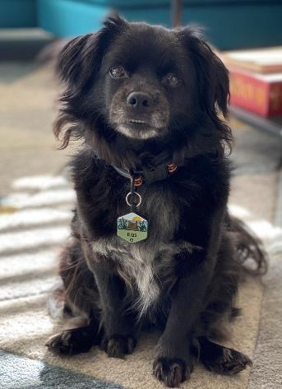
Introduction to Your Speakers
Stephanie Hughes is a registered professional Chemical Engineer with more than 25 years of experience in chemical fate and transport, water quality, and regulatory compliance. Stephanie provides consulting services and technical support to California local government agencies and is a Senior Lecturer in Environmental Science at Santa Clara University.
David Robertson is the Associate Environmental Services Specialist in the Sustainability and Compliance Division of the San José-Santa Clara Regional Wastewater Facility. David has a BS in Environmental Systems from UC San Diego.
Stephanie’s dog, Beau
David’s dog, Ellis

Slide 3
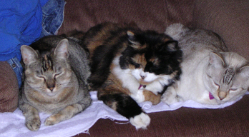

Organizations involved in this project
Bay Area Clean Water Agencies (BACWA)
City of Palo Alto
City of San Jose
San Francisco Estuary Institute
San Francisco Dept of Environment
San Francisco Public Utilities Commission
Notes:
A number of local govt agencies as well as the SFEI – a non profit that conducts research re the health of SF Bay

Slide 4
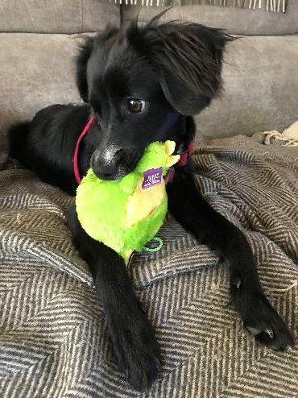
Today’s Topics
Intro to wastewater treatment
Your options for flea and tick control
Our concerns about pesticidal options
Alternatives to pesticides
Resources for follow-up information
Notes:
Insights as to which pesticides are of greatest concern (for human health and aquatic toxicity)
Transfer of pesticides around the home and onto people
On-pet and indoor treatments as sources to the sewer

Slide 5
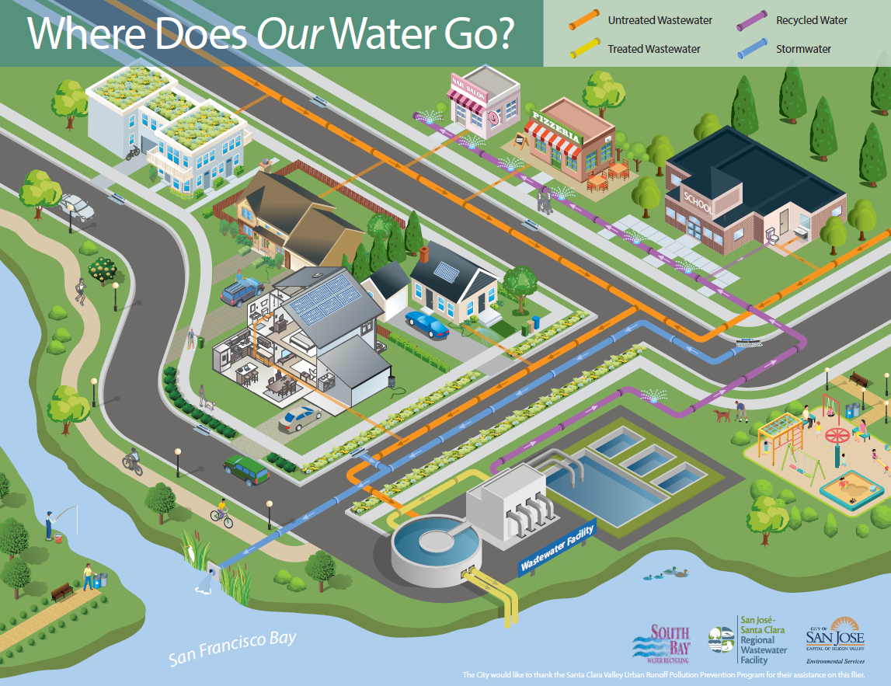

Slide 6
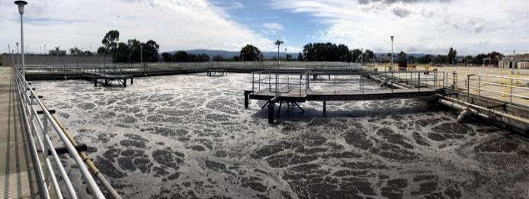

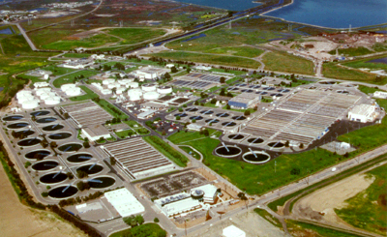
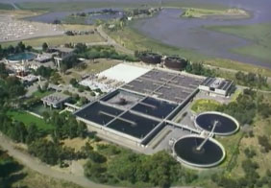
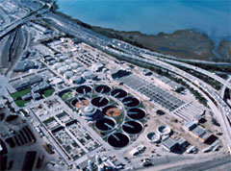
There are 39 municipal wastewater treatment facilities in the Bay Area…
…that treat 500,000,000 gallons of wastewater every day from homes, industry and businesses
…and discharge the treated water into San Francisco Bay!
Notes:
(Insert aerial photo of plant in your service area if your have one.)

Slide 7
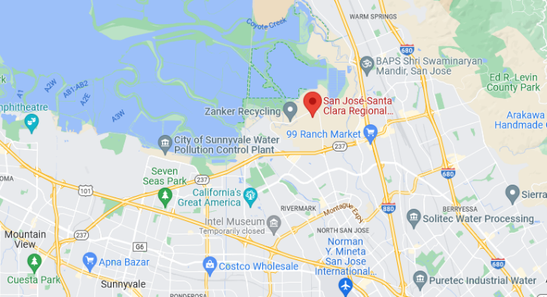
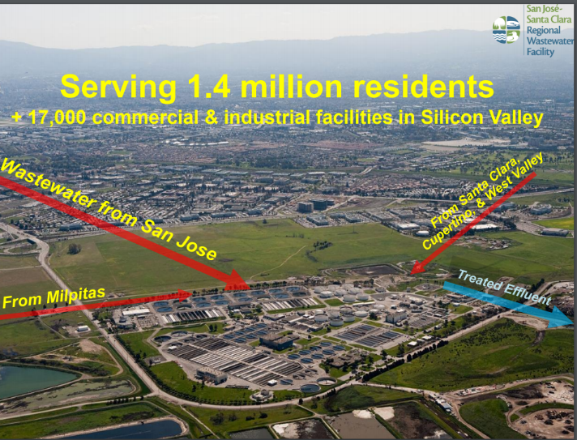
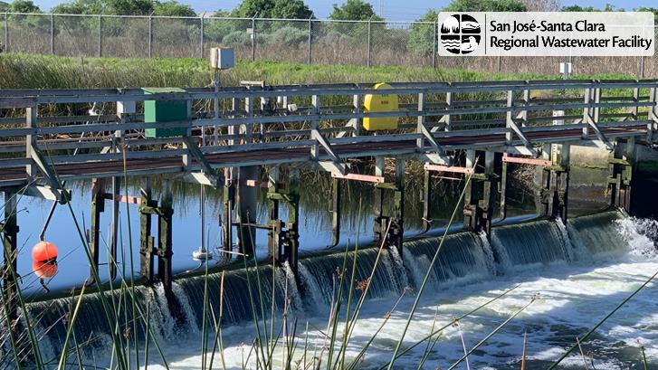
The San Jose – Santa Clara Regional Wastewater Facility
Notes:
Insert your agency photos

Slide 8
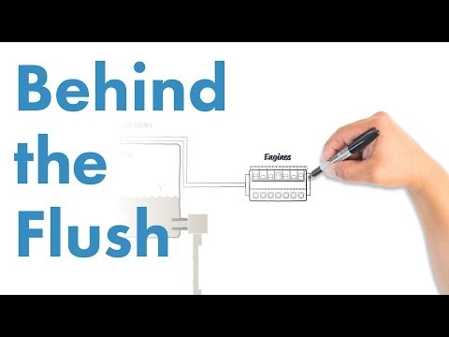
A brief primer on wastewater treatment
Video courtesy of San Jose – Santa Clara Regional Wastewater Facility

Slide 9
“Conventional wastewater treatment technologies are generally ineffective at removing pesticides from wastewater…”
“seven compounds… were detected in treated wastewater effluent at levels exceeding U.S. Environmental Protection Agency (US EPA) aquatic life benchmarks for chronic exposure to invertebrates.”
Sutton et al. (2019). “Occurrence and Sources of Pesticides to Urban Wastewater and the Environment” in Goh et al.; Pesticides in Surface Water: Monitoring, Modeling, Risk Assessment, and Management ACS Symposium Series; American Chemical Society: Washington, DC, 2019.
Notes:
Numerous pesticides pass through POTWs. This scientific paper reviewed US monitoring data for several dozen common conventional pesticides. Key findings quoted.
Meanwhile, it is not realistic to change the treatment plant processes – due to cost and energy demands. Plus there are hundreds of pesticides.

Slide 10

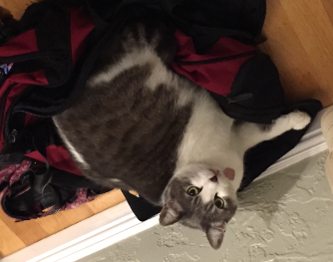

Questions?
Then we’ll return to protecting our pets!

Slide 11
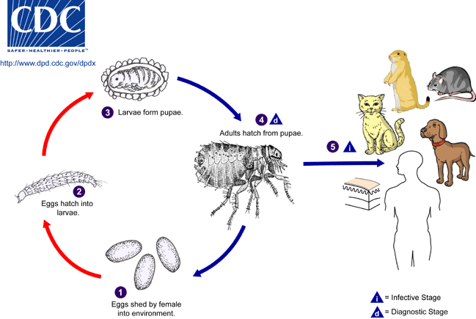
Let’s focus on the flea cycle
https://www.pesticideresearch.com/site/?page_id=2933
Notes:
An “adulticide” - an active ingredient that kills the adults
An “insect growth regulator” – an active ingredient that minimizes number or viability of eggs or larvae
To my knowledge, no active ingredients penetrate the shell and kill the pupae

Slide 12
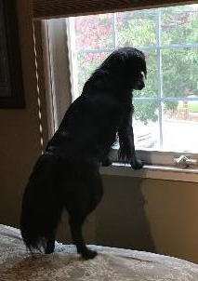
What options are available for flea control?
If in person, talk to the person next to you. Then we’ll ask what you talked about.
If a Zoom meeting, please type in the chat some methods you have used or are aware of for flea control.

Slide 13
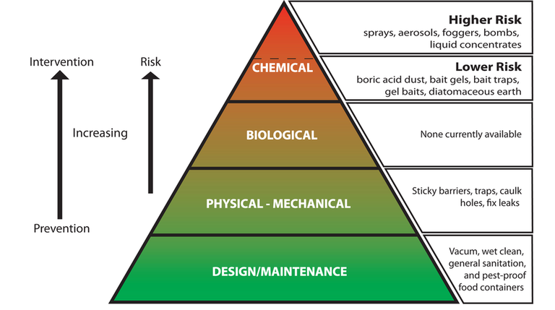
There is a powerful concept for indoor pest control: integrated pest management (IPM)
https://ento.psu.edu/outreach/extension/ipm/english/about-1/what-is-ipm

Slide 14



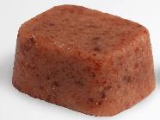
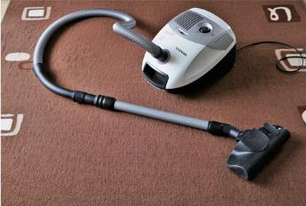

In this context, what options do we have for flea and tick control?
Pesticides
  Indoors
  On-pet
Pet medications
  Orals/chewables
Preventive measures
Vacuum; clean bedding
Monitoring
Keeping out of tall grass
https://www.k9ofmine.com/best-short-dog-leashes-for-training/
http://npic.orst.edu/pest/homeipm.html
Notes:
Let’s start at the top of this pyramid, the higher risk options and examine that risk.

Slide 15
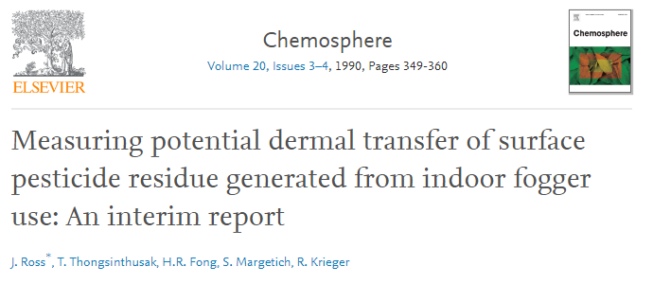
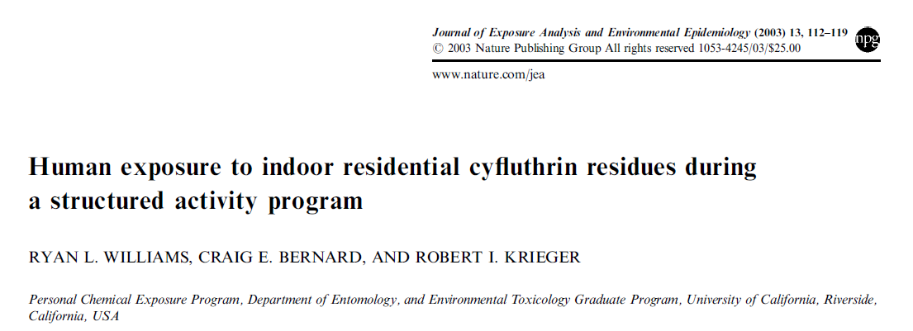
Using foggers exposes people to pesticide residue
Notes:
In 1990, the California Department of Food and Agriculture published a dermal contact study presenting findings regarding the transfer of residue to people and their clothing following a chlorpyrifos/allethrin fogger treatment in carpeted rooms. The rooms were all located in a new hotel so as to eliminate background pesticide residue and to provide repeatability from room to room.
Foggers (containing allethrin and chlorpyrifos) were set up per label instructions
Following room ventilation, participants conducted a standardized exercise routine in specific locations
Shirts, tights, gloves and socks were subsequently collected for analysis.
Both pesticides were detected in all exposed clothing samples
When the volunteer participants showered, the residue on their heads and other bare skin transferred to the sewer
Ross, J., T. Thongsinthusak, H.R. Fong, S. Margetich, R. Krieger, California Department of Food and Agriculture, “Measuring Potential Dermal Transfer of Surface Pesticide Residue Generated from Indoor Fogger Use: An Interim Report,” Chemosphere, Vol.20, Nos.3/4, pp 349-360, 1990.

Slide 16
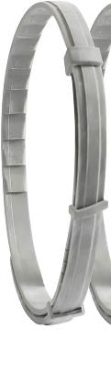
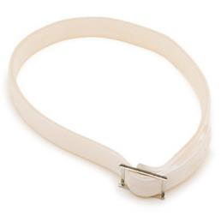
Collars work topically
Work topically on the fur/skin
The active ingredient permeates slowly out of the collar over time
  Collars may release the active ingredient during storage so that when it is first applied to the pet, it initially exposes the pet to a large initial dose of the active ingredient.
"Long-Acting Control of Ectoparasites: A Review of Collar Technologies for Companion Animals," Witchey-Lakshmanan, L., Advanced Drug Delivery Reviews, 1999, Vol 38, pp 113–122.
Notes:
Majority only include an “adulticide” as the active ingredient
Typically last 6-8 months
Some studies indicate that the pet dander is larvecidal
An “adulticide” - an active ingredient that kills the adults
An “insect growth regulator” – an active ingredient that minimizes number or viability of eggs or larvae

Slide 17
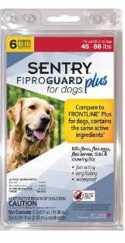
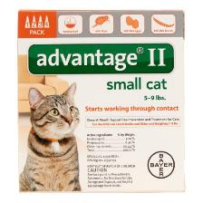
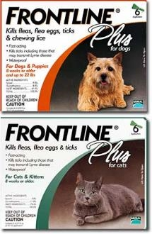
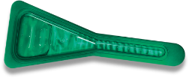
How (Most) Topical Spot-Ons Work
Work topically on the fur/skin
Often 2 or 3 active ingredients
According to manufacturers, they don’t wash off
  But they do!
Notes:
What is often used and bought at the store
An “adulticide” - an active ingredient that kills the adults
An “insect growth regulator” – an active ingredient that minimizes number or viability of eggs or larvae

Slide 18
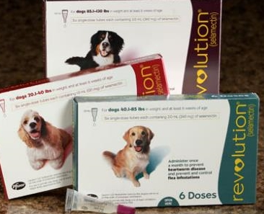
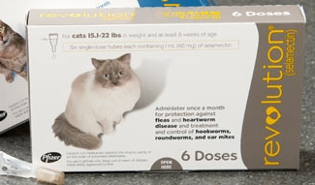
Revolution is an example of a topical treatment that works systemically
It is applied topically but works as a systemic (like oral medications)
  Also protects against some internal parasites
Some of the active ingredient remains on the skin/ fur (and has topical / contact impact)
Notes:
Because it is a systemic treatment it is considered a pharmaceutical rather than a pesticide and is regulated by FDA instead of EPA and requires a prescription

Slide 19
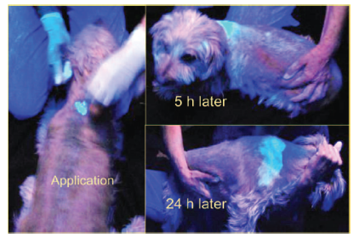
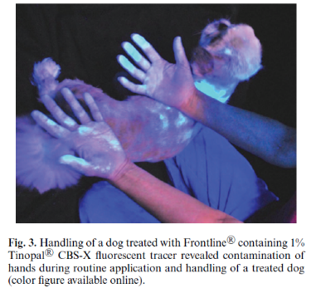
Topical treatments do not remain on the pet
Researchers incorporated a fluorescent dye into the spot treatment to photograph the spread.
“Fate and Distribution of Fipronil on Companion Animals and in Their Indoor Residences Following Spot-On Flea Treatments," Bigelow Dyk, M., et al., J. of Env Science and Health, Part B, 2012, Vol 47, pp 913-924.
Notes:
The photos above are part of a study where researchers incorporated a fluorescent dye into the spot treatment to photograph the spread.

Slide 20


Spot-on products typically state that they are waterproof once dry
Notes:
While the labels on spot-on products say they are waterproof, the next slide will showcase a study by California’s Dept of Pesticide Regulation in which they washed dogs following spot-on application.

Slide 21
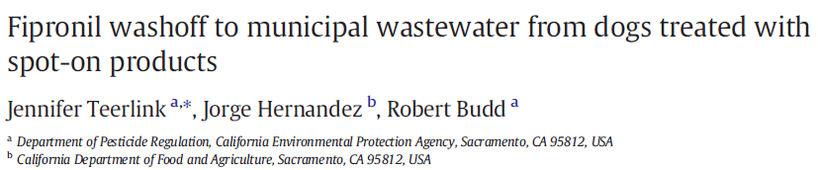

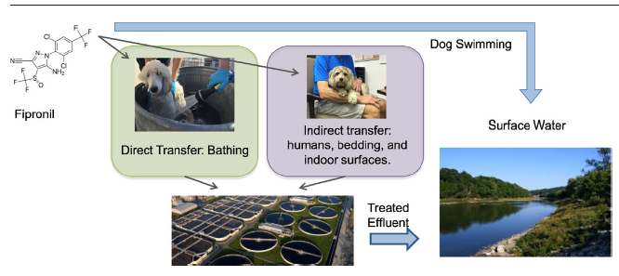
Fraction applied that washed off
Source: Teerlink, J., J Hernandez, R Budd. 2017. Fipronil washoff to municipal wastewater from dogs treated with spot-on products. Sci Total Environ 599-600: 960-966.
Notes:
DPR conducted a study in which they washed volunteer dogs 2, 7, or 28 days post application.
The wash off continued even after 28 days.

Slide 22
These On-Pet and Indoor Flea/Tick Treatments Travel to Sewer Systems and San Francisco Bay
Indoor pet flea/tick control product
Washing of pets, hands, pet bedding, floors, carpets, and clothing
Transport to sanitary sewer system
Discharge to water body, recycled water, and/or biosolids

Slide 23
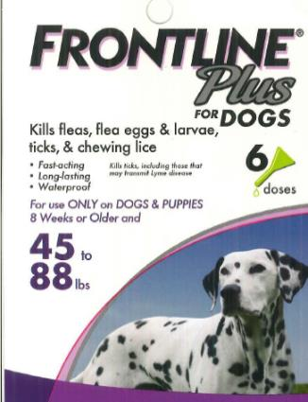
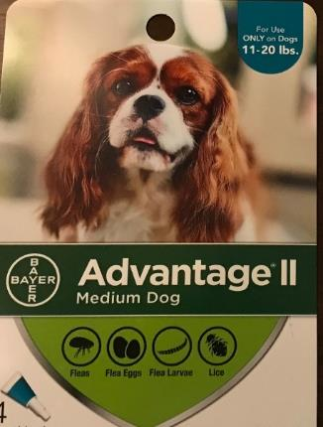
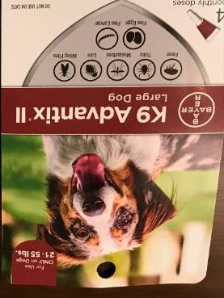
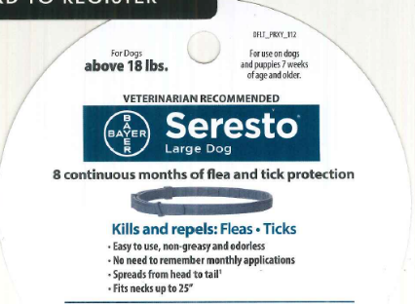
Pesticides of concern are those that exhibit aquatic toxicity and persist in the environment
Fipronil
Imidacloprid
Bifenthrin
Deltamethrin
Indoxacarb
Permethrin
Notes:
Per these examples:
Frontline products have fipronil
Advantage and Advantix have imidacloprid
Seresto collar has has Flumethrin (a pyrethroid) 4.5% and Imidacloprid 10.0%

Slide 24
We have evidence that on-pet pesticides pass through wastewater treatment at concentrations above toxicity thresholds for sensitive organisms
Sadaria, A.M. et al. 2017. Passage of Fiproles and Imidacloprid from Urban Pest Control Uses Through Wastewater Treatment Plants in Northern California. Environmental Toxicology and Chemistry. 36 (6), 1473-1482.
Aquatic toxicity thresholds:
11 ng/L for fipronil
10 ng/L for imidacloprid
Notes:
Point out at least one location. NOTE that in the Bay Area this effluent is diluted once the water mixes with the Bay water.
Fipronil = 11 and Imid = 10 (estimated values below which not expected to be a risk to aquatic life)
Fipronil & imidacloprid data are the data shown: RMP special study BACWA/DPR partnership
Pyrethroids data (not shown): POTW Pyrethroids Survey (DPR, CASA, Pyrethroids Working Group partnership) & Las Gallinas
https://www.epa.gov/pesticide-science-and-assessing-pesticide-risks/aquatic-life-benchmarks-and-ecological-risk
(The LC50 for salt water crustacean is 140 for fipronil)

Slide 25
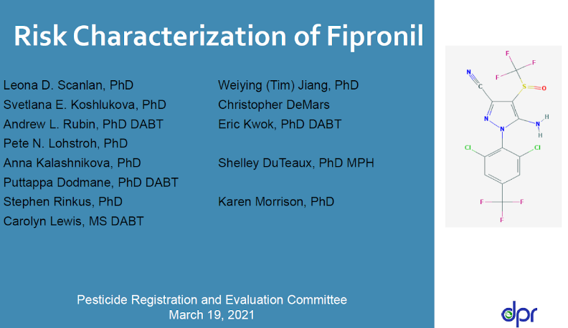
California’s Department of Pesticide Regulation is studying the human health risks associated with fipronil exposure
“Scenarios that pose a potential risk to home users include:
  Acute dermal exposure for users who apply pet spray at home
Post-application residential exposures for adults considered to pose a potential health risk include:
  Seasonal exposure to pet spray and pet spot-on products
Post-application residential exposure for children considered to pose a potential health risk include:
  • Short-term oral exposure to turf granules
  • Seasonal oral exposure to pet products
  • Seasonal dermal exposure to pet products”
Fipronil Risk Characterization Document, Draft, Human Health Assessment Branch, Department of Pesticide Regulation, California Environmental Protection Agency. January 2021.
Notes:
Technical jargon but because it is a scientific study about human health risk I didn’t want to alter the language lest I inadvertently change the meaning. Note: turf granules are outdoor uses for termite control

Slide 26
Concerns with Pesticides for Flea and Tick Control
Pesticides from common flea and tick control products are reaching the sewer systems.
Pesticides subsequently discharged into San Francisco Bay can exceed toxicity thresholds for aquatic life.
CA’s Dept of Pesticide Regulation has identified potential human health risks associated with fipronil, a common topical.
Notes:
These discharges may compromise wastewater effluent quality to the Bay and impact agency compliance with the Clean Water Act.
These active ingredients exhibit aquatic toxicity and persist in the environment:
Bifenthrin
Deltamethrin
Fipronil *
Imidacloprid
Indoxacarb
Permethrin

Slide 27

What are the alternatives?

Slide 28
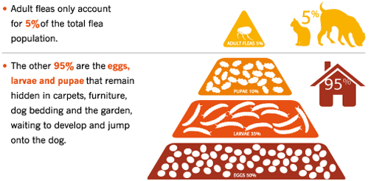
Let’s look at the flea cycle another way
The majority of the flea cycle is the “environmental reservoir” within and throughout your home.
http://www.allcreaturesvet.biz/fleas.html
Notes:
If you kill the adult fleas and do not kill the eggs, larvae and pupae, your pet will become reinfested when these fleas become adults and the cycle will start all over again.
Use the fleas biological cycle to our advantage; all animals need a habitat/shelter and source of food. So if you can take it away.

Slide 29

The American Veterinary Medical Association presents one solution
“Because much of the flea’s life cycle is spent off of your pet, treating only your pet will not eliminate the problem. ….
Therefore, in addition to treating your pet, reduce the flea population in your house by thoroughly cleaning your pet’s sleeping quarters and vacuuming floors and furniture that your pet comes in contact with frequently. Careful and regular vacuuming/ cleaning of the pet’s living area helps to remove and kill flea eggs, larvae, and pupae.”
American Veterinary Medical Association, "External Parasites" brochure from AVMA web site, January 2016.
Notes:
The American Veterinary Medical Association concurs that treating the pet is not enough. Must vacuum and reduce the overall reservoir of fleas in the home.

Slide 30
That returns us to the IPM Pyramid
Pesticides
  Indoors
  On-pet
Pet medications
  Orals/chewables
Preventive measures
Vacuum; clean bedding
Monitor
Keep out of tall grass
https://www.k9ofmine.com/best-short-dog-leashes-for-training/
http://npic.orst.edu/pest/homeipm.html
Notes:
Let’s start at the top of this pyramid, the higher risk options and examine that risk.

Slide 31
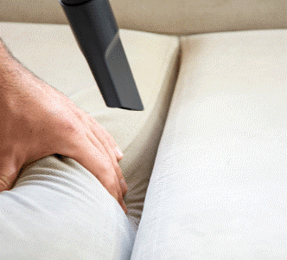
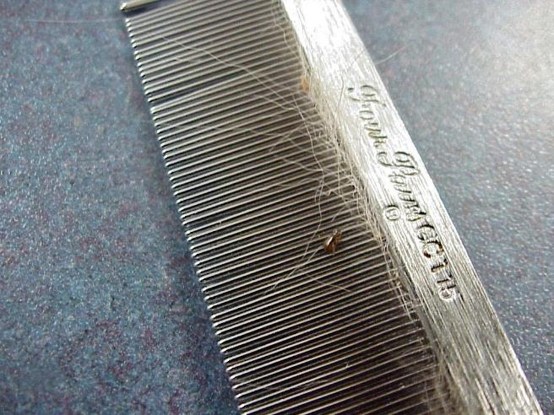
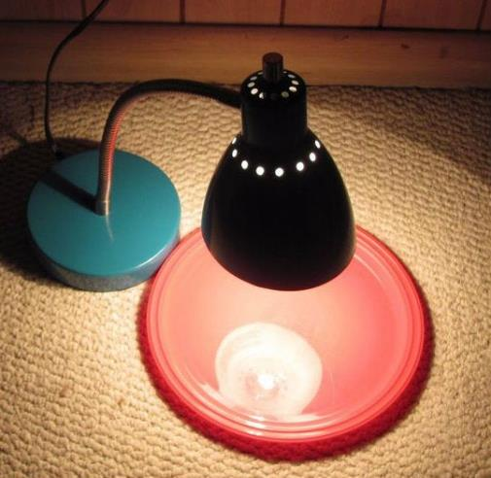
Using IPM for Flea Control
Prevent: vacuum (everywhere and often!), wash bedding, steam clean
Monitor: flea combs, flea traps
https://www.preventivevet.com/pets/how-to-get-rid-of-fleas-in-your-home
https://www.ecats.vet/siteSearch/view/225302_Fleas.pml
https://www.instructables.com/Simple-Flea-Trap/
Notes:
Put soapy water in the bowl and place a light over it at night. Count the dead fleas in the morning. Very satisfying and gives a sense of the infestation.
The Environmental Protection Agency (EPA) recommends the following cleaning approaches:
Use a powerful vacuum on any floors, upholstery, and mattresses. Cracks and other tight spaces are usually good hiding places for fleas and their cohort of eggs, larvae, and cocoons. If you can, use a vacuum with a bag you can dispose of without coming into contact with its contents.
Employ a steam cleaner for carpets and upholstery, including pet beds. The combination of high heat and soap is the enemy of fleas in all stages of life. Pay special attention to any spots where your pet usually lies down or spends a lot of time.
Wash all bedding, including your pet’s, in hot water and detergent. Dry it at the highest heat setting. If the infestation is severe, consider getting rid of old bedding and starting anew.
https://www.healthline.com/health/healthy-home-guide/how-to-get-rid-of-fleas#indoor-flea-removal

Slide 32
Similarly for ticks…prevention via physical control is the key
If possible, keep your dog’s coat short.
Try to keep out of the brush.
Thoroughly inspect your pet after walks. Pay particular attention to the nose, mouth, eyes, ears (inside too), around tails and under the collar.
Seek to create a tick-free zone in your yard, controlling brush or tall grass.
Notes:
Again, removing the food source; removing shelter/habitat
If possible, keep your dog’s coat short
Try to keep out of the brush. Seek to walk in the center of trails and use shorter leashes.
Thoroughly inspect your pet after walks before ticks have time to attach. Pay particular attention to the nose, mouth, eyes, ears (inside too), around tails and under the collar.
Seek to create a tick-free zone in your yard, controlling brush or tall grass. Consider providing a 3-foot wide barrier (e.g., wood chips or gravel) between lawns and wooded areas to restrict tick movement. Keep play and deck equipment away from yard edges. Keep outside areas neat to discourage rodents or other wildlife

Slide 33

When prevention and monitoring are not enough
Consider talking to your vet about oral medication
Notes:
We understand that not everyone can do this, so if you can use these options…
If you can’t, we understand. Holistic approaches are good to consider. These can be more expensive route than topicals so might not be accessible to everyone.

Slide 34
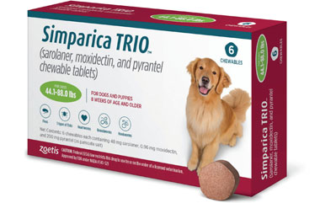
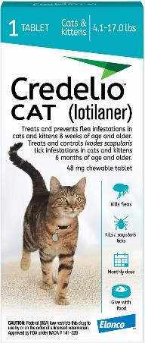
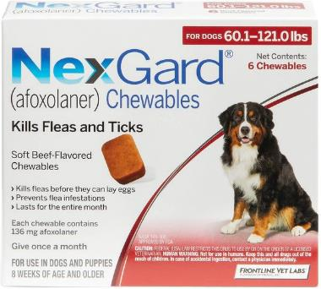
On-Pet Controls: Oral Medications
Systemic
  Requires adult flea to bite the animal
Typically monthly or quarterly doses
Prescription rather than over the counter
Some also protect against heartworm and/or other internal parasites
  Reducing number of monthly medications
Notes:
As an aside for WWT: also regulated by FDA, not EPA.
Although rare, adverse reactions can include vomiting, lethargy – this can also happen with topicals and collars
The active ingredient in Program is an insect growth regulator

Slide 35
Evidence suggests that systemics may be more effective than topicals
Why? Hypotheses include:
  More accurate application method
  More direct approach (pest bites animal rather than happens upon the topical on the skin or fur)
  The active ingredient is not being licked off or diluted around the home
"Flea blood feeding patterns in cats treated with oral nitenpyram and the topical insecticides imidacloprid, fipronil and selamectin," McCoy, c., et al., Veterinary Parasitology, Vol. 156, pp 293-301, 2008.
Notes:
"In this study systemically acting insecticides such as nitenpyram, and the topically applied but systemically active insecticide selamectin, were more effective in interfering with flea blood feeding than were imidacloprid and fipronil.”
While the systemic-acting ingredients require the animal to be bitten, there is evidence that there is less biting of the animal using these orals than with the topical treatments

Slide 36
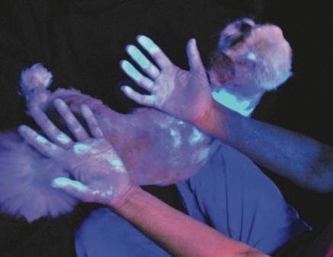

Summary
Scientific evidence shows that pesticides from indoor flea treatments transport around the home (and wash off)
These pesticides travel through the sewer system and wastewater treatment plant
These pesticides have been observed in wastewater effluent at concentrations that exceed EPA aquatic toxicity thresholds
Indoor use of fipronil has been identified as a possible risk to human health
Better options are to prevent and monitor fleas/ticks and talk to your vet about chewables

Slide 37

For more information: www.baywise.org:

Slide 38


Slide 39
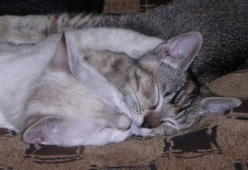
Thank you for your attention!
David Robertson
San José-Santa Clara Regional Wastewater Facility
David.Robertson@sanjoseca.gov
408.635.4033
Stephanie Hughes, P.E.
Santa Clara University
sehughes@scu.edu

Slide 40

Questions?

